Slide 1
Colonial Modern
9 May 2024

Slide 2
Why, according to Partha Mitter’s chapter ‘Colonial Modern,’ do we need to rethink our ideas of time when trying to understand non-European art?

Slide 3
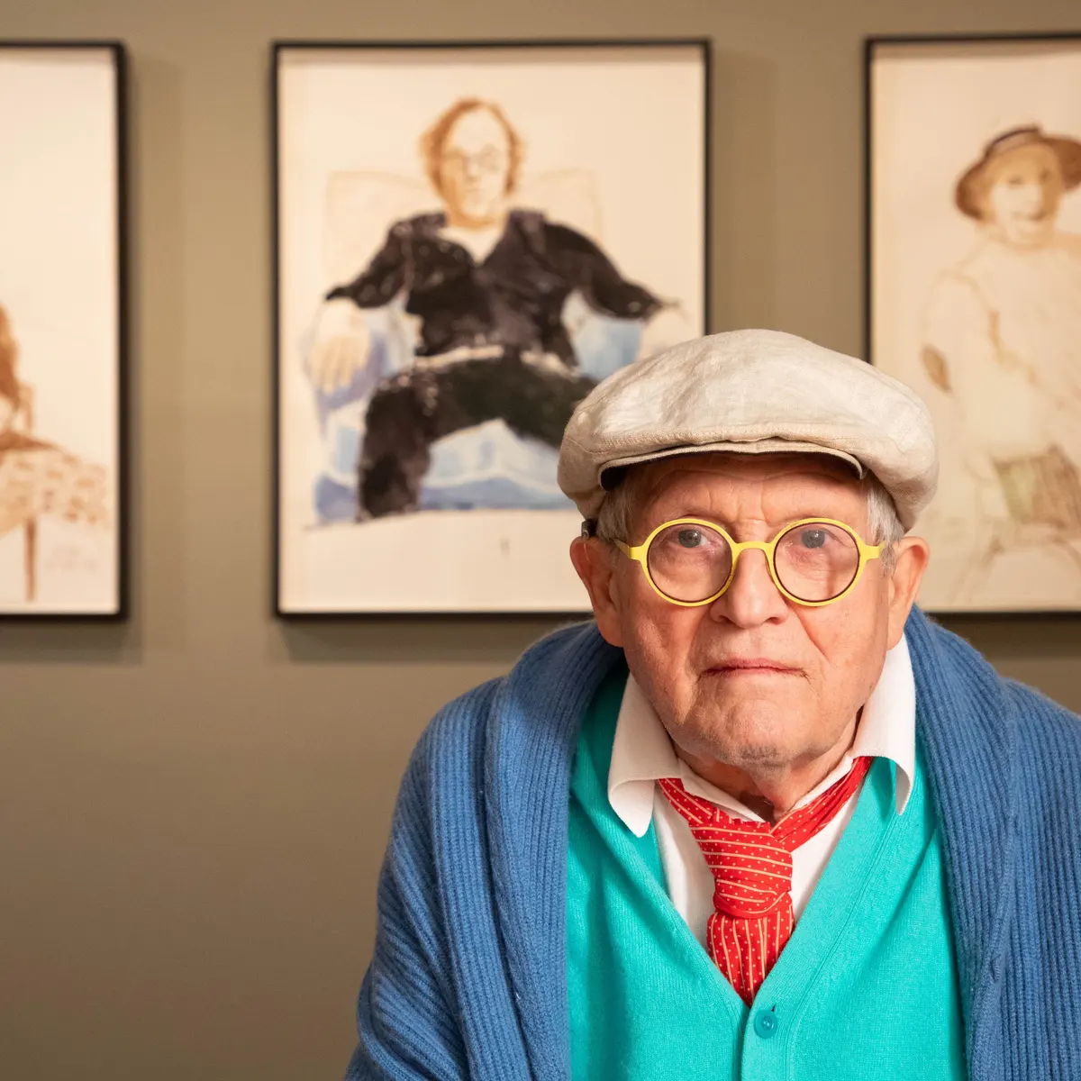
Why does art have to go anywhere? Art hasn’t ended and neither has the history of pictures. David Hockney

Slide 4
Non-western Modernism: A Case of Delayed Growth
Creating an Art History for the Indians
Colonial Time and Rediscovery of the Indian Past
What Now? Radical Changes in Our Historical Thinking

Slide 5
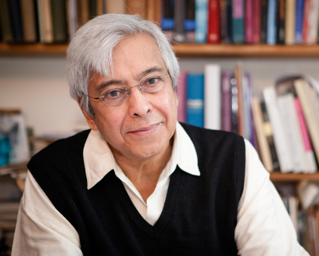
Following decolonization and more recent globalization of art, contemporary Indian artists, caught in the predicament of derivativeness, seek to erase the stigma by denying history and the dominant chronology of modern art with its universalist ambtions. Contemporary Indian artists are convinced that they were born fully armed in the manner of goddess Athena, owing almost nothing to history, or to the cultural context of their art production. Many artists tend to invoke history merely to repudiate its claims.

Slide 6
Non-western Modernism: A Case of Delayed Growth
He's basically saying that art from non-Western places, like modern and global contemporary art, is limited by how Westerners see art history. This perspective often sees artistic evolution as a linear progression from ancient masters like Cimabue to renowned figures such as Leonardo and Michelangelo, as outlined by Giorgio Vasari. This narrow view makes it challenging for us to fully appreciate non-Western art within its own cultural context.

Slide 7
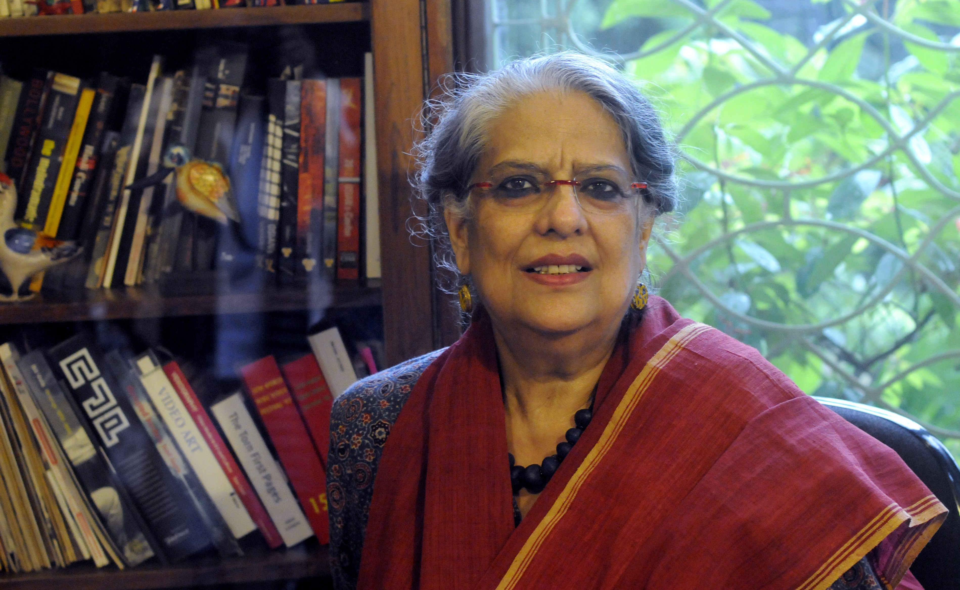
Geeta Kapur, a famous Indian art critic, talks about criticisms of non-Western modern art, especially about it being seen as late or unoriginal

Slide 8
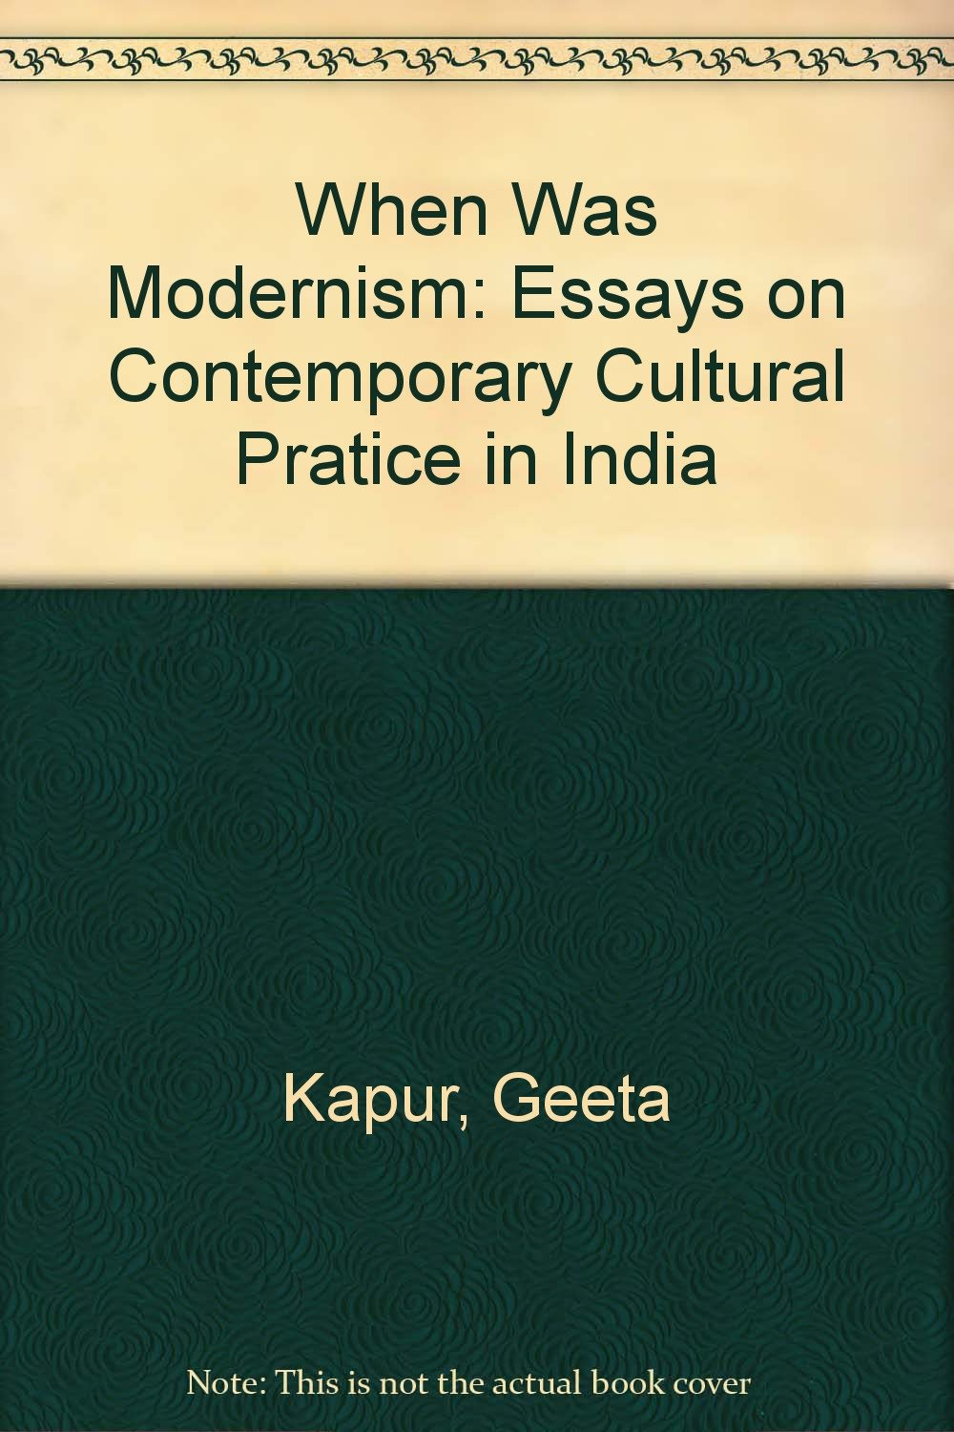
we should reperiodize the modern in terms of our own historical experience of modernization . . . [which] would enable us to enter the postmodern at least potentially on our own terms. Kapur, “When was Modernism . . .?”, 298.

Slide 9
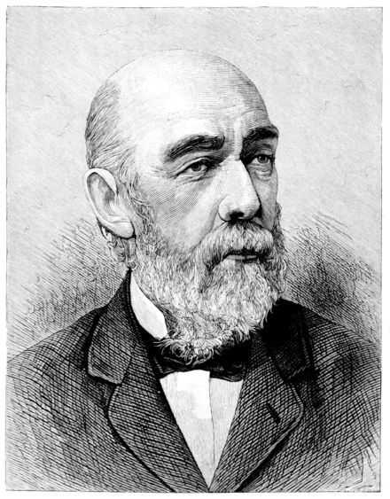
Creating an Art History for the Indians
James Fergusson, an influential architectural historian, is often called as the founding figure of Indian art history. His seminal work, "The History of Indian and Eastern Architecture," published in 1876, set the groundwork for understanding Indian architectural evolution.

Slide 10
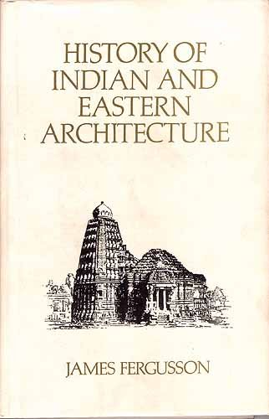
Sculpture in India may fairly claim to rank, in power of expression, with mediaeval sculpture in Europe, and tell its tale of rise and decay with equal distinctness, but it is also interesting as having that Indian peculiarity of being written decay. The story that Cicognara tells [of medieval European art] is one of steady forward progress towards higher aims and better execution. The Indian story is that of backward decline from the sculptures of Bharhut and Amaravati topes, to the illustrations of Coleman’s “Hindu mythology .

Slide 11
Colonial Time and Rediscovery of the Indian Past
During colonial times, European scholars were fascinated by the idea of rediscovering ancient Indian civilization. They followed European historical concepts to create a timeline for India, dividing it into ancient, medieval, and modern periods. This effort was supported by the documentation of antiquities and key texts by institutions like the Asiatic Society of Bengal and the Royal Asiatic Society of London. Archaeologists like Fergusson and Cunningham played crucial roles in mapping ancient monuments and texts, which helped establish a historical framework.

Slide 12
Before colonial times, India had lots of different calendars based on the sun and moon. By the late 1700s, there were over thirty calendars used by different religious groups. To make things simpler for governing, the East India Company made all these calendars the same and introduced the Gregorian calendar. Britain did the same thing in 1750. But what's really important about the Gregorian calendar is that it became super important globally at the start of globalization, even though calendars have always been different around the world, and they've often been changed by powerful governments.

Slide 13
What Now? Radical Changes in Our Historical Thinking
In recent times, there's been a big shake-up in how we think about history, not just in India but worldwide. After World War II, the idea that history had one universal truth took a hit. Decolonization made minorities' voices heard, and new approaches questioned old beliefs about progress and facts.

Slide 14
Octavio Paz
In spite of what my senses told me, the time from over there, belonging to the others, was the real one, the time of the real present. For us, as Spanish Americans, the real present was not in our own countries: it was the time lived by others, by the English, the French and the Germans. It was the time of New York, Paris, London. I wanted to belong to my time and to my century . . . I wanted to be a modern poet . . . The idea of modernity is a by-product of our conception of history as a unique and linear process of succession . . .

