Slide 1
Nineteenth Century Art: a Critical History
The Appeal of Modern Art: Touluse-Lautrec

Slide 2
How do we define this approach?
The Social History of Art:
The study of the sociology of art through history is called Social History of Art. Its primary concept as a critical methodology is that contextual influences of culture and society can never be too far removed from artwork. Art cannot stand alone and independent from the cultural context of the time and place in which it was created.

Slide 3
The critique of art through a sociological methodology, however, is different from art as social commentary. Art that is necessarily political or documentative falls into the categories of protest art and history painting, respectively, and can be read as expository. Artistically depicting scenes inspired by major events of the time is something closer to journalism, whereas the social critique of art involves deconstructing elements of the work which may have been influenced by the time and place in which the artist lived, unconsciously. In other words, according to this approach the artist does not create art for the purpose of disseminating a direct message, but rather, the work is to be studied as indirectly referential.

Slide 4
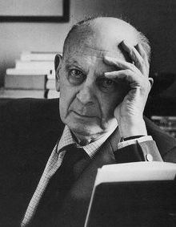
Systematic application of the method: the case of Arnold Hauser (1892-1978)
By way of example, it is possible to mention the figure of Arnold Hauser, who devoted an entire monograph to the subject. Hauser was a Hungarian art historian active mainly in Great Britain (University of Leeds), whose The Social History of Art, first published in 1951, based on the Marxist doctrine of his compatriot György Lukács, outlined an art theory in which artistic phenomena are analysed in close relation to their historical and social context. He rejected the theory of the autonomy of art, which in his view is made up of interdependent material factors.

Slide 5
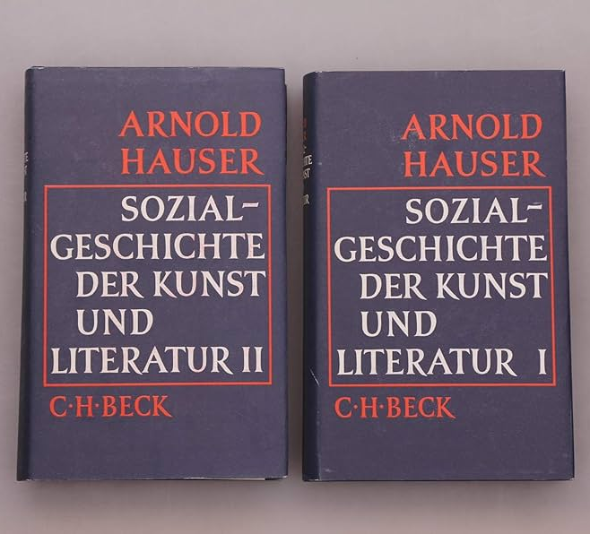
For Hauser, every society has its own specific style; for example, the aristocratic society prefers a rigid, traditionalist style; whereas a society such as the democratic society prefers elements that are as naturalistic as possible, an art that is closer to the city. So, Art became more realistic and naturalistic as societies became less hierarchical and authoritarian, and more mercantile and bourgeois.

Slide 6
Criticism of the Hauserian approach: Ernst Gombrich (1909-2001)
Hauser's Marxist approach was criticized mainly by Ernst Gombrich (1909-2001) as «social determinism» going too far. Gombrich wrote in his review of The Social History of Art that
«Hauser's theoretical prejudices may have thwarted his sympathies. For to some extent they deny the very existence of what we call the ’humanities’. If all human beings, including ourselves, are completely conditioned by the economic and social circumstances of their existence then we really cannot understand the past by ordinary sympathy […]».

Slide 7
Social history of art: a tradition of studies
This approach was, however, fraught with consequences, and has evolved and matured over the decades. It led to the flourishing of a rich tradition of studies, examples of which are given below in chronological order.

Slide 8
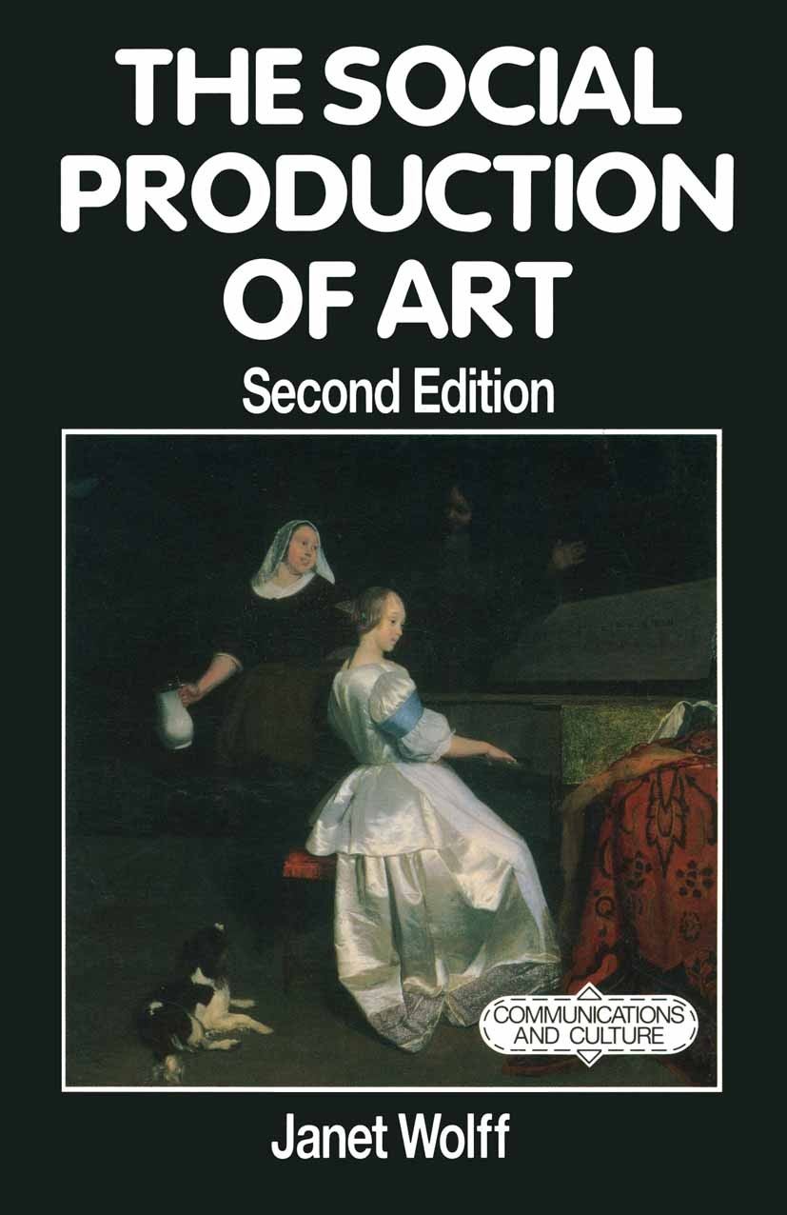
20th century
F. Antal, Florentine painting and its social background. The Bourgeois Republic before Cosimo de' Medici's Advent to Power: XIV and Early XV Centuries. London, Kegan Paul, 1947.
A. Hauser, Sozialgeschichte der Kunst und Literatur. 1°ed. München, C. H. Beck, 1951.
T.J. Clark, Image of the People / Gustave Courbet and the 1848 Revolution. London, Thames & Hudson, 1973.
M. Baxandall, The Period Eye, From M. Baxandall, Painting and experience in fifteenth century Italy : a primer in the social history of pictorial style. Oxford, Oxford University Press, 1988. pp.29-57.
J. Wolff, The Social Production of Art. Basingtoke, The Macmillan Press LTD, 2°ed. 1993.
T. Crow, Modern art in the common culture: essays. New Haven, Yale University Press, 1996.

Slide 9
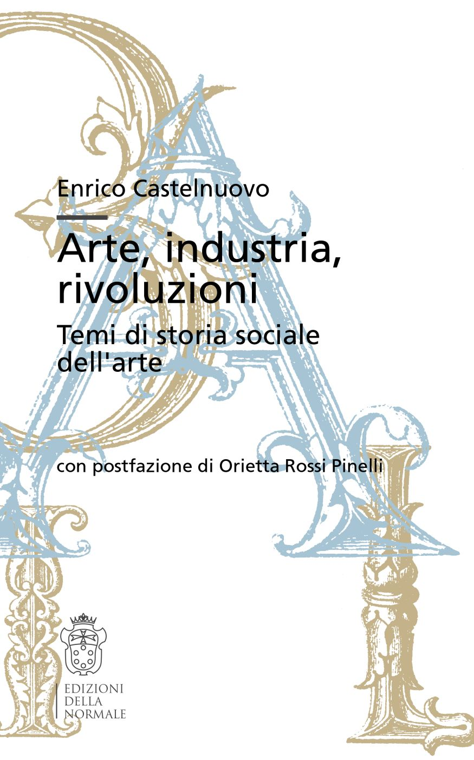
21st century
J. Tanner, The Sociology of Art: A Reader. New York, Routledge, 1°ed. 2003.
N. Heinich, La sociologia dell’arte. Italian translation by G. Zattoni Nesi. Bologna, Il Mulino, 2004.
E. Szívós, Fin-de-Siècle Budapest as a Center of Art. From East Central Europe, Vol. 33, 2006. Parts I-II, pp. 141-168.
E. Castelnuovo, Arte, industria, rivoluzioni. Temi di storia sociale dell'arte. Con postfazione di O. Rossi Pinelli. Pisa, Edizioni della Normale, 2007.
J. Cooke, Storia sociale dell’arte o Kulturgeschichte? Millard Meiss e la recensione a Frederick Antal. From Crepuscoli dottorali. Quaderni di arte, musica e spettacolo. Rivista semestrale Anno I, numero 2. Torino, edizione digitale, 2011, pp. 81-91.
S. Eisenman, The Appeal of Modern Art: Toulouse-Lautrec, c. 1880-1900. From S. Eisenman T. Crow, B. Lukacher et al., Nineteenth Century Art: A Critical History. London, Thames & Hudson, 5°ed. 2020, pp. 424-432.

Slide 10
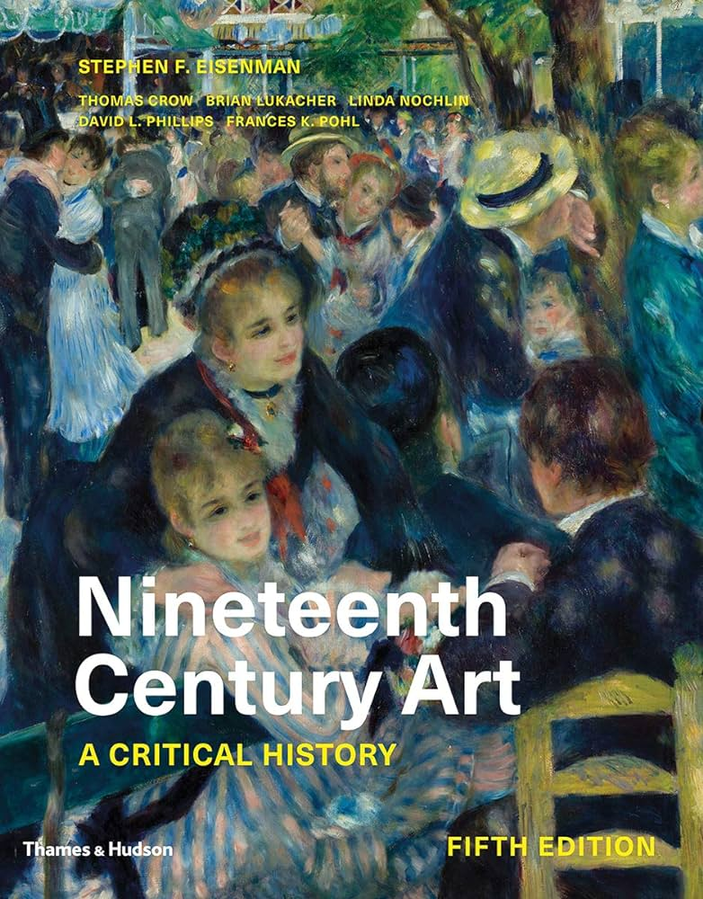
First case study: Henri de Toulouse-Lautrec (1864-1901)
One of the most recent and most adequate scientific contributions to fully understand how this approach works and the kind of results it offers us is
S. Eisenman, The Appeal of Modern Art: Toulouse-Lautrec, c. 1880-1900, from S. Eisenman T. Crow, B. Lukacher et al., Nineteenth Century Art: A Critical History. London, Thames & Hudson, 5th ed. 2020, pp. 424-432.

Slide 11
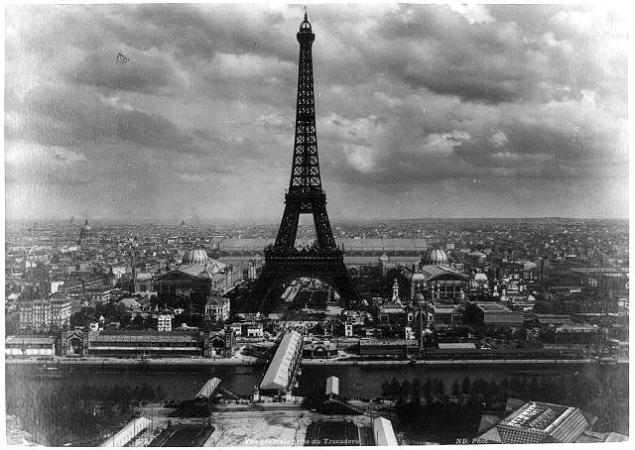
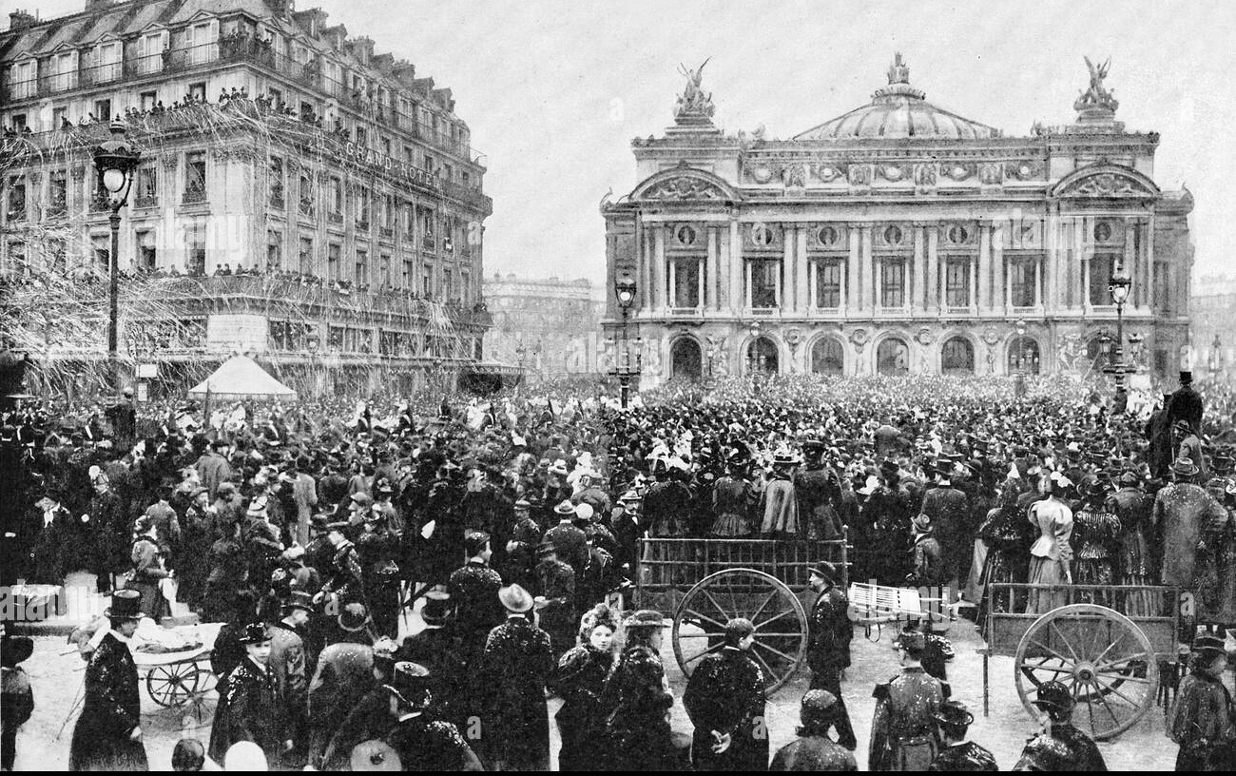
MAIN ARGUMENTS:
1. Context of Urban Growth and Industrial Revolution

Slide 12
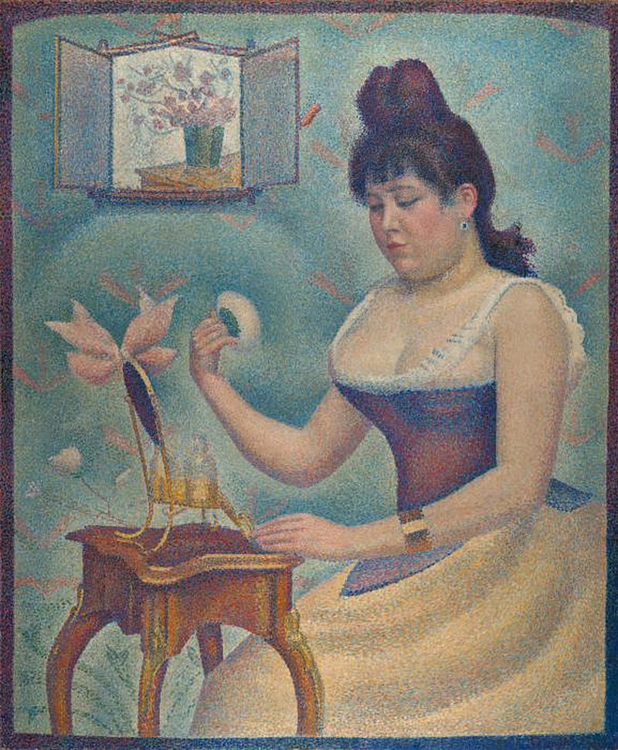
2.Comparasion with Courbet and Seurat:

Slide 13
3.Toulouse-Lautrec’s Art as Popular culture

Slide 14
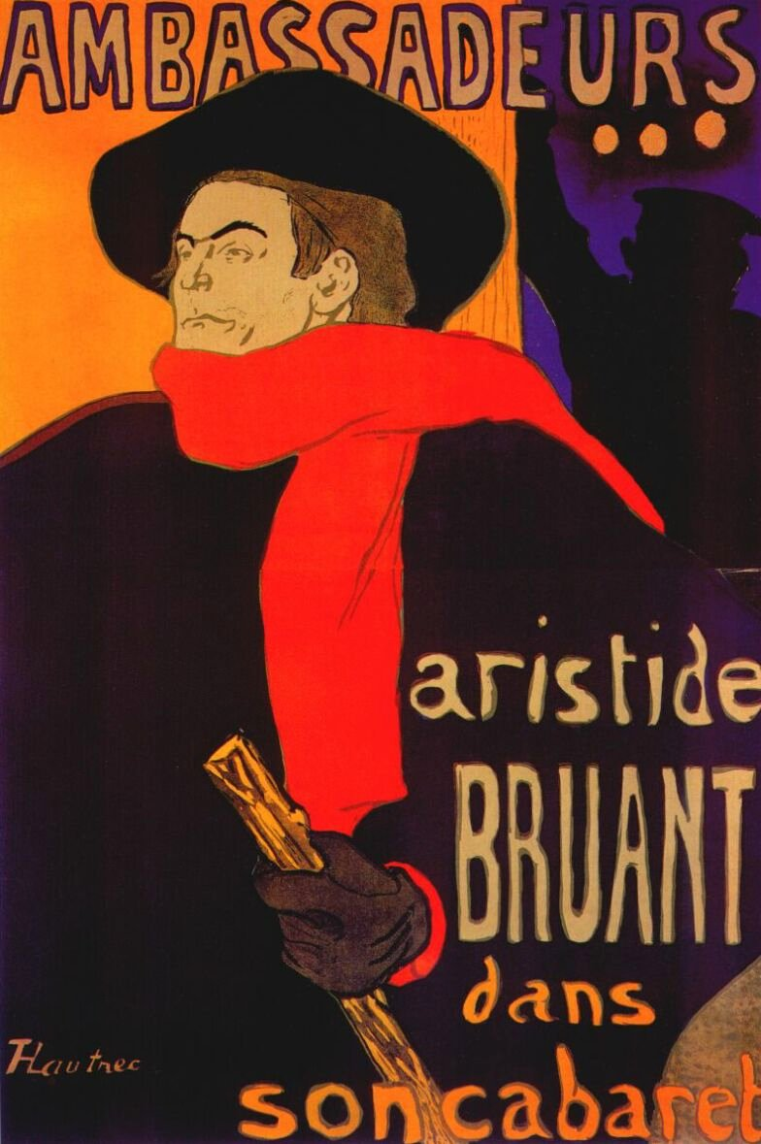
4. Fetishism and Homosexuality in Toulouse-Lautrec’s Art

Slide 15
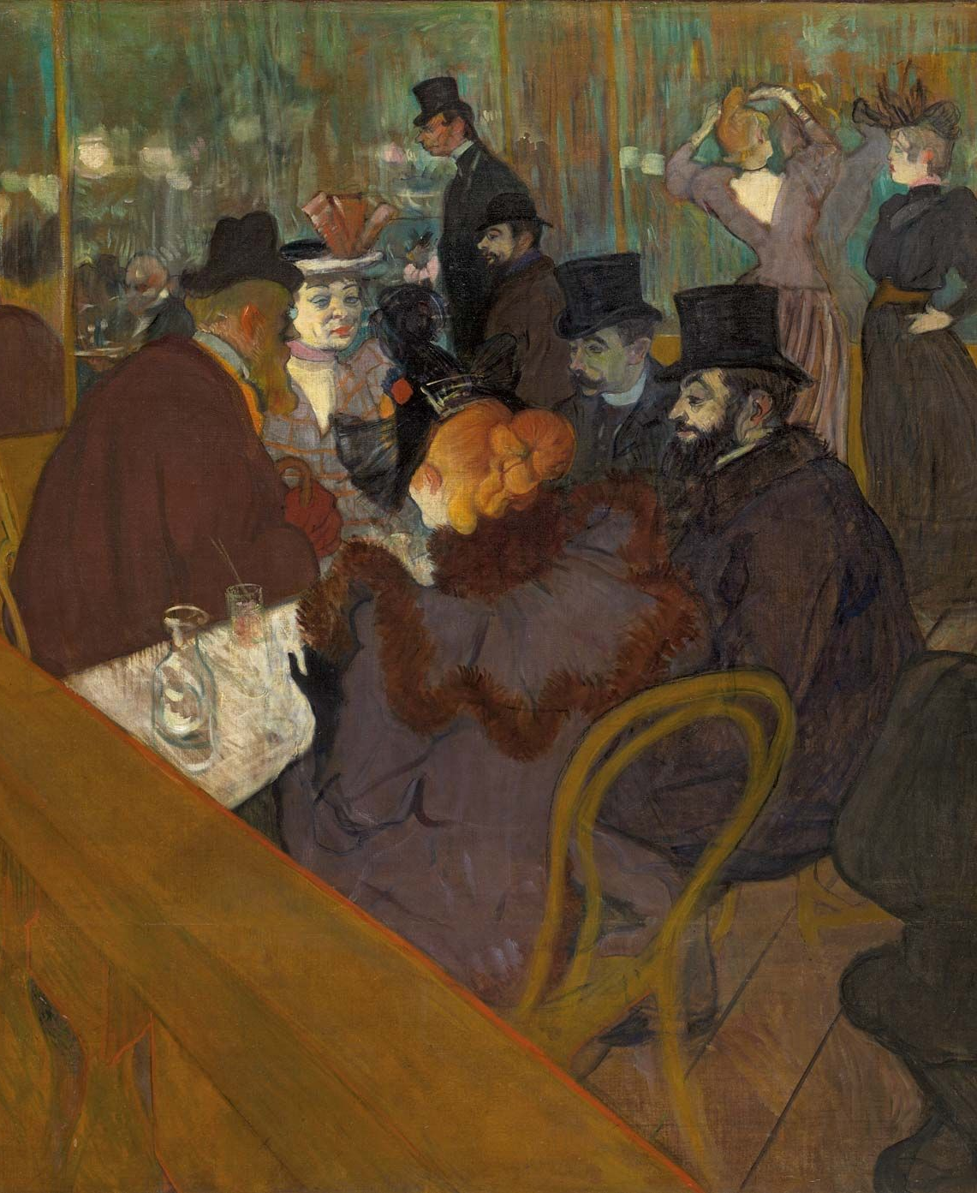
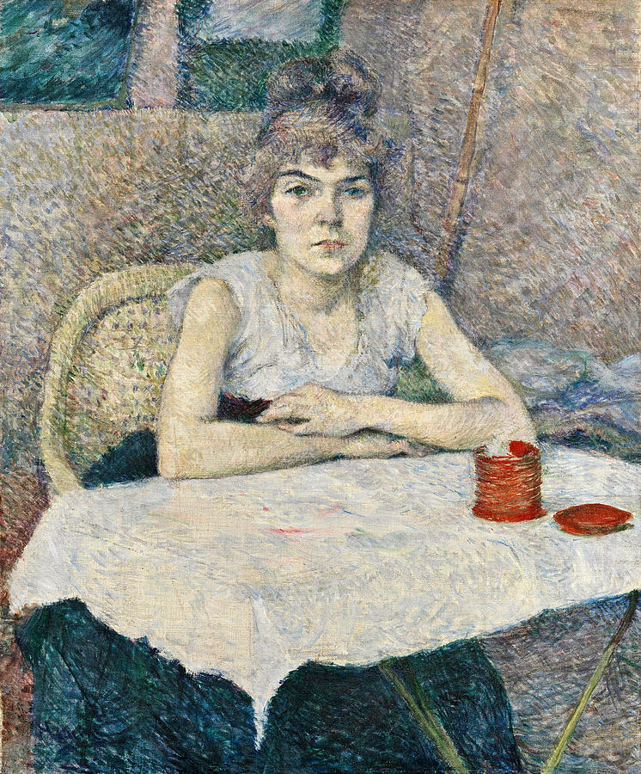
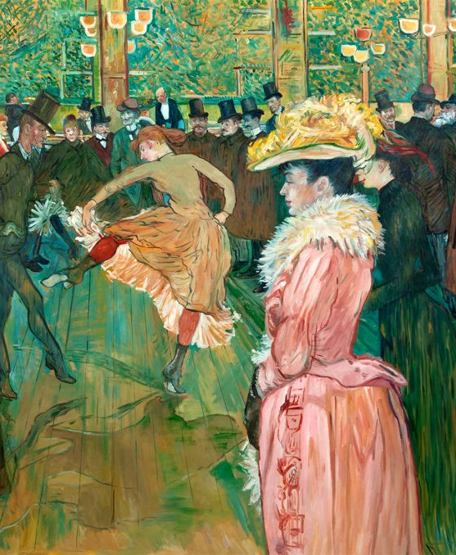
5.Novelty, Desire and the Crowd

Slide 16
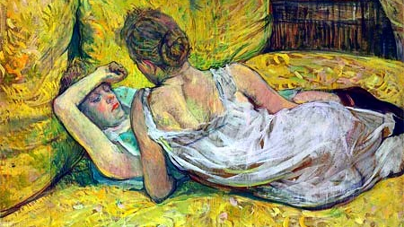
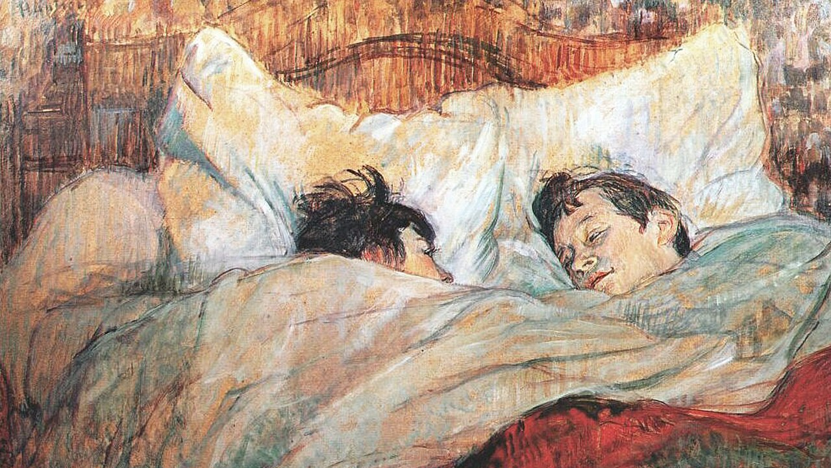
6.The Impact of Urbanization, Feminism and and Lesbianism

Slide 17
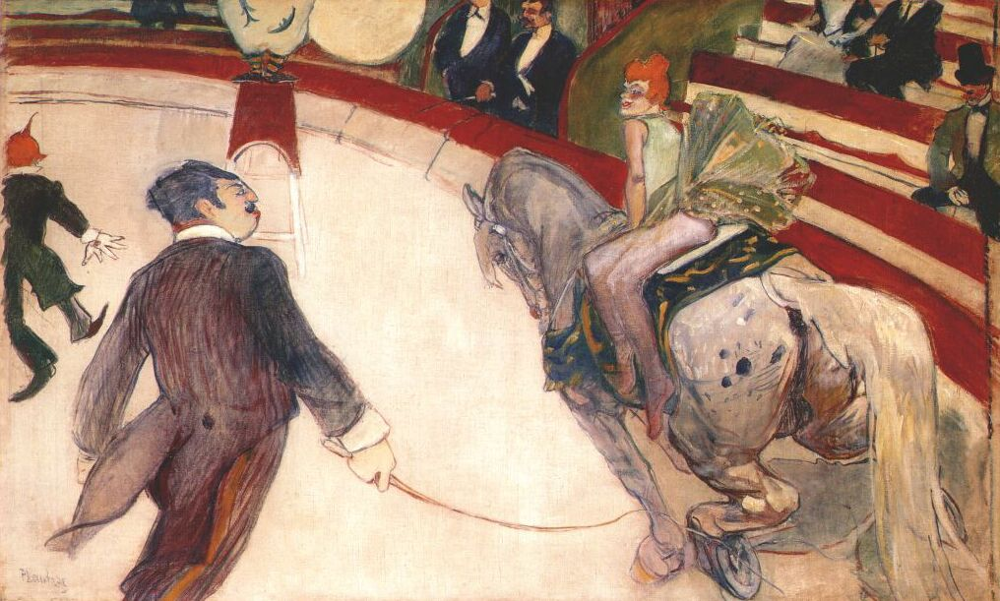
7. New Types of Entertaintments

Slide 18
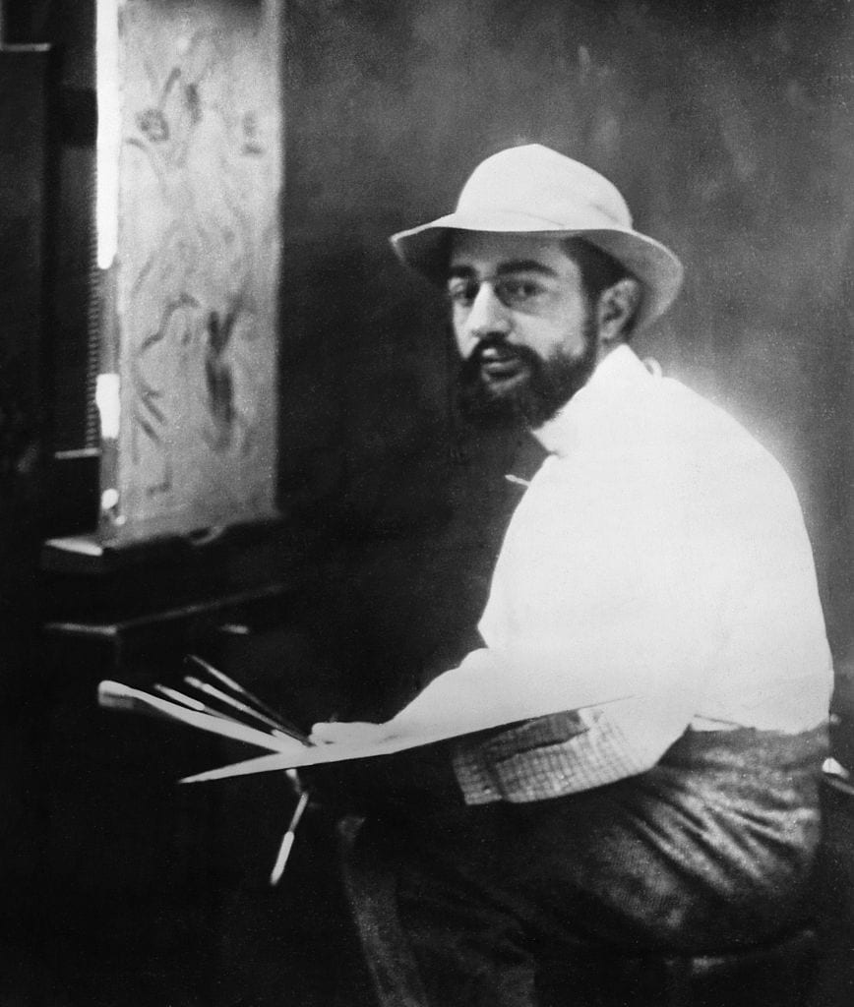
Conclusions

Slide 19
Second case study: Masaccio’s (1401-1428/9) and Gentile da Fabriano’s (1385-1427) Madonnas

Slide 20
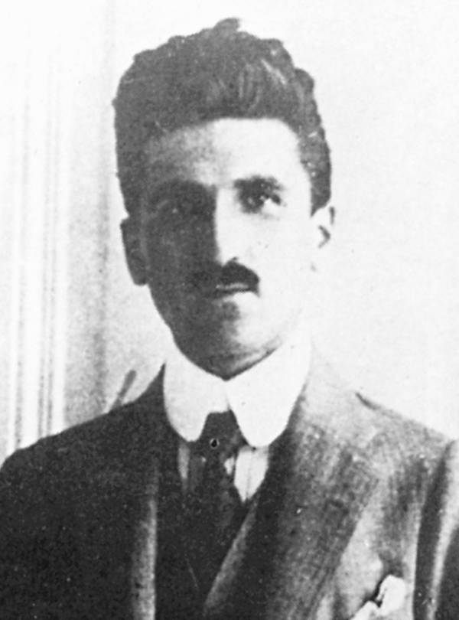
In 1947 the Hungarian Marxist art historian Frederick Antal (1887-1954) published the famous essay Florentine Painting and Its Social Background in London.
The fundamental thesis is that contemporary stylistic tendencies found correspondence in the different social composition of the patron class.
bourgeois rationalism, sober, severe and worldly, proper to the educated upper middle class and expressed in Giotto/Masaccio’s logical and monumental style;
a feudal nostalgia that grasps the lower middle class at the end of the 14th century, found in certain Gothic and pompous aspects of painting (Gentile da Fabriano) of the same period;
an emotionally religious attitude of the petit-bourgeois class, which informs so much two-dimensional, illustrative and edifying painting of the later 14th century;

Slide 21
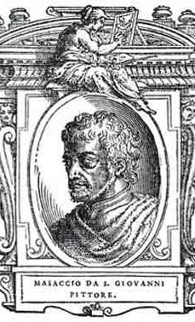
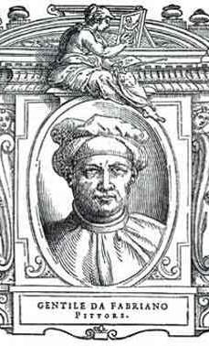
This scheme fully reflected Antal's theoretical assumption:
«we can understand the origins and nature of co-existent styles only if we study the various sections of society, reconstruct their philosophies and thence penetrate to their art».
To sum up, a current defined as 'rationalist' that united Giotto and Masaccio was highlighted as the perfect expression of the upper middle class, while Gentile da Fabriano's late Gothic persistence found justification in the neo-feudal nostalgia of the lower middle class.

Slide 22
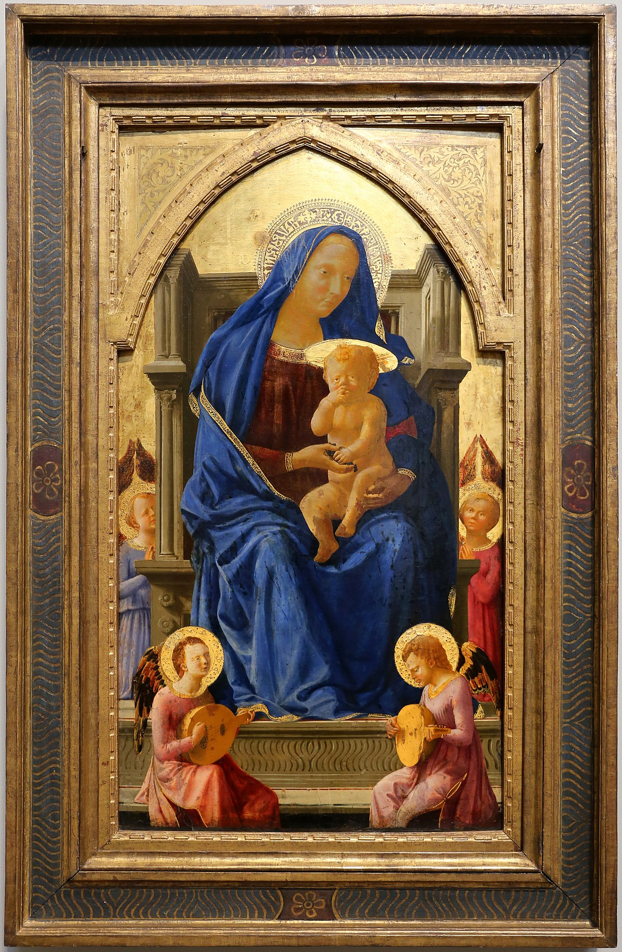
« […] Masaccio’s picture is matter-of-fact, sober and clear-cut. The sacred personages have a marked earthly flavour. Mary is depicted as an unpretentious woman, who appears somewhat weary. The child, shown quite naked, asserts his divine character even less, and looks more like an infant Hercules than an infant Jesus. His hands are not engaged in a ritual gesture; he is sucking his thumb like any human baby. This matter-of-fact conception is in harmony with the matter-of-fact treatment of the figures and their placing in space. The structure of the figures is clear, and so are their poses. The frugal use of colour (blue mantle, rose-red tunic, grey stone throne) and the meticulously calculated fall of light are also intended to stress the modelling. All the figures in the picture are grouped in natural balance, giving a clear, simple composition of horizontals, verticals and calm diagonals […] ».
Masaccio (1401-1428/9), Madonna col Bambino, 1426. London, The National Gallery. Central part of a dismantled polyptych.

Slide 23
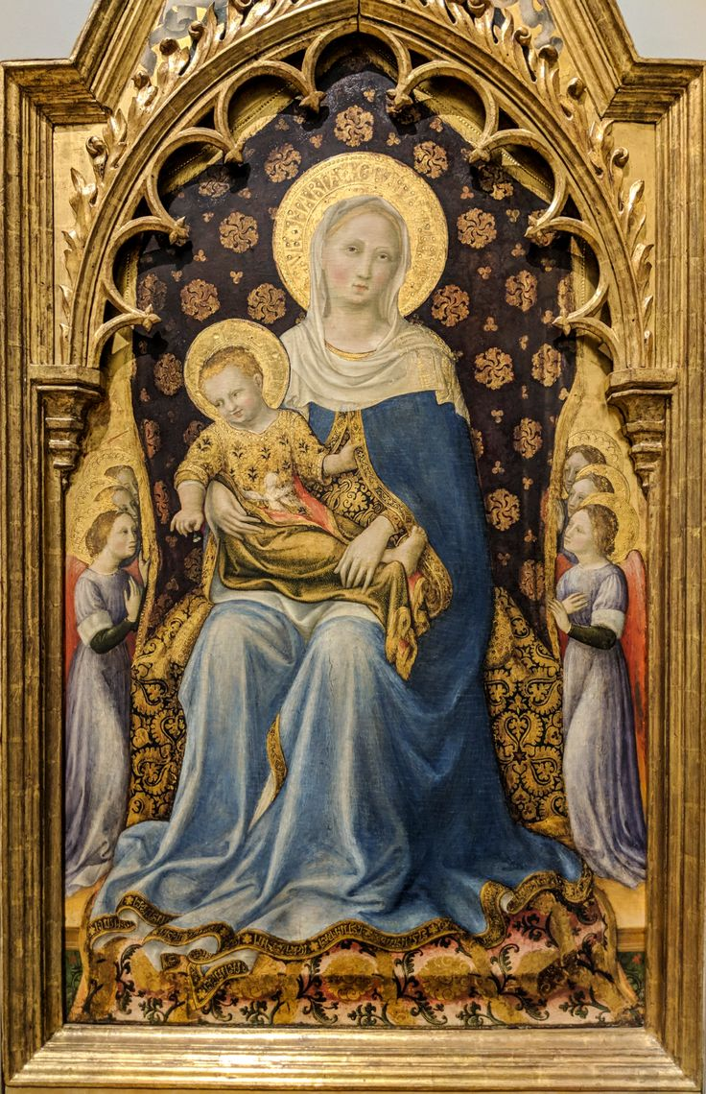
« […] Gentile’s picture has none of this clarity and objectivity, none of Masaccio’s austerity. His Mary’s bearing and pose are those of a lovely and gracious queen, enthroned in a pomp-loving Court of Heaven. Her mantle, open in front, reveals richly ornamented robes. Compared with Masaccio’s figures, her body has little plasticity. Gentile’s infant Jesus is the child of a very wealthy house; he is dressed in a gold-embroidered garment, and wrapped in a dark golden shawl, so that no part of his body is left uncovered. Courtly pomp is as much a characteristic of the subject-matter of this picture as two-dimensional flatness is of its form. The impression given by the whole picture is that of a surface covered with rich materials into which figures are introduced in a rhythmic pattern […] ».
Gentile da Fabriano (1385-1427), Madonna Quarratesi, 1425. London, The National Gallery. Central part of a dismantled polyptych.

Slide 24
« […] How could two such widely differing pictures have been painted in the same town and at the same time? It would seek to explain the difference between these two pictures by saying that each belongs to a different stylistic trend, one to what it calls the “classic” or “renaissance” style and the other to the “late-Gothic”. Art history is the history of these styles, but can styles be explained merely by putting labels on them and describing their characteristics? In other words, is the co-existence of various styles in the same period explained by merely stating the fact that they do co-exist? […]» .
« […] The public is by no means unanimous in its outlook on life, and this divergence of outlook among its various sections explains the coexistence of different styles in the same period. Such divergence is, in its turn, due to the fact that what we call the public is not a homogeneous body, but is split up into various often antagonistic groupings. Since the public is merely another word for society in its capacity as recipient of art, what is required next is to examine the structure of society and the relationship between its various sections. To this end, we must ascertain the economic and social causes which have produced these divisions […]» .
F. Antal, Florentine painting and its social background. The Bourgeois Republic before Cosimo de' Medici's Advent to Power: XIV and Early XV Centuries., London, Kegan Paul, 1947. Introduction, pp. 1-4.

Slide 25
Sources
https://www.artshelp.com/art-theory-social-history/
https://arthistorians.info/hausera/
S. Eisenman, The Appeal of Modern Art: Toulouse-Lautrec, c. 1880-1900, in S. Eisenman T. Crow, B. Lukacher et al., Nineteenth Century Art: A Critical History. London, Thames & Hudson College, 5°ed. 2020, pp. 424-432.
J. Cooke, Storia sociale dell’arte o Kulturgeschichte? Millard Meiss e la recensione a Frederick Antal. From Crepuscoli dottorali. Quaderni di arte, musica e spettacolo. Rivista semestrale Anno I, numero 2. Turin, digital edition, 2011, pp. 81-91.
F. Antal, Florentine painting and its social background. The Bourgeois Republic before Cosimo de' Medici's Advent to Power: XIV and Early XV Centuries., London, Kegan Paul, 1947. Introduction, pp. 1-4.
https://www.nationalgallery.org.uk/paintings/gentile-da-fabriano-the-quaratesi-madonna
https://www.nationalgallery.org.uk/paintings/masaccio-the-virgin-and-child

