Slide 1
Session 1: Introduction
23 February 2024

Slide 2
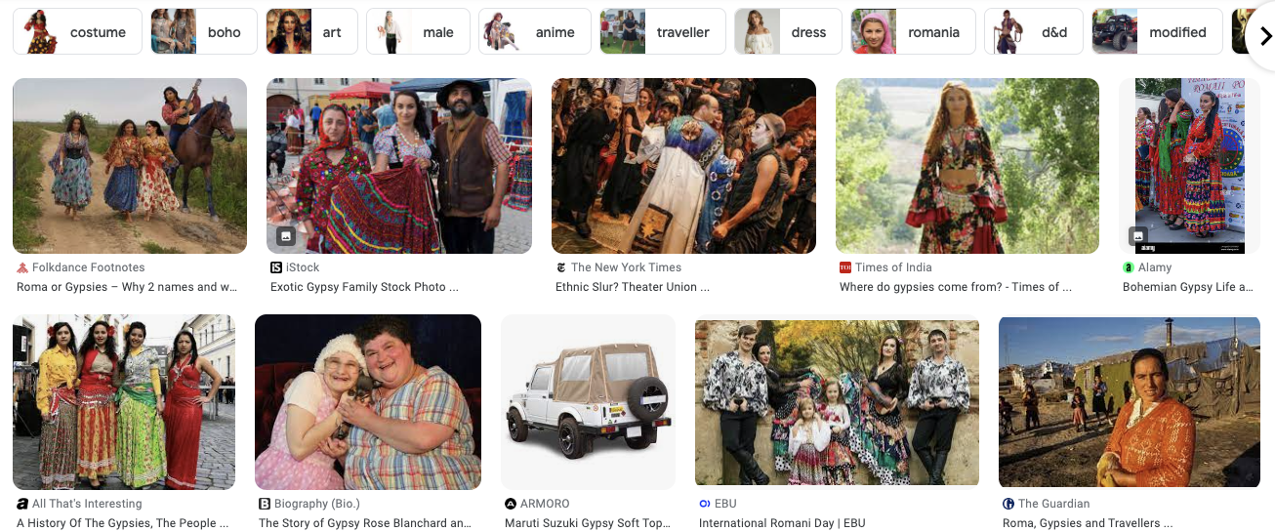

Slide 3
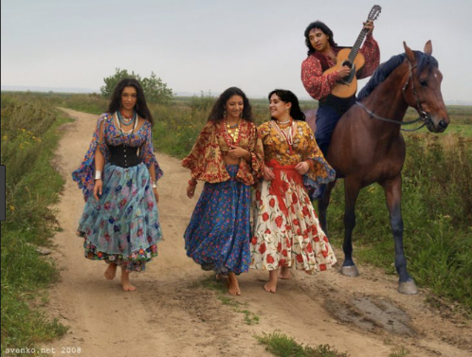
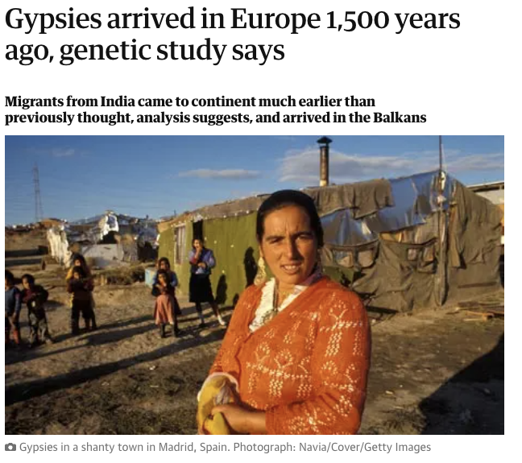

Slide 4
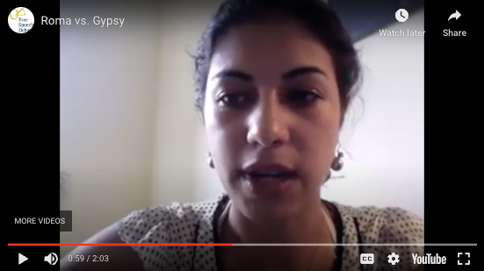
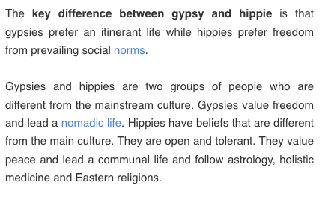
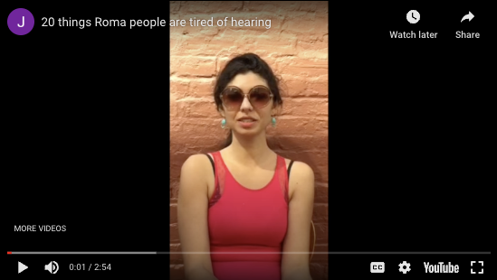
Trivial and dagerous stereotypes? Roma & “Gypsies”
https://youtu.be/2C3WETz0SN8
https://youtu.be/QmOyG1yz9G8

Slide 5
1 March 2024
Who are the real Bohemians? Artists and cultural appropriation
Karel Hynek Mácha, Cikáni (1835)
Karel Anton, Cikáni (1921)

Slide 6
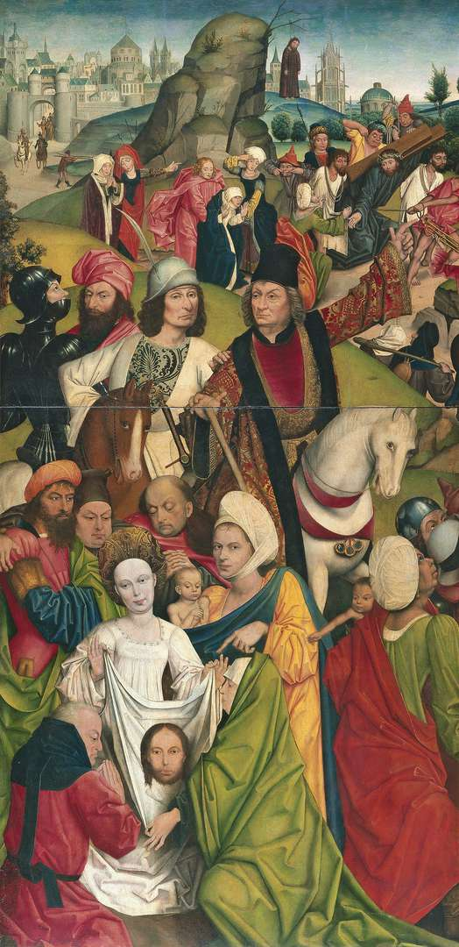
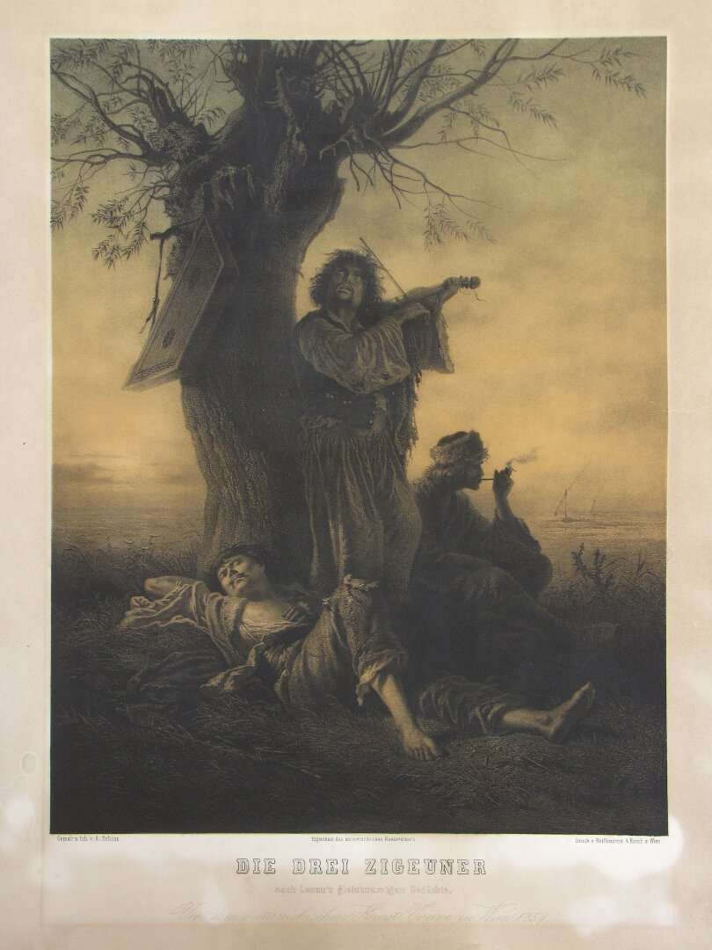
8 March 2024
What does postcolonialism have to do with it? The "Gypsy" body and blackness
Alois Schönn | Three Gypsies | lithography | Austria | 1859 | vis_00027
Derick Baegert | Christ Bearing the Cross | painting | unknown | 1477 - 1478 | vis_00042

Slide 7
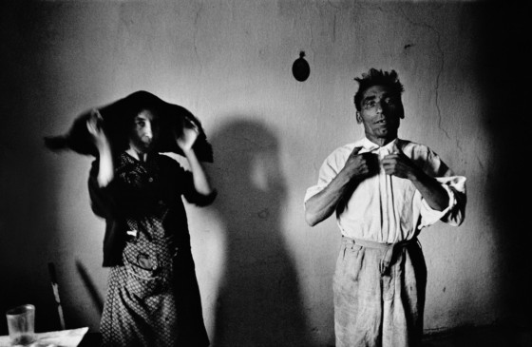
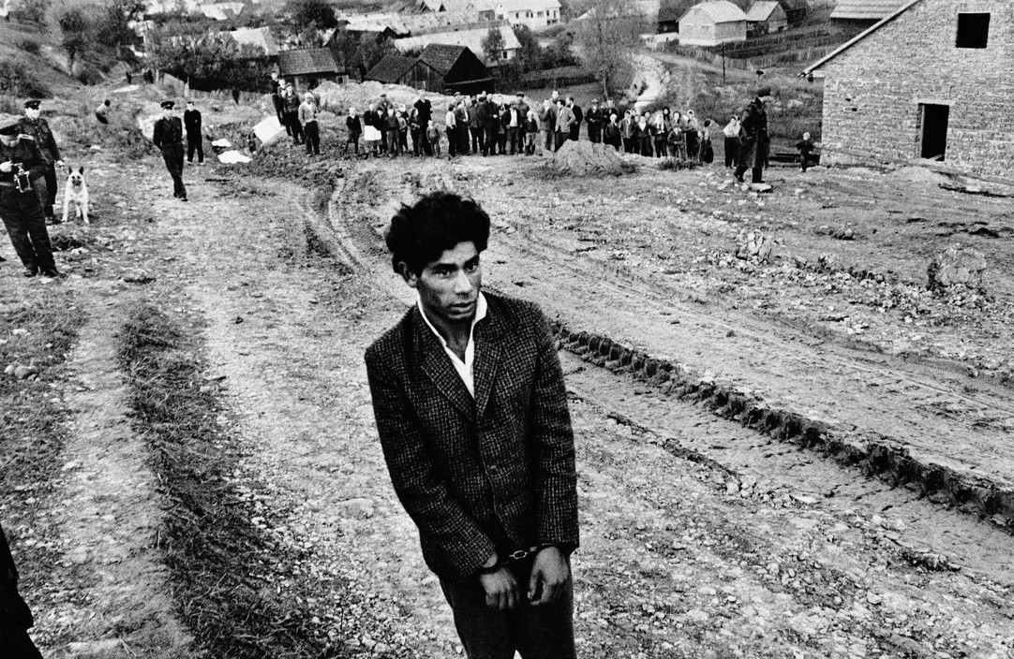
15 March 2024
Stereotypes, photography and mass media
Josef Koudelka | Gypsies Gypsies. Velka Lomnica, Czechoslovakia. 1966. © Josef Koudelka | Magnum Photos
Josef Koudelka | Gypsies Reconstruction of a homicide. In the foreground: a young gypsy suspected of being guilty. Jarabina, Czechoslovakia. 1963. © Josef Koudelka | Magnum Photos
Josef Koudelka, Gypsies, 1967

Slide 8
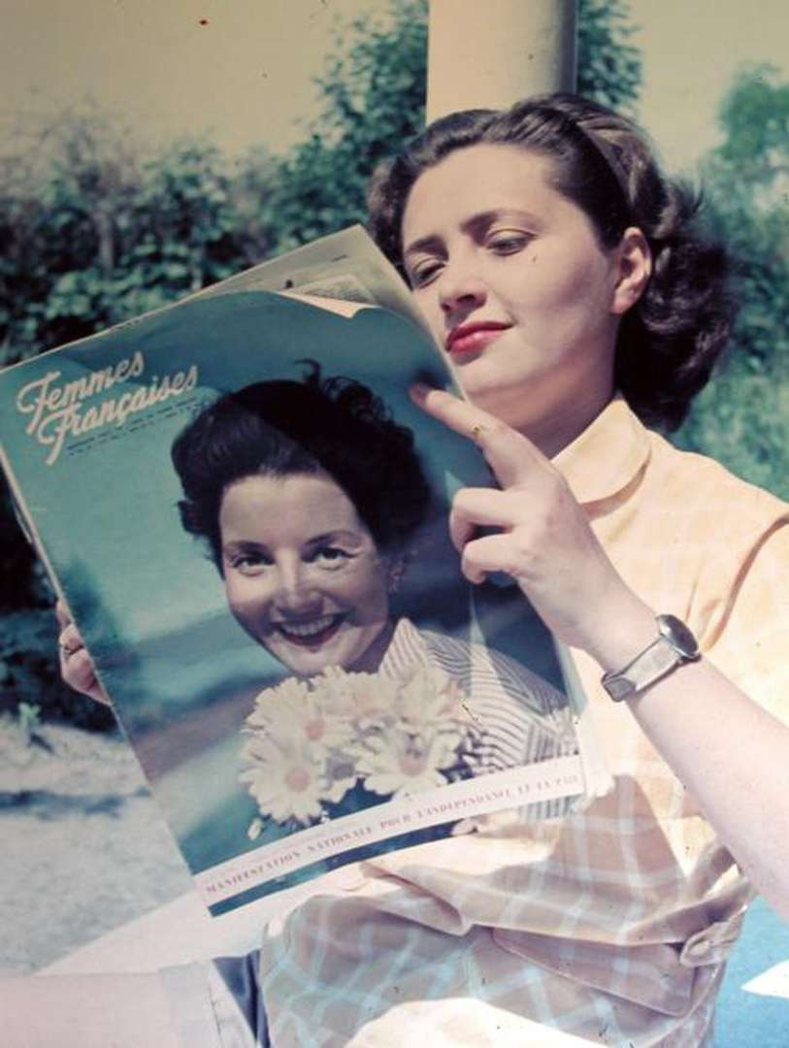
22 March 2024
Returning a name: how to make individuals visible
„The Gypsy image must be deconstructed and replaced by a more accurate one“
Ian Hancock, 1997, “The Struggle for the Control of Identity”, Transitions Vol. 4, No. 4
unknown | Ohne Titel | photography | unknown | 1947 | pho_00028

Slide 9
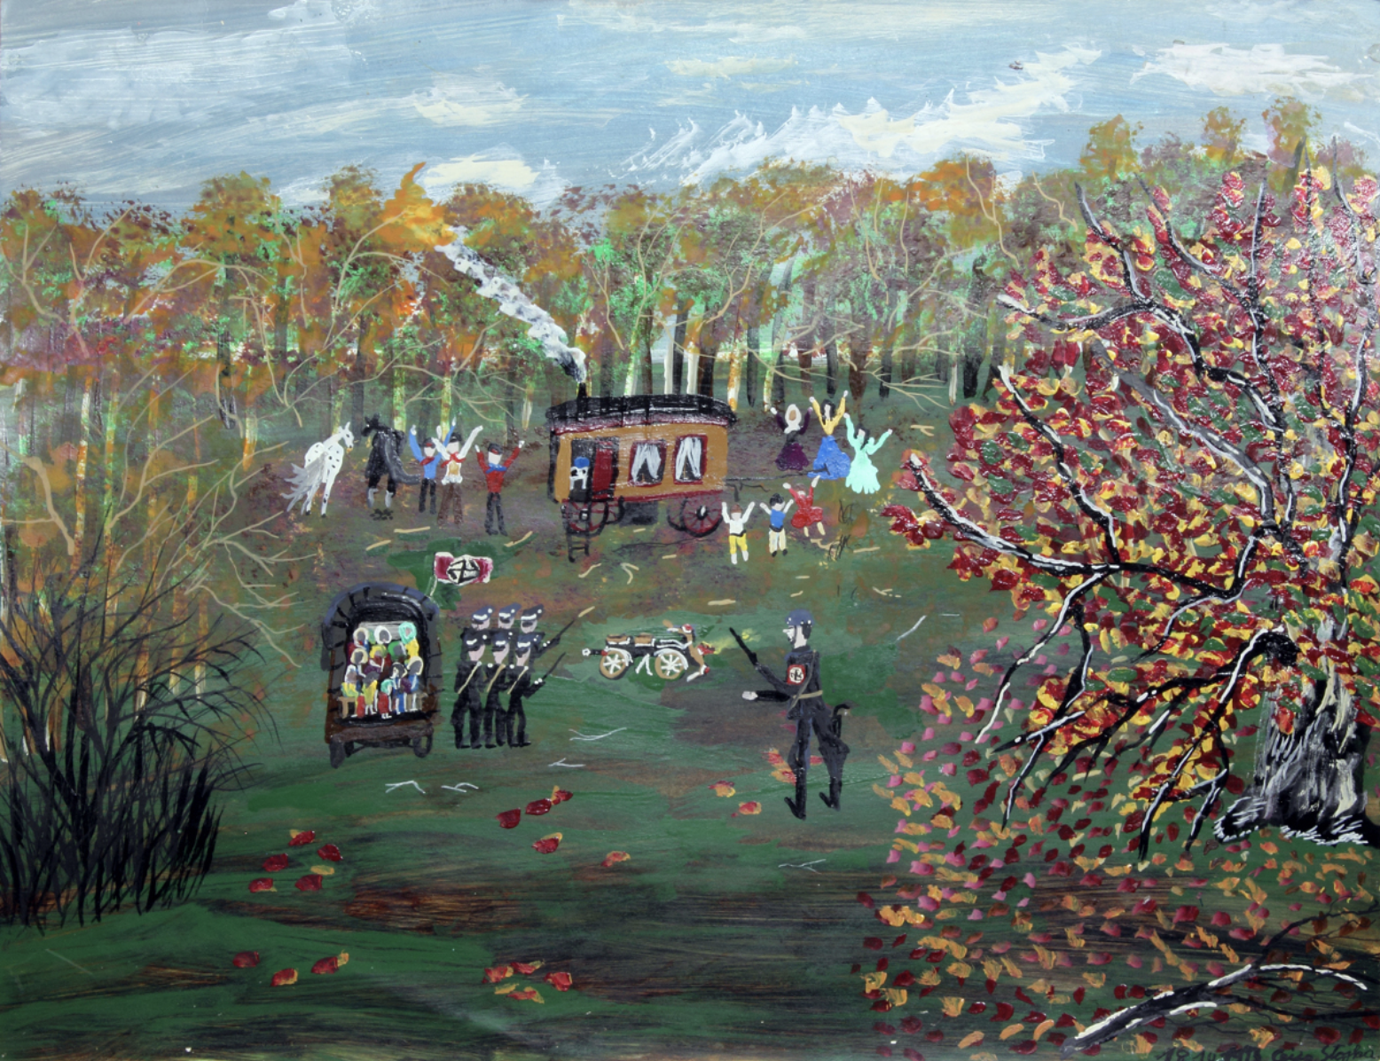
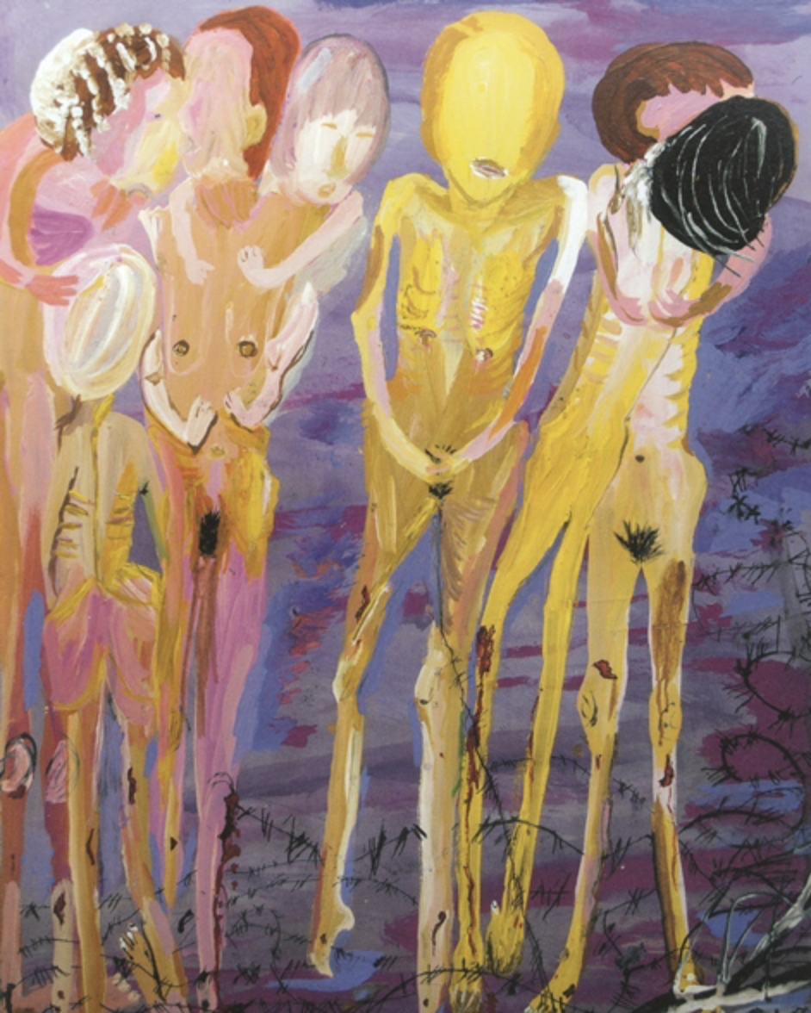
5 April 2024
Documents of Persecution: The Romani Genocide (Porajmos) in Visual Culture
Ceija Stojka, Sans titre, 1993, acrylic on board, Courtesy Hojda et Nuna Stojka, © Ceija Stojka, © ADAGP, 2017
Ceija Stojka, image from: https://volksgruppen.orf.at/v2/roma/stories/2904664/

Slide 10
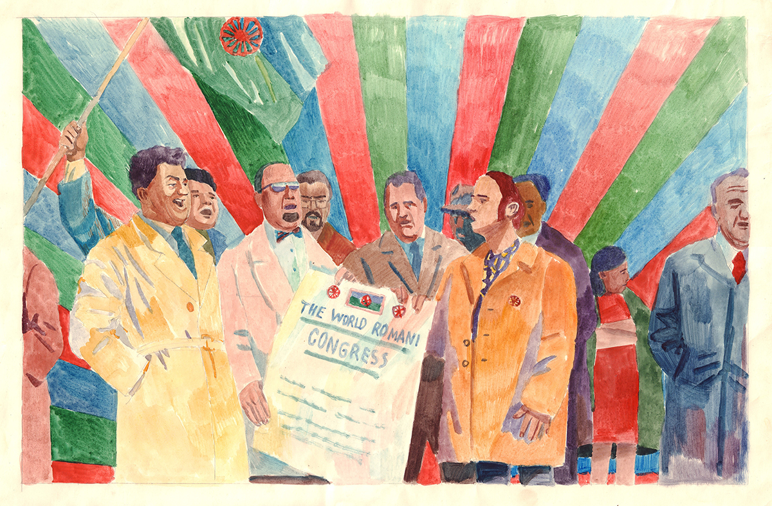
12 April 2024
The struggle for control of Romani identity: Emancipation after 1945
Rozana Kuburovič, The First World Romani Congress, 1971.

Slide 11
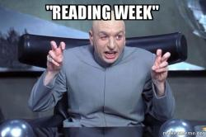
19 April 2024
NO CLASS TODAY
What to do during reading week?
https://medium.com/youalberta/7-tips-to-help-you-get-the-most-out-of-reading-week-fdda6f1e8b38

Slide 12
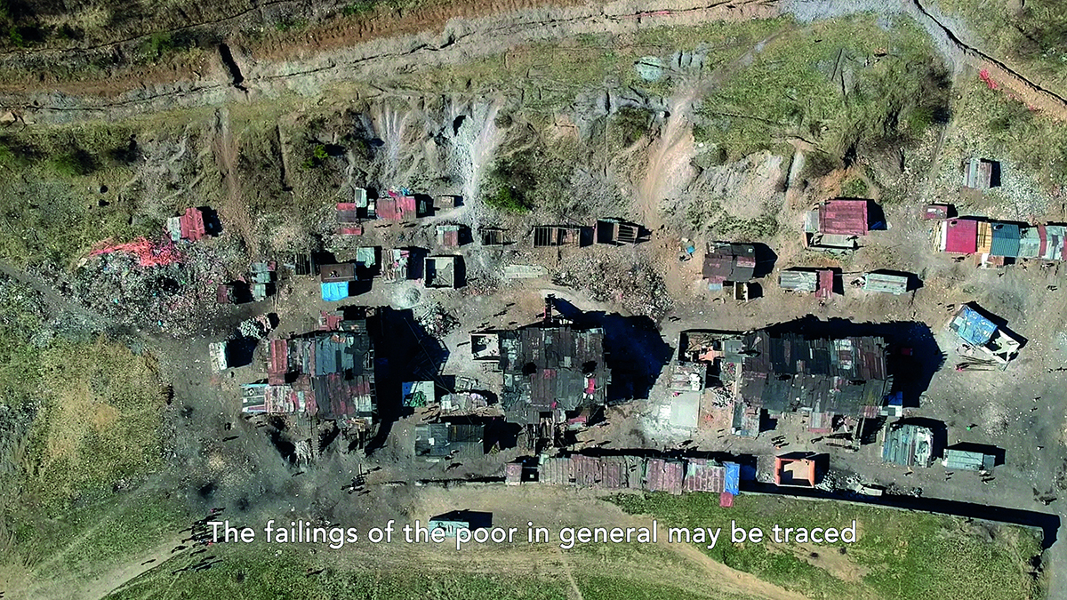
26 April 2024
Decades of inclusion? Roma artists and contemporary art
Averklub Collective, Social Murder (still), 2021.

Slide 13
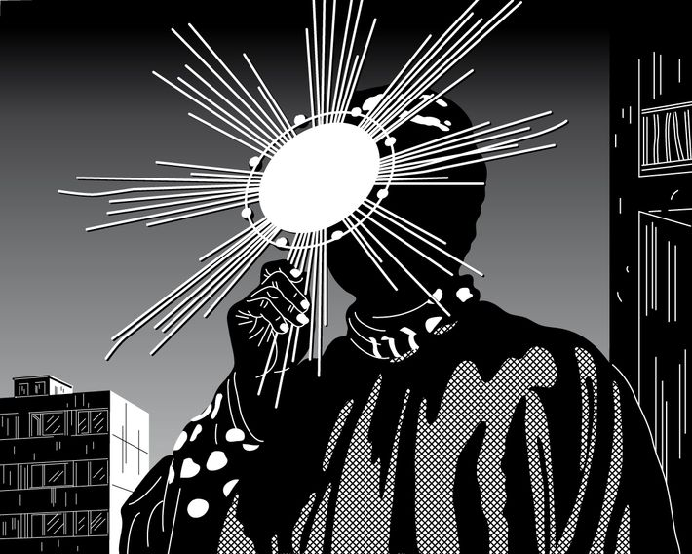
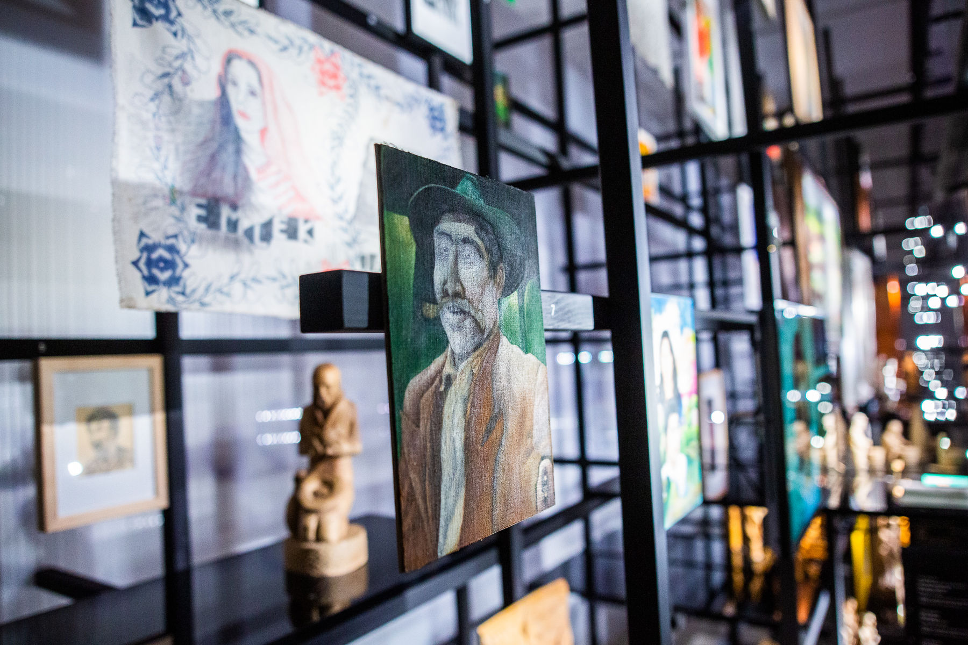
3 May 2024
Roma Art and "Gypsy" images in the public
O kosmos hino kalo/The Universe is Black, 2017, Moravian Gallery in Brno,
Phundrado drom / The Open Road, Ethnographic Museum, Prague, 3. 6. 2022 – 31. 5. 2024
Ladislava Gažiová,
https://www.artmap.cz/artist/ladislava-gaziova/
https://www.nm.cz/en/program/exhibitions/phundrado-drom-the-open-road#gallery-9

Slide 14
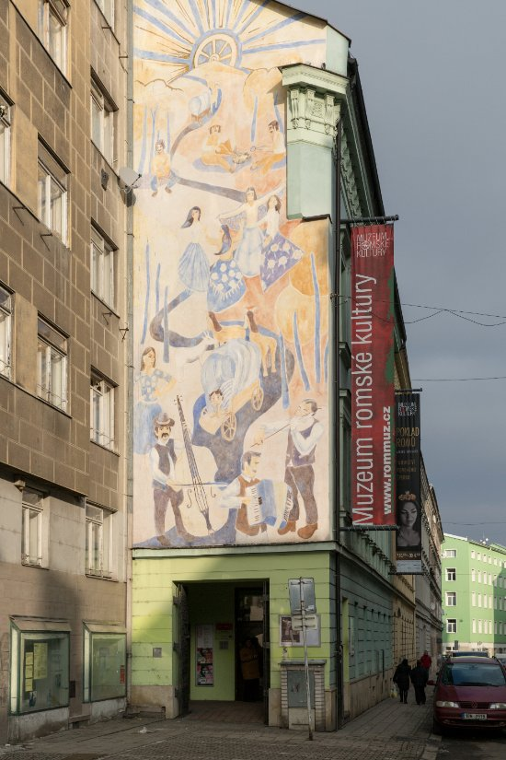
10 May 2024
Visit to the Museum of Romani culture in Brno
https://www.rommuz.cz/en/

Slide 15
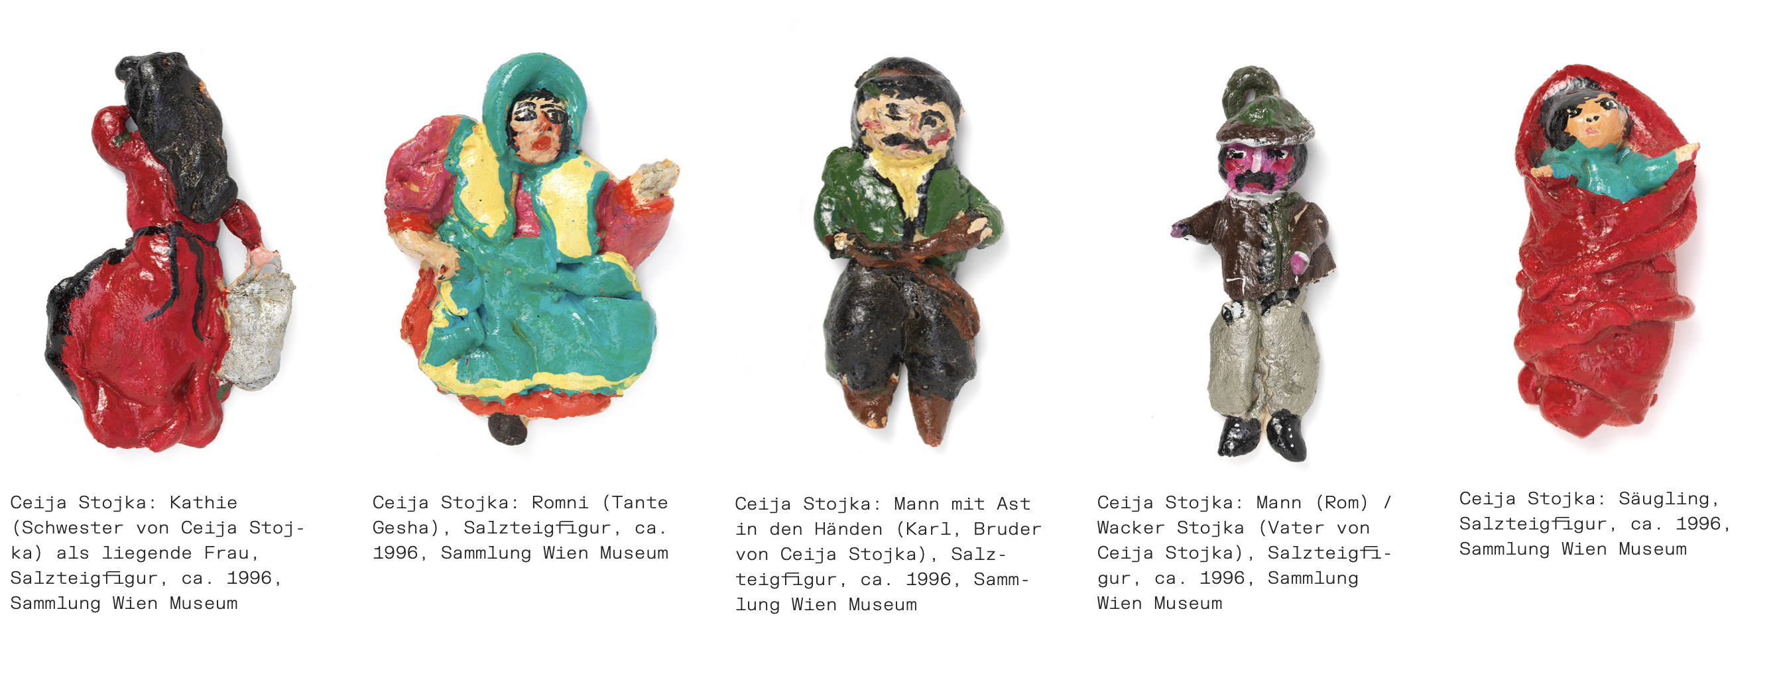
17 May 2024
Presentations
TASK 1: Presentation
- 5 minutes
- 5 slides
- open feedback round

Slide 16
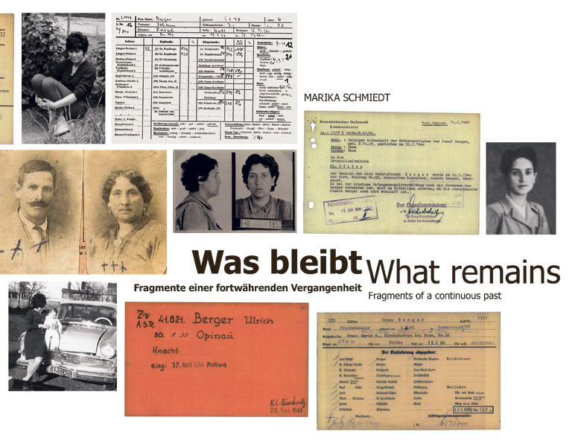
24 May
Feedback Session
TASK 2: Poster
- A2 format
- about the object of your choice
- details on poster-making follow later
- deadline: 24 May 2024
Marika Schmiedt, What remains, 2014

Slide 17
What will be our key terms?

Slide 18
Assessment
active participation in the course
Presentation on a topic of your choice related to the course
poster on a topic of your choice related to the course
Questions or suggestions?
Speak to me or send me an email:
Julia Secklehner – secklehner@phil.muni.cz

