Slide 1
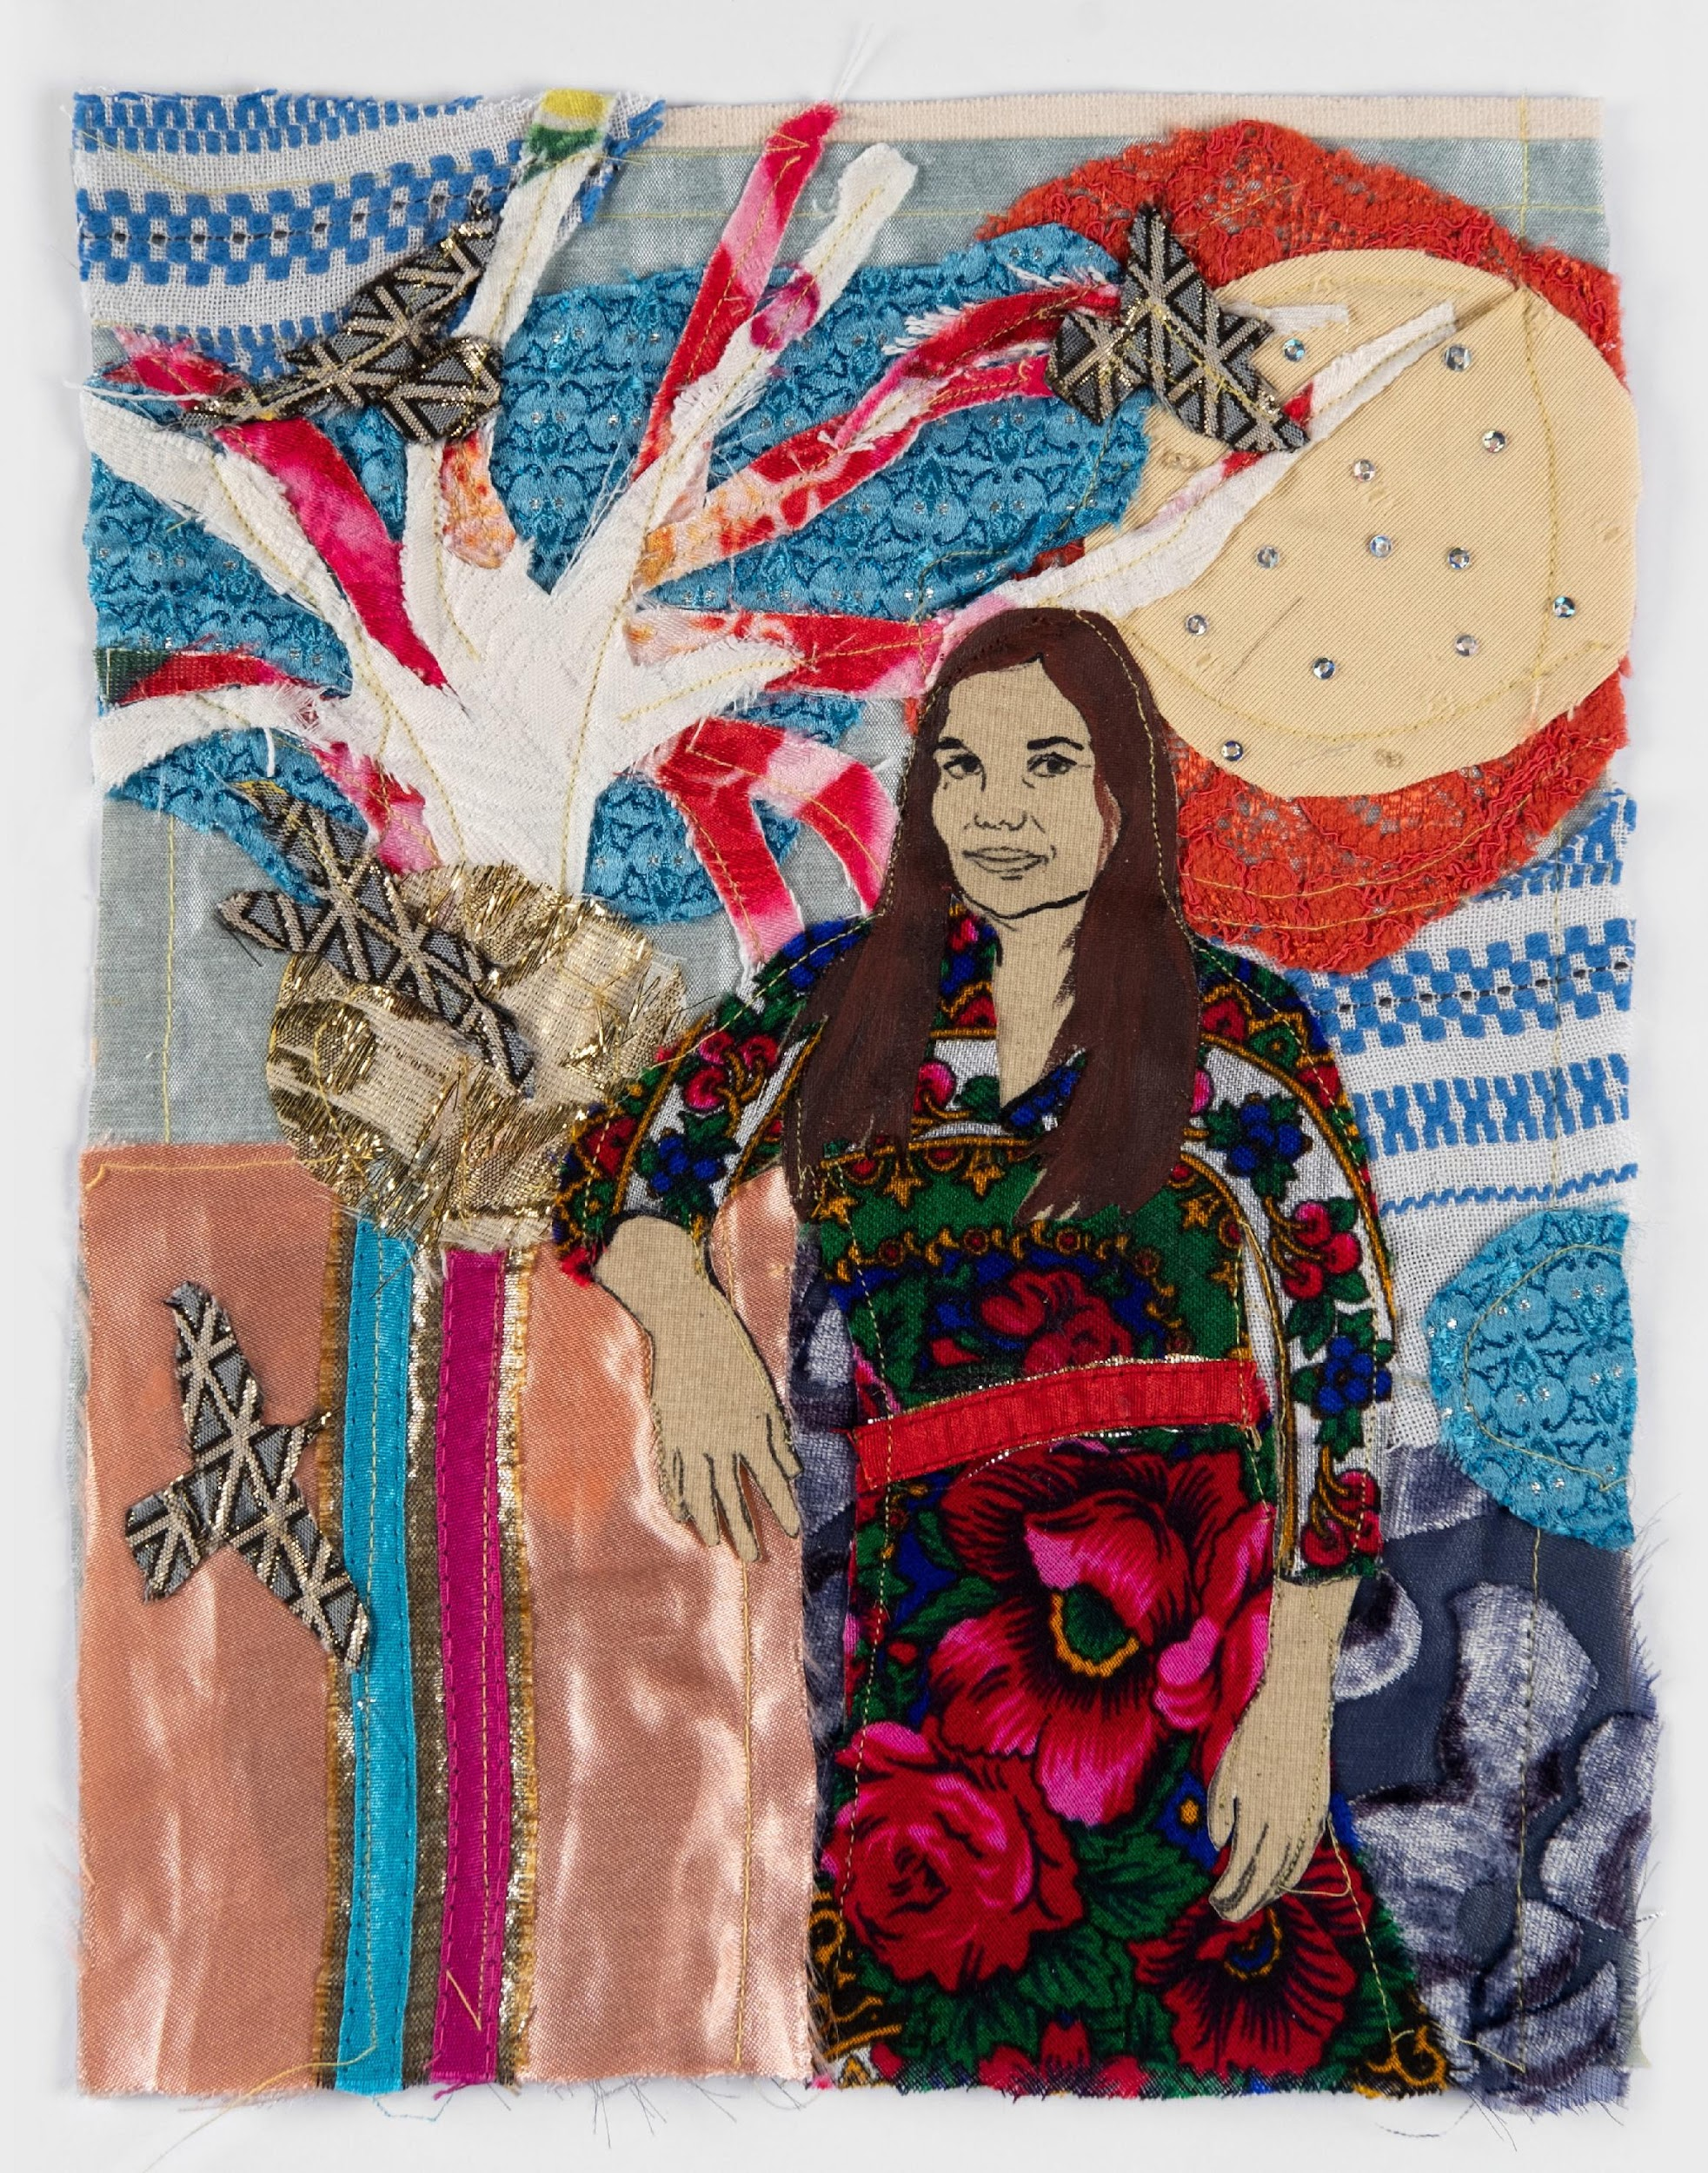
Returning a name: how to make individuals visible
Gender and sexual politics through an intersectional lens
22 March 2024
Małgorzata Mirga-Tas, Tímea Junghaus, 2020

Slide 2
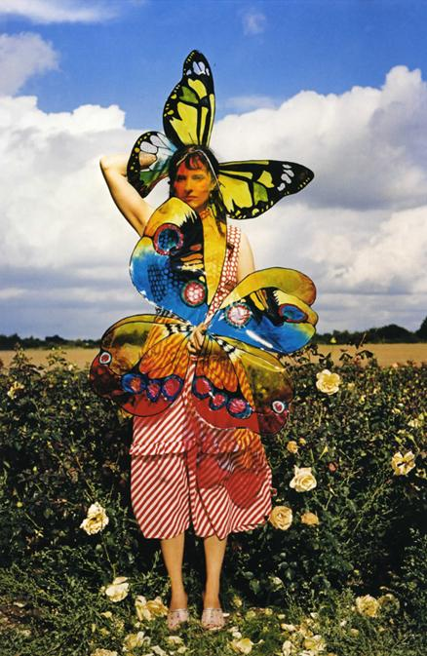
What does adding a name do?
Identity
Is the crisis can't you see
Identity, Identity
When you look in the mirror
Do you see yourself
Do you see yourself
On the TV screen
Do you see yourself in the magazine
When you see yourself
Does it make you scream
When you look in the mirror
Do you smash it quick
Do you take the glass
And slash you wrists
Did you do it for fame
Did you do it in a fit
Did you do it before you read about it
Identity by X-Ray Spex
1978
How does it challenge hegemonic art histories?
Delaine LeBas, Butterfly Ball, Vogue Italia 98, https://delainelebas.com/works/gypsy-couture/
https://youtu.be/Pst5K6uEPUc?si=lG4MJbWpusY59A-1

Slide 3
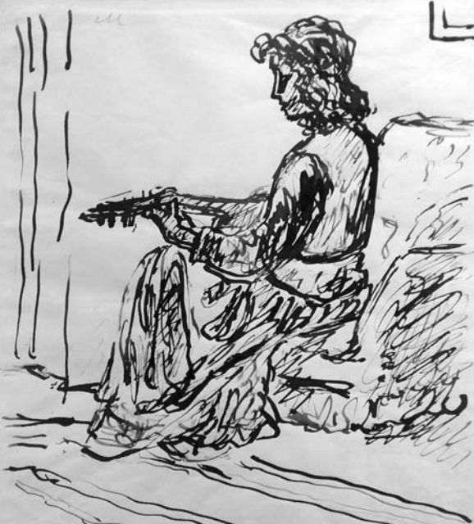
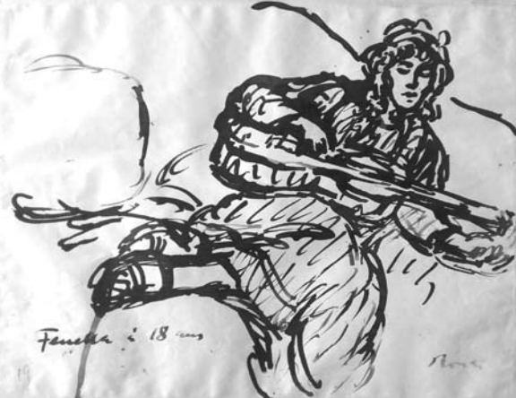
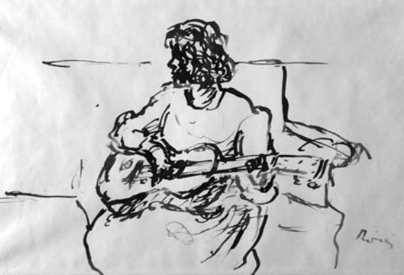
Fenella Lowell
Sketches of Fenella Lowell by József Rippl-Rónai (1861 –1927) 1910, Hungarian National Museum

Slide 4
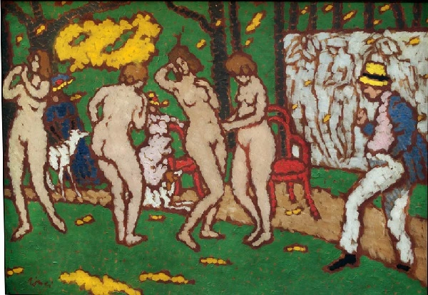
József Rippl-Rónai: My models in my garden in Kaposvár, 1911 (GM)

Slide 5
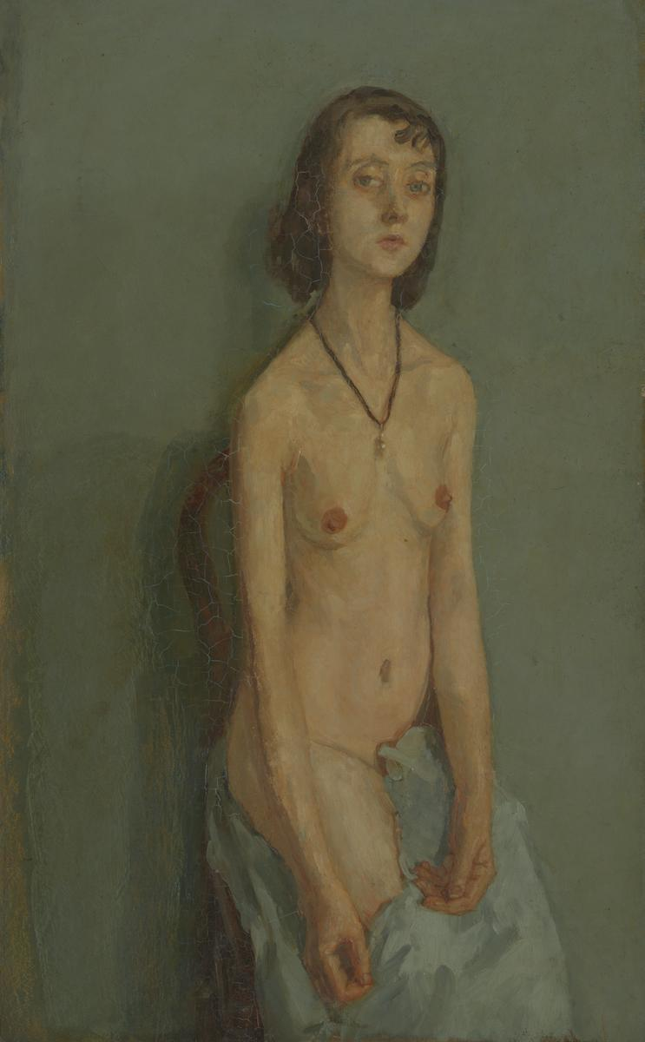
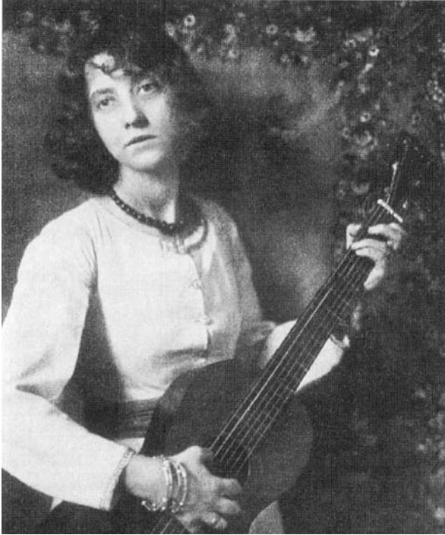
Olga Máté (1878-1961), Portrait of Fenella Lowell. 1910 c. © Hungarian Museum of Photography
Gwen Jon (1876–1939), Nude Girl, 1909/1910, Tate Britain

Slide 6
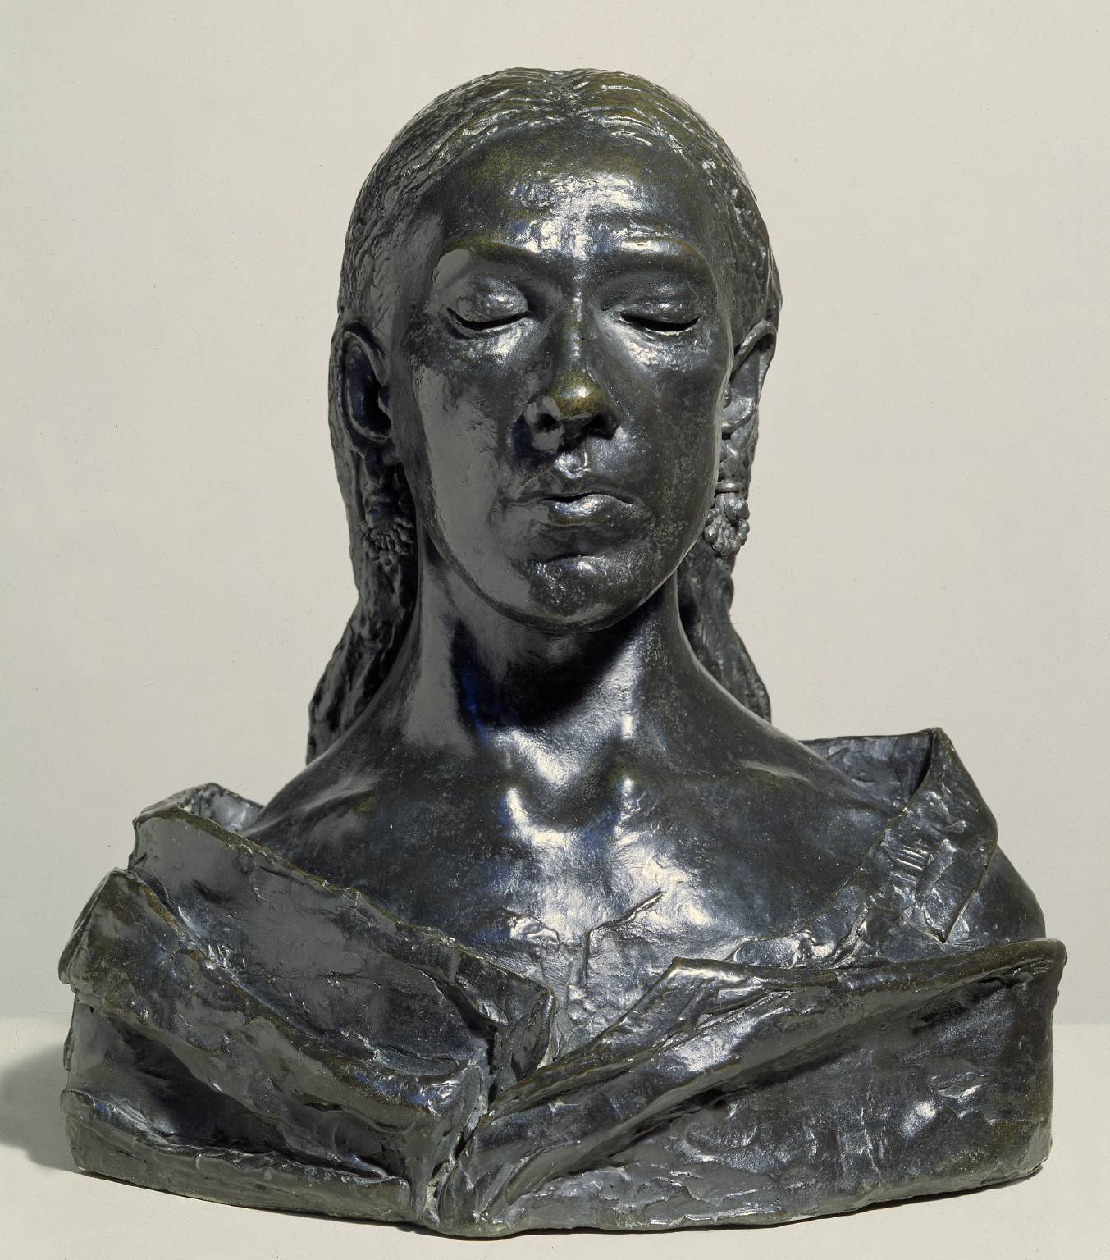
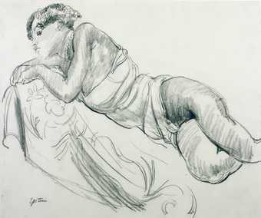
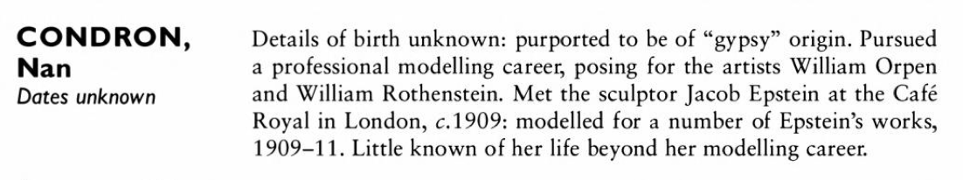
Nan Condron
Jacob Epstein, Nan, 1909, Tate Britain
“Condron was a bohemian and Epstein sought a likeness that was expressive of her character and presence as well as her appearance.”
Tate Gallery label, October 2020
From: Dictionary of Artists' Models, edited by Jill Berk Jiminez, 2001
Jacob Epstein, Nan, 1909, Tate Britain

Slide 7
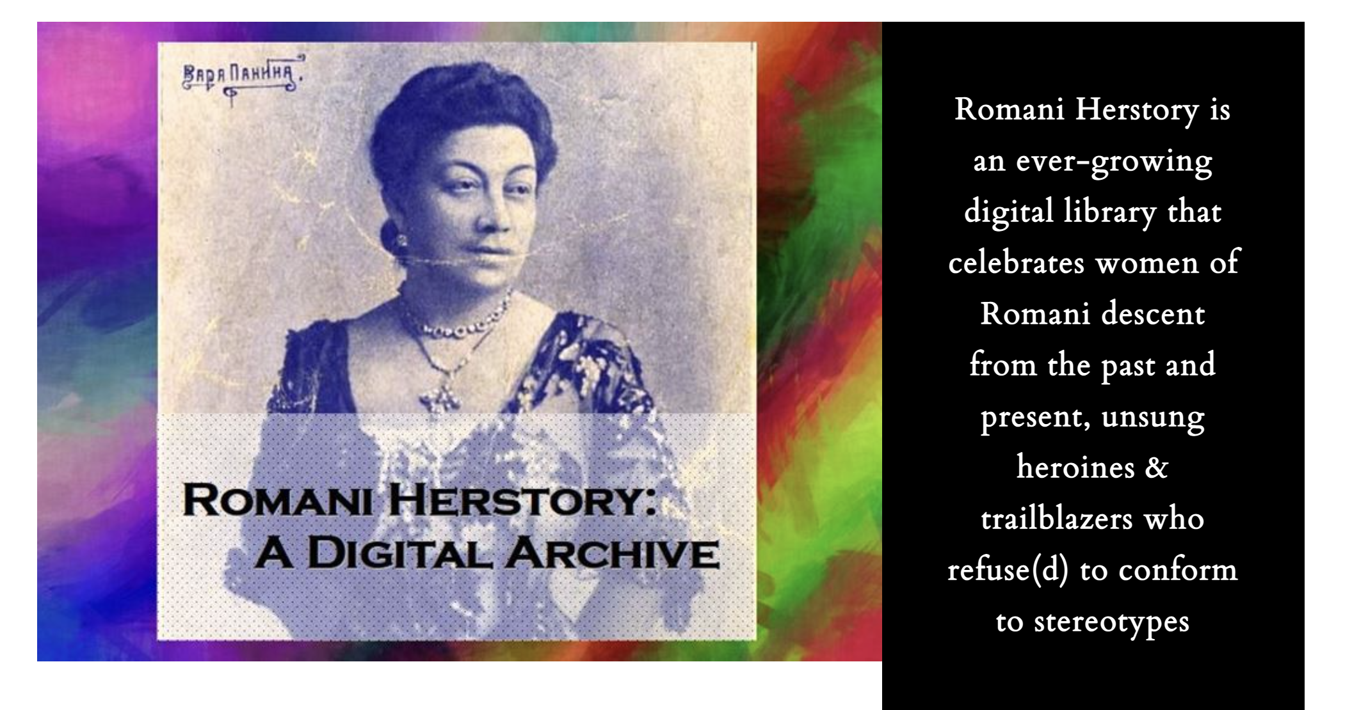
Is the personal still political? – Or: your body is (still) a battleground
https://www.romaniherstory.com/

Slide 8
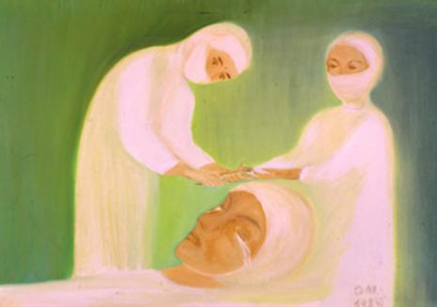
OMARA (1945–2020)
“As an uneducated artist, I became a naive painter, but the real reason for my recognition lies in my Roma identity. If I did not experience on my own skin the minutes, days, years that only a gypsy could experience, I would be a dreary painter. If I didn’t experience a lot of humiliation, shaming, disdain, hatred, there would not be this otherness in my paintings that makes me unique. With all my pictures, I want to express emotions, tell stories, fight for freedom against injustice.”
Omara, https://secondaryarchive.org/artists/mara-olah-omara/
Omara (Mara Oláh): My Eye Operation, 1989, oil, fiberboard, Collection of FROKK.

Slide 9
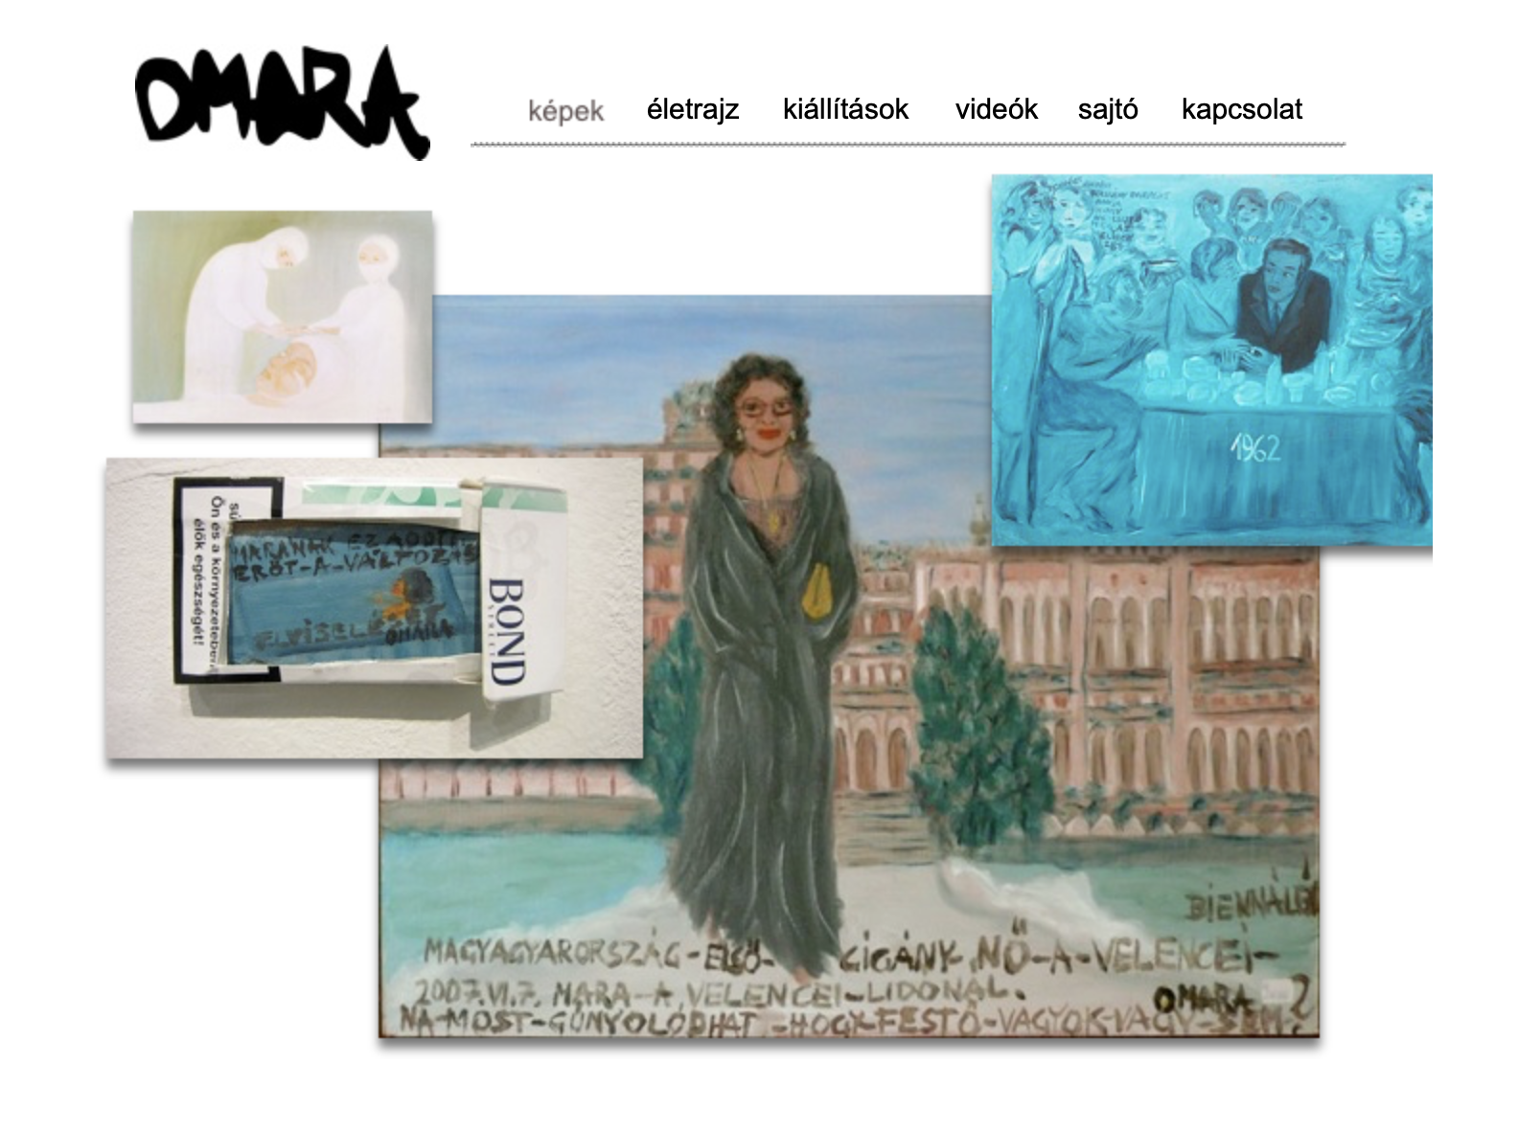
http://www.omara.hu

Slide 10
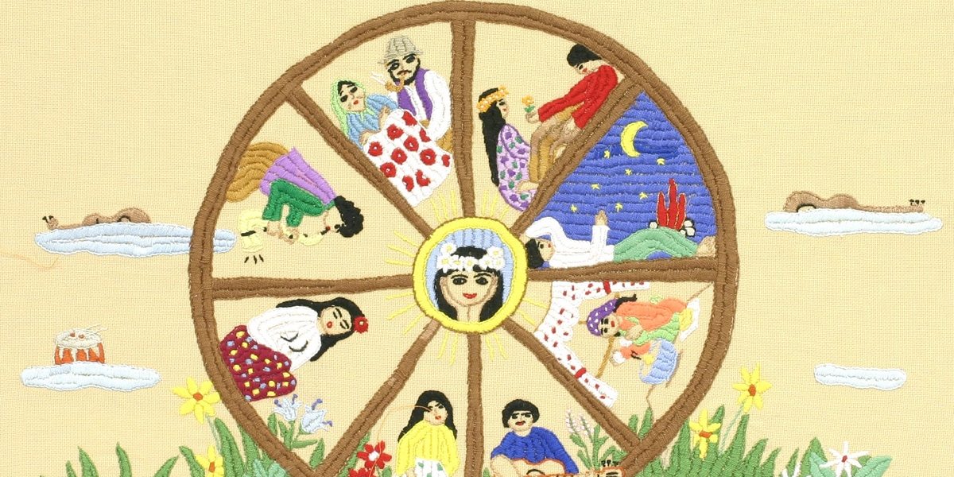
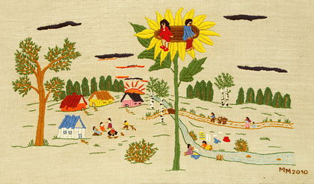
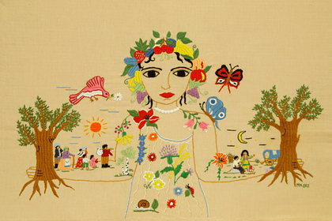
Markéta Šestáková (*1952)
Mother Nature, 2012
Children’s dream, 2010

Slide 11
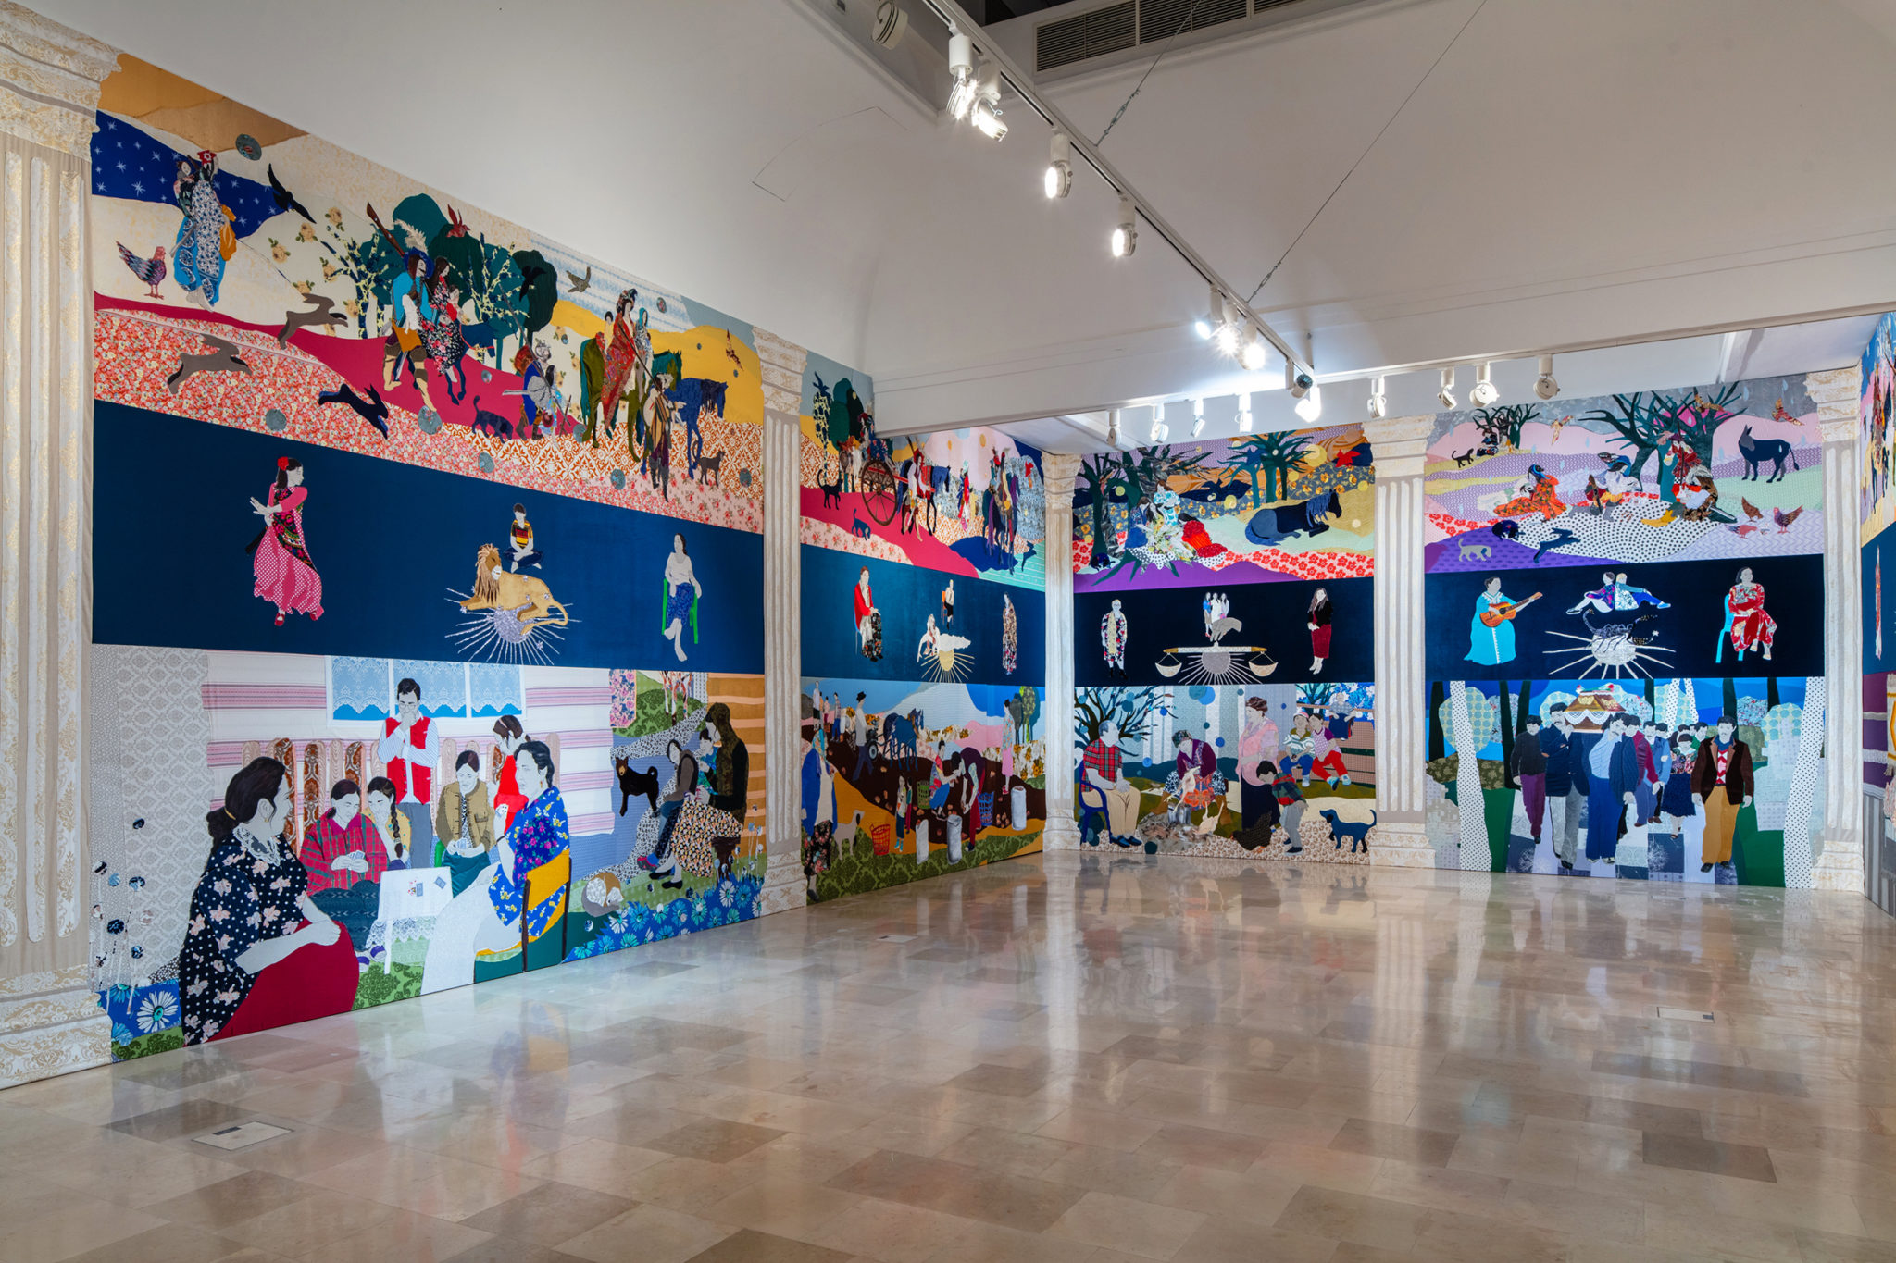
Małgorzata Mirga-Tas (*1978)
Małgorzata Mirga-Tas, Re-enchanting the World, exhibition view, Polish Pavilion at the 2022 Venice. Biennale. Image courtesy Zachęta National Gallery of Art. Photo: Daniel Rumiancew.

Slide 12

“For Mirga-Tas, the stories of real women who often live outside of ideology rooted in a meritocratic system become examples of emancipation and strength. According to the artist, her work speaks about women of her community to emphasize their ability to “foster the reality around them,” not the least because of their role in rearing the new generation.”
Alexandra Timonina, “Małgorzata Mirga-Tas: Re-enchanting the World, Polish Pavilion at the 2022 Venice Biennale”, Art Margins, 2023
Silvia Federici, Re-enchanting the World: Feminism and the Politics of the Commons,2018

Slide 13
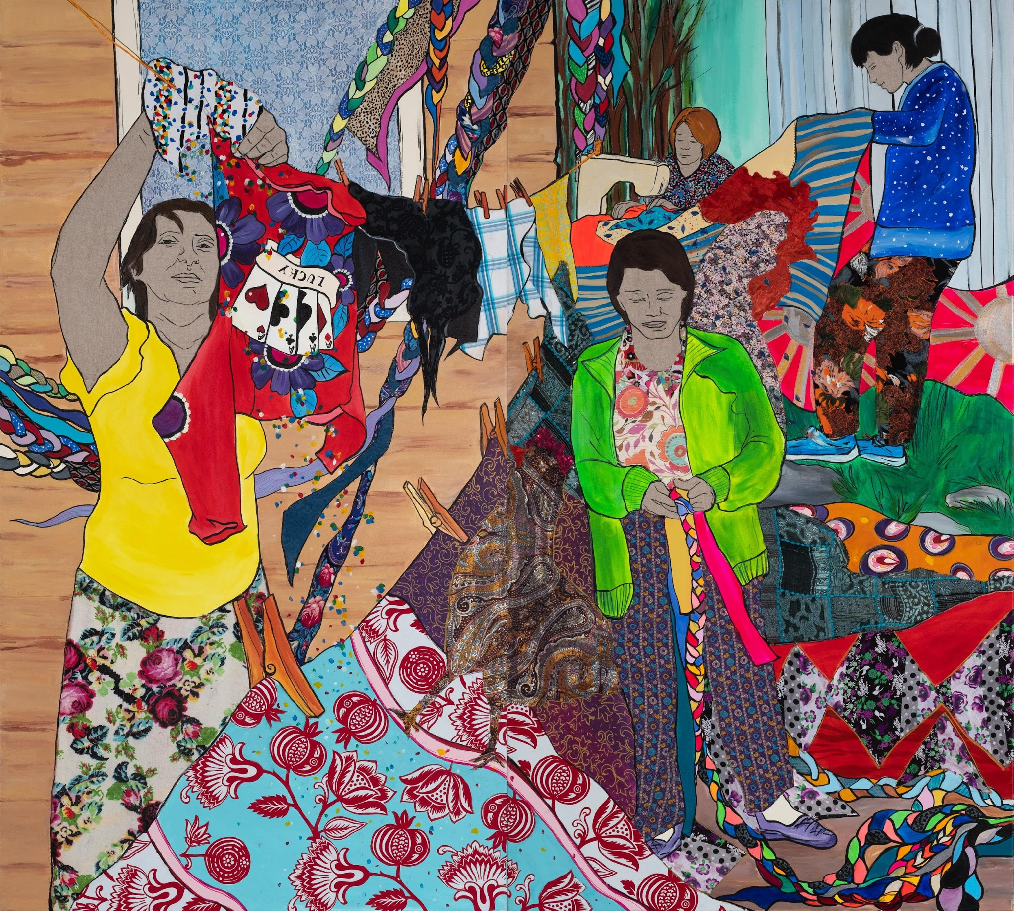
https://ingart.pl/pl/kolekcja/artysci/malgorzata_mirga_tas
Siostry (Phenia)
2019

Slide 14
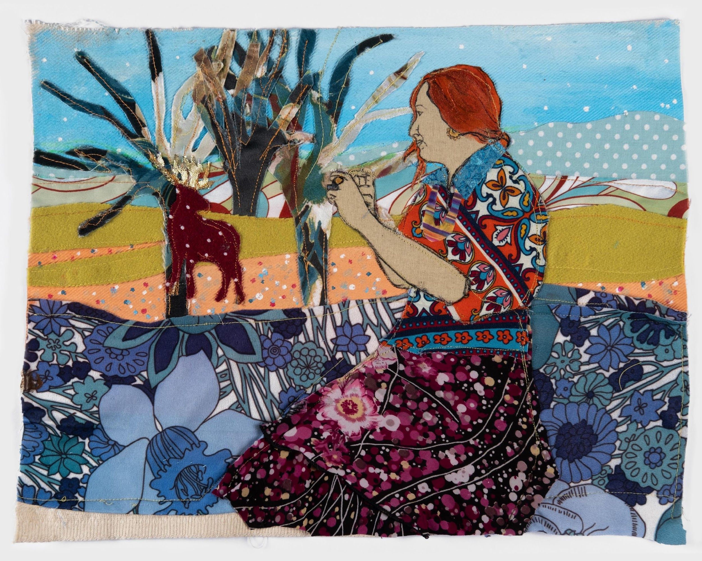
Delaine Le Bas
2020

Slide 15
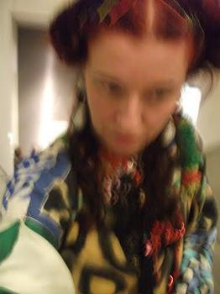
https://youtu.be/hhEX9n5DjZQ?si=UI1G2wNIgUsIcvUr
“We are stolen artefacts, physically, mentally, artistically. Even now in 2015 we are still seen and contextualised by everyone else but ourselves. How we are perceived by 'others' is still valued more important than how we see ourselves in the world view. We have been and continue to be stereotyped out of our own existence; our mere presence as human beings is a contested site. A colonialist way of seeing dominates the language that surrounds us and many others still, and continues to try and suppress us.
Artistically across practice I continue to question this.
My body as artefact, the object, the artistic site. A living sculpture. The works take place within the gallery setting and on the street.
The multiplicity of my identity and my questioning of this is an ongoing everyday artistic unravelling of what it means to always to be seen by outside positions. Orientalism and it's legacy still infiltrates ways of seeing and in order to be seen a different space needs to be created that refuses to speak in the language that has continued and allowed our bodies to be objectified, highly sexualised and stereotyped.I say no to Identity theft. I say no to who you think I am. I say no to what you think I should look like.
The gaze that is put upon us is disrupted. The 'passing' of being white is played upon and the true historical legacy that continues to dominate our identity is exposed for the antiquated and exclusion based structure that it is. To question these structures that are based in 'old fashioned' ways of thinking and seeing is to question ideas of culture itself and who owns this in terms of visual representation, historical and academic documentation.”
(Introduction for the Say No to Identity Theft – Exhibition at Gallery8, March, 2015.)
Delaine LeBas: Élő szobor-sorozat /Living Sculpture Series, 2012

Slide 16
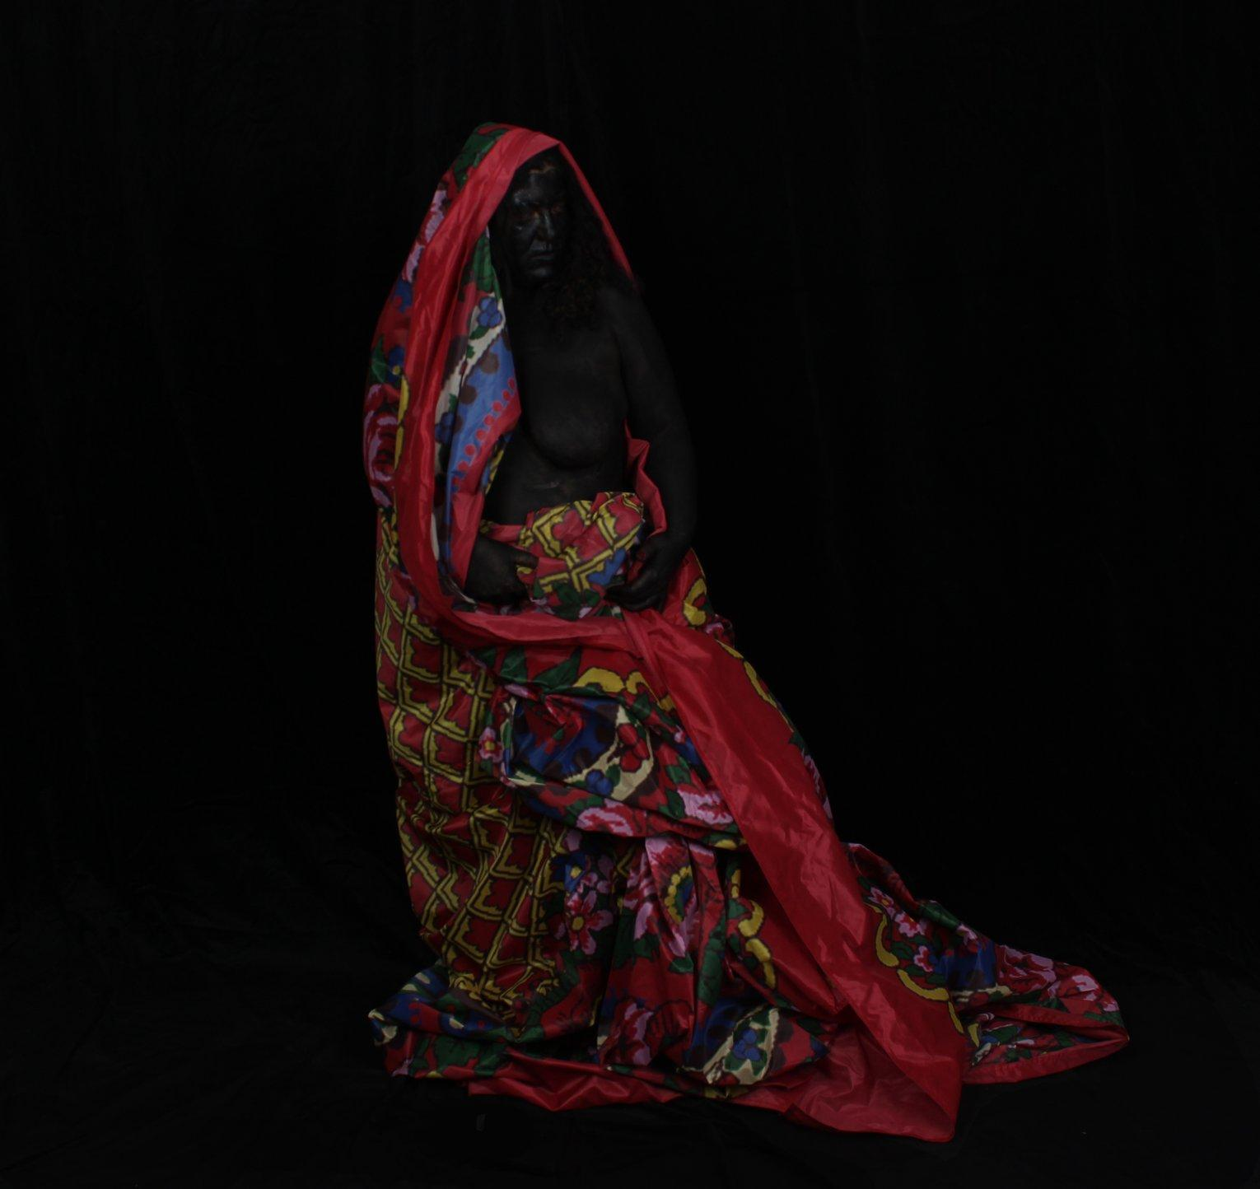
Emilia Rigová (*1980)
Crossing B(l)ack
2017
Digital Photograph
130x100cm, C-Print, aluminium dibond
130 x 100 cm
The impulse for this work is the author’s light skin-color which allows her to pass in the society as a non-Roma.
The self-portrait is a declaratory act of making herself visible as a Roma and simultaneously self-stylization as a black Madonna, i.e. an iconic female figure with whom Roma could identify.
https://emiliarigova.com/a-self-portrait.html

Slide 17
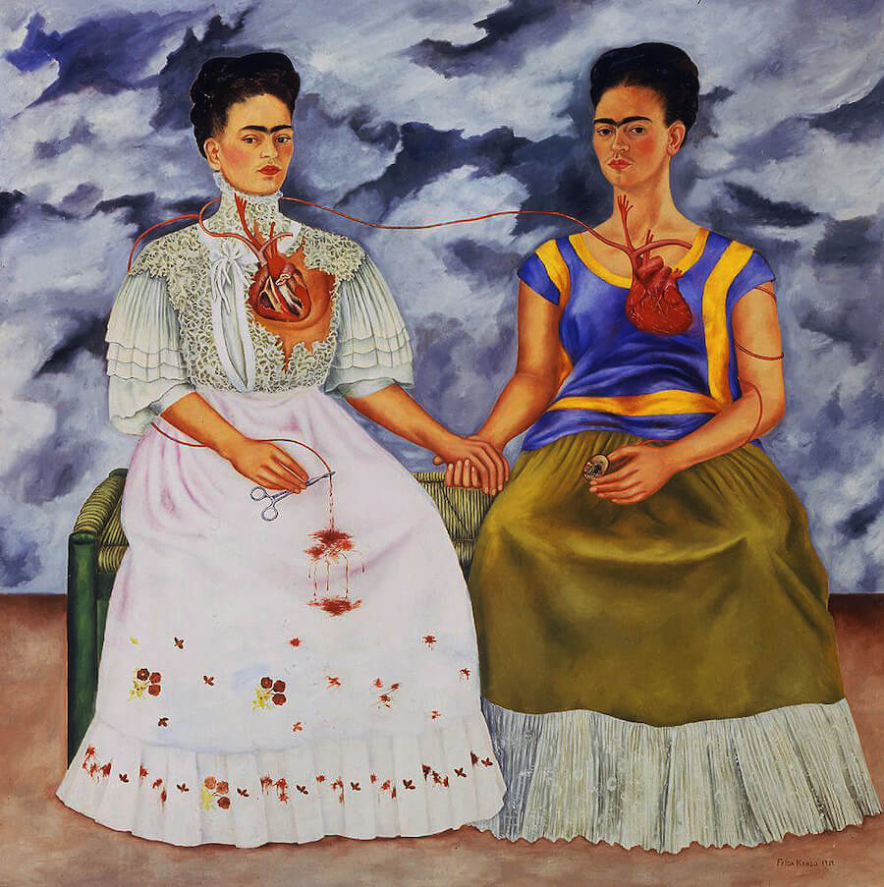
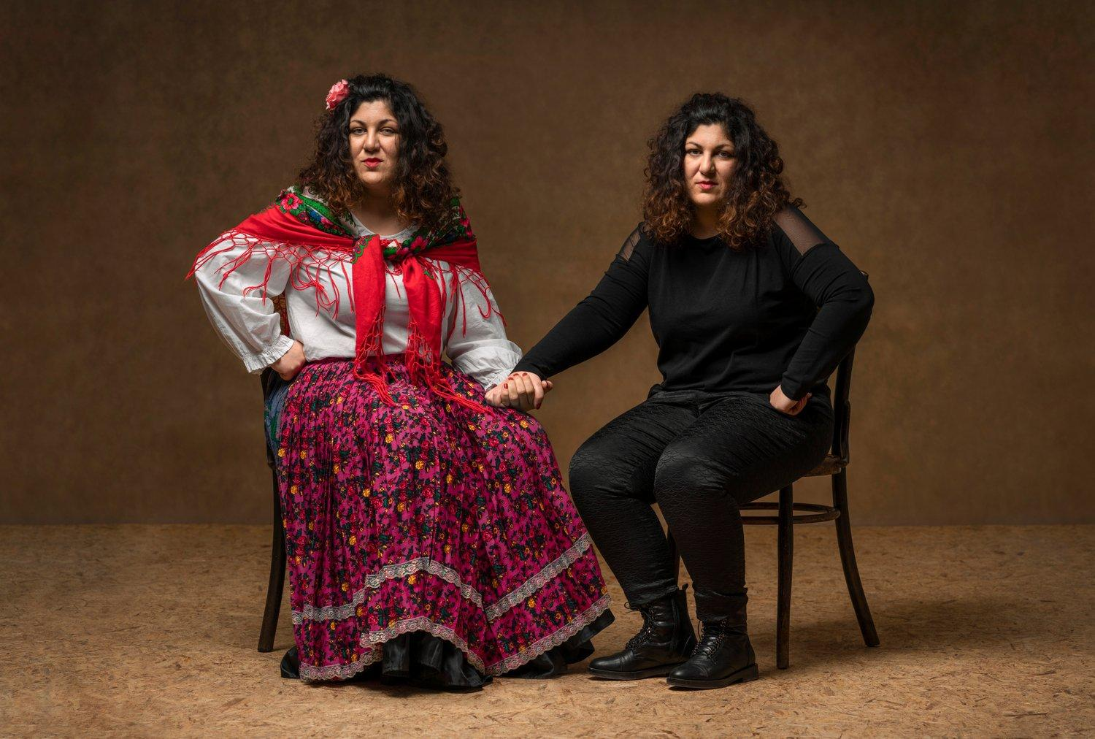
Emilia Rigová, Transgressing the past, shaping the future, 2017
Frida Kahlo, The Two Fridas, 1939, https://www.fridakahlo.org/the-two-fridas.jsp

Slide 18
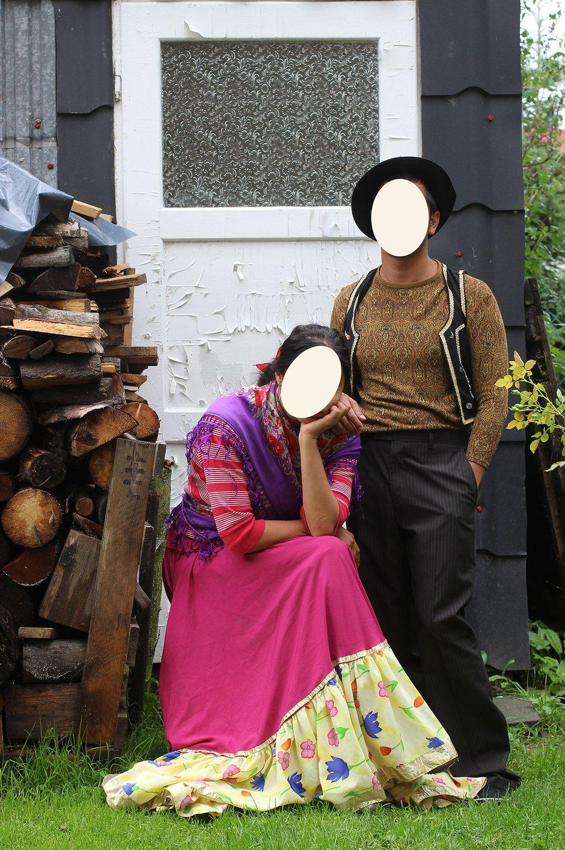
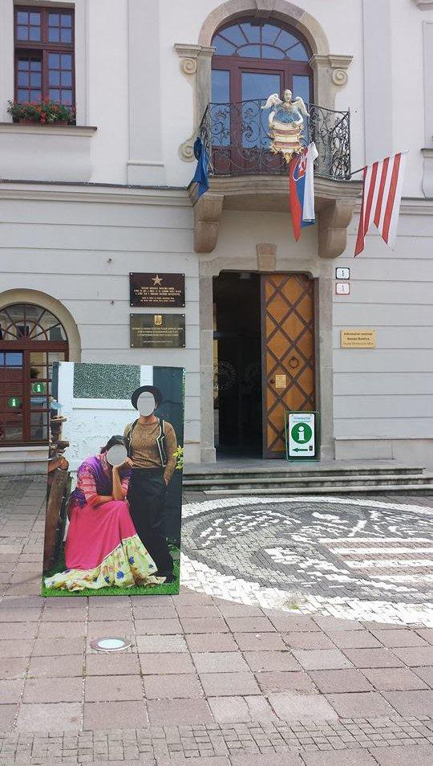
Icons of the Peripheral
Czarna Gora, Krakow, Banská Bystrica 2014 / PL, SK /
“For the work Icons of the Peripheral (2014), I created life-size face-in-the hole boards which represented Roma people in their home setting. The photos were taken in the Roma settlement in Czarna Gora, Poland. I installed these photo-objects in main squares of various towns and cities. In this project, I worked with the visual archetype of Roma and presented it as a cut out, the familiar object used as a fairground attraction, whereby the Roma becomes a pop icon. With these objects, I recreated a fairground setting in which people could “become a Roma” for the moment the picture is taken. My aim was to point out that we have no power over the circumstances of our life into which we have been born, and ask the viewer: would you like to be Roma?”

Slide 19
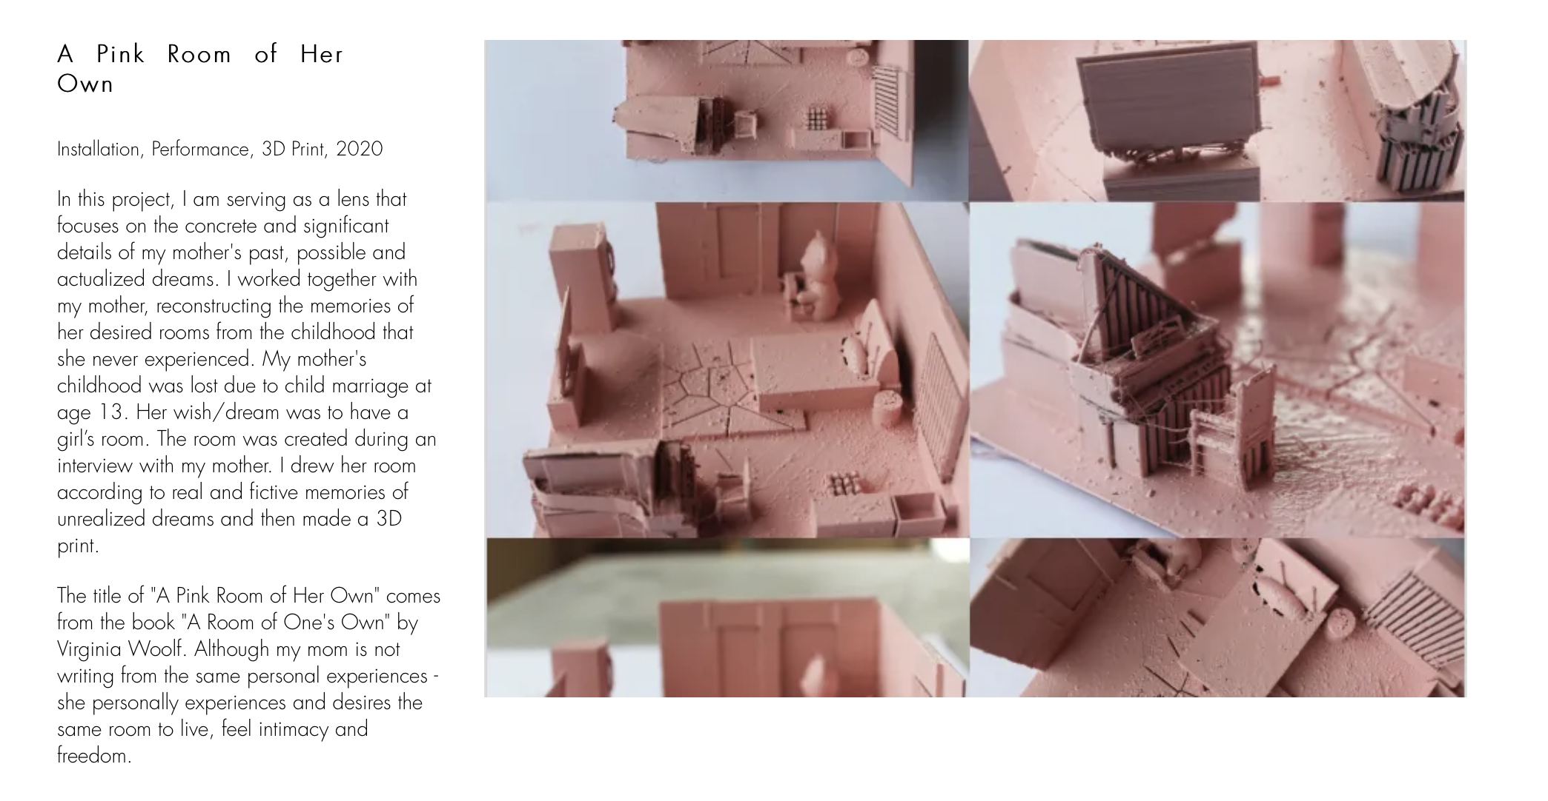
Selma Selman (*1991)
https://www.selmanselma.com

Slide 20
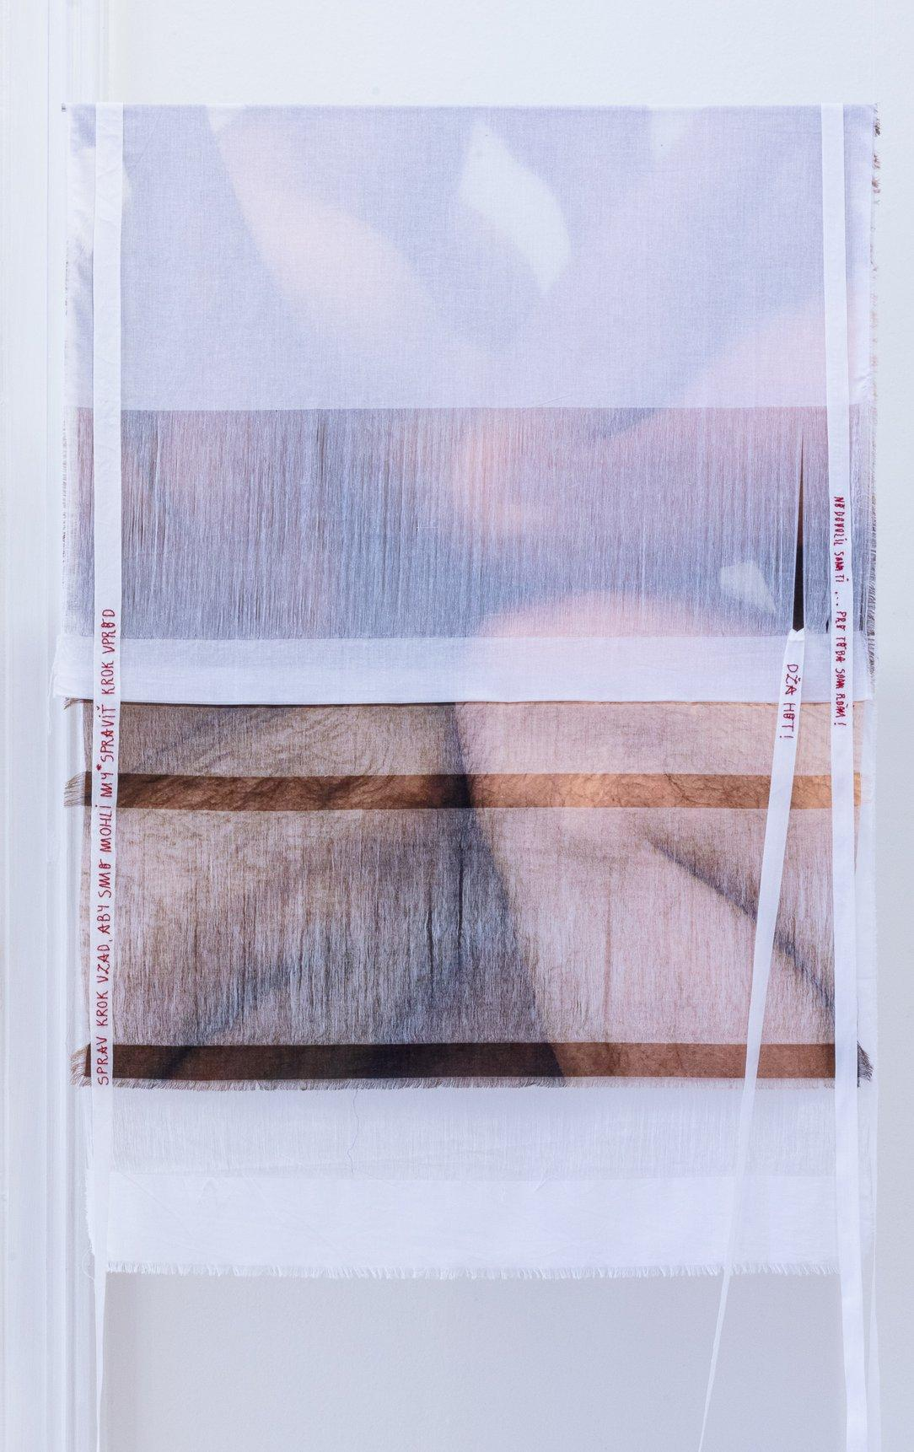
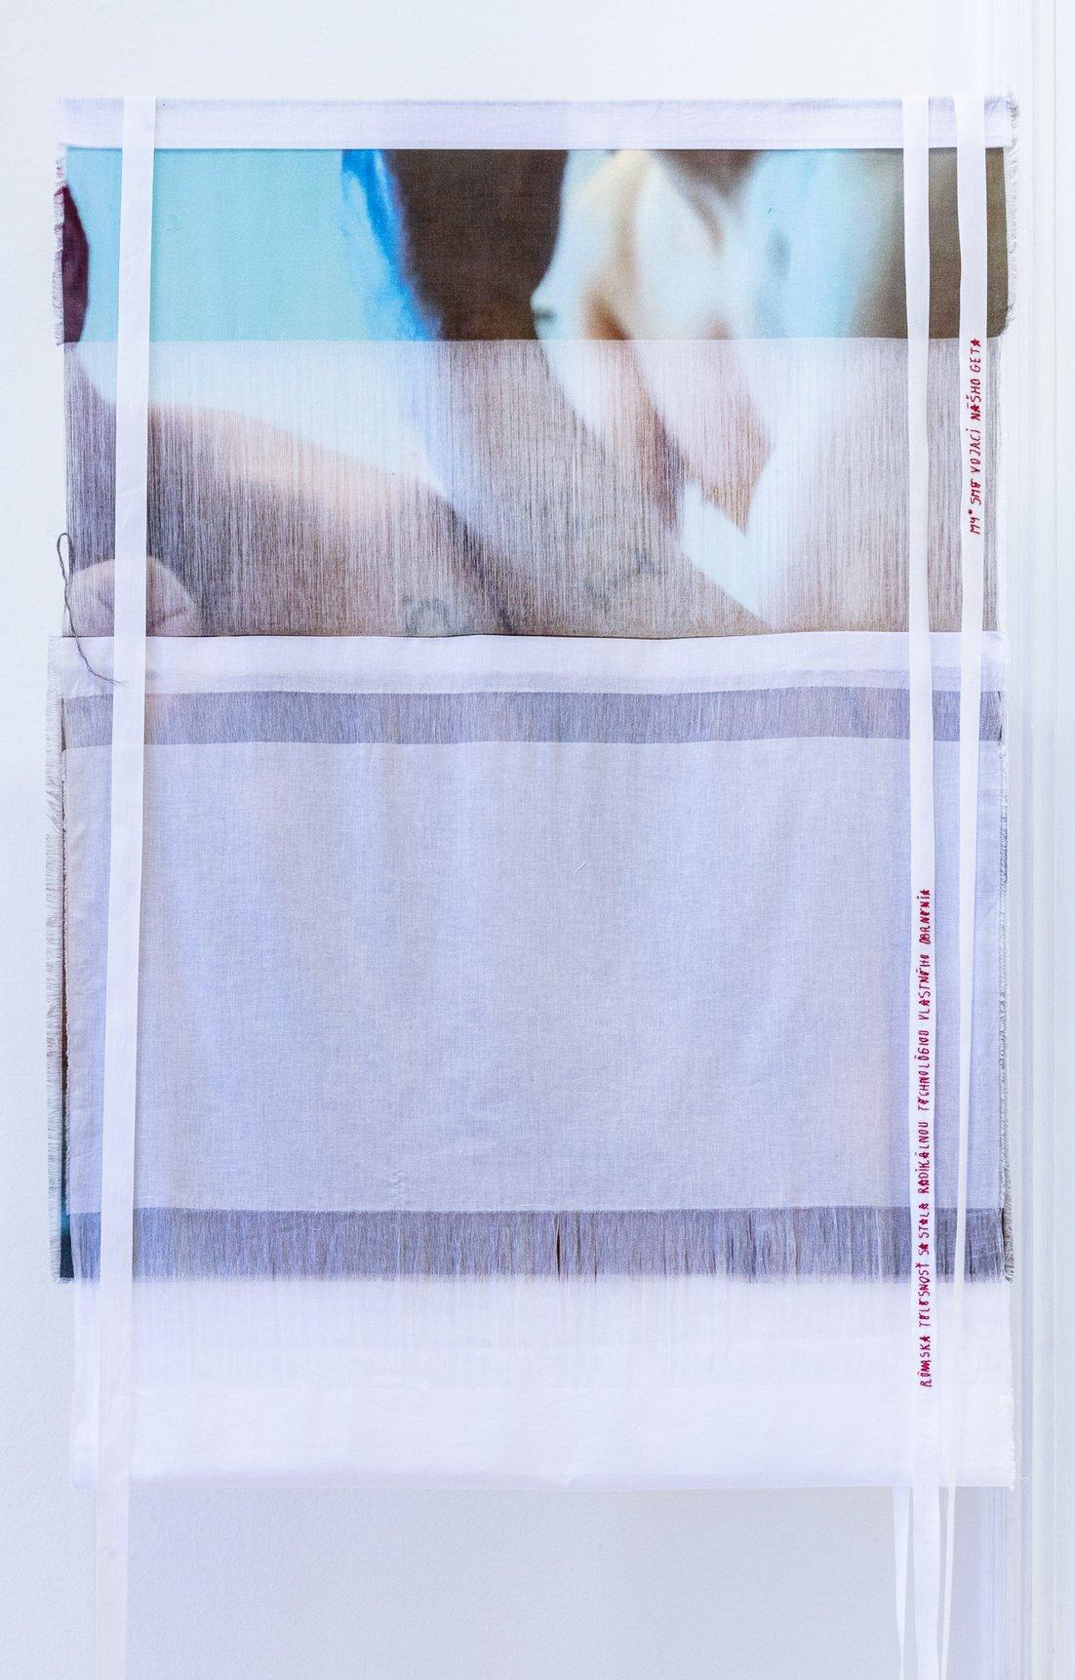
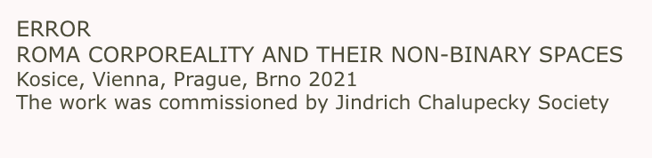
Robert Gabris (*1986)

