Slide 1
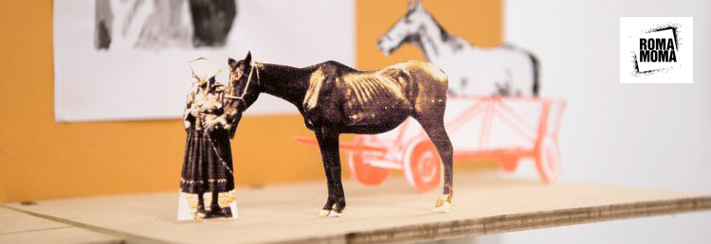
Decades of inclusion? Roma artists and contemporary art
Oto Hudec: Invisible Museum, project, 2017
26 April 2024

Slide 2
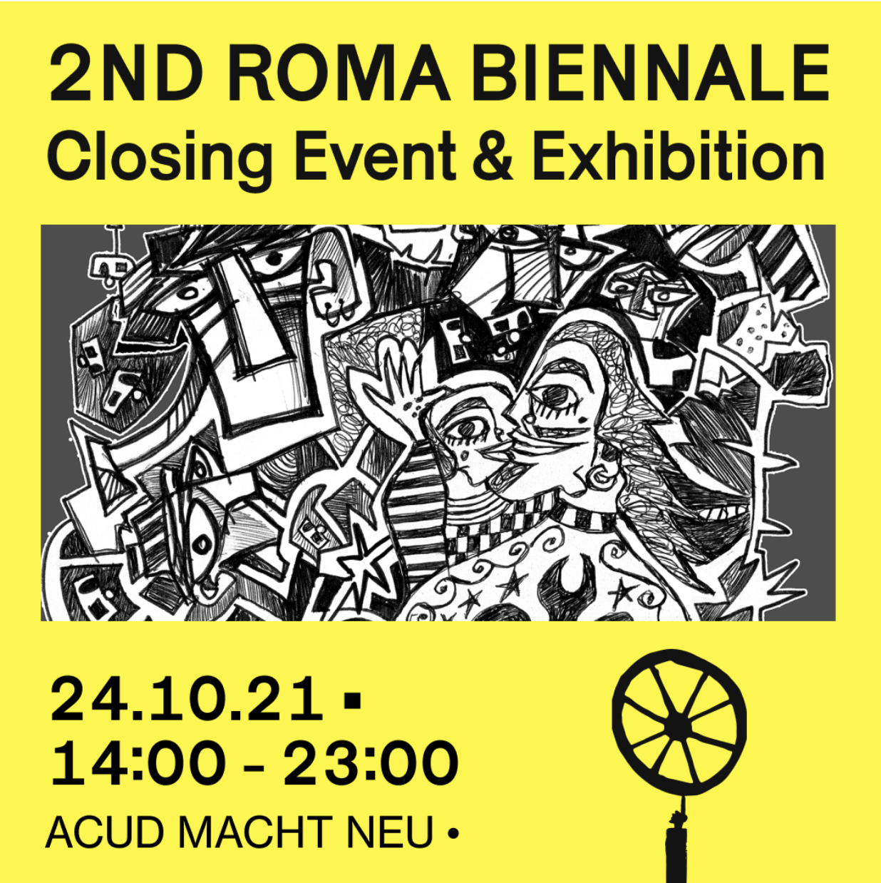
Internationally…
…regionally…
…locally

Slide 3
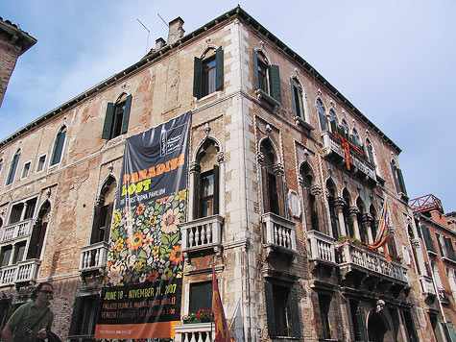
52nd Venice Biennale (2007): "Think with the Senses, Feel with the Mind: Art in the Present Tense"
Roma pavilion – transnational representation; ethnic collective
Tunali, T. (2011). The politics of "Roma inclusion" at the 52nd venice art biennale. Studia Politica: Romanian Political Science Review, 11(4), 701-711.
Is art history lagging behind processes of inclusion? – first Romani Group exhibition in 1979 (Budapest)
Inclusion as “the consequence of a sudden and spontaneous humanitarian interest. They are the continuation of a complex set of political, economic, and discursive relations marked by the collapse of State Socialism and EU expansion which helped to institutionalize ”Western” human rights discourses to frame ”Eastern” ethnic conflicts and tensions in the process of the ongoing ”liberalization” and ”democratization” of the CEE countries”
Tunali, T. (2011). The politics of "Roma inclusion”, 702–703.

Slide 4
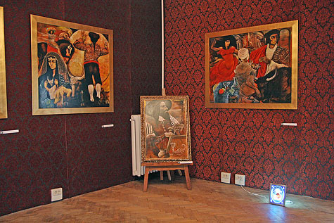
Did the Roma Pavilion in the 52nd Venice Biennial aim for negotiating the Roma’s ”particular political vocabulary” in need to be visible to Romany populations around Europe to build an alternative political solidarity?
Or was this exhibition part of the institutional creativity aimed at the socio-political integration of the former communist Europe into the global economic circuits?
Tunali, T. (2011). The politics of "Roma inclusion”, 703.

Slide 5
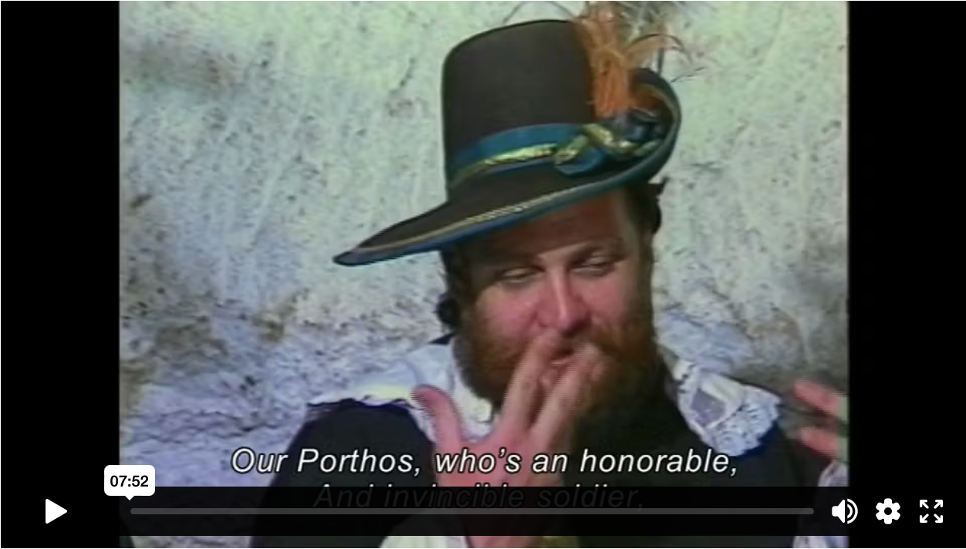
Vanda Zsoldos, Stációk (Stations), 1988
‘…and in order to become a Roma painter, the existence of the Roma bricklayer should be acknowledged. This is a massive and difficult question … and I would like to be a Hungarian painter … The time will come but I will not get the final immigration license from my colleagues for another year or two … I am going to present a significant piece of art at the World Fair and this work of art … will not be made by Tamás Péli the Roma painter but Tamás Péli, a painter with a European mind and soul, that of the image designer who is concerned with the future of this country and his community’.
Tamás Péli (b. Budapest 1948, d. Budapest 1994),
https://www.romarchive.eu/en/collection/staciok-portrefilm-peli-tamas-festomuveszrol/

Slide 6
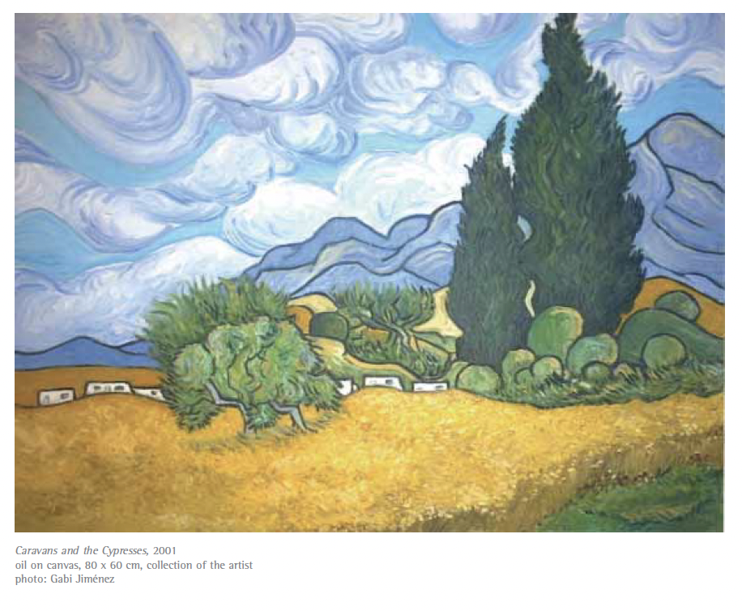
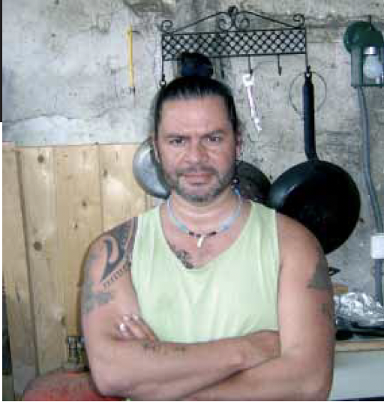
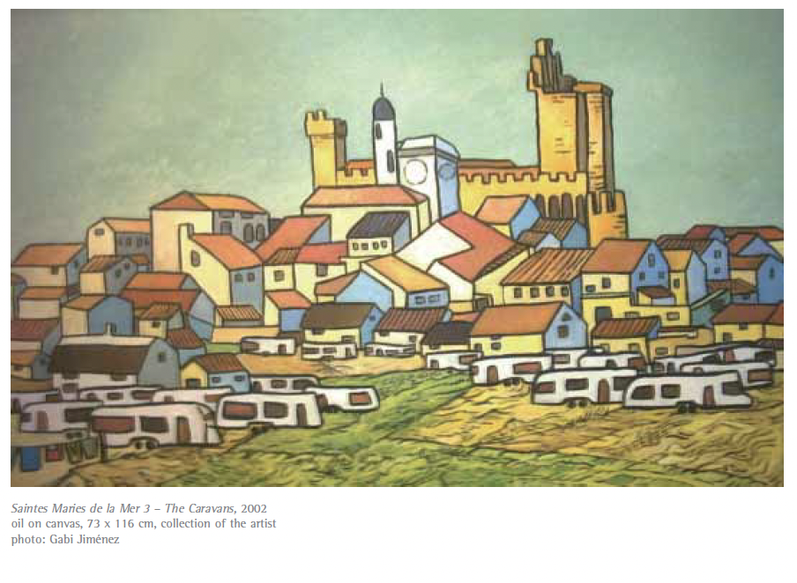
Gabi JIMÉNEZ

Slide 7
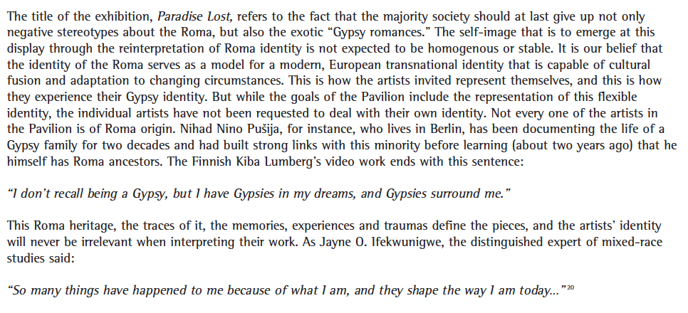
Identity and artistic expression

Slide 8
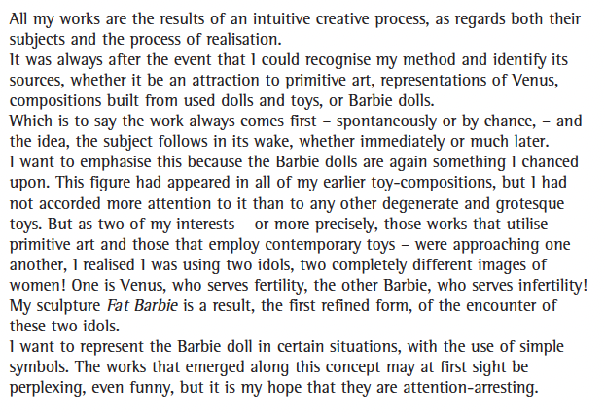
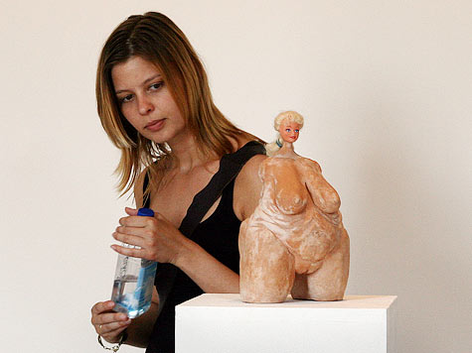
András KÁLLAI
András Kállai, Fat Barbie. 2006, Terracotta, plastic, 28 x 13 x 14 cm, http://universes-in-universe.de/car/venezia/eng/2007/tour/roma/img-19.htm

Slide 9
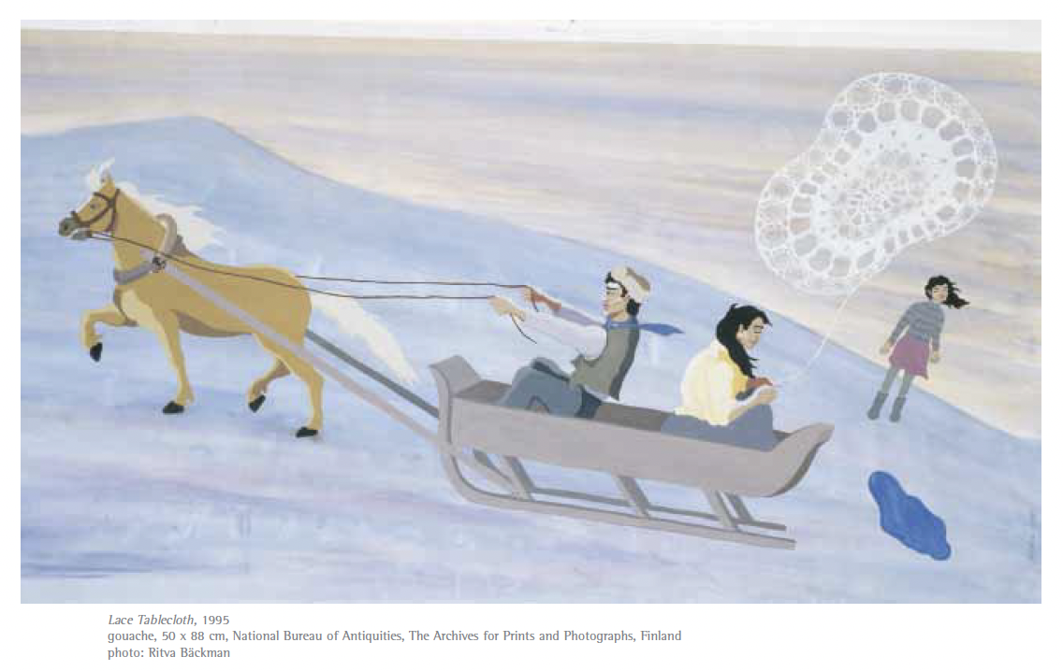
Kiba LUMBERG

Slide 10
Roma identity politics in the EU has not been employed to unveil the reasons of increasing social inequality; instead it has been applied to define Roma as a distinct community, which, in turn, has triggered traditional prejudices on them.
Tunali, T. (2011). The politics of "Roma inclusion”, 705.
”Are we creating an ethnicising, socially motivated ’special case’, sponsored by philanthropy, in the hybrid environment of the art establishment?”
Gottfried WAGNER, ”The Roma Pavilion in Venice: A Bold Beginning”, in Exhibition Catalogue: Paradise Lost, Open Society Foundations, Budapest, 2007, p. 36.

Slide 11
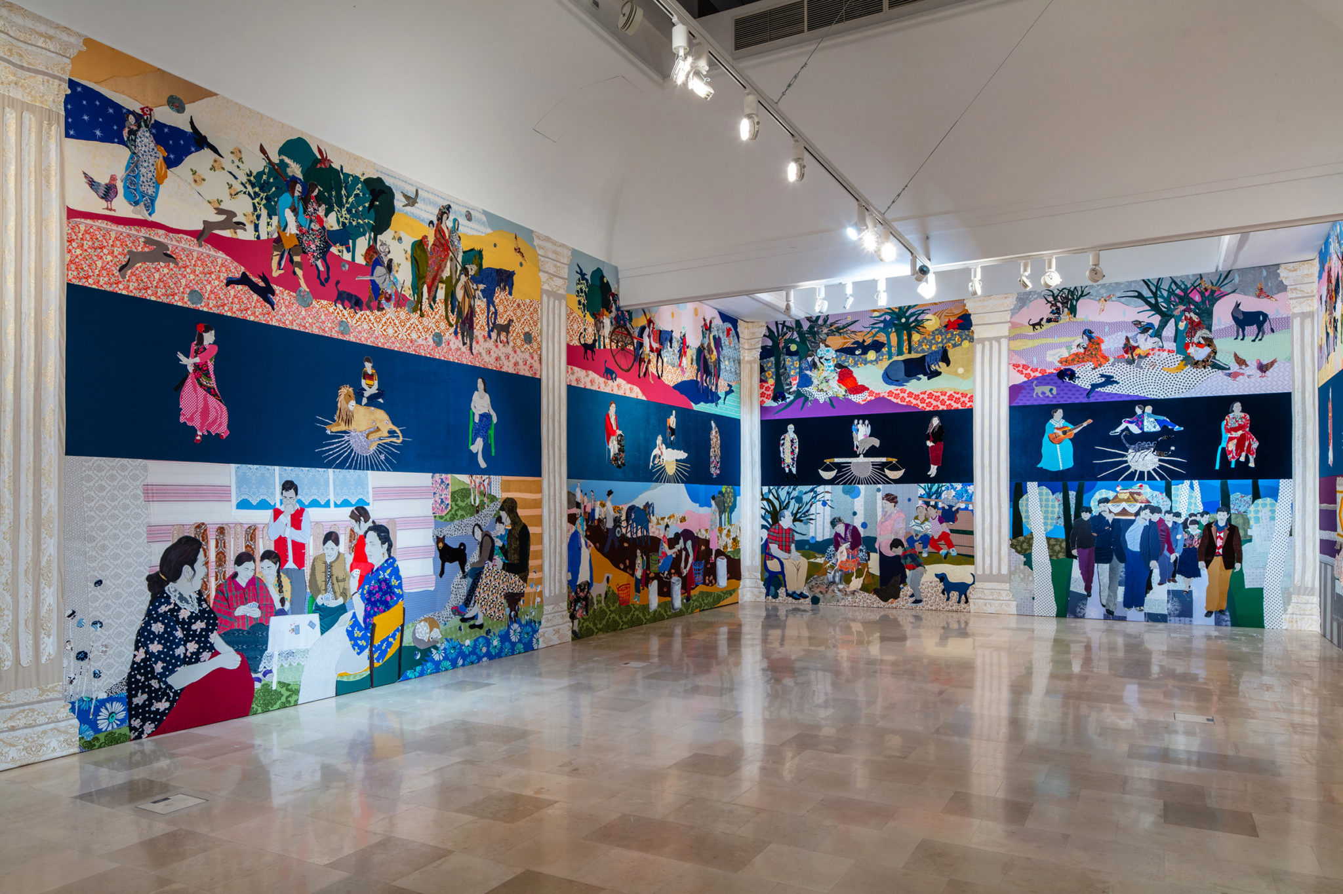
Małgorzata Mirga-Tas (*1978)
Małgorzata Mirga-Tas, Re-enchanting the World, exhibition view, Polish Pavilion at the 2022 Venice. Biennale. Image courtesy Zachęta National Gallery of Art. Photo: Daniel Rumiancew.

Slide 12
First Biennale in 1895
collective exhibition spaces as well as 30 permanent national pavilions
https://www.labiennale.org/en/news/biennale-arte-2024-stranieri-ovunque-foreigners-everywhere

Slide 13
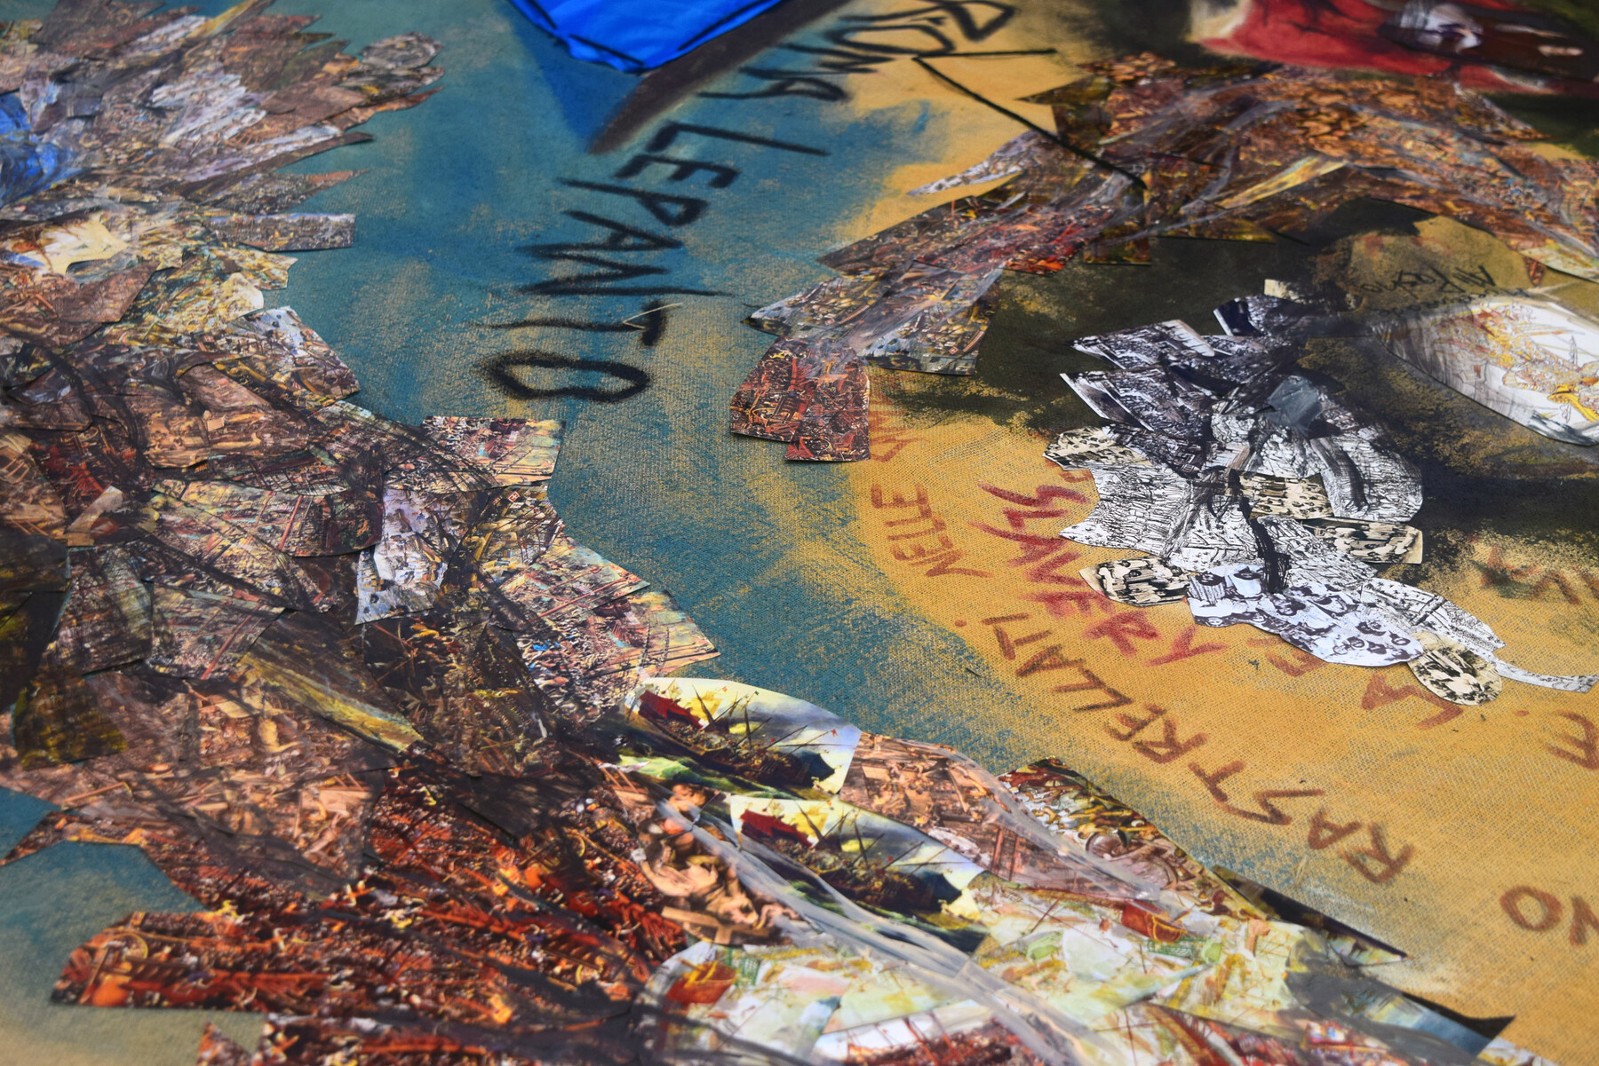
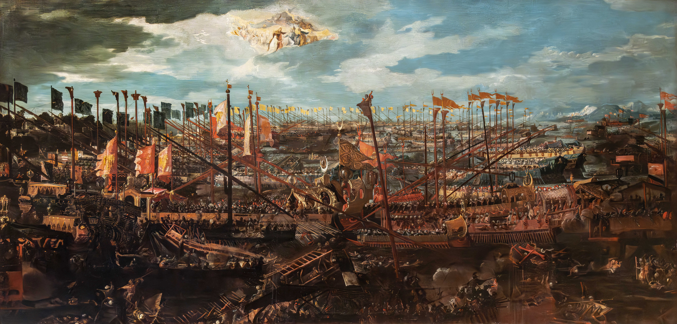
Luna De Rosa, RrOMA LEPANTO (detail), 2024.
The Battle of Lepanto by Andrea Vicentino (c. 1571-1600), Museo Correr, Venice
RrOMA LEPANTO refers to the naval Battle of Lepanto (1571), highlighting the role of enslaved Gitanos from Spain and Roma from Italy, tasked with rowing the vessels. The site-specific installation initiates a discourse concerning the (in)visibility and recognition of Roma contributions to European history and societies. The choice of the exhibition venue is deliberate: the show takes place at Palazzo Bembo, as Giovanni Bembo served as commander during the battle, which culminated in the triumph of the Holy Alliance.
https://www.e-flux.com/announcements/592567/rroma-lepanto/

Slide 14
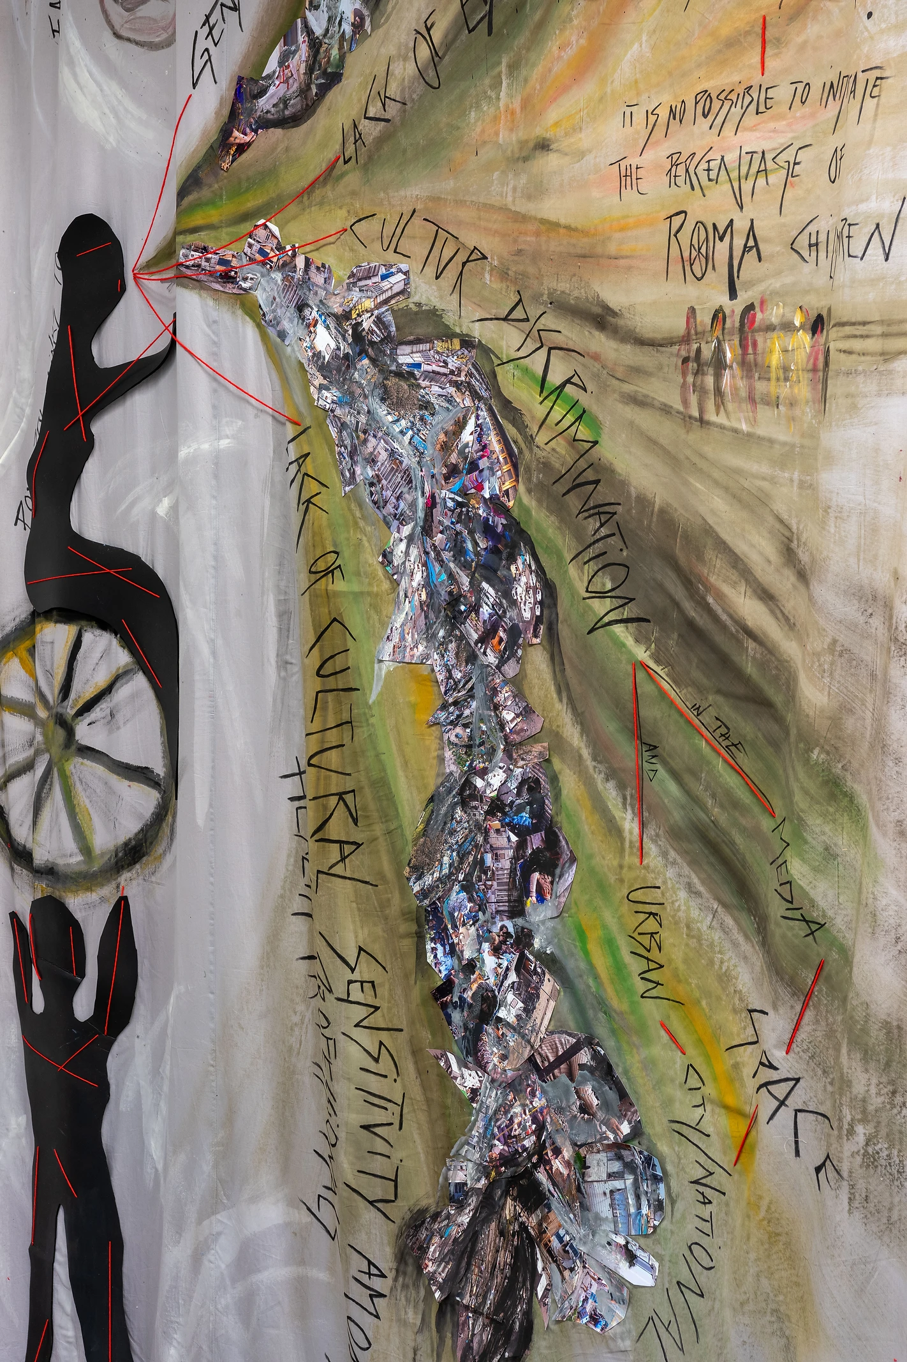
Luna De Rosa
https://www.lunaderosa.com

Slide 15
Manolo Gómez Romero
https://en.kaidikhas.com/artists/70063/manolo-gomez-romero/works/

Slide 16
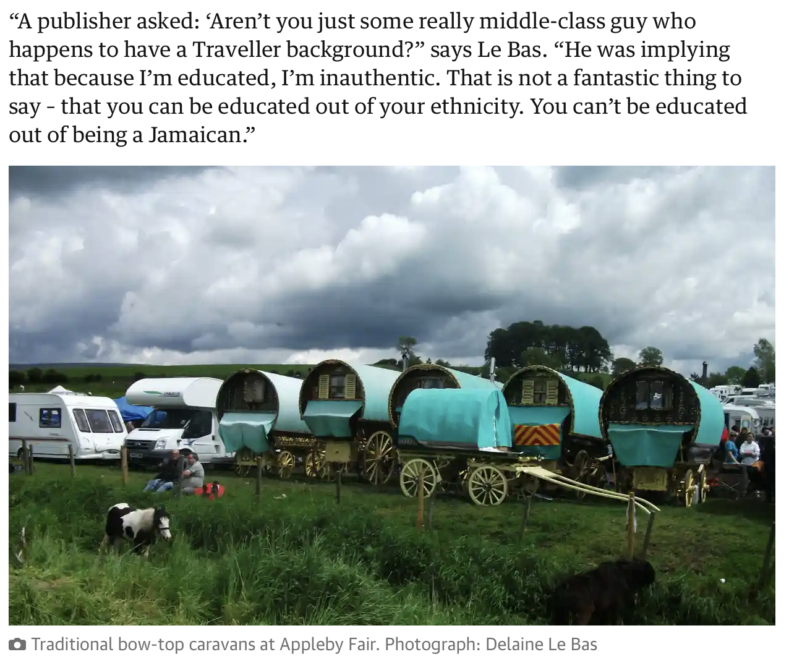
Damian Le Bas
https://www.theguardian.com/world/2018/jun/06/racism-gypsy-damian-le-bas-travellers-stopping-places

Slide 17
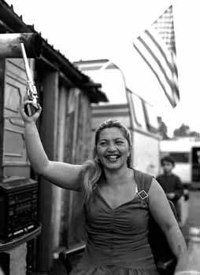
“WE ARE WHAT WE ARE” ASPECTS OF ROMA LIFE IN CONTEMPORARY ART @ MINORITEN GALLERY, GRAZ (2004)
(shown in trnava in the following year)
Matei Bejenaru (RO)
Michaela Bruckmüller (A)
Pavlina Fichta Cierna (SK)
Cosmin Gradinaru (RO)
Iosif Kiraly / Mariana Celac / Marius Marcu-Lapadat (RO)
Monika Kovacova (SK)
Aydan Murtezaoglu (TR)
Terez Orsos (HU)
Nihad Nino Pusija (D/BiH)
Gyöngyi Raczne Kalanyos (HU)
Mario Rizzi (I), Erzen Shkololli (KOS)
Mladen Stilinovic (HR)
Ceija Stojka (A)
Chad Evans Wyatt (USA/CZ)
Dusan Zahoransky (CZ/SK)
Nihad Nino Pusija, photo from the series "Ramadan Armani"

Slide 18
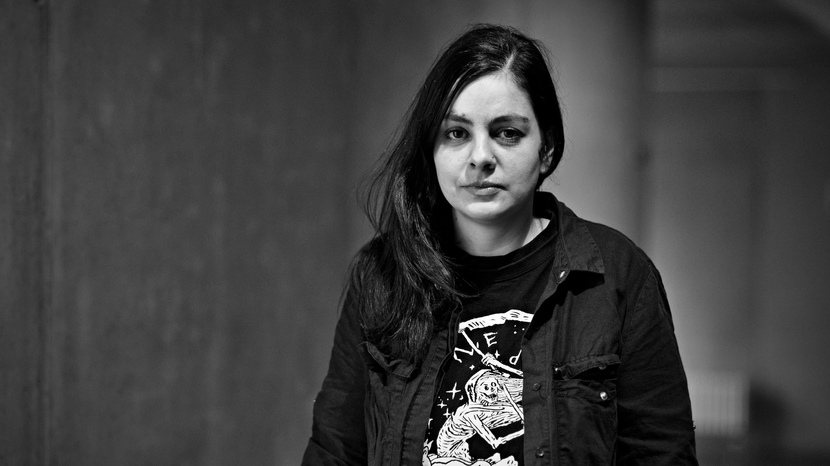
LACKA – Ladislava Gažiová
https://www.artlist.cz/en/lacka-ladislava-gaziova-618-video/

Slide 19
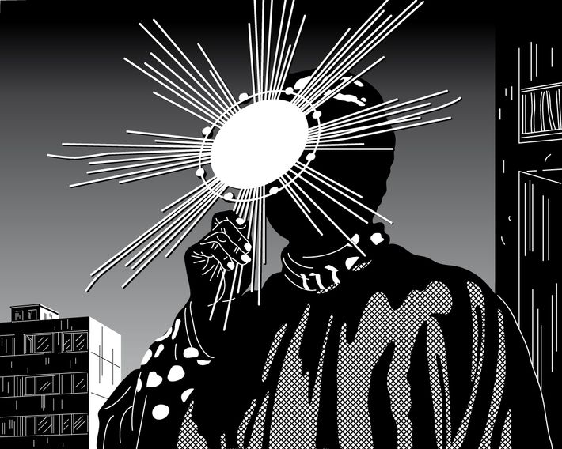
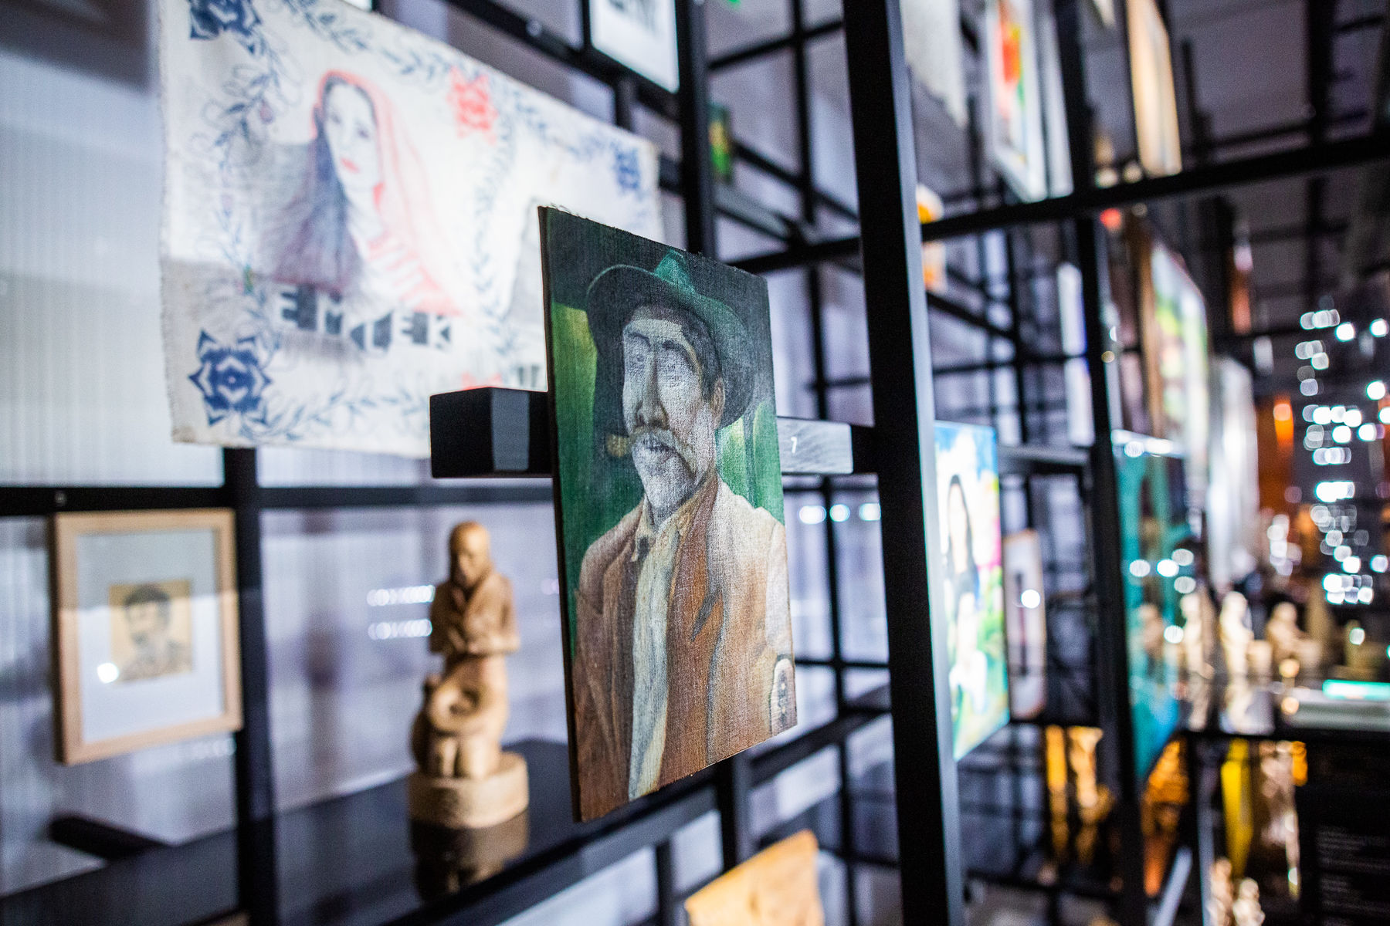
O kosmos hino kalo/The Universe is Black, 2017, Moravian Gallery in Brno,
Phundrado drom / The Open Road, Ethnographic Museum, Prague, 3. 6. 2022 – 31. 5. 2024
Ladislava Gažiová,
https://www.artmap.cz/artist/ladislava-gaziova/
https://www.nm.cz/en/program/exhibitions/phundrado-drom-the-open-road#gallery-9

Slide 20
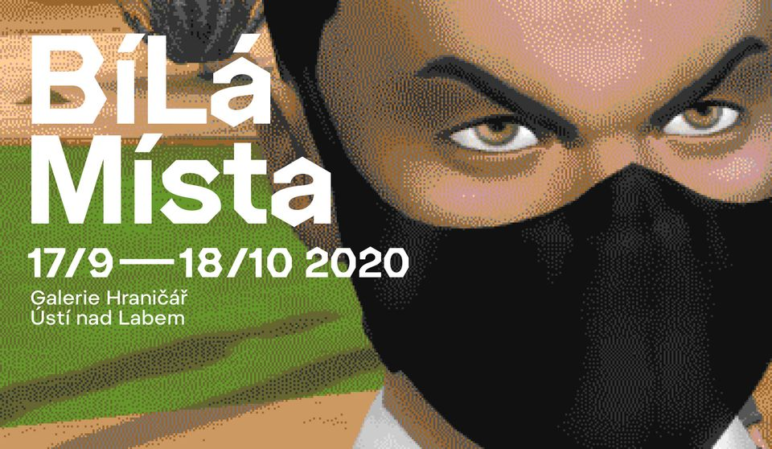
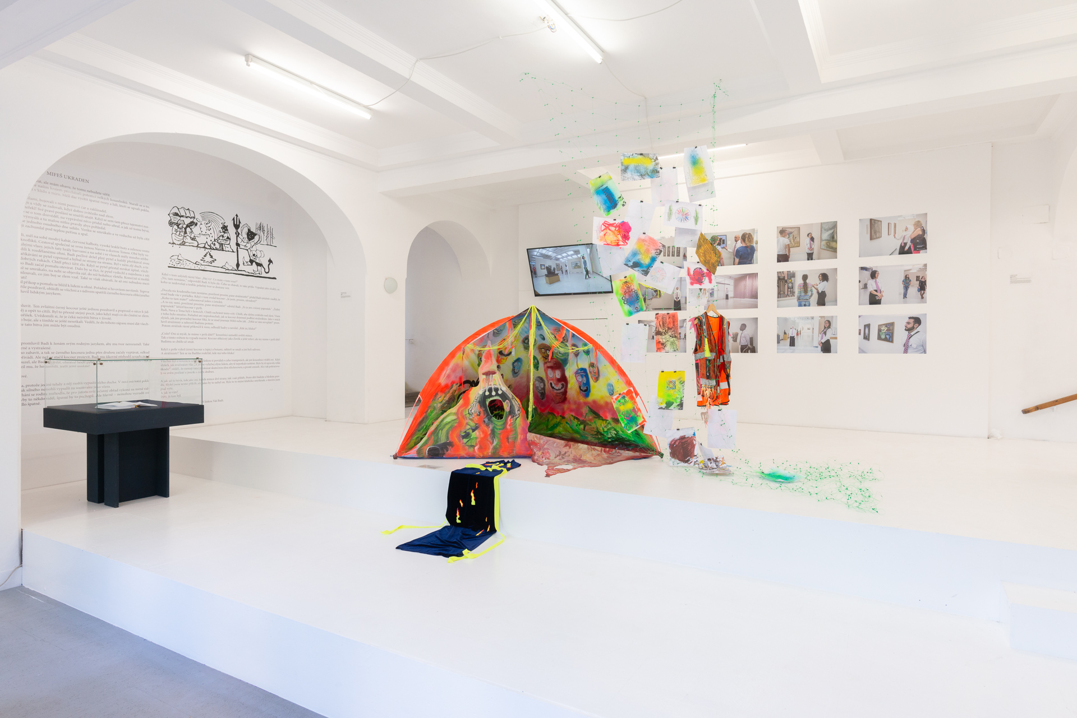
BíLá Místa, Hranicář Gallery, Ustí nad Labem (2020)
https://artalk.cz/2020/10/05/roma-lives-matter-v-hranicari/?fbclid=IwAR2zbG0yCtwDxh874ZrCspWpNciDXDcyPXIozFszM1hilHljIcTH42TT3Dw

Slide 21
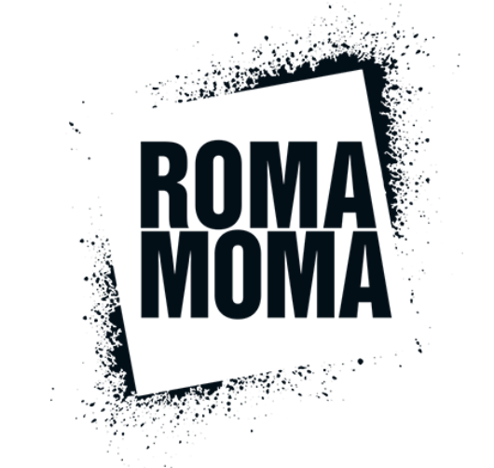
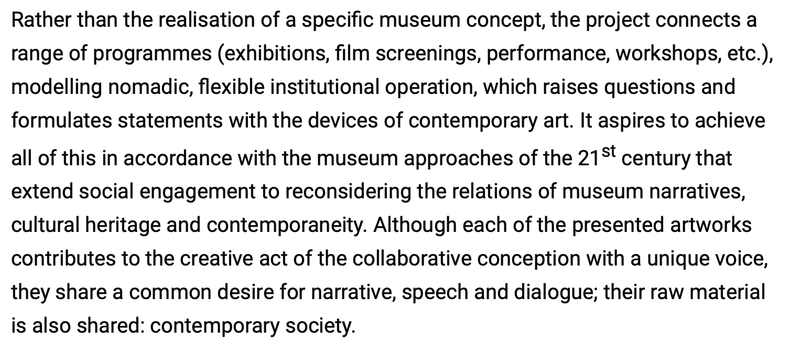
https://eriac.org/category/romamoma/

Slide 22
Internationally…
…regionally…
…locally
Which different strategies do you detect?
Are there any regionally or locally specific practices?

