Slide 1
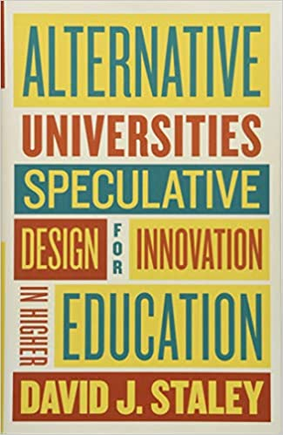
Alternative models of university education
Michal Černý, Ph.D.

Slide 2
Professionally oriented study

Slide 3
Structure of study programs

Slide 4
Minor, Maior, completus

Slide 5
Distributed study programs

Slide 6
Associated PhD schools

Slide 7
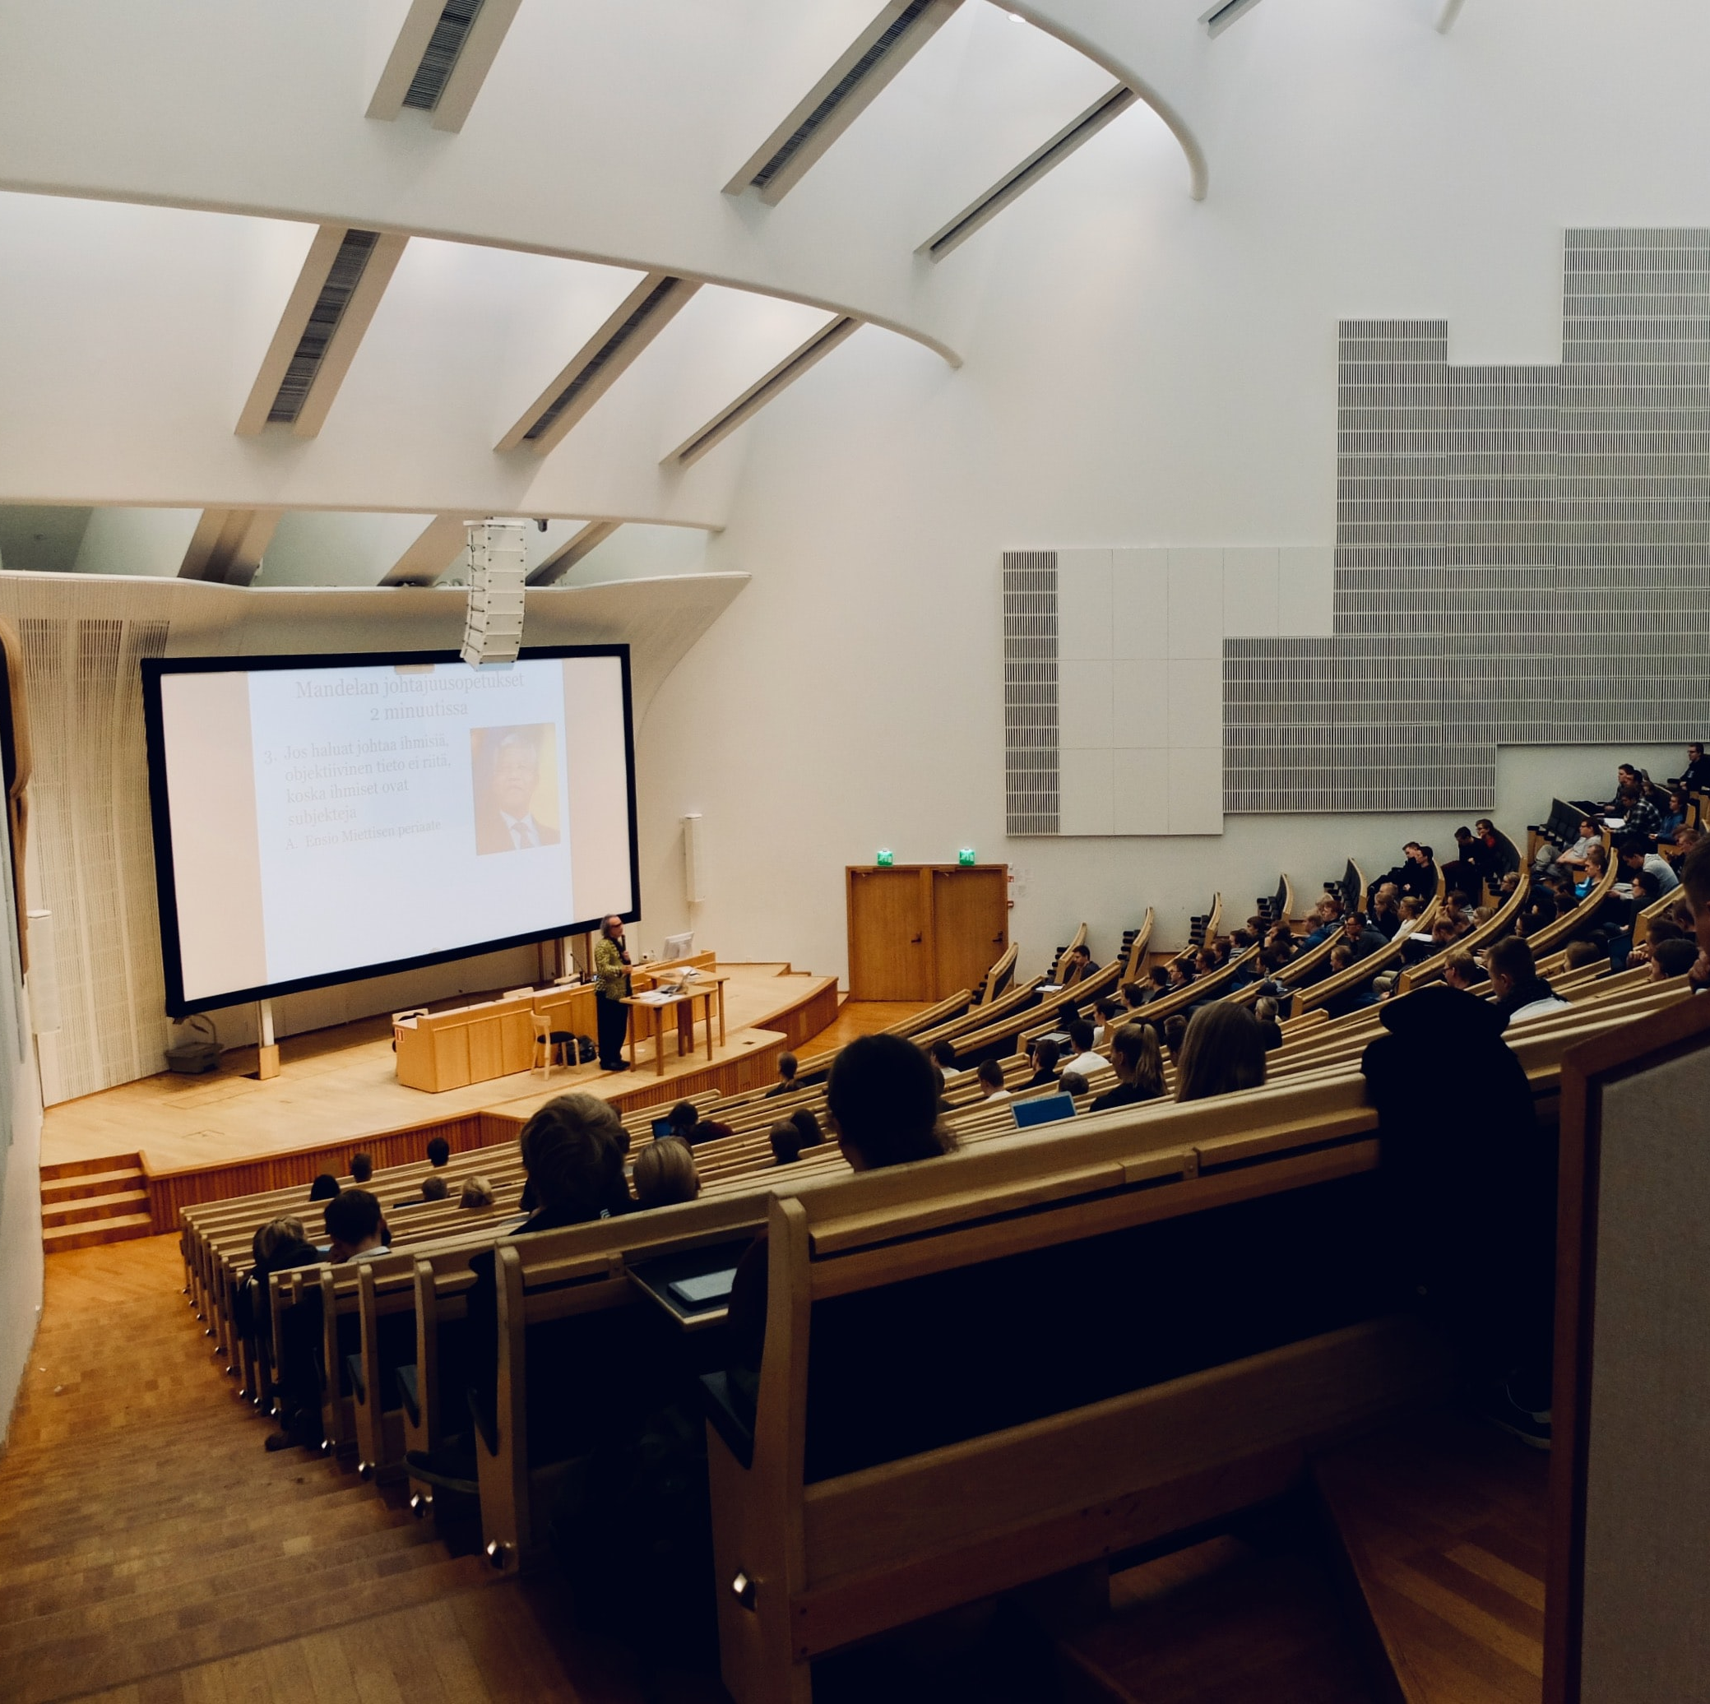
The Liberal Arts Collage
1) Solving complex problems
2) Creating meaning
3) Creation
4) Imagination
5) Multimodal communication
6) Multicultural competences
7) Leadership

Slide 8
Microcredits

Slide 9
MOOC

Slide 10
EDUC

Slide 11
Degree mills

Slide 12
International curriculum, leadership, …

