Slide 1
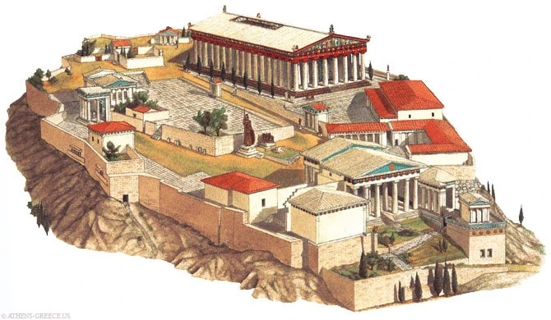
Grécke umenie II. Klasické a helenistické Greek Art II. Classical and Hellenistic
Jar 2024

Slide 2
Organizácia kurzu/ Course organisation
Rozvrh / Timetable:
21. feb. 10-11:50 MM
11. mar. 18-19:50 AS
12. mar. 18-19:50 AS
13. mar. 10-13:50 AS
14. mar. 18-19:50 AS
15. mar. 10-11:50 AS
18. mar. 18-19:50 AS
19. mar. 18-19:50 AS
20. mar. 10-13:50 AS
21. mar. 18-19:50 AS
22. mar. 10-11:50 AS
10. april 10-11:50 MM
All above in the classroom M11
22.5. online presentations – will be specified
Passing the course
Active attendance at the lectures
Presentation of the topic
elf.phil.muni.cz – course of the Greek Art II.
The topics will be available from 22nd. of Feb to 10th. of March
Presentations – 22nd of May online. In case of not presenting the topics you obliged to submit written thesis on at least 5 pages following the proper citation standards
Oral exam - online
Erasmus students have to present the seminary thesis only
Excursion to the KHM?

Slide 3
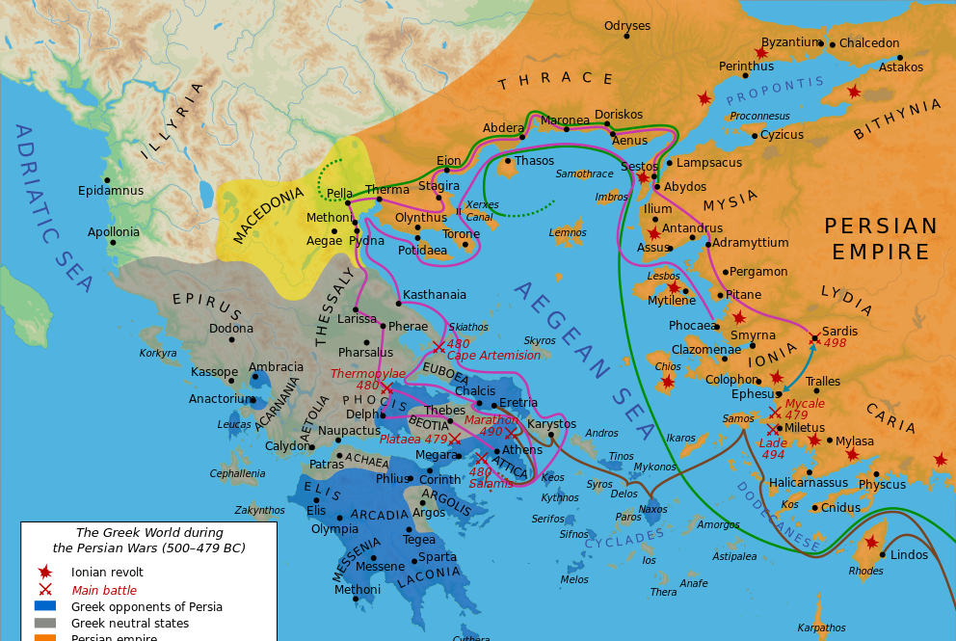
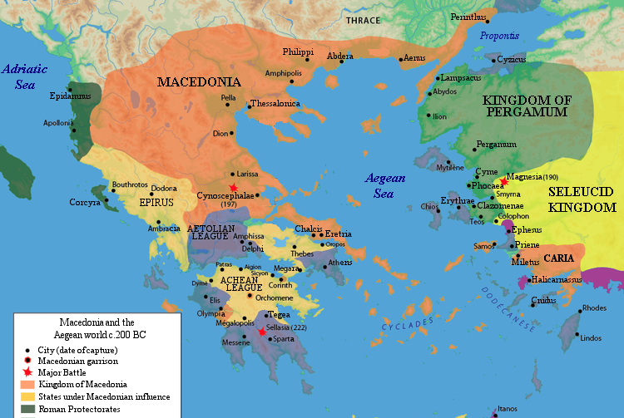
Chronology

Slide 4
Opakovanie / Recap from the autumn
Obdobie „Temna“
Zánik mykénskych palácov LH IIIB/C; prelom 12. a 11. st. BC
Submykénske obd.
Doba transformácie
Doba (proto)geometrická
1100 – 900 BC
900 – 700 BC
Archaické obdobie (700 – 480 BC)
The Dark ages
Destruction of the Mycenean palaces – LH IIIB/C period – Turn of the 12th and 11th C BC
Submycenean period
Period of transformation
(Proto)geometric period
1100 – 900 BC
900 – 700 BC
Archaic Period (700 – 480 BC)

Slide 5
Archaické obd. / Archaic period
Počiatky kolonizácie
Magny Graecie 1. štvrtina 8. st. Bc
Iónie polovica 7 st. Bc
Prvé Olympijské hry 776 BC
Umenie (sochárstvo) – začiatok / polovica 7. st
480 Bc porazenie Atén peržanmi
Beginning of the colonisation
Magna Graecia – 1st quarter of 8th C BC
Ionnia – half of the 7th C BC
First Olympic games 776 BC
Art (sculptures) – mostly beginning / half of the 7th C BC
480 BC Persian sack of Athens

Slide 6
Klasické obdobie / Classical Period
Prísny štýl (525/480-450)
Prechodné obdobie medzi archaikou a klasikou
Archaické prvky – postoj, úsmev, drapéria
Vysoká klasika (450-400)
Neskoré klasické o. (400 – 323)
Severe style (525/480-450)
Transitional period between archaic and classical period
Achaistic tendencies – smile, drapery, posture
High classical p. (450-400)
Late classical p. (400 – 323)

Slide 7
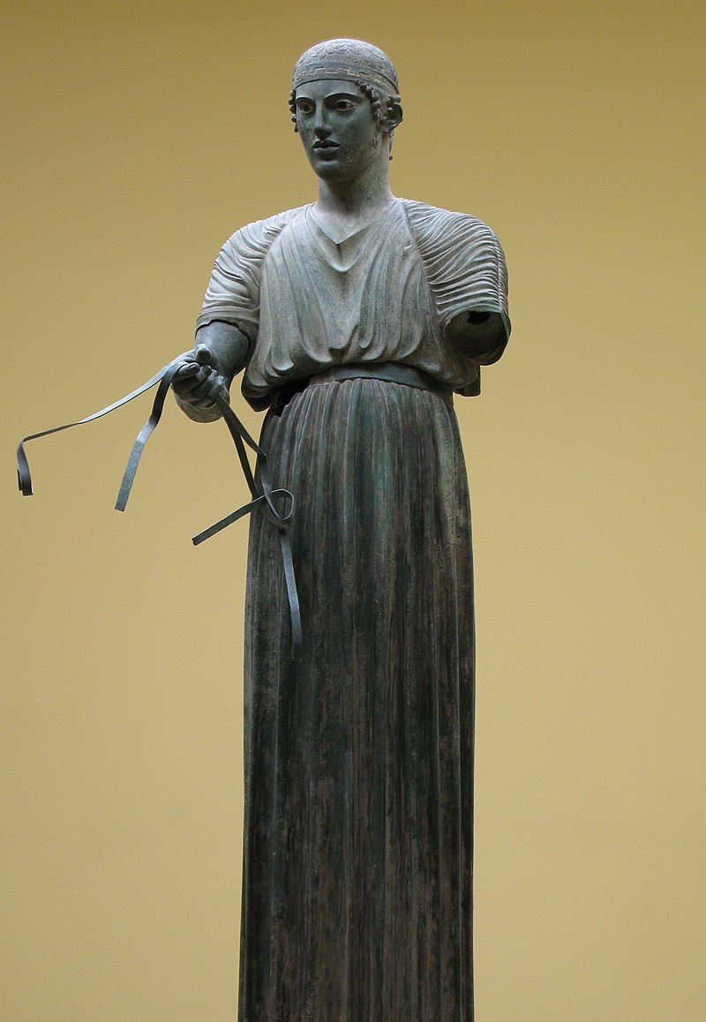
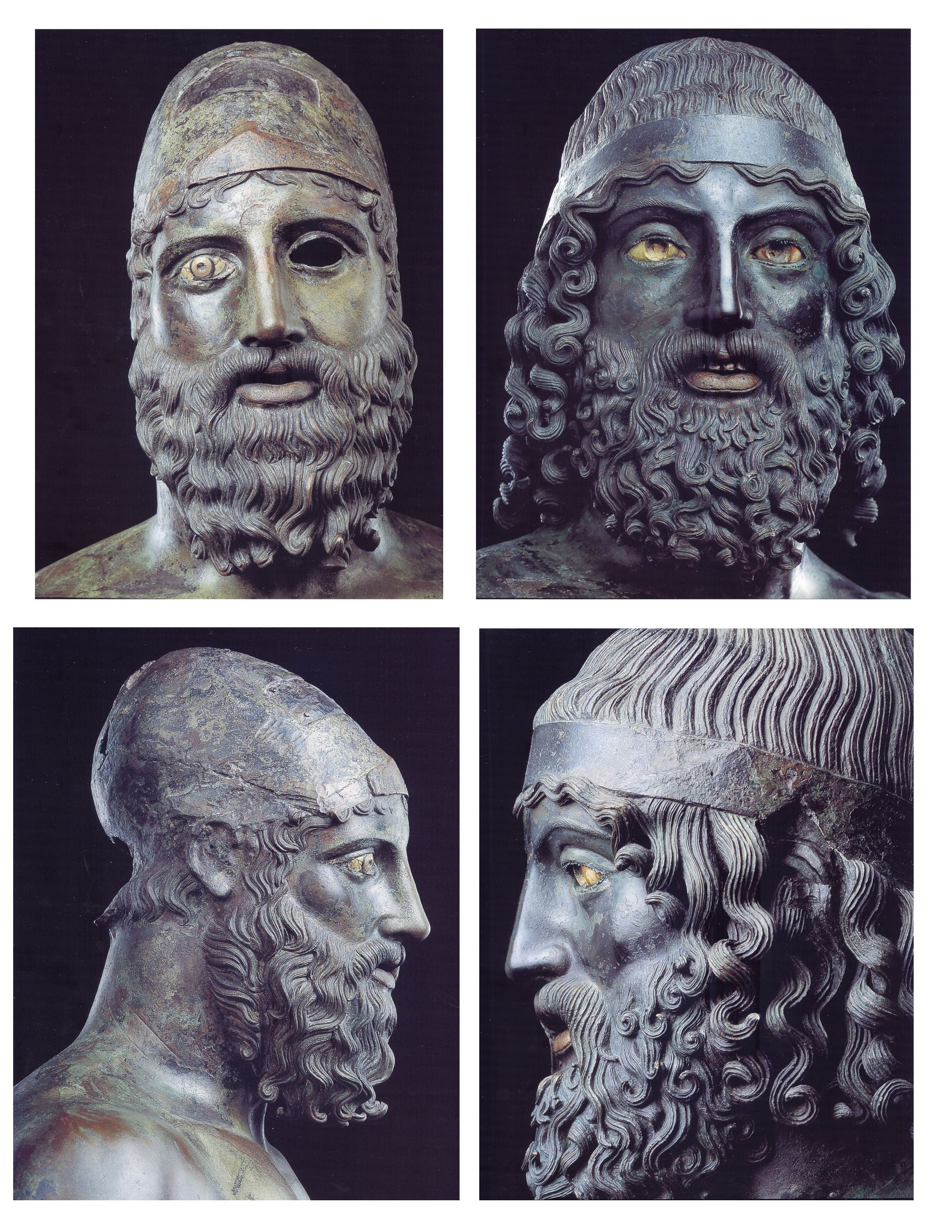

Slide 8
Klasické obdobie / Classical Period
Prísny štýl (525/480-450)
Vysoká klasika (450-400)
Atény – obd. vlády Perikla
Obdobie umeleckej a monumentálnej prosperity
Obd. Feidia, Polykleita
Začiatok iónskych chrámov
Neskoré klasické o. (400 – 323)
Severe style (525/480-450)
High classical p. (450-400)
Athens – period of the Pericles rule
Period of artistic and monumental prosperity
Period of Pheidias and Polycleitos
Ionic order
Late classical p. (400 – 323)

Slide 9
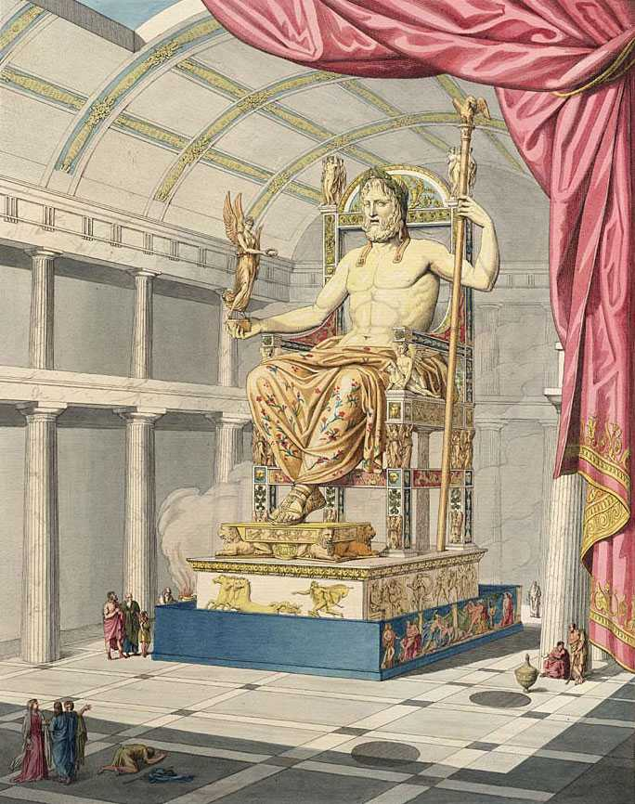

Slide 10
Klasické obdobie / Classical Period
Prísny štýl (525/480-450)
Vysoká klasika (450-400)
Neskoré klasické o. (400 – 323)
Nárast bohatstva
Nárast umelcov/centier
Odpútanie sa od zaužívaných klasických konvencií
Individualistické tendencie
Portréty
Lyssipos, Praxiteles, Skopás
Severe style (525/480-450)
High classical p. (450-400)
Late classical p. (400 – 323)
Increasing of wealth
Increasing of artist
Breaking the Classical conventions
Individualistic tendencies
Portraits
Lyssipos, Praxiteles, Scopas

Slide 11
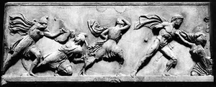

Slide 12
Helenistické obd. / Hellenistic period 323-30 BC
Smrť Alexandra – bitka u Actia
Monumentalizmus, naturalizmus, groteska, brutalizmus
Niké Samothrácka
Nahota (Venuša Mélska)
Deti, starci
Opilci, satyrovia
Death of Alexander – battle at Action
Monumentalism, naturalism, grotesque, brutalizmus
Níké of Samothrace
Nakedness Venus of Milo)
Children, Old people
Drunk people, satyrs

Slide 13
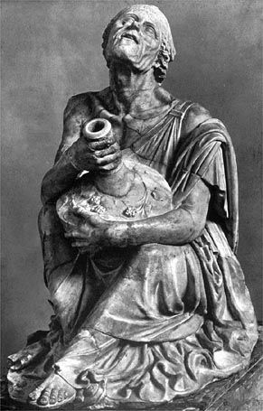
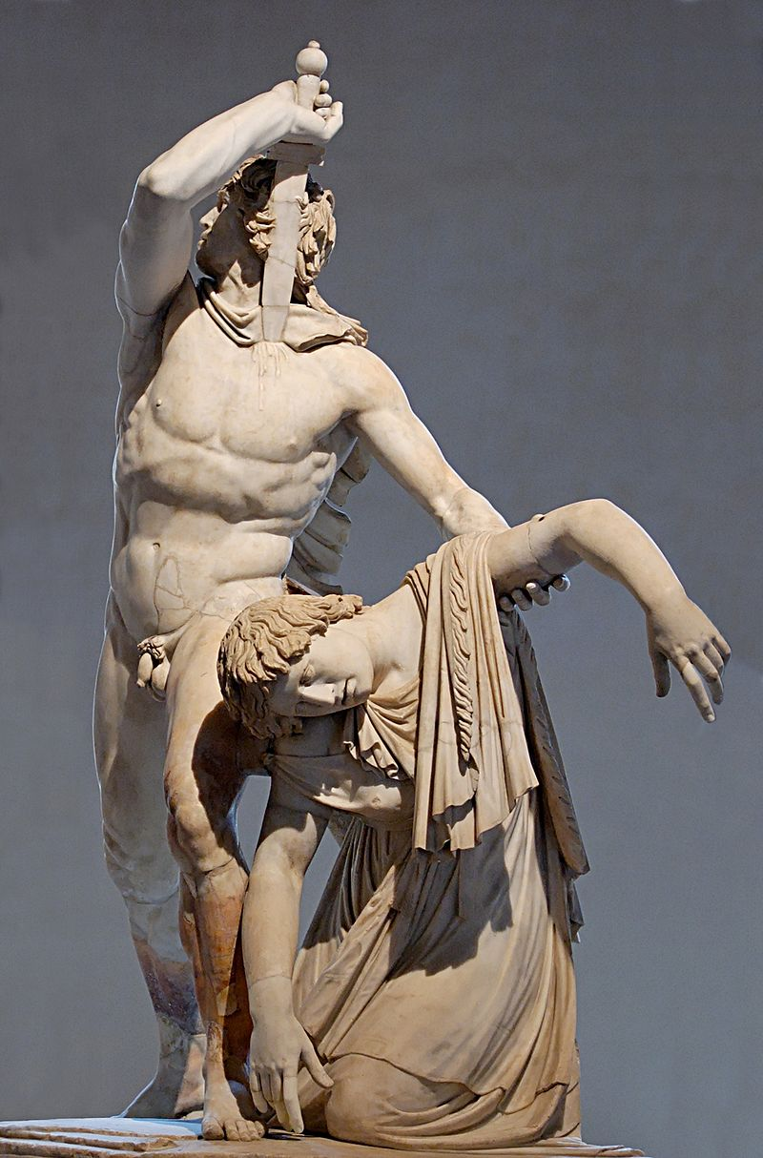
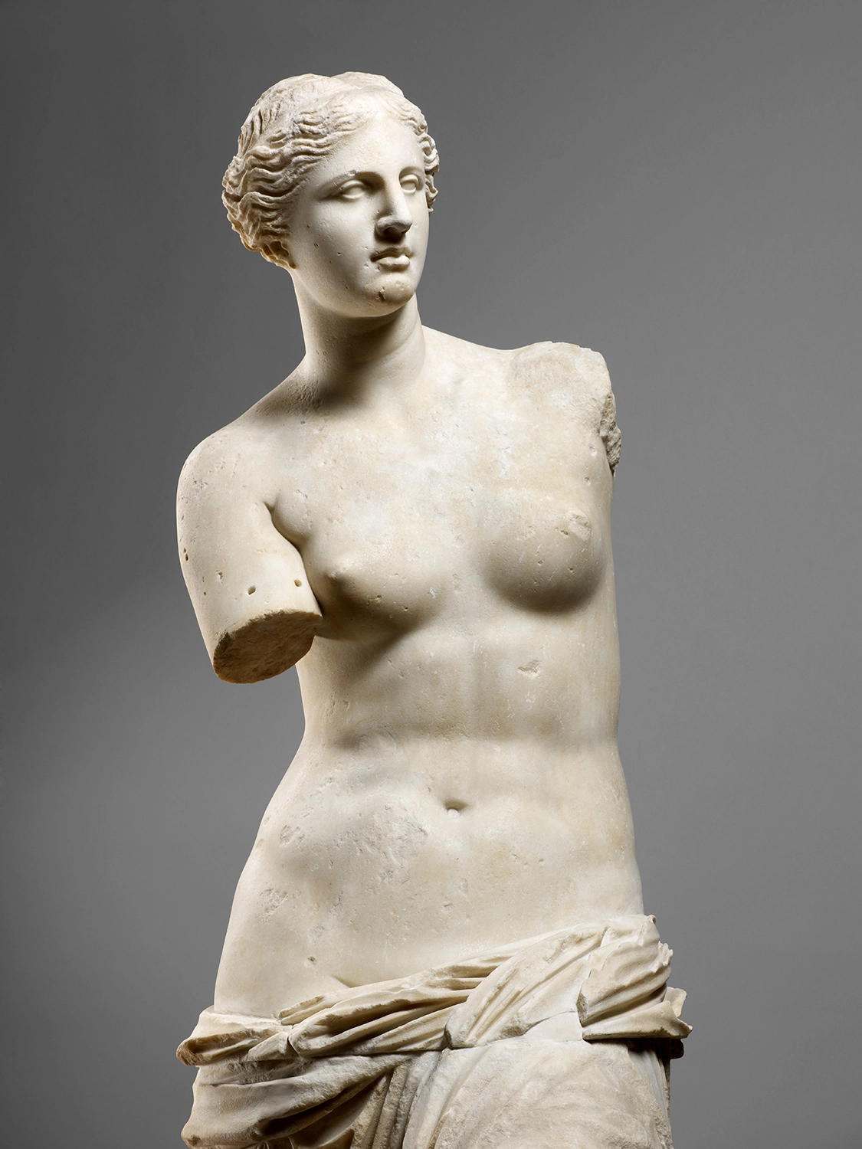
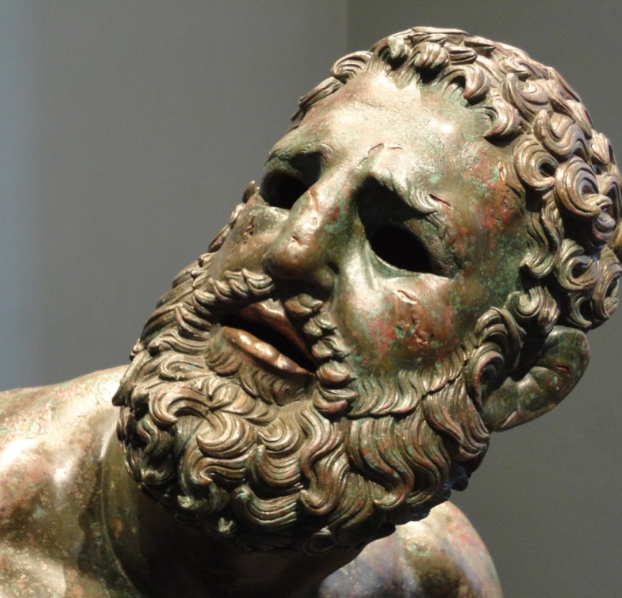
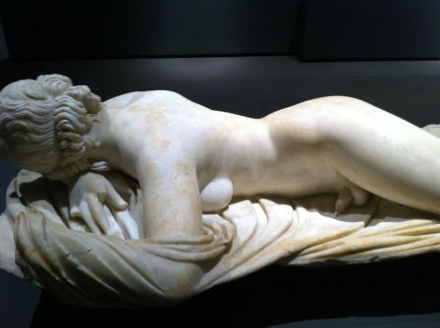

Slide 14
Pottery shapes!

Slide 15
Pottery shapes! (Shapes (ox.ac.uk))

