Slide 1
Korean Language Class Week 3
백지윤 Jiyun Baek

Slide 2
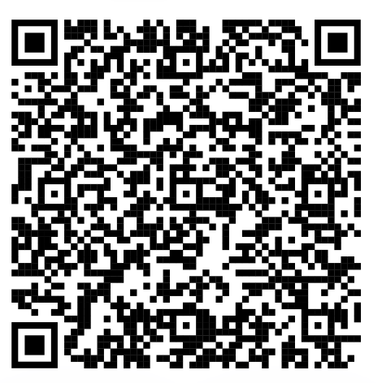

Slide 3
The Ending: Past Tense Marker
Final Endings include various speech level
ex) 어요/아요 [-eo yo/ a yo]
Pre-final endings are inflectional elements
come between stem and the final ending
ex) -(으)시 honorific suffix [-(eu) si] : 가르치시다 teach [ga-leu-chi-si-da]
-었/았 past tense marker [-eot / at]

Slide 4
The pre-final ending 었/았
The past tense marker
Two different form depending on which vowel it is
stems end with a bright vowel → 았 [at]
ex) 아 [a] / 오 [o] → 았 [at]
stems end with all other vowels → 었 [eot]
ex) 으 [e] / 어 [eo] / 이 [I] etc → 었 [eot]

Slide 5
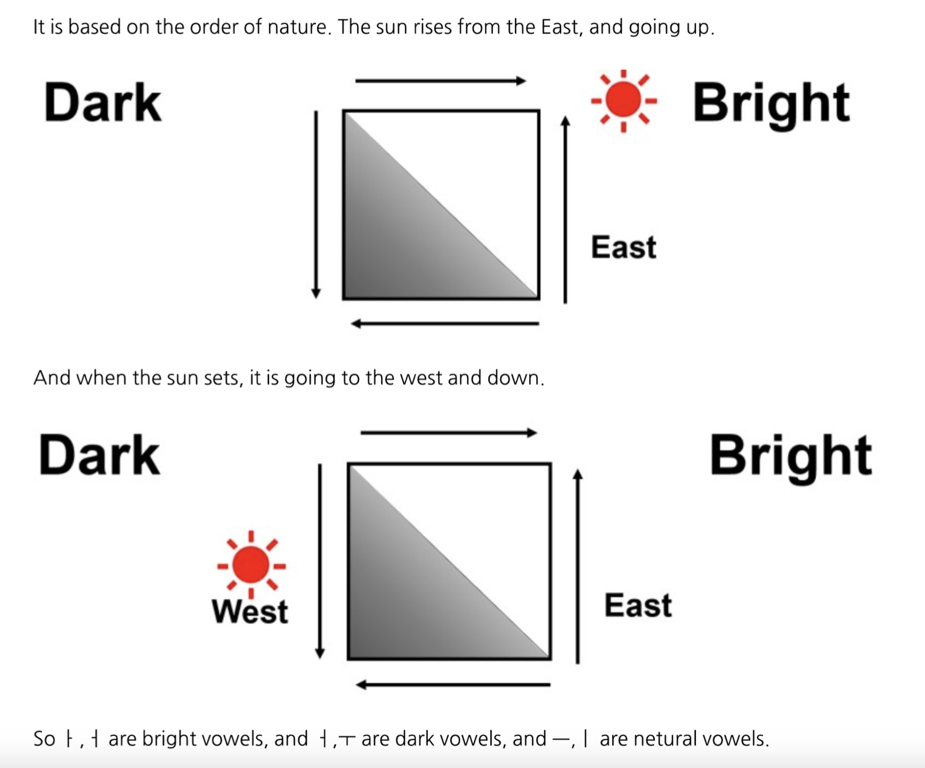

Slide 6
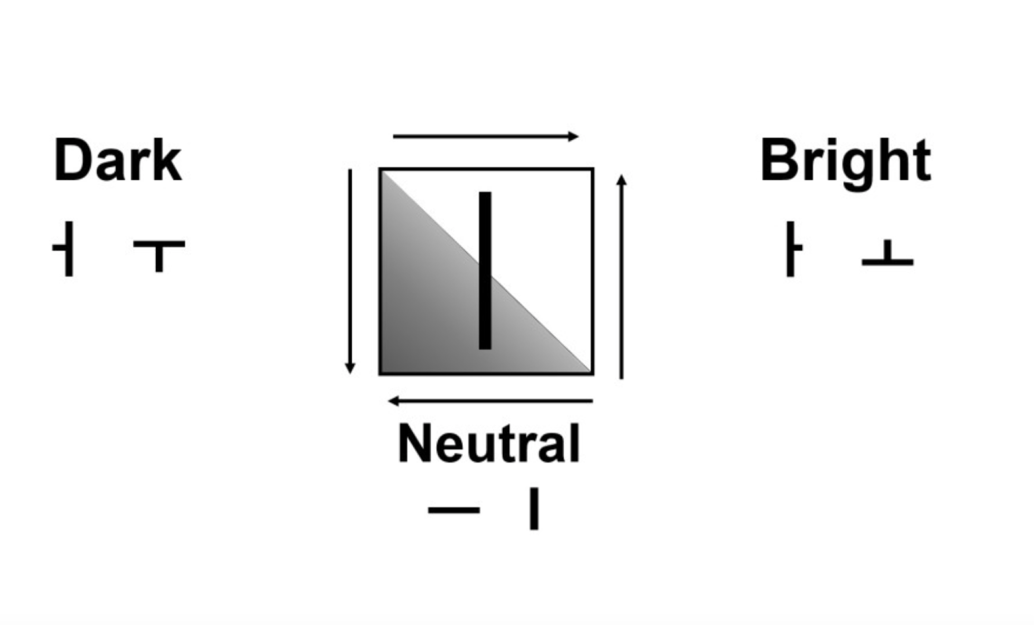

Slide 7
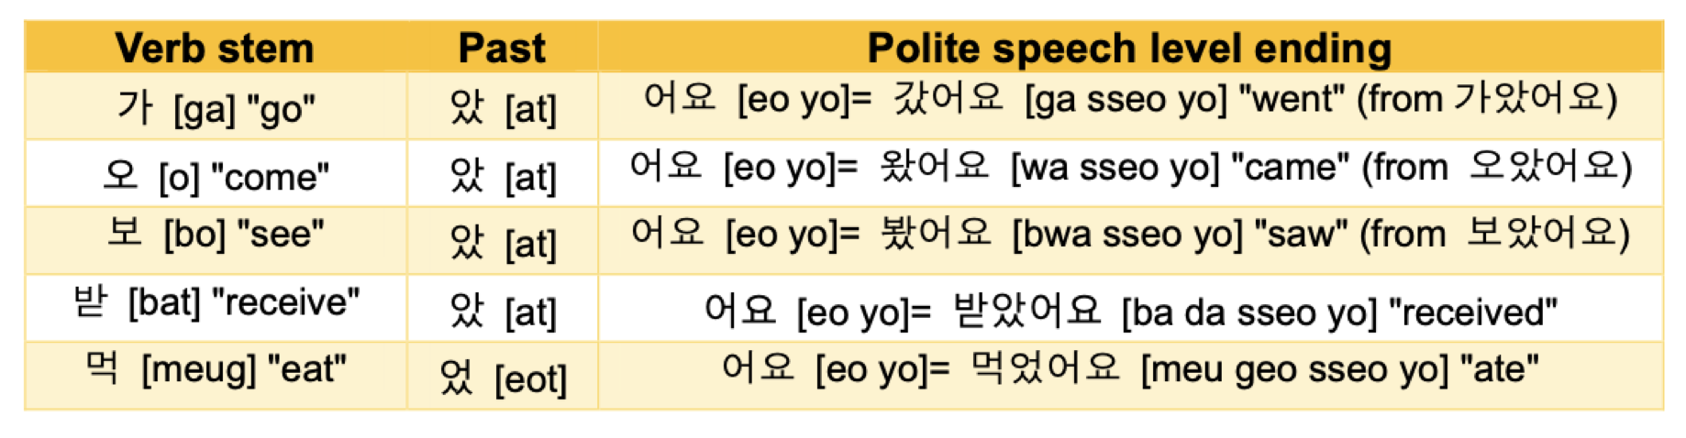
The combination with pre-final ending 었/았 and -(으)시
선생님이 영어를 가르치셨어요 Teacher taught English
[Seon saeng ni mi yeong eo leul ga reu chi syeo sseo yo]
가르치 stem of verb + 시 honorific suffix + 었 past tense marker + 어요 speech level ending
[ga reu chi]. [si] [eot] [eo yo]
시 honorific suffix + 었 past tense marker = 셨

Slide 8
The combination with pre-final ending 었/았 and -(으)시
가 [ga] stem of verb + 았 [at] past tense marker + 어요 [eo yo] speech level ending
가 [ga] stem of verb + 았 [at] past tense marker = 갔어요 [ga sseo yo]
오 [o] stem of verb + 았 [at] past tense marker + 어요 [eo yo] speech level ending
오 [o] stem of verb + 았 [at] past tense marker = 왔어요 [wa sseo yo]
보 [bo] stem of verb + 았 [at] past tense marker + 어요 [eo yo] speech level ending
보 [bo] stem of verb + 았 [at] past tense marker = 봤어요 [bwa sseo yo]
받 [bat] stem of verb + 았 [at] past tense marker + 어요 [eo yo] speech level ending
받 [bat] stem of verb + 았 [at] past tense marker = 받았어요 [ba da sseo yo]
먹 [ga] stem of verb + 었 [eot] past tense marker + 어요 [eo yo] speech level ending
먹 [ga] stem of verb + 었 [eot] past tense marker = 먹었어요 [meu geo seeo yo]

Slide 9
The combination with pre-final ending 었/았 and -(으)시
1. ᅡ/ᅥ + 었/았→ same
ex) 가 go + 았 → 갔 went
2. ᅩ/ᅮ + 었/았→ 웠/왔
ex) 배우 learn + 었 → 배웠 learned 주 give + 었 → 줬 gave
3. ᅳ + 었/았 → ( ᅳ omission ) 었/았
ex) 끄 turn off + 었 → 껐 turned off
4.ᅵ+었→이었/였
ex) 이 be + 었 → 이었 was, were 먹이 feed + 었 → 먹였 fed
5. But still exception ex) 하 do + 았 → 했 did

Slide 10
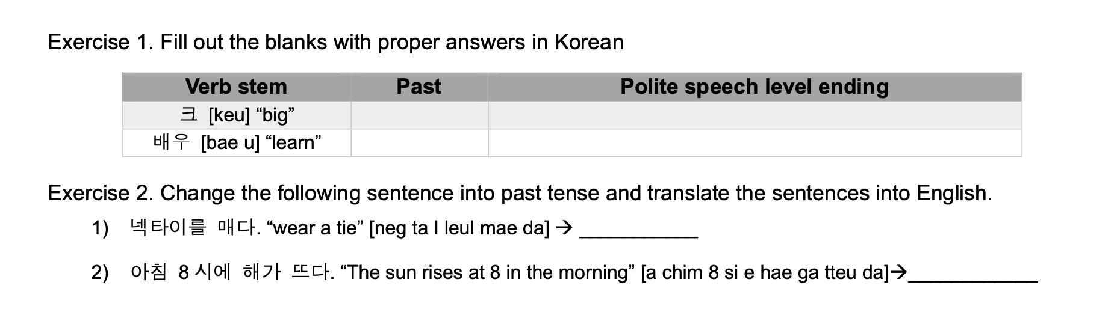
었/았
어요

Slide 11
었/았
었
크+었+어요= 크었어요 = 컸어요
었
배우+었+어요=배웠어요
매 + 었 + 다 = 맸다 : 넥타이를 맸다 I wore a tie
뜨 + 었 + 다 = 떴다 : 아침 8시에 해가 떴다 The sun rose at 8 in the morning

Slide 12
Two kinds of Korean past tense represents
Something did happen in the past / the condition of an action or event completed
집에 왔어요 [ji ba wa sseo yo]
came home + I am home now
(as a result of the complete action of coming home)
바지를 입었어요 [ba ji leuI i beo sseo yo]
wore a pants + I am wearing a pants now
(as a result of the complete action of wearing pants)

Slide 13
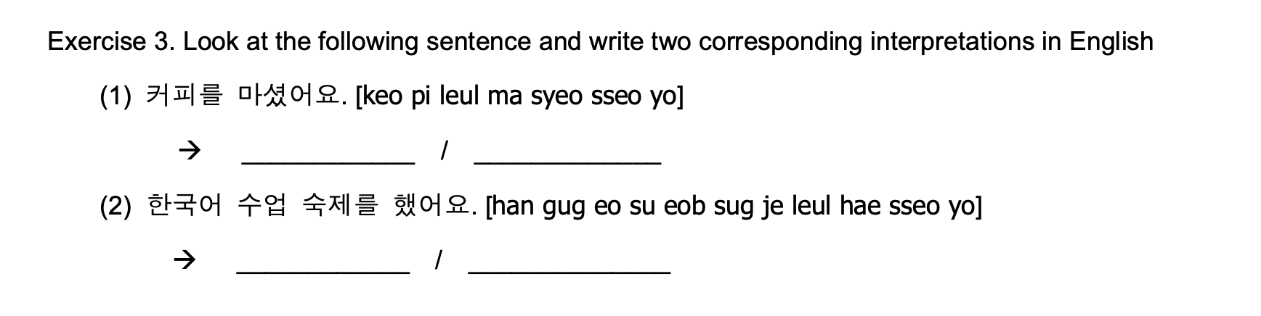

Slide 14
I drank a coffee
I am drinking coffee (the action of drinking coffee is completed)
I did a homework for the Korean lessons
I am doing Korean class assignment.
(the action of doing homework is completed)

Slide 15
Vocabulary
선생님 [seon-saeng-nim] teacher
아침 [a-chim] breakfast
점심 [jeom-sim] lunch
저녁 [jeo-nyeog] dinner, evening
해 [hae] the sun
집 [jib] house, home
바지 [ba-ji] pants
커피 [keo-pi] coffee
어제 [eo-je] yesterday
영화 [yeong-hwa] movie
친구 [chin-gu] friend
강도 [gang-do] robber / robbery
시민 [si-min] citizen
인질 [in-jil] hostage
도둑질 [do-dug-jil] theft / rob
요리하다 [yo-li-ha-da] cook

Slide 16
Vocabulary
수업 [su-eob] class course lesson
숙제 [sug-je] homework, assignment
밥 [bab] rice, meal, food
영어 [yeong-eo] English
넥타이 [neg-ta-i] necktie

Slide 17
Conversation 3
하윤 : 너 어제 뭐 했어?
[neo eo-je mwo haess-eo?]
Hayun : What did you do yesterday?
민준 : 친구랑 집에서 저녁 먹고 영화 봤어
[chin-gu-lang jib-e-seo jeo-nyeog meog-go yeong-hwa bwass-eo]
Minjun : I had dinner at home with a friend and watched a movie.
하윤 : 진짜? 어떤 영화 봤어?
[jin-jja? eo-tteon yeong-hwa bwass-eo?]
Hayun : Really? Which movie did you watch.

Slide 18
Conversation 3
민준 : 강도가 시민들을 인질로 잡고 도둑질하는 액션 영화를 봤는데 생각보다 별로였어. [gang-do-ga si-min-deul-eul in-jil-lo jab-go do-dug-jil-ha-neun aeg-syeon yeong-hwa-leul bwass-neun-de saeng-gag-bo-da byeol-lo-yeoss-eo]
Minjun : I watched an action movie that robbers took citizens as hostages and steal money, but it wasn’t as good as I thought.
Situation + 는데 + sentences
this sentences uses to explain, ask, request, suggest for this situation
ex) 배고픈데 안배고파? I am hungry, but aren’t you hungry ?
ex) 방이 더러운데 방 좀 치울래? The room is so messy so would you like to clean?

Slide 19
Conversation 3
하윤 : 그렇구나. 밥은 맛있었어?
[geu-leoh-gu-na. bab-eun mas-iss-eoss-eo?]
Hayun : I see. How was the meal?
민준 : 정말 맛있었어. 다음에 내가 요리해 줄게 !
[jeong-mal mas-iss-eoss-eo. da-eum-e nae-ga yo-li-hae jul-ge !]
Minjun : It was really delicious. I will cook it next time.

