Slide 1
Korean Language Class Week 4
백지윤 Jiyun Baek

Slide 2
The Ending Form for verbs and adjectives
Including nuance of tense, aspect, speech levels etc.
Pre-final endings & final ending depending on where they placed in verb or adjective ex) 가르치시다 teach [ga-leu-chi-si-da] 행복합니다 (I am) happy [haeng-bog-hab-ni-da]

Slide 3
The pre-final ending -(으)시
존댓말, Polite Speech, zdvořilostní forma
Inflectional element between the stem and final ending
Respectful, honorific suffix

Slide 4
The pre-final ending 겠
“Will” in English
“I guess/think” or “do you think that…” in English
겠 expresses the speaker’s intentions ex) 열심히 공부하겠습니다 (l) will study hard [yeol-sim-hi gong-bu-ha-gess-seub-ni-da]
겠 indicates the speaker’s conjecture (guessing) ex) 내일 시험이 어렵겠어요 (I guess that) tomorrow’s test will be difficult [nae-il si-heom-i eo-lyeob-gess-eo-yo]

Slide 5
The non-sentence final ending
Non-sentence final endings & sentence-final endings ex) -다
-고 and then [go]
-어/아서 because [eo/a-seo]
-으면서 while [eu-myeon-seo]
-지만 although [gi-man]
-도록 in order to [do-rok]

Slide 6
The sentence final ending
Non-sentence final endings & sentence-final endings
Six speech level: the speaker’s interpersonal relationship with addresses or attitude toward them ex) social meaning such as intimacy ad formality of the situation
존댓말, Polite Speech, zdvořilostní forma, vykání
반말, Casual Speech, tykání

Slide 7
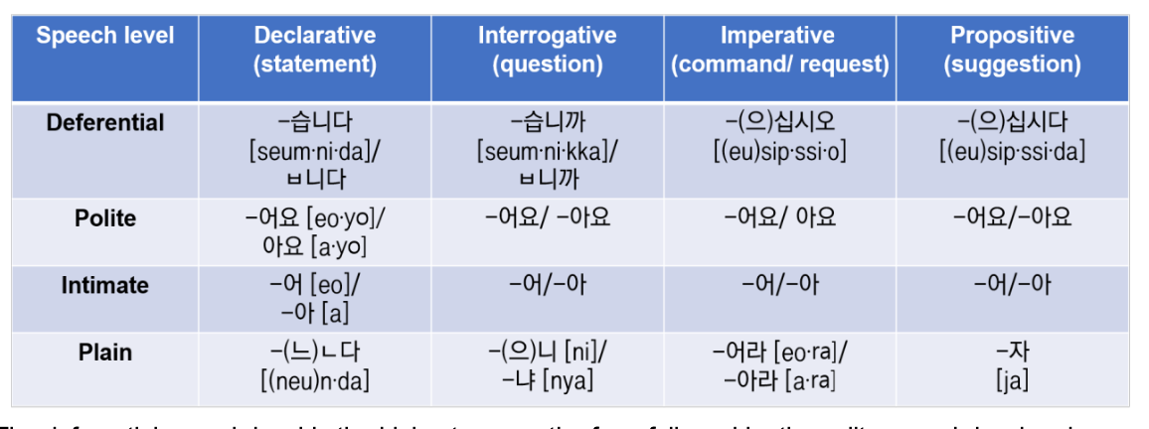

Slide 8
The pre-final ending 었/았
The past tense marker
Two different form depending on which vowel it is
stems end with a bright vowel → 았 [at] ex) 아 [a] / 오 [o] → 았 [at]
stems end with all other vowels → 었 [eot] ex) 으 [e] / 어 [eo] / 이 [I] etc → 었 [eot]

Slide 9
The Double Past Tense Marker 었/았었
The double past tense marker
Used to do (but no longer now)
Adding 었 after the Past Tense Marker ex) 었었 [eoteot] 았었 [atet]

Slide 10
In short,
하 stem of the verb + 시 honor suffix + 었 past tense + 었 double past tense + 어요 final ending = 하셨었어요

Slide 11
Café & Restaurant
물 한 잔 주시겠어요? [mul han jan ju si ge sseo yo?] “Could I have a glass of water?” → (what) (how many) 잔 주시겠어요? Could you please (many) glass of (what)?
냅킨은 어디 있나요? [naeb kin eun eo di it na yo?] “Where is the napkin?” → (what) 은/는 어디 있나요? Where is (what) ?
오늘 카페에서 숙제를 했어요. [o neul ka pe e seo sug je leul hae sseo yo] “I did my homework at the café today” → (when), (where)에서 (what)을/를 (action/verb)어요. (When), I (verb) my (what) at the (place).

Slide 12
Café & Restaurant
4. 메뉴에 아메리카노, 카페라떼, 마카롱 등 이 있어요. [men yue amelikano,kape latte, makalong deung i i sseo yo] “There are Americano, Cafe Latte, Macarons, etc. on the menu.”
→ (where)에 (what),(what),(what) 등 이 있어요. There are (what), (what), (what), etc in (where).
5. 아메리카노 두 잔 이랑 초콜렛 마카롱 하나 주세요. [amelikano du jan Ilang cho kol let ma ka long ha na ju se yo] “(Give me) Two glasses of Americano and one chocolate macaron”
→ (what) (how many)잔 이랑 (what)(how many) 주세요.
Give me (how many) glasses of (what) and (what).
6. 화장실이 어디 있는지 알 수 있을까요? [hwa jang sil i eo di it neun ji al su i sseul kka yo?] “Can I know where the toilet is?”
→(what)이/가 어디 있는지 알 수 있을까요? Can I know where (what) is?

Slide 13
Café & Restaurant
7. 너는 뭐 주문 할래? [neo neun mwo ju mun hal lae?] “What do you want to order?” →(who)은/는 뭐 (action/verb)할래? What do (who) want to (verb)?
8. 남은 음식 포장해주세요. [nam eun eum sig po jang hae ju se yo] “Please pack the leftovers.”
→(what) (action/verb)주세요 Please, (verb) (what). - when you request something for others
9. 어떤 메뉴가 제일 인기 많나요? [eo tteon me nyu ga je il in gi manh na yo?] “Which menu is the most popular?” → 어떤 (what)이/가 제일 인기 많나요? Which (noun) is most popular?
10. 피클이랑 김치 더 주시겠어요? [pi keul I lang gim chi deo ju si ge sseo yo?] “Would you please give more pickle and kimchi?” →(what)(이)랑 (what) 더 주시겠어요? Would you please give more (noun) and (noun)?

Slide 14
The Special particle 은/는
은/는 is a topic particle
은 after consonants (with 받침) / 는 after vowels (without 받침)
Topic + 은/는 + Predicate
Ex) 채경은 한국 사람이에요 [Chae gyeong eun han guk sa ra mi eyo] As for Chae-Kyung, (she) is a Korean 메디는 프랑스 사람이에요 [Me di neun peu rang seu sa ra mi eyo] As for Mehdi, (he) is a French

Slide 15
The Special particle 은/는
미카엘은 프랑스 사람이에요 [Mikaer eun peu rang seu sa ra mi eyo] “As for Mickael, (he) is a French” 대학생이에요 [Dae hak saeng ieyo] “(He) is an university student” 21살이에요 [21 sar ieyo] “(He) is 21 years old” 교카이는 터키 사람이에요 [Gyo kai neun teo ki sa ra mi eyo] “As for Gokay, (he) is a Turkish”

Slide 16
The Special particle 은/는
The noun marked by 은/는 appears to be the subject of the sentence
은/는 is not a subject particle
it does not mark the noun as the subject
햄버거는 파이브 가이즈 햄버거가 맛있어요 [Haem beog eo neun pai beu gai jeu haem beog eo ga mas iss eoyo] “As for hamburgers, Five Guys Hamburger is tasty.”

Slide 17
The Special particle 은/는
Compare and Contrast
Switching topics
Interplay between the subject and the topic particles
Appearing at the beginning of the sentence

Slide 18
1) Compare and Contrast
Compare and contrast the two topics of the sentences
Ex) 교카이는 터키 사람이에요 [Gyokai neun teak salami eyo] “As for Gokay, (he) is a Turkish.” 그렇지만 메디는 프랑스 사람이에요 [Geureo china media neun peu rang seu sara mi eyo] “However, as for Mehdi, (he) is a French.”

Slide 19
2) Switching topics
은/는 when they switch the topic from one thing to another
A: 실례합니다. 이 바지 얼마예요? [Sil lye ha mni da. i baji eol ma ye yo?] “Excuse me, how much is this pair of pants?” B: 네. 30,000원입니다. [ne. Sam man won imnida] “Yes, (it) is 30,000 won.” A: 그럼, 이 치마는 얼마예요? [Geureom I chima neun eolma yeyo?] “Then, as for the skirt, how much is (it) ?” B: 네. 50,000원입니다. [ne. oman won imnida] “Yes, (it) is 50,000 won.” A: 이 청바지는요?? [I cheong baji neun yo?] “How about this pair of jeans?”

Slide 20
3) Interplay between the subject and the topic particles
When asking a question in Korean, the question word is usually marked by the subject particle 이/가 [I/ga]
When answering the question, it is used by the topic particle 은/는
the word is new information which was just brought up in the conversation when asking the question → 이/가 for asking question
after question, the word becomes the topic → 은/는 for answering the question
Elma: 전공이 뭐예요? [jeon gong i mwo ye yo?] “What is (your) major?” Nina: 전공은 한국어예요 [jeon gong eun han gug eo ye yo] “As for (my) major, (it) is Korean.”

Slide 21
3) Interplay between the subject and the topic particles
Su: 이름이 뭐예요? [I reu mi mwo ye yo?] “What is (your) name?” Mehdi: 제 이름은 메디예요 [je I reu m eun me di ye yo] “As for my name, (it) is Mehdi.”
Su: 고향이 어디예요? [gohyangi eodiyeyo?] “Where is (your) hometown?” Mehdi: 제 고향은 파리예요 [je gohyangeun pariyeyo] “As for my hometown, (it) is Paris.”

Slide 22
4) Appearing at the beginning of the sentence
You can make any element of the sentence the topic by adding the topic particle to it and placing it at the beginning of the sentence, except the verb/adjective that appears at the end of the sentence

Slide 23
4) Appearing at the beginning of the sentence
베녹은 오전 10 시에 엘마하고 도서관에서 한국어를 공부해요. [be nog eun oj eon 10si e el ma ha go do seo gwan e se o han gu geo reul gong bu hae yo.] “As for Vinok, (he) studies Korean with Elma at the library at 10:00 a.m.”
오전 10 시에는 베녹이 엘마하고 도서관에서 한국어를 공부해요. [oj eon 10 si e neun be no gi el ma ha go do seo gwan e seo han gu geo reul gong bu hae yo.] “At 10:00 a.m, Vinok studies Korean with Elma at the library.”
엘마하고는 베녹이 오전 10 시에 도서관에서 한국어를 공부해요. [el ma ha go neun be no gi oj eon 10si e do seo gwan e seo han gu geo reul gong bu hae yo.] “With Elma, Vinok studies Korean at the library at 10:00 a.m.”
도서관에서는 베녹이 오전 10 시에 엘마하고 한국어를 공부해요. [do seo gwan e seo neun be no gi o jeon 10 si e el ma ha go han gu geo reul gong bu hae yo.] “At the library, Vinok studies Korean with Elma at 10:00 a.m.”

Slide 24
Difference with 이/가 and 은/는
The subject particle 이/가 is used to mark a subject (which happens to be new information or has not been mentioned previously in the context)
Ex) 어느 식당 음식은 맛있어요? (X) [eoneu sigdang eumsig-eun mas-iss-eoyo?] 어느 식당 음식이 맛있어요? (O) [eoneu sigdang eumsig-i mas-iss-eoyo?] “Which restaurant food is delicious?”
누구는 슬로베니아 사람이에요? (X) [nuguneun seullobenia salam-ieyo?] 누가 슬로베니아 사람이에요? (O) [nuga seullobenia salam-ieyo?] “Who is a Slovenian?”

