Slide 1
Civil society and human rights in eastern europe
Spring 2025
Kateřina Hyťha špácová
core099

Slide 2
INTRODUCTORY CLASS
course
students
teacher
region
civil society

Slide 3
Main questions of the course
BY WHAT ACTIVITIES DOES CIVIL SOCIETY PROTECT HUMAN RIGHTS, ENVIRONMENT AND DEMOCRACY
IN OUR REGION?
WHAT IMPACT HAVE THESE ACTIVITIES HAD?

Slide 4
EASTERN EUROPE ?
ARMENIA, AZERBAIJAN AND GEORGIA ARE CONSIDERED TO BE EASTERN EUROPEAN COUNTRIES By
THE UN
(CAN BE ELECTED TO UN HUMAN RIGHTS COUNCIL FOR EASTERN EUROPEAN REGION)

Slide 5
GOALS of the course
By the end of the course, students will be able to:
Explain civil society, human rights, democracy, and NGOs in the context of Eastern Europe and the South Caucasus.
Summarize examples of civil society activities in the region.
Identify how civil society addresses human rights, democracy, and environmental challenges.
Compare regional civil society strategies with those in their own country.
Evaluate the impact of civic engagement and advocacy.
Reflect on their potential to contribute to human rights, democracy, and environmental protection

Slide 6
Format of the course - weekly
Preparation at home
https://is.muni.cz/auth/predmet/phil/jaro2024/CORE099 - Study materials - Interactive Syllabus
Reflection on home preparation in class every week (not graded)
Presentation of the guest and discussion – check for updates: interactive sylabus
Reflection

Slide 7
aSSESSMENT
ENGAGEMENT WITH A MINIMUM OF 9 TOPICS
either presence in class or a short written reflection on home preparation materials – to be sent to the teacher by email by May 5, max. 300 words
The week without a lecture, the one for test revision, does not count toward this
SHORT WRITTEN ANALYSIS (450-600 words) – during reading week, on human rights and/or civil society in our region or elsewhere in the world - show us what you‘re interested in
OPEN-BOOK TEST – at home
QOLLOQUIUM – discussion on a text provided by the teacher

Slide 8
WORKLOAD
3 CREDITS
1 CREDIT = 30 HOURS OF WORK PER SEMESTER
1 CREDIT – LECTURES AND/OR WRITTEN REFLECTION OF HOME ASSIGNMENTS
1 CREDIT – AT-HOME PREPARATION – 3 HRS WEEKLY
1 CREDIT – SHORT WRITTEN ANALYSIS, OPEN-BOOK TEST, COLLOQUIM

Slide 9
Careful!
11.3. class beings at 18.30
18.3. no class
8.4. class via a zoom call, from home
22.4. Reading Week – no class
6.5. Open-book test - at home

Slide 10
Your task throughout the semester keep a record
After each homework and each class, note down:
What civil society does (type of activity)
Who benefits (local communities, activists, marginalized groups, etc.)
What changes it brings (policy shifts, legal victories, public awareness)

Slide 11
INTRODUCTION OF THE TEACHER
English and Russian Studies, Faculty of arts, muni
Work for human rights organizations
- People in Need – covered Ukraine and Belarus
- Civic Belarus
- Human Rights House Foundation – a Norwegian organization – lived in Tbilisi, Georgia and covered mainly Azerbaijan and Armenia
Teaching English FOR ADVOCACY to human rights defenders AND ACTIVISTS from eastern europe and central asia

Slide 12
Civic belarus keep a record
Providing support to HRDs, other prodemocracy activists and citizens
Azerbaijan The most important thing for a political prisoner is to know they are remembered)
Capacity building: the case of Euraradio

Slide 13
HUMAN RIGHTS HOUSE FOUNDATION keep a record
https://humanrightshouse.org/
Capacity building
Networking
International advocacy
Protection

Slide 14
introduction of students (in groups of 3)
Where are you from and/or what do you study?
2. Why are you interested in Eastern Europe and/or human rights and civil society?
3. What is one topic you’re particularly interested in?

Slide 15
OUR REGION
(individually)

Slide 16
When did the Soviet Union dissolve?
a) 1989
b) 1991
c) 1993

Slide 17
When did the Soviet Union dissolve?
a) 1989 – fall of communism in Czechoslovakia, Eastern Germany, Hungary, Poland…
b) 1991 – Soviet Union dissolves
c) 1993 – Czechoslovakia splits into Czechia and Slovakia

Slide 18
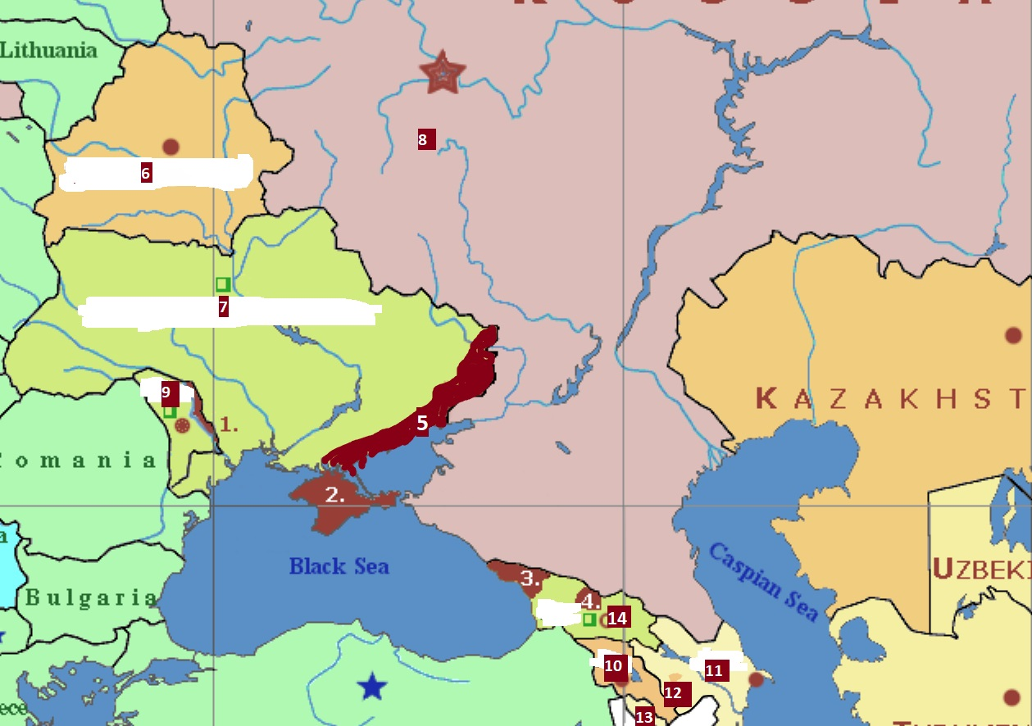
Connect the numbers with the names of countries and territories
Abkhazia, Armenia, Azerbaijan, Belarus,
Crimea, Georgia, Russia-occupied territories of
mainland Ukraine, Moldova, Nakhichevan,
Nagorno Karabakh, Russia, South Ossetia,
Transnistria, government-controlled territories
Of Ukraine
Map of current situation in Ukraine:
https://liveuamap.com/

Slide 19
Connect the numbers with the names of countries and territories
3 Abkhazia, 10 Armenia, 11 Azerbaijan, 6 Belarus,
2 Crimea, 14 Georgia, 5 Russia-occupied territories of
mainland Ukraine, 9 Moldova, 13 Nakhichevan,
12 Nagorno Karabakh, 8 Russia, 4 South Ossetia,
1 Transnistria, 7 government-controlled territories of Ukraine
Map of current situation in Ukraine:
https://liveuamap.com/

Slide 20
Civil society

Slide 21
Václav Havel and civil society
The Václav Havel Library collects, researches, disseminates, promotes and advocates the spiritual, literary and political legacy of the author, playwright, thinker, human rights defender and Czechoslovak and Czech president, Václav Havel.
https://www.vaclavhavel.cz/elearning/en/course/9

Slide 22
Definition
organized groups and institutions
outside of the family, market and state
represent or advance particular interests, values or causes of people
some definitions: promote the public good

Slide 23
The rise of illiberal civil society in the former Soviet Union

Slide 24
The rise of illiberal civil society in the former Soviet Union
2018
covers: Georgia, Armenia, Ukraine, Kyrgyzstan and Moldova
illiberal, anti-Western and socially conservative civil society, anti-civil rights
Particularly regarding LGBTI rights, women‘s role in society, abortion, the attitudes toward ethnic and religious minorities
linked to the dominant religious organisations, or political factions with influence over state resources
while some groups have direct or indirect contact with Russia, many do not and the primary drivers of such activity are to be found in the local societies
https://fpc.org.uk/publications/the-rise-of-illiberal-civil-society-in-the-former-soviet-union/

Slide 25
2013 – Georgia – 17 IDAHO activists VS thousands of violent anti-gay activists and Orthodox Church representatives

Slide 26
NGO vs CSO
NGO – non-governmental organization
CSO - include NGOs, but also professional associations, foundations, independent research institutes, community-based organizations, faith-based organizations, social movements, and labor unions.

Slide 27
ON A SCALE OF 1-5, HOW ENGAGED DO YOU FEEL IN CIVIL SOCIETY?

Slide 28
In what ways are you active in civil society? - in groups of 3
Are you a member of a political party, trade/labor union, business/professional organization, rights advocacy group, church/religious organization, sports/leisure club, cultural association, another voluntary association, or an online group related to your interests?
Have you taken part in a protest, demonstration, strike, or social movement?
Have you helped organize an event or gathered people around a shared cause?
Have you signed a petition for a social or political cause?
Have you contacted a politician or civil servant about an issue you care about?
Have you volunteered your time or skills for a cause?
Have you donated money or resources to a non-governmental organization or a social cause?
Have you shared information about a public issue on social media?
Have you participated in an online campaign, written a blog post, or created digital content to raise awareness about an issue?
If you have engaged in any of these ways, HOW DID IT FEEL?
WHICH OF THE ACTIVITIES ABOVE DO YOU THINK ARE MOST impactful? WHY?

Slide 29
After the discussion, would you change your answer: ON A SCALE OF 1-5, HOW ENGAGED DO YOU FEEL IN CIVIL SOCIETY?

Slide 30
RECENT SITUATION IN YOUR COUNTRY – in groups
Are there any important or unique non-governmental organizations (NGOs) making an impact?
Have there been any protests or demonstrations in your country recently? If so, around which topics?
Are there pressing human rights concerns? If so, how are they being addressed?

Slide 31
Final reflection - in groups (5 mins) - slido individually (5 mins)
What do you want to remember from today about civil society?
Today we covered about:
The lecturers experience:
international advocacy (Council of Europe, the UN, the EU
Support to political prisoners
support to independent media and human rights acvitists and organizations
Support in fundrasing
What is civil society?
Illiberal civil society
Forms of involvement in civil society

Slide 32
NEXT WEEK‘s lecture

