Slide 1
Nobel Prize in Literature
Doc. PhDr. Miluše Juříčková, CSc.

Slide 2
Tomas Tranströmer (1931 – 2015)

Slide 3
Bertha von Suttner (1841 – 1914) not literature: Peace 1905

Slide 4
Selma Lagerlöf

Slide 5
Knut Hamsun (1859 – 1952)

Slide 6
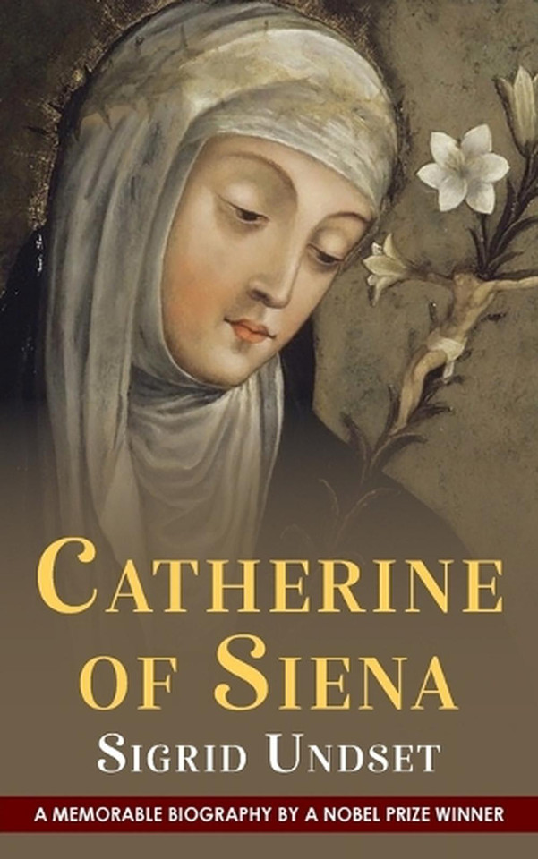
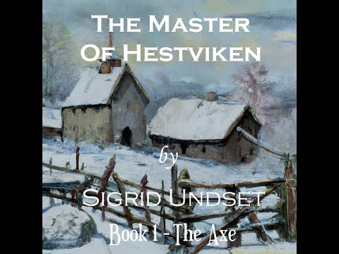
Sigrid Undset (1882 – 1949)

Slide 7
Jon Fosse, born 1959

