Slide 1
British North America Act 1867 (Acte de l’Amérique du Nord Britannique)
Notes:
1

Slide 2
Problems to be solved
Immigration and a sharp increase in population (from 2.4 million to 3.2 million between 1851 and 1861)
Predominance of the Anglophone element, which thus begins to be disadvantaged by the current laws in Parliament (half of the seats go to French-Canadians)
Radicalism of George Brown’s Clear Grits party, rebelling against the domination of the „clerical East“, i.e. the French-Canadians.
Incorporation of Maritime and othes provinces
Dangerous USA and reapid colonization of the Middle-West (Mississippi basin)Economic crisis: end of the Crimean war (1952) and the flow of Russian grain in Europe
Civil war in the USA

Slide 3
Conferences
1864 Charlottetown and Quebec under the presidency of Sir Étienne Taché to discuss the establishment of the federation. The example of the recent civil war in the US was positive: federal powers had to be strengthened on the model of the British Empire government (federal tax collection vested in the federal government, the right of the federal government to repeal provincial laws that would conflict with federal laws).
The conclusions of the Quebec Conference were presented by Canadian representatives to their British counterparts at a conference in London in December 1866. This is the constitutional beginning of the Confederation of Canada (La Confédération Canadienne, Dominion of Canada)
The Constitution Act, 1867 was originally known as the British North America Act (BNA Act). It was the law passed by the British Parliament on 29 March 1867 to create the Dominion of Canada. It came into effect on 1 July 1867. The Act is the foundational document of Canada’s Constitution. It outlines the structure of government in Canada and the distribution of powers between the central Parliament and the provincial legislatures. It was renamed the Constitution Act, 1867 with the patriation of the Constitution in 1982.

Slide 4
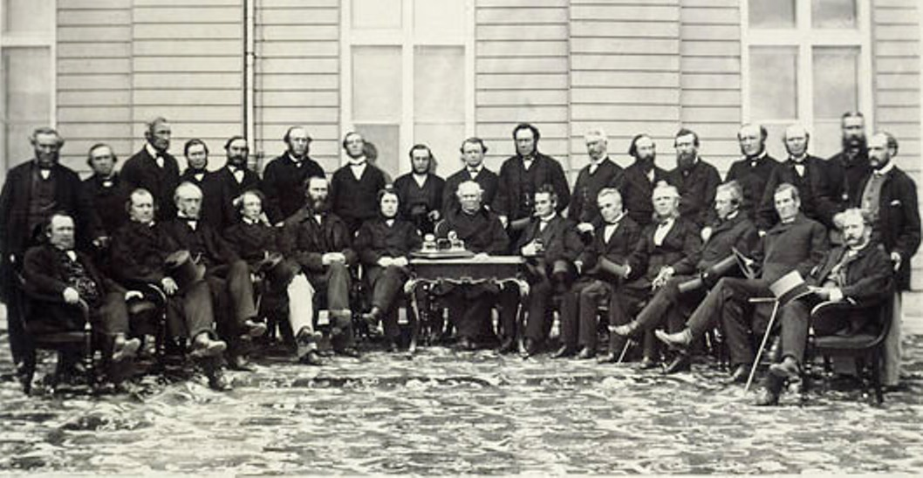

Slide 5
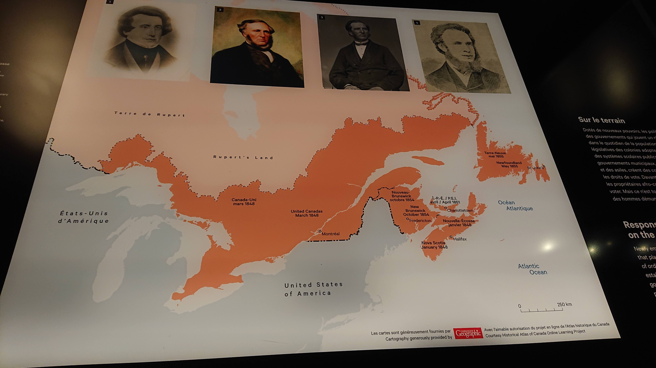

Slide 6
Territory:
provinces of Ontario, Quebec, New Brunswick and Nova Scotia merged into one entity
annexation of other provinces is not excluded
1869 the Canadian government bought from the Hudson’s Bay Company all the territories in the west and north-west, which later became the provinces of Manitoba (1870), Alberta and Saskatchewan (1905)
British Columbia joined the confederation in 1871 and Prince Edward Island in 1873
In the former territories of the Hudson’s Bay Company, the government had to face an uprising of francophone métisses (Louis-David Riel), deprived of the benefits of their status
Indian Act (1876) was also a terrorial measure to demarcate Indian reserves
The unity of Canada was completed by the construction of the first transcontinental railway in 1884-1885.
Political Arrangement
Governor, appointed by the British Crown for 5 years
Federal government („Conseil Privé“ - „Privy Council of Canada“), headed by the prime minister, is responsible to a bicameral Parliament: elected Lower House („Chambre Basse“) and an Upper House („Chambre Haute“) appointed for life by the British Crown on the advice of the Governor and the Government of Canada
provinces are headed by an appointed „lieutenant-gouverneur“. Each province has its own government responsible to the provincial parliament. With the exception of Quebec, it is a unicameral parliament.

Slide 7
Statute
Confederation has internal autonomy, meaning that foreign policy is determined by the British Crown. The gradual fight for international independence would become the hallmark of Canadian politics from the late 19th century onwards.
In the internal structure, there is legislative supremacy of the federal government and parliament. The federal government sets and collects taxes. In a unified fiscal system, some taxes are federal, some provincial. The governor also has a one-year veto over new provincial laws and measures that conflict with the interests of Confederation. Other powers are divided between the federal government and the provincial governments and parliaments
Status of the French-Canadians: French language is on an equal footing with the English language.

Slide 8
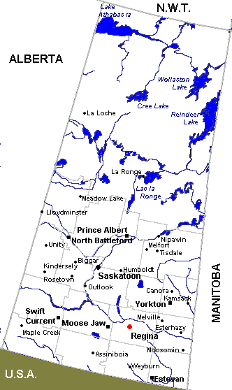
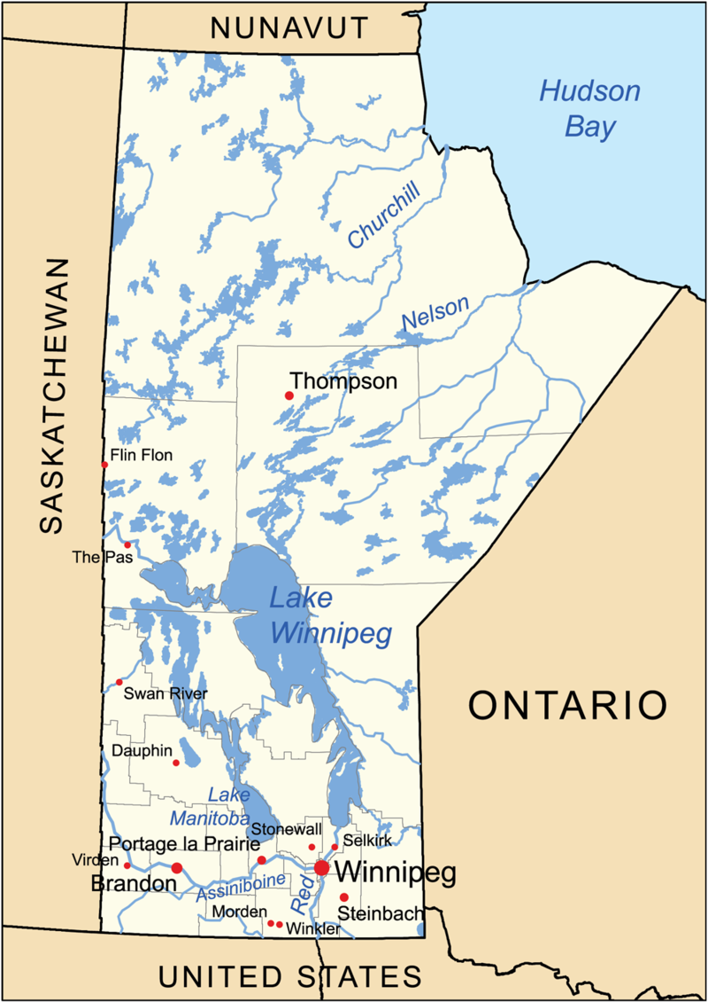
Colonization of the Midwest and the creation of the provinces of Manitoba, Saskatchewan and Alberta

Slide 9
These are the territories where two beaver fur trading companies had long operated North-West Fur Company (Compagnie du Nord-Ouest) Hudson Bay Company (Compagnie de la Baie d’Hudson), which had its bases on the shores of Hudson Bay and in the so-called „Ruppert Territory“ („Territoire de Ruppert“)
The result of this long-term activity was the creation of a distinctive community where business leaders, fur traders, fur trappers, buffalo hunters, Native tribes, farmers, herders, Catholic and Protestant missionaries lived in a kind of symbiosis.
At the top of the social organization were the Anglophone merchants and the managers (English and Scots)
Lower down the hierarchy were the francophone employees, who knew the area intimately and maintained good relations with the Aboriginal chiefs.
A significant number of these native Europeans mixed with the local Native tribes. Mixed-race people and Natives either worked for the companies directly or supplied them with buffalo meat and pemmican. Some of the mixed-race people and Europeans were farmers or semi-agriculturalists and semi-hunters. Social and economic life centered around trading posts and around Protestant and Catholic missions (e.g., Saint-Albert, etc.). This society had its administration and its courts, but these were non-state administration and courts.
different legal environment
different land ownership: Francophone westerners and mixed-race people kept the original French division into ‘lots de rivière’ (elongated strips perpendicular to the course of the rivers), while the new Canadian law provided for a division according to the Anglo-Saxon custom of the ‘township’ - a rectangular shape.

Slide 10
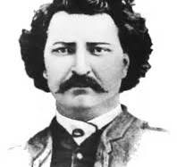
The population of what is now Manitoba was less than 12,000 at the time and the Canadian government wanted to economically develop the area. Without consulting the local population on the method of annexation, the administration of the territory and its economic intentions, it immediately proceeded to parcel out the land in the Red River Valley to offer it to new agricultural homesteaders. The original owners, who did not possess any written document, were often illiterate and ignorant of the law, were outraged by confederate officials’ arrogance and contempt. In addition, the new parcelling did not respect the old customs (‘lots de rivière’). The conflict was compounded by the language barrier, since those affected are mostly French-Canadians and Francophone mixed-race people, and are opposed by Anglophone officials.
At the head of the resistance, with the tacit approval of the Catholic Church, was a half-breed Louis-David Riel, who took advantage of the legal interregnum following the departure of the Hudson’s Bay Company administration, seized a key stronghold (Fort Garry) militarily and created a ‘provisional government’ (‘gouvernement provisoire’). This forced the Canadian government to negotiate. The result is the ‘Manitoba Act’ (Acte de Manitoba), by which the territory enters the Canadian Confederation on July 15, 1870, not as an administered territory but as a separate province headed by Governor G.A. Archibald.

Slide 11
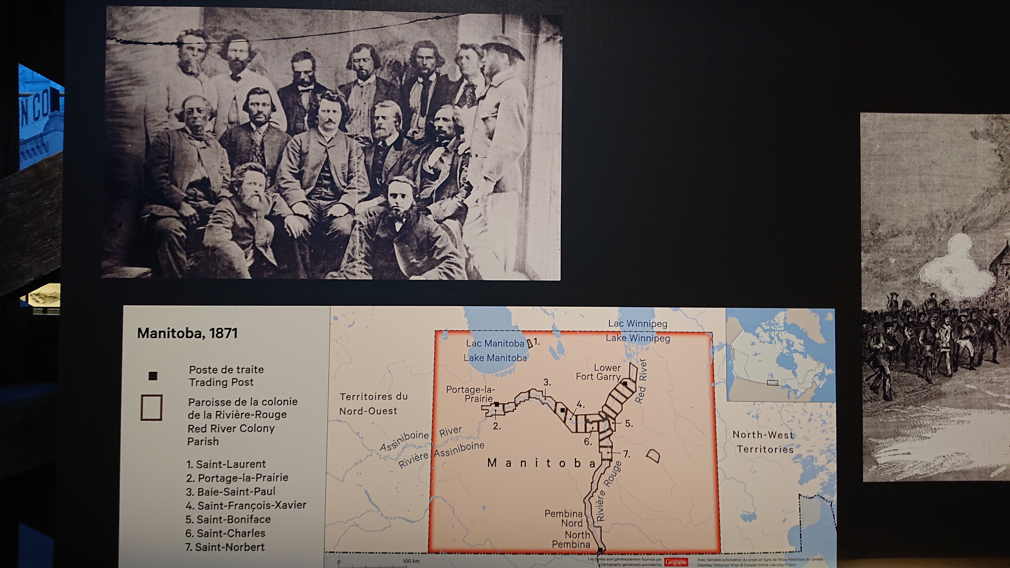

Slide 12
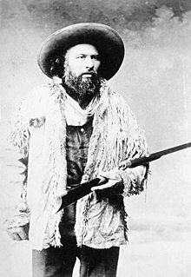
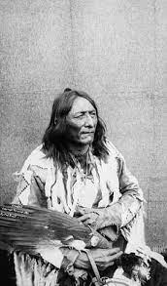
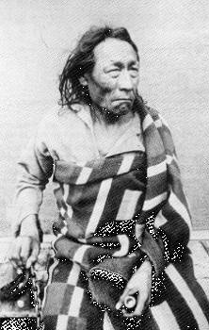
Louis-David Riel did not, however, avoid certain blunders (the unnecessary execution of political opponent Thomas Scott) that justified the federal army’s new military intervention. Riel fled to the United States and in 1875 was sentenced to five years’ exile.
The situation in Manitoba in 1869 repeated in Saskatchewan and Alberta
petitions by aboriginal people and métis demanding that traditional land tenure be respected
designated areas - reserves - which in Canada were intended to gradually convert the population from hunting to subsistence agriculture
total eradication of the buffalo herds
1884 - a new armed resistance of mixed-blood Indians and Indians took place, led by Louis-David Riel alongside Gabriel Dumont and the Native chiefs (Big Bear, Poundmaker). This time, however, the insurgents did not obtain the support of the Anglophones, nor of the Catholic Church, which already predicted failure. The rebels were defeated, Riel was convicted and executed in Regina (1885).
Native tribes forced to accept the reserve system
Métis transformed into a pauperized social scum
Cultural heritage
Literature
michif
https://michif.org/dictionary/

Slide 13
Rapid colonization
Factors
1873 Mounted Police (Police Montée, North-West Mounted Police) to administer the new territories, combining military, police and judicial powers. This contributed to the orderly colonization of the Canadian Midwest and West.
Railroads and shipping
Red River area connected to the United States rail network in 1878
shipping on the Red River
1881 - Minnesota capital company „Great Nothern Railroad“ founded the „Canadian Pacific Railway Company“, headed by Sir William Van Horn, an American of Dutch origin. The work is completed on November 7, 1885, and in the summer of 1886 the first transcontinental convoy passes over the line. Regina, Medecine Hat, Calgary are built along the line. These complement older settlements such as Prince-Albert, Saint-Albert and Edmonton. In 1896, construction then began on a second parallel line of the railway, the Canadian Nothern.
Demographic growth
Manitoba 1870: 12.000; 1880: 80.000 (German Mennonites, Icelanders, Dutchmen); 1891: 160.000; Winnipeg 8.000
Around 1900, the population of the three new provinces increased to 2.5 million (Hungarians, Ukrainians, Poles, Scandinavians, but also Quebecers)

Slide 14
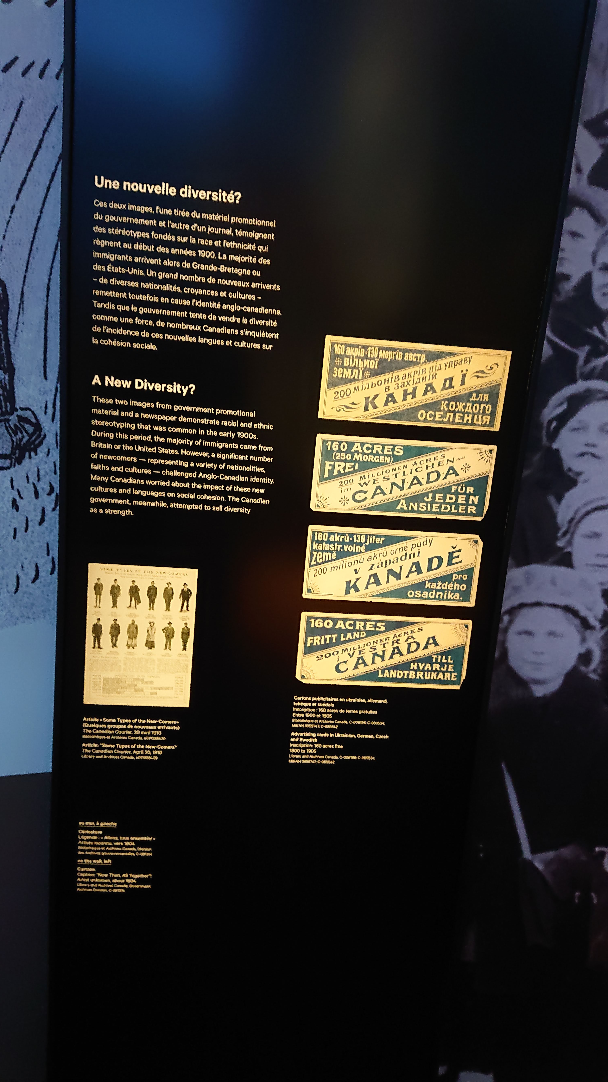
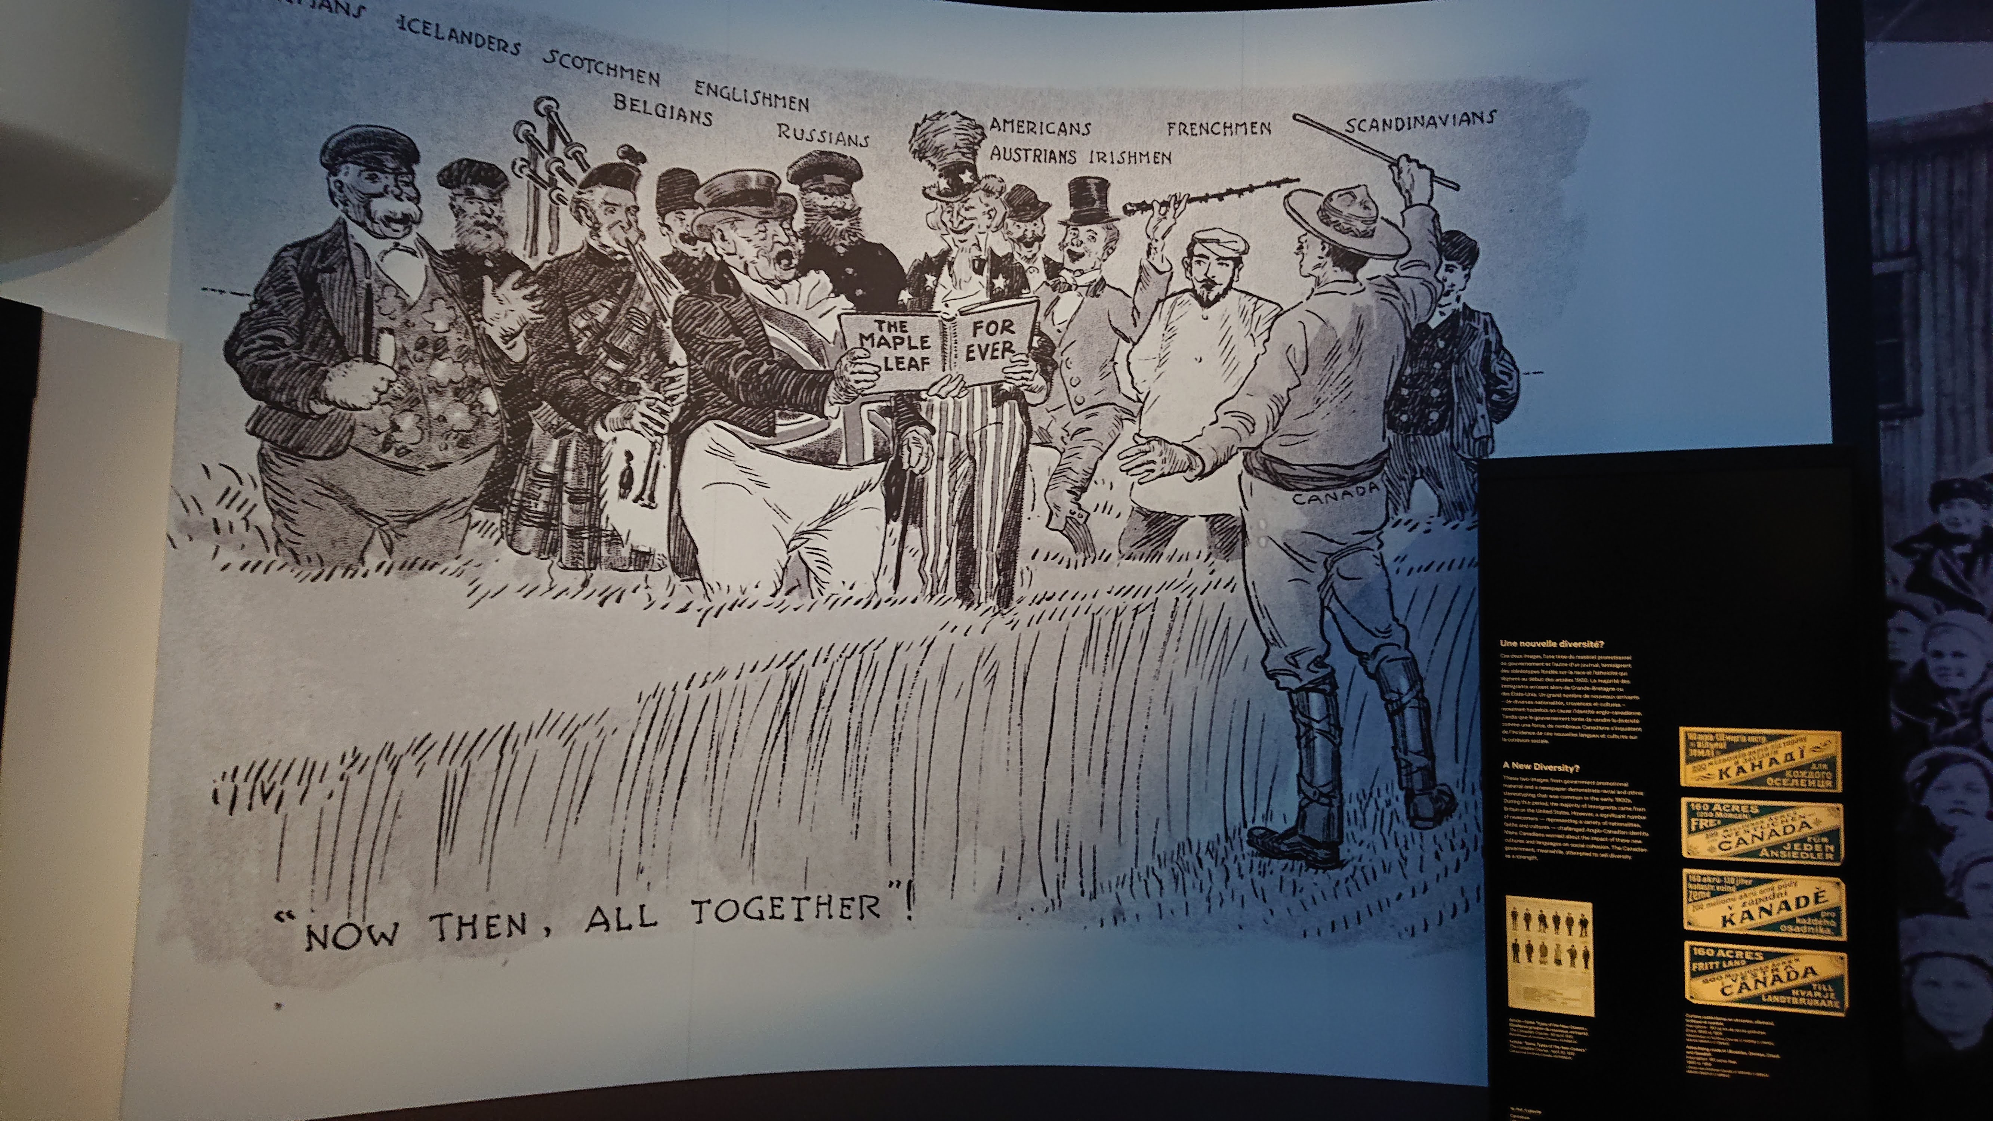

Slide 15
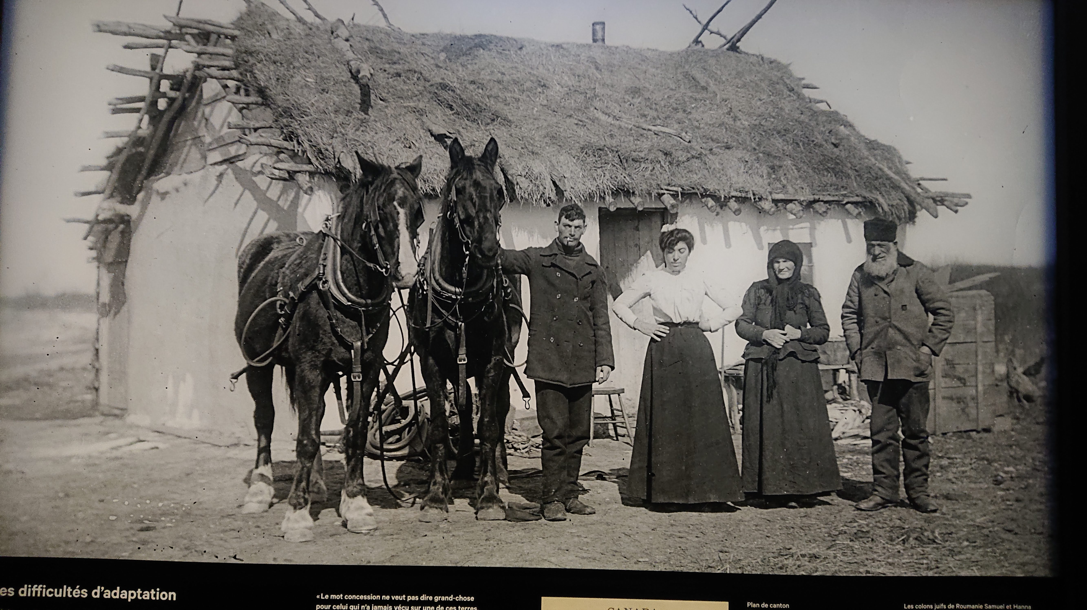

Slide 16
Linguistic problem
High diversity of the new population
Wilfrid Laurier government’s 1897 Education Act allowed the establishment of monolingual schools and classes with 10 pupils of another language, a full 1/6th of the pupils in the new areas were educated in a language other than English.
In this situation, the Manitoba government enacted in 1916 compulsory scholarship in English. This became another in a series of language disputes in modern Canadian history, for the problem of the francophone population of Manitoba affected the francophone population of Quebec emotionally

Slide 17
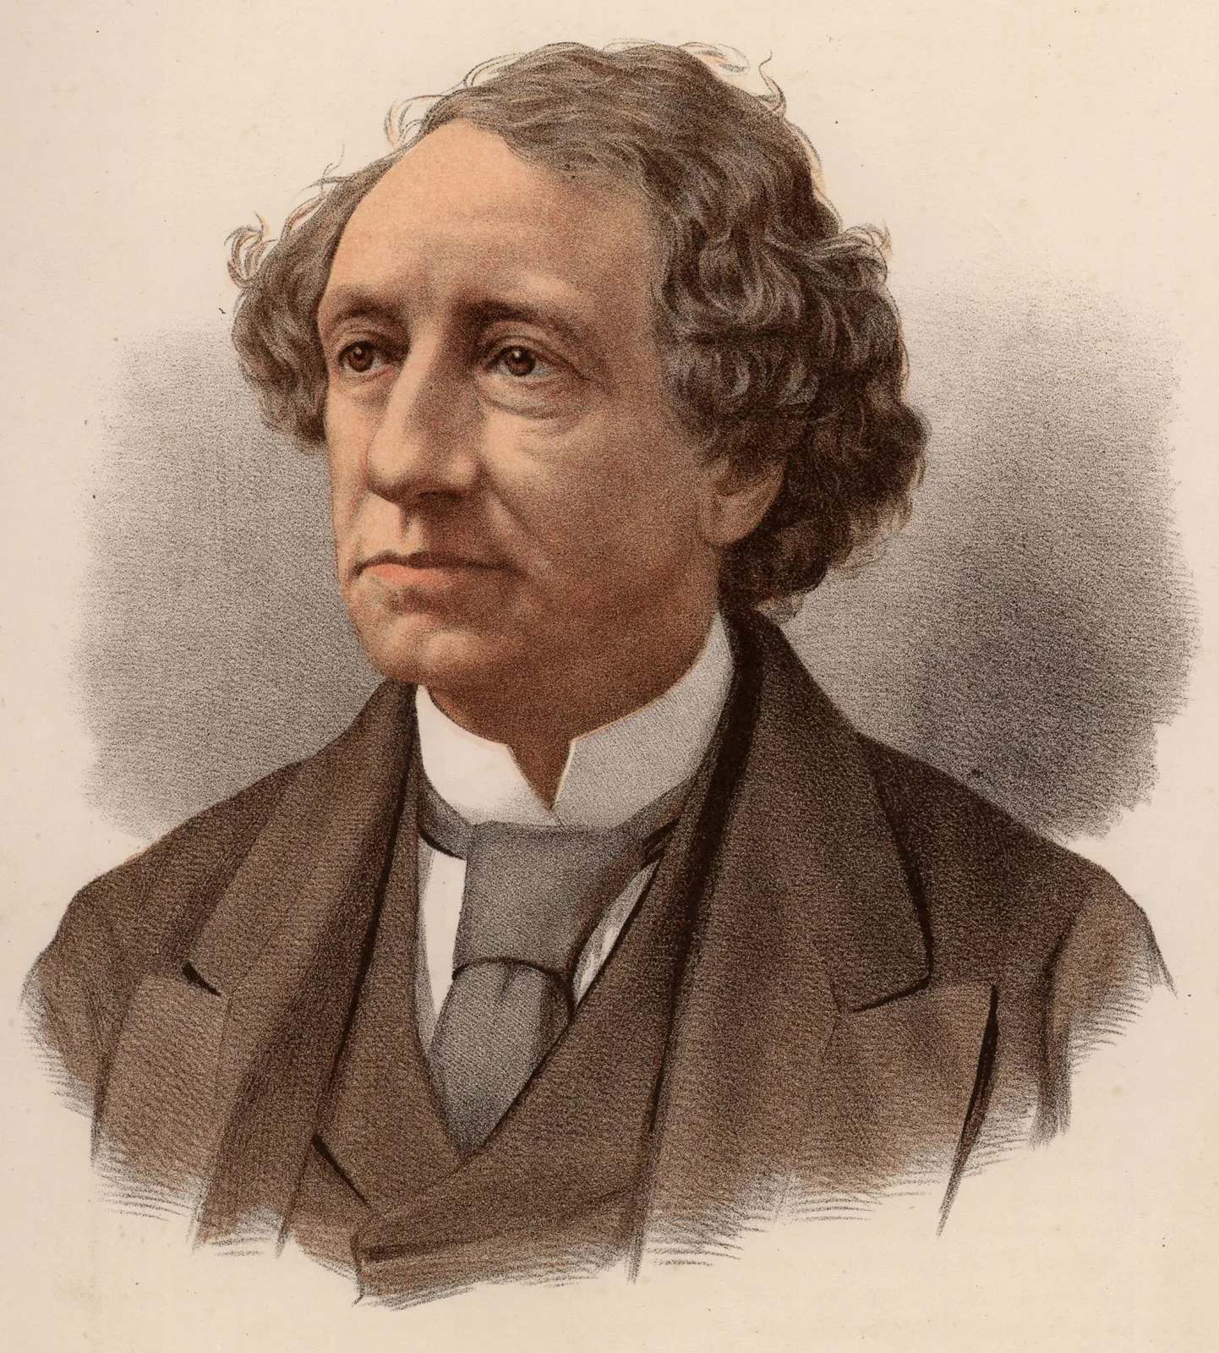
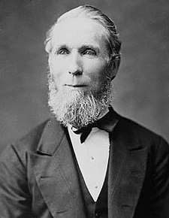
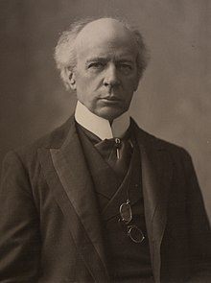
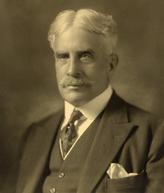
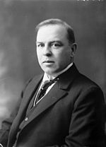
Politics
The Conservatives were in power from 1867-1873 and 1878-1896. The Prime Minister, John Macdonald, is a skilful tactician, and can win the Quebec Clericals to his side.
focus on cooperation with the London metropolis
protection of the emerging Canadian industry against the United States with protective tariffs
building of the trans-Canada railway
1873-1878 – liberal interlude - Alexander Mackenzie
open policy towards the United States
failure to protect the Canadian economy
neglect of the railway
1896-1911 liberal era Wilfrid Laurier
introduction of conservative elements into his Liberal strategy, abandoning Mackenzie’s commercial liberalism and supporting the building of the railway
strict separation of state and churches
important education laws that allow for the establishment of minority schools in Manitoba in a non-linguistic (anglophone) environment
Liberals and Conservatives alternate:
Robert Borden (1917 - Grand Coalition)
W.L. Mackenzie King (since 1921).

Slide 18
Foreign affairs
Emancipation in relation to Great Britain
under Laurier’s government, British troops leave Canada and it sovereignly secures its own borders
1908 - Laurier remembers that no treaty concluded by Great Britain binds Canada unless it joins the treaty
1910 - Canada has also had the right to control the flow of immigration from the British Isles
1910 - Laurier creates the Department of External Affairs (Département des Affaires Extérieures), but treaties negotiated by Canada must still always be negotiated in the name of the King of England and signed by the British Foreign Secretary. This practice ends in 1923 with the Pacific Fisheries Treaty with the United States
1926 - Conference of the British Empire, the equality of the various members of the Empire is proclaimed, and this is confirmed in 1931 by the Statute of Westminster (Statuts de Westminster). Canada is fully independent, linked to Great Britain only by the person of the monarch. Equality is confirmed by the fact that Canada sends its High Commissioner („haut-commissaire“) to London, and this fact is reciprocal. When George VI visits Canada in 1938, he is greeted everywhere as „King of Canada“
Since 1926, Canada has also been sending diplomatic representatives („ministres“) abroad: the first of them to Washington. Foreign legations are then established in Ottawa. In 1944, these diplomatic legations become embassies. This completes the long process of emancipation begun by Lord Durham in 1840.
The New National Flag: https://www.canada.ca/en/canadian-heritage/services/flag-canada-history.html

