Slide 1
Radicalization and Disintegration in the 20th Century
Notes:
1

Slide 2
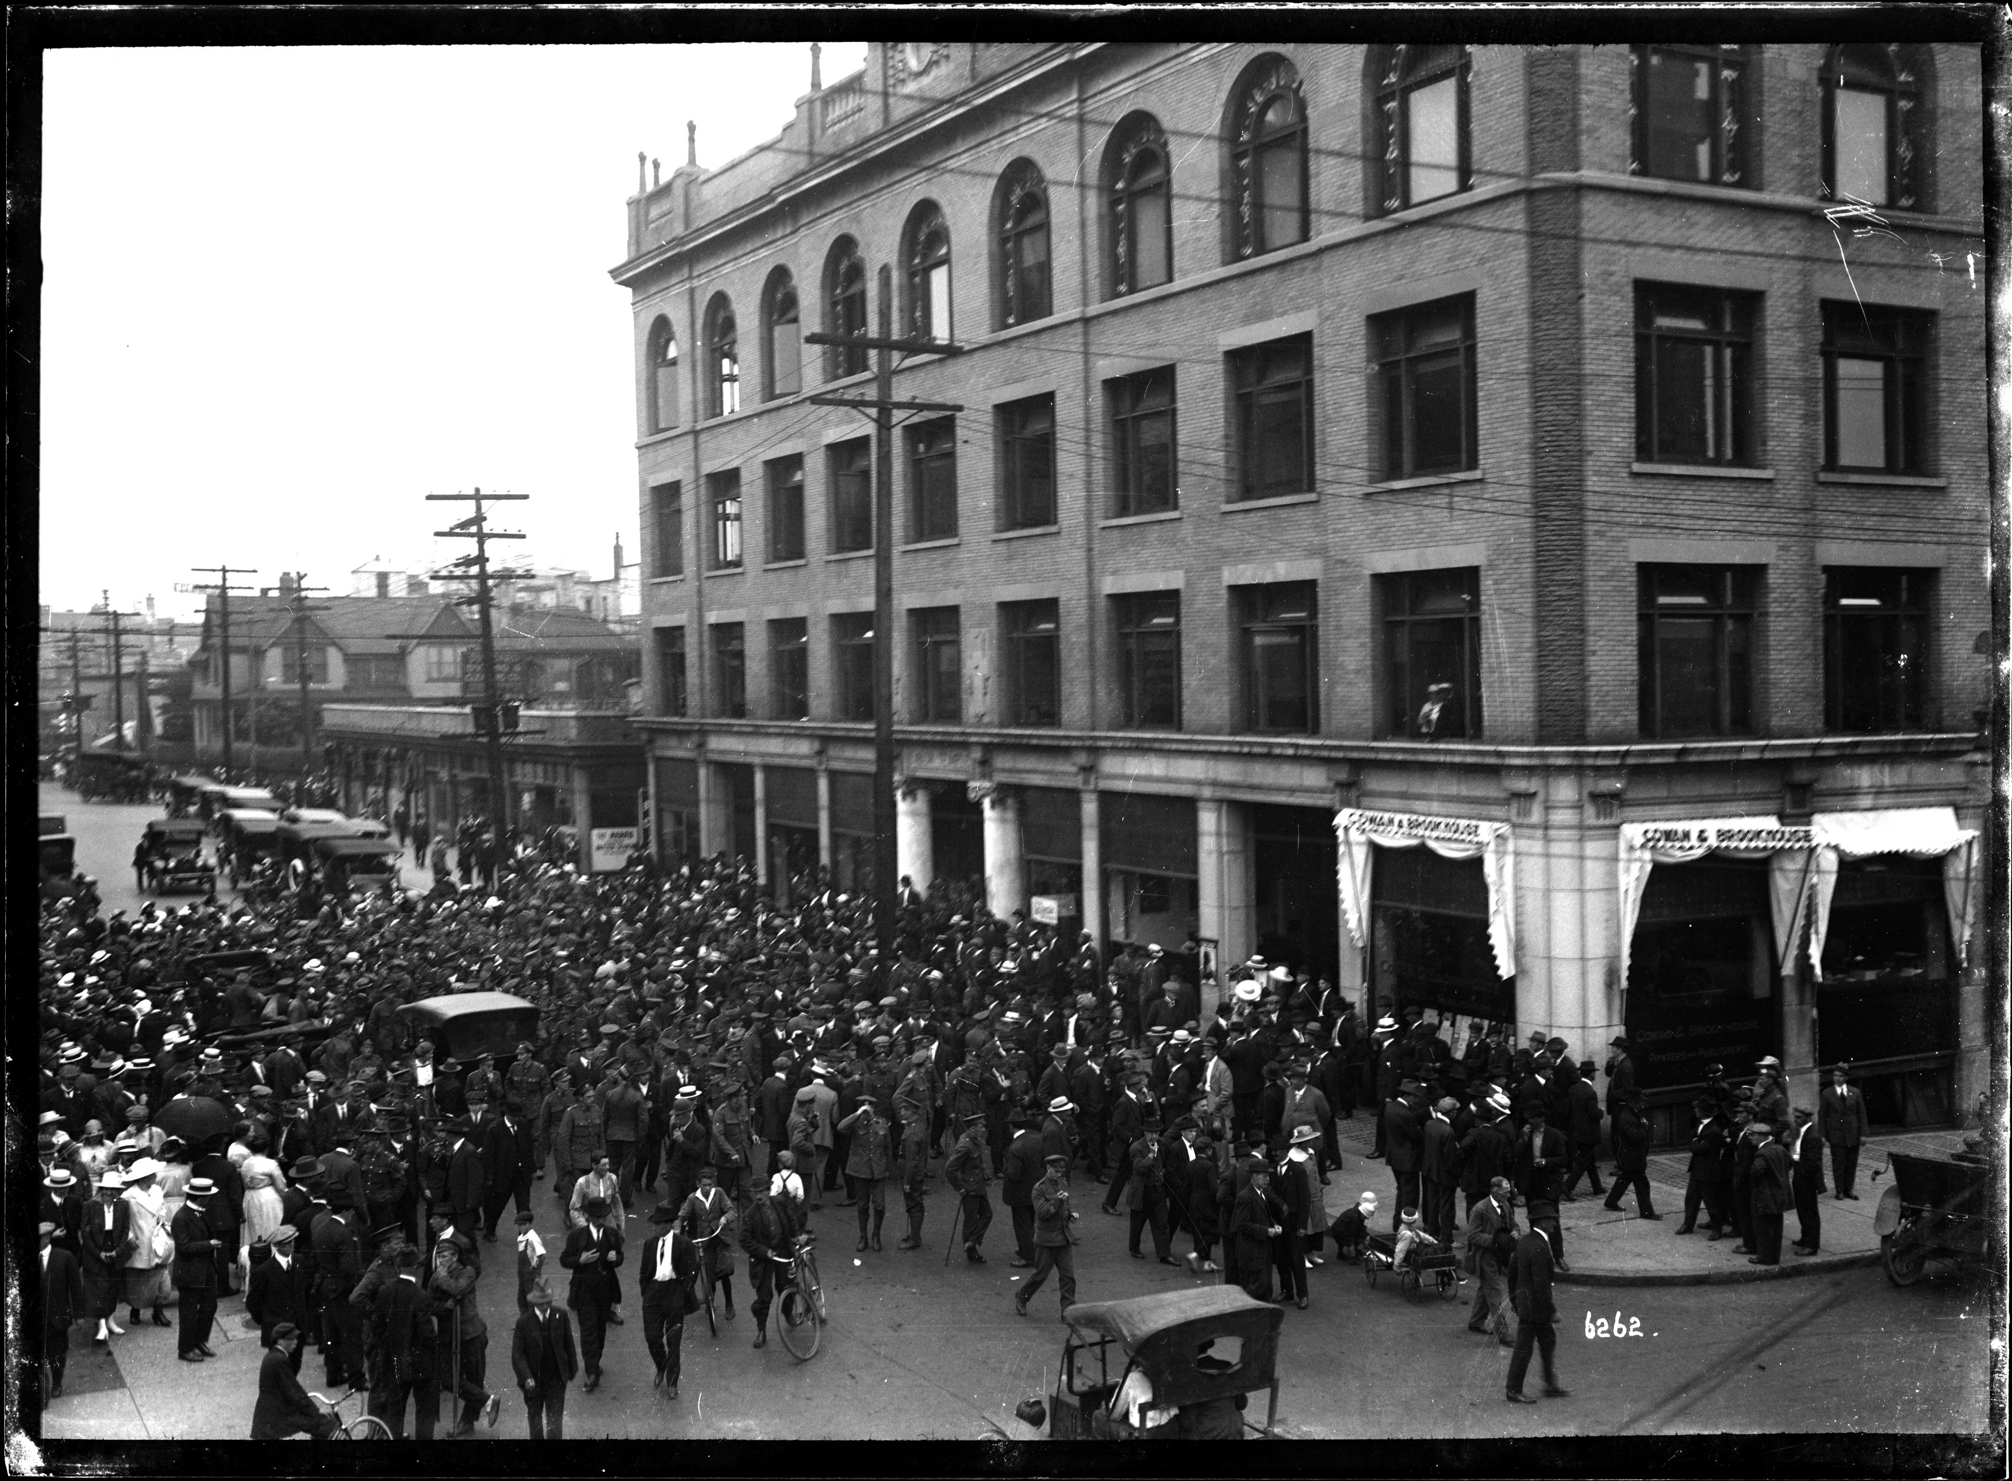
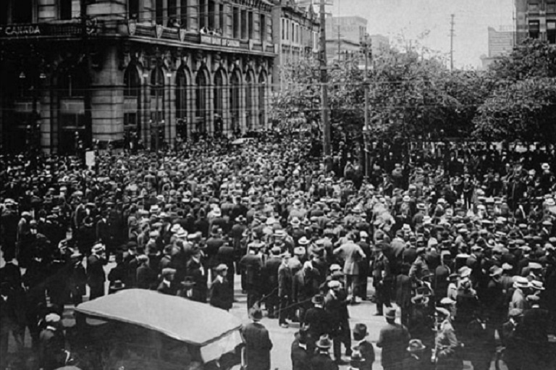
Destabilizing factors were at work in Canadian public life in the 20th century.
social factor: after-effet of the World War I
economic factor: Great Depression after 1929
radicalization of the left-wing movement
socialist National Progressive Party that formed after 1918,
Labour Progressive Party with strong communist features
Cooperative Commonwealth Federation

Slide 3

La tentation exemplaire de Jocelyne Saucier
Petr Kyloušek
La vie comme une image, Montréal : XYZ, 1996; House of Sighs, 2001
Les héritiers de la mine, Montréal : XYZ, 1999; Twenty-One Cardinals, 2015
Jeanne sur les routes, Montréal : XYZ, 2006; Jeanne's Road (2010)
Il pleuvait des oiseaux, Montréal : XYZ, 2011; And the Birds Rained Down, 2012
À train perdu, Montréal : XYZ, 2020; And Miles To Go Before I Sleep, 2022
Je n'ai jamais lu Baudelaire, Montréal : XYZ, 2022

Slide 4
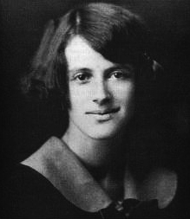
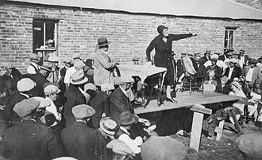
Jeanne Corbin (March 1906 – 7 May 1944) was a communist activist and trade union organiser in Canada.
Corbin and her family emigrated from France to Canada in 1911. After landing in Newfoundland, the family made their way to a farm near Edmonton, Alberta.
In high school, she joined the Young Communist League of Canada. Later, she was a member of the Workers' Defense League. An active member of the Communist Party of Canada, she is considered a "Party heroine" of the CPC.
She died at the age of 38 due to tuberculosis.

Slide 5
The environment of miners and loggers in Ontario and Abitibi in the 1930s and 1940s.
The journalist, father of the her-narrator, falls in love with communist activist Jeanne Corbin.
He is the father of three daughters, his Catholic wife keeps the family together with her love, and a mixture of Marxism and Catholicism is projected into the imagery of the daughters, named after famous revolutionaries. They reenact revolutionary scenes in the style of religious pageant dramas.
The journalist carries on the work of Jeanne, who died of tuberculosis, but by the 1950s the crisis is over, no one understands the need for revolution anymore. His daughter accompanies him on his travels out of pity. He's considered a fool by everyone.
Recurring expressions
holy, holiness, sacred, transubstantiation, (Ukainian) Temple (of Labor), blessing, moment of grace, saving faith, hope (at the end of hands), desolation, quest, pilgrimage

Slide 6
When I was born ten years later [narrator Jeanne], everything was there, firmly anchored, and I never felt the need to change anything. I studied the sacred texts with my sisters. We read Marx and Lenin in the literature for Young Pioneers, the Clarté that our father received at home when it wasn't prohibited. We read the New and Old Testaments, the leaflets recounting the lives of the holy martyrs that our mother brought home from her Sunday masses. We read Jeanne's correspondence, our most memorable reading moments. And we listened to our father's tales of heroic times (J 49).
[...] we imagined scenes where Jeanne rises above her body and joins the pantheon of Communist souls who have saved the world. [...] "And Marx said to him: 'Welcome among us, Comrade Corbin. Then it was Lenin's turn to stand up. He has a red rose in his hand and is wearing a fine military capote. He approaches Jeanne and says. Comrade Corbin, we salute you as a great Party heroine. Then Jdanov and Liebknecht and Bukharin, they all come, each in turn, a red rose in hand, and all together sing the Internationale." The most touching moments are those when comrades Kollontaï and Zetkin come to pay their respects. (J 119)

Slide 7
It pains me, it must be said, to see him thus exposed to ridicule. But I know he's happy, yes, happy to be the one who raises the hopes of new times like the great orators of the heroic age, and the laughter of the crowd won't change a thing. I'm standing next to him with my stack of newspapers, I can see him getting carried away, flying out of time, and I know with a certainty both delighted and appalled that after such and such a passage, I'll hear [...] phrases from the very famous speech at the Ukrainian Temple of Labor, and the illusion will be complete. He sees himself surrounded by ardent activists, a motley crowd of colorful kerchiefs, embroidered shirts and thick felt berets, instead of the uniformly flabby, polite crowd in front of a country church (J 68-69).
I've been on the road for a long time now, simply because I like to wander. I've lost my mission, my saving faith, my sense of the world. It's pitiful to wander like this for pure existential pleasure when you have in your life a Jeanne who supports the vault of heaven with her only hope. Jeanne on the road fears nothing, because she has a mission. (J 34)

Slide 8
left-wing programmes were gradually absorbed by the liberal party: social and health insurance and the creation of a state-owned productive sector were put on the agenda after the Second World War and gradually implemented in the vision of the welfare state
This, and the fact that Canada benefited from the economic development of the United States after World War II, largely weakened the radicalism of the left’s demands. The left parties were only partially successful in gaining a foothold in Ontario and some other anglophone provinces. The Catholic, traditionalist population of Quebec remained unaffected by these tendencies. On the contrary, Christian trade unions took firm root here, where the Catholic Church retained a strong influence.

Slide 9
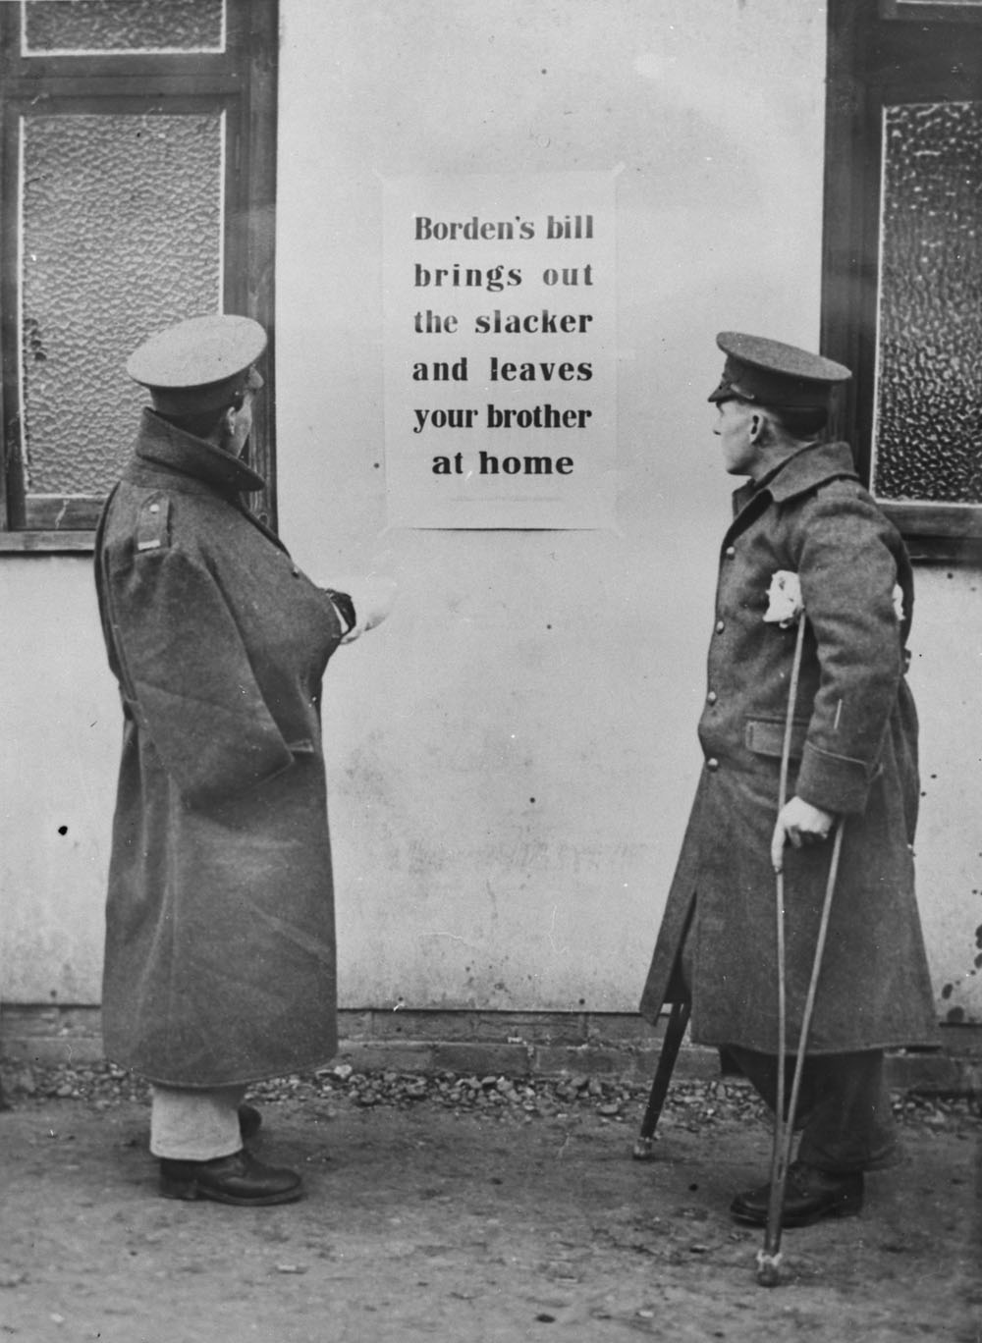
Loyalty of French-Canadian population to Canada and the British Crown
manifested in the context of military conflicts: the Boer War and the First and Second World Wars. Not, perhaps, because the French-Canadians refused to participate in the fighting entirely, but because Quebec’s leaders were opposed to compulsory conscription on principle. Thus, during the two World Wars, nationalist tendencies intensified: Henri Bourassa in World War I and Montreal mayor Camilien Houde in World War II contributed to the creation of the anti-British organizations Ligue pour la défense du Canada and Bloc populaire.

Slide 10
23/5 1917 | First riot in Montreal. La Presse and La Patrie offices ransacked. Three soldiers wounded.
11/6 1917 | The Military Service Act introduced in the Parliament of Canada
16/7 1917 | Anticonscriptionist gathering of 10,000 people at Parc La Fontaine in Montreal
9/8 1917 | Dynamite attack on the home of Hugh Graham, owner of The Montreal Daily Star
29/8 1917 | The Military Service Act is passed. Montreal riots end with four police officers and some twenty demonstrators injured.
17/12 1917 | Canadian federal election of 1917. Quebec is the only province not to vote massively for Borden's Unionist government.
21/12 1917 | Francoeur Motion presented to the Quebec Legislative Assembly, stating that Quebec would be prepared to leave Canada.
1/11918 | Application of the Military Service Act. Thousands of men go into hiding in the wilderness
28/3 1918 | Quebec City riots begin following the arrest of a man unable to prove his exemption from military service. Ransacking of police headquarters.

Slide 11
On 29 March 1918, Good Friday, Quebec City’s Military Service Registry office was destroyed by fire, with all records lost. By Saturday, 30 March, the Commanding Officer of the District had requested reinforcements of 1000 troops, in addition to the 890 already on-hand. In the evening of 30 March and the following day, rioters broke into hardware stores, hoping to obtain firearms, and began to assault the troops, throwing snowballs and ice at those manning the picquets.
The riots reached their climax on the evening of 1 April. Now reinforced by 700 troops from Ontario, the military began moving through the city, breaking up gatherings of civilians. While doing so, rioters again bombarded the troops with ice, bricks and improvised missiles. Those who were armed also began shooting at the troops, wounding some. Under orders, the soldiers returned fire with rifles and machine guns, killing four and injuring many more. Despite the sudden escalation, order was restored by one o’clock in the morning. The Quebec Conscription Riots were over.
(See Nicholson, Canadian Expeditionary Force, 1914-1919, p. 347-348).

Slide 12
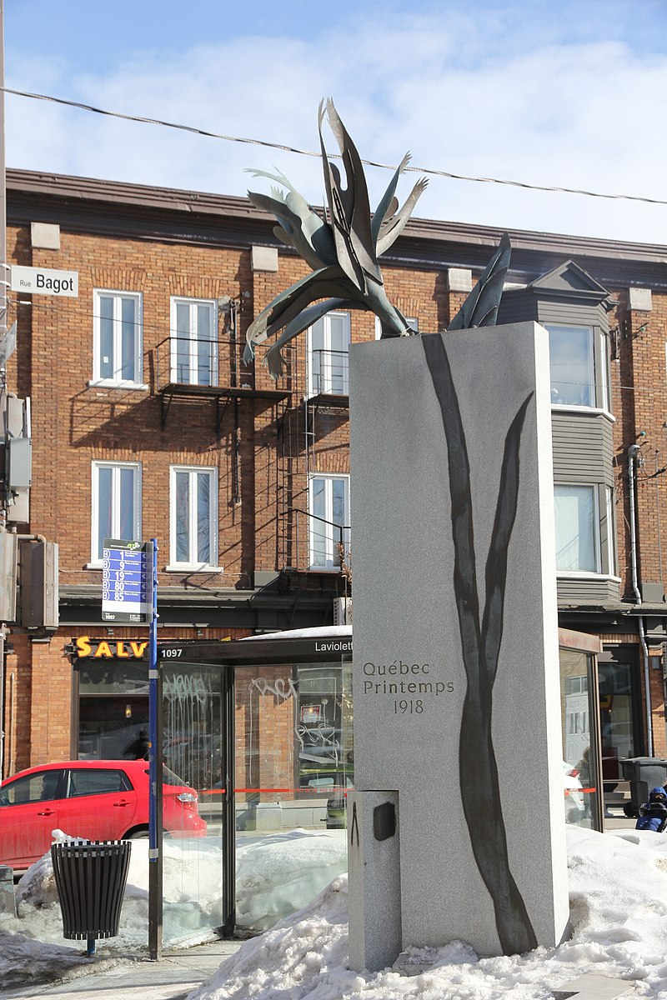
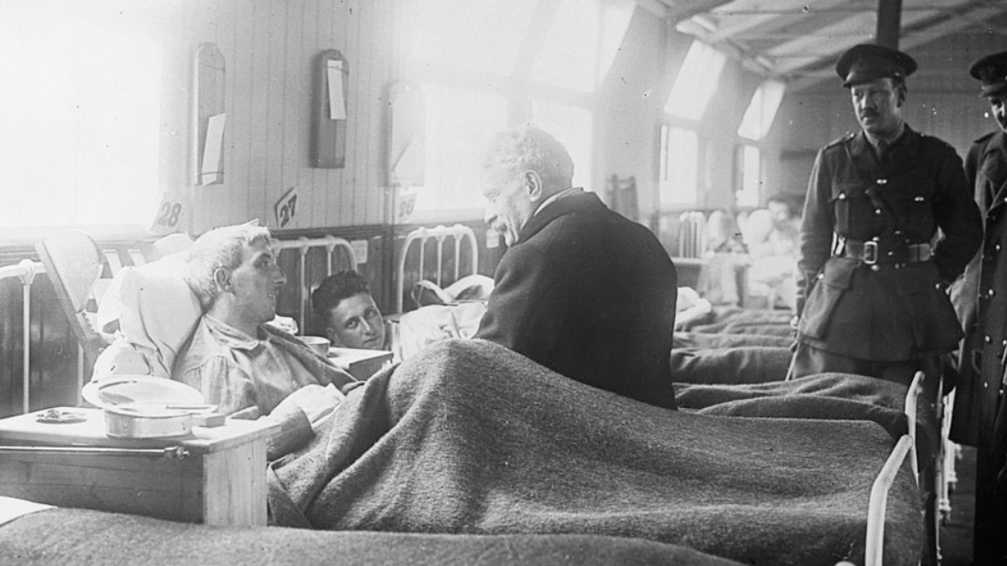
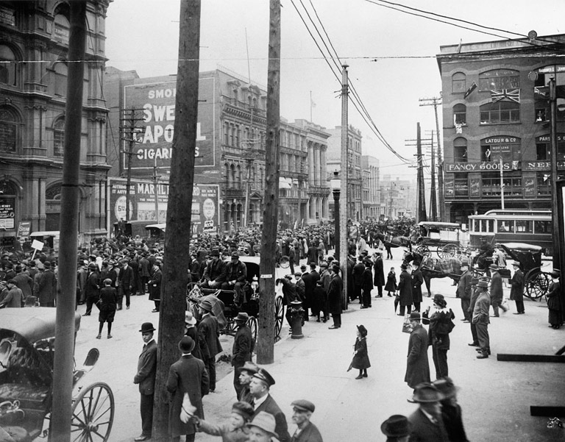
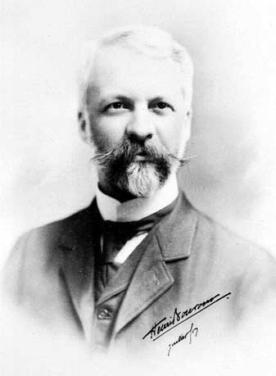

Slide 13
World War I: a group of young people fleeing conscription and hiding in the forest survive the harsh winter only by cannibalism. Burk, a representative of the Canadian Expeditionary Force on a hunt for deserters, becomes their prey:
Excited, David and Paul light the fire and prepare the spit in silence, their eyes shining. They're so hungry they're trembling. They burst out laughing when they discover the pale, abnormally hairy body of their prey. [...] The left leg is chosen. Paul suggests using David's razor to strip the thigh of its fur before cooking it, otherwise the skin will burn off before roasting. David refuses, as he has his limits. Shaving his cheeks with an instrument that has shaved a dead man is a no-no. They put the other pieces in storage, safe from predators, but they don't know what to do with the smashed head. They'd like to salvage the cheeks, but their stomachs aren't strong enough to do the fine slicing. Antoinette is the first to wake up, grab the skull by the hair and throw it into the fire, as her companions look on in astonishment. The spit is removed. The three of them gorge themselves before waking the others. They chew vigorously, their chins glistening with fat. Burping. They grunt with pleasure.(Julie D. Kurtness, Aquariums, 2019 : 98)

Slide 14
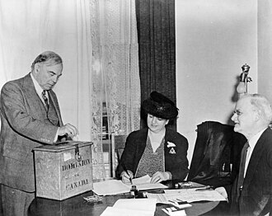
Conscription during the Second World War
In the provincial election of 1939, the Quebec Liberal Party, led by Adélard Godbout, won, with the federal support of William Lyon Mackenzie King's Liberal government. The Canadian prime minister made a public promise, echoed by all his federal political lieutenants in Quebec, not to impose compulsory military service during the war.
On April 27, 1942, William Lyon Mackenzie King asked Canadians, in a plebiscite, to release him from the promise he had made to Quebecers in 1939: "Do you agree to release the government from any obligation arising from previous commitments restricting methods of mobilization for military service?„

Slide 15
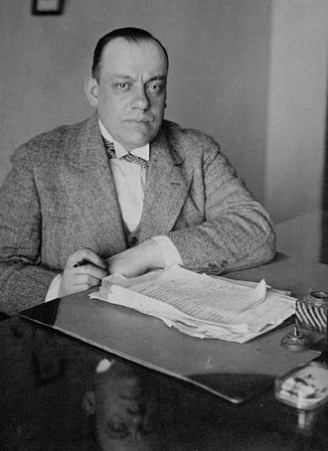
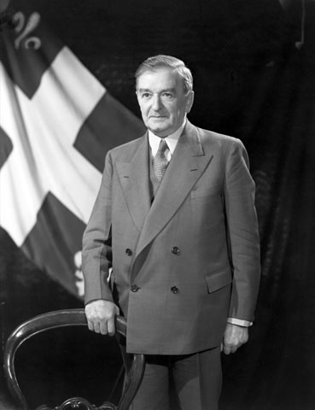
In Canada's predominantly English-speaking provinces, 80% of voters voted "yes". In Quebec, 71.2% voted "no". Among Francophones, the "no" vote was over 85%. Across Canada, 63.7% of voters voted in favor of the bill.
Despite urgent appeals from English-Canadian conservatives, Mackenzie King's government waited until the end of 1944 before imposing conscription. In the end, very few Canadians were conscripted: 2,463 men were sent to the Front.
This second conscription crisis, between 1942 and 1944, was less extensive and, above all, less tragic, but it nevertheless sounded the defeat of Godbout's provincial Liberal government in the Quebec elections of 1944. The reign of Maurice Duplessis began between 1936 and 1939, and was consolidated between 1944 and 1959.

