Slide 1
Quiet revolution Révolution tranquille
Notes:
1

Slide 2
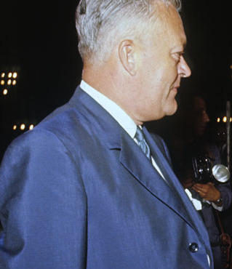
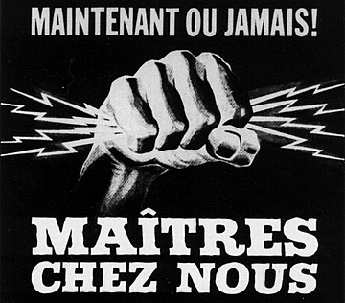
The situation began to change after the death of Quebec’s long-time Prime Minister Maurice Duplessis (1959). In 1960, the Liberal Quebec government of Jean Lesage (Parti Libéral Québecois) launched the Quiet Revolution (Révolution tranquille).
ambitious programme for building a modern state within the province of Quebec
reorganisation of education system
development of the economy
secularisation of the state and of public and cultural life
break with the Catholic Church

Slide 3
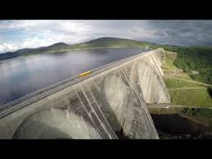
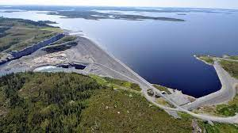
The project included an active provincial government policy on economic management. This economic strategy was based on the state-owned energy concern Hydro-Québec.
See power stations Manic and Baie James as a counter evidence to the 1950's claim that nothing can be built in Canada and made economically viable in French.

Slide 4
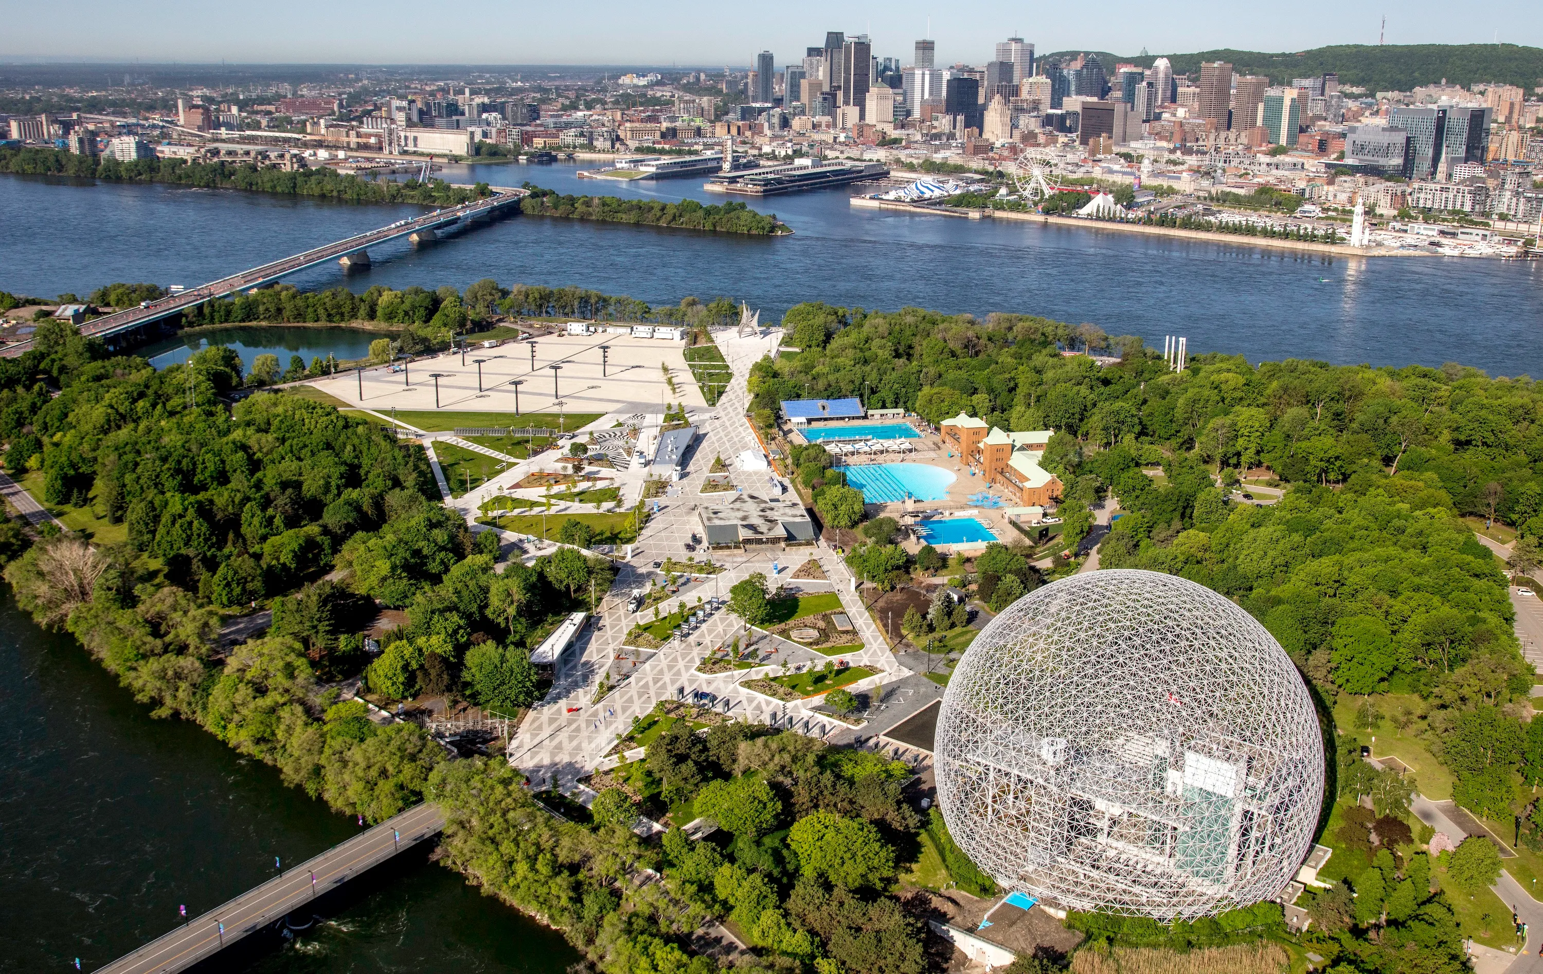
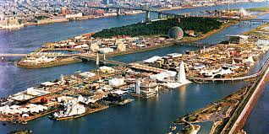
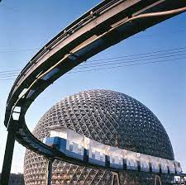
Montreal hosts Expo-1967 on two partly artificial islands made of rocks quarried during the construction of the metro.

Slide 5
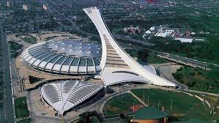
In 1976, another global event followed: the Olympic Games. Montreal has gone from a provincial city to a world city. And with it, province of Quebec.

Slide 6
The success of the economic sector and the entry into the global spotlight completed the national self-confidence of the French-Canadians, who had hitherto lived in the shadow of their English-speaking compatriots: social emancipation was thus gradually completed not only in the linguistic and political spheres, but also in education and in the technical and business spheres.
Series of substantial reforms
Franchifying of the Quebec provincial and federal administration through federal (1969) and provincial legislation (1969, 1974, 1977)
Educational reforms and the systematic promotion of university education. Investments in education represented 20% to 30% of the Quebec provincial budget. The Universities of Montreal, Sherbrooke and Laval were expanded, and in 1968 a network of ten higher education institutions – the so-called Universities of Quebec – was created. Already by 1983 the 26,000 graduates of these universities represented twice the number of graduates of Anglophone universities within the province The strength of the French-speaking elites was also growing due to their bilingualism, which gave them a great advantage in the new provincial and federal conditions.

Slide 7
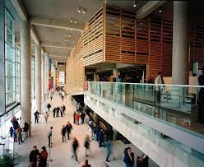
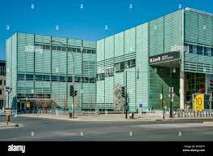
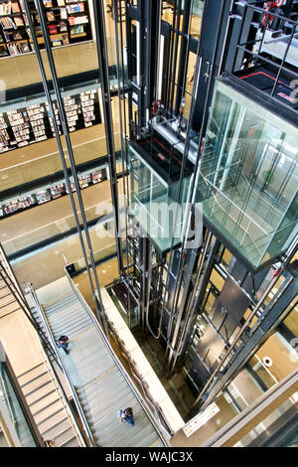
The Quebec Ministry of Culture created in 1961 immediately launched a support policy for Quebec publishers, libraries, museums, galleries and theatres.
In 1967, the National Library of Quebec was established, with a mandatory deposit of copies of all works required of publishers. The number of compulsory non-periodical copies increased from 653 titles submitted in 1968, 2,446 in 1976, and 4,336 in 1982 (Linteau et al. II, 1989: 771-772 and 785). The public library network expanded from 70 branches in 1960, to 114 in 1967, reaching 138 by 1983.

Slide 8
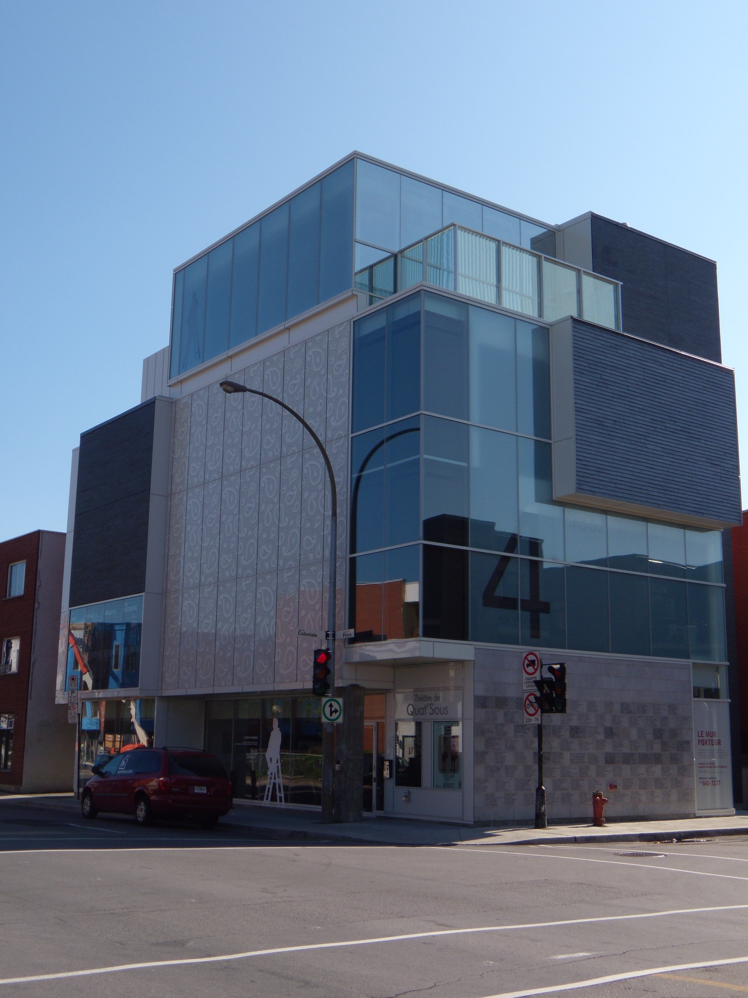
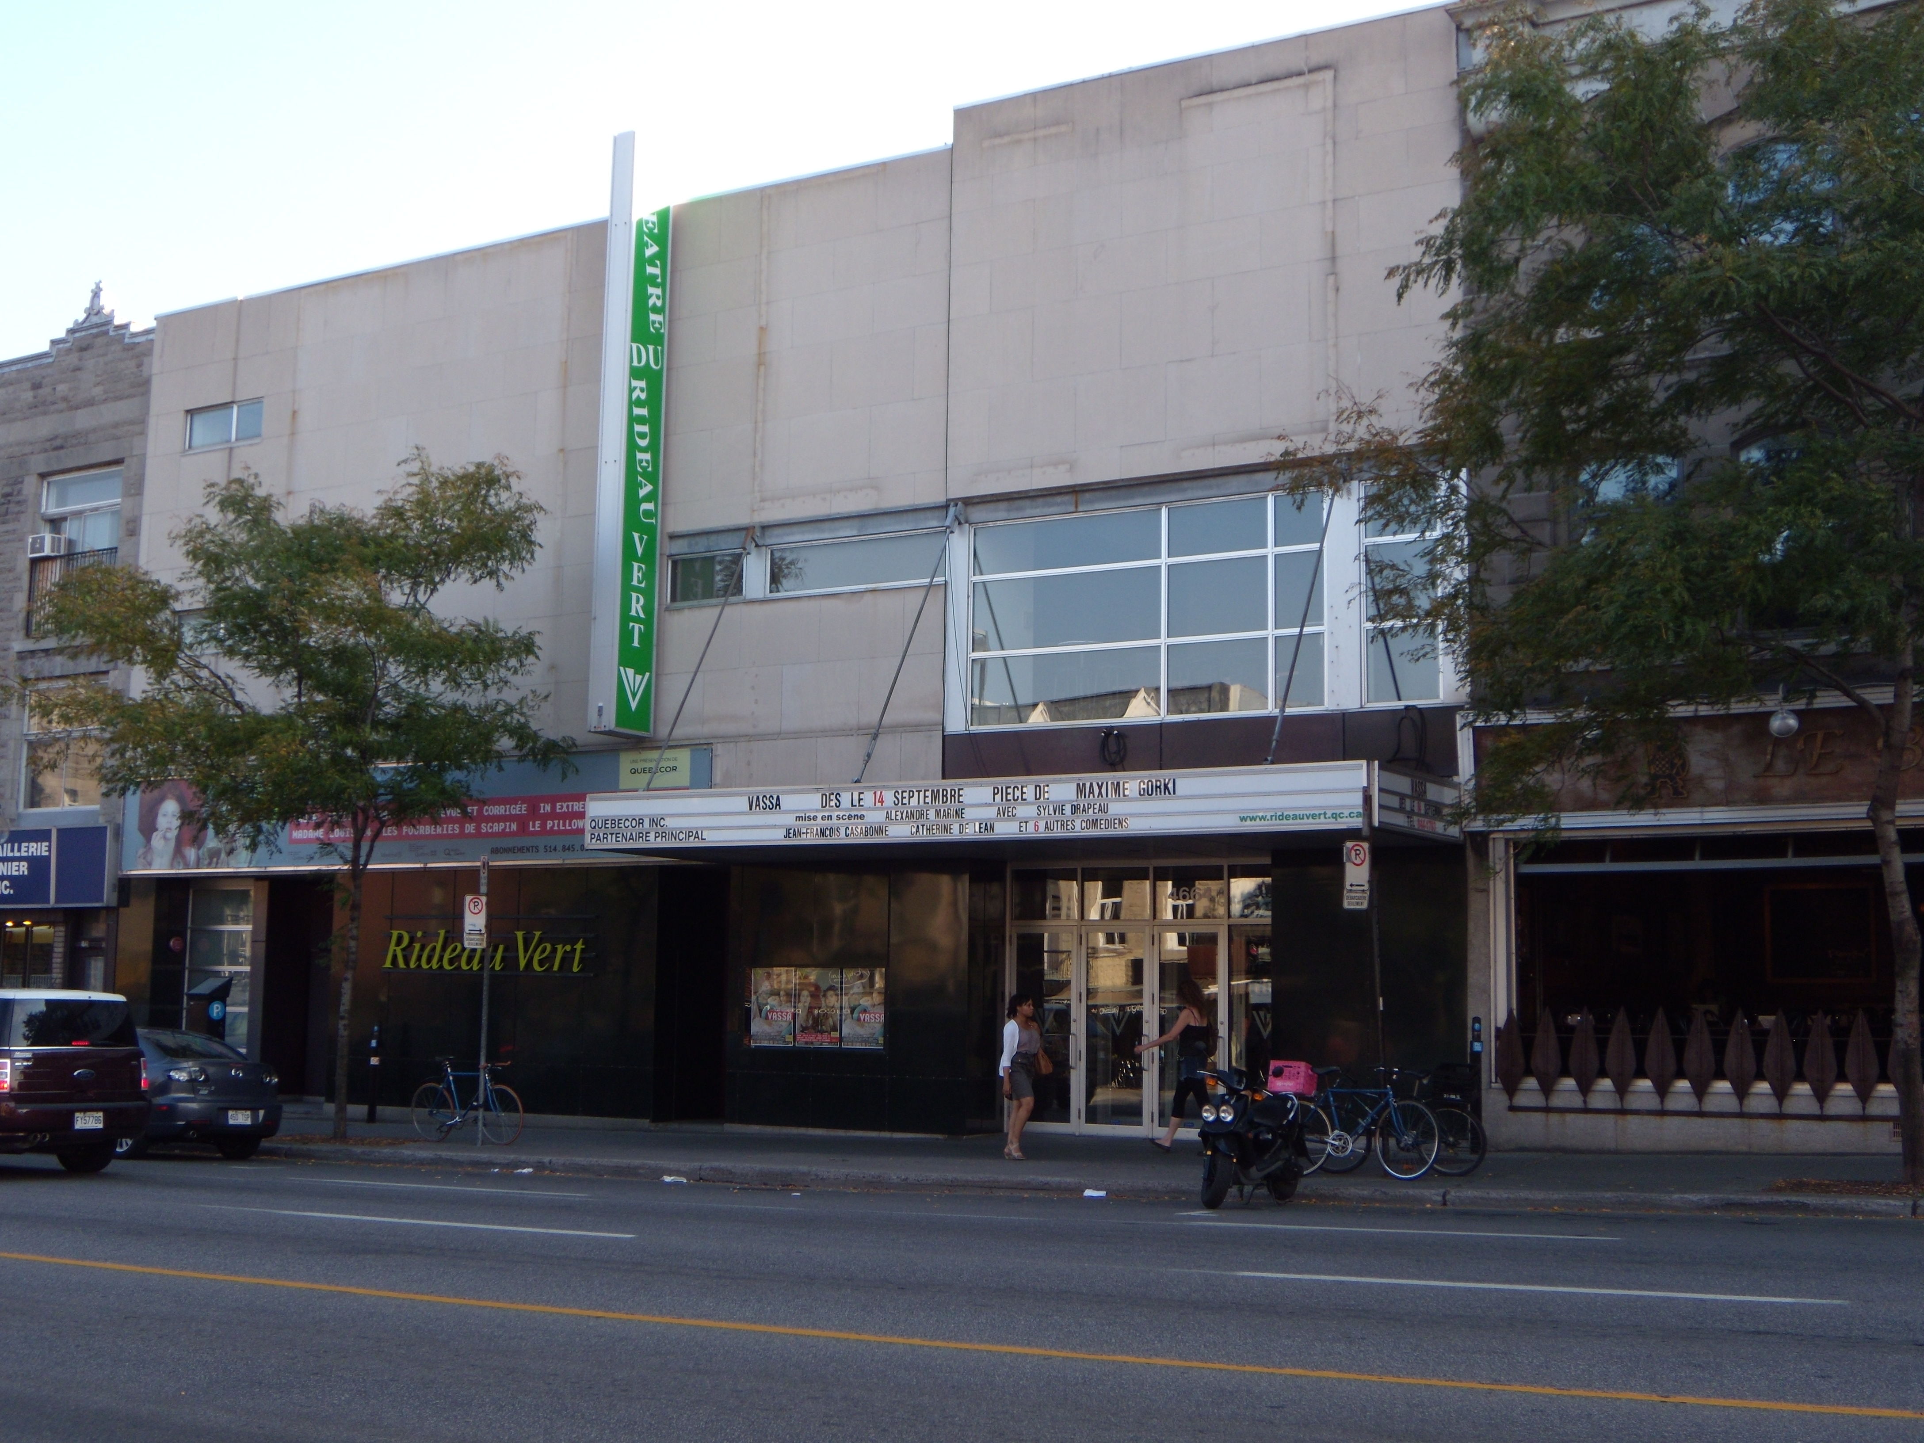
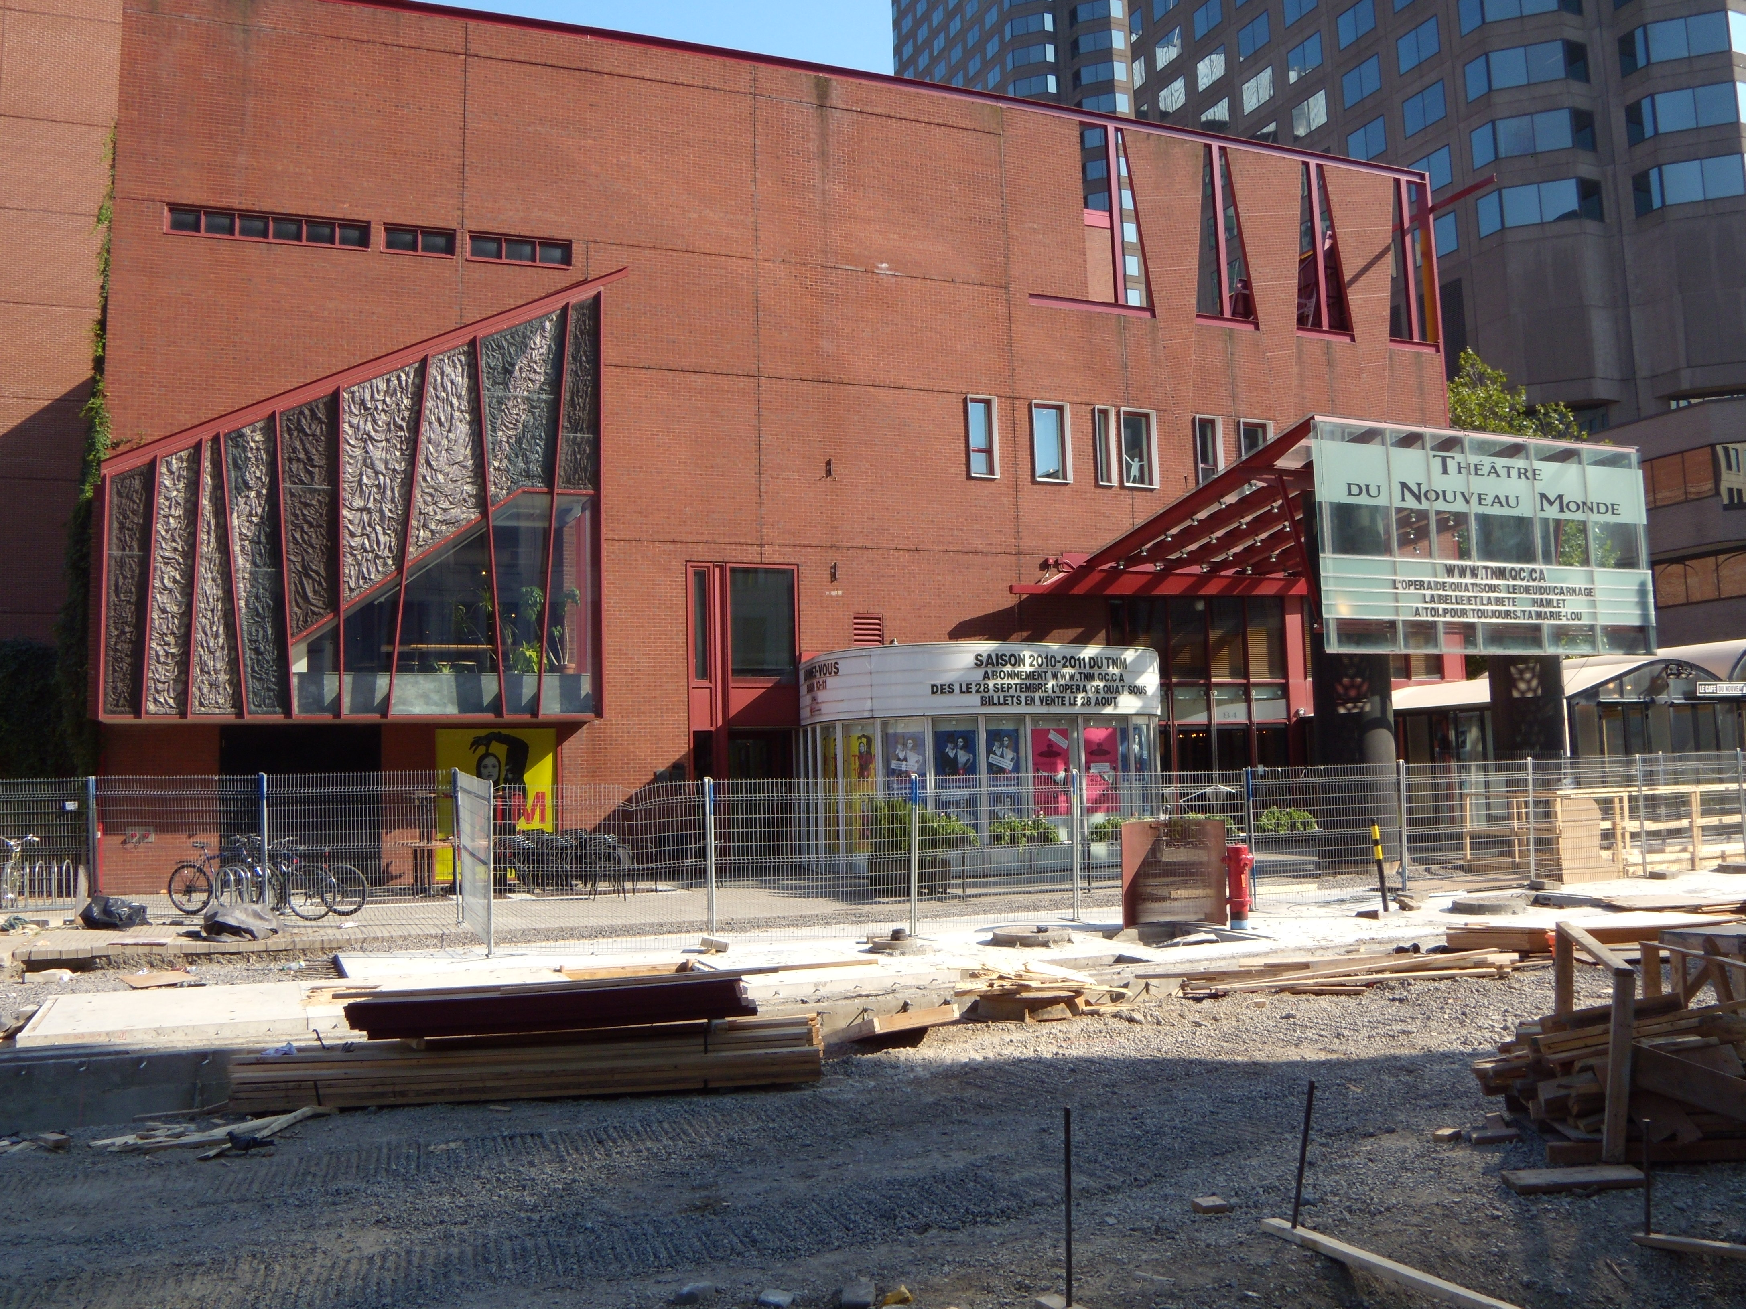
Another sector of cultural development is the theatre. Shortly after the establishment of the educational facility École Nationale de Théâtre in 1960, the experimental workshop and theatre Center d’essai des auteurs dramatiques was created five years later.
The ministry also subsidizes the major Montreal professional theatres Compagnie Jean Duceppe, the Théâtre du Nouveau Monde, the Théâtre du Rideau Vert, and the Théâtre de Quat’Sous, alongside which numerous medium- and small-sized theatres have been established.

Slide 9
The growth in self-confidence of French Canadian theatre artists and playwrights can be summarized by the practitioner Robert Gurik:
“There are now twenty-five young playwrights in Montreal. Even if only five of them fulfil the promise of their talent, this city will become one of theatre capitals of the world.”
Between 1965 and 1972, 110 plays were produced and published, 50 were published only, with 225 produced but not published; 135 of these were radio plays and 20 television plays
Official statistics list 2,770 performers in Quebec (1,800 in Montreal)
Two professional journals devoted to theatre production are Canadian Drama/Art dramatique canadien, founded 1975, and Cahiers de théâtre Jeu, established in 1976.

Slide 10
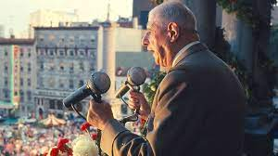
Quebec nationalism was encouraged by the French president during his visit to the 1967 Expo
Arriving by the cruiser Colbert in Québec City on 23 July 1967, de Gaulle was mobbed by enthusiastic crowds as his motorcade made its way to Montréal. The president noticed that some in the throng waved placards with the separatist slogan “Vive le Québec libre.” De Gaulle was not even scheduled to speak that evening of the 24th, but as the people chanted “we want de Gaulle,” the president told Mayor Jean Drapeau: “I have to speak to those people who are calling for me.” No one knows to this day if his message was premeditated or whether he was overtaken by the emotion of the day. “Vive le Québec,” he concluded, and then after a long pause, “libre.” The crowd was silent for an instant, not believing that the general had uttered the fateful phrase. Then they burst into frenzied applause and de Gaulle strode away, confident once again he had made history.
Prime Minister Pearson went on television to tell de Gaulle that his statements were “unacceptable to the Canadian people.” The newly appointed minister of Justice, Pierre Elliott Trudeau, asked what the French reaction would be if a Canadian prime minister shouted “Brittany to the Bretons!”

Slide 11
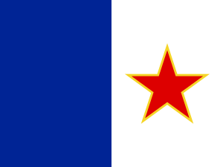
This emancipation, however, only increased the desire for complete emancipation, and thus encouraged separatist tendencies. These also took on a radical leftist form, inspired by a decolonizing, anti-imperialist ideology.
The „Front de Libération de Québec“ was created (1963). The assassinations and kidnappings of this Liberation Front would eventually force repression and the declaration of martial law (autumn 1970).
The FLQ conducted a number of attacks between 1963 and 1970, which totaled over 160 violent incidents and killed eight people and injured many more. These attacks culminated with the Montreal Stock Exchange bombing in 1969 and the October Crisis in 1970, the latter beginning with the kidnapping of British Trade Commissioner James Cross. In the subsequent negotiations, Quebec Labour Minister Pierre Laporte was kidnapped and murdered by a cell of the FLQ. Public outcry and a federal crackdown subsequently ended the crisis and resulted in a drastic loss of support for the FLQ, with a small number of FLQ members being granted refuge in Cuba.

Slide 12
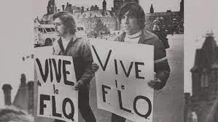
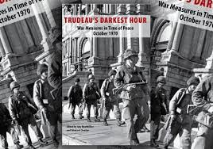
The October Crisis (French: Crise d'Octobre) was a chain of political events in Canada that started in October 1970 when members of the Front de libération du Québec (FLQ) kidnapped the provincial Labour Minister Pierre Laporte and British diplomat James Cross from his Montreal residence. These events saw the Prime Minister Pierre Trudeau invoking the War Measures Act for the first time in Canadian history during peacetime.
The Premier of Quebec, Robert Bourassa, and the Mayor of Montreal, Jean Drapeau, supported Trudeau's invocation of the War Measures Act, which limited civil liberties and granted the police far-reaching powers, allowing them to arrest and detain 497 people. The Government of Quebec also requested military aid to support the civil authorities, with Canadian Forces being deployed throughout Quebec.

Slide 13
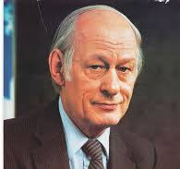
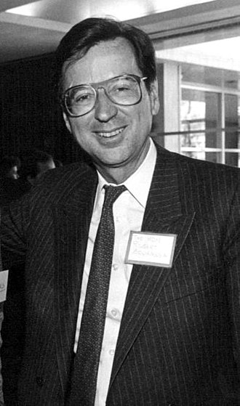
In 1968, René Lévesque founds the „Parti Québecois“. 1976, René Lévesque wins the provincial elections against the Liberal Robert Bourassa and launches a policy leading to autonomy for Quebec. 1980
The first of the referendums on self-determination is organized, but the separatists lose by 40% to 60%.
In 1985, the Liberal Robert Bourassa regains power and, as part of the new negotiations on the Canadian constitution („accords du Lac Meech“, 1990), he negotiates with Ottawa the special status of Quebec, a „nation distincte“. However, this is opposed by English-speaking Manitoba and Newfoundland. Other frictions are played out around the new Quebec Language and Education Acts (1977, Act 101), which went beyond the federal Language Act (1969) and which Quebec guaranteed French the status of a majority, official language in the province.

Slide 14
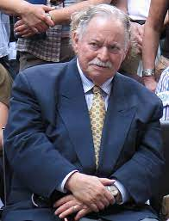
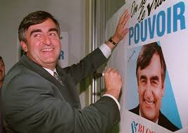
The fundamental transformation of Canadian politics did not occur until the 1993 election. Until then, the Parti Québecois (or Bloc Québecois) had faced competition from two other parties: the Liberals and the Conservatives. However, this election marks the collapse of the Conservatives in Quebec and the swing of the Conservative (and traditionally nationalist) electorate towards the Quebec Nationalists. The consequence is the strength of the „Parti Québecois“ led by Lucien Bouchard and Jacques Parizeau.
In the fall of 1995, the Quebec government (Jacques Parizeau, then Lucien Bouchard) called another referendum on Quebec sovereignty. The Parti Québécois wins by the narrowest of margins - just 42,000 votes (50.6% to 49.4%). However, in the next election, the Parti Québécois wins the provincial election again and governs until 2003 (Lucien Bouchard until 2001, then Bernard Landry), when the Liberals (Jean Charrest) win the provincial election again.

Slide 15
Emancipation of Canadian French and literature from Continental French
First stage around 1900
The speech of the literary critic and historian Camille Roy at the annual meeting of the Société du parler français au Canada (French Language Society of Canada) held at Laval University on December 5, 1904 can be taken as a reference.
“Nationalization of Canadian Literature”
“our greatest enemy is contemporary French literature”
“national spirit”
“ treat Canadian topics, and treat them in a Canadian way ”
Second stage in the 1940s
dominated by the liberal elites of the 1940s
avant-garde openness and linkage of identitarian performance with Canadianness and Americanness
polemic between Quebec and France, specifically between the representative of the La Relève generation (1934-1948) and French intellectuals such as Jean Cassou, Louis Aragon, Jérôme and Jean Tharaud, and Stanislas Fumet. A series of polemical essays were organized into the collection La France et nous. Journal d’une querelle (France and Us. Journal of a Controversy, 1947).

Slide 16
Third and final stage Quiet Revolution of the 1960s
two seemingly contradictory but ultimately complementary tendencies
the first is linked to the decolonizing ideology of the leftist intellectuals of the journal Parti pris (1963-1968), who contended that French Canadians could not break out of colonial-cultural dependence on France as long as they accepted the dictates of its language and its authority over language. It was, therefore, necessary for French Canadians to develop a culture in their own language, that is, the language of the putatively colonized and humiliated. This language was to be joual, the sociolect of the working-class periphery of Montreal, a tongue which alone could properly grasp and express the position of Vallières’ Nègres blancs d’Amérique (White Niggers of America, 1968). The main features of this movement were similar to the Martinique créolité movement of Jean Bernabé, Patrick Chamoiseau and Raphaël Confiant and to the promotion of Creole in Haitian literature. Thus, in Quebec the Canadian Creole language — joual — entered literature through the main gateway and is elevated to the pedestal of the sophisticated language of high literature, especially in the theatrical and later novel works of Michel Tremblay (along with other writers).
the second is the foundation of the Office de la langue française by Quebec government
Norme du français écrit et parlé au Québec (Canadian Standard of Written and Spoken French in Quebec, 1965): French was declared an international language with several variants as spoken in France, Belgium, Switzerland, and Quebec.
rejection of the Parisian authority of the French Academy over the linguistic norm

Slide 17
This linguistic deperipheralization and the move towards linguistic centrality were taking place in parallel with the deperipheralization of culture and literature. It is no coincidence that it was the Parti pris in a special issue Pour une littérature québécoise (For a Quebec Literature; Parti pris, 1965: 2), that opposed the French Canadian label and deliberately omitted references to France, Frenchness, and Canadianness
And all that Quebec writers are trying to say, more or less deftly, to European French writers is that literary language is too slick, too cultivated, too worn, too worn out, too learned, too codified, too much private property, too correct for what we want to use it for. To enter history and violate American space-time, we need a language more flexible and crazy than theirs, we need a French that is savage, a Quebec language to civilize us. (Godbout, 1974: 33)
Godbout conceived the concept of “vécrire” (a made-up verb from vivre + écrire, i.e. “live-writing” or “life-writing”) as employed in his novel Salut, Galarneau! (Hail, Galarneau!, 1967), the experimental language and narrative of Réjean Ducharme in the novels L’Avalée des avalés (The Swallower Swallowed,1966), L’Océantume (Oceancorous, 1968), Les Enfantômes (Childghosts, 1976), and in the drama Ines Pérée et Inat Tendu (Unex Pected and Unev Entful, 1976). Let us also recall Gérard Bessette’s “body language” in Anthropoïdes (1977) as well as the male-female language of Gaétan Soucy’s story La petite fille qui aimait trop les allumettes (The Little Girl Who Was Too Fond of Matches, 1988).

