Slide 1
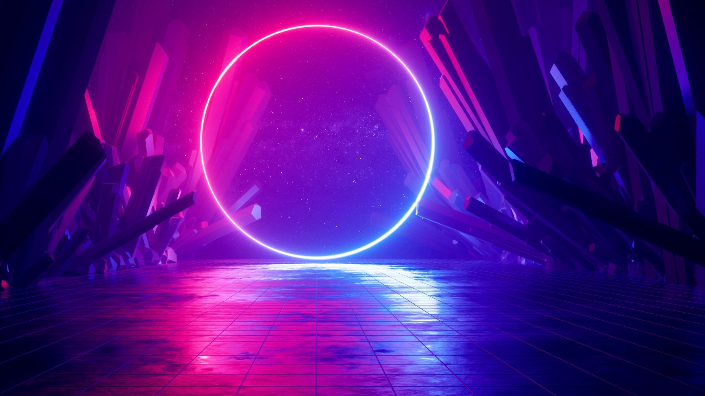
K-dramas...
INTRO 25/26 SS

Slide 2
Let’s get know each other FIRST
Let’s get started!

Slide 4
TBD
https://docs.google.com/spreadsheets/d/11oeV7pGBfVU-b9sk4oClaNcNvgbM1_vI2aw9mOUZMCE/edit?gid=1309938494#gid=1309938494

Slide 5
Past vs Present: The Evolution of Korean Cinema and Television

Slide 6
Introduction
Korean cinema and television have evolved significantly over the decades.
From historical dramas and local films to global blockbusters and K-dramas.
This presentation explores key changes in storytelling, production, and global influence.

Slide 7
The Early Days (Pre-2000s)
Cinema: Influenced by political censorship, historical themes, and local storytelling.
Television: Traditional family dramas, historical series, and early romantic stories.
Limited international exposure.

Slide 8
The Hallyu Wave (2000s-2010s)
Cinema: Rise of internationally acclaimed films (Oldboy, The Host).
Television: K-dramas gain popularity (Winter Sonata, Boys Over Flowers).
Streaming services start spreading Korean content.

Slide 9
Global Breakthrough (2019-Present)
Cinema: Parasite wins the Oscar, Korean films gain global recognition.
Television: K-dramas on Netflix (Squid Game, The Glory).
Increased diversity in storytelling and production scale.

Slide 10
Key Differences (Past vs Present)
Aspect | Past | Present
Storytelling | Traditional, local themes | Diverse, global themes
Production | Low budget, local focus | High budget, global reach
Technology | Basic effects | Advanced CGI, streaming
Audience | Domestic | International (Hallyu)

Slide 11
The Future of Korean Entertainment
Expansion into international collaborations.
More diverse storytelling and genres.
Influence of AI and virtual production.

Slide 12
Even now?
international collaborations....

Slide 13
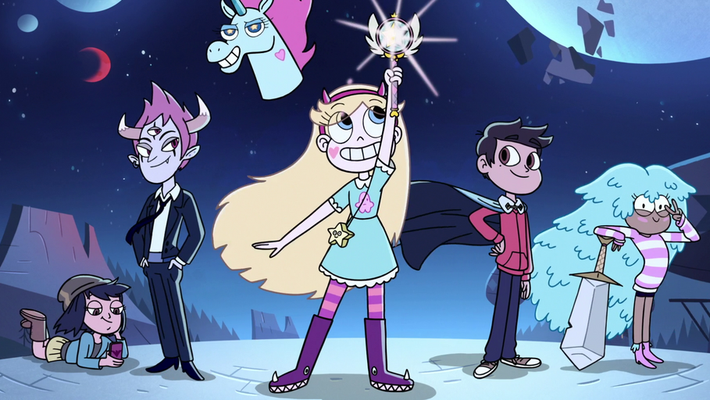
Star vs. Forces of evil
Till 2019

Slide 14
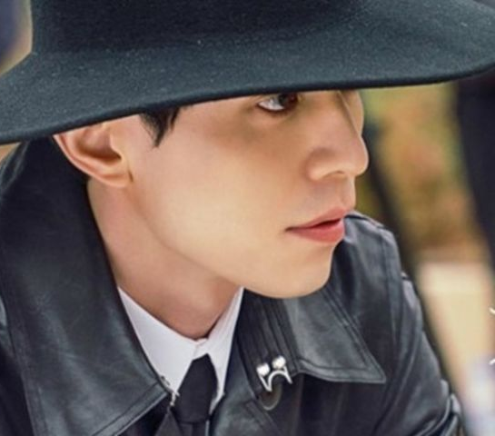
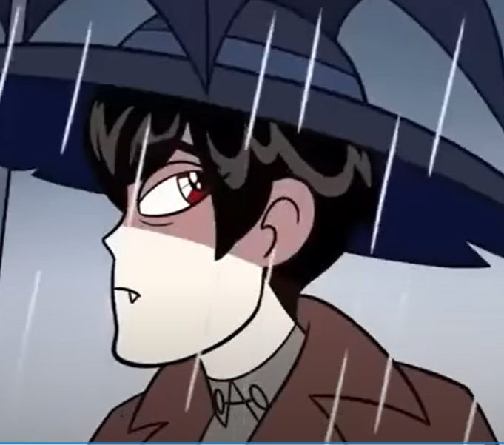
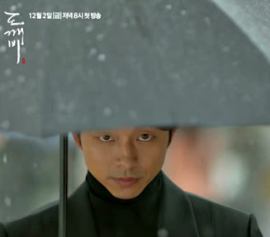
Goblin?
https://www.youtube.com/watch?v=7AM0UVSn7R8

Slide 15
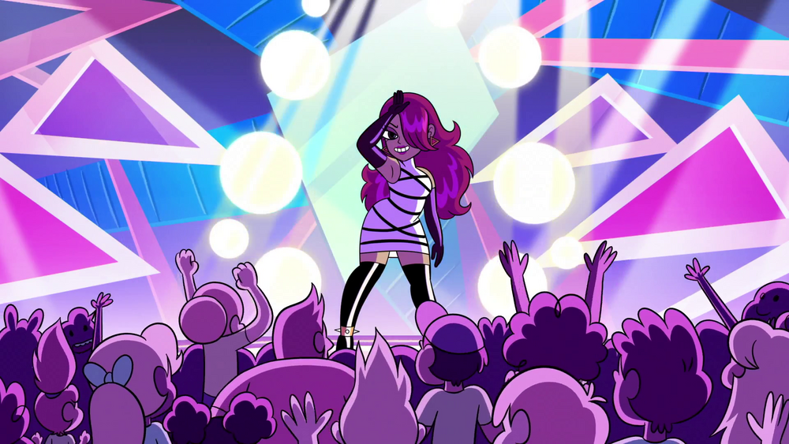
Bam Ui Pati
너의 목소리가 나를 불러 벨벳 같은 느낌 초대처럼 밤의 파티 (우 오 ~) 밤의 파티 저 달이 우리를 태우게 해 너와 나, 단둘이 이 최고의 순간을 영원히~ 바아암~의 파티에~서 밤의 파티 Let's start it up tonight~ 밤의 파티!
Your voice Calls me It feels like velvet Like an invitation Party of the Night (Whoa oh~) Party of the Night That moon is Making us burn You and I, together This best moment Forever~ At the Party of the Night Party of the Night Let's start it up tonight~ Party of the Night!

Slide 16
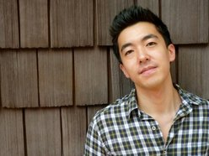
He writes the music in a program called Cubase and does some audio editing in Pro Tools. Plugins from Universal Audio.
Vienna Ensemble Pro as a mixing board
Samples from Native Instruments Kontakt, Vienna, AudioBro (LA Scoring Strings), East West, Spitfire, Spectrasonics (Omnisphere and Stylus RMX) ProjectSAM, SonicCouture, Tonehammer (Defunct. Now udner Soundiron), 8Dio, Sonokinetic (He follows it on Twitter), Arturia, Heavyocity, and Cinesamples.
Drum samples from That Sound Drums, FXpansion, and Izotope. He also has a Roland Juno 106 synth and a Dave Smith Mopho.
Brian Hyunjoon Kim is a composer for film, television, and multimedia, based in Los Angeles, CA. He is the series composer for Star vs. the Forces of Evil. Kim grew up in Syracuse, New York. He went to high school at Christian Brothers Academy and graduated from Yale University with a degree in Music.

Slide 17
Nose thing joke intro/outro https://www.youtube.com/watch?v=FxJ-6oktJds
https://www.youtube.com/shorts/gHc6RK6DUSw

Slide 18
