Slide 1
History and Development of Korean Cinema
An overview of its history and development from early beginnings to global success.

Slide 2
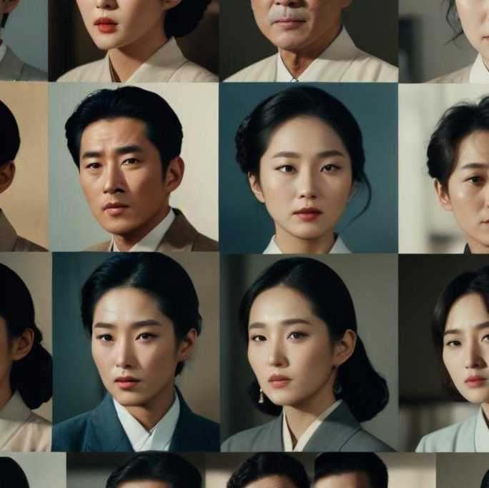
Introduction
Korean cinema's journey reflects the nation's historical, social, and political changes over the past century, culminating in its current global prominence.

Slide 3
01
Early Cinema

Slide 4
Japanese colonial influence
During the Japanese occupation (1910-1945), Korean cinema faced restrictions that stifled creative expression. Despite censorship, filmmakers used subtle techniques to convey national identity and resistance, leading to a unique cinema style developed in secret.

Slide 5
First Korean silent film
The Korean film industry began with the release of 'Fight for Justice' in 1919, signifying the start of national cinema. This was followed by 'Arirang' in 1926, which became a poignant symbol of the Korean struggle against colonial rule and represented the burgeoning spirit of Korean identity in film.

Slide 6
1. "Arirang" (Song) – The Korean Folk Anthem
A traditional Korean folk song, often considered Korea’s unofficial national anthem.
Originates from the Joseon Dynasty and has many regional versions.
Symbolizes sorrow, resilience, and national identity.
Recognized by UNESCO as Intangible Cultural Heritage in 2012.
Frequently used in films, sports events, and political contexts.

Slide 7
1. Core Meaning of "Arirang"
The word Arirang itself has no direct translation but is believed to express longing, sorrow, and resilience. Some theories suggest:
"Ari" (아리) could mean "beautiful" or "sad."
"Rang" (랑) may refer to a dear one, a companion, or simply function as a melodic ending.
Some interpretations suggest Arirang could mean "a path of pain and hardship" or "crossing over a mountain pass" (as in the lyrics).

Slide 8
2. Semantic Themes in the Song
Separation & Longing → "If you leave me, you will suffer." (이별하면 고생한다)
Sorrow & Hardship → "Crossing the Arirang pass" symbolizes struggle.
Resilience & Hope → Despite sadness, the song carries a sense of moving forward.
Universality → The flexible lyrics allow for different emotional interpretations (love, nationalism, personal hardship).

Slide 9
3. Pragmatic and Cultural Semantics
National Identity → Used in resistance movements, Olympic ceremonies, and unification efforts.
Personal Emotions → Can be sung in a sad or celebratory tone, depending on context.
Intergenerational Meaning → Different versions (Jeongseon, Jindo, Miryang) carry regional and historical variations in nuance.
https://www.youtube.com/watch?v=67Tg7JwdepM&t=113s

Slide 10
2. "Arirang" (Movies) – Different Film Versions
Arirang (1926) – A silent film by Na Un-gyu, symbolizing Korean resistance under Japanese rule.
Arirang (2011) – A documentary by Kim Ki-duk, reflecting on his struggles as a filmmaker.
Other films have also used Arirang as a title, referencing the folk song’s deep emotional and cultural meaning.

Slide 11
How They Connect
The 1926 film was named after the song, reinforcing its message of national struggle.
The song is often featured in Korean movies as a symbol of nostalgia and identity.

Slide 12
Censorship challenges
During the Japanese colonial period, strict regulations curtailed filmmakers' creativity, forcing them to work under tight restrictions. Censorship continued post-liberation, especially under authoritarian regimes, leading to a reliance on safe genres like melodrama and action films. This environment stifled innovation and limited the diversity of narratives in Korean cinema during critical years.

Slide 13
02
Golden Age

Slide 14
Post-liberation landscape
After Korea's liberation in 1945, the film industry faced challenges due to the Korean War. Despite this, the 1950s and 1960s marked a period of artistic awakening, where filmmakers started to explore deeper social themes and personal narratives. This era produced numerous classics that not only entertained but also reflected the turbulent social climate of the time.

Slide 15
Influential directors
Directors like Shin Sang-ok and Kim Ki-young became pivotal during the Golden Age, crafting films that resonated with public sentiment. Their works integrated innovative storytelling techniques, challenging societal norms while gaining critical acclaim. This period also saw a growth in the artistic landscape, as filmmakers experimented with new styles and genres that would define Korean cinema's identity.

Slide 16
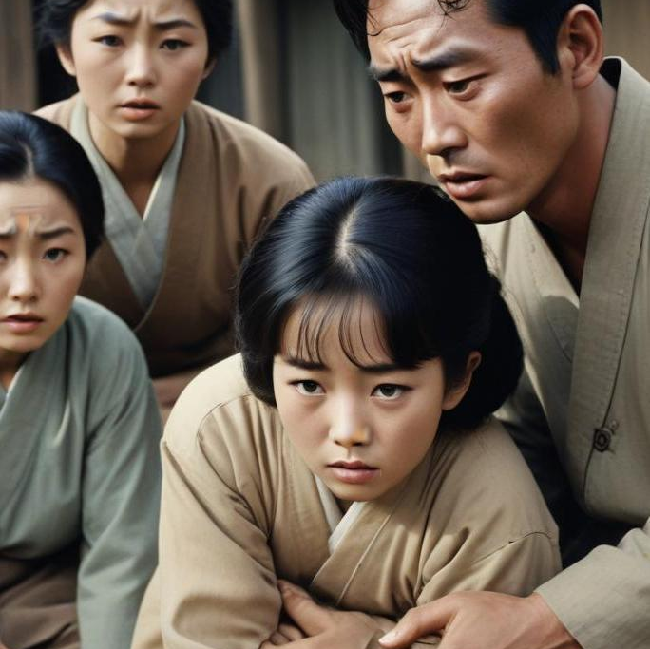
Social anxieties in film
Films from this era often reflected the social anxieties of Korean society, addressing themes such as poverty, moral decay, and familial issues. Cinematic narratives highlighted the struggles of ordinary people during rapid social changes, effectively using cinema as a mirror to society. The emotional depth and artistic exploration in these films allowed them to resonate with audiences on a personal level.

Slide 17
03
Modern Korean Cinema

Slide 18
The New Wave (1990s–2000s)
Democratization: The 1980s-1990s democratization of South Korea had a profound impact on cinema, leading to more freedom of expression.
The Korean New Wave: A movement marked by a focus on realism and artistic expression, with films that were more bold in tackling social issues.
Popular Films:
"Peppermint Candy" (1999) by Lee Chang-dong, addressing the effects of Korea’s political turmoil.
"Oasis" (2002) also by Lee Chang-dong, dealing with themes of love and societal prejudice.
Emerging Genres: The 2000s saw an explosion in popular genres like action, horror, and romantic comedies.

Slide 19
04
Global Recognition

Slide 20
Korean Wave (Hallyu) (2000s–Present)
Korean Wave (Hallyu): Korean films began gaining international recognition with global audiences and critics. This period also coincides with the rise of K-pop and Korean TV dramas.
Bong Joon-ho’s “Parasite” (2019) made history by becoming the first non-English language film to win the Academy Award for Best Picture.
Other international hits include "Train to Busan" (2016), a zombie horror film that also explored social issues.
Themes of Social Issues: Modern Korean cinema often explores themes of class disparity, societal pressures, and the complexities of identity.
Film Festivals: Korean cinema continues to dominate at major international film festivals, with directors like Lee Chang-dong and Hong Sang-soo maintaining critical acclaim.

Slide 21
05
Modern History

Slide 22
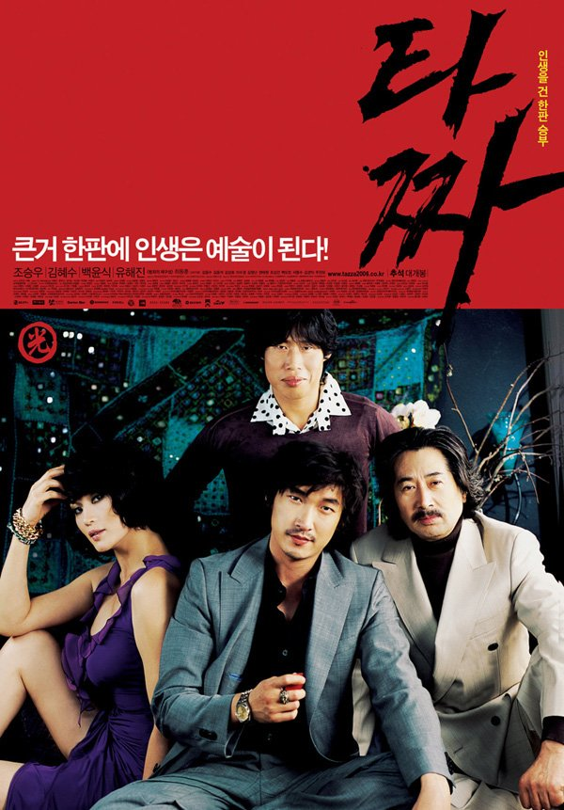

Slide 23
Tazza: The High Rollers (2006) – It's about a man who enters the world of high-stakes gambling and poker, facing tough opponents and trying to rise to the top.
Tazza: The Hidden Card (2014) – The sequel follows the next generation of characters involved in risky gambling games, seeking money and respect.

Slide 24
Historical Context of "Tazza"
Hwatu Gambling:
Korean card game Hwatu has historical roots from Japan.
Widely popular in 20th-century Korea, it became central to illegal gambling rings.
Underground Culture:
Reflects the reality of illegal gambling and organized crime in post-war Korea.
Gambling was common in Korea despite being illegal, linked to poverty and survival.

Slide 26
Cultural Significance of "Tazza"
Class Struggle and Greed:
The film highlights economic disparity, social mobility, and betrayal, common in post-war and industrialized Korea.
Modernity vs. Tradition:
Depicts the tension between traditional gambling and modern Korean law.
Showcases the clash between old cultural practices and contemporary society.

Slide 28
https://youtu.be/lVudO9x8fbQ?si=9kZXT7OD9Fxi5B5S&t=145

Slide 29
Conclusions
Korean cinema's evolution from its early struggles through the Golden Age reflects a resilient culture. The blending of artistic creativity and social commentary has enabled the industry to flourish, captivating global audiences and shaping contemporary narratives.

