Slide 1
La cyberculture

Slide 2
Computer Metaphors & Reality
People are just sitting on the curb of the information highway
Old browsers are roadblocks, detouring the surfer from third-generation sites.
Examples
OS, graphical OS: Desktop, Windows, copy&paste, open, close, tiles, scrapbook, drag & drop, bootstrapping
Computer medecine: virus, worm, antivirus, infection,…
Web - ocean: navigation, surfing, browser, piracy
Networking: mail, client/server, peer-to-peer, star, token ring network
Process control: Semaphore, traffic control, mutex, round-robin, killing a process, stack (LIFO), queue (FIFO),flags, handshaking
Social interaction: network native, flamewar, flamebait, elf, troll, phishing, mail, chat
Resource management: starvation, deadlock, idle, busy, sleeping, sandbox, data mining, writers and readers
IT humour: more/less, BASH (Bourne-again shell), GNU (Gnu’s not UNIX)

Slide 3
Internet
Global, worldwide
Network of networks
Run on TCP/IP, a suite of accessory standards
Heterogeneous & homogeneous
Media aggregation
No centralized governance
Robust, fault-tolerant, distributed

Slide 4
Visionaries
Kurt Gödel (1906-1978), Bertrand Russell
Norbert Wiener (1894-1964)
Alan Turing (1912-1954)
John von Neumann (1903-1957)
Claude Shannon (1916-2001)
Douglas Engelbart (1925)
Ted Nelson (1937)
Tim Berners-Lee (1955)
Vinton Cerf (1943) & Robert Kahn (1938)
Steve Jobs (1955-2011)

Slide 5
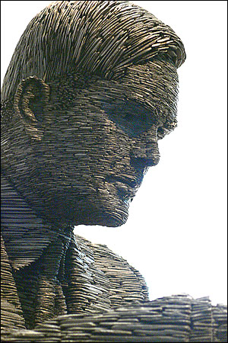
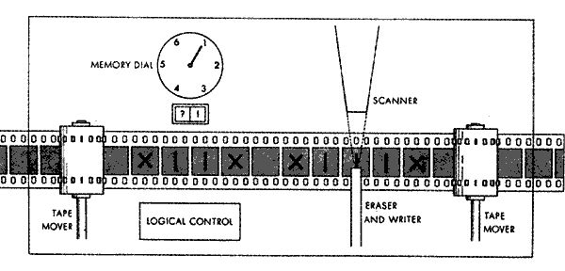
Alan Turing
Logicien, mathématicien, chercheur en cryptoanalytique, fondateur de l’informatique théorique moderne
Machine de Turing
A Bletchley Park, il a décrypté le code de la machine allemande Enigma – exploit qui a probablement rapproché a victoire des Alliés Deuxième guerre mondiale

Slide 6
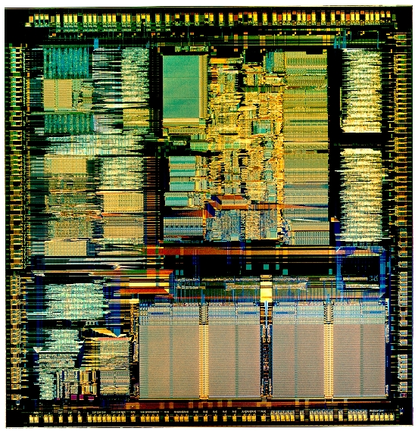
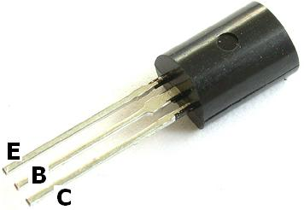
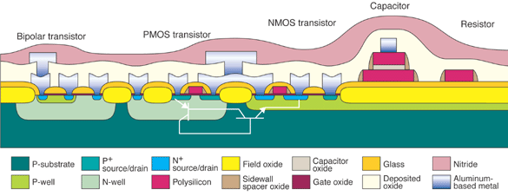
Transistor, IC 1947 (Bardeen, Brattain, Shockley)

Slide 7
WWW (Web)
Founder: Tim Berners-Lee, CERN (1989)
Global set of documents, texts, images and other resources
Connected by hyperlinks
URI (URL) references
HTTP
Browser dependence

Slide 8
Networking, TCP/IP
No central governing body
Origins in the USA/USSR military race
DARPA net
Reliability, disaster survivability
Packet switching technology
Complex system of IP addressing (IPv4, IPv6)
Stateless protocol

Slide 9
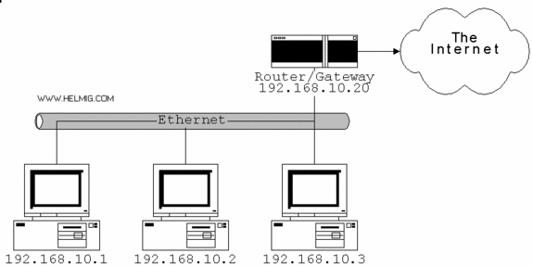
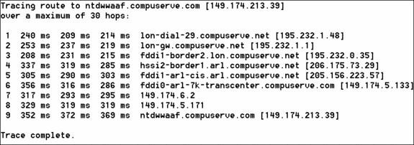

Slide 10
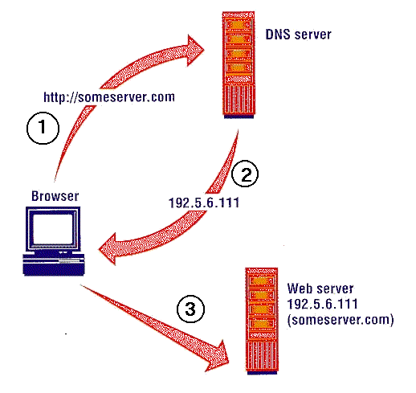

Slide 11
Code
code, in communications, an unvarying rule for replacing a piece of information such as a letter, word, or phrase with an arbitrarily selected equivalent. The term has been frequently misapplied and used as a synonym for cipher. In the past this blurring of the distinction between code and cipher was rather inconsequential; in fact, many historical ciphers would be more properly classified as codes according to present-day criteria.
In modern communications systems, information is often both encoded and encrypted (or enciphered), and so an understanding of the difference between the two is important. Both codes and certain kinds of ciphers—substitution ciphers—replace elements of a message with other symbols; however, unlike codes, ciphers do so in accordance with a rule defined by a secret key known only to the transmitter of the information and the intended receiver. Without this secret key, a third party cannot invert the replacement to unscramble the cipher.
During the early years of the 20th century, elaborate commercial codes were developed. One such system was the Baudot code, which encoded complete phrases into single words (five-letter groups) for use by telegraphers. This type of code proved inadequate for radio, however, and other, more advanced forms of communications subsequently developed. In recent years various codes have been introduced to accommodate computer data and satellite communications. See also cryptology; cipher.

Slide 12
Code - properties
Conventional (symbolic) – no link to real world whatsoever
Homogeneous – twofold: inside & outside the code
“Double (multiple) articulation”: bit, byte, kB, …
Unambiguous – 1:1 correspondence – 255 is coded as 11111111, 11111111 gives 255
Code translation (homomorphism): e.g. bin2hex 1011 0101 = B5.

Slide 13
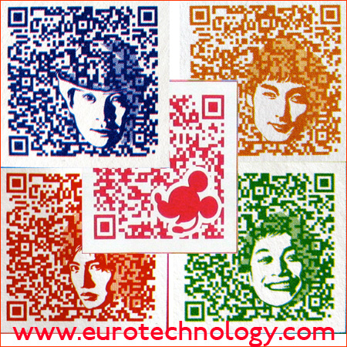
Notes:
Piet,
Helloworld in Piet
Qr
High capacity color barcode
Maxicode

Slide 14
QR code generator
http://qrcode.kaywa.com/

Slide 15
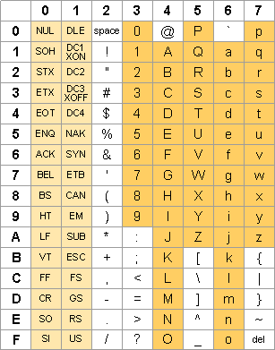
Binary, hexadecimal, ASCII code

Slide 16
Exercices
Write in hex: 1101 1001 1100 0010 1111 1010 0101 1000 1010
Decode into ASCII: 43:41:52:50:45:20:44:49:45:4d
%4C%61%20%76%69%65%20%65%73%74%20%62%65%6C%6C%65
Add 1101 + 111 = …
Compare by size: 1000 ? 1011
Multiply 11000
by 2
by 4

Slide 17
Projekt - prezentace
Představit prototyp projektu, nápad, umělecké dílo, didakticky materiál…
…. Ve stylu grantové přihlášky
Prezentace bude obsahovat
Typologické zařazení (viz nt2.uqam.ca), jasné položení problému a cílového publika
Požadované prostředky a „lidské zdroje“
Přibližná cena
Představení prototypu samotného, včetně základní kostry (např. série obrázků bez nutnosti vytvořit hypertext samotný)
Zhodnocení přínosů a omezení daného díla
Prezentace česky, francouzsky, anglicky
Příklady:
Cvičení na spojení jazyka a vyhledávání v Googlu
http://google.isnotthemap.net/ http://www.iterature.com/life/
Hypertextové dílo (didaktické či literární)
Poesie – vhodné spojení slova a hypermédií, kinetická poesie
Slovo & obraz
Cvičení / testy na daný jazykový jev s vhodným využitím hypermédií Návrh na zpracování jednu z kategorií NLP ve francouzštině

