Slide 2
Management
KIT
Zpravodajský expert
Gatekeeper
Analytik
Výsledná CI zpráva
Management

Slide 3
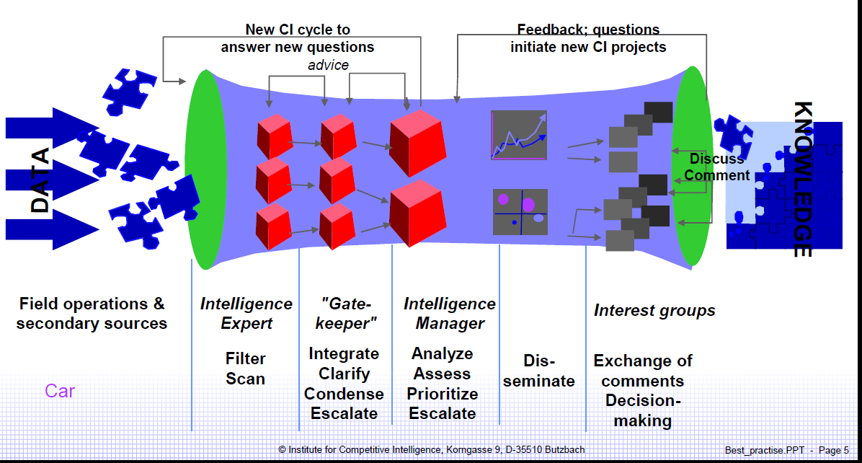

Slide 4
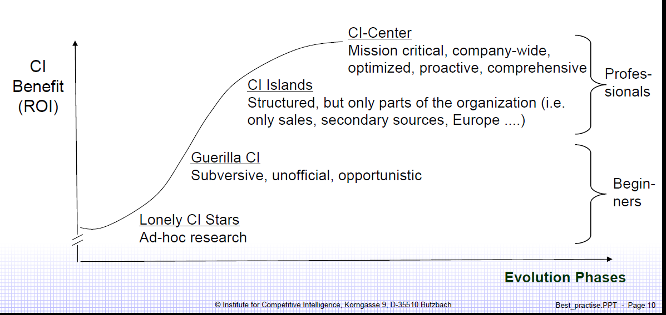

Slide 5
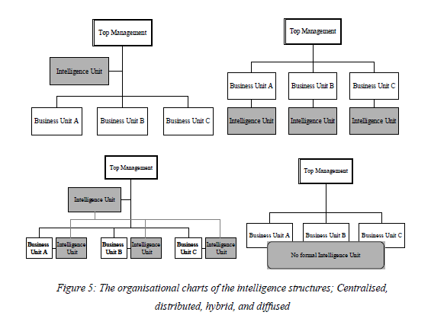
http://www.google.com/url?sa=t&rct=j&q=analitic+researcher+gate+keeper+competitive+intelligence+michaeli&source=web&cd=18&ved=0CL4BEBYwEQ&url=http%3A%2F%2Fciteseerx.ist.psu.edu%2Fviewdoc%2Fdownload%3Fdoi%3D10.1.1.66.3146%26rep%3Drep1%26type%3Dpdf&ei=VirdTv3TNYrZsga8uNmuCg&usg=AFQjCNGFsG_mxZaVlDI1eLXV_B8stynUkA

Slide 6
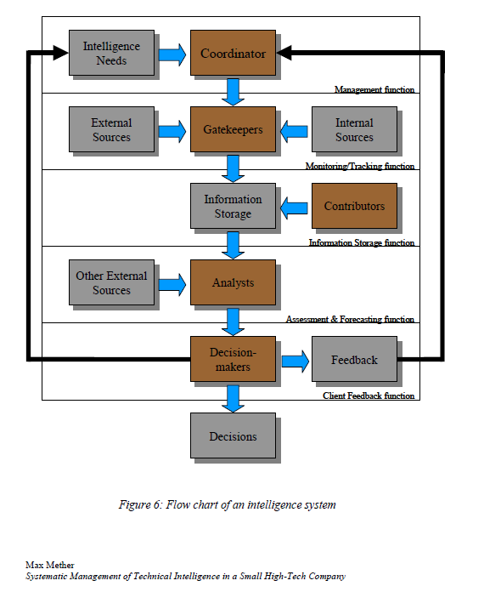

Slide 7
2.3.3.4 Contributors
People who do not have any key roles in the intelligence system but still contribute with
information that they have seen or heard are called “contributors”. A gatekeeper of one
technology may also get some information about a technology that is outside his
responsibility. By submitting that information, the gatekeeper plays the role of a
2 Competitive Intelligence 28
Max Mether
Systematic Management of Technical Intelligence in a Small High-Tech Company
contributor in the other topic. Almost all employees have some information to
contribute. It is well known that the employees of a company usually are the best
information sources [Att99]. Hence, everyone in the company should be a contributor.
2.3.3.5 Decision-makers
Decision-makers are the clients or users of the intelligence system. The goal of the
intelligence system is to provide DMs with analyses that enhance their decision-making.
Hence, the DMs are not directly part of the system, but act as clients and evaluate the
end product i.e. the intelligence, and provide feedback. The task of the DMs from the
system’s point of view is thus to provide feedback so that the system can be improved.

Slide 8
2.3.4.1 Interviewing the decision-makers
The first step in designing an IS, is to interview the management and other key decisionmakers
that will be the possible users of the system. There are two main objectives with
these interviews:
• To get the decision-makers acquainted with the proposed system
• To obtain the decision-makers’ opinions on the goals and objectives of the
system.
2 Combination of the steps defined in [McD1997] and [Kah1996]
The key information sought is the type of analysis that is wanted from the system and
what its use would be. It is also important to win the support of the management at this
stage and if possible, to find champions that promote the system in the organisation.
These interviews also indicate what technologies/companies need to be monitored.
After the interaction with the decision-makers, the key topics that the system should
start with should be defined. The monitored topics are likely to change later on, and one
should not start with too many topics so that the introduction of the system is not too
difficult. It is easy to add topics later when the system is already running.
2.3.4.2 Selection of gatekeepers
The next step is to choose gatekeepers. The aim is to find gatekeepers with the
characteristics described in the previous chapter (2.3.3 Roles). The management group of
the company often suggests proficient gatekeepers. An obstacle with selecting
gatekeepers is often their lack of availability. Since the gatekeepers should be experts in
their areas, they often already have a heavy workload, and if their manager doesn’t see
the importance of the IS it may be difficult to get them assigned as gatekeepers.
2.3.4.5 Training
Once the system has been designed, the gatekeepers and other key participants need to
be trained. The participants need to understand the purpose of the system and how it is
designed so that they can use it easily. Everyone should know how the system works and
what its purpose is; it is also a good idea to have special training for gatekeepers and
analysts. The gatekeepers may need to refine their information collection technique and
get new ideas about possible sources. The analysts should be aware of what types of
analyses are expected of them and the tools and methodologies available for the analyses.

Slide 9
2.3.5.1 Top management involvement
According to Kahaner, the single biggest reason why intelligence programs fail is the lack
of top management involvement [Kah96]. Herring calls the involvement of the top
management “the critical element for success” [Her97]. The function of the intelligent
system is to provide analyses for the top management, so without the top management
support this cannot succeed. Another reason why top management involvement is
essential is that, without top management endorsement, information will not be passed
on to the system, since the contributors are less motivated [Cos96].

Slide 10
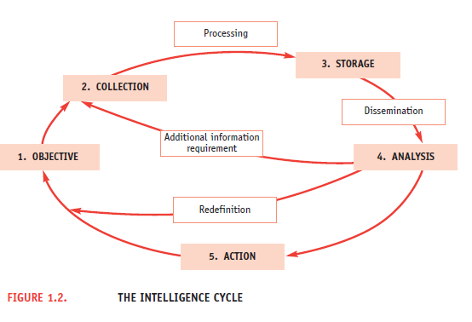
http://www.google.com/url?sa=t&rct=j&q=analytic+researcher+gatekeeper+competitive+intelligence+role&source=web&cd=12&ved=0CKUBEBYwCw&url=http%3A%2F%2Fwww.madrimasd.org%2Fqueesmadrimasd%2Fsocios_europeos%2Fdescripcionproyectos%2Fdocumentos%2Fcetisme-eti-guide-english.pdf&ei=SkrdTrPbEYvDtAajh53JBA&usg=AFQjCNHqkbPcYiQ66gLddHXwx1U511ilrA

Slide 11
Human factor
The development of information technology and the existence of software tools covering various fields and facilitating information processing4 are providing a strong impetus to the dissemination of Intelligence disciplines, at the moment mainly amongst large companies. However, it must be stressed that the human factor is pivotal in the process of creating Intelligence in any kind of company or organisation. More and more sophisticated software cannot be relied upon to solve the question of strategic choice and arbitrate when there are actual or apparent contradictions, but human beings make the difference. The definition of the intelligence problem, the development of information into knowledge and the decision making process, all depend on the human team at work and not only on the top manager of a company or an organisation. The integration of the different levels of responsibility - general management, marketing people, process management, R & D staff, finance…, enlightened by the EI strategy is the best way to help decision makers make the choices at any moment.
This human process is not an easy one, it must be encouraged by the top management, recognised as a valued skill, maintained for the long term and be facilitated by specialists, at least at the beginning or when strategy is refreshed.
• Educate Employees
Building on the above, everyone in the company has a role to play in EI even if they do not have an EI-specific job description. All people should be considered sources and be encouraged to be aware of their company’s strategy and to pass on any piece of information to the relevant people, as a matter of course. Traditionally, company employees have not been encouraged to share information, and there has often been competition between departments. Building a culture of information-sharing and breaking down inertia through education is a large part of the process. But as Kahaner notes ‘ Company spirit can take you just so far’6. Some people, inevitably, may contribute more information than others but the system will still be yielding benefits. Some companies may choose to reward staff for their contributions, particularly in the early stages when there is a need to strengthen employee motivation.
• A Team Approach
Involve as many people as possible in the establishment of an EI system from all parts of the business - sales, HR/personnel, operations, marketing and communications, etc. This will ensure that it meets the needs of all sections of the business and will, in turn, be likely to make people more accepting of it. They will learn how they too can play a role, why their input is needed, and what to expect in return.
• Communication
Communication and open information channels are key to the success of any EI activities. Regardless of where you choose to place an EI-responsible employee or an EI unit or whether you simply wish to encourage employees to employ EI techniques on a day-to-day basis, people must talk and communicate with each other effectively. Ensuring that there is adequate communication and information infrastructure, be it through email, intranet, bulletin board, meetings, newsletters, and changing the way in which information currently moves about within the company, will prevent people/departments becoming information ‘islands’.
Communication technology – fax, email, mobile phones, portable laptops can all aid in transmitting information. Raising internal awareness of the email address, fax or phone number of an employee responsible for information handling, is also recommended. Building an intranet can also increase the accessibility of information for employees especially when linked to databases, but requires staff to be motivated and encouraged to participate. Information must flow both downwards and upwards through the company.

Slide 12
ci cyklus
1. příprava ci
šampion - prolobovat ve vedení - sponsorship, ukazat co to přinese
ci manager - obstarat si team
zalezi na velikosti
sit info specialistu v ci center
podle cyklu - researcher, analytik, gate keeper, ci manager, grafik
kompetence jednotlivých pozic, aby jasne co kdo dělá a kam se hodí
kompetence:
šampiona - zpropagovat ci, aby se zavedlo, komunikacní schopnosti, vazby na vedení, rozumnet zakladní funkci ci, vyzdvyhnout plusy, byt si vědom nedostatku, měl by mit schopnost sales člověka, prodat ci, marketing, toto chceme a přesvědčit o tom ostatní
ci manager - řídit procesy a lidi celého cyklu, manažerské kompetence (najit!!!), řídit a motivovat lidi, představa o týmu, co dělají jednotlivý lidi. aby to zapadlo do firmy, do služeb, rozumnět strategickým cílům, jasně mluvit s vedením, umět říct nepříjemné věci, politicky schopný, umět jednat s nadřízenými i podřízenými, aby to přinášelo plusy nahoru i dolu, prezentační schopnosti, odlišit důležité od nedůležitého poznat KITs, rozumnět misi podniku
brokers - umět hledat informace, vyhledávací strategie, techniky, rozumnět zadání, hlavní misi. najít co je relevantní a co ne
gatekeeper – vybira co je dulezite, co je ve scope of KIT, hlida, aby nebyl GIGO, stanovuje rules
Analytik -
HUMINT – primarni research
Ziskavani informaci
Typy vyjednavaní
Komunikace s vedenim
ztráta dat a informací - člověk je nejslabší článek v bezpečnosti
vnímání
- anchoring, člověk jinak vnímá jinak reprezentovaná stejná čísla
ovlivňují ho i nahodná čísla, která vnímá
sebevědomí a pravda - absolutně nesouvisí
Etika

Slide 13
Lidský faktor v CI - 2
Organizace a role - 6
Kompetence a školení - 10
Komunikace a etika - 8
Primary research - 15
  Význam - 5
  Techniky - 5
  Úskalí - 5

