Slide 2
Designing Social Interaction
MichailTsikerdekis
tsikerdekis@gmail.com
http://tsikerdekis.wuwcorp.com
October2012 HCI
FacultyOfArts MasarykUniversity
This work is licensed under a Creative Commons Attribution-ShareAlike 2.0 Generic License.

Slide 3

“Social media is a group of Internet-based applications that build on the ideological and technological foundations of Web 2.0, and that allow the creation and exchange of user-generated content.” p. 61
Source: Kaplan, A. M., & Haenlein, M. (2010). Users of the world, unite! The challenges and opportunities of Social Media. Business Horizons, 53(1), 59–68. doi:10.1016/j.bushor.2009.09.003
Source: http://blogs.earthlink.net/the-4-ps-of-social-media-etiquette/

Slide 4
Social Media Classifications
Blogs
Collaborative Projects
Microblogging
Social Networking Sites
Content Communities
Virtual Social Worlds
Virtual Game Worlds
Kaplan, A. M., & Haenlein, M. (2010). Users of the world, unite! The challenges and opportunities of Social Media. Business Horizons, 53(1), 59–68. doi:10.1016/j.bushor.2009.09.003
Kaplan, A. M., & Haenlein, M. (2011). The early bird catches the news: Nine things you should know about micro-blogging. Business Horizons, 54(2), 105–113. doi:10.1016/j.bushor.2010.09.004
Notes:
Many had a firm idea prior to the publications made in 2010 and 2011 that all of these types of services are in fact social media. However, these publications were a great help for me that I wanted to develop a unified framework that will involve all social media.

Slide 5
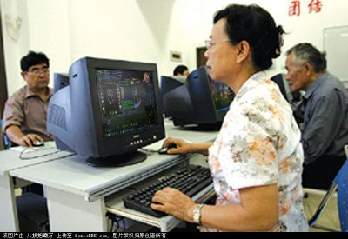
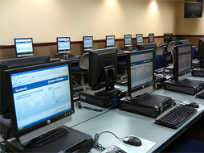
Applications of Social media
Entertainment
Workplace
Source: http://thechinabeat.blogspot.cz/2008/10/wow-in-china-and-us.html . Accessed September 8, 2012
Source: Sarah Houghton, Source: Flickr.com
Notes:
People playing World of Warcraft at a Chinese Senior Center. Companies employ strategies for reaching customers, hiring employees and maintain an innovative atmosphere for the workplace. Meister, J.C. and Willyerd K. (2010). The 2020 Workplace: How Innovative Companies Attract, Develop, and Keep Tomorrow's Employees Today. HarperCollins
Social media can be used for: collaboration, social interaction, collective participation and so on and research! Lofgren and Fefferman (2007) investigated what happens when a pandemic is released on WoW.

Slide 6
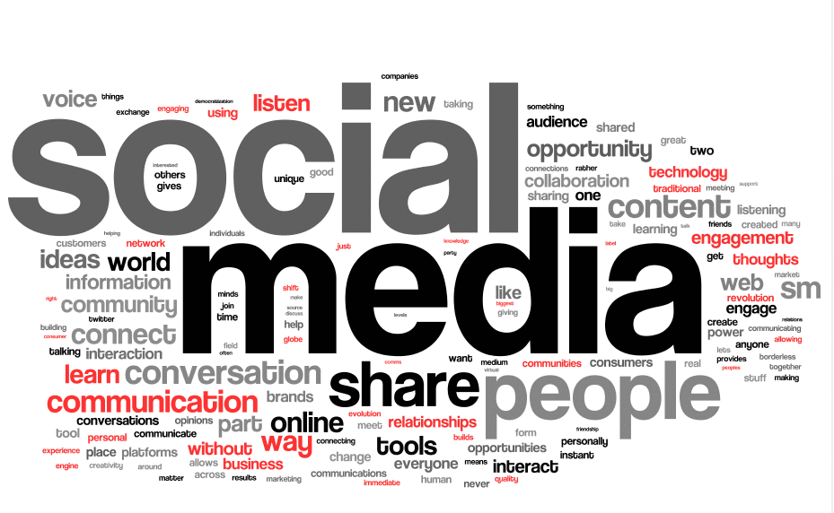
Today’s Forecast
“[…] the rate of change and development of new features of social media will continue for the foreseeable future.” p. 256
Source: Poynter, R. (2010). The Handbook of Online and Social Media Research: Tools and Techniques for Market Researchers. John Wiley & Sons.

Slide 7
Defining Social Networks and Online Communities

Slide 8
What is a Social Network?
A social network is a social structure made up of individuals (or organizations) called "nodes", which are tied (connected) by one or more specific types of interdependency, such as friendship, kinship, common interest, financial exchange, dislike, sexual relationships, or relationships of beliefs, knowledge or prestige.
Online communities are Web sites where user relationships develop.
Source: Wikipedia (2011). http://en.wikipedia.org/wiki/Social_network . Accessed November 2011.
Source: Buss, A. and Strauss, N., Online Community Handbook: Building Your Business and Brand on the Web, 2009
Notes:
First definition from wikipedia *

Slide 9
Comparison of Social Networks and Online Communities (1)
A social network
Has an organizational structure focused around an individual’s one-to-one relationships.
Has weak secondary connections between members.
An online community
Has an organizational structure focused around a shared purpose rather than one-to-one relationships.
Has strong, predictable secondary relationships among members.
Allows its users to be members of many communities in the network at the same time.
Is distinct from other communities because of differences in purpose, policies, and computing environment.
Source: Tharon Howard, Elsevier - Morgan Kaufmann Design to Thrive Creating Social Networks Edition 2010
Notes:
Usability Professionals Association (UPA) conference and I meet someone for
the first time, someone with whom I don’t share a primary connection, I can
still make a number of predictions about their values, background, and com-
mon practices.

Slide 10
Comparison of Social Networks and Online Communities (2)
A social network
Is good for sharing activities.
Is less effective at activities requiring cooperation and collective action.
An online community
Is good for activities requiring sharing and cooperation.
Is effective at providing the framework for activities requiring collective action.
Makes it easier for users to build communities.
Should not be confused with “adhocracies”, “discussion groups”, “forums”, or “lists”.
Source: Tharon Howard, Elsevier - Morgan Kaufmann Design to Thrive Creating Social Networks Edition 2010
Notes:
Adhocracies as short term groups formed to solve issues.
Groups though that are connecting for long term purpose are communities.
Communities are not confined through within tools, emails, forums, SNS

Slide 11
Shirky's ladder
Source: Shirky, C. (2009). Here Comes Everybody: How Change Happens When People Come Together (p. 344). Penguin.
Sharing
Ideal for social networks, i.e. exchanging photos
Cooperation
takes more effort and demands more complexity, organizing activity for gathering resources for a party, strong secondary connections needed
Collective action
dealing with large organizational structures, such as unions, government agencies, corporations.
Notes:
Clay Shirky teaches at the Interactive Telecommunications Program at New York University, where he researches the interrelated effects of our social and technological networks.
Activities with increased complexity
A social network has an organizational structure focused around an individual user’s one-to-one relationships, its secondary connections are generally weak, and its users can be members of many communities in the network at the same time.

Slide 12
Ingredients for a social network site
Construct a public or semi-public profile within a bounded system
Articulate a list of other users with whom they share a connection
View and traverse their list of connections and those made by others within the system.
Source: boyd, d. m. and Ellison, N. B. (2007), Social Network Sites: Definition, History, and Scholarship. Journal of Computer-Mediated Communication, 13: 210–230.
Notes:
April's fools linkedin prank

Slide 13
“social network site” ≠ “social networking sites”
“‘Networking’ emphasizes relationship initiation, often between strangers.”
In a network, “Participants are not necessarily ‘networking’ or looking to meet new people; instead, they are primarily communicating with people who are already a part of their extended social network.”
“What makes social network sites unique is not that they allow individuals to meet strangers, but rather that they enable users to articulate and make visible their social networks.”
Source: boyd, d. m. and Ellison, N. B. (2007), Social Network Sites: Definition, History, and Scholarship. Journal of Computer-Mediated Communication, 13: 210–230.

Slide 14
Designing Social Spaces
Considerations

Slide 15
Maslow’s Hierarchy of Needs
Self Actualization
Physiological
Security and Safety
Social
Self-Esteem
Source: Kim, A. J. (2000). Community Building on the Web. Peachpit Press.
Notes:
Physiological - System access, retain management of system identity.
Security and Safety - Protection from hacking and trolling, privacy, level playing field.
Social - Belonging to a community as a whole and swarms (subgroups)
Self-esteem - Ability to contribute and be recognised for those contributions
Self Actualization - Take on new roles and new
opportunities

Slide 16
Examples of satisfying needs for Security and Safety & Self-Esteem
Protecting against Aggressive content
Protecting against Racist content
Controlling for Pornographic content
Safeguarding against Abusive content
Eliminating Cyberbullying
Dealing with Copyright Issues
Notes:
Question: Anyone can think of one why to eliminate such content from an online community?

Slide 17
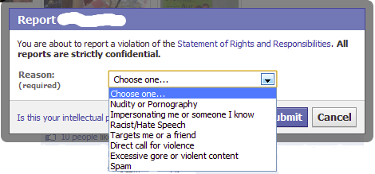
Moderating the content
Notes:
1 way is to ask moderators to scan for abuses
2 way is to ask users to report and then moderators investigate

Slide 18
Youtube's automated approach: What is the Content ID tool?
The Content ID tool is the latest way YouTube offers copyright holders to easily identify and manage their content on YouTube. The tool creates ID files which are then run against user uploads and, if a match occurs, the copyright holders policy preferences are then applied to that video. Rights owners can choose to block, track or monetize their content.
Source: http://www.youtube.com/t/contentid

Slide 19

Youtube's Content ID Video
Notes:
100 years of video

Slide 20

Software moderation: Bullytracer's example
Rules based on a dictionary of keywords are used to classify a window of posts.
A truth set of MySpace threads was created.
Identified correctly windows containing cyberbullying 85.30%, and identified innocent 51.91%
The overall accuracy is 58.63%.
Source: Bayzick, Jennifer and Kontostathis, April and Edwards, Lynne (2011) Detecting the Presence of Cyberbullying Using Computer Software. pp. 1-2. In: Proceedings of the ACM WebSci'11, June 14-17 2011, Koblenz, Germany.
Notes:
Other scientists try to prevent harassment and improve their software with machine learning techniques

Slide 21
Best approach: Mixed-Methods(?)
Moderators as the main protective force of a social network site
Users contributing by reporting what moderators cannot see or do not have enough time to see(such as personal messages)
Software used to detect suspicious messages which moderators can investigate later on and evaluate them

Slide 22
Cooperative principle
Maxim of Quality
Maxim of Quantity
Maxim of Relevance
Maxim of Manner
Be Truthful: Do not say what you believe to be false. Do not say that for which you lack adequate evidence.
Make your contribution as informative as is required and not more informative than required.
Relevance: Be relevant.
Be Clear: Avoid obscurity of expression. Avoid ambiguity. Be brief. Be orderly.
Source: Grice, Paul (1975). "Logic and conversation". In Syntax and Semantics, 3: Speech Acts, ed. P. Cole & J. Morgan. New York: Academic Press. Reprinted in Studies in the Way of Words, ed. H. P. Grice, pp. 22–40. Cambridge, MA: Harvard University Press (1989)
Notes:
Ensuring the elimination of misinterpreted content
Quantity – dissertations example
Relevance – out of topic threads in forums
These aren't etiquettes but conditions for a successfully communication. They are also what every receiver expects from a broadcaster.

Slide 23

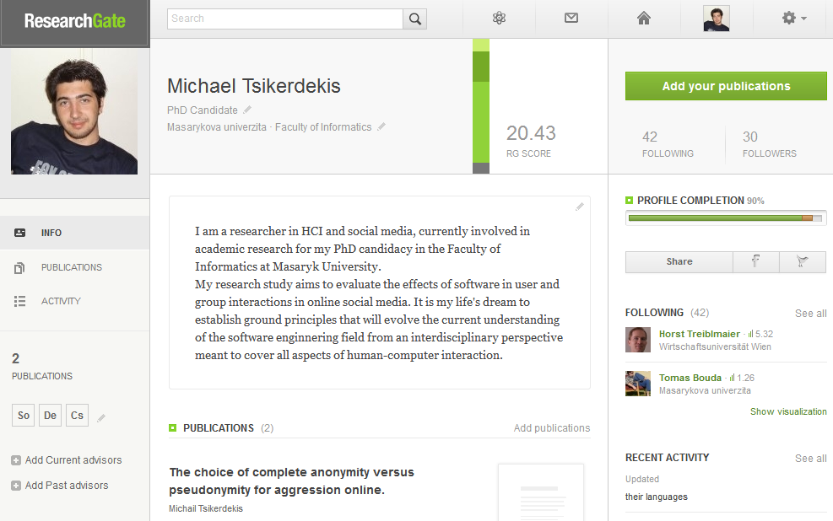
Example: Maxim of Quality
Notes:
Citation needed introduced in 2007
Researchgate currently does not require verification of credentials

Slide 24
Design, Development and Management of a Social Network/ing Site

Slide 25
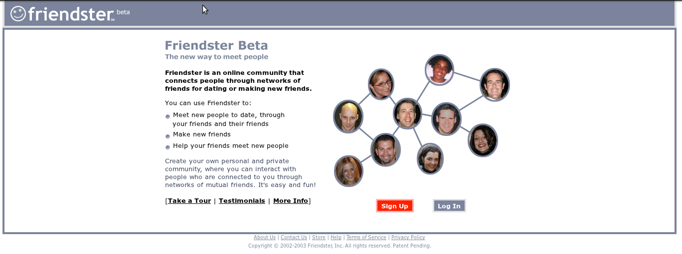
The Friendster case

Slide 26
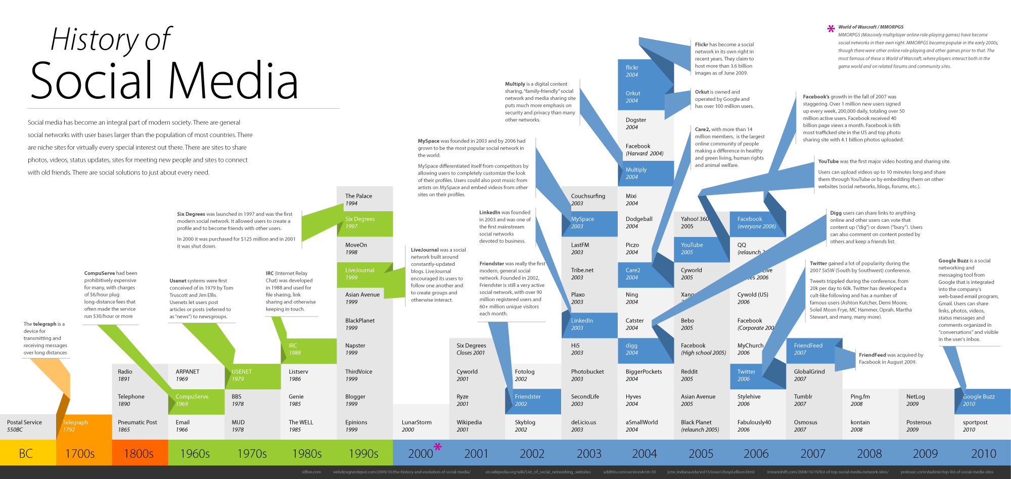
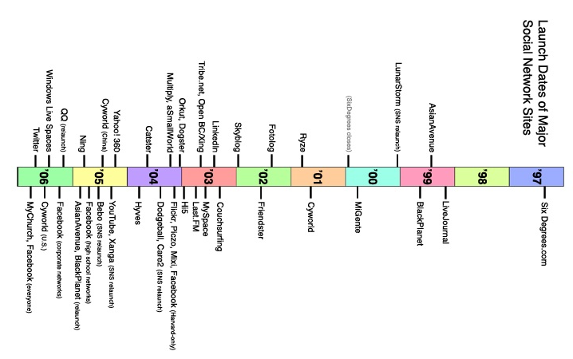
How old is Friendster?
Image Source: Skloog. http://www.ritholtz.com/blog/2010/12/history-of-social-media/. Accessed September 11, 2012

Slide 27
Friendster highlights
Friendster is built on the assumption that friends-of-friends are more likely to be good dates than strangers.
While Stanley Milgram argues that everyone is connected within 6 degrees, Friendster only allows you to see or communicate with those who are within 4 degrees.
Friendster encourages users to join even if they are not looking for dates Friendster launched into public beta in the fall of 2002. By mid-August 2003, the site had 1.5 million registered accounts and was still growing exponentially.
danah boyd (2003). "Reflections on Friendster, Trust and Intimacy." Ubiquitous Computing (Ubicomp 2003), Workshop application for the Intimate Ubiquitous Computing Workshop. Seattle, WA, October 12-15, 2003.
Notes:
Stanley Milgram was an American social psychologist most notable for his controversial study known as the Milgram Experiment and conducted the small-world experiment (the source of the six degrees of separation concept) as part of his dissertation while at Harvard.

Slide 28
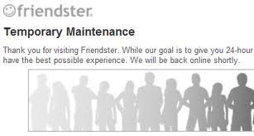
Technical Difficulties
Friendster's servers and databases were ill-equipped to handle its rapid growth, and the site faltered regularly, frustrating users who replaced email with Friendster.

Slide 29

Social difficulties
Upset cultural balance
Collapse in social contexts
Fakesters & Trophy Friends
Notes:
- Because organic growth had been critical to creating a coherent community, the onslaught of new users who learned about the site from media coverage upset the cultural balance.
- Users had to face their bosses and former classmates alongside their close friends.
- In order to view additional profiles, users began adding acquaintances and interesting-looking strangers to expand their reach. Some began massively collecting Friends, an activity that was implicitly encouraged through a "most popular" feature. The ultimate collectors were fake profiles representing iconic fictional characters: celebrities, concepts, and other such entities.

Slide 30

Friendster's solution
Active deletion of Fakesters (and genuine users who chose non-realistic photos) signaled to some that the company did not share users' interests.
Many early adopters left because of the combination of technical difficulties, social collisions, and a rupture of trust between users and the site.
Source: boyd, d. m. and Ellison, N. B. (2007), Social Network Sites: Definition, History, and Scholarship. Journal of Computer-Mediated Communication, 13: 210–230.
Notes:
The chose to delete the kitty, dooming the social network

Slide 31
Friendster's Violations of Maslow's Hierarchy
Psysiological (Restricting access either intentionally or unintentionally)
Social (Not allowing users to form subgroups based on their interests)
Self Actualization (Not allowing users to form their identities as they wish or use pictures other than the ones with their real faces)

Slide 32
Building Communities and Social Network Sites
Skip

Slide 33
RIBS Model
Remuneration
Influence
Belonging
Significance
Source: Tharon Howard, Elsevier - Morgan Kaufmann Design to Thrive Creating Social Networks Edition 2010

Slide 34
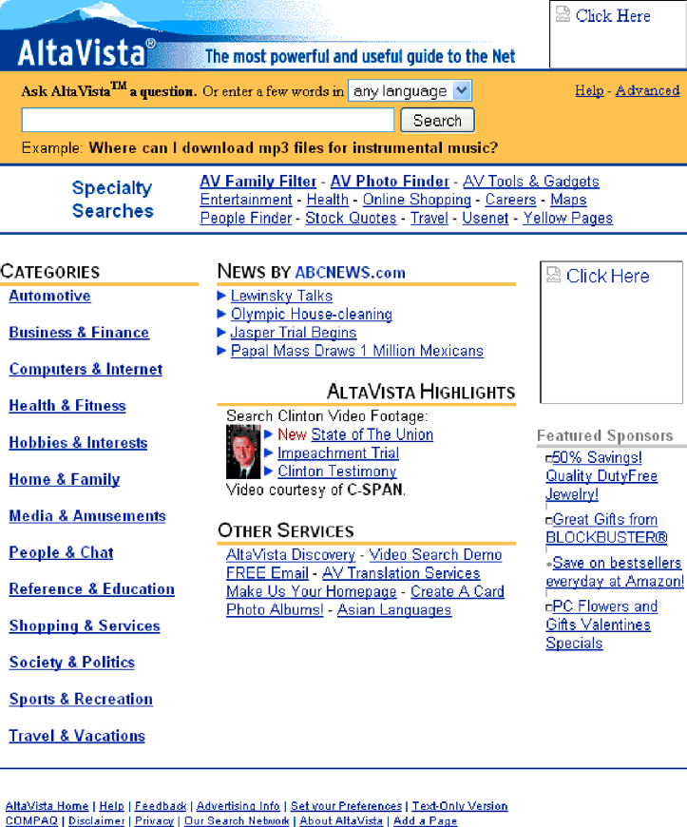
Remuneration (1)
In January 1999, AltaVista was reaping the benefits of being one of the first search engines
However, AltaVista just like Yahoo began to suffer from what some might call “feature creep.”

Slide 35
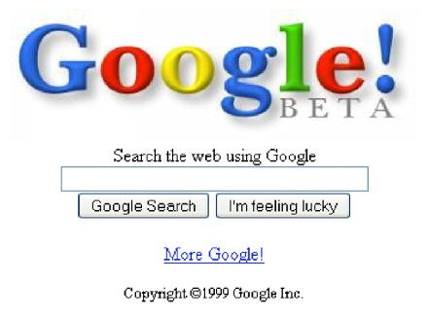
Remuneration (2)
Google's website in 1999 was simple, less time consuming and efficient
it offered the kind of user experience people appreciated.
Google’s Interface “remunerated” users because it was more fun to use than AltaVista’s 1999 home page.

Slide 36
Remuneration: Examples of Techniques
Make the text editor fun; add emoticons
Mentors teach
Seed the discussion
Use stars to show membership contribution levels
Rank the value of members’ messages
Remove the fear factor by providing examples of how to participate
Create a safe environment by sending out “tickle” messages
Notes:
All of these have to be applied depending on the situation and purpose of the website. In general remuneration and user experience has to be evaluated for every aspect of the site.

Slide 37
What is Influence?
Influence can be said to exist in a community when its members believe that they can control or at least shape the policies, procedures, topics, and standards of evidence used to persuade others in an online community or social network.
Notes:
Play is exactly like a guitar string. It can wave back and forth but only with the boundaries of the elasticity of the string.

Slide 38
Three membership models for considering influence needs
Social technographics ladder
Membership lifecycle model
The five trajectories of learners
Notes:
Will go through the first one as an example

Slide 39
Social technographics ladder and influence needs
Creators: Need to know when they're being read and have some impact
Critics: Need feedback that helps them determine how values in the network are lining up
Collectors: Need to hear that their social bookmarking, archives, or collecting behaviors are valued by the community
Joiners: Need to see that other people have viewed their profile information
Spectators: Need to see that Creators and Critics appreciate the time that they invest reading their posts
Inactives: Have all the influence needs of the previous five membership types, but these needs aren't being met
Source: Groundswell: Winning in a World Transformed by Social Technologies - Charlene Li, Josh Bernoff. 2008

Slide 40
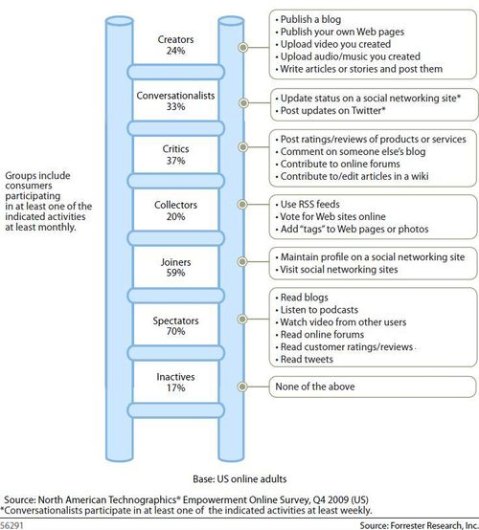
Social technographics ladder
Analyzed data for 13 countries, for business buyers, and even for voters. Profiles for over a hundred clients, profiling Walmart shoppers, non-profit donors, and doctors.
Ranks on the ladder have shown steady growth, with some (like Joiners) growing faster than others (like Creators)
Source: Groundswell, Expanded and Revised Edition: Winning in a World Transformed by Social Technologies - Charlene Li, Josh Bernoff. 2011

Slide 41
Belonging
Belonging are the techniques or mechanisms by which we help members of the community develop the sense of “social presence,” a sense that they belong in that community, that they identify with it, and that they share a bond with its other members.

Slide 42
Belonging: Examples of techniques
Create and distribute a story of origin
Create an initiation ritual
Encourage your leaders and elders to share mythologies: Use negative myths
Encourage members to share myths and stories about themselves
Create leveling up ceremonies: Use podcasts
Establish routines and protocols: “Fight Club” protocol
Establish symbols, colors, and visual identities
Use a membership application as an initiation ritual
Notes:
Story of origin of Facebook
Login and verification is a ritual, training and tracking through MySQL DB
SN, sharing member stories,negative myths for warning about prohibited behavior
Even fictional stories
Ceremonies help public recognition, Podcasts could help
Protocols establish ground rules for coorporate SNS
Logos are powerful

Slide 43
Significance
In order to be considered “significant,” your network or community needs to be: well recognized established as the “go-to place” for accomplishing your users’ goals valued by people your users respect populated by people who are serious and passionate in their field distinguished as a reputable brand to your users

Slide 44
The paradox of exclusivity
Difficult paradox that social network and community designers have to overcome in order to take advantage of exclusivity and its impact on the significance of the community or network
People are perverse; they want to be part of group, but they don’t want to be another face in the crowd.
Obama’s community designers paradoxically created popularity and drove eyeballs to their site by promising exclusivity
Notes:
Making a website open in order to grow a big community as fast as possible not necessary the best choice.

Slide 45
Social Capital & Significance
Friedster started off as an open SNS, whereas Facebook started off as closed one
People will attempt to acquire “social capital” that will “buy” them access to individuals and conversations that will allow them to achieve their particular, individual goals.
College students on Facebook befriended particular groups to demonstrate that they were part of the “in crowd.”

Slide 46
Quality vs Quantity
The Cluetrain Manifesto and Seth Godin’s recent book Tribes have made it clear that traditional methods of branding aren’t as successful in online social media as they were in print and television.
Building significance for your community through conversations and through the quality of relationships you can have with customers and potential members of your network and community. It’s less about the number of people you reach and more about helping them feel like they are earning social capital by connecting with you.

Slide 47
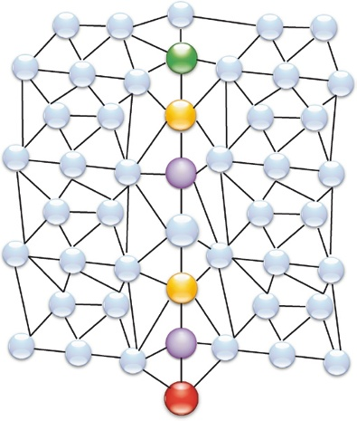
Using Nodes and Connectors to Start the Conversation (1)
In 2001, Watts recruited 61,000 people and then asked them to transmit messages to 18 targets worldwide. Like Milgram, he found that average length of the chain was roughly six links.

Slide 48
Using Nodes and Connectors to Start the Conversation (2)
Gladwell identified three types of individuals who can “tip” a trend into a word-of-mouth viral marketing campaign.
- Connectors: people that seem to know everybody and have many connections
- Mavens: collecting information about subject of interest
- Salesmen: sharing information and persuading people
Notes:
To get closer to spreading our significance meme selectively, we need to understand that not all nodes are created equal.

Slide 49
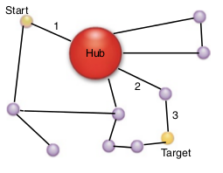
Using Nodes and Connectors to Start the Conversation (3)
These three types of individuals have more impact on a networking system of a hub on network than the typical node because they have the effect of shortening the number of links needed from six to as few as three.

Slide 50
Social Interaction Design
A practical guide

Slide 51
Interaction Design (IxD)
“A central concern of interaction design is to develop interactive products that are usable. By this is generally meant easy to learn, effective to use, and provide an enjoyable user experience.” p. 2
Identify Needs
(Re)Design
Build an Interactive Version
Evaluate
Source: Rogers, Y., Sharp, H., & Preece, J. (2011). Interaction Design: Beyond Human-Computer Interaction. John Wiley & Sons.

Slide 52
Interaction Design Goals
Usability Goals
User Experience Goals
Efficient to use
Effective to use
Safe to use
Have good utility
Easy to learn
Easy to remember how to use
Fun
Emotionally fulfilling
Rewarding
Supportive of Creativity
Aesthetically Pleasing
Motivating
Helpful
Entertaining
Enjoyable
Satisfying
Source: Rogers, Y., Sharp, H., & Preece, J. (2011). Interaction Design: Beyond Human-Computer Interaction. John Wiley & Sons.

Slide 53

Usability Goals
User Experience Goals
Image Source: Bdate Kaspar/Franziska Sponsel. http://www.iconhot.com/icon/rrze/user-computer.html. Accessed September 8, 2012.

Slide 54
Usability Goals
User Experience Goals
Image Source: Bdate Kaspar/Franziska Sponsel. http://www.iconhot.com/icon/rrze/user-computer.html. Accessed September 8, 2012.

Slide 55
Usability Goals
User Experience Goals
Social Dimension
Image Source: Bdate Kaspar/Franziska Sponsel. http://www.iconhot.com/icon/rrze/user-computer.html. Accessed September 8, 2012.
Notes:
Each icon depicts a user and the system, in our case the software. Licklider (1960) described it as human-computer symbiosis. We tend to think of social interactions as happening between people but if a social interaction occurs through a software then this depiction of individuals and software is more appropriate.

Slide 56
Social Interaction Design
“Social interaction design is a set of principles, models, methodologies and other aids that are used in the proactive design and development of systems which involve social environments, in order to satisfy a system’s social experience goals. In turn, social experience goals are a set of goals derived from the social dimension of a system and describe social behaviors, interactions, attitudes and phenomena, which are identified by designers in order to meet system and user explicit as well as implicit overall goals.”

Slide 57
Social Experience Goals: Classified Examples
Desirable
Altruism
Cooperation
Undesirable
Groupthink
Aggression
Neutral
Empathy
Trust

Slide 58
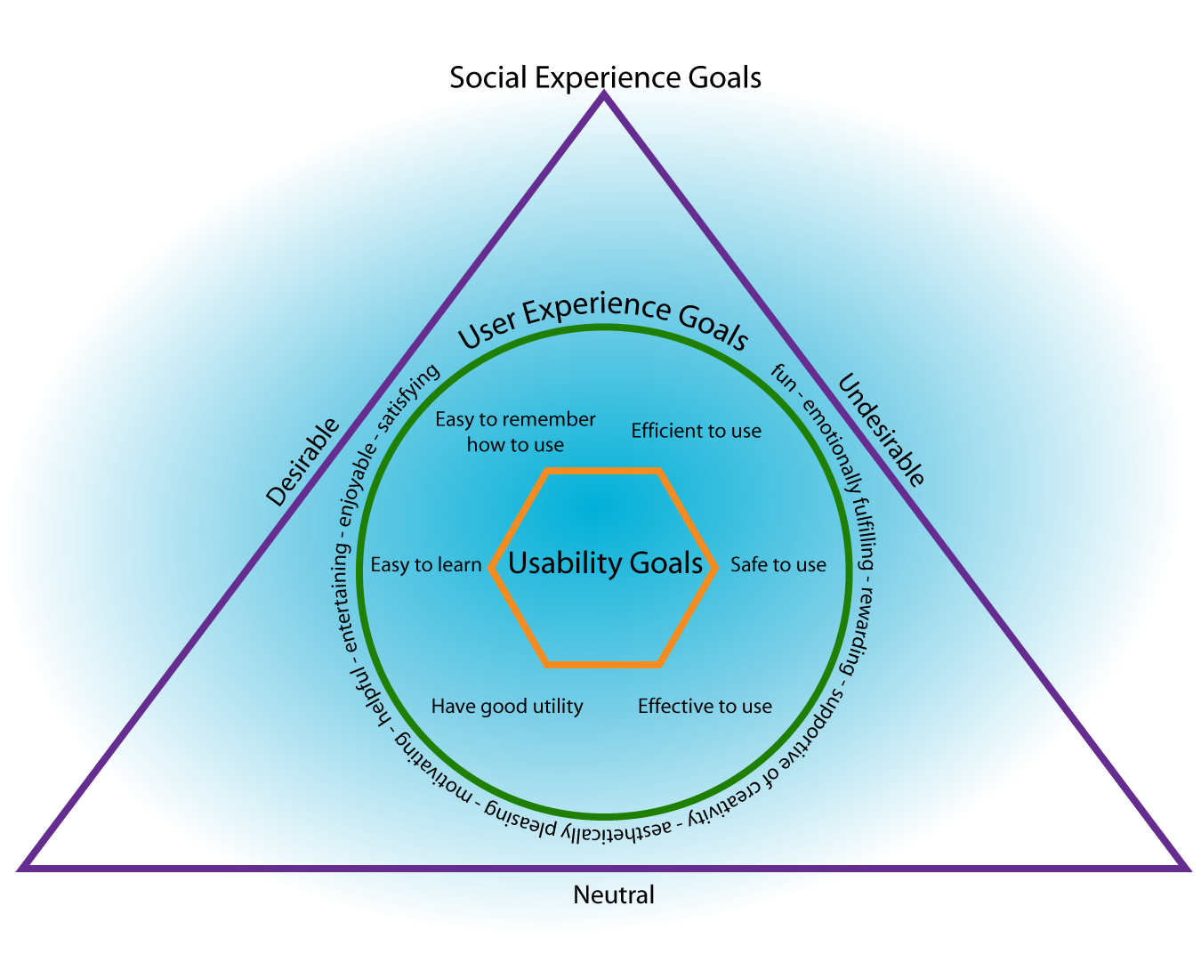

Slide 59

Example: Social Interaction Design in Practice
Social media service: YourCity
Active involvement of people in their communities.
Understand issues, find solutions and help notify authorities faster about problems.
The public has not only power to report and find solutions for problems but also has power to assess on whether high rank officials are effectively doing their job.
Image Source: Paulo Barcellos at http://www.flickr.com/photos/paulobar/230134559
Notes:
A government organization is asked to develop a social media software called UrCity to encourage an active involvement of people in their communities. They want to empower communities, states and the country as a whole to understand issues, find solutions and help notify authorities faster about these problems. Additionally, this project helps also evaluate the efficiency of authorities. Authorities that are not willing to listen get a lower rating based on how long it takes them to resolve a problem. The public has not only power to report and find solutions for problems but also has power to assess on whether high rank officials are effectively doing their job.

Slide 60
Needfinding for Social Experience Goals
Source: Users but also system designers and stakeholders
Methods: On-site Observation, Interviews, Participant Observation, Questionnaires, Focus Groups etc.
Development of personas
Groupthink
Aggression

Slide 61
Designing Social Interaction
Groupthink
Aggression
Anonymity states
Pro/con lists
Public identification of leaders
Response Item randomization
Anonymity states
Message submission errors
Helpfulness, aesthetics and comprehension of error messages

Slide 62
Prototyping for SIxD

Slide 63
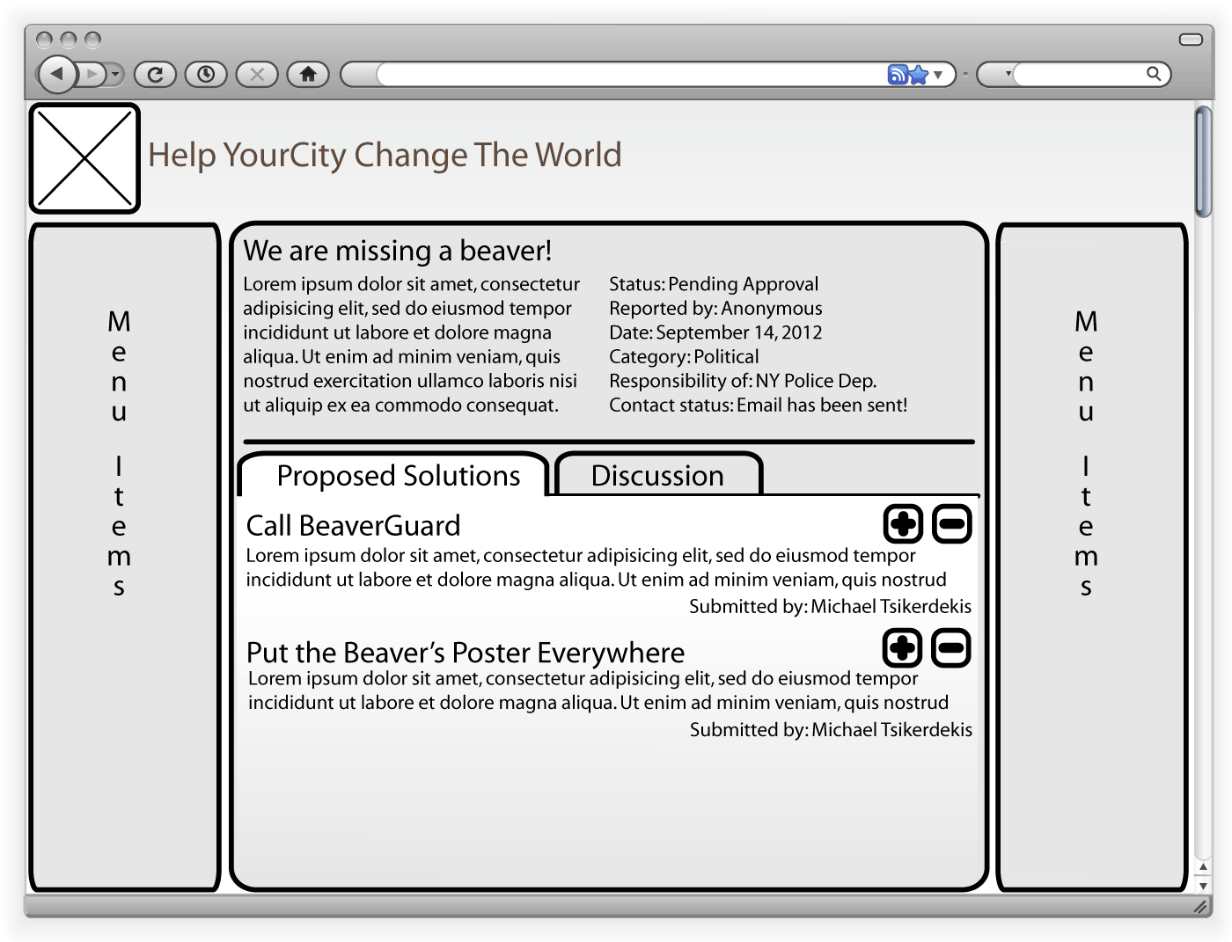

Slide 66
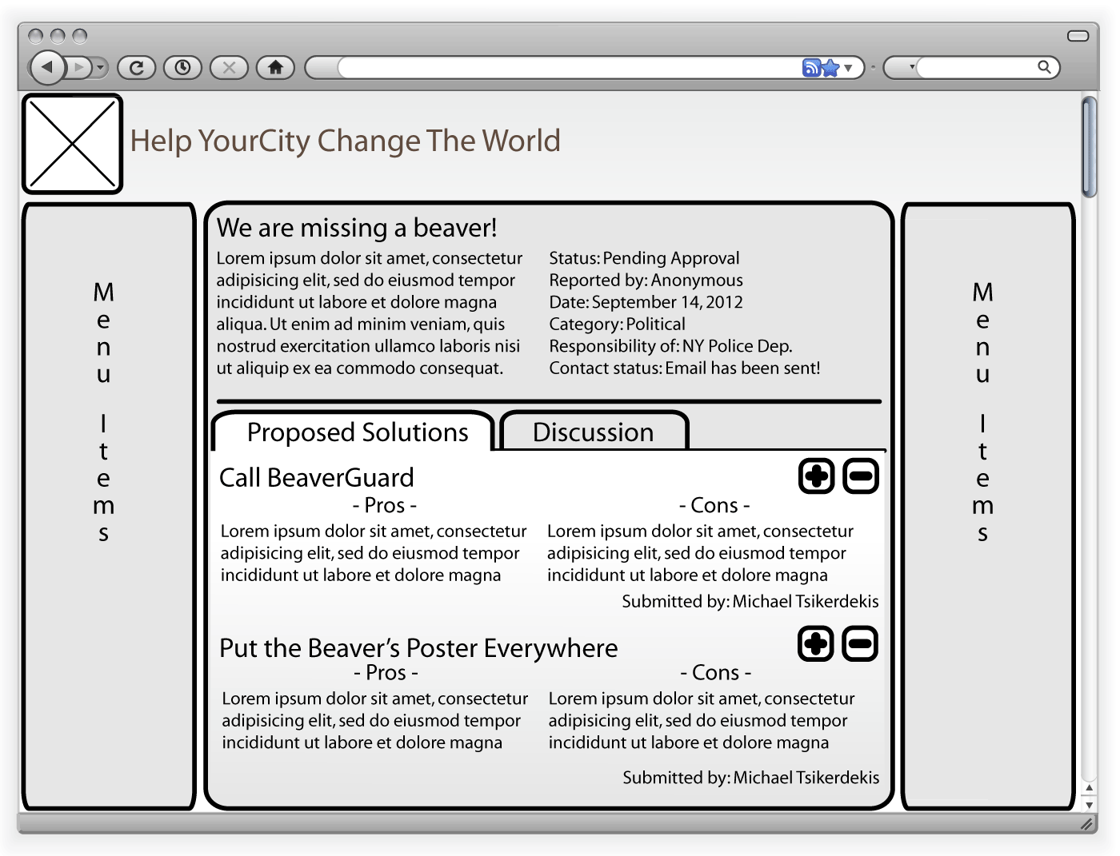

Slide 67
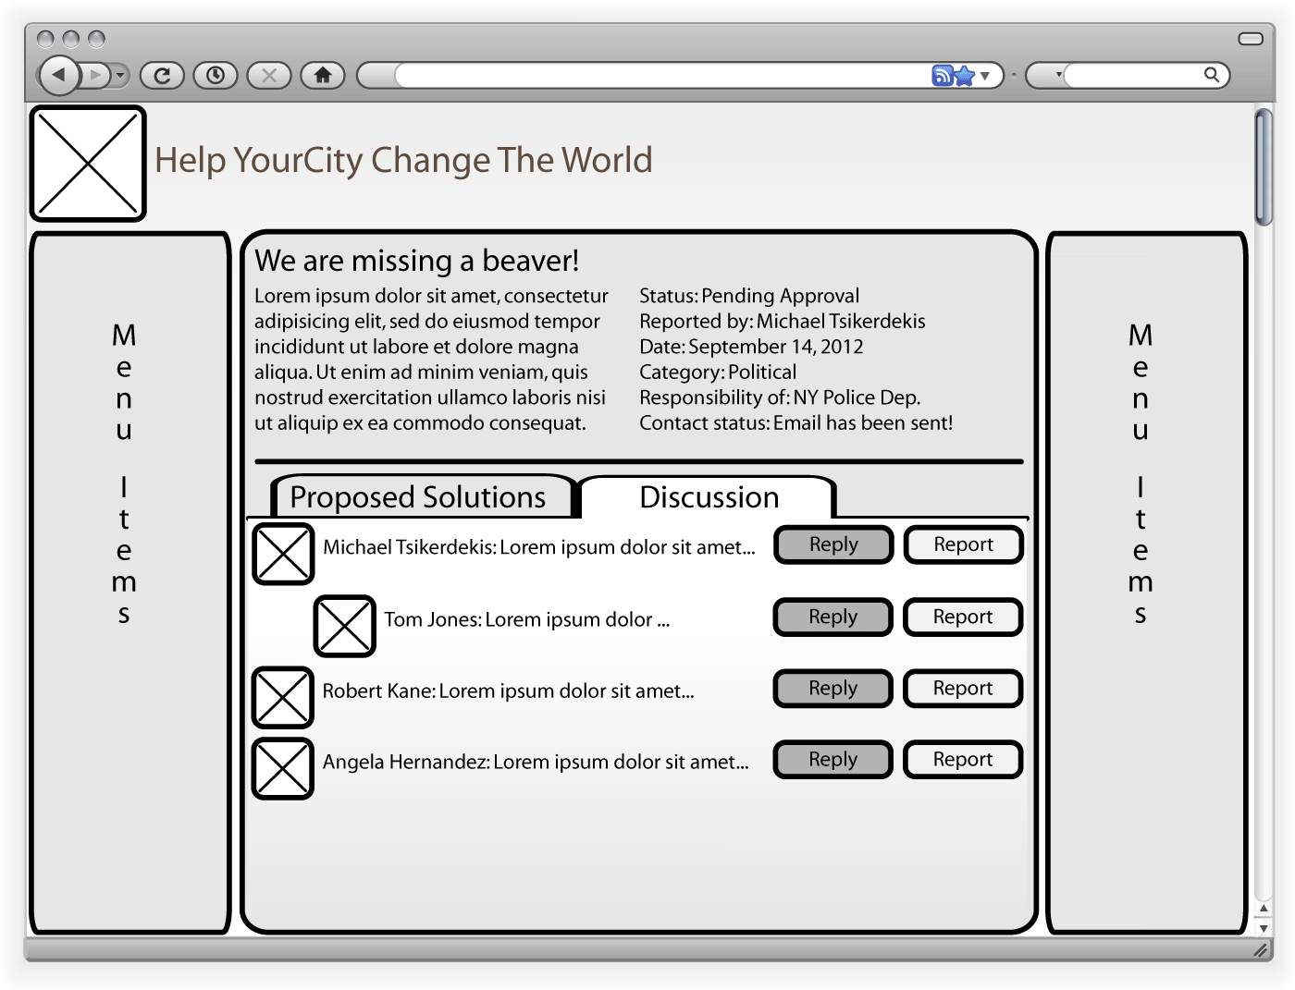

Slide 69
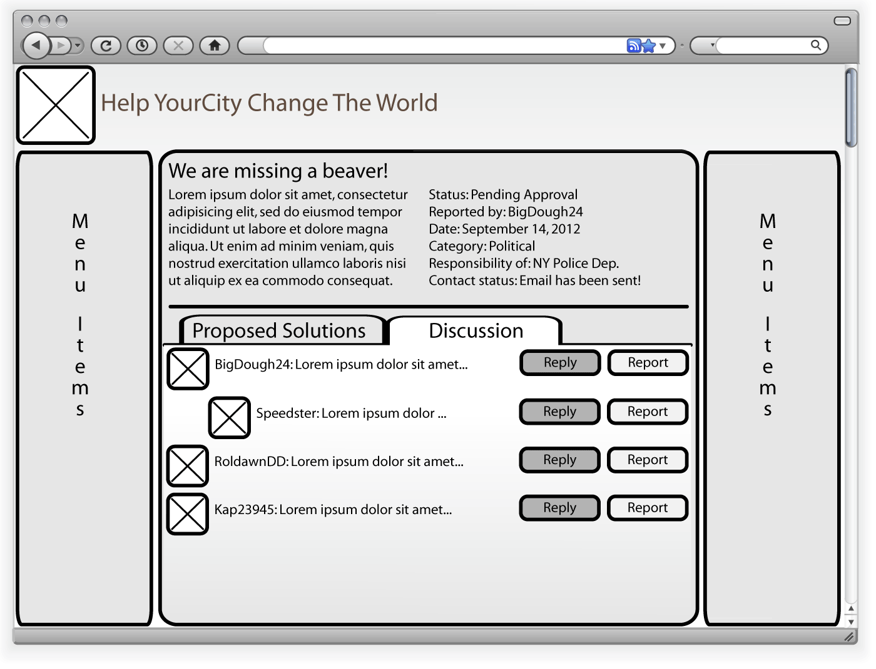
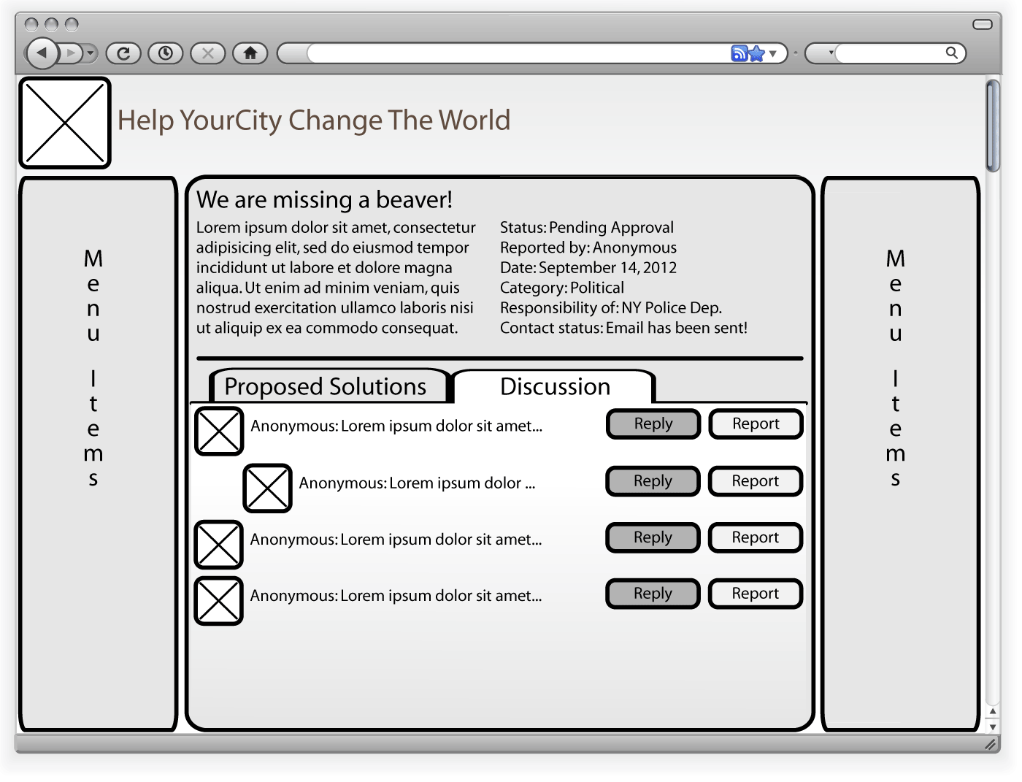

Slide 70
Evaluation in Social Interaction Design
H1: As anonymity rises so does the likelihood of individuals contributing more solutions.
H2: Pro/con lists may help individuals process information better and produce more arguments than textual information representation.
H3: Pseudonymity is a more powerful contributor to aggression than complete anonymity.

Slide 71
H1: Wikipedia Survey
Obtain opinion about problems and selection of an optimum solution
Deliver a more realistic scenario where group collaborates under one anonymity state.
Most of the group supports a solution other than the optimum selected. To conform or not?

Slide 72
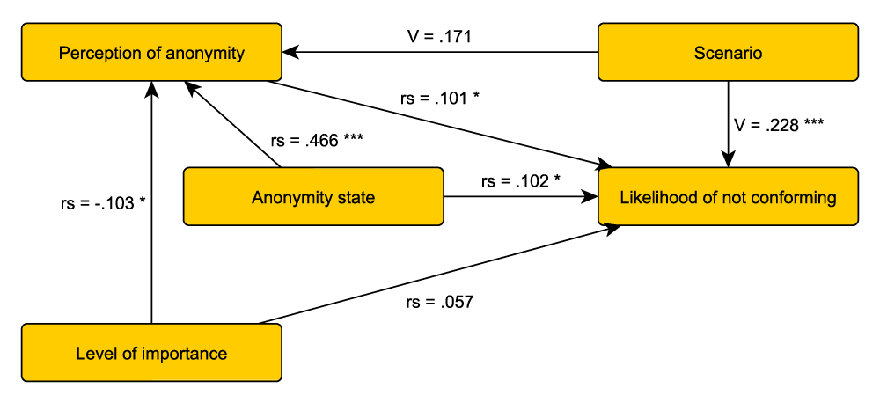
H1: Results
Source: Tsikerdekis, M. (2012). The Effects of Perceived Anonymity and Anonymity States on Conformity and Groupthink in Online Communities: A Wikipedia Study. Journal of the American Society for Information Science and Technology. To be published in 2012.

Slide 73
H2: Comparative analysis Wikipedia - Debatepedia
Obtaining a random sample of corresponding article from Wikipedia and Debatepedia
Content analysis for arguments on each article.
Statistical comparative analysis to determine differences in argument production and readability.

Slide 74
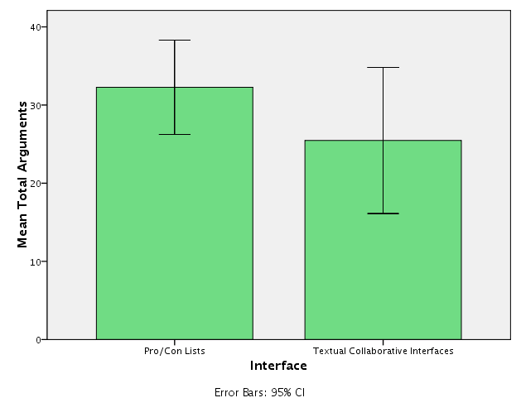
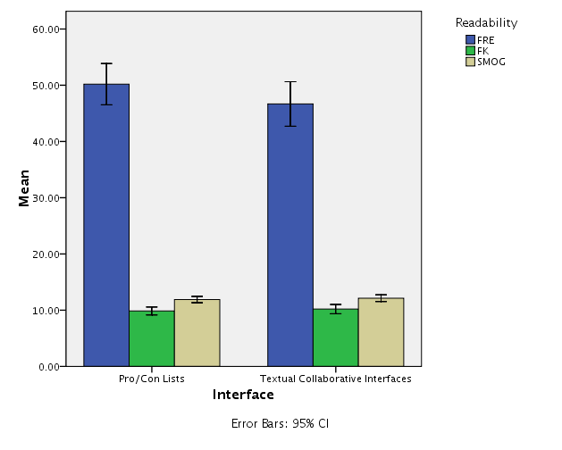
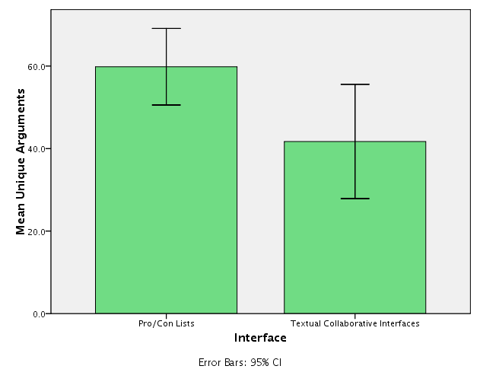
H2: Pro/Con lists and Groupthink Goal
Total Arguments: U = 68.5, Z = −1.827, p = .068, r = .334
Unique Arguments: t(28) = 2.332, p = .027, r = .403
Readability: FRE (t(28) = −1.398, p = .173, r = .255), FK (t(28) = 0.666, p =. 511, r = .124), SMOG (t(28) = 0.649, p = .522, r = .122)
Source: Tsikerdekis, M. (2012). Pro/Con Lists and their Use in Group Decision Support Systems for Reducing Groupthink. INFOCOMP Journal of Computer Science, 11(3). To be published in September 2012

Slide 75
H3: Facebook Survey
Obtain opinion and strength of opinion about controversial topics.
Face scenarios under different anonymity states based on the topics depending on the opinion reported.
A response is required in a set of predetermined messages

Slide 76
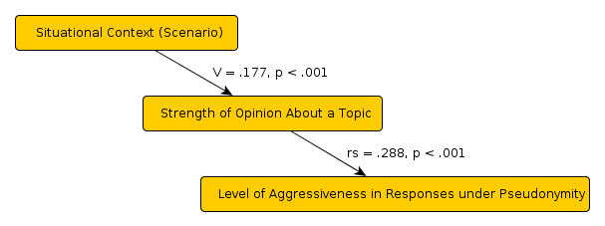
H3: Anonymity States and Aggression
Real names and complete anonymity produced similar levels of aggressive responses and lower than pseudonymity.
Source: Tsikerdekis, M. (2012). The choice of complete anonymity versus pseudonymity for aggression online. eMinds International Journal on Human-Computer Interaction, 2(8), 35–57. Retrieved from http://www.eminds.uniovi.es/index.php?journal=eminds&page=article&op=viewFile&path%5B%5D=106&path%5B%5D=67

Slide 77
Decisions on Design based on Evaluation
Norms and other strategies will be employed so that members will be using their real names (at least the majority).
Additional option will be given for posting and proposing solutions where individuals can post completely anonymously.
Solutions will have a description section as well as a pro/con list section where users can contribute their own opinions on the solutions.
Notes:
Give friendster examples about the first point

Slide 78
Summary (1)

Slide 79
Summary (2)

Slide 80
Further Reading
John P. Scott. Social Network Analysis: A Handbook. Sage Publications Ltd; 2nd edition (March 2000)
John P Scott (Editor), Peter Carrington (Editor). The SAGE Handbook of Social Network Analysis. Sage Publications Ltd (May 25, 2011)
Penelope Hawe and Laura Ghali Use of social network analysis to map the social relationships of staff and teachers at school Health Educ. Res. (2008) 23(1): 62-69 first published online February 7, 2007 doi:10.1093/her/cyl162

Slide 81
Further Reading
Tharon Howard, Elsevier - Morgan Kaufmann Design to Thrive Creating Social Networks Edition 2010
Amy J. Kim. Community Building on the Web : Secret Strategies for Successful Online Communities. Peachpit Press, April 2000.
boyd, d. m. and Ellison, N. B. (2007), Social Network Sites: Definition, History, and Scholarship. Journal of Computer-Mediated Communication, 13: 210–230.
Mayfield, Anthony. 2007. What is Social Media? (Online resource:http://www.icrossing.co.uk/fileadmin/uploads/eBooks/What_is_Social_Media_iCrossing_ebook.pdf). ICrossing.
Kaplan, Andreas M.; Michael Haenlein (2010). "Users of the world, unite! The challenges and opportunities of Social Media". Business Horizons 53 (1): 59–68.

