Slide 1
ENGLISH AUTONOMOUSLY
Martina Šindelářová Skupeňová
Lenka Zouhar Ludvíková

Slide 2
ENGLISH AUTONOMOUSLY – 2nd session
learning process
multiple intelligencies
focus on the language
SILL
contract
support groups selection, counselling reservation

Slide 3
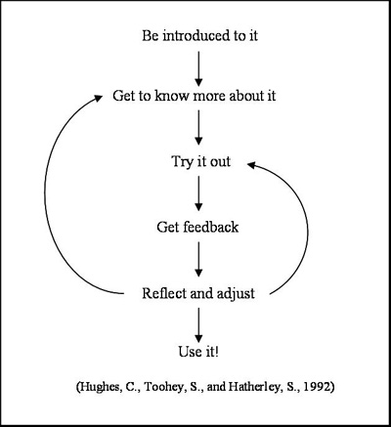
ENGLISH AUTONOMOUSLY - learning process

Slide 4
ENGLISH AUTONOMOUSLY - multiple intelligences

Slide 5
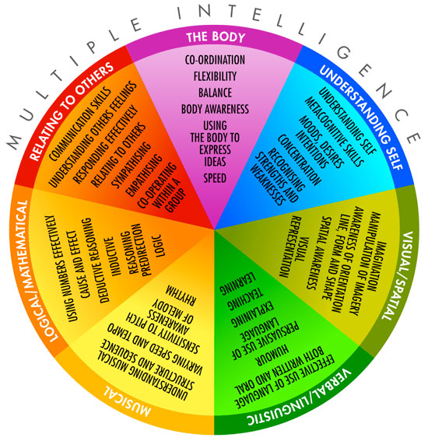
ENGLISH AUTONOMOUSLY - multiple intelligences

Slide 6
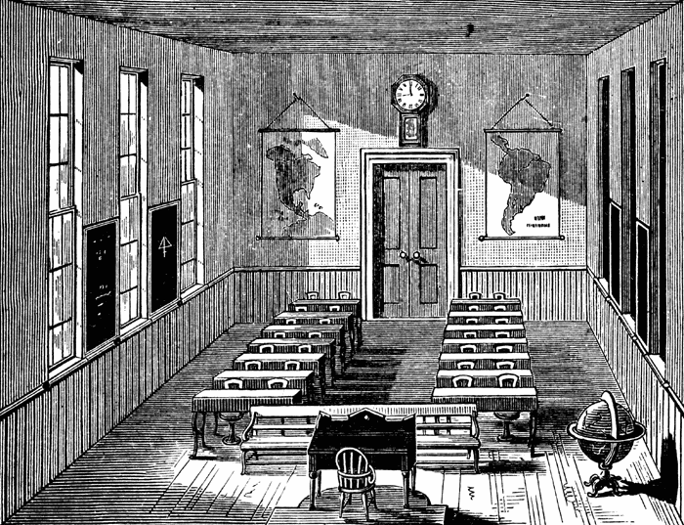
ENGLISH AUTONOMOUSLY - focus on the language
teacher centred class
student centred class
learning centred class

Slide 7
ENGLISH AUTONOMOUSLY - log writing tips
regular, frequent, English learning focused
- what, why, when, where…
- objective, goal, reflection, actual gain…)
online log, video log, audio log, hand-written log, portfolio, book...
https://sites.google.com/site/eportfolios4ell/s-h-o-w-c-a-s-e-1

Slide 8
ENGLISH AUTONOMOUSLY - strategy invent. for lg. learning
Memory strategies
Cognitive strategies
Compensation strategies
Metacognitive strategies
Affective strategies
Social strategies
Notes:
strategy invent. for lg. Learning - SILL

Slide 9
ENGLISH AUTONOMOUSLY - contract / plan
 | hours
1st and 2nd session + HW | 10
min. 2 modules of your choice | 10 + 10
counselling and log writing | 1 + 5
??? | 14
TOTAL | 50

Slide 10
ENGLISH AUTONOMOUSLY
Thank you for the second session:).

