Slide 1
SHIRDASHT (MANGALAT) and DUZARAY
Patty Jo Watson
Spring 1960

Slide 2
Mangalat
At north edge of Kermanshah plain at mouth of Tang-i-Knesht.
The winter site for Kurdi pastoralists who take their herds up the Kuh-i-Parau.
Near Taq- Bustan the Sasanian reliefs and huge spring.
Wild fauna still abundant – goats, wolves, partridges, etc.
About 160 people. Some worked at Warwasi and Kobeh.
Houses here built of stone with mud packing. Roofs the same as Faraman
No good water. Use seeps and pools left from snow, or trek to Taq-I Bustan.
Farm small plots on rocky, irregular terrain.

Slide 3
Husbandry
Animals given salt every 10-14 days. It is spread on the surrounding boulders. Sheep and goats crave it and come running.
Young males culled before winter, along with old animals. Sheep meat costs 2x that of goats.
Wool is a cash crop and is harvested at Duzaray, but goats at Medan.
Sheep and goats milked 2x/day. After milking ewes are put with their lambs and kids to nurse.
Lambs and kids are kept in pens to keep them from ewes, and sent out to graze separately.
Most milk is used to make dugh. Milk is boiled, then mast starter is added so it will develop overnight. The mast is then put into goatskin bag and churned to make butter and dugh. Dugh can be dried to make kashk, which can be used throughout the winter.
The people also make panir (curd cheese), which is sold in Kermanshah

Slide 4
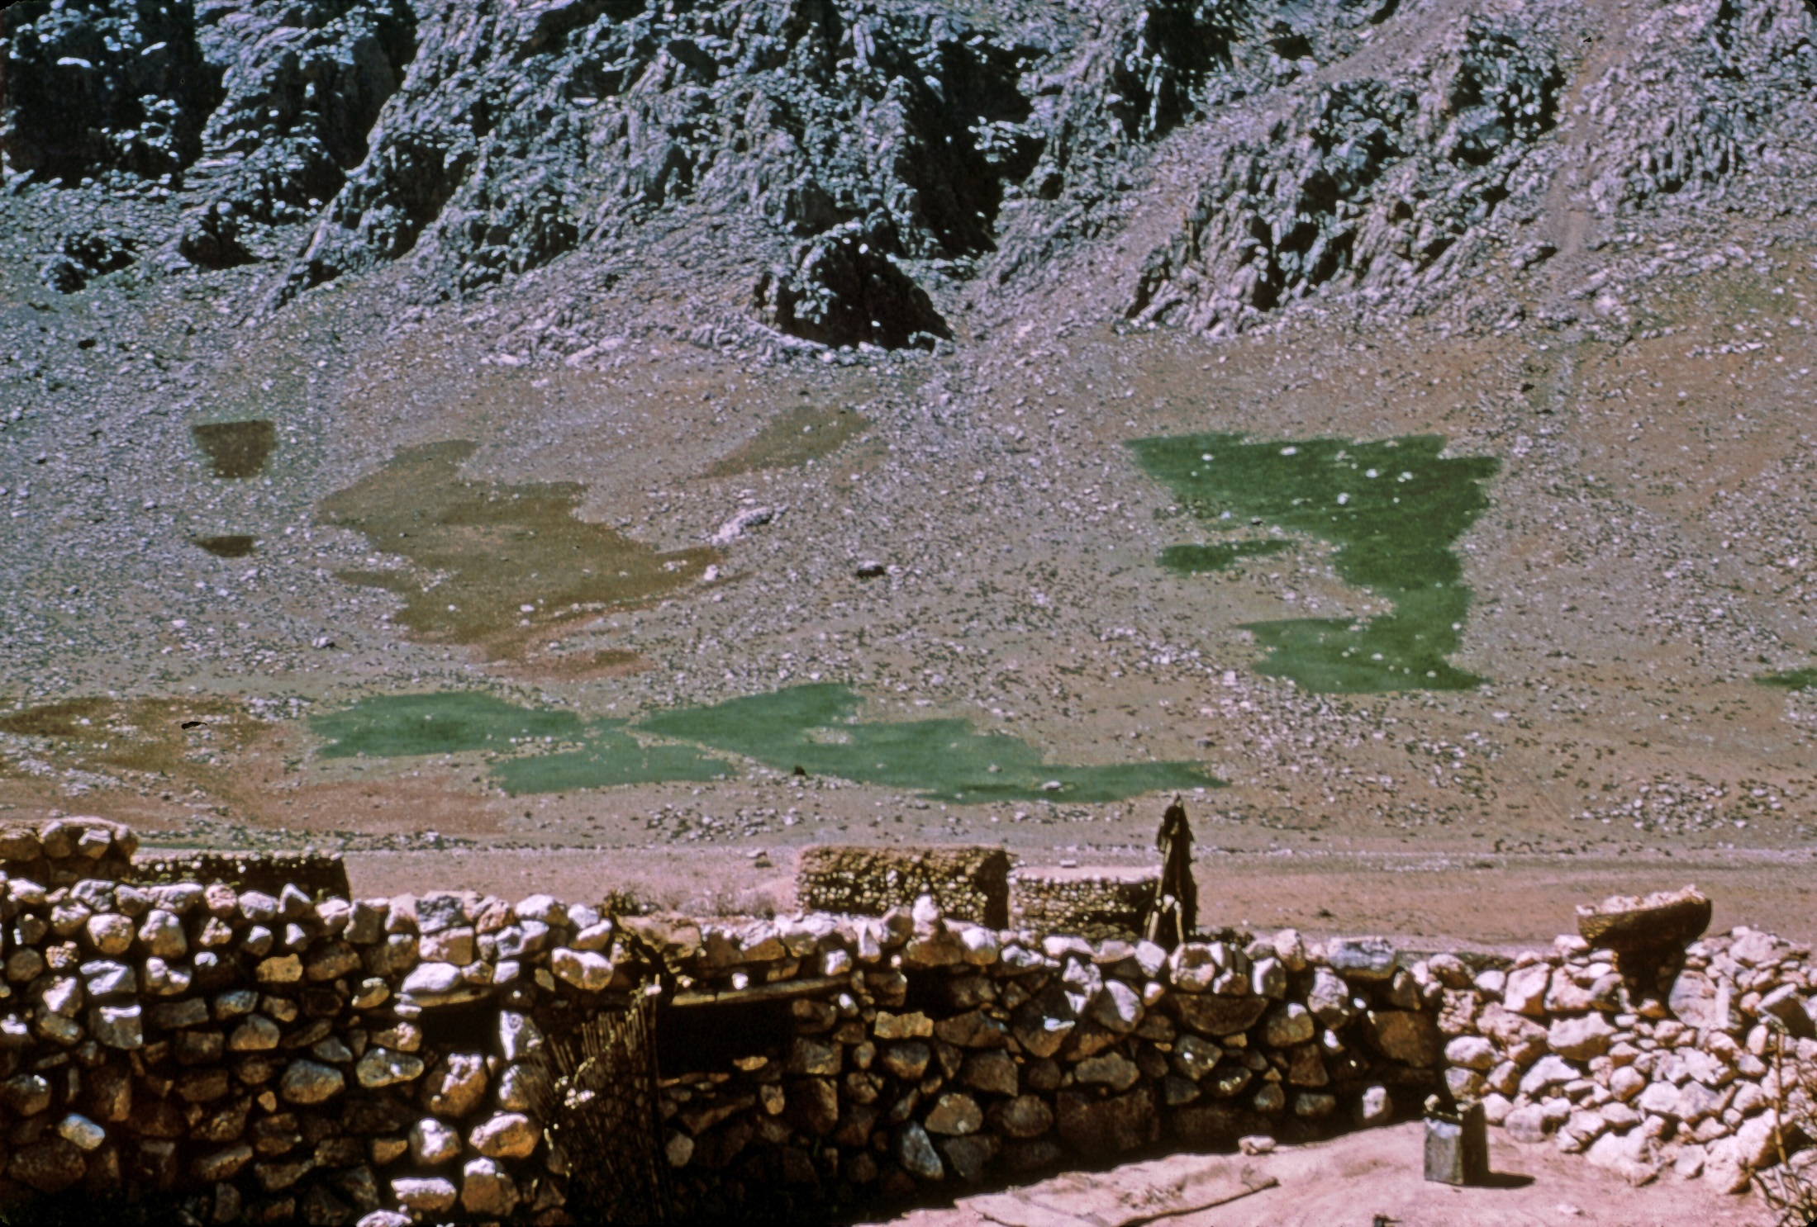
Mangalat settlement and fields

Slide 5
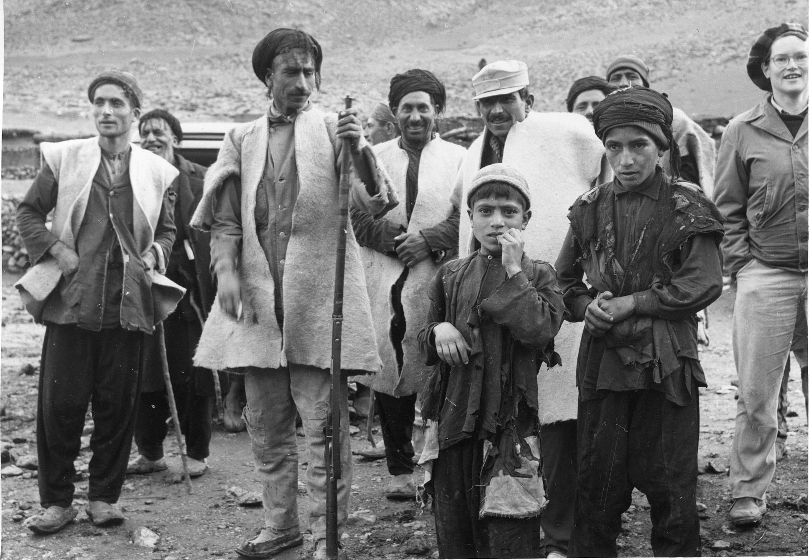

Slide 6
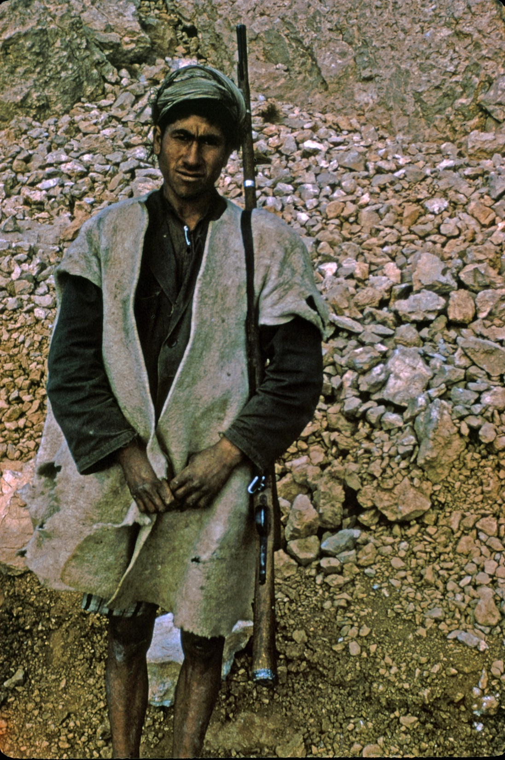
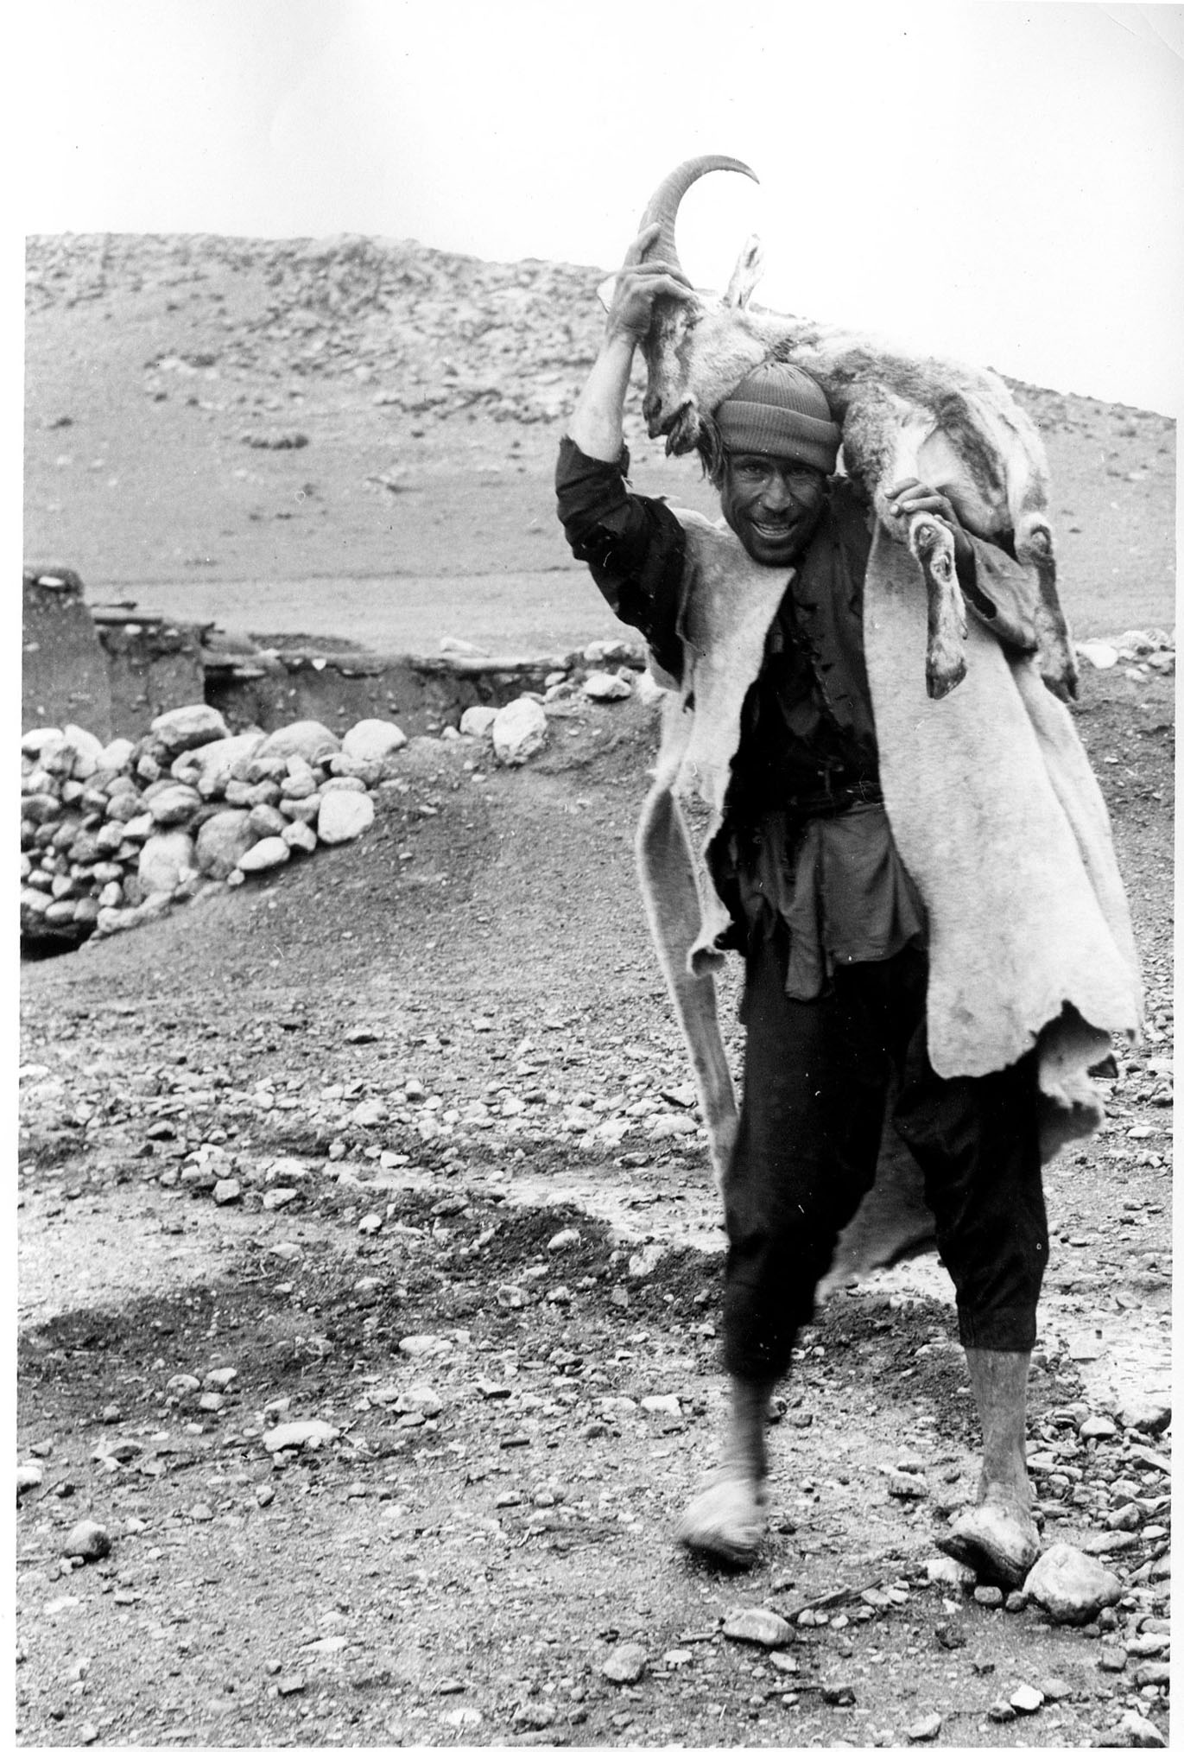
Mangalati with rifle Mangalati with goat

Slide 7
DUZARAY
Mangalatis have three principal sites: the village, which is occupied in the winter; Duzaray, a camp ground some 2 hours walk up the mountain; and Medan, the summer camp ground atop the mountain at 3000m.
In August again return to Duzaray; thence to a lower pasture and finally Mangalat.
Crops are planted in the autumn and harvested in the spring.
The fields are owned by absentee landlords; the Mangalatis are share-croppers like the villagers at Faraman.

Slide 8
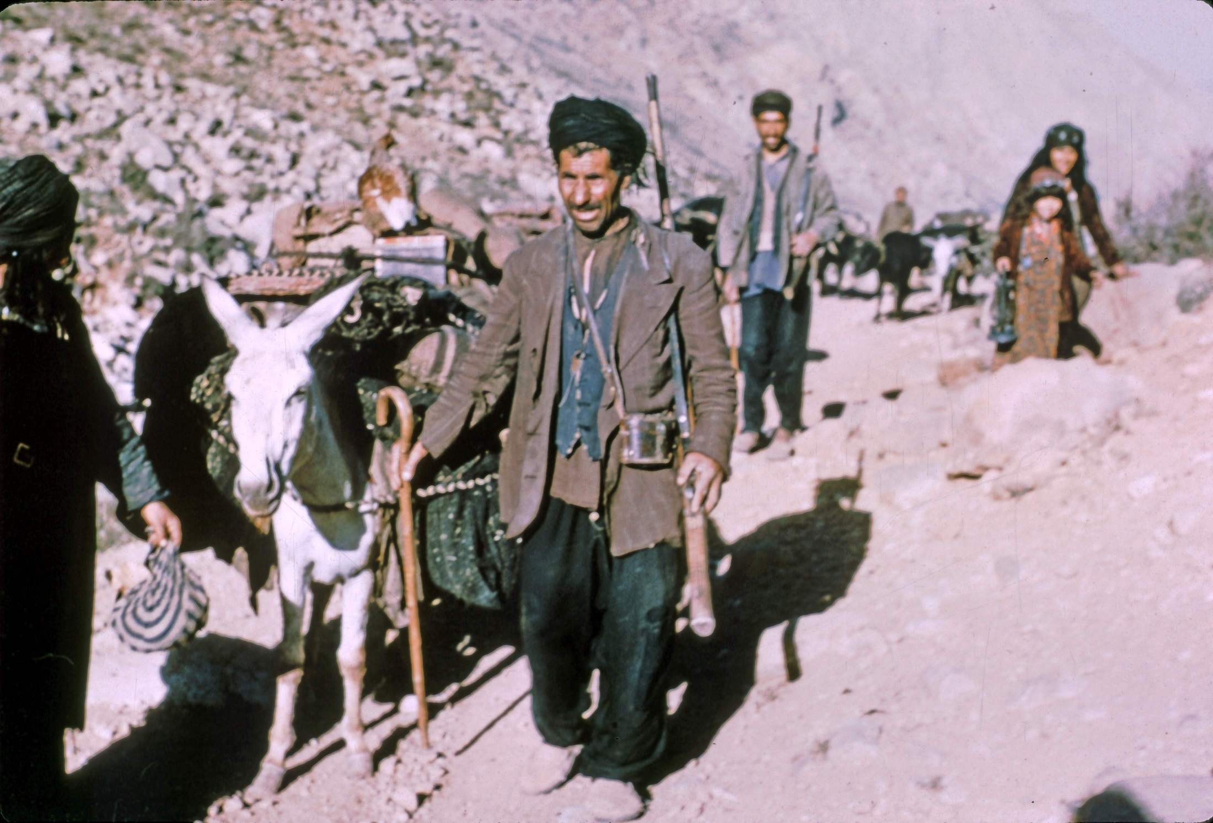
En route to Duzaray

Slide 9
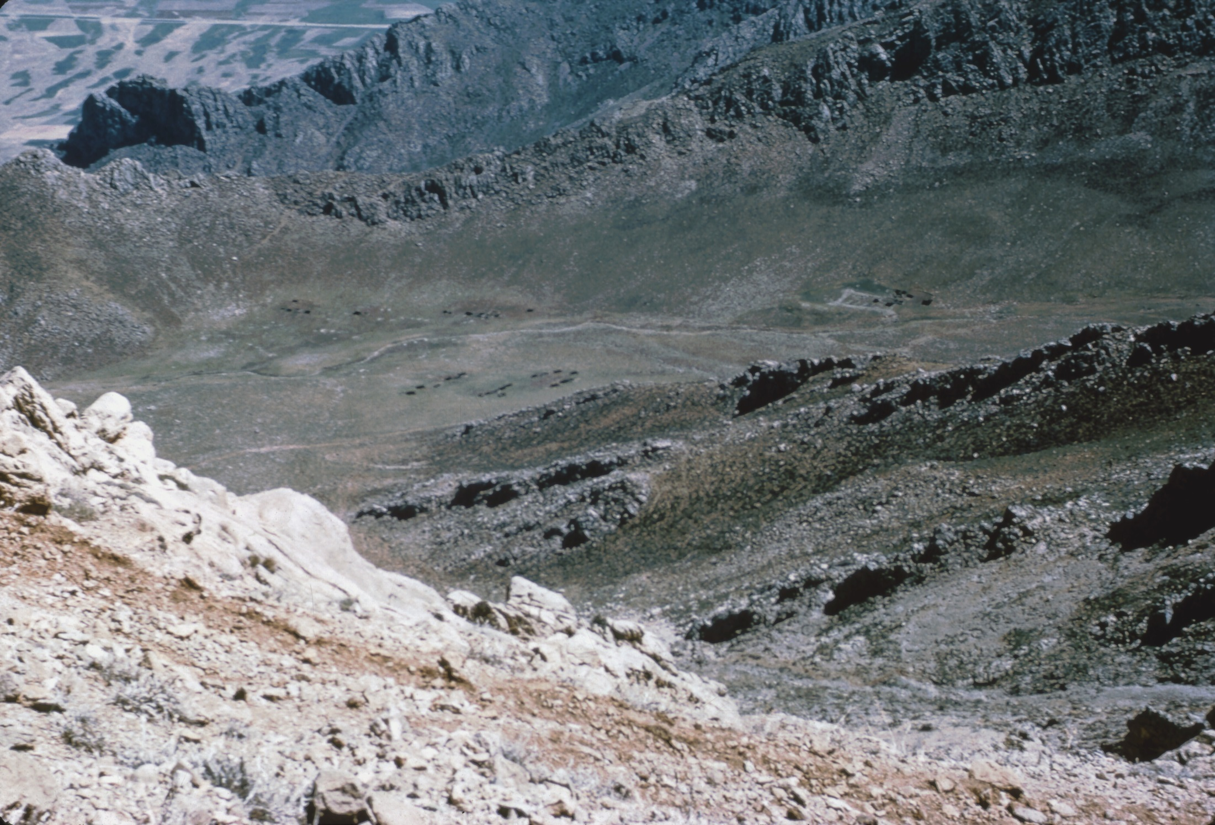
Duzaray Camp Site

Slide 10
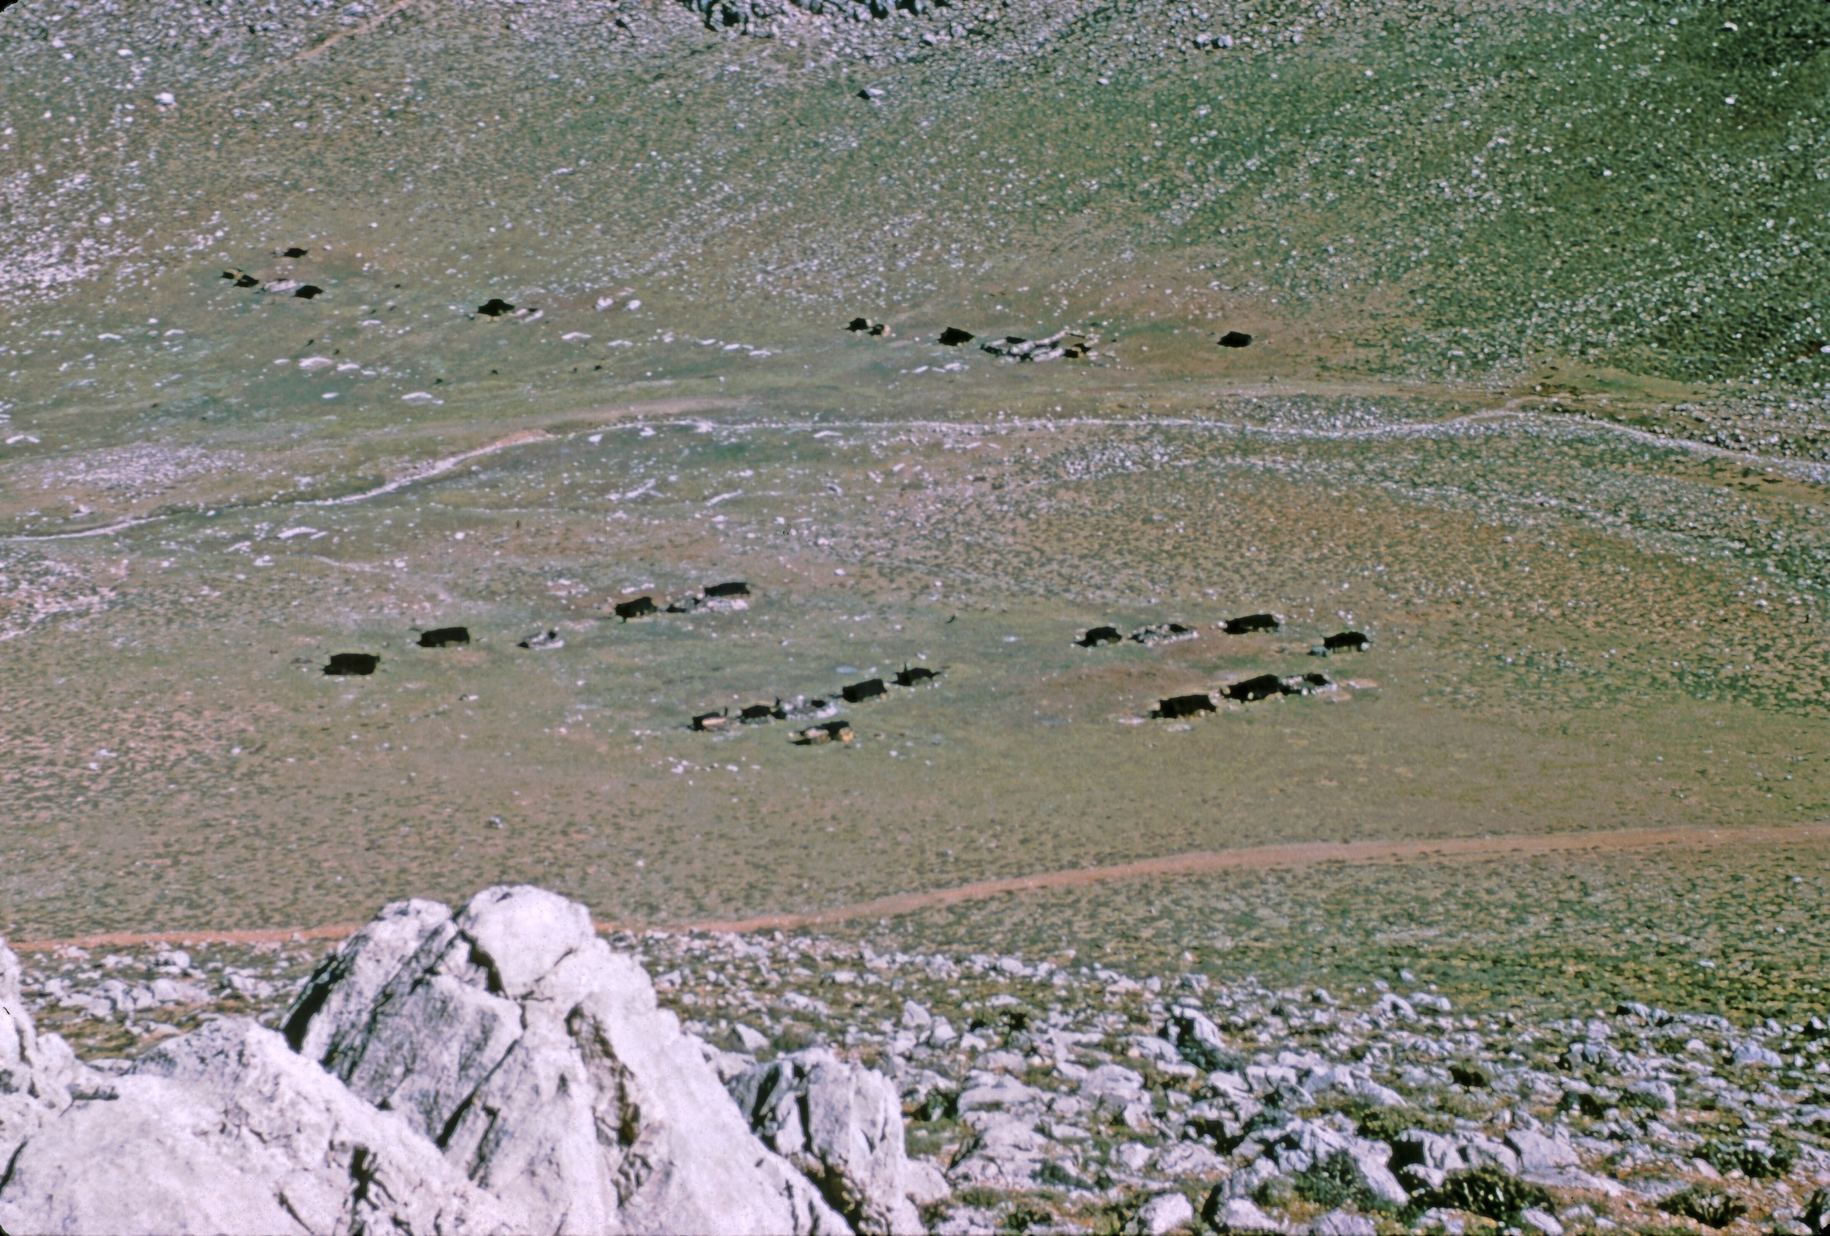

Slide 11
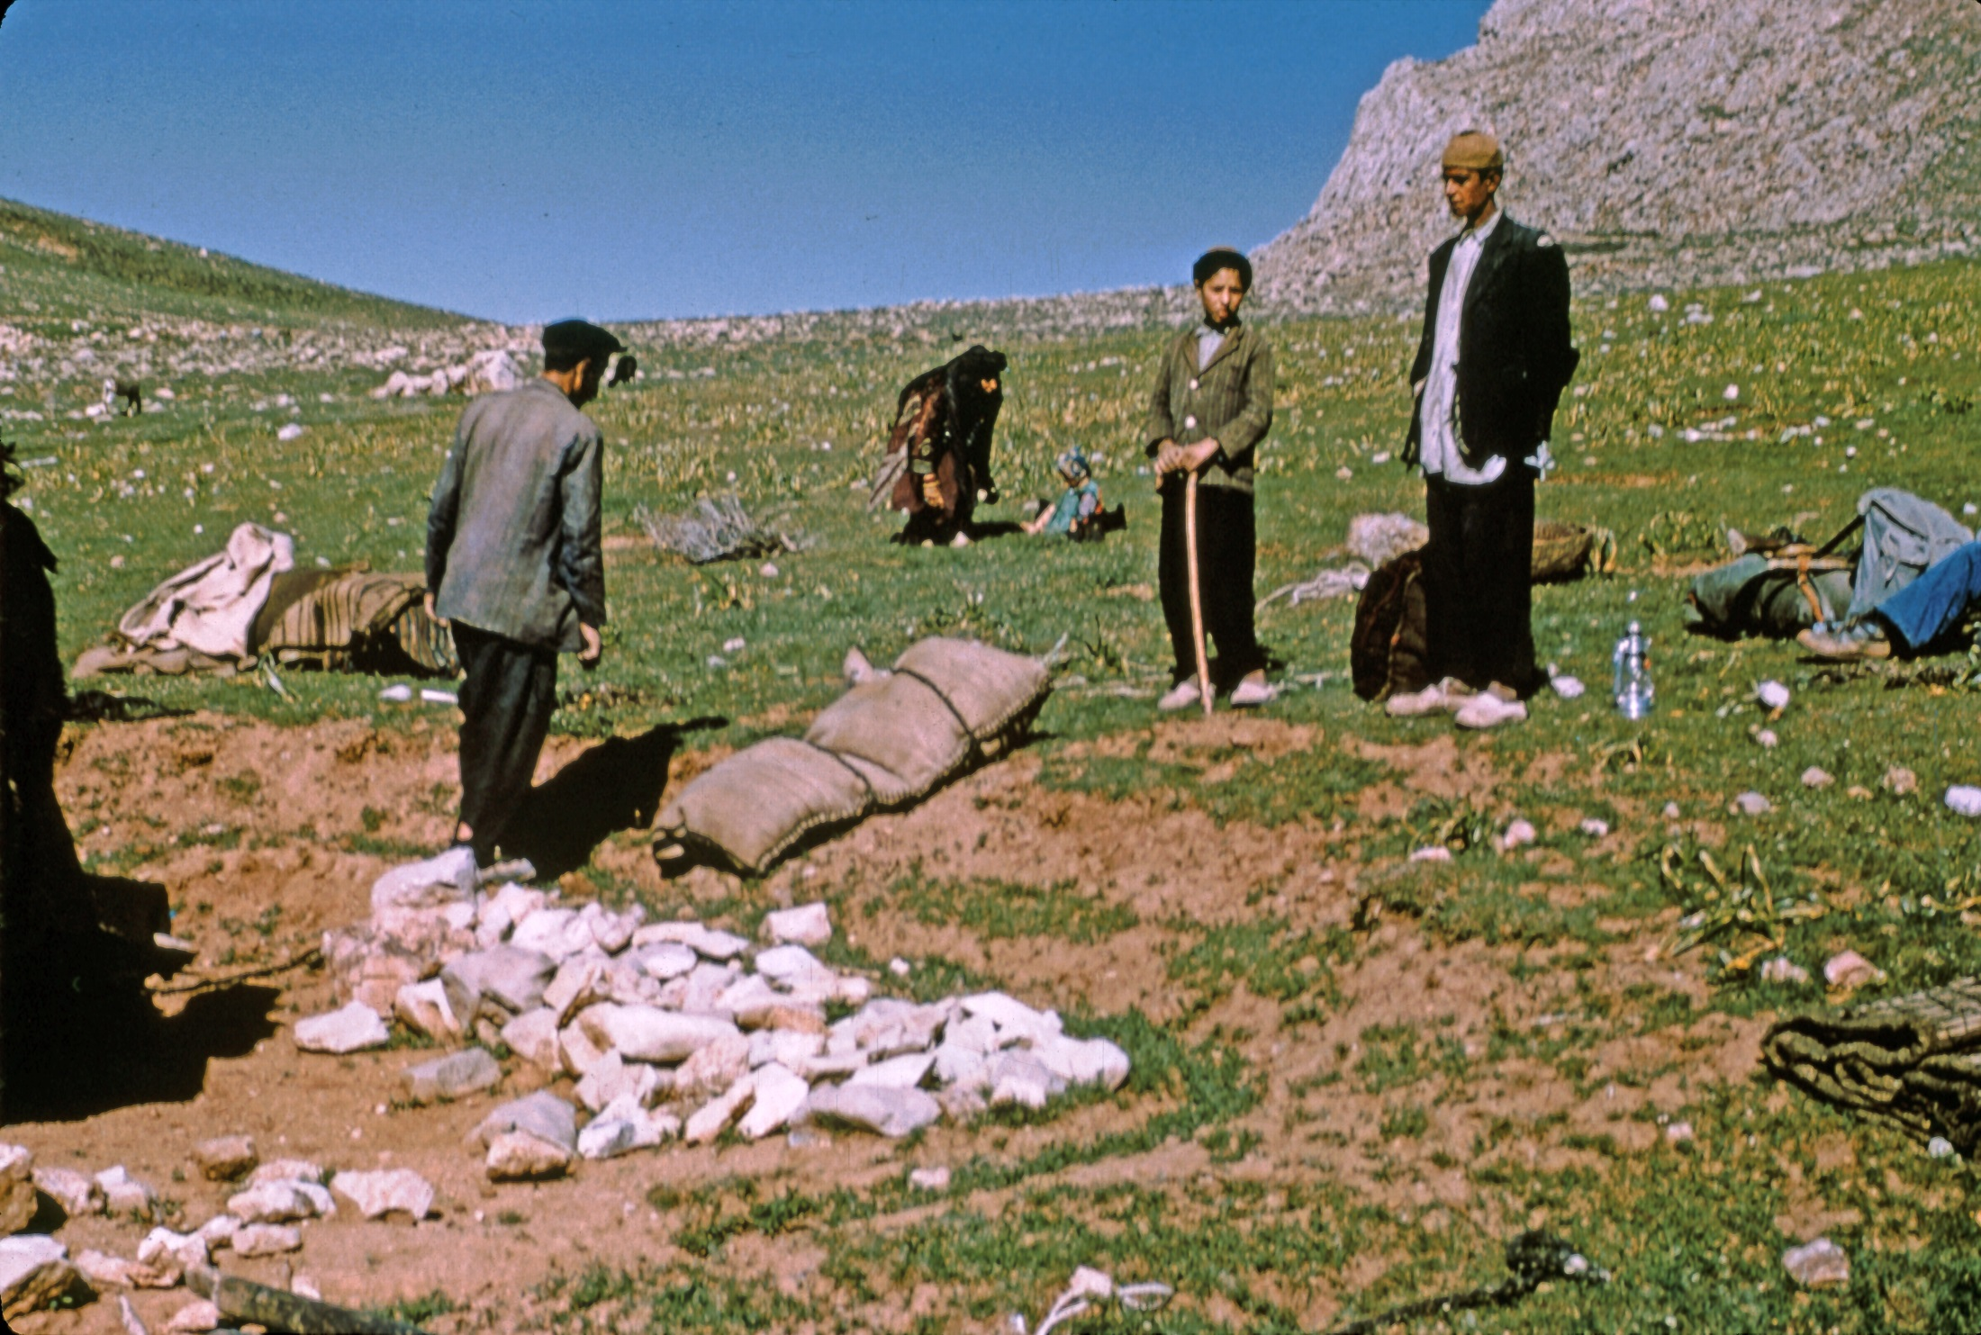

Slide 12
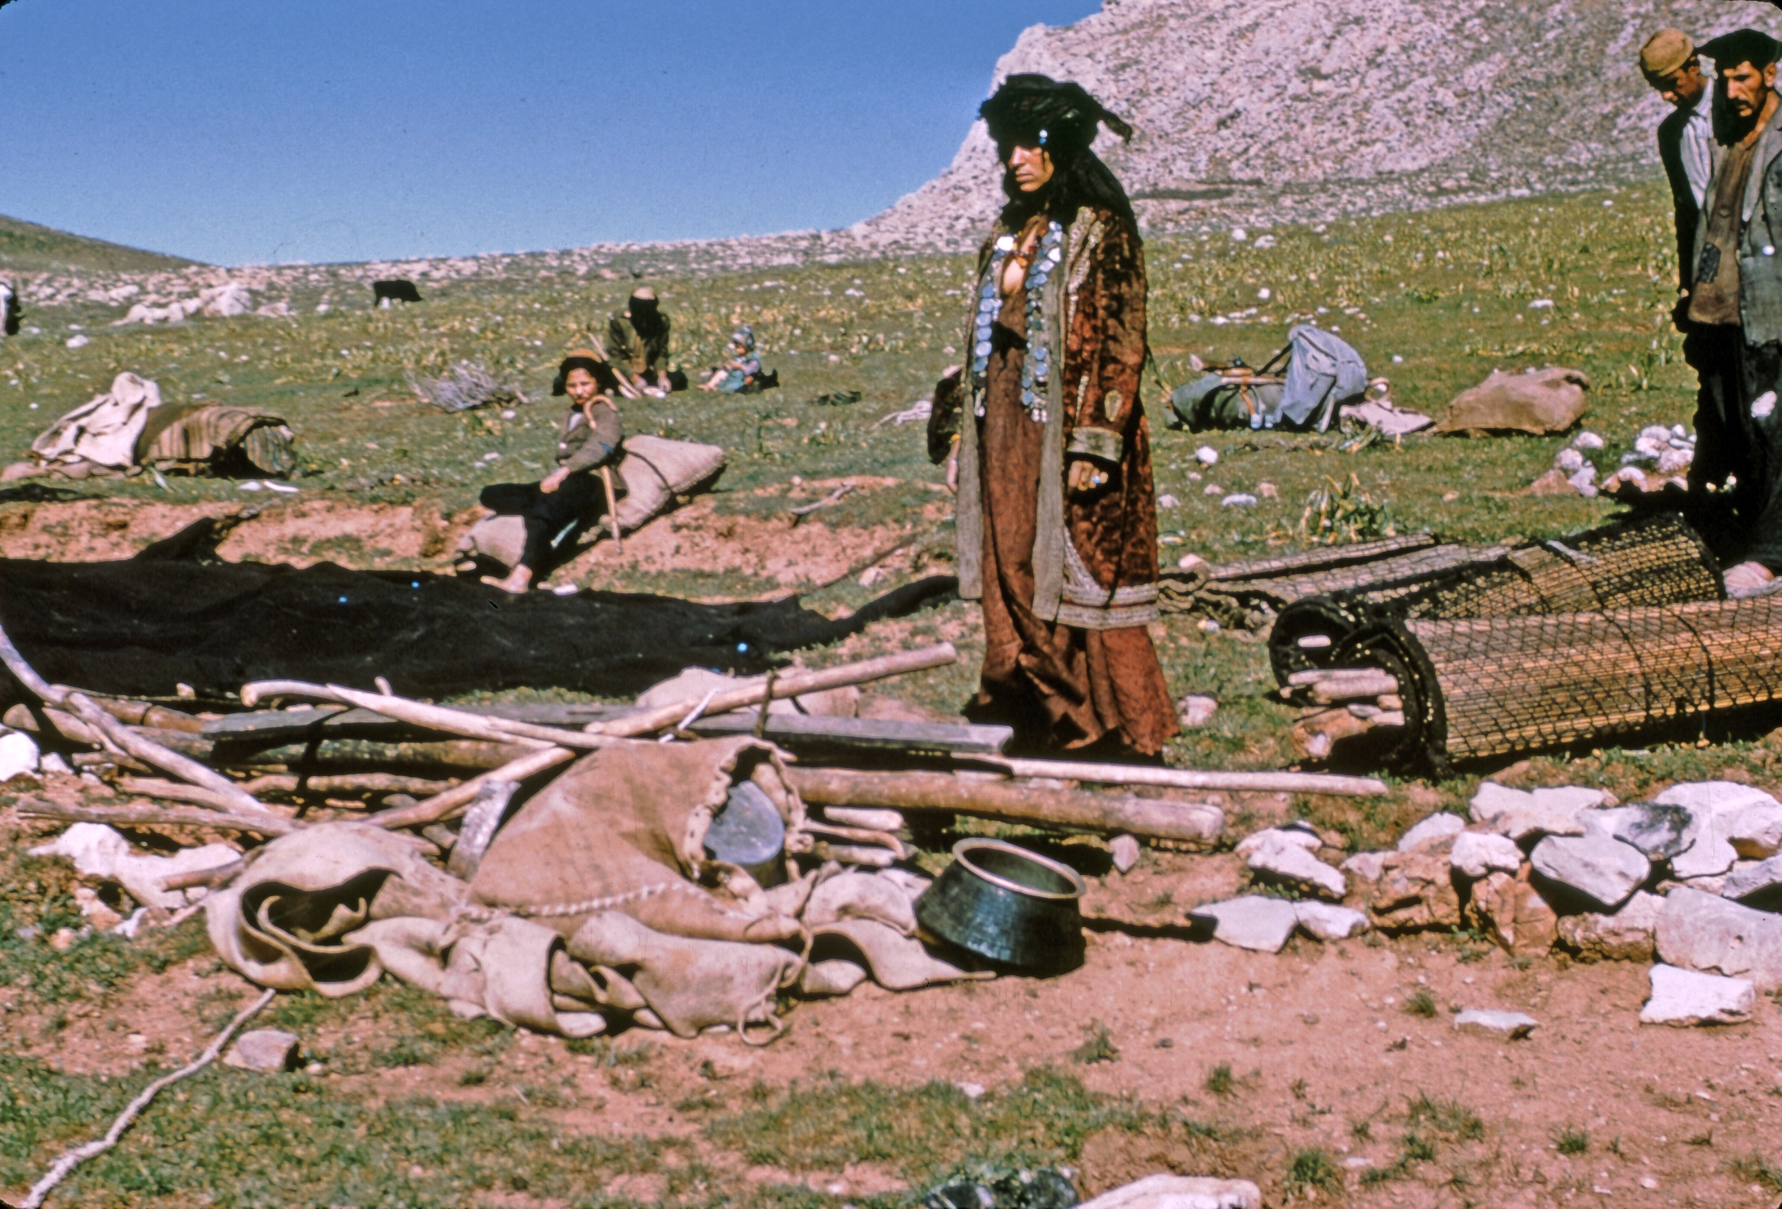

Slide 13
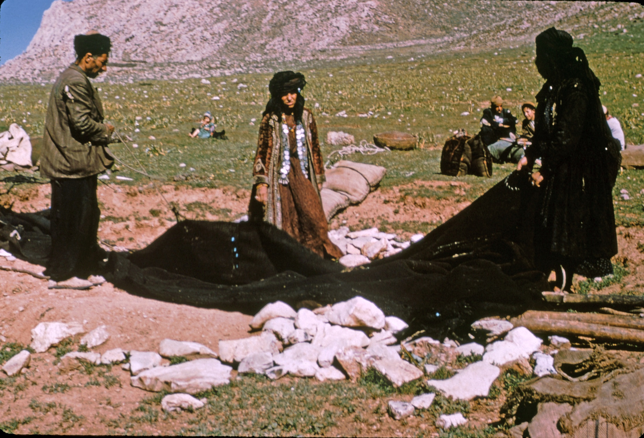

Slide 14
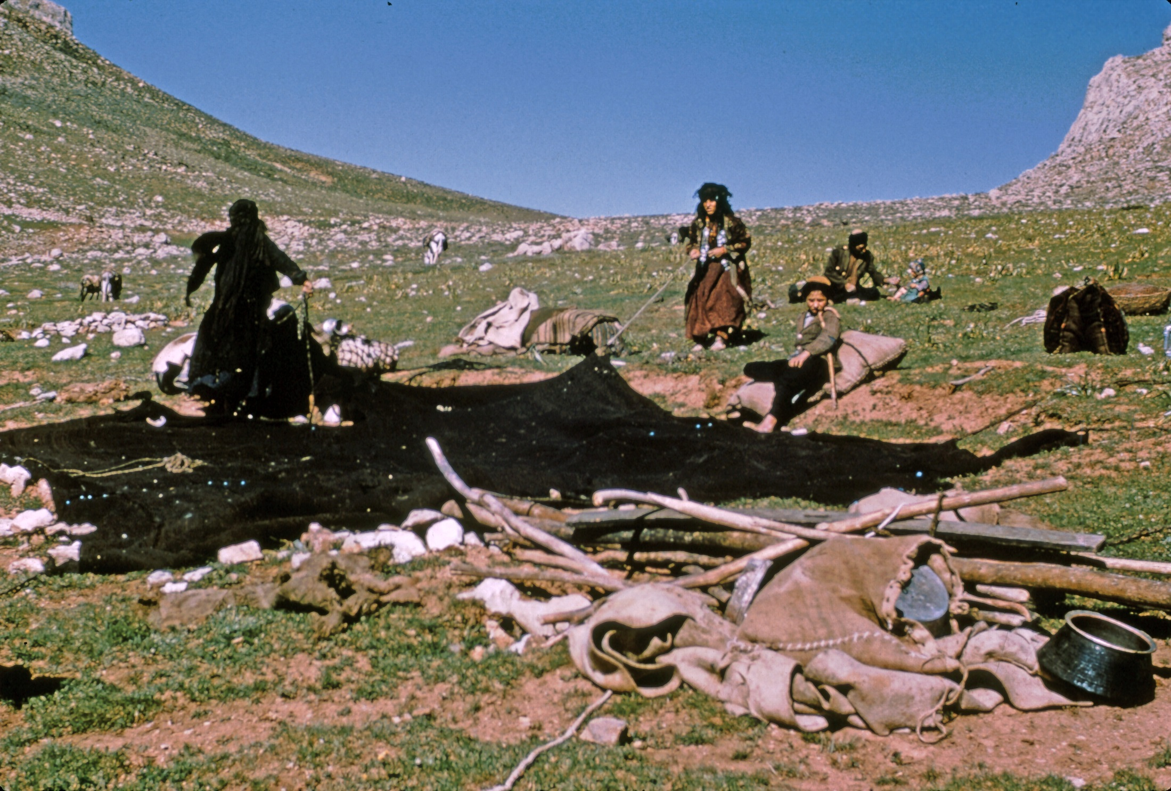

Slide 15
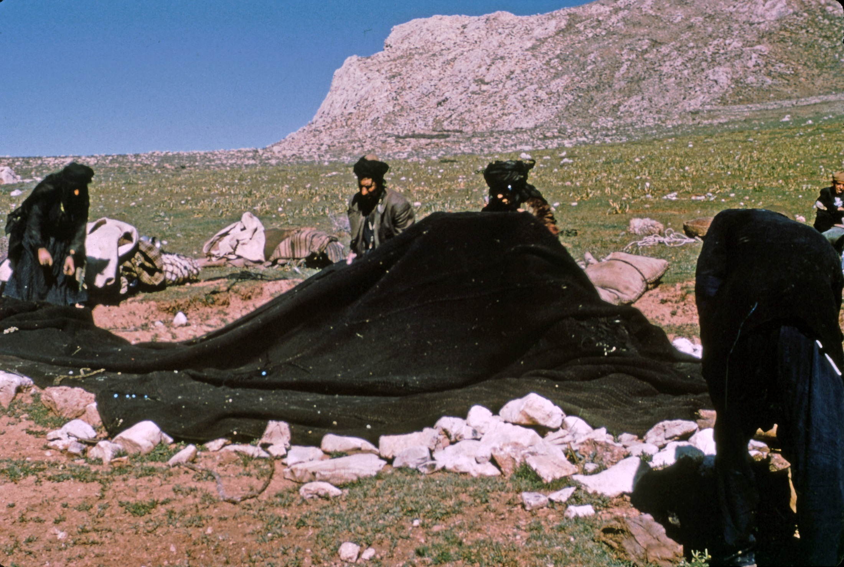

Slide 16
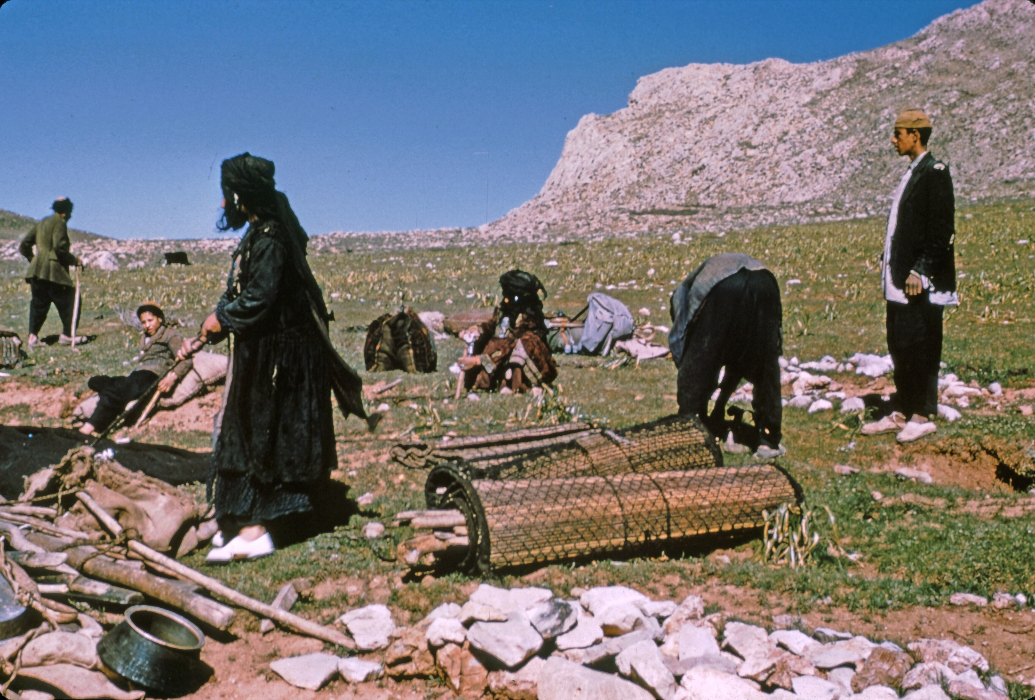

Slide 17
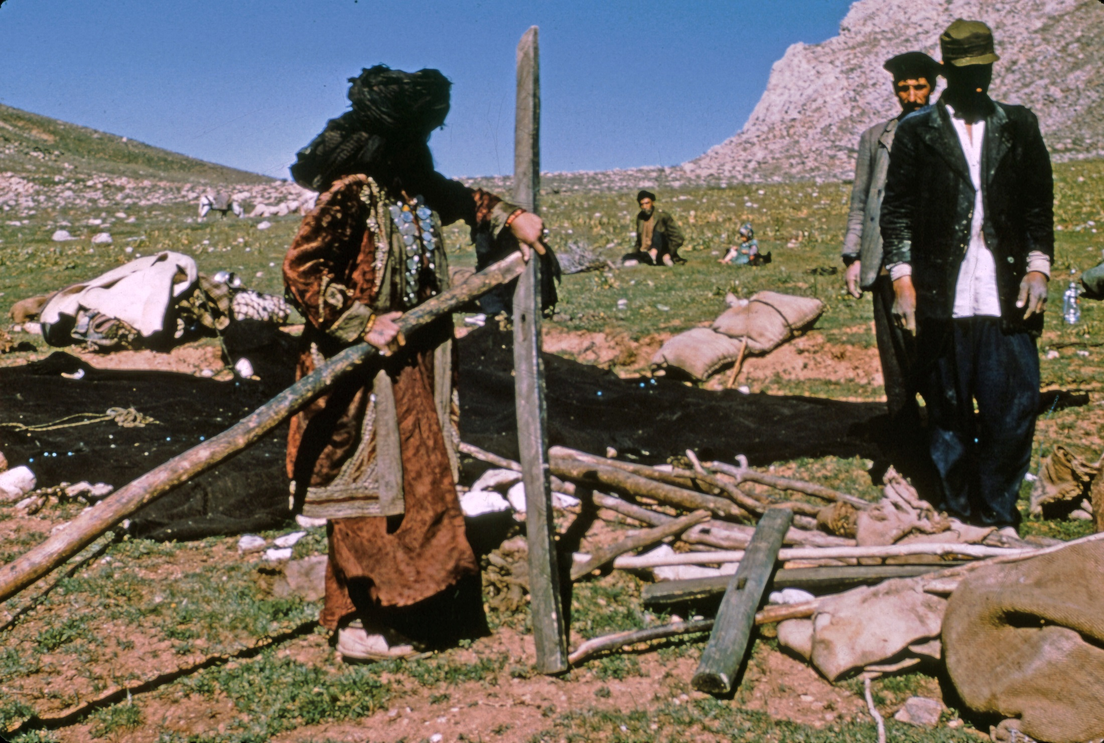

Slide 18
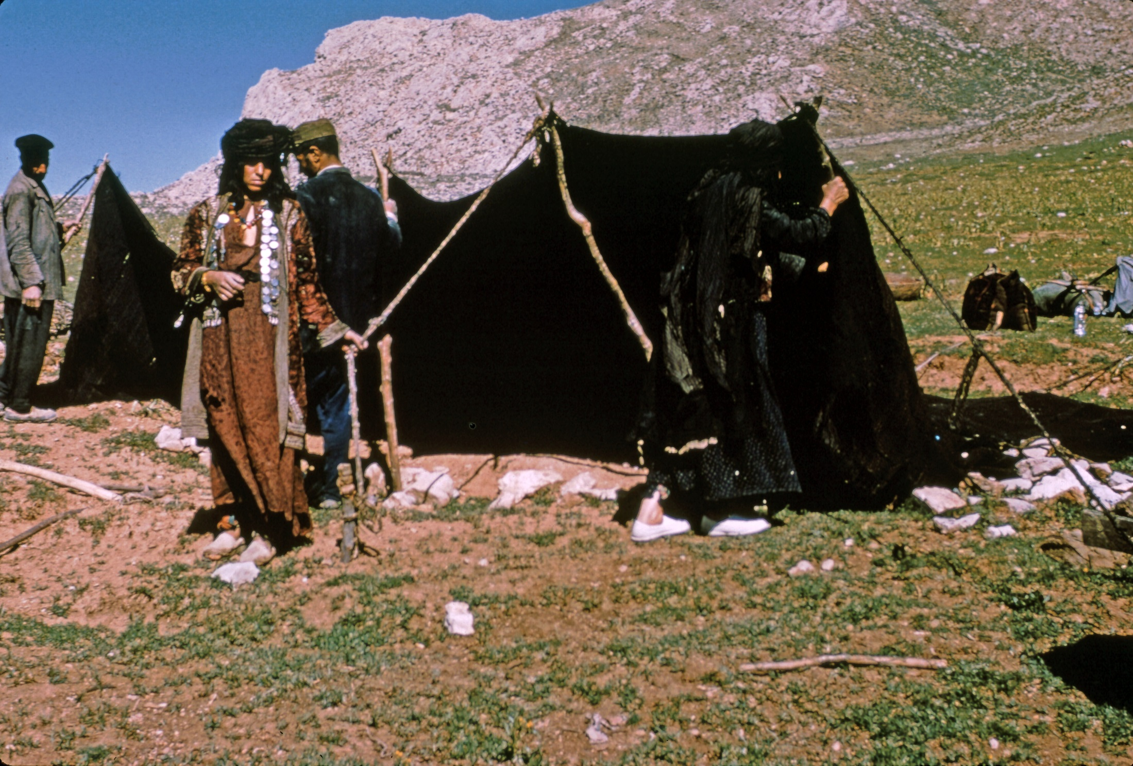

Slide 19
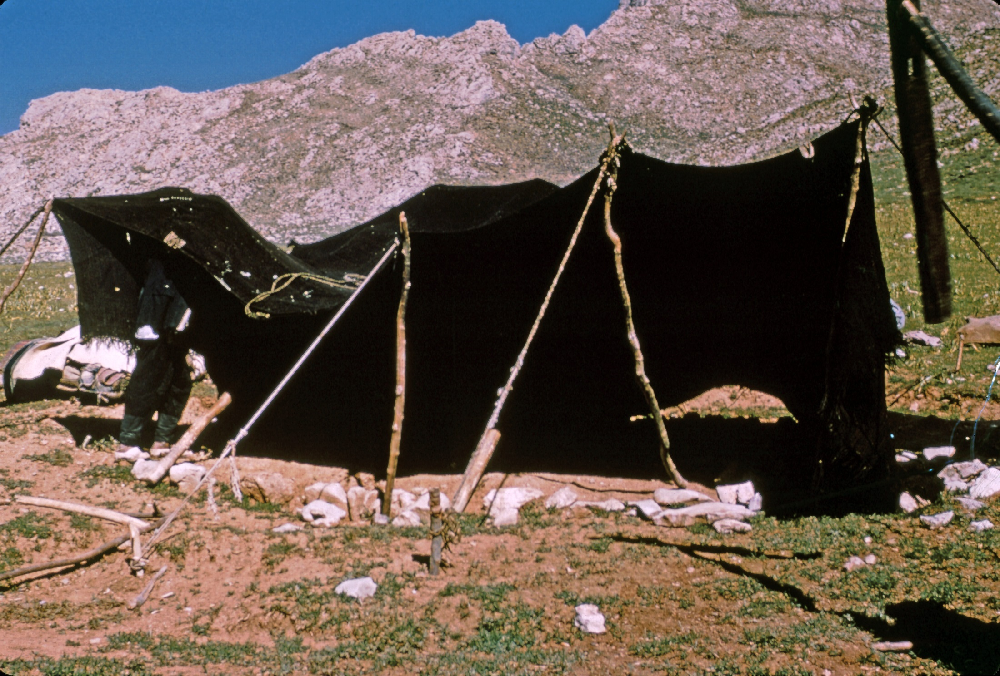

Slide 20
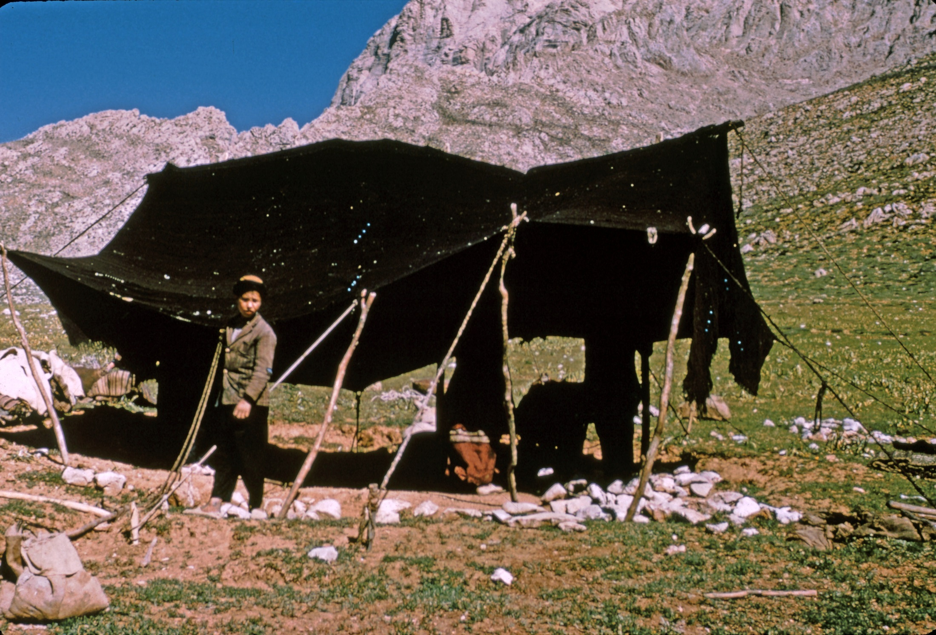

Slide 21
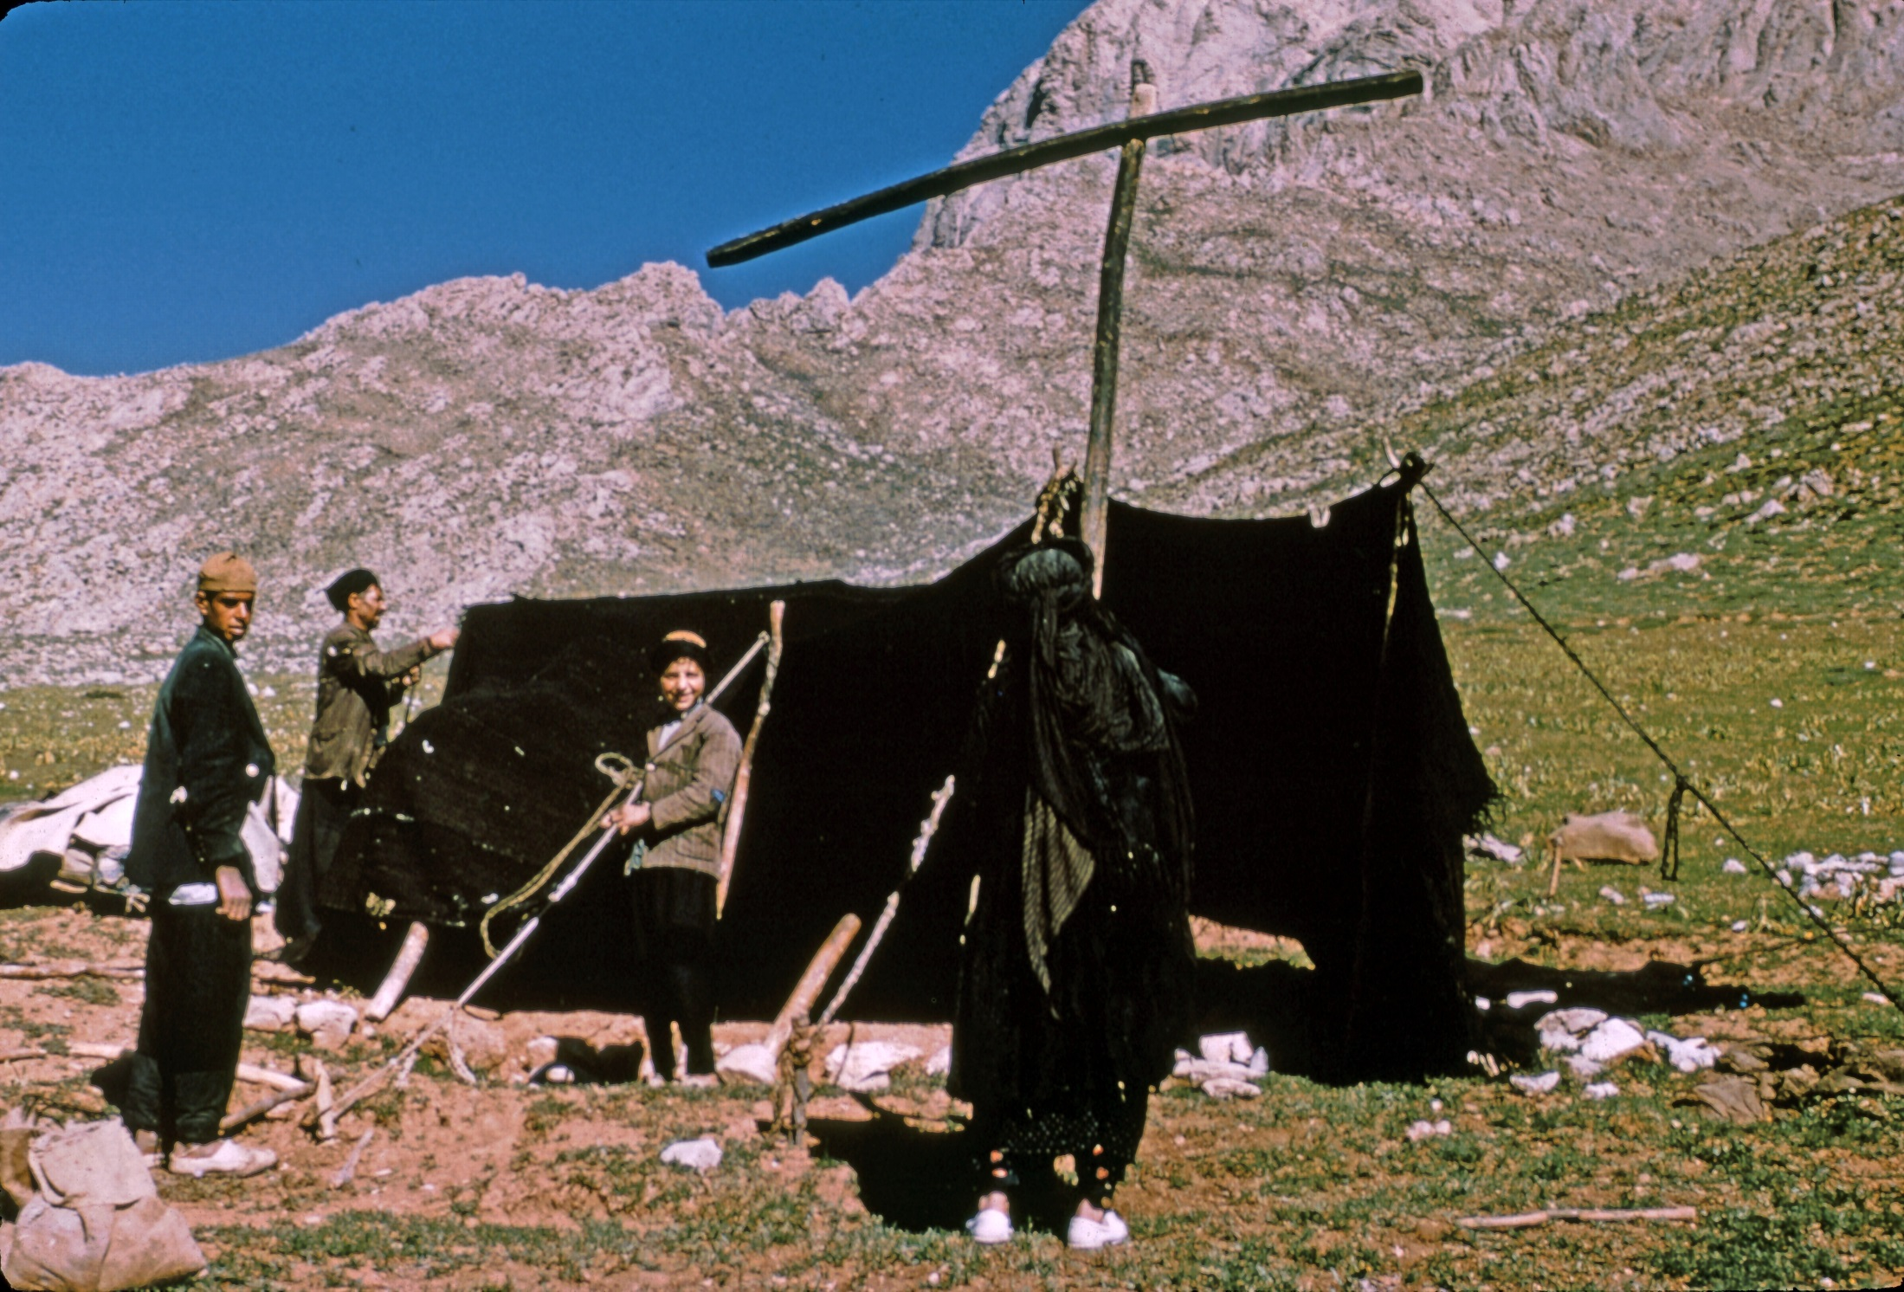

Slide 22
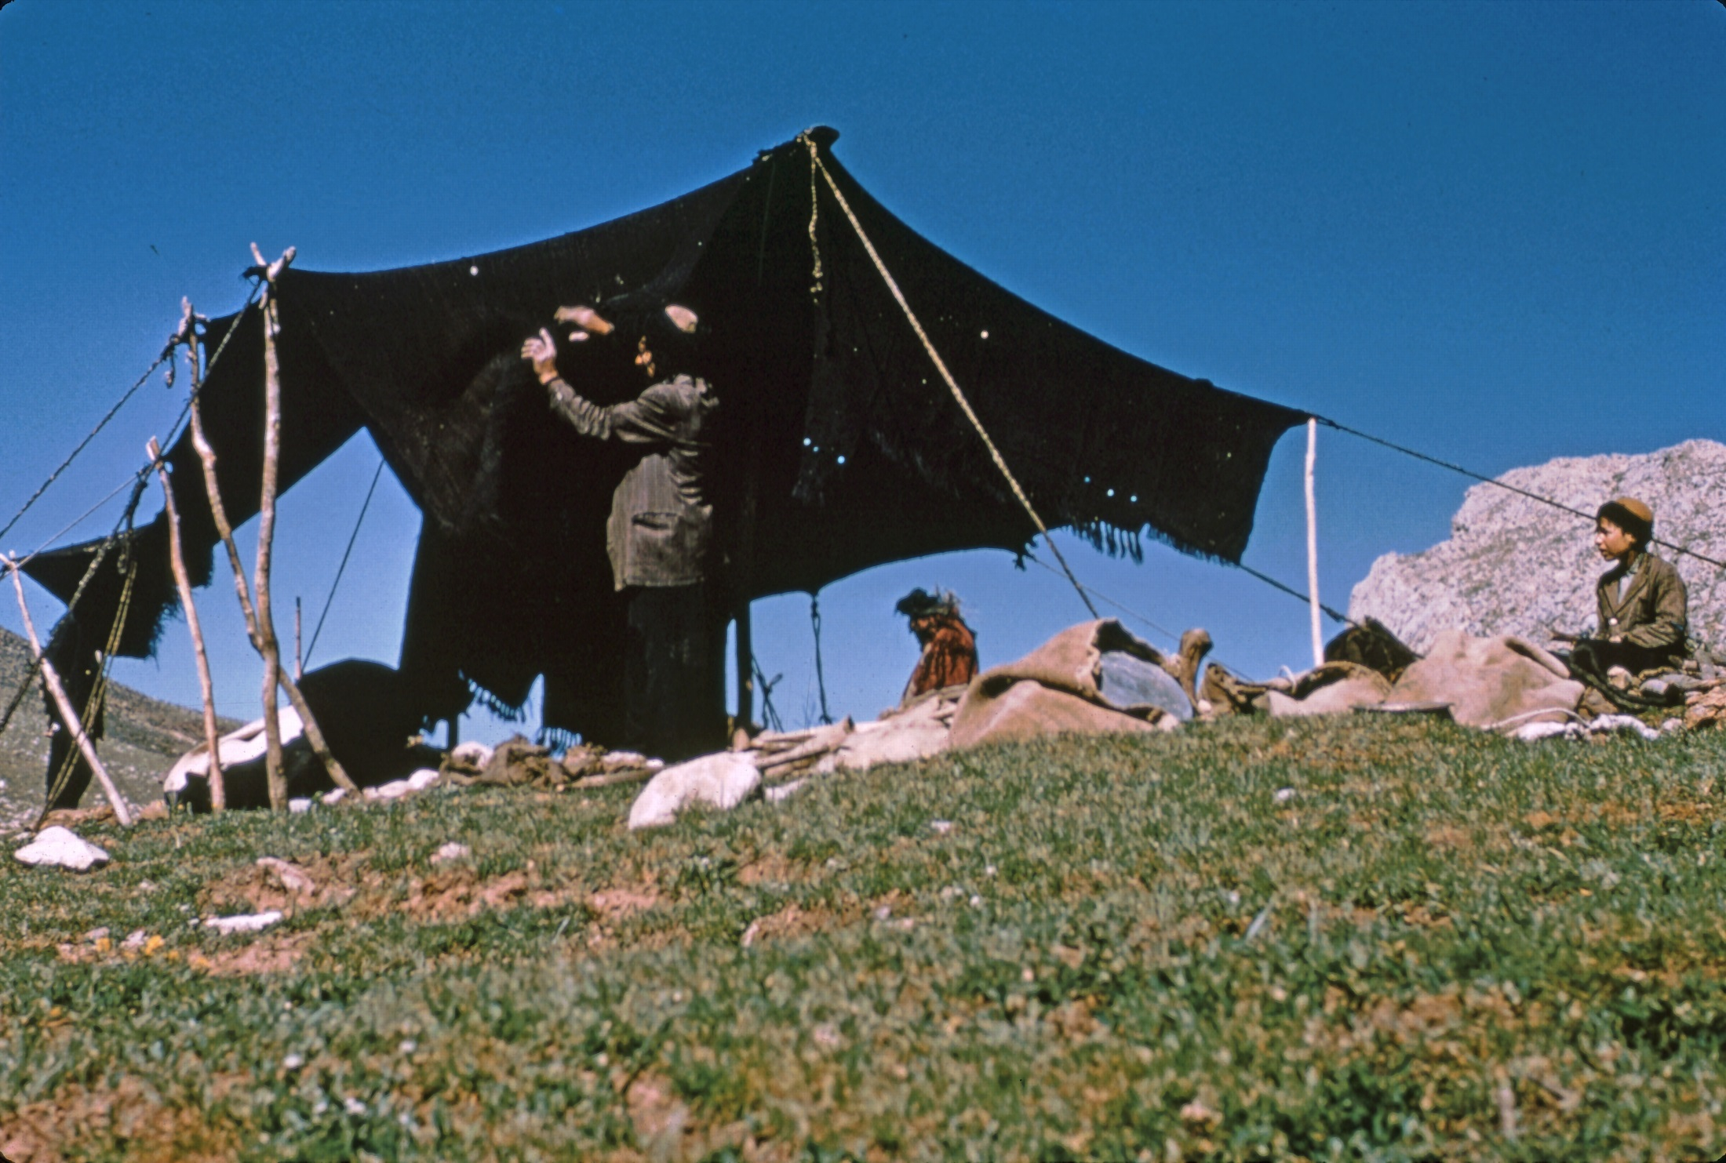

Slide 23
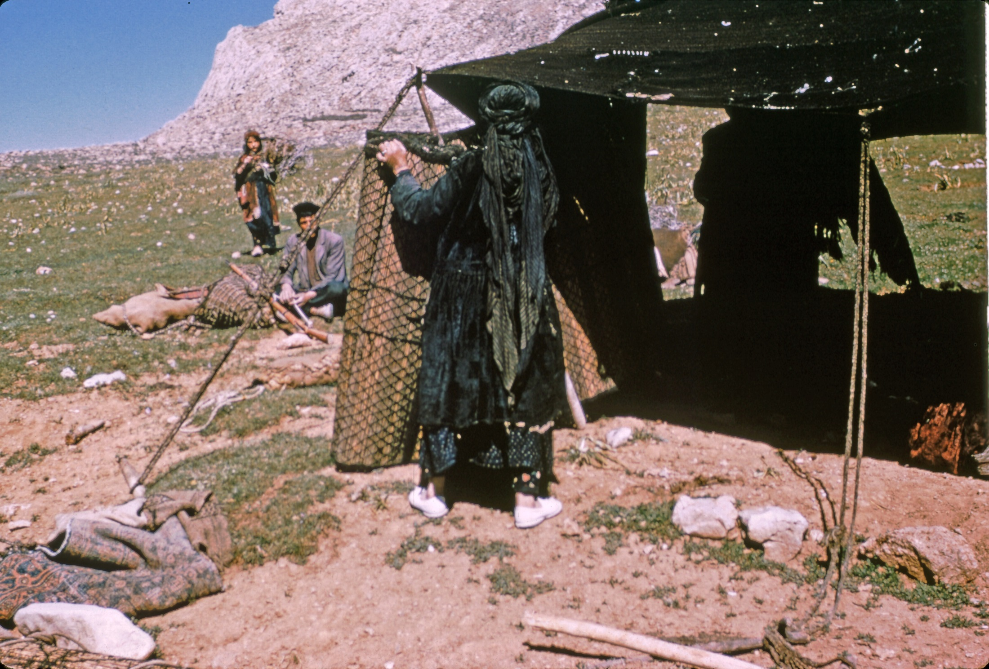

Slide 24
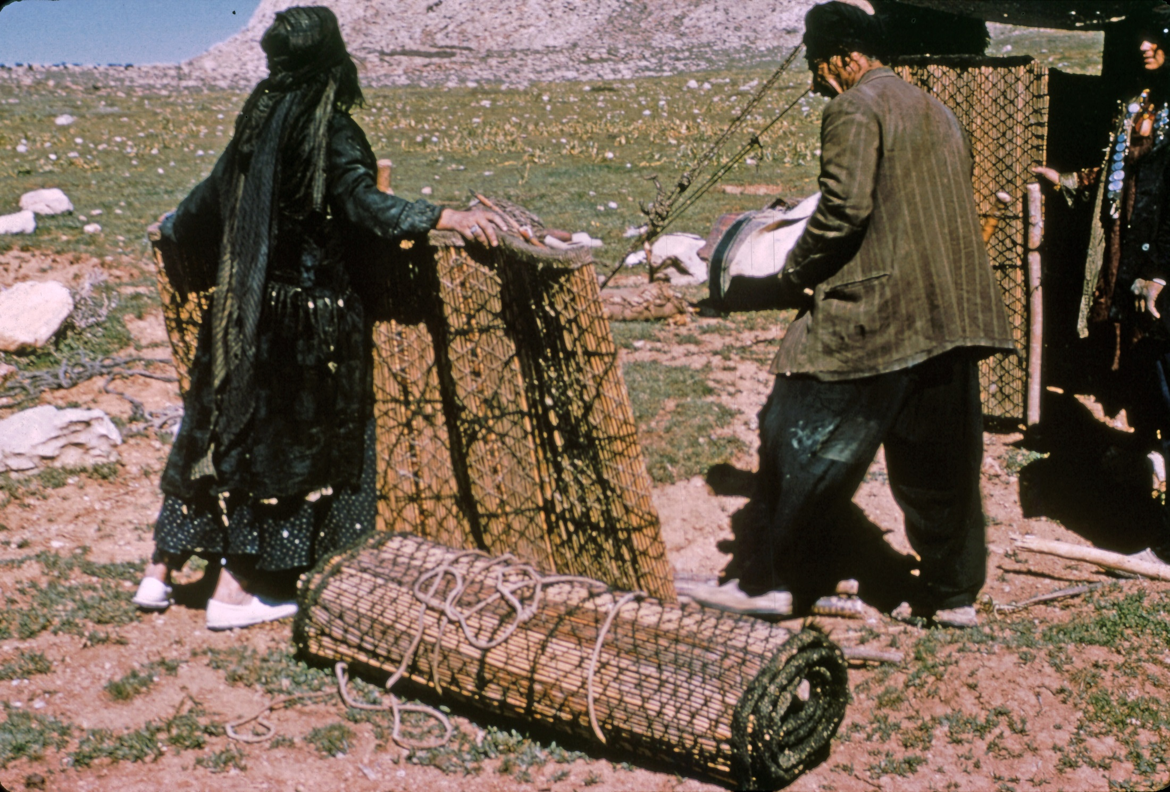

Slide 25
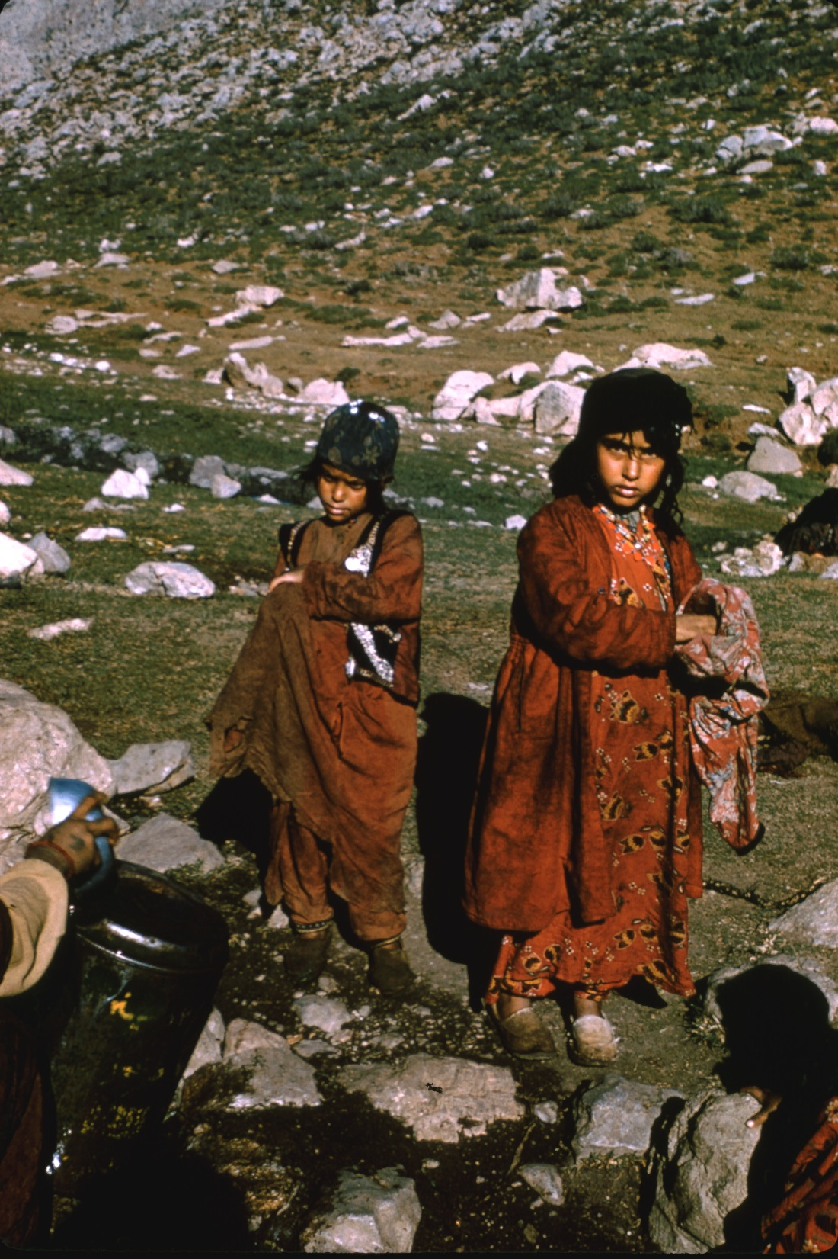

Slide 26
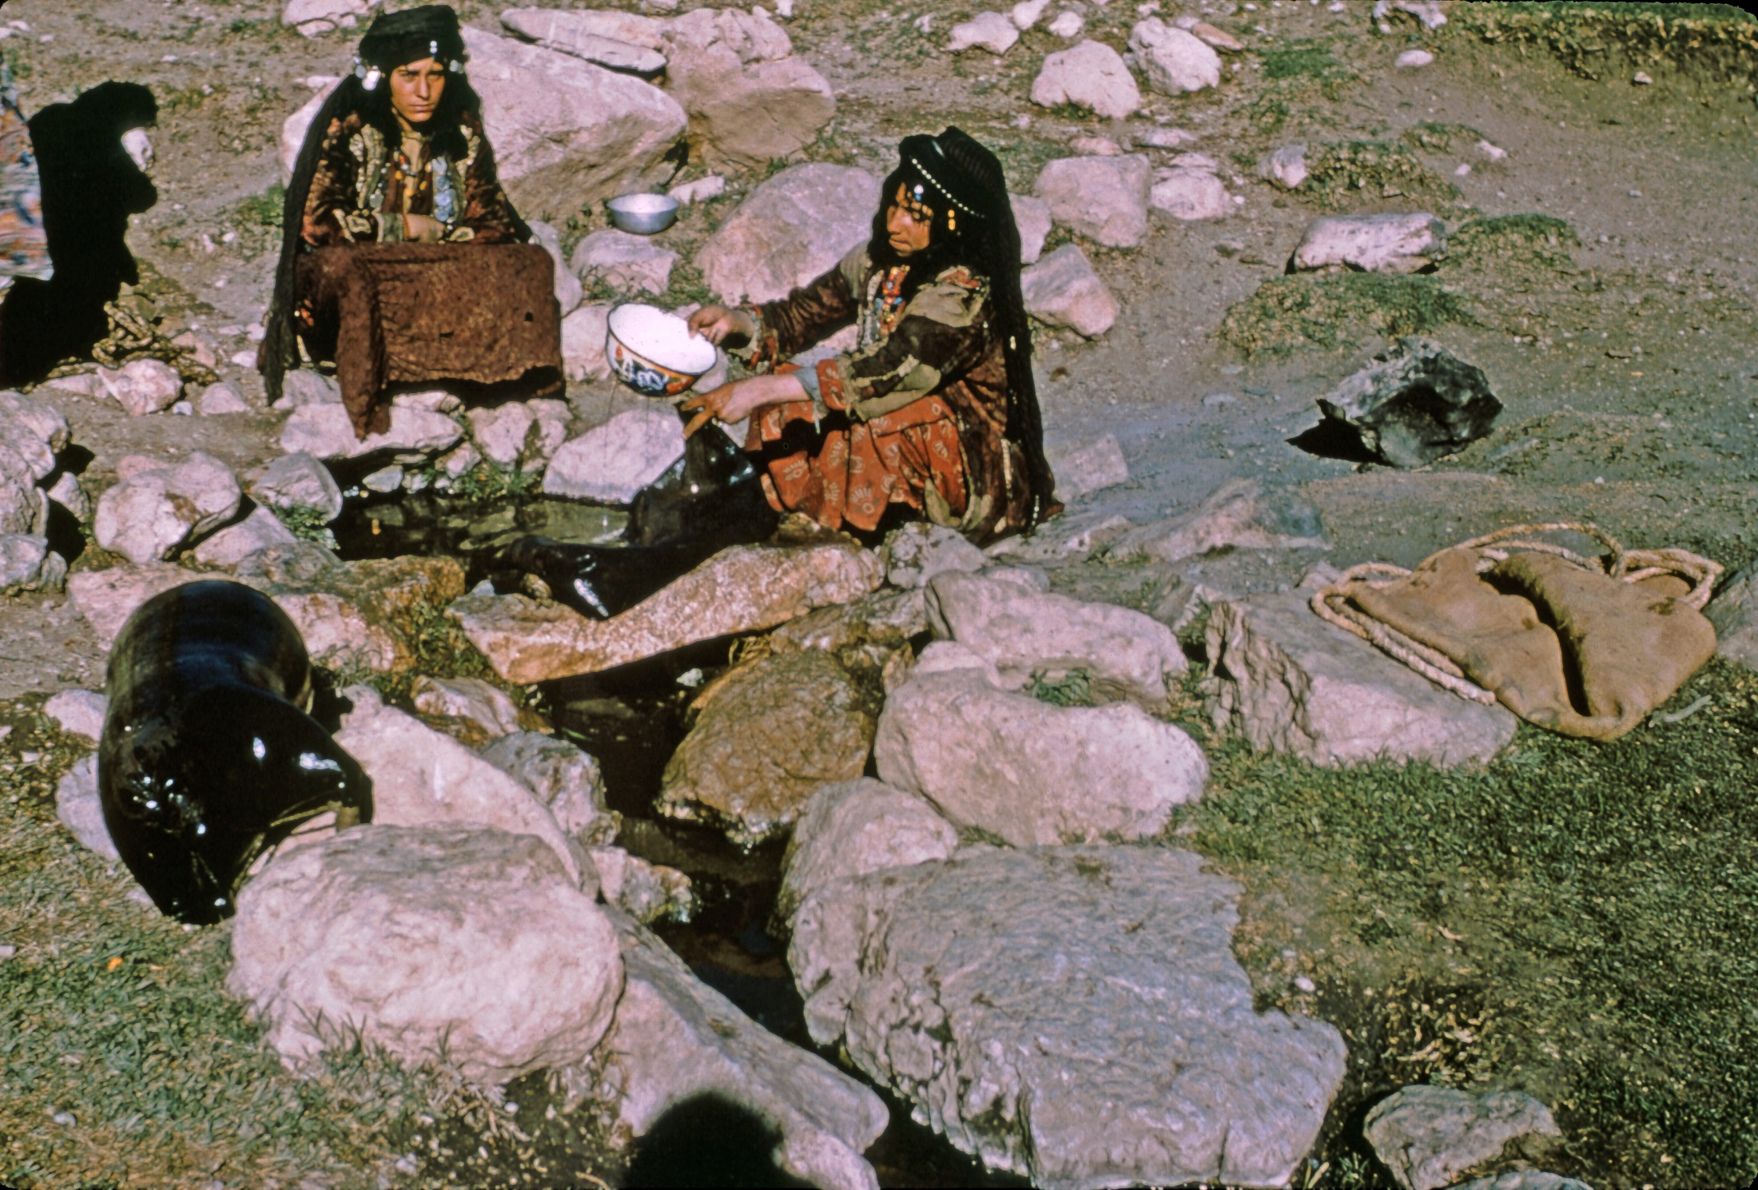

Slide 27
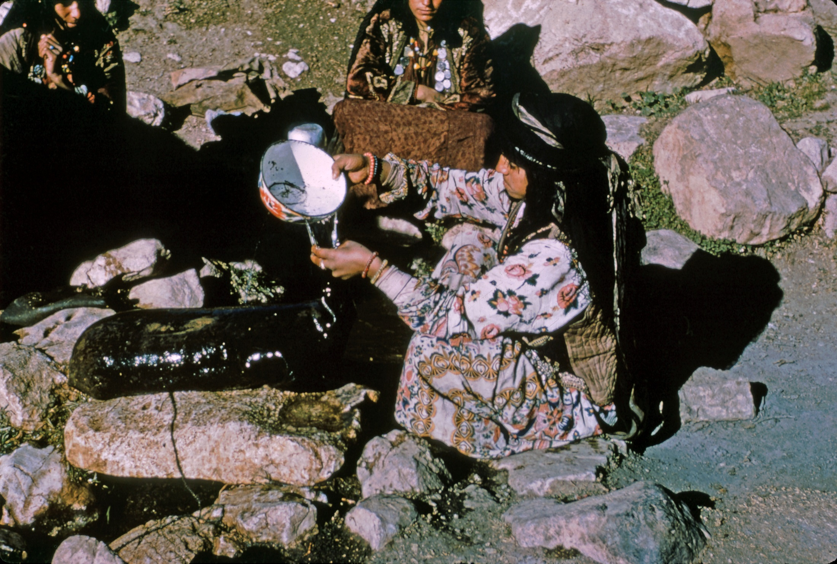

Slide 28
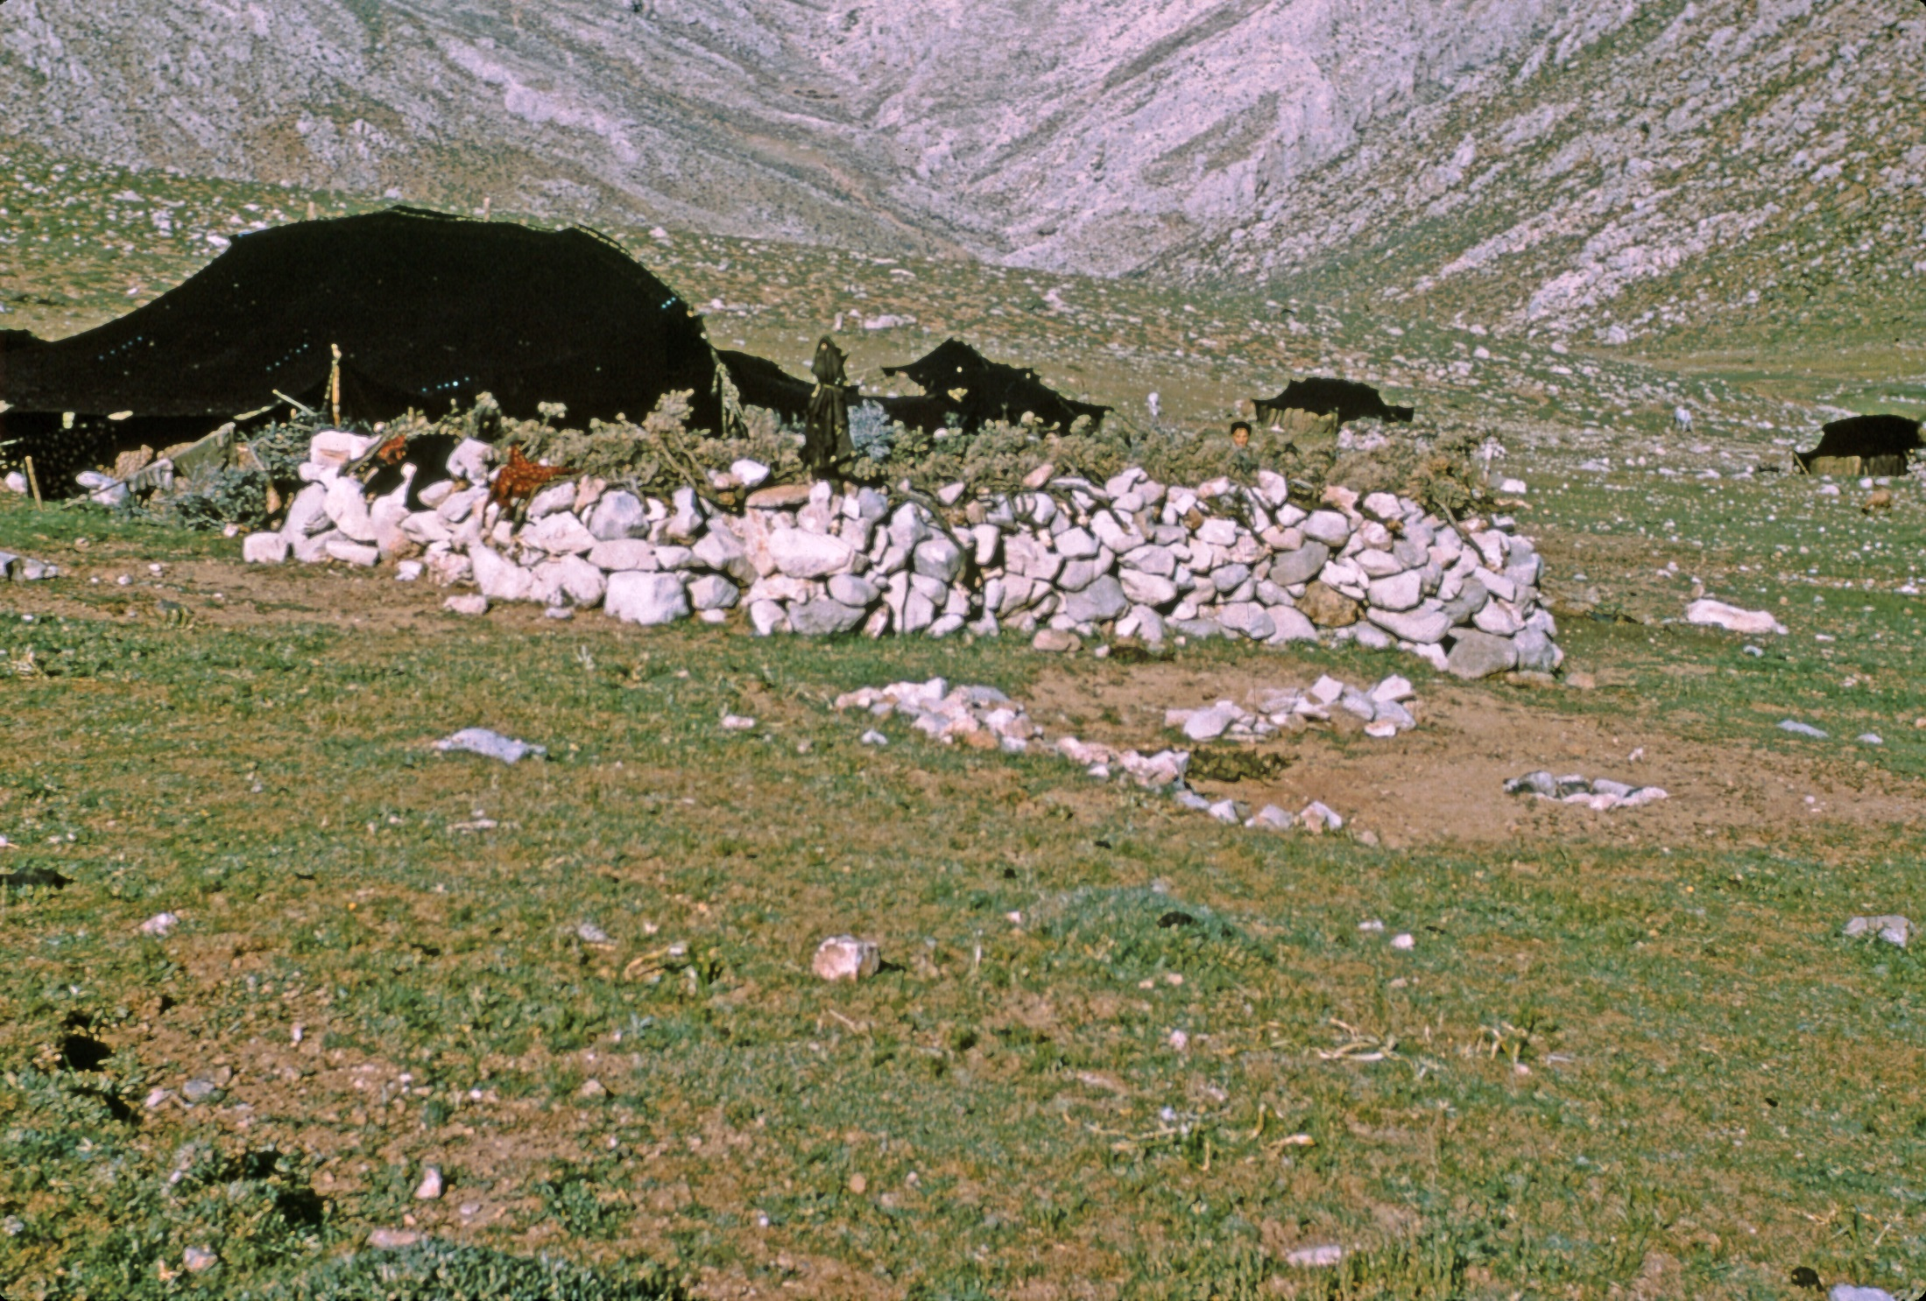

Slide 29
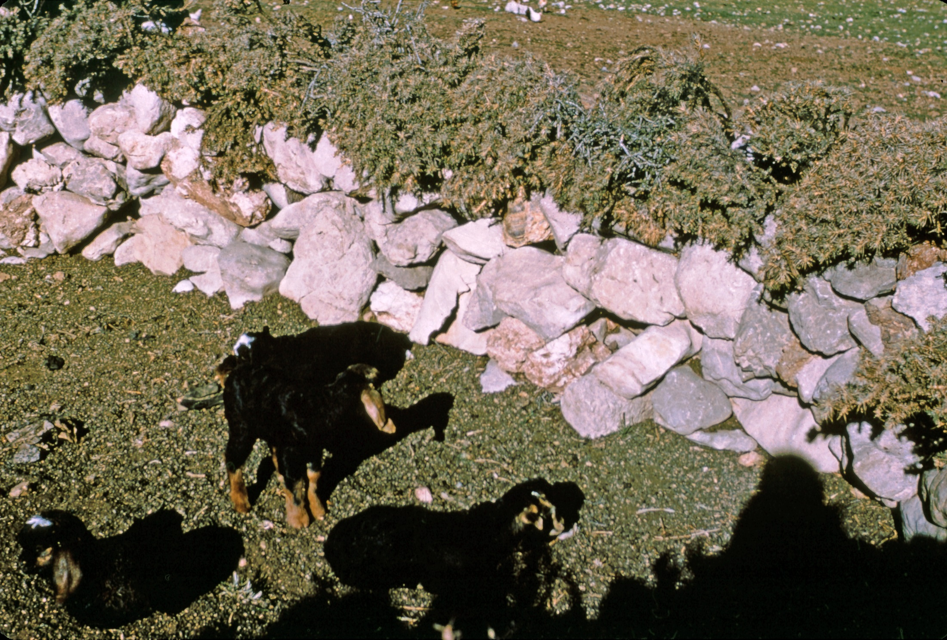

Slide 30
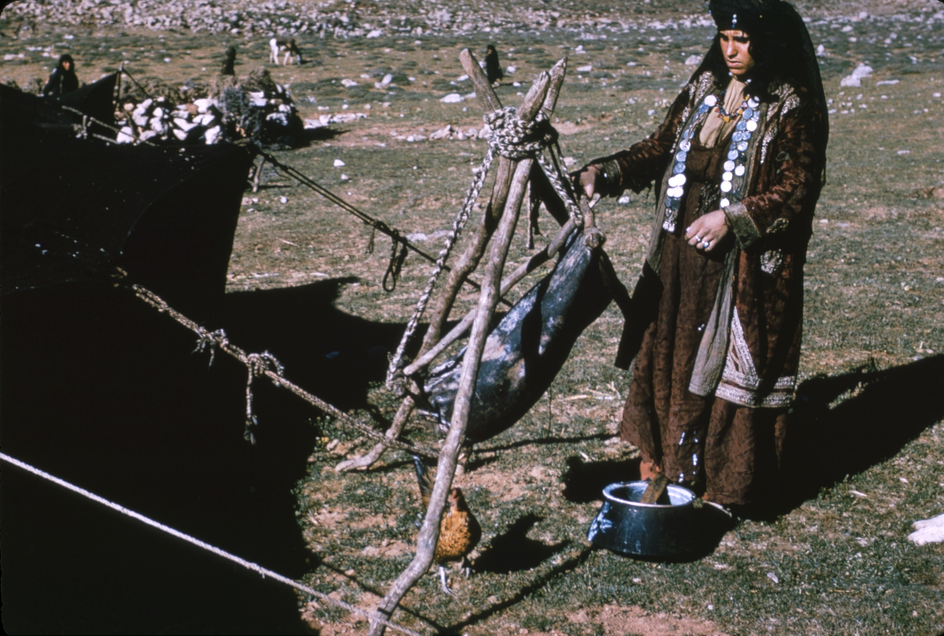

Slide 31
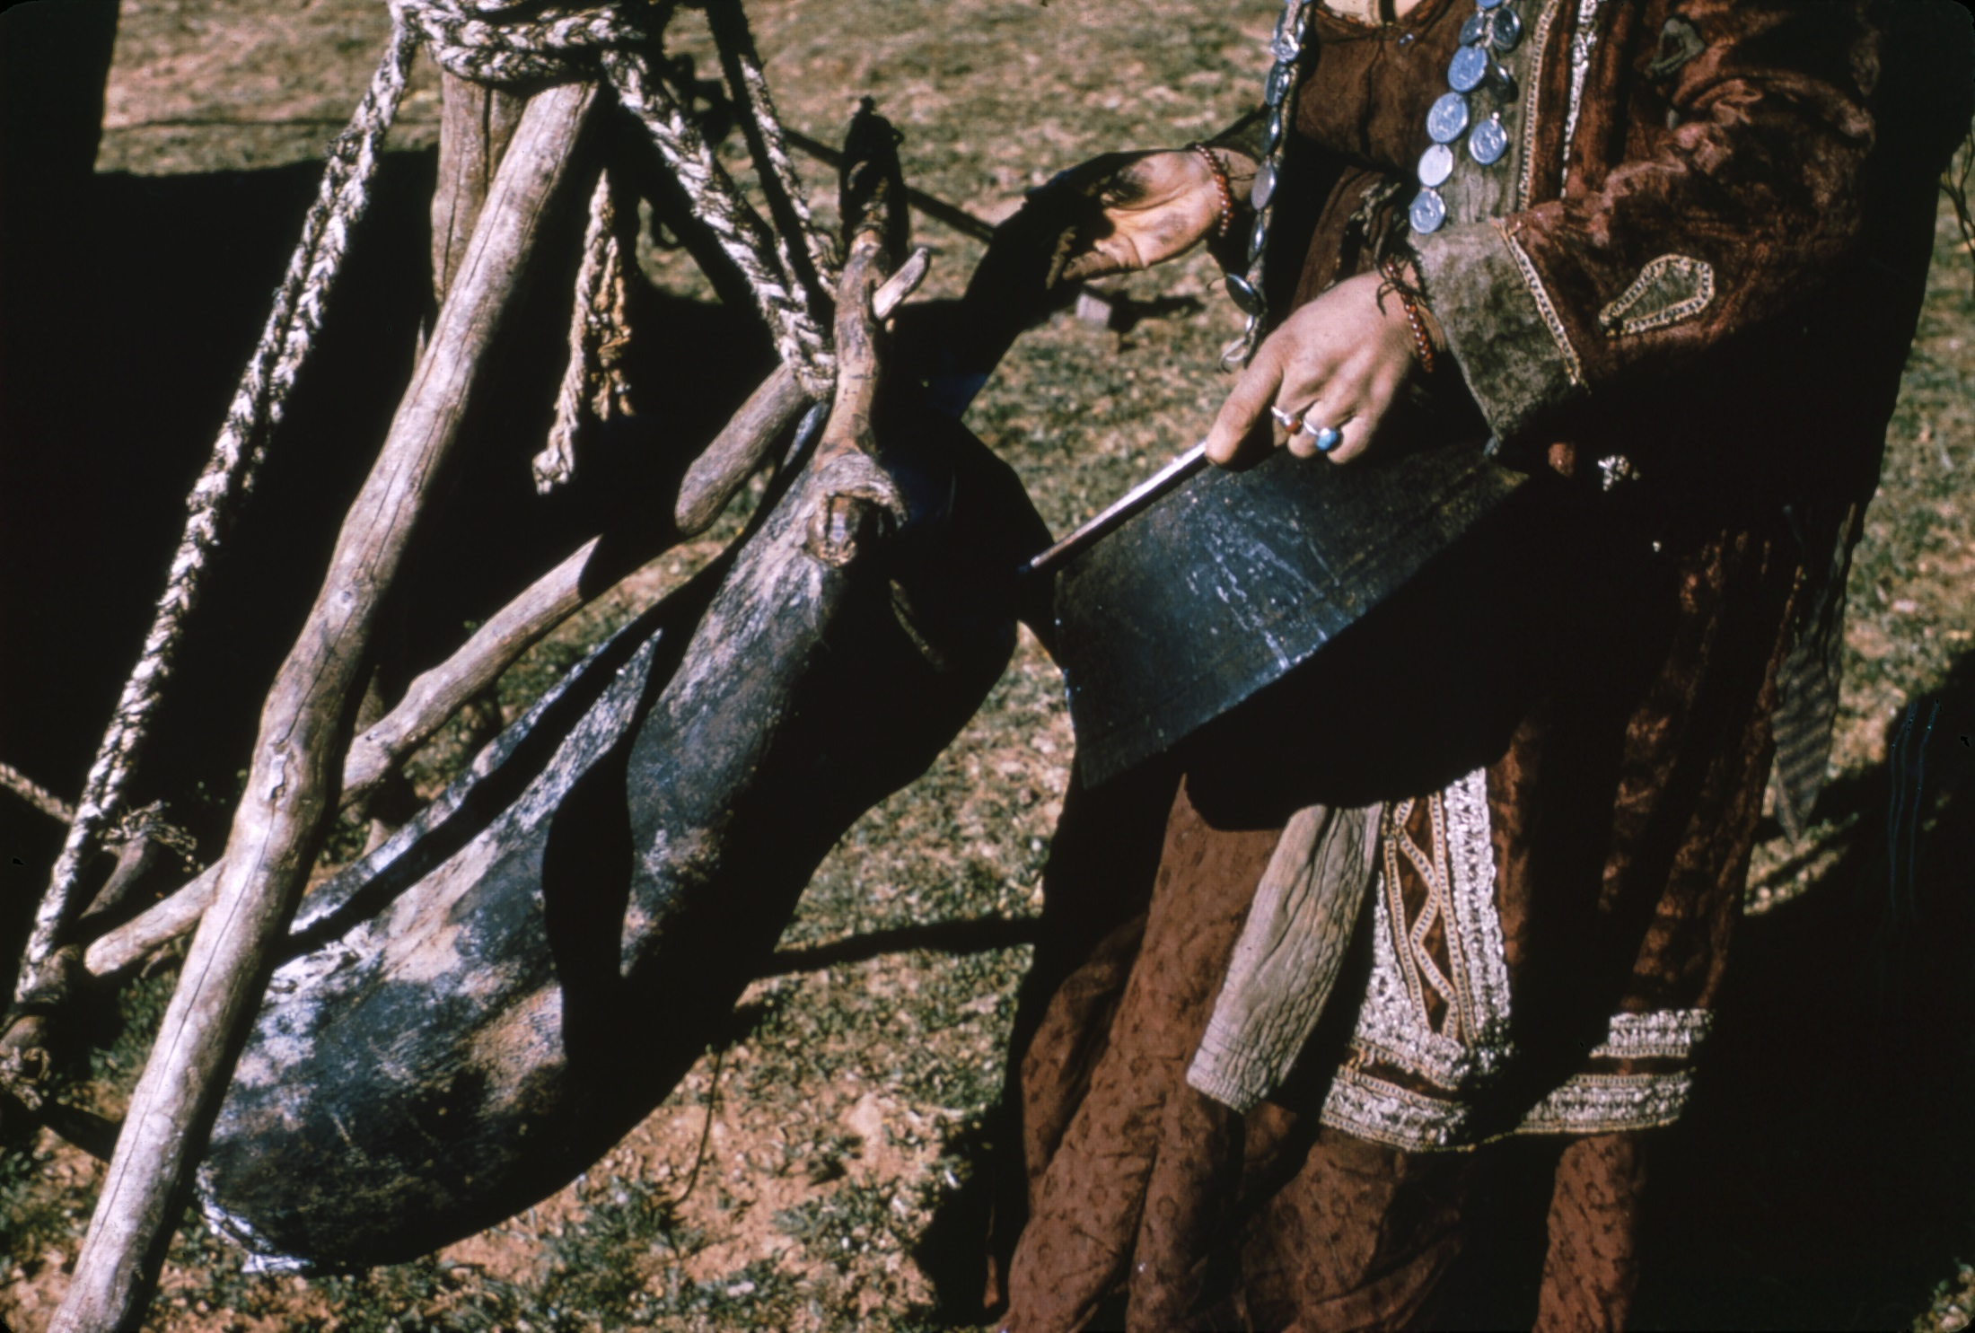

Slide 32
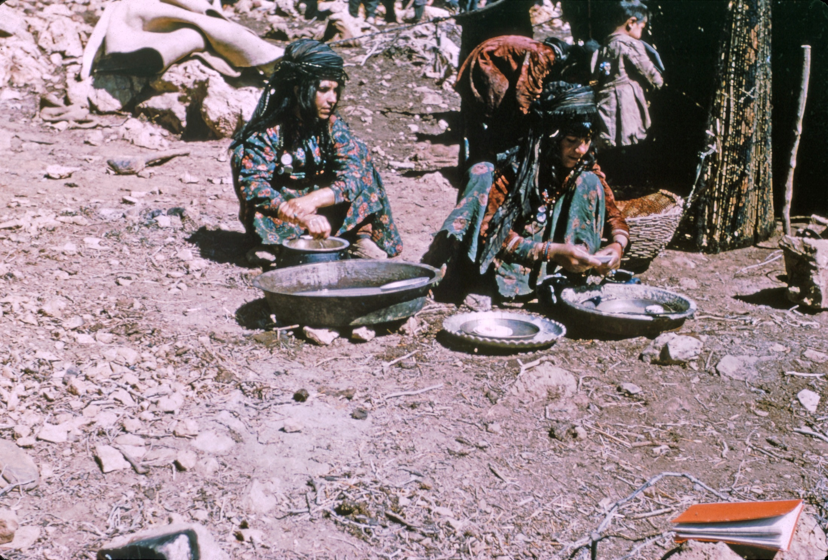

Slide 33
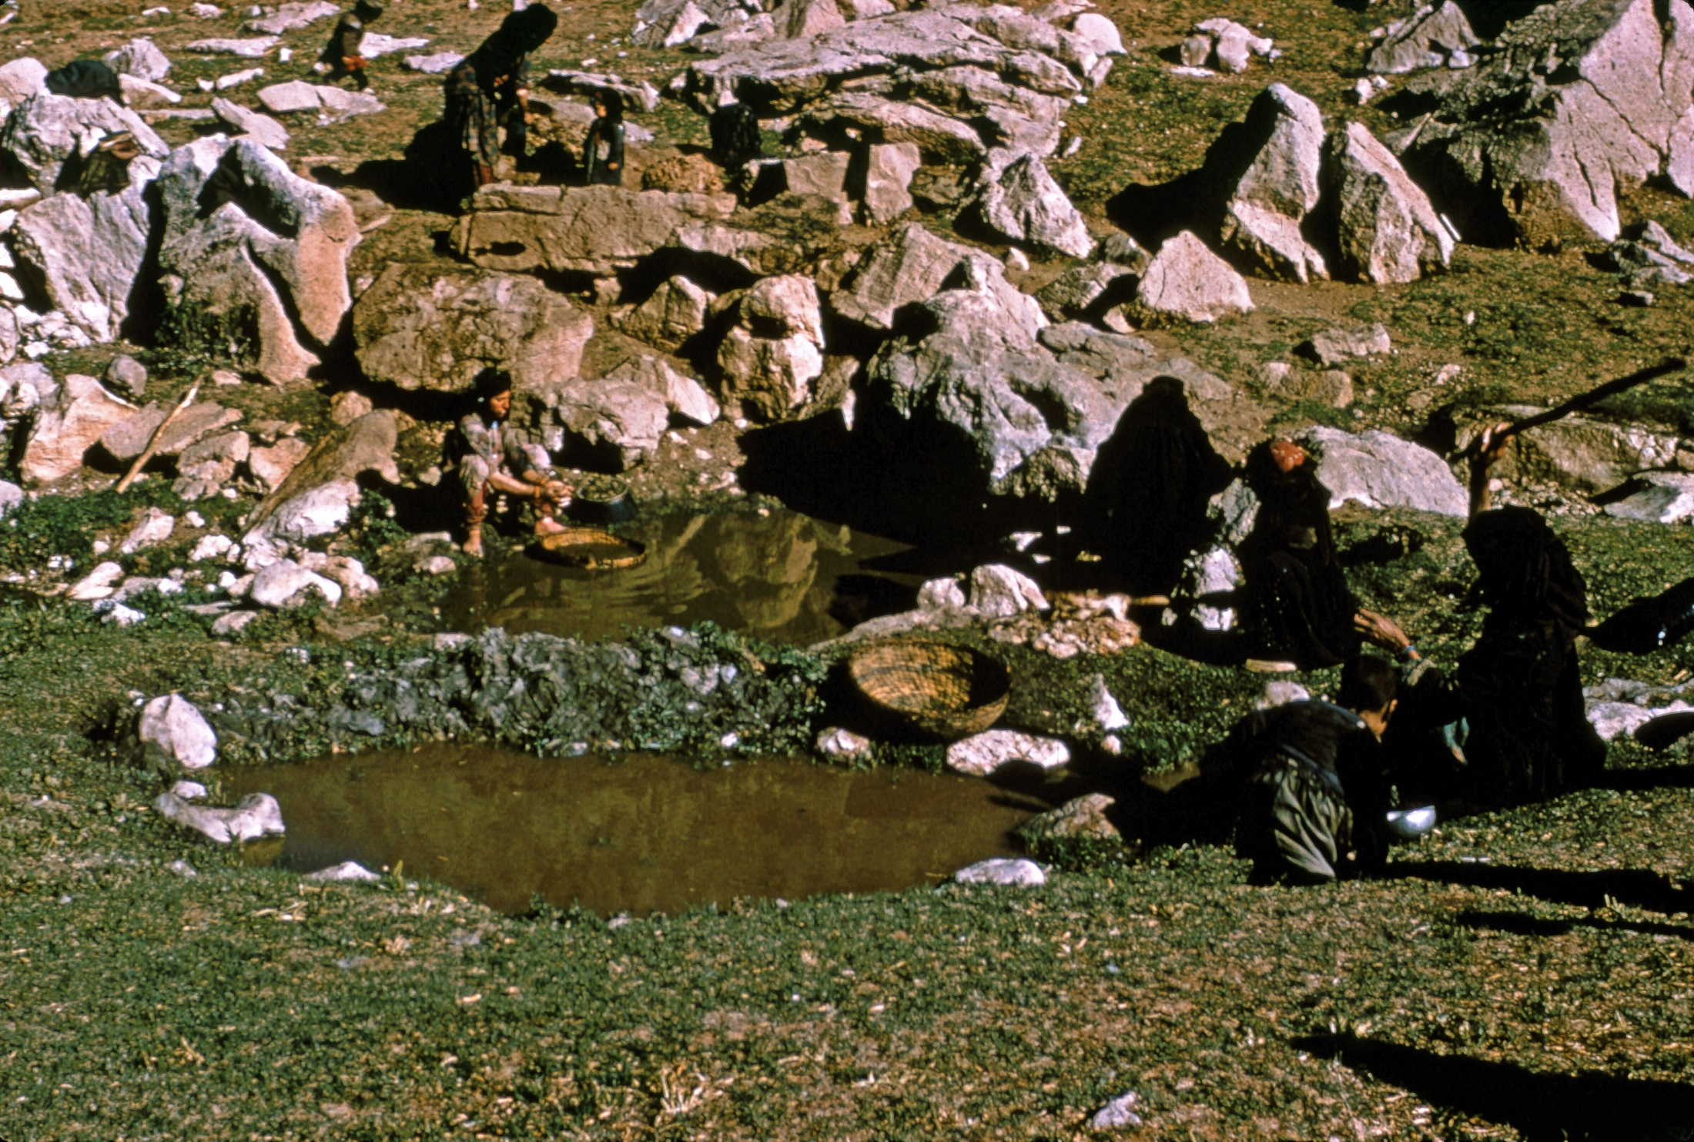

Slide 34
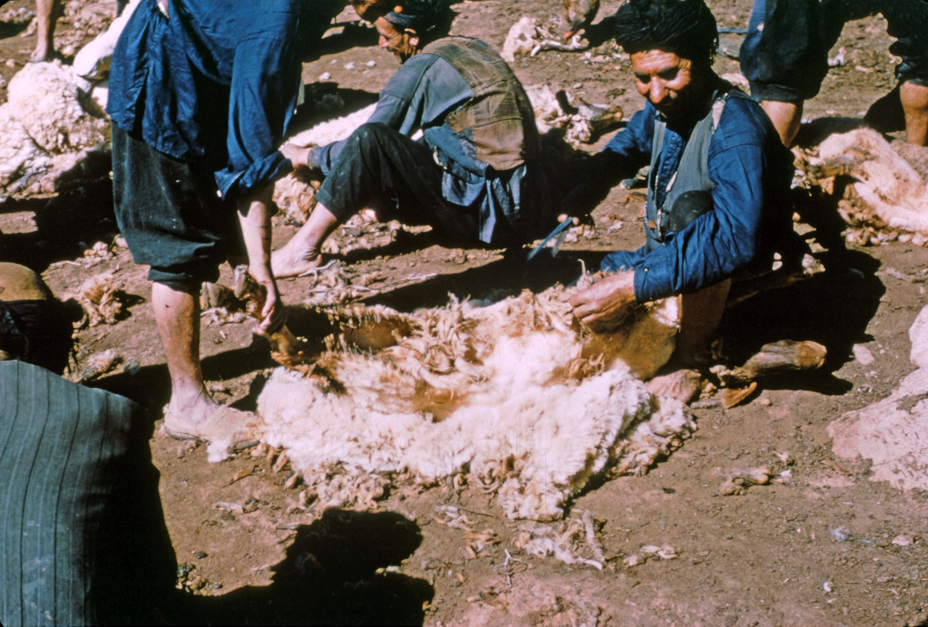

Slide 35
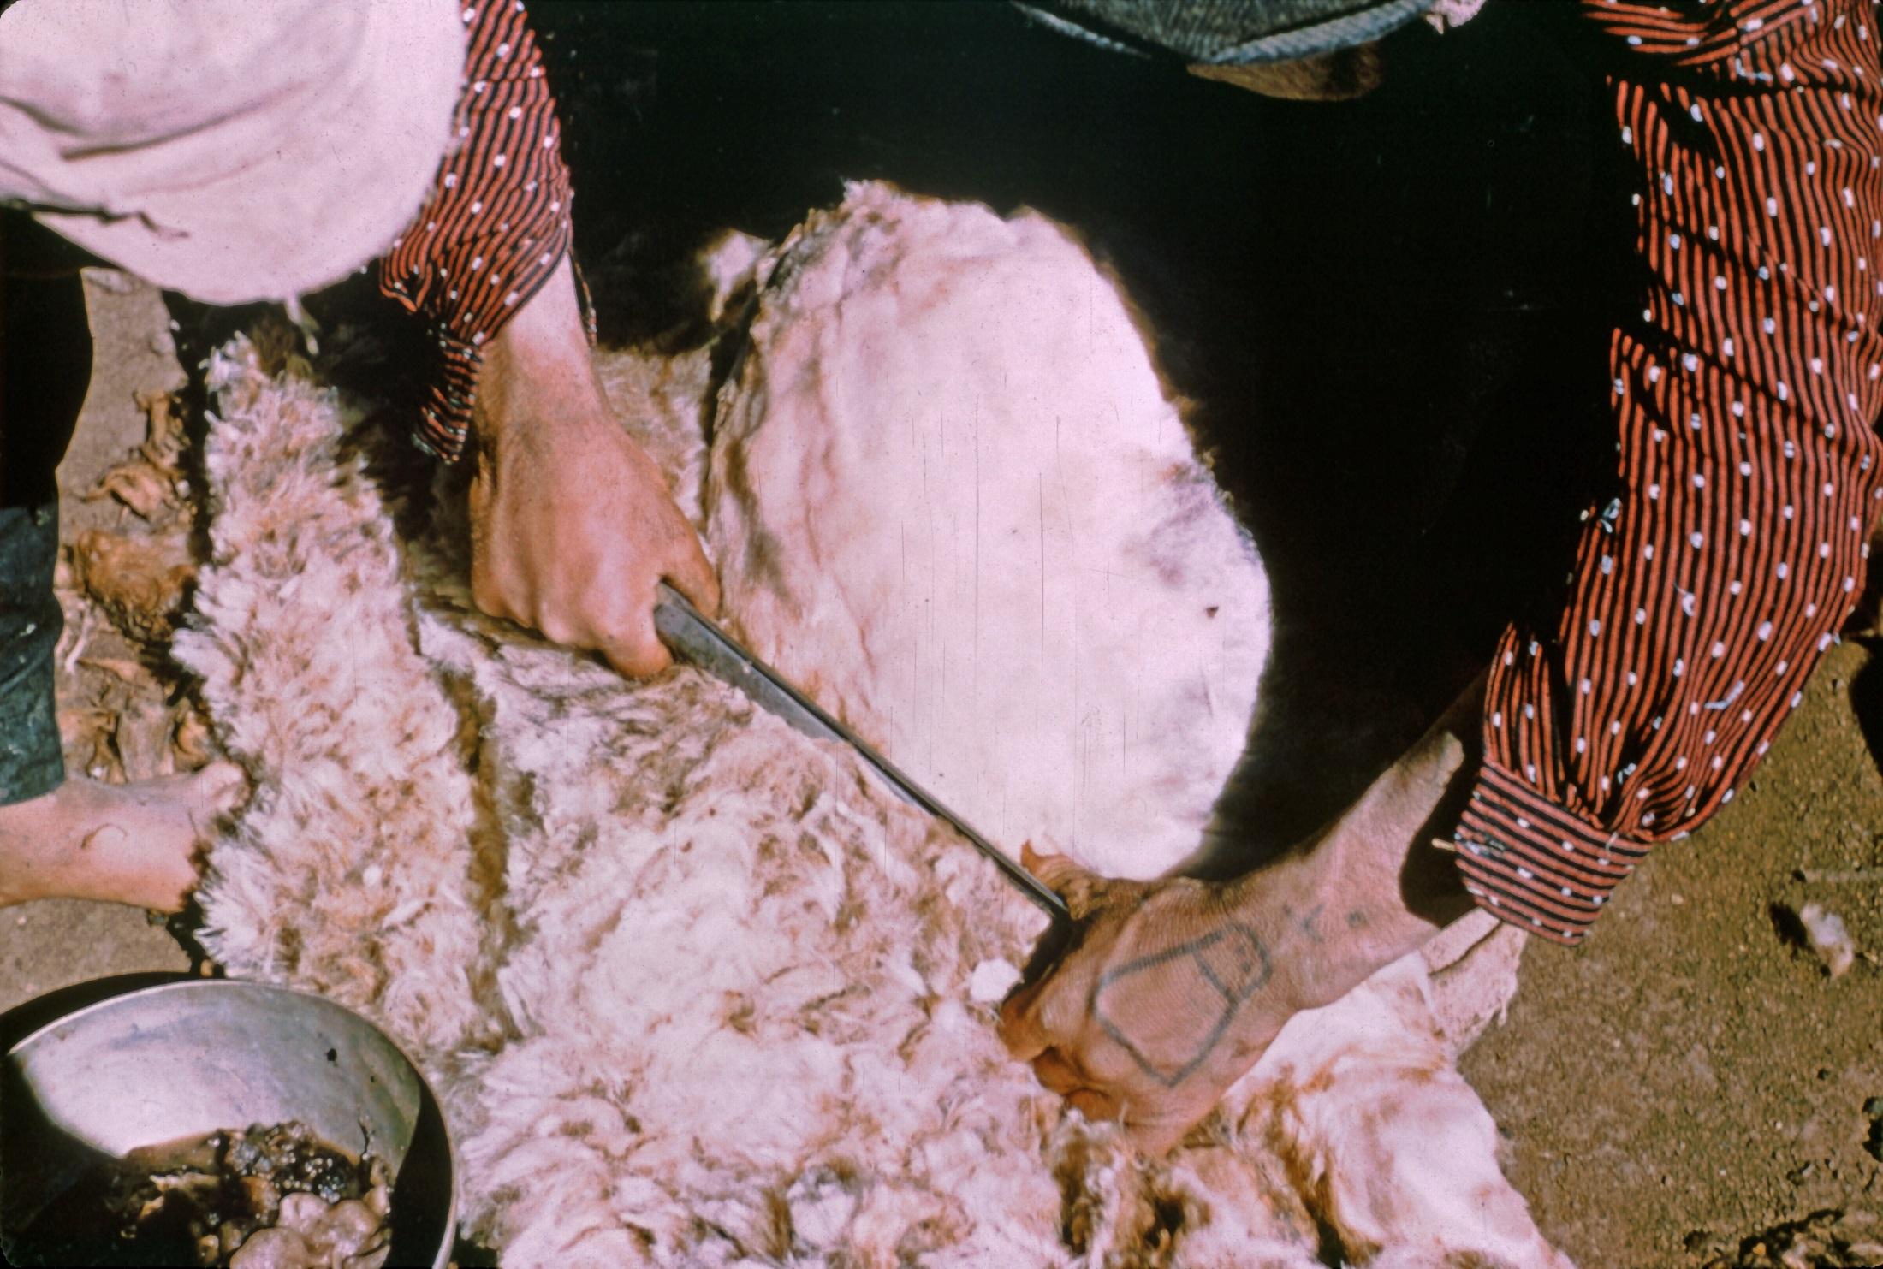

Slide 36
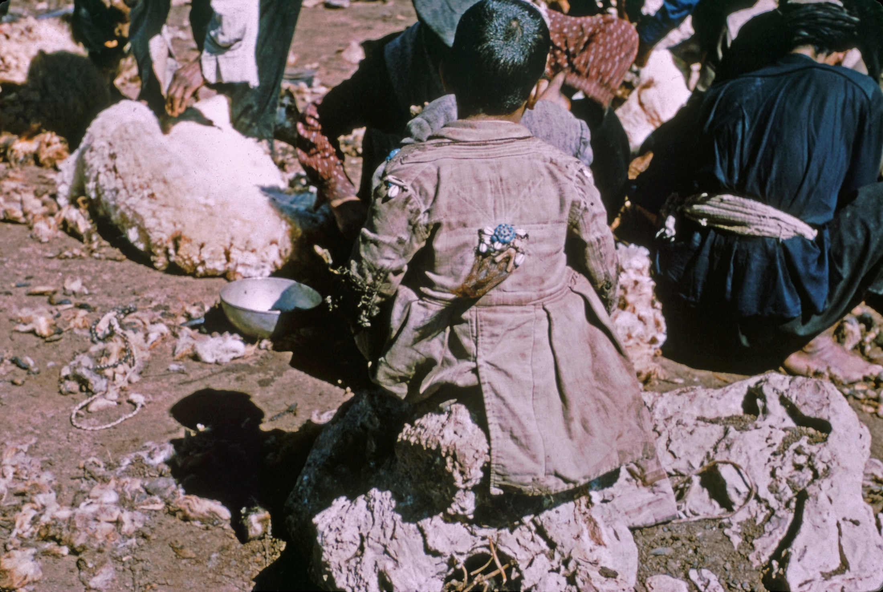

Slide 37
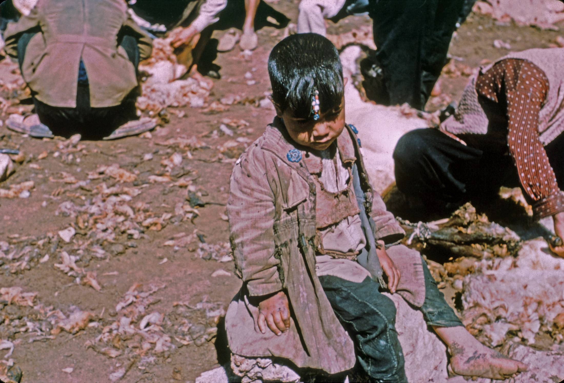

Slide 38
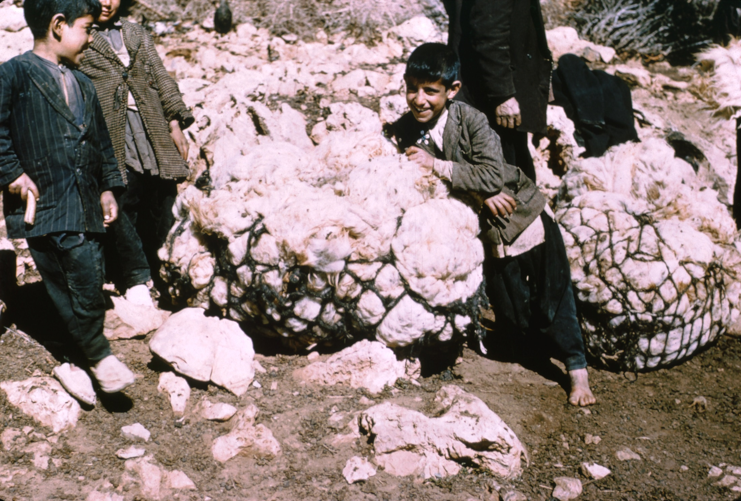

Slide 39
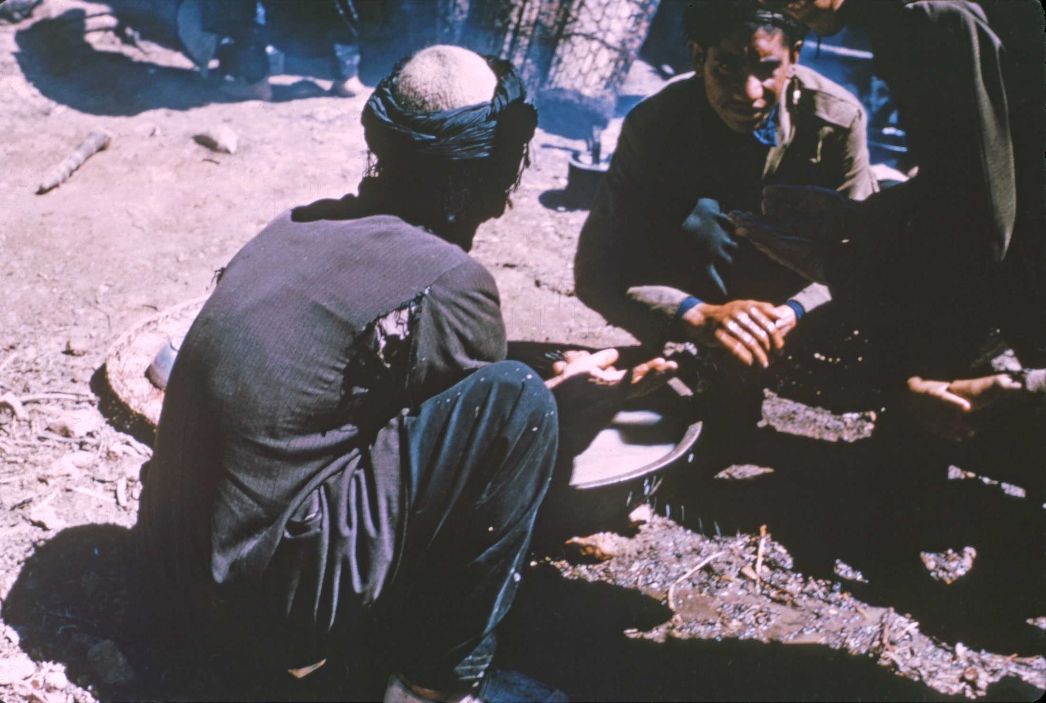

Slide 40
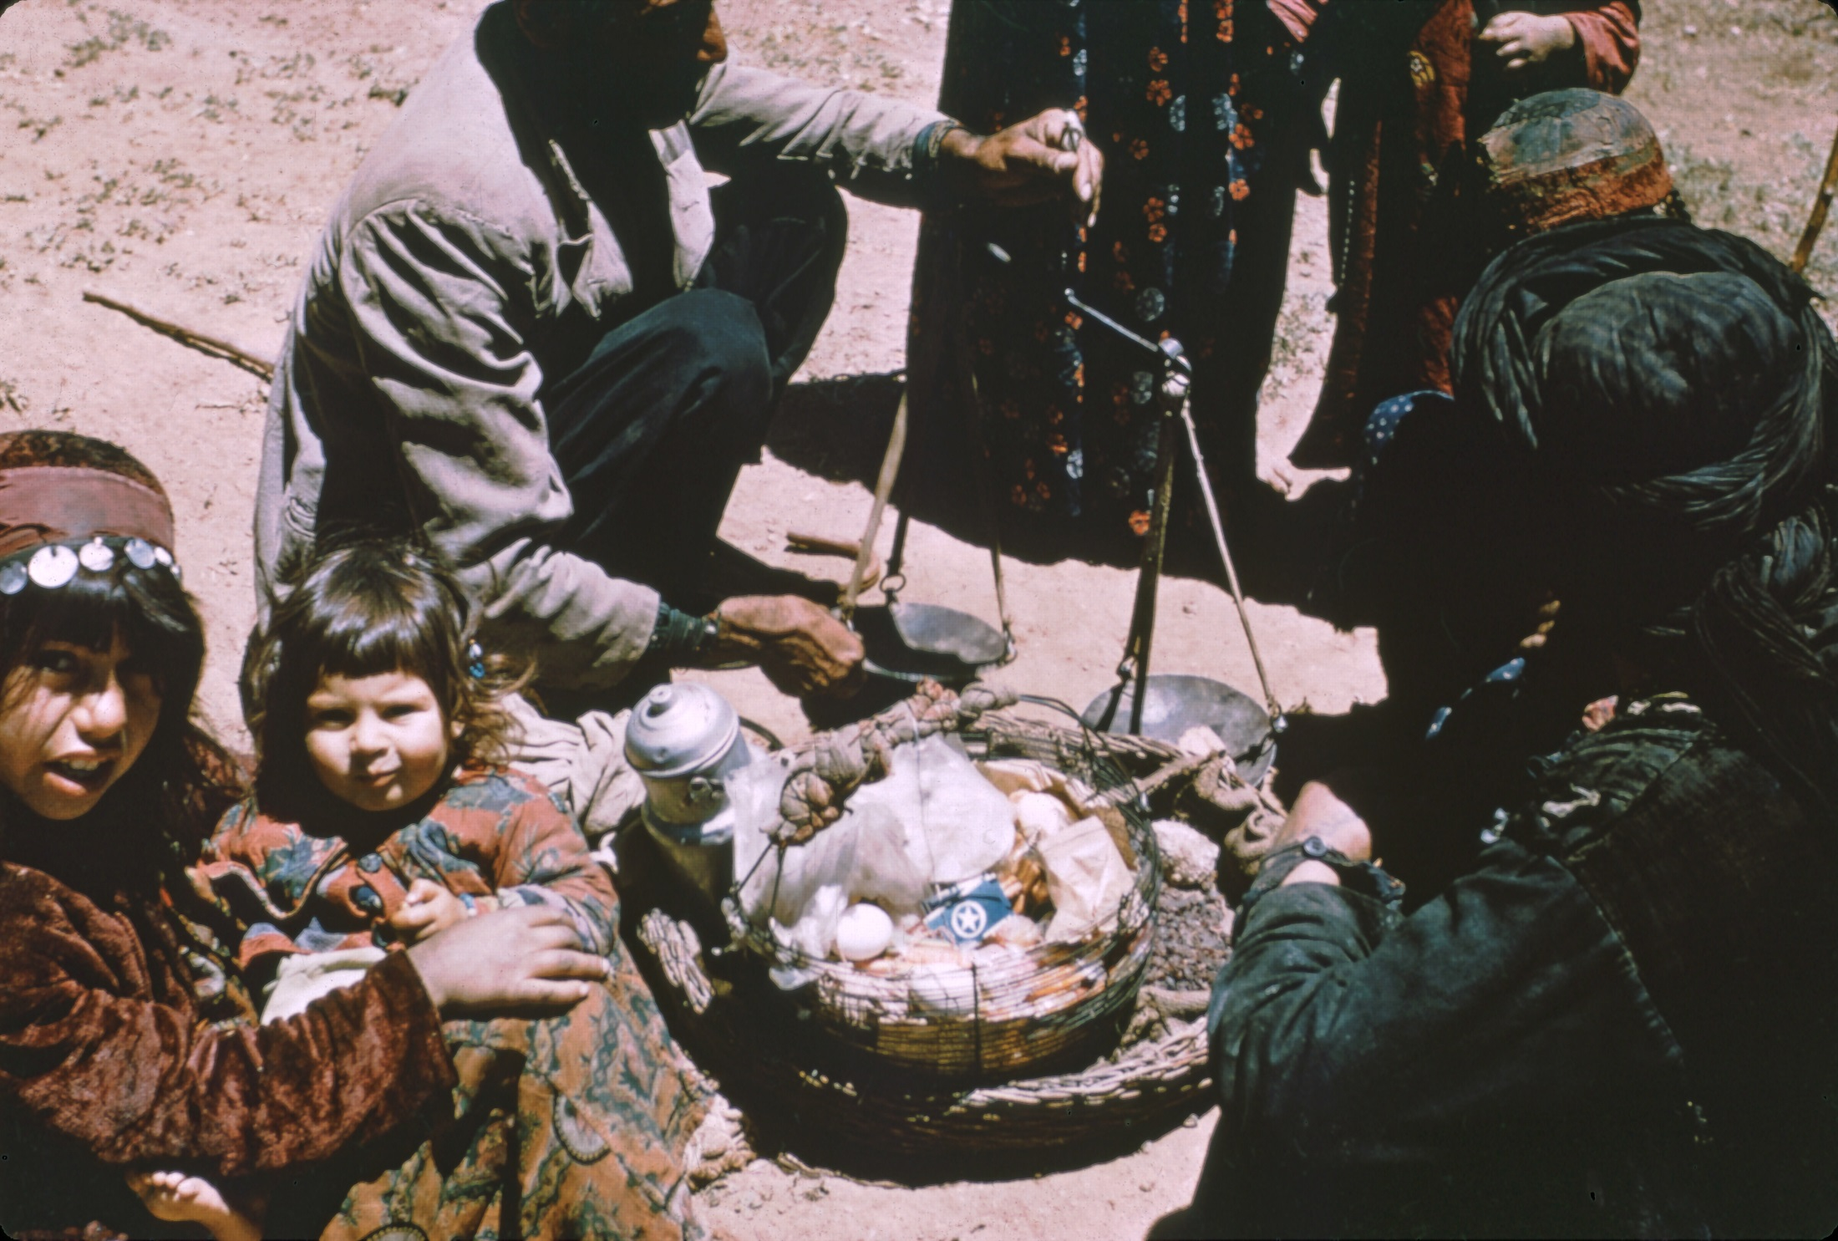

Slide 41
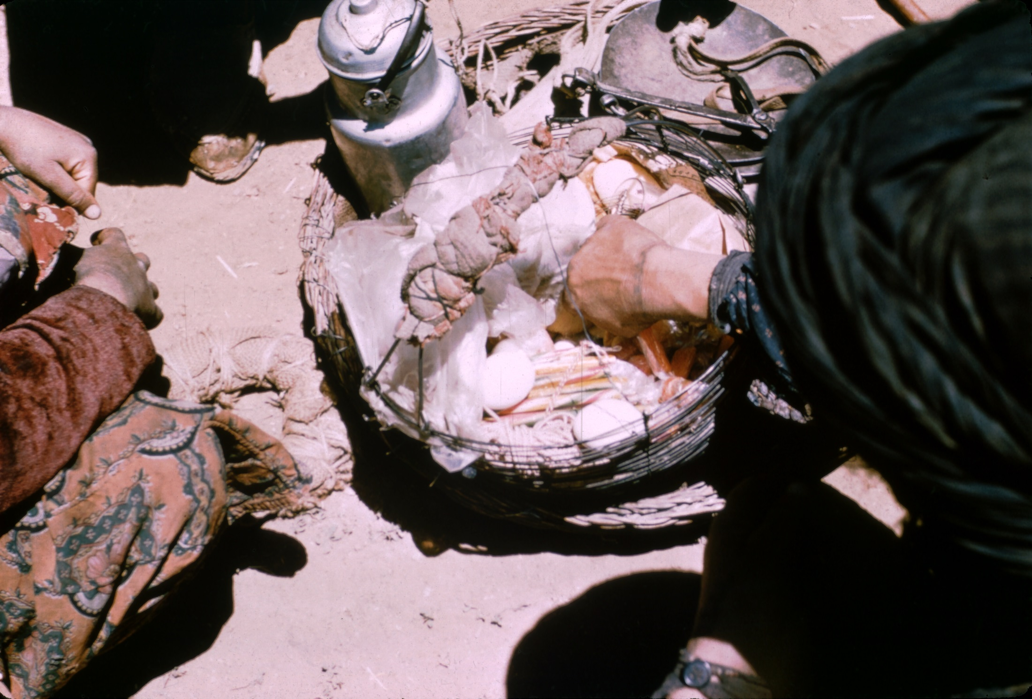

Slide 42
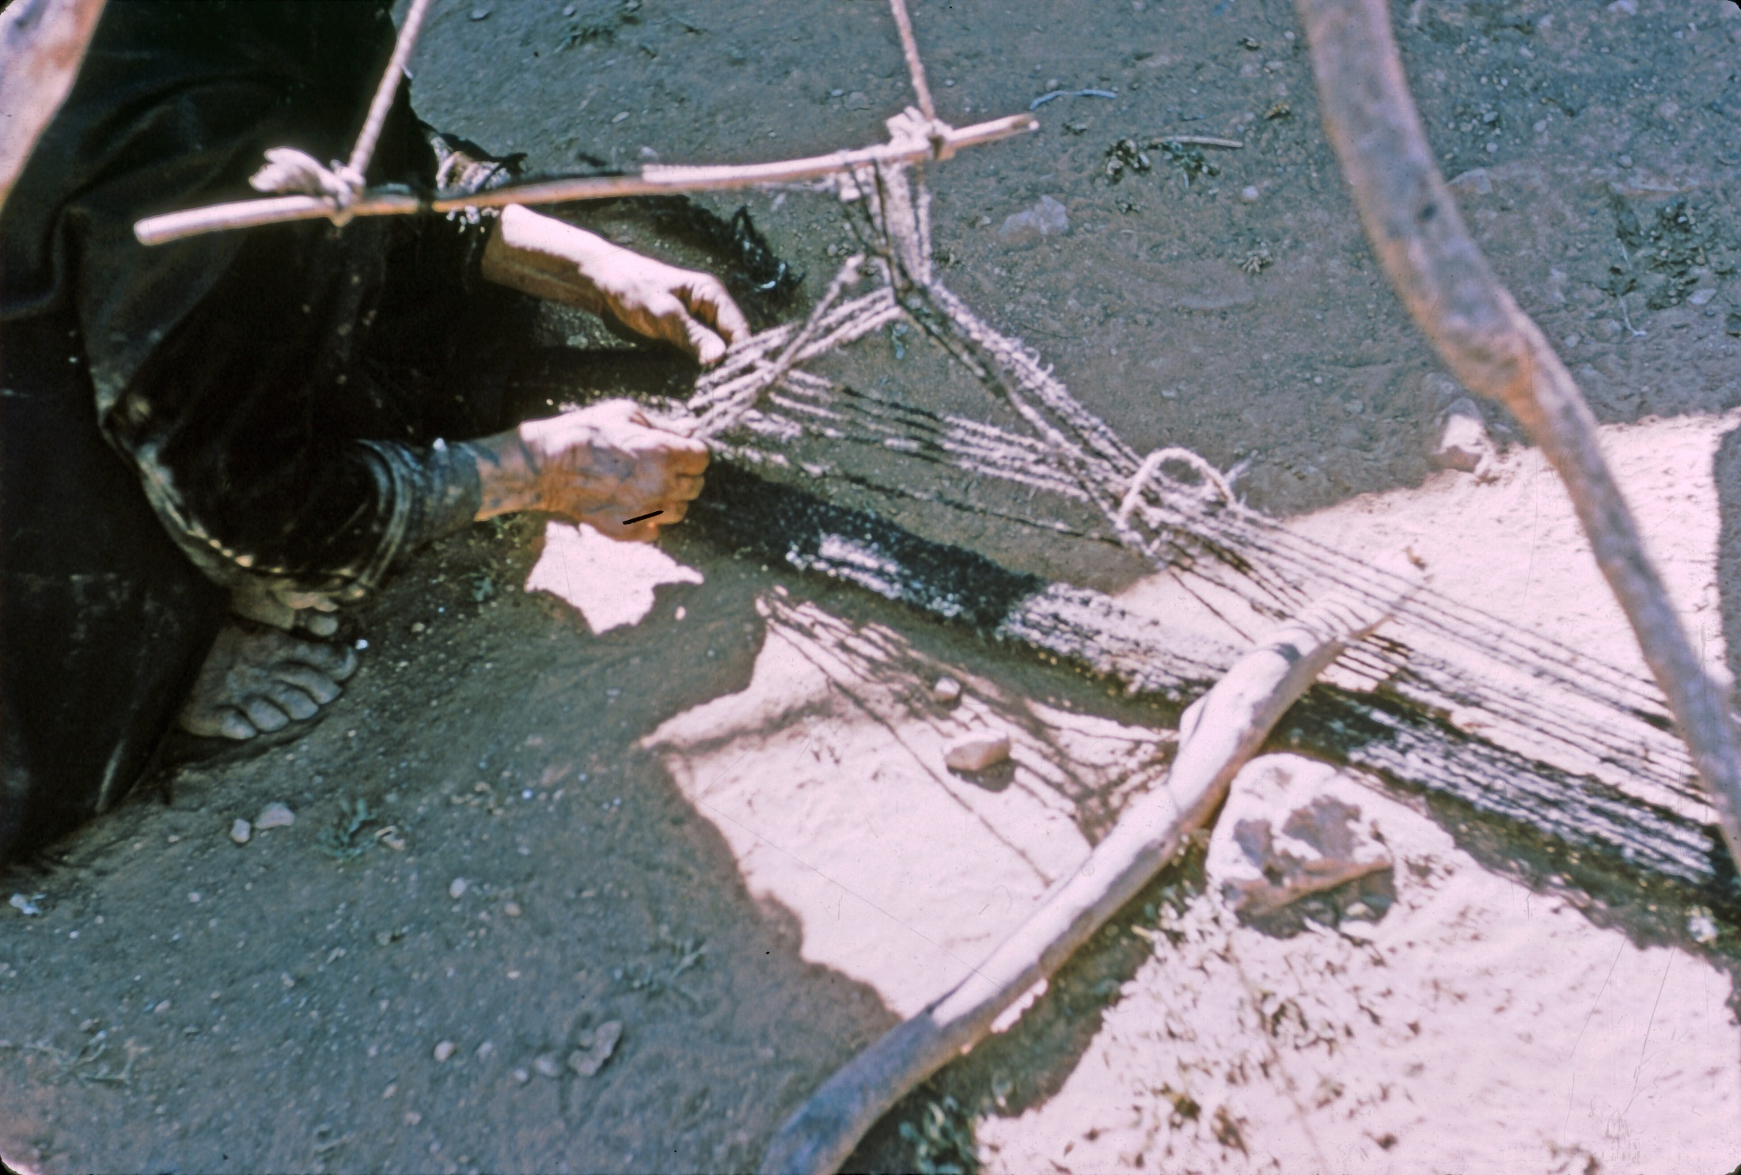

Slide 43
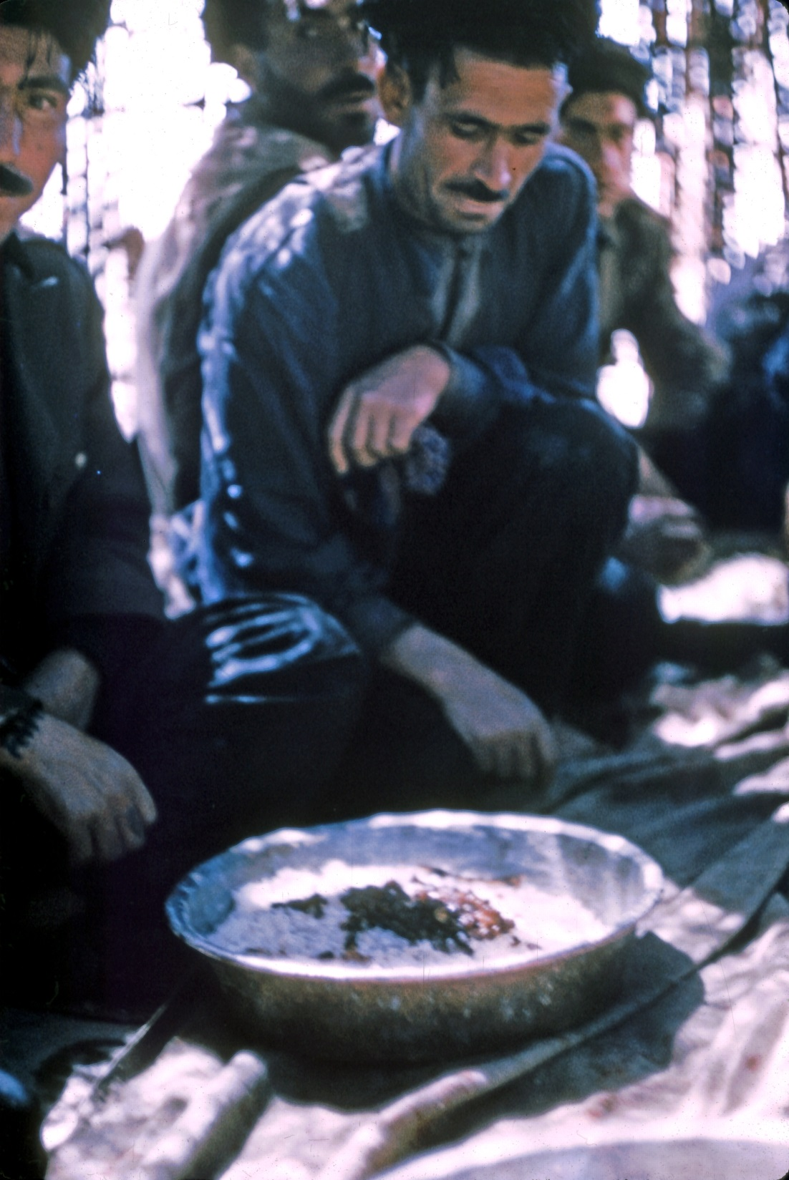

Slide 44
