Slide 1
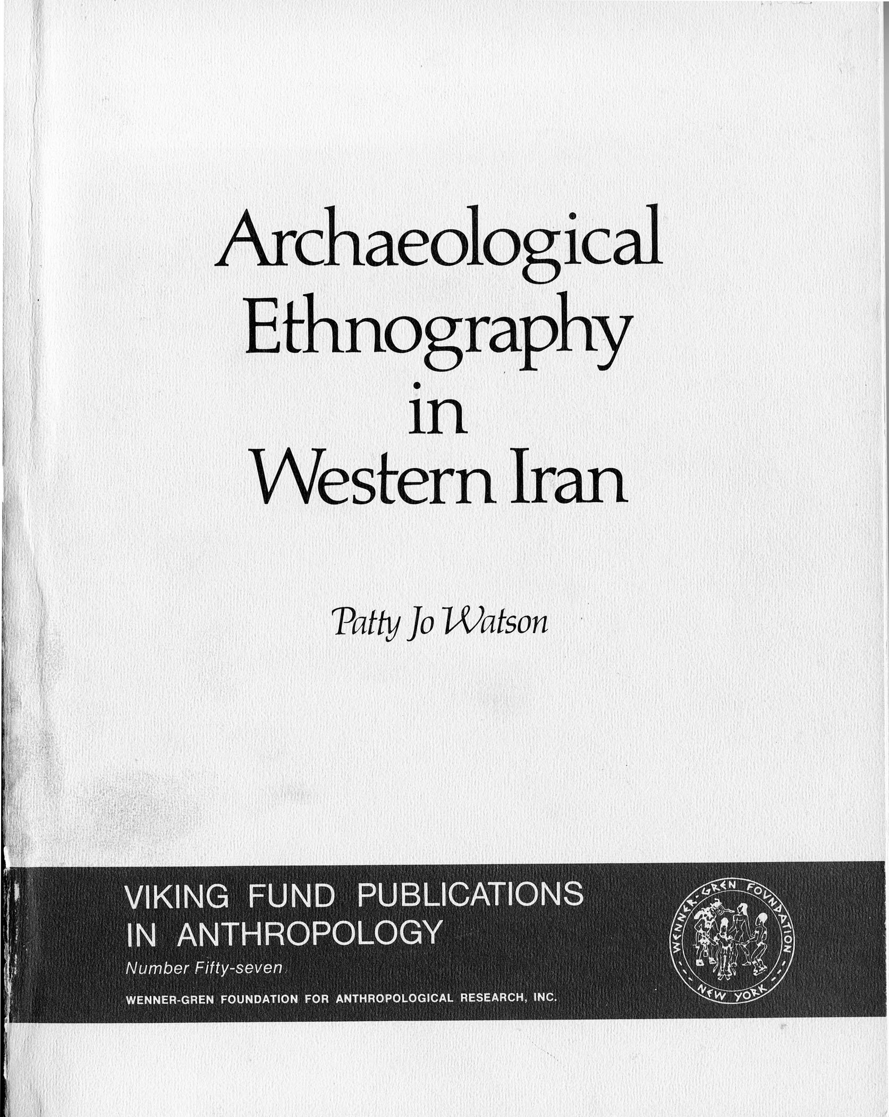
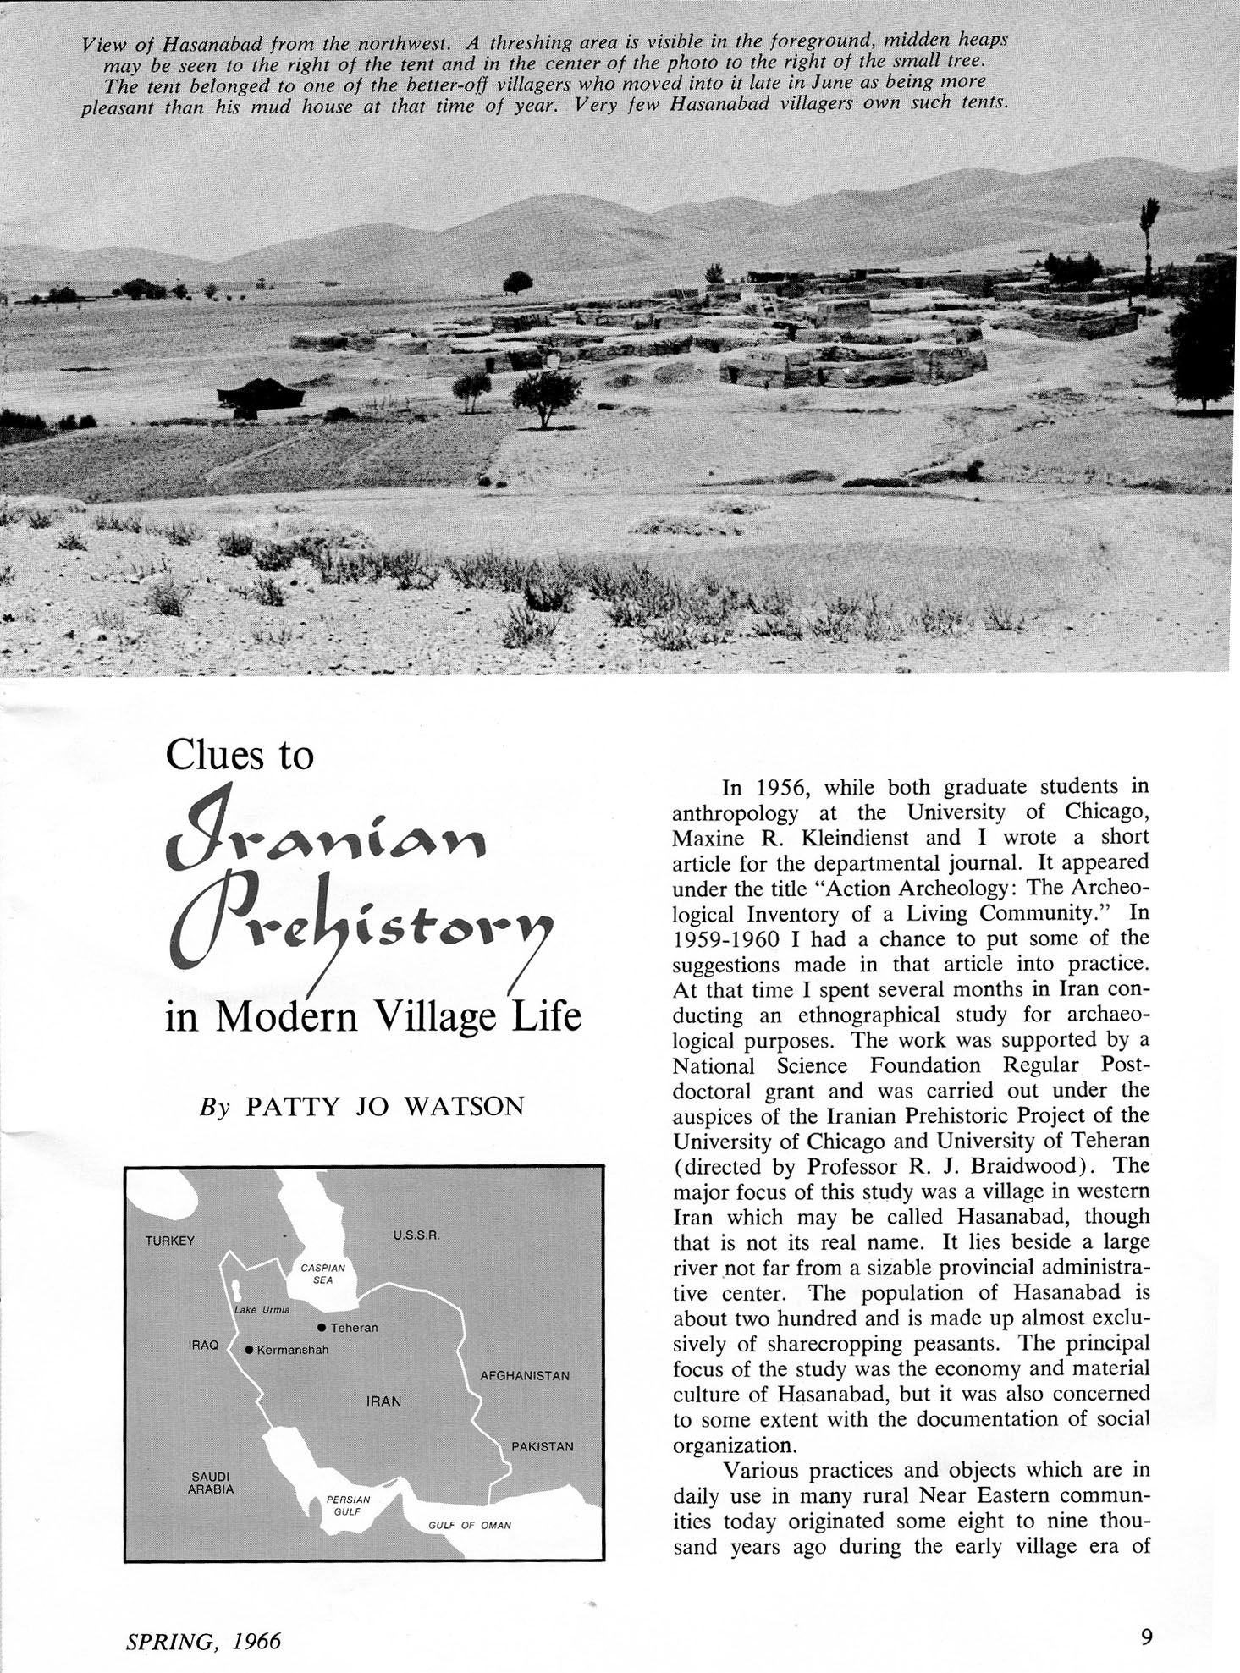

Slide 2
CASE STUDY – Hasanabad (Faraman), Iran
From September 1959-June 1960 (53 years ago)
Carried out by Patty Jo Watson as PhD dissertation fieldwork, published as book in 1979
Part of Braidwood’s Iranian Prehistoric Project, which involved survey and excavation of Paleolithic and Neolithic sites.
One of the first explicitly ethnoarchaeological studies

Slide 3
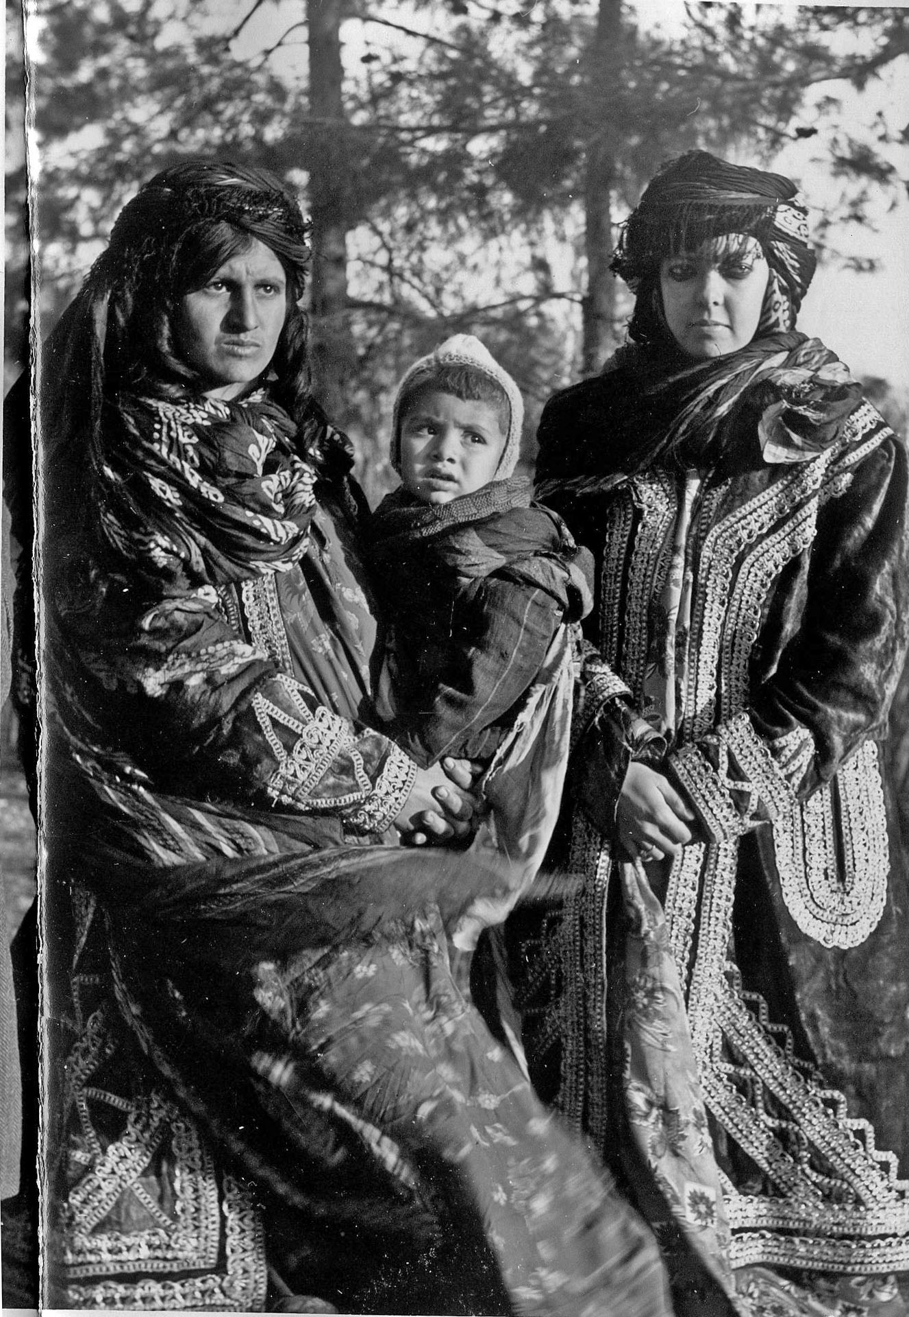
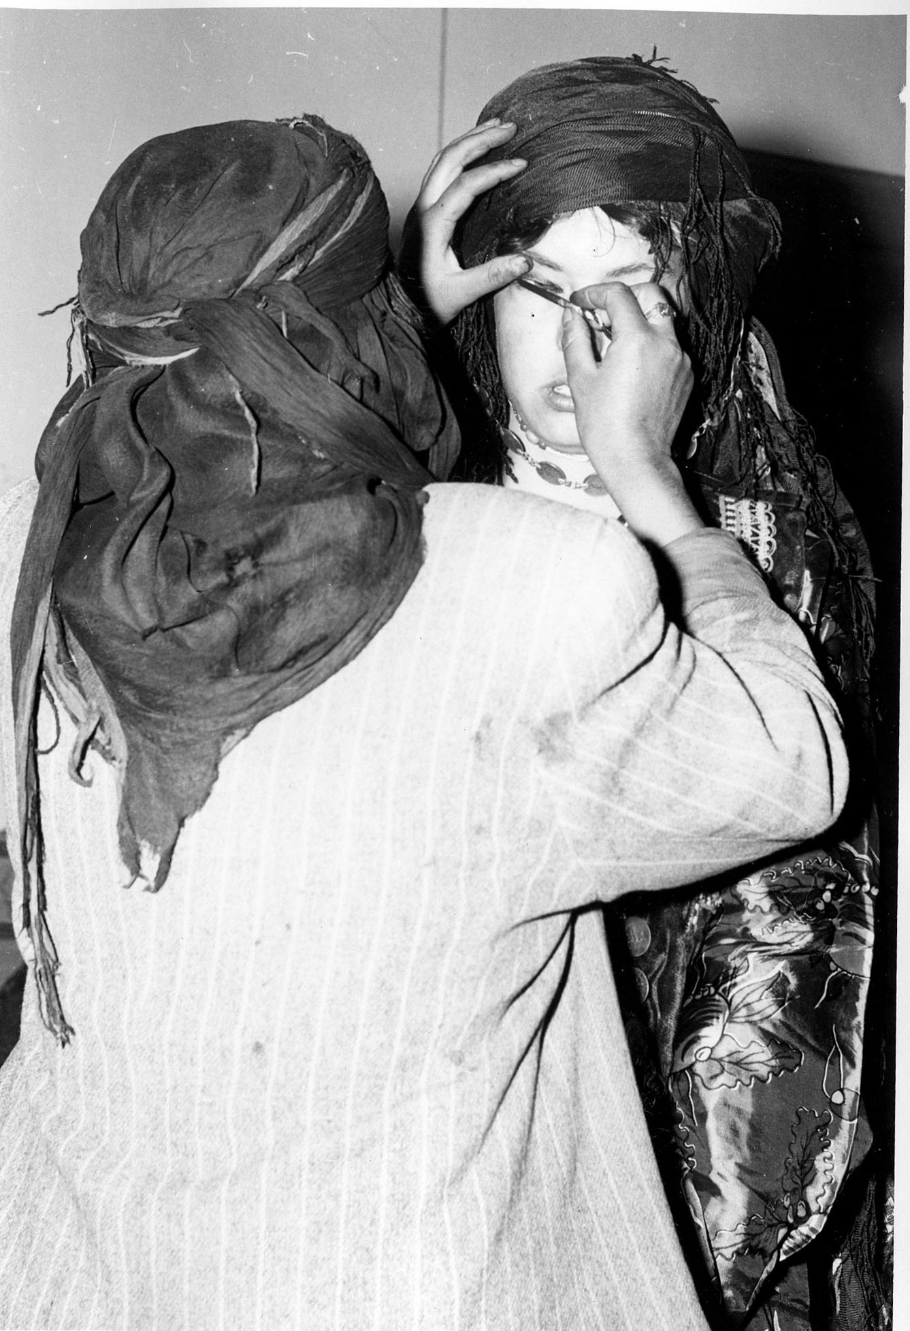

Slide 4
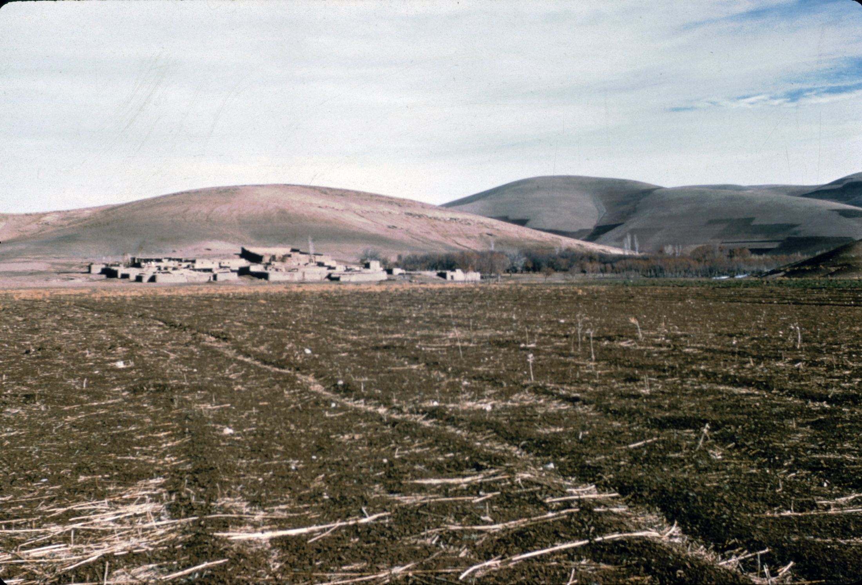

Slide 5
Faraman Village
200 people, mud houses, with fields nearby
The setting is along a seasonal tributary to a permanent river, at the edge of hills, in a valley flanked by high mountains.
Drinking water is from a nearby spring
Mountains are now deforested, but trees along the river
In winter, travel is difficult because of snow and mud
Wild sheep and goats commonly seen; wolves come to the village; bears in the mountains

Slide 6
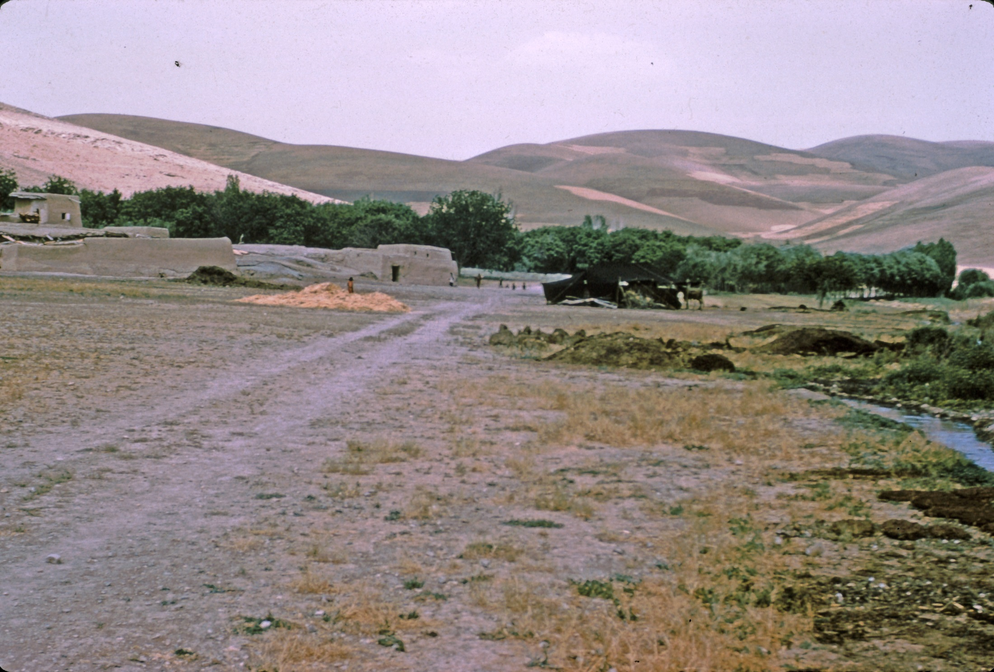

Slide 7
Watson’s Assumptions and Goals
“The past cannot be understood without reference to events and processes occurring in the present” 8
Traditional patterns of life are changing very rapidly and need “rescuing”
1. To record and make available data on technology and subsistence in a traditional village.
2. To contribute to understanding the relationship between (a) settlement pattern, domestic architecture and equipment, and (b) population size and economic and social organization.

Slide 8
Watson’s Fieldwork
Village of Laki-speaking sharecropping tenants near Kermanshah, Iran.
Village in desperate straits owing to four years of crop loss due to insects (sün).
She stayed in nearby orphanage managed by American missionaries.
Worked without an interpreter, but had help from missionaries and their workers
Went to village early morning each day and stayed until dark.
Had hepatitis for more than a month in the spring.
Also shorter studies of two other communities, both Kurdi

Slide 9
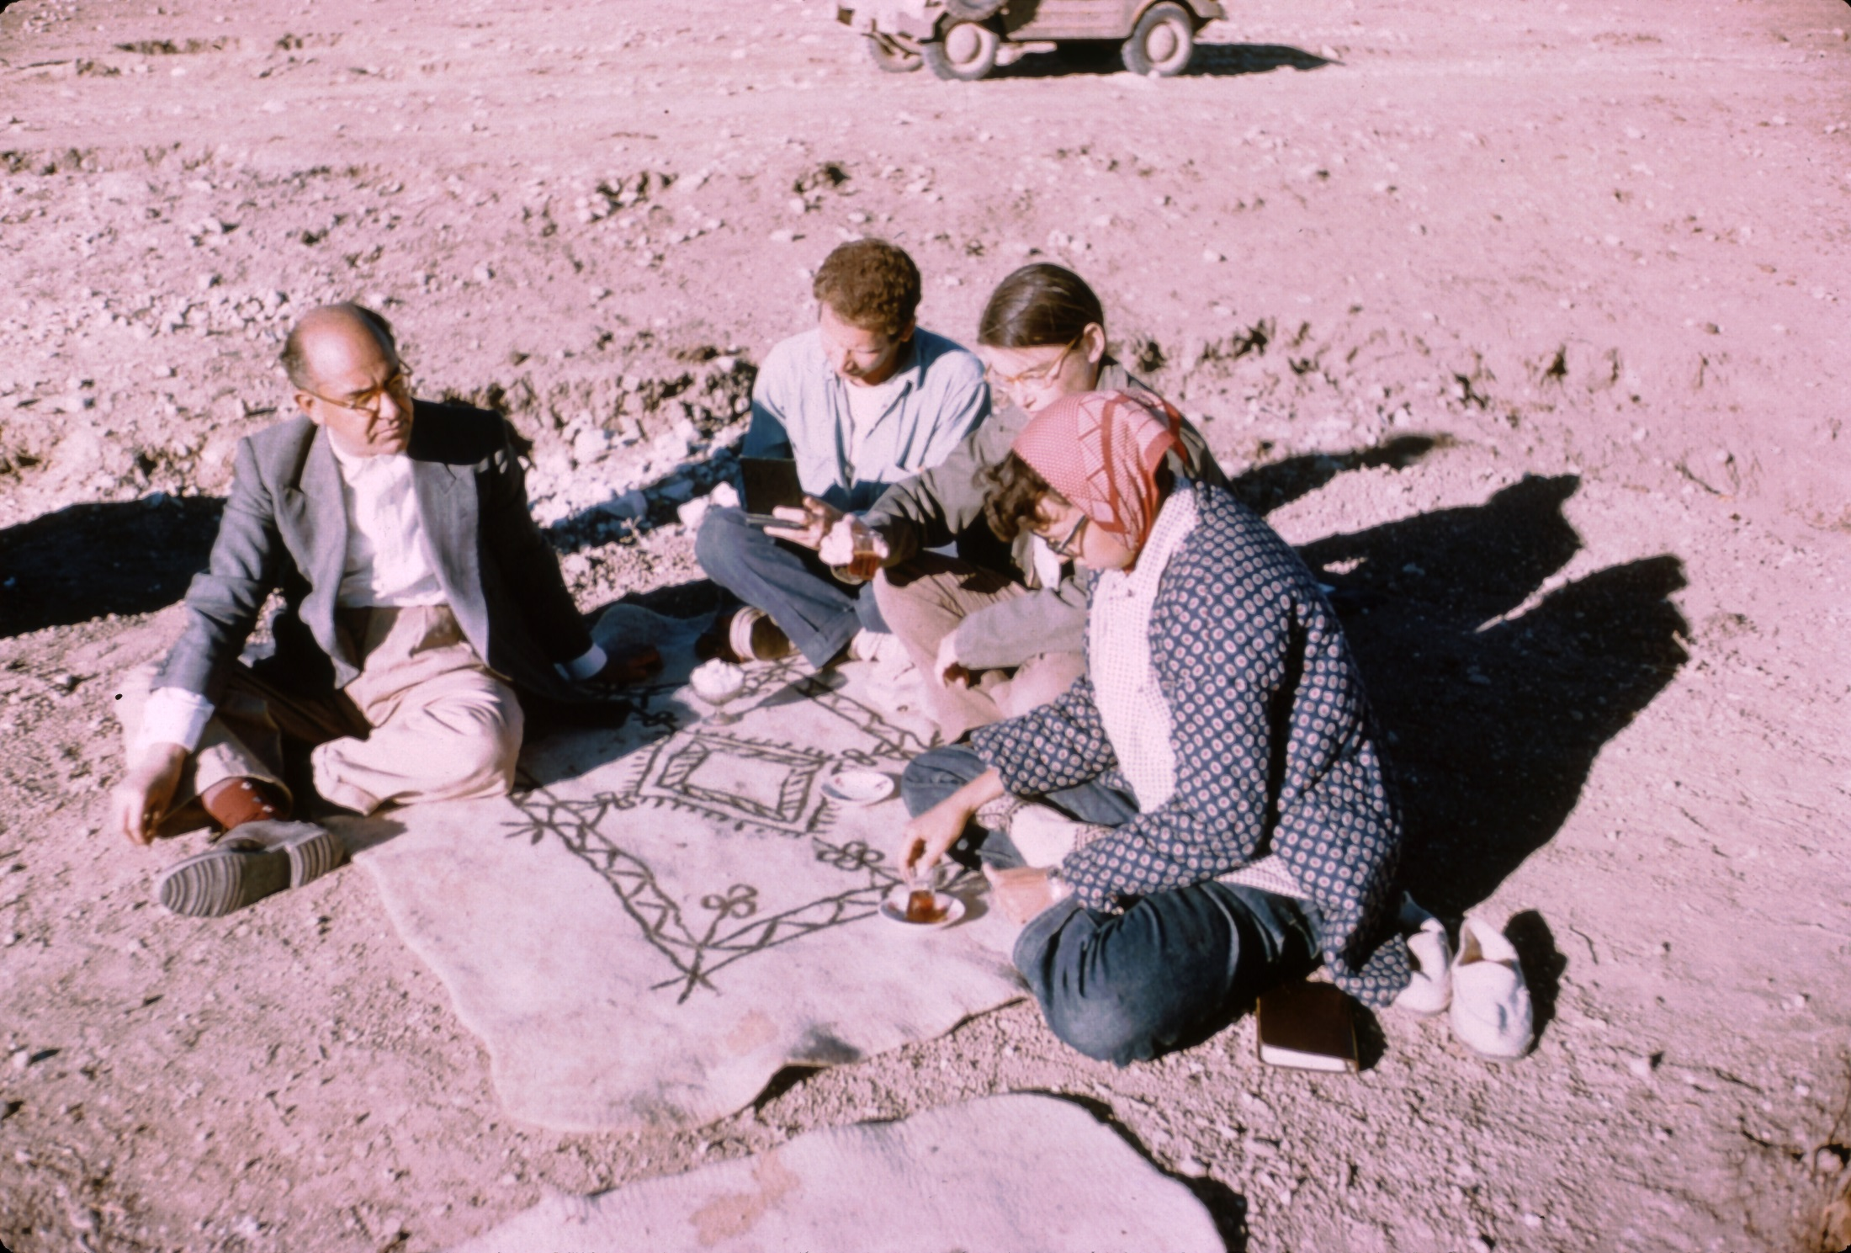

Slide 10
The Village
“Each household usually consists of an open court with the family’s quarters, animal stables, and storerooms opening off it.” 34
An irrigation canal jub crosses north end and irrigates fruit trees – apply, plum, mulberry, apricot and almond
Formerly several qanats, but only one not dried up.
Houses built of chineh, tauf in Arabic. These are layers of mud dug from borrow pits
Hearths cleaned out every day and the ash dumped in middens, which hold all sorts of stuff from bones to pottery, cloth and old shoes
Dung is kept for making dung cakes

Slide 11
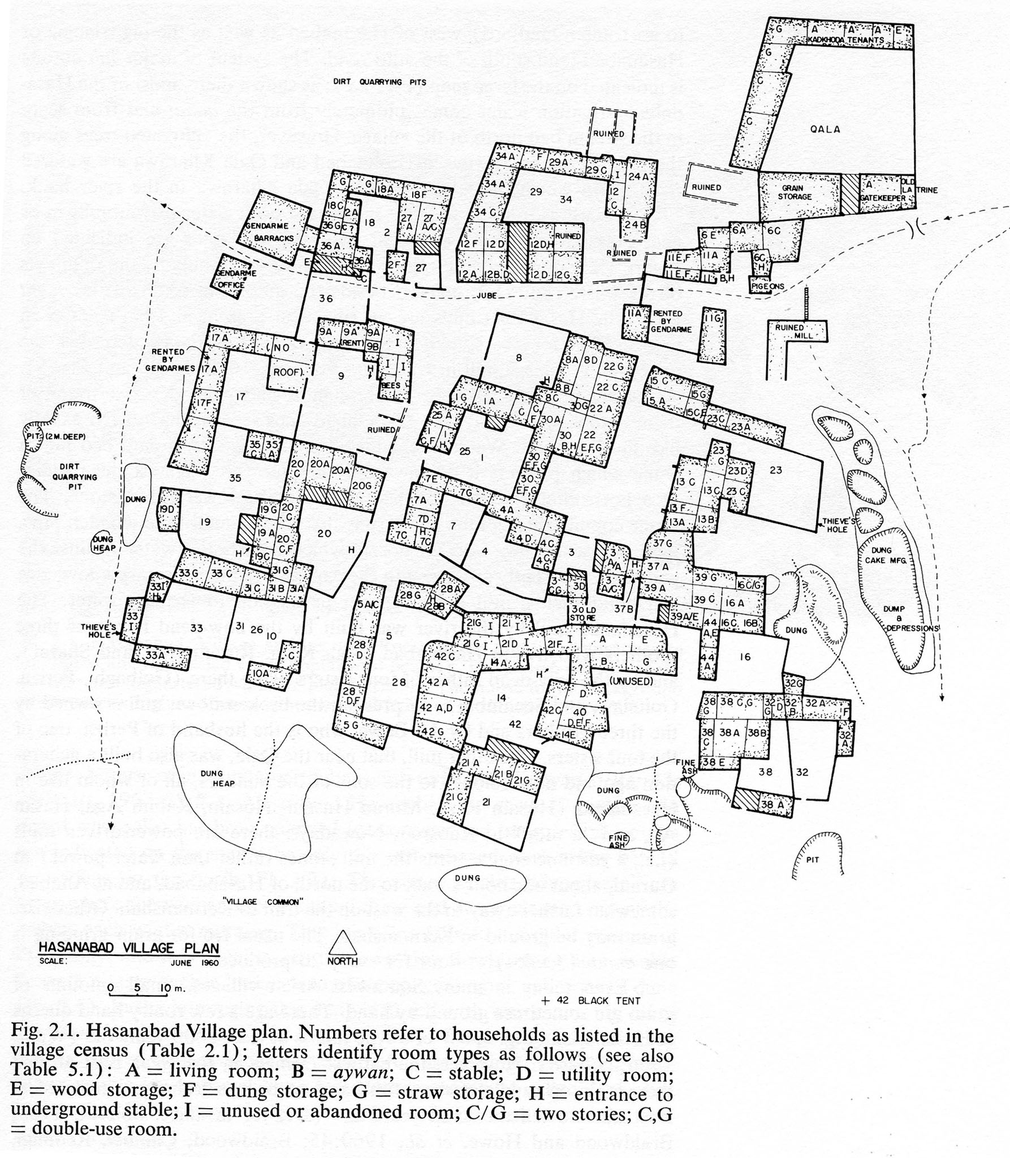

Slide 12
Activity Areas
1. middens
2. Borrow pits
3. Streets/lanes/latrines
4. Common open area
5. Courtyards for daily tasks, weaving, etc
6. Threshing floors
7. Springs to gather water, wash things
8. Cemetery, apart from village.

Slide 13
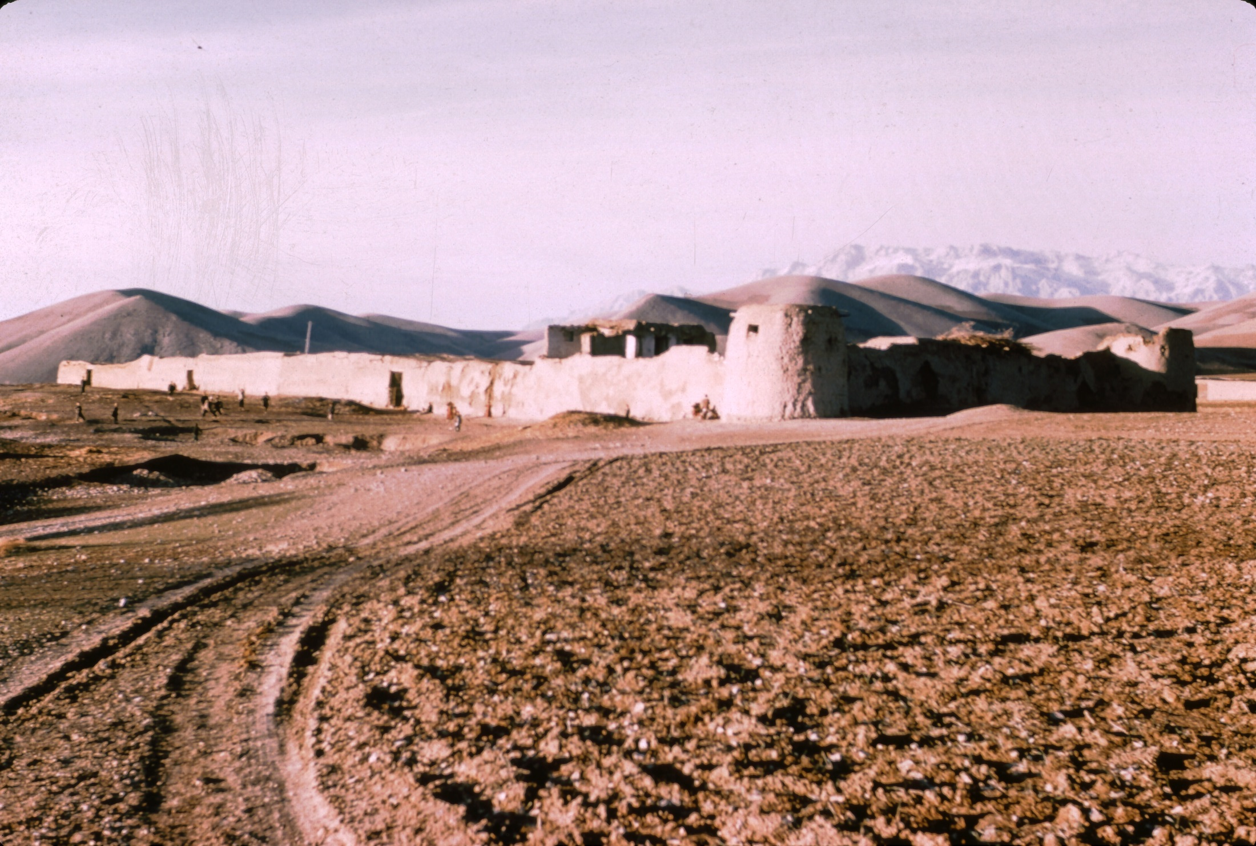
The Qala – old fort and headman’s house

Slide 14
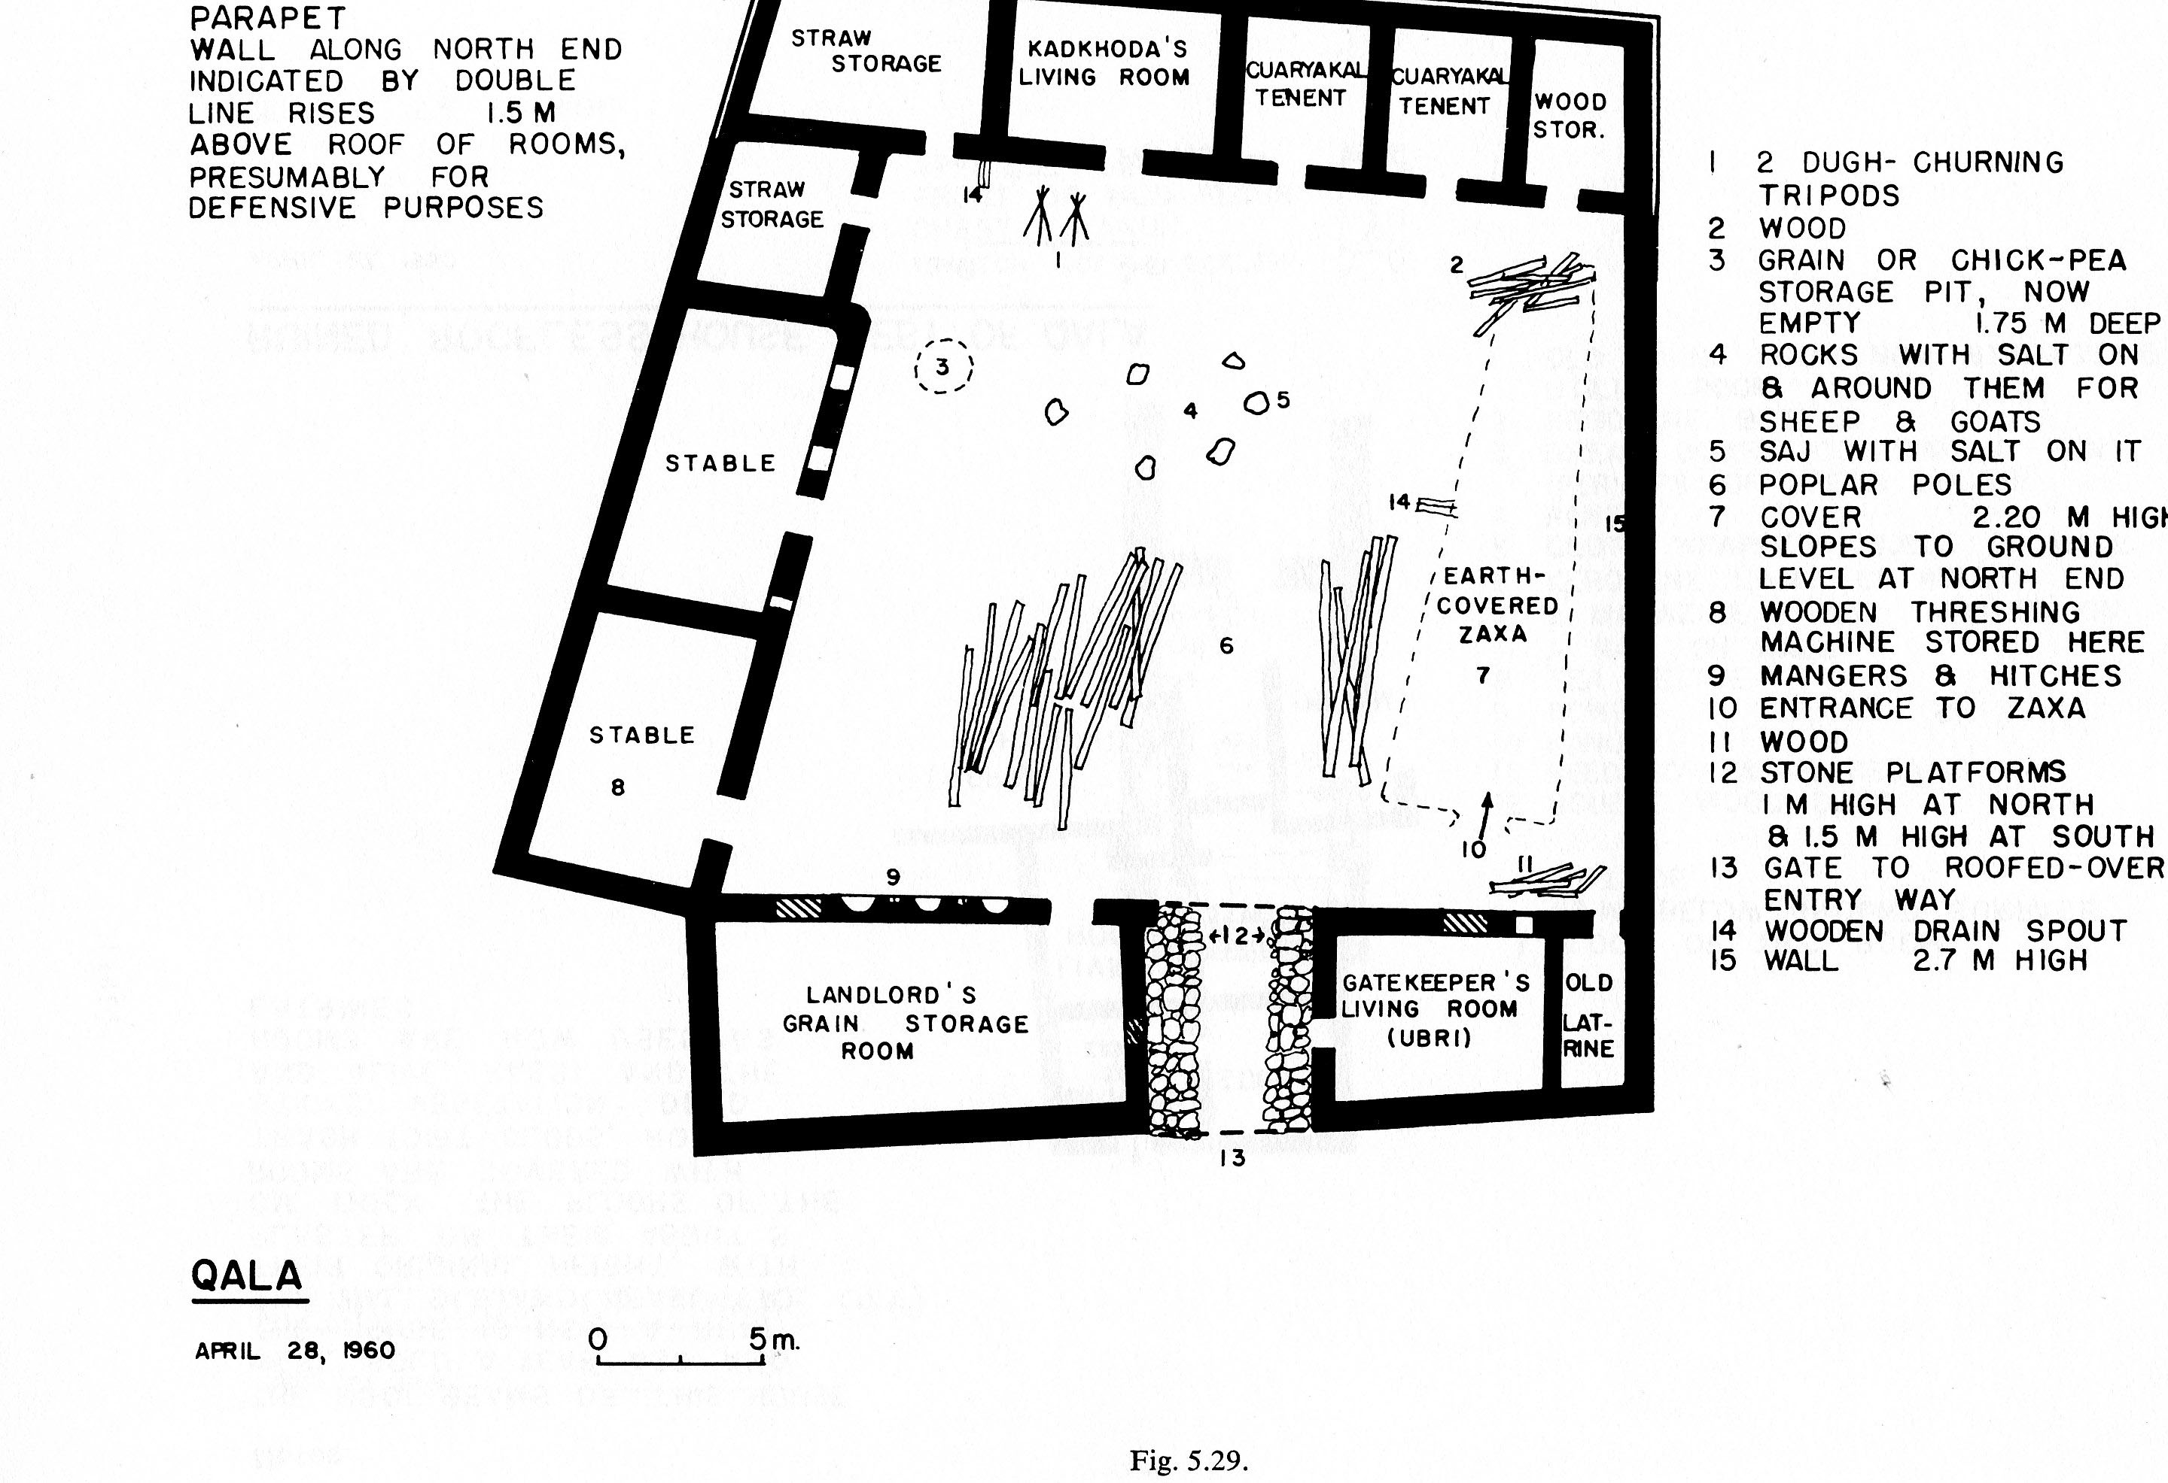

Slide 15
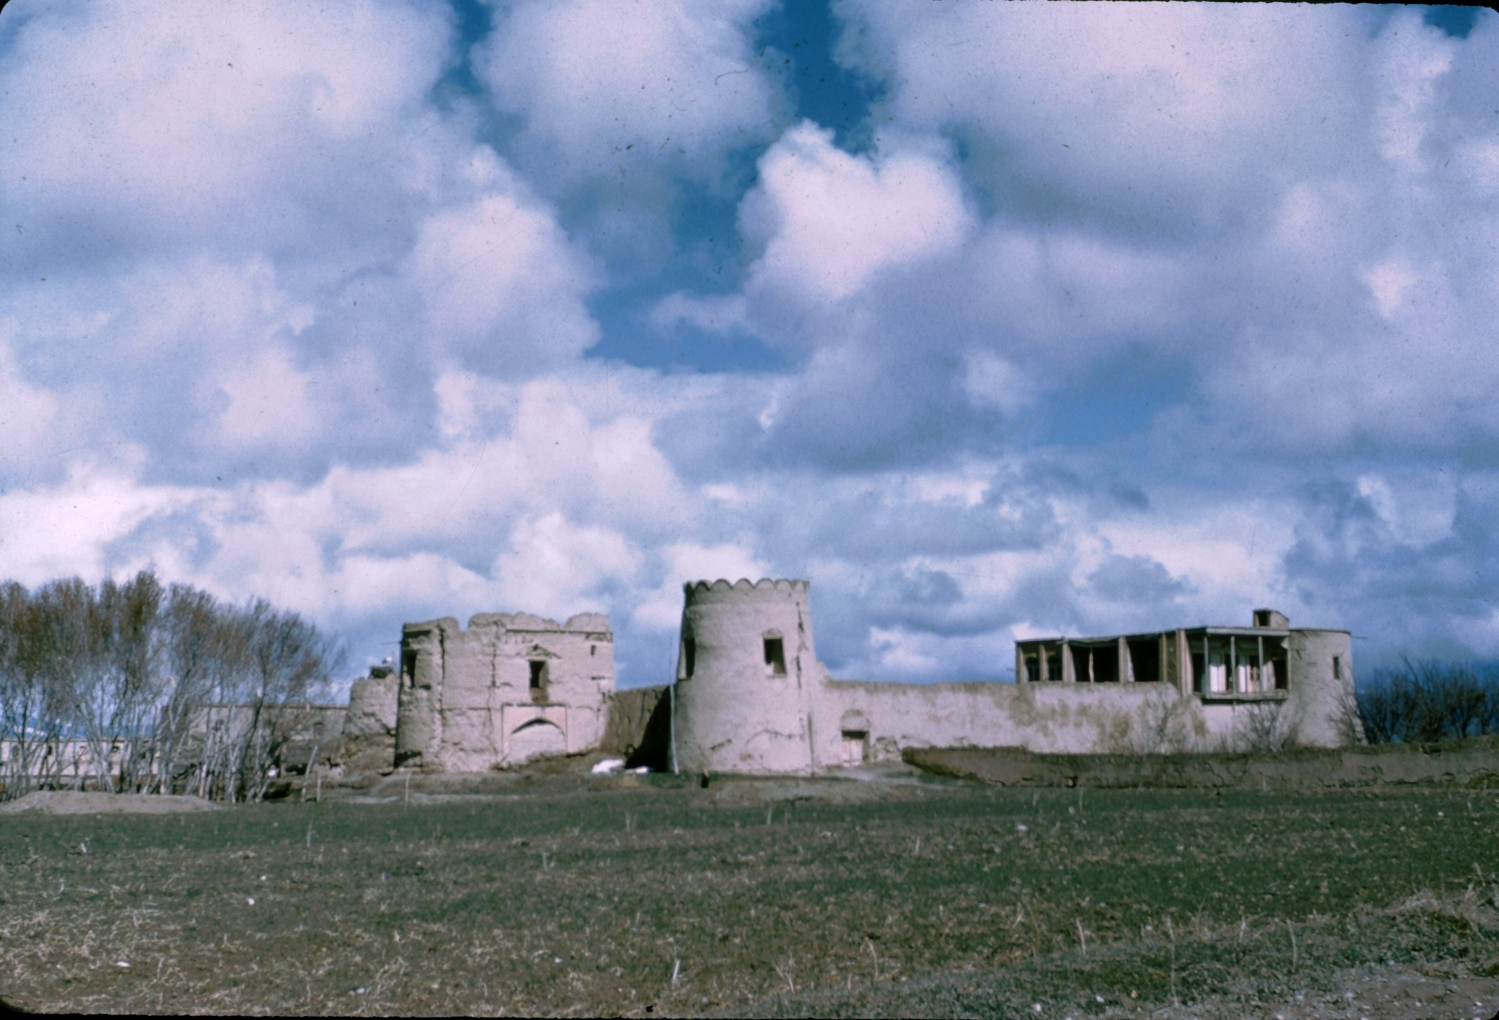

Slide 16
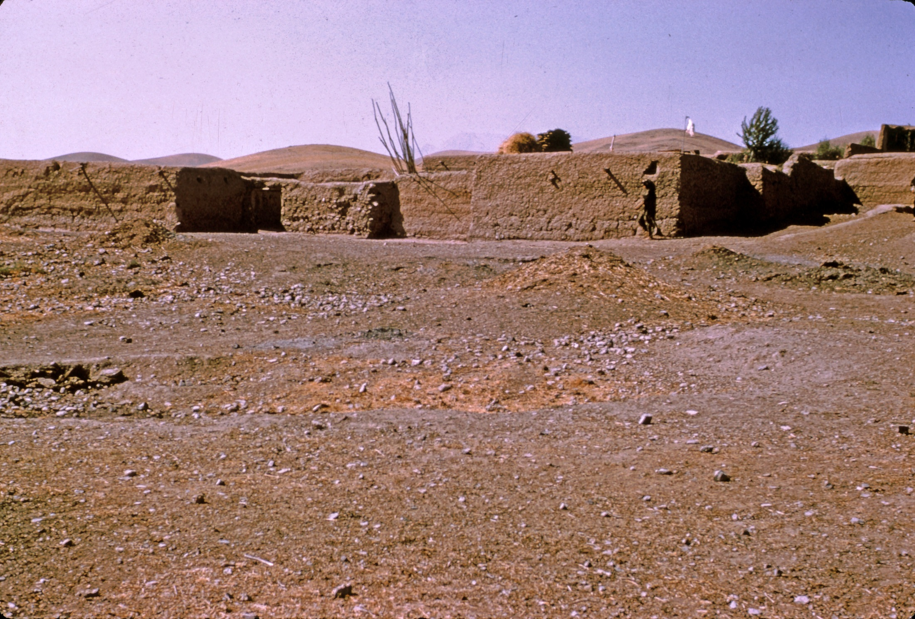

Slide 17
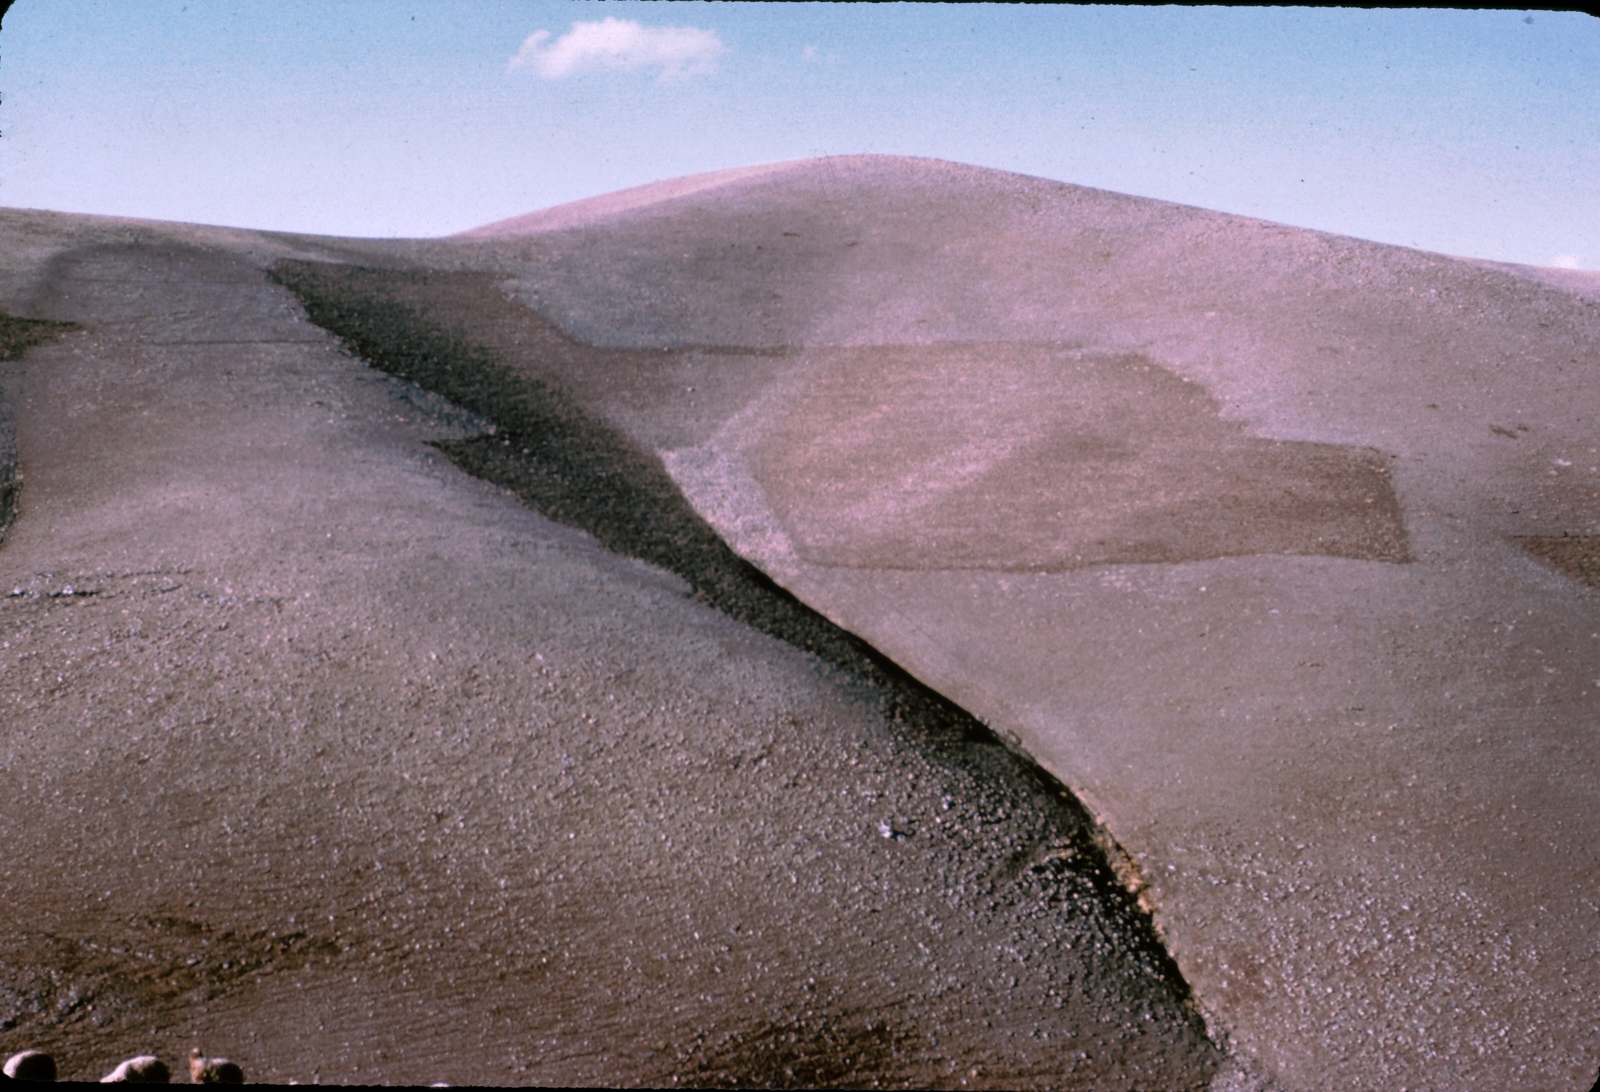

Slide 18
House Construction
Wall trench 90 cm x 60 cm deep. Bottom course has rocks.
Each course of chineh is about 50cm thick.
As wall gets higher it gets narrower . Walls are about 2-2.5m high and .75-.50 wide at top.
Borrow pits everywhere and trash is often incorporated into mud.
Walls plastered inside and out with mud.

Slide 19
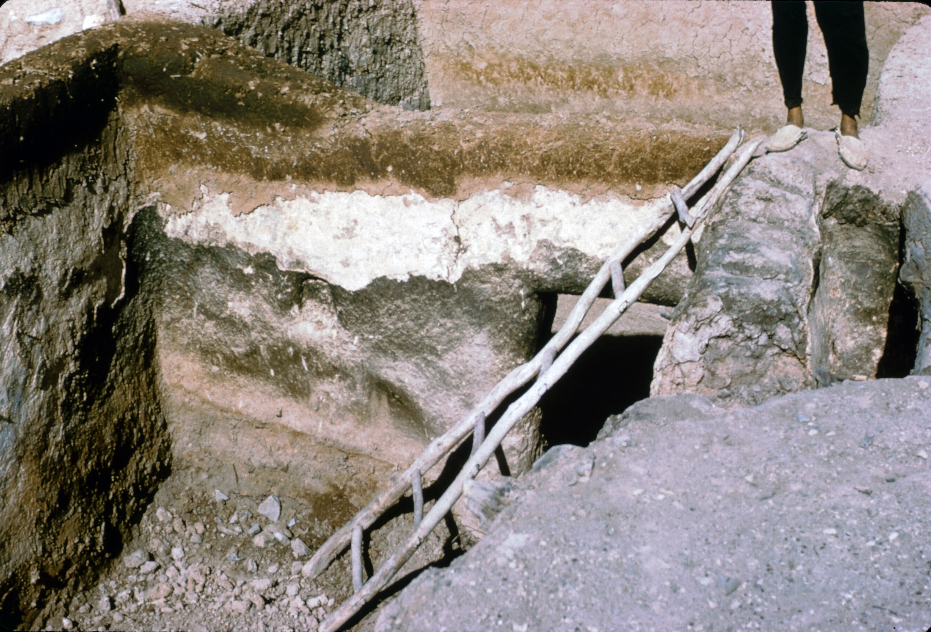

Slide 20
Construction
Roofs are wooden poles, usually poplar embed into upper course of chineh.
Smaller cross branches laid on the beams, then twigs, reeds, mud, dirt and then a layer of mud and chaff plaster on top.
Interior walls plastered to 3-4cm thick; sometimes with white topping – a natural source near the village. Mixed with cattail fuzz and smeared on with a cloth by women and children.
Most houses have an entrance chamber, avian
Some wattle and daub used on doors; sometimes wattle and dung.

Slide 21
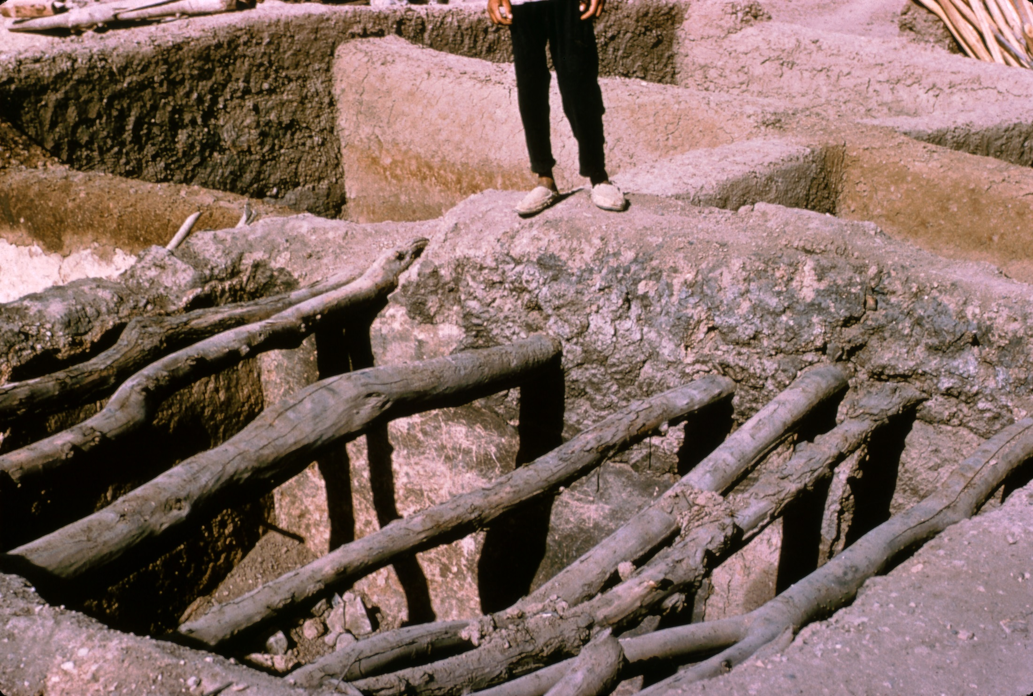

Slide 22
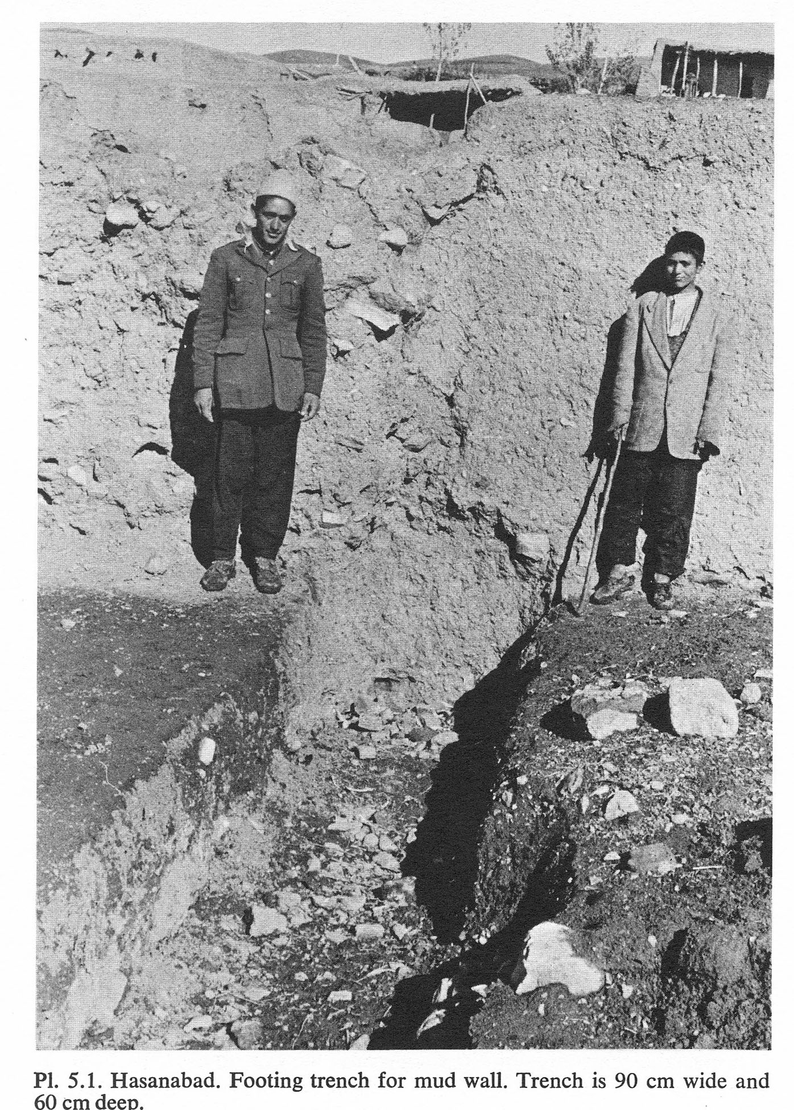
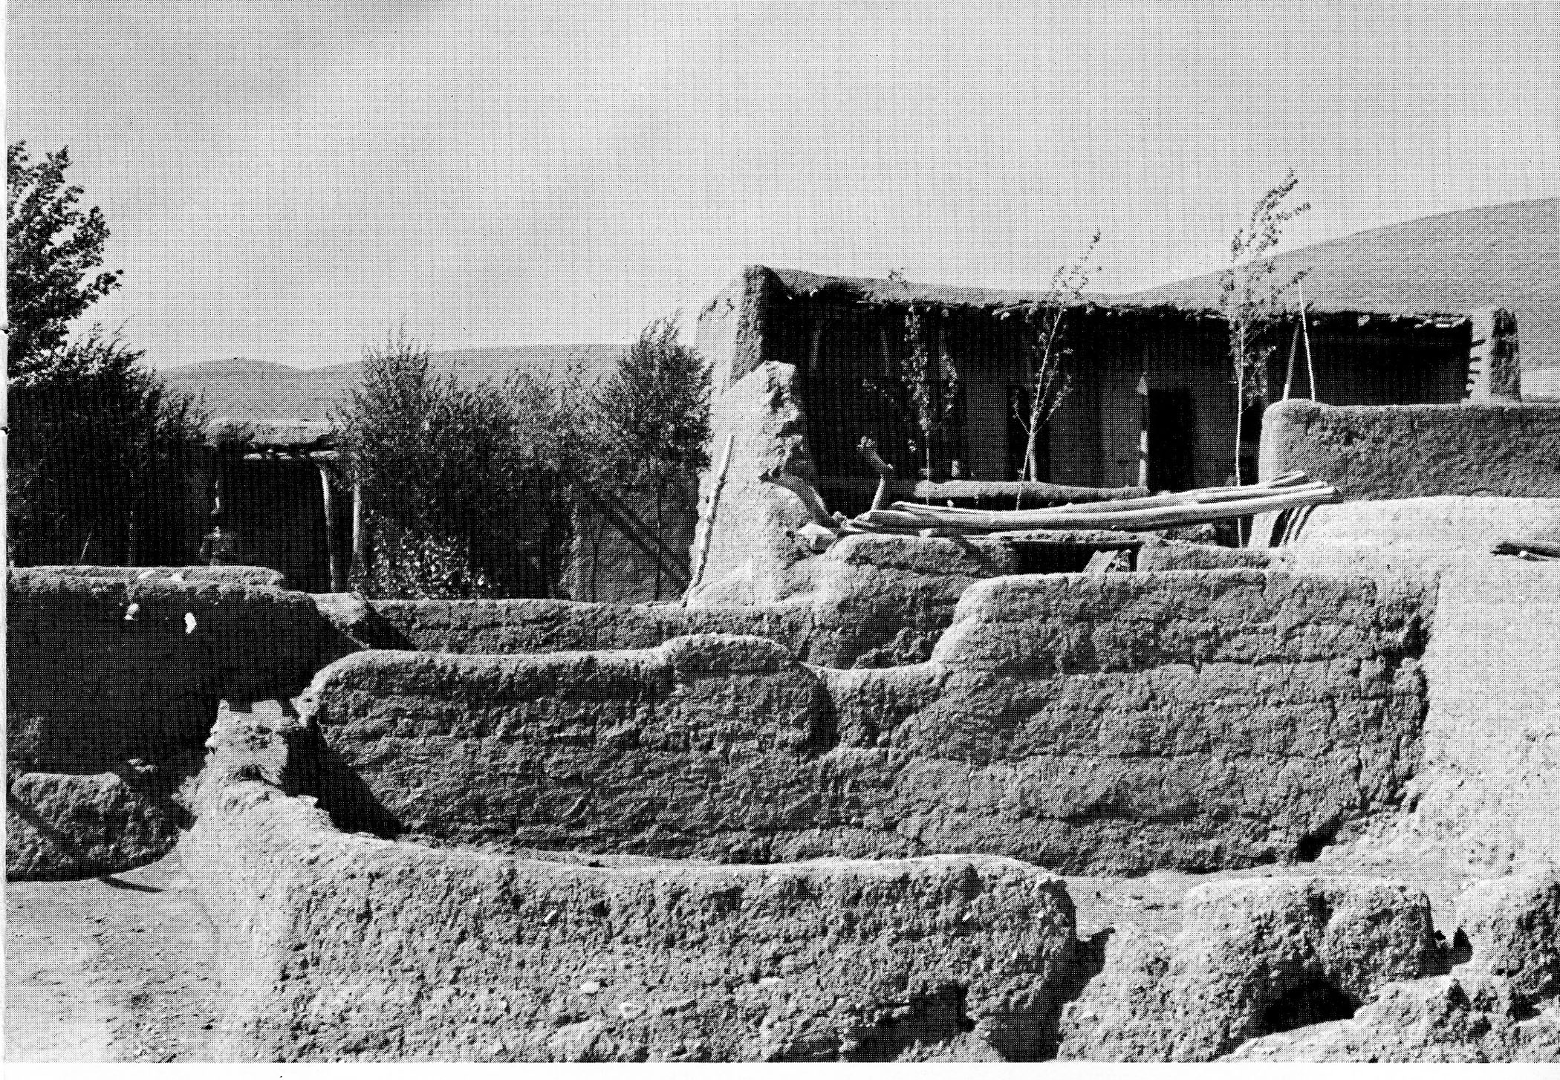
Chineh house walls
Footing trench

Slide 23
Typical House
Walled courtyard in front. Aivan opens into court. Door from aivan leads to living room, the stables, storage rooms for straw and dung, and stables (both above and under ground).
Courtyard walls typically 2-2.75m high. A gateway leads to the street. Most have pole bars to close at night.
Houses can last 50+ years with maintenance.

Slide 24
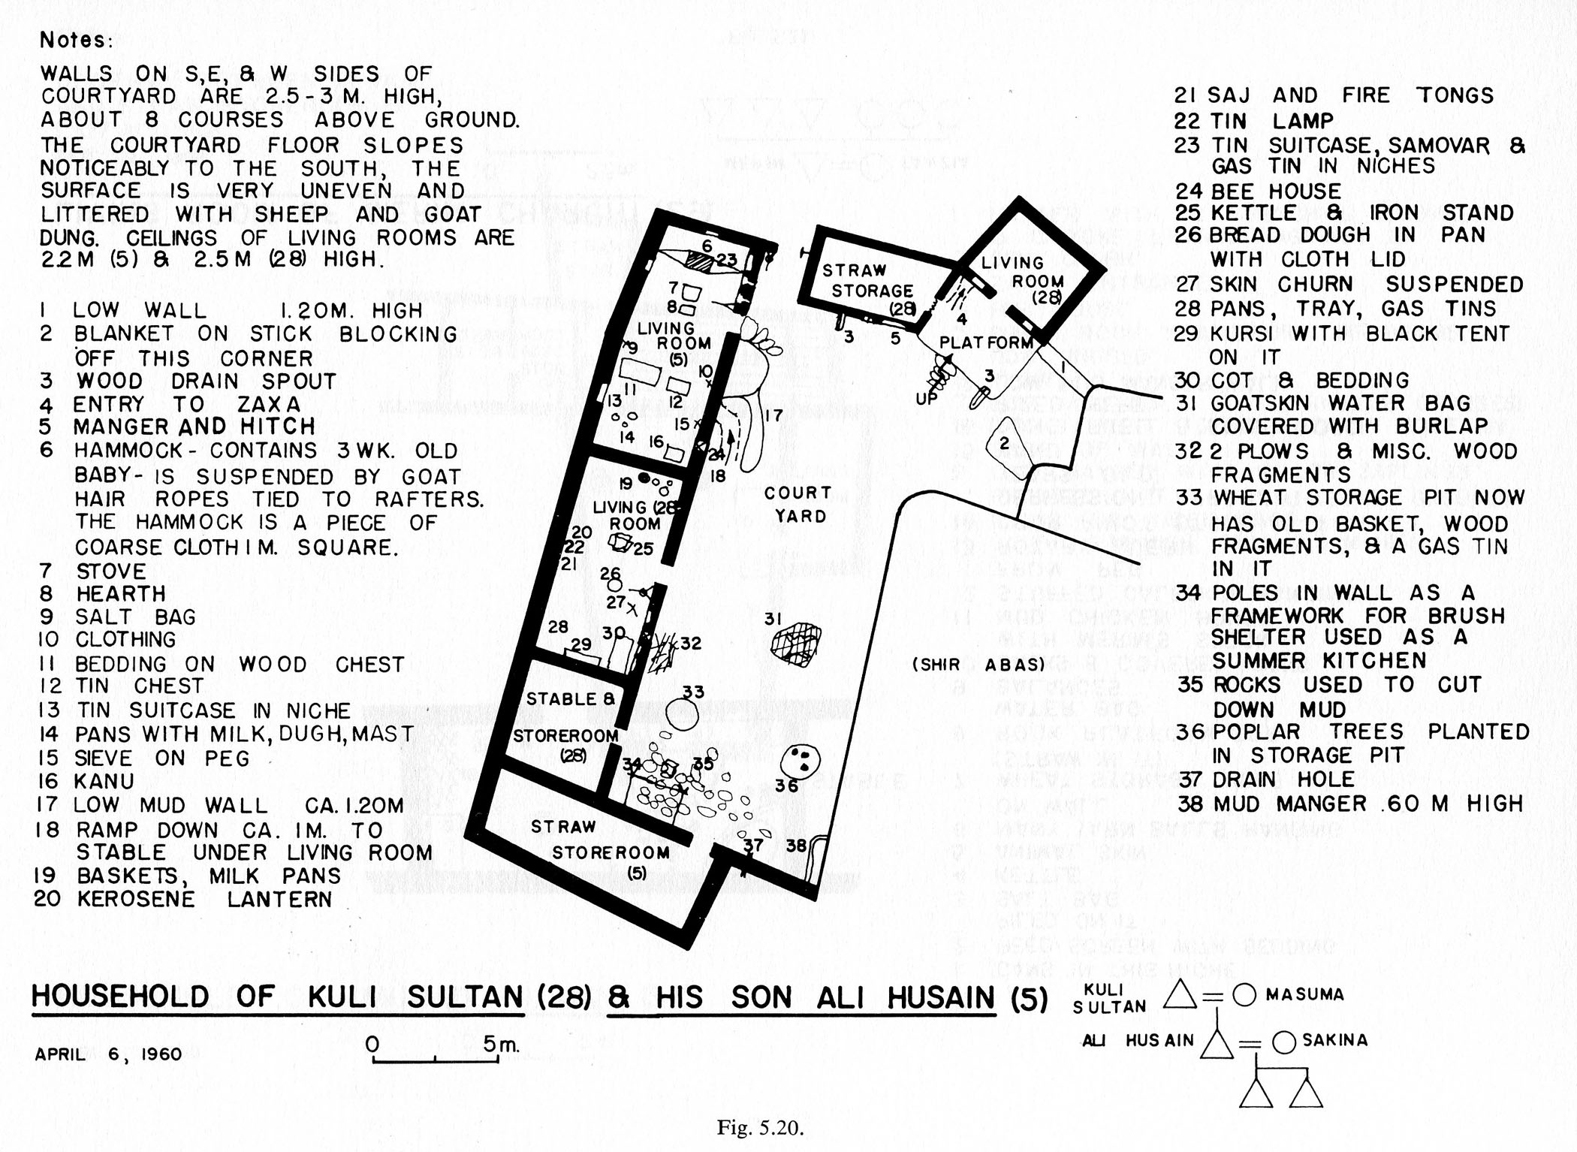

Slide 25
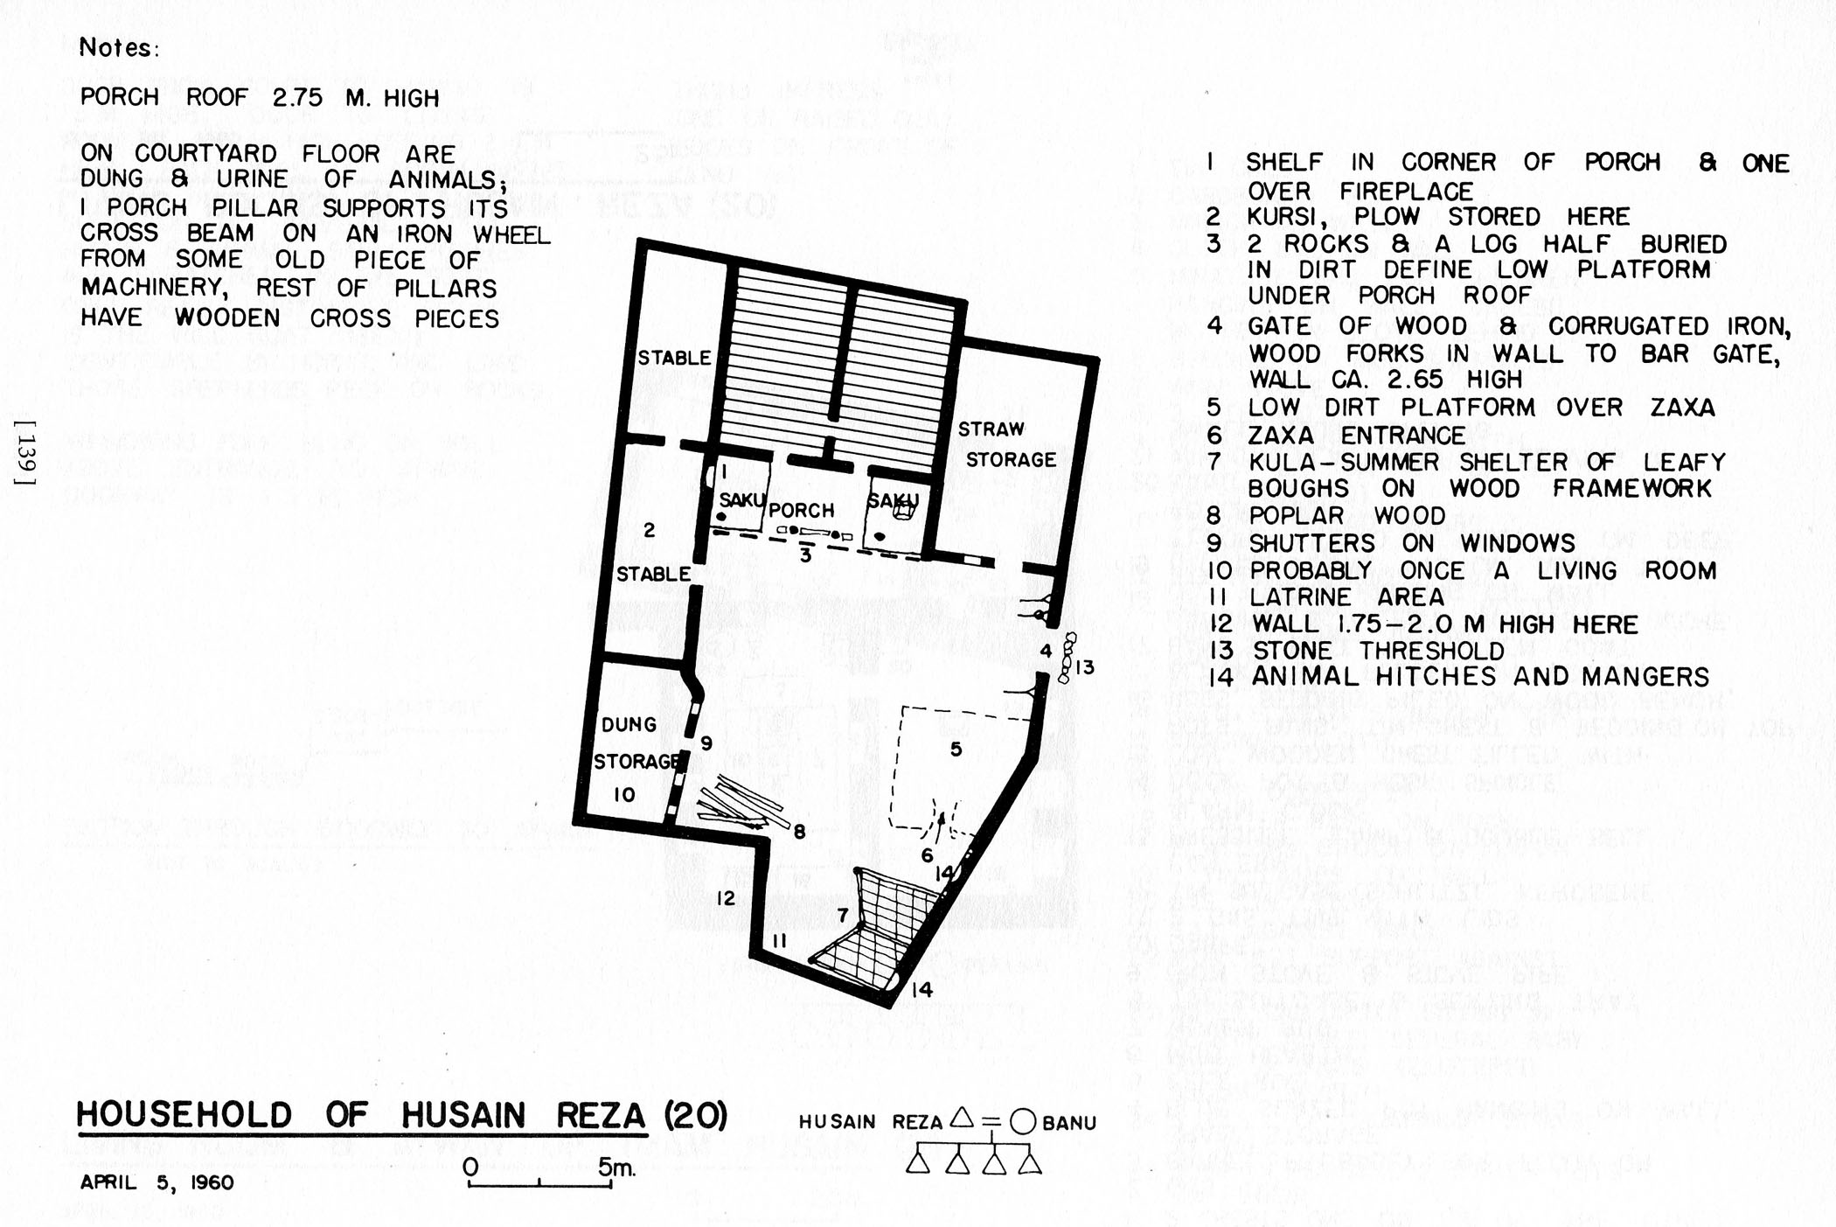

Slide 26
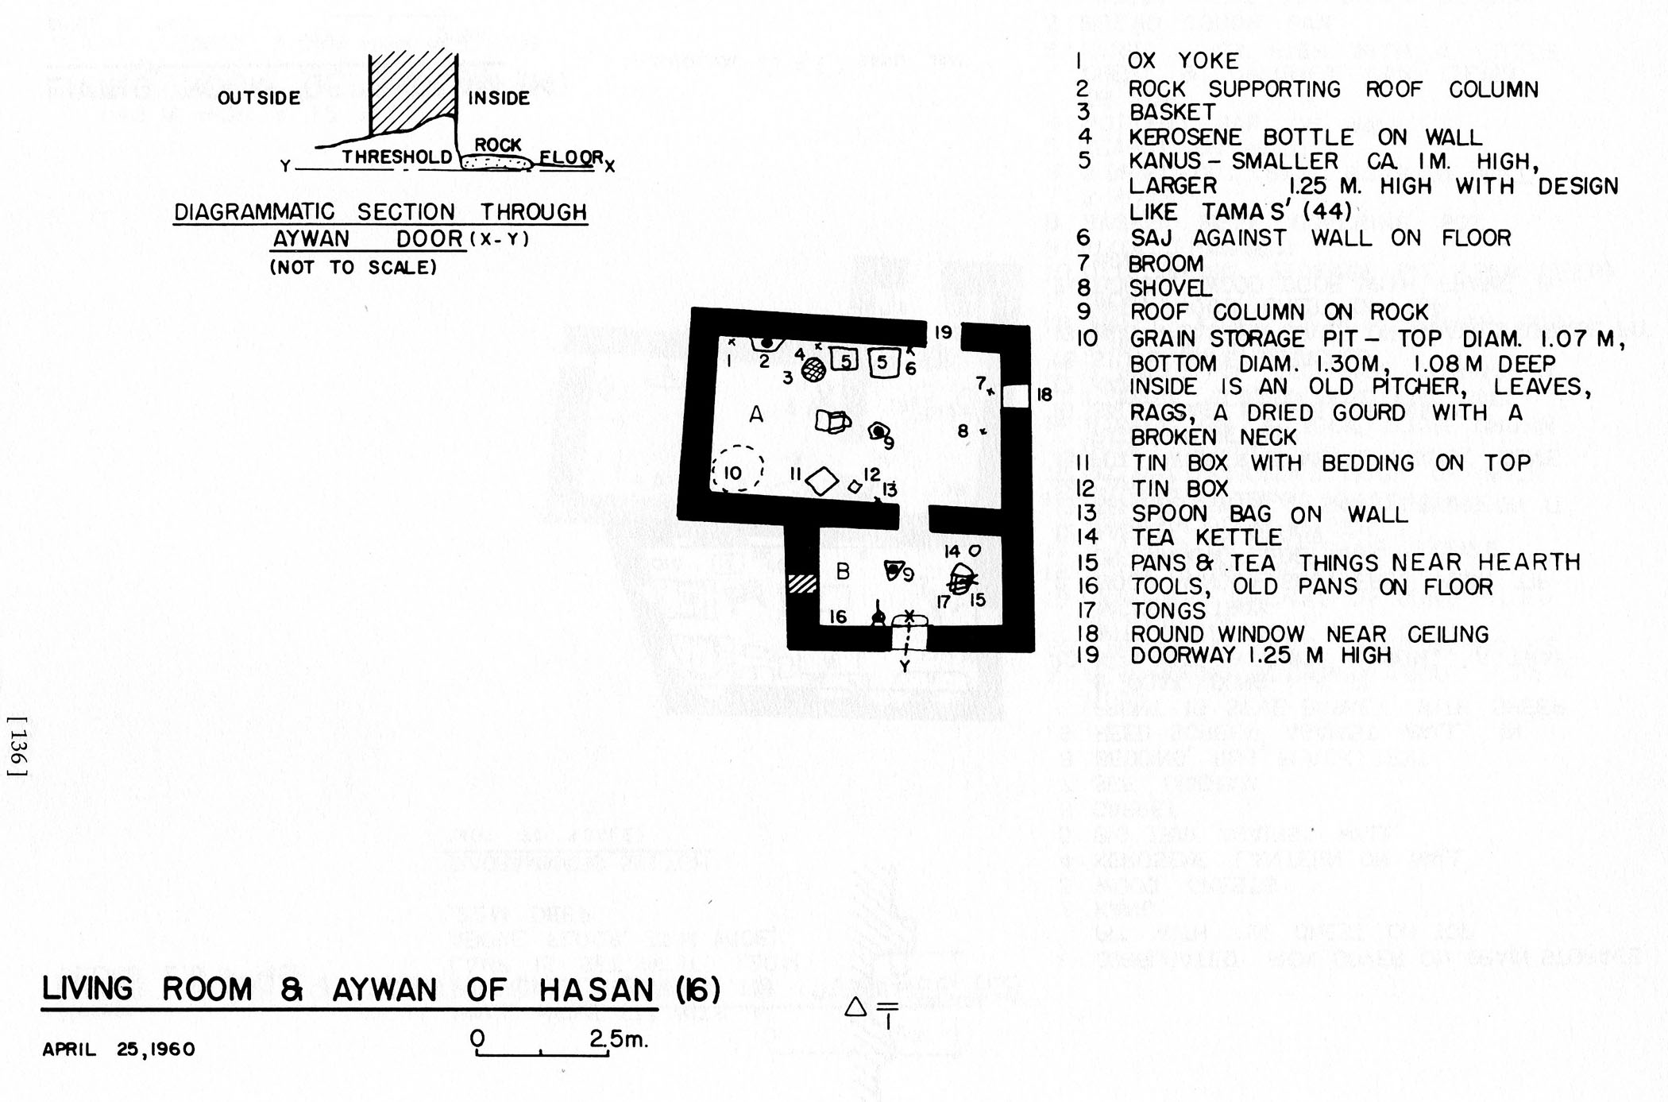

Slide 27
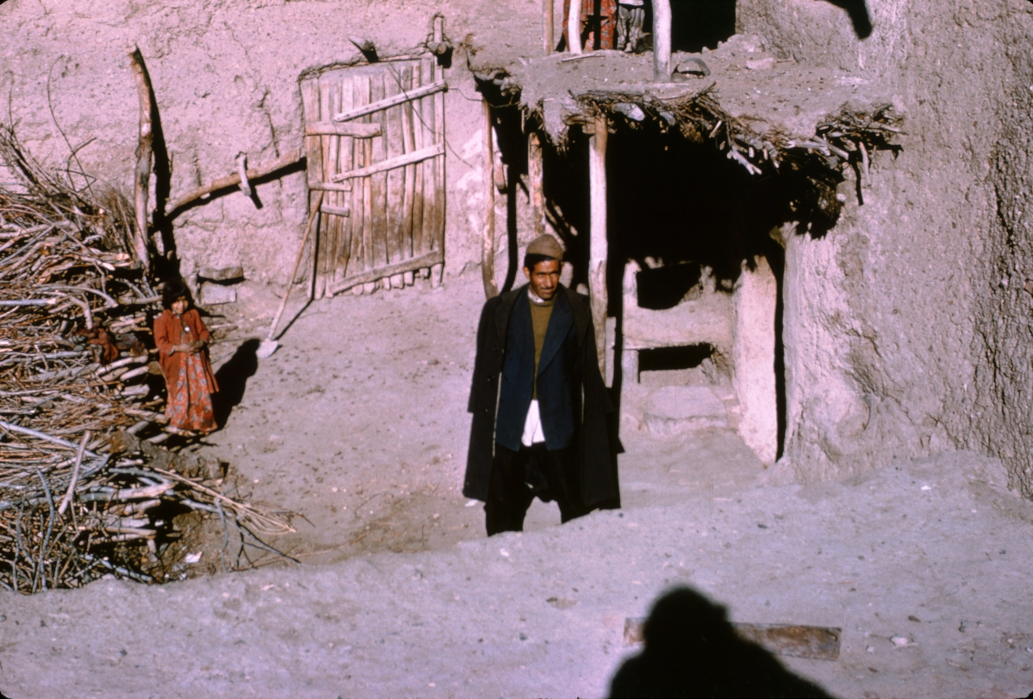

Slide 28
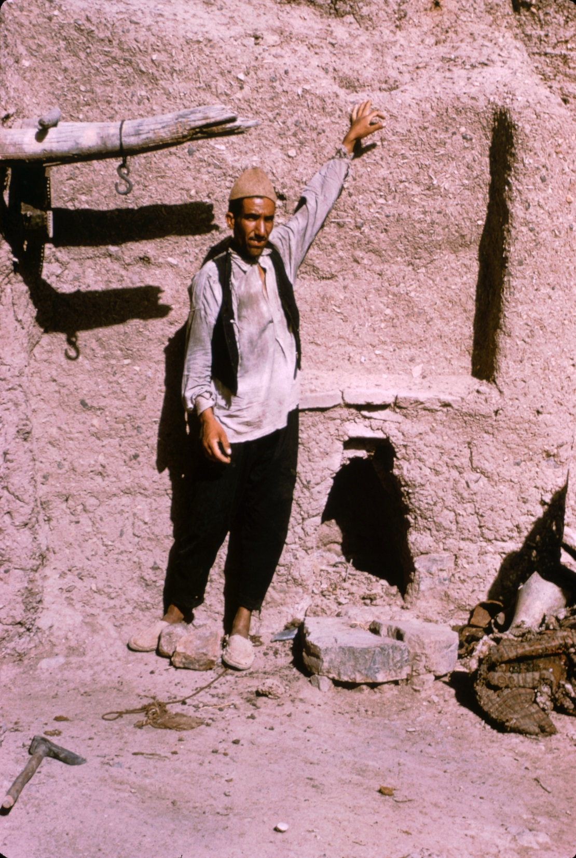

Slide 29
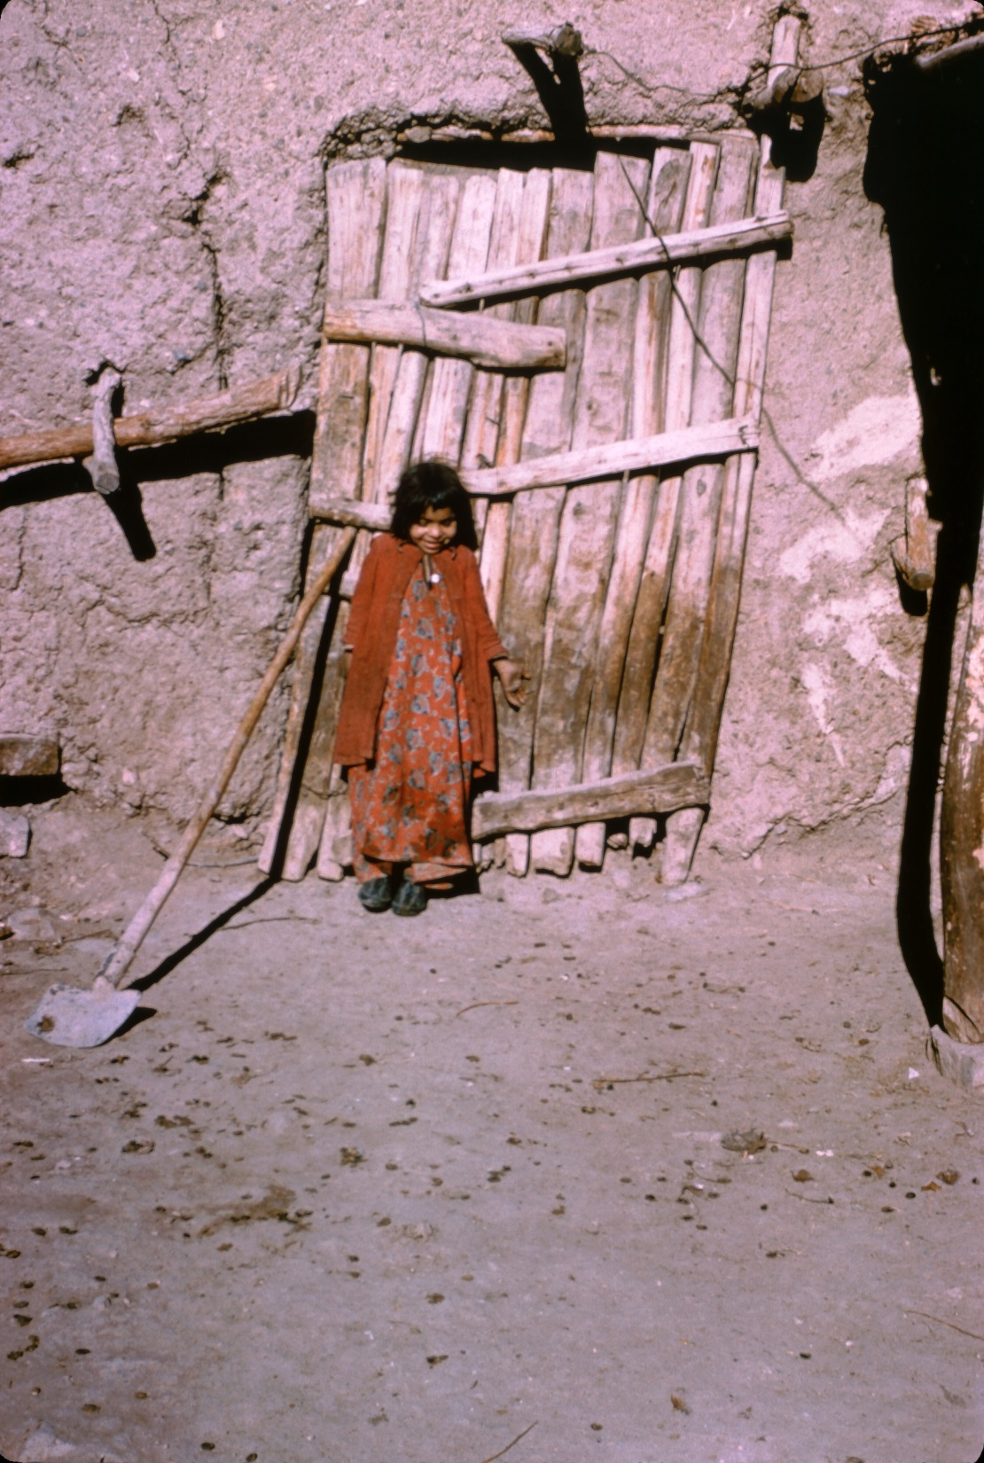
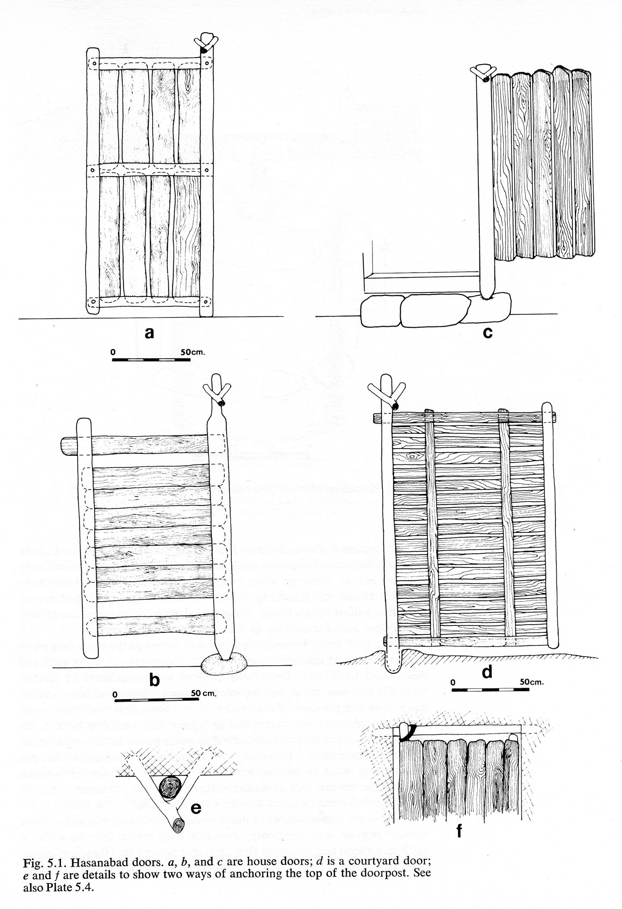

Slide 30
Courtyards
Not paved but hard from use. May have rock “paving” but rare in Faraman. In spring and summer is often covered with dung and urine because animals are now above ground. Dung cleaned out daily, as it is from underground stables. Women load it onto their skirts.
Features in courtyards: grain pits, wooden troughs for dogs, limestone slabs on which salt is spread for the animals, hearths for outdoor cooking, agricultural implements, brooms, rocks platform for water bags, mangers, “trees”
A few have kulas, leafy bowers over summer hearths

Slide 31
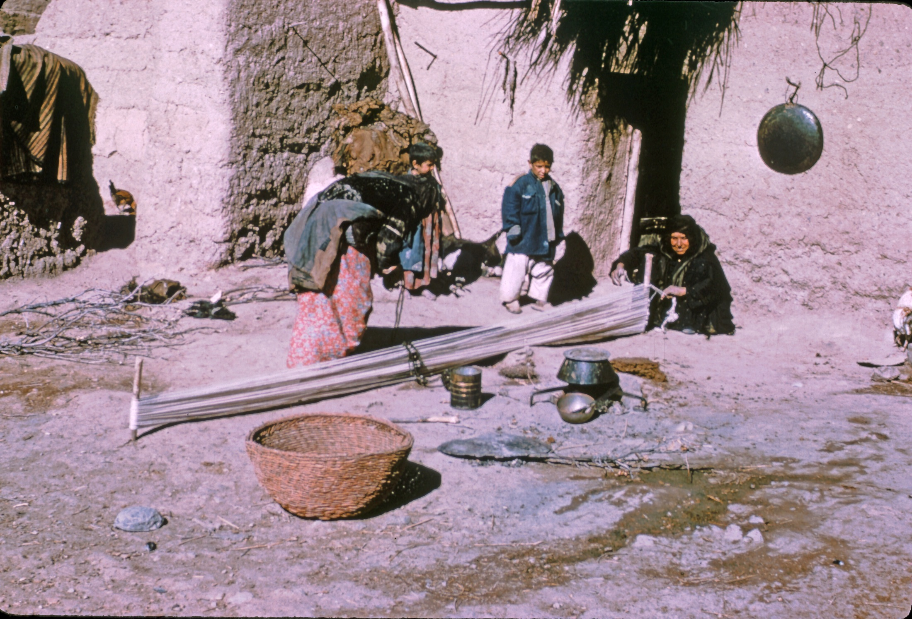

Slide 32
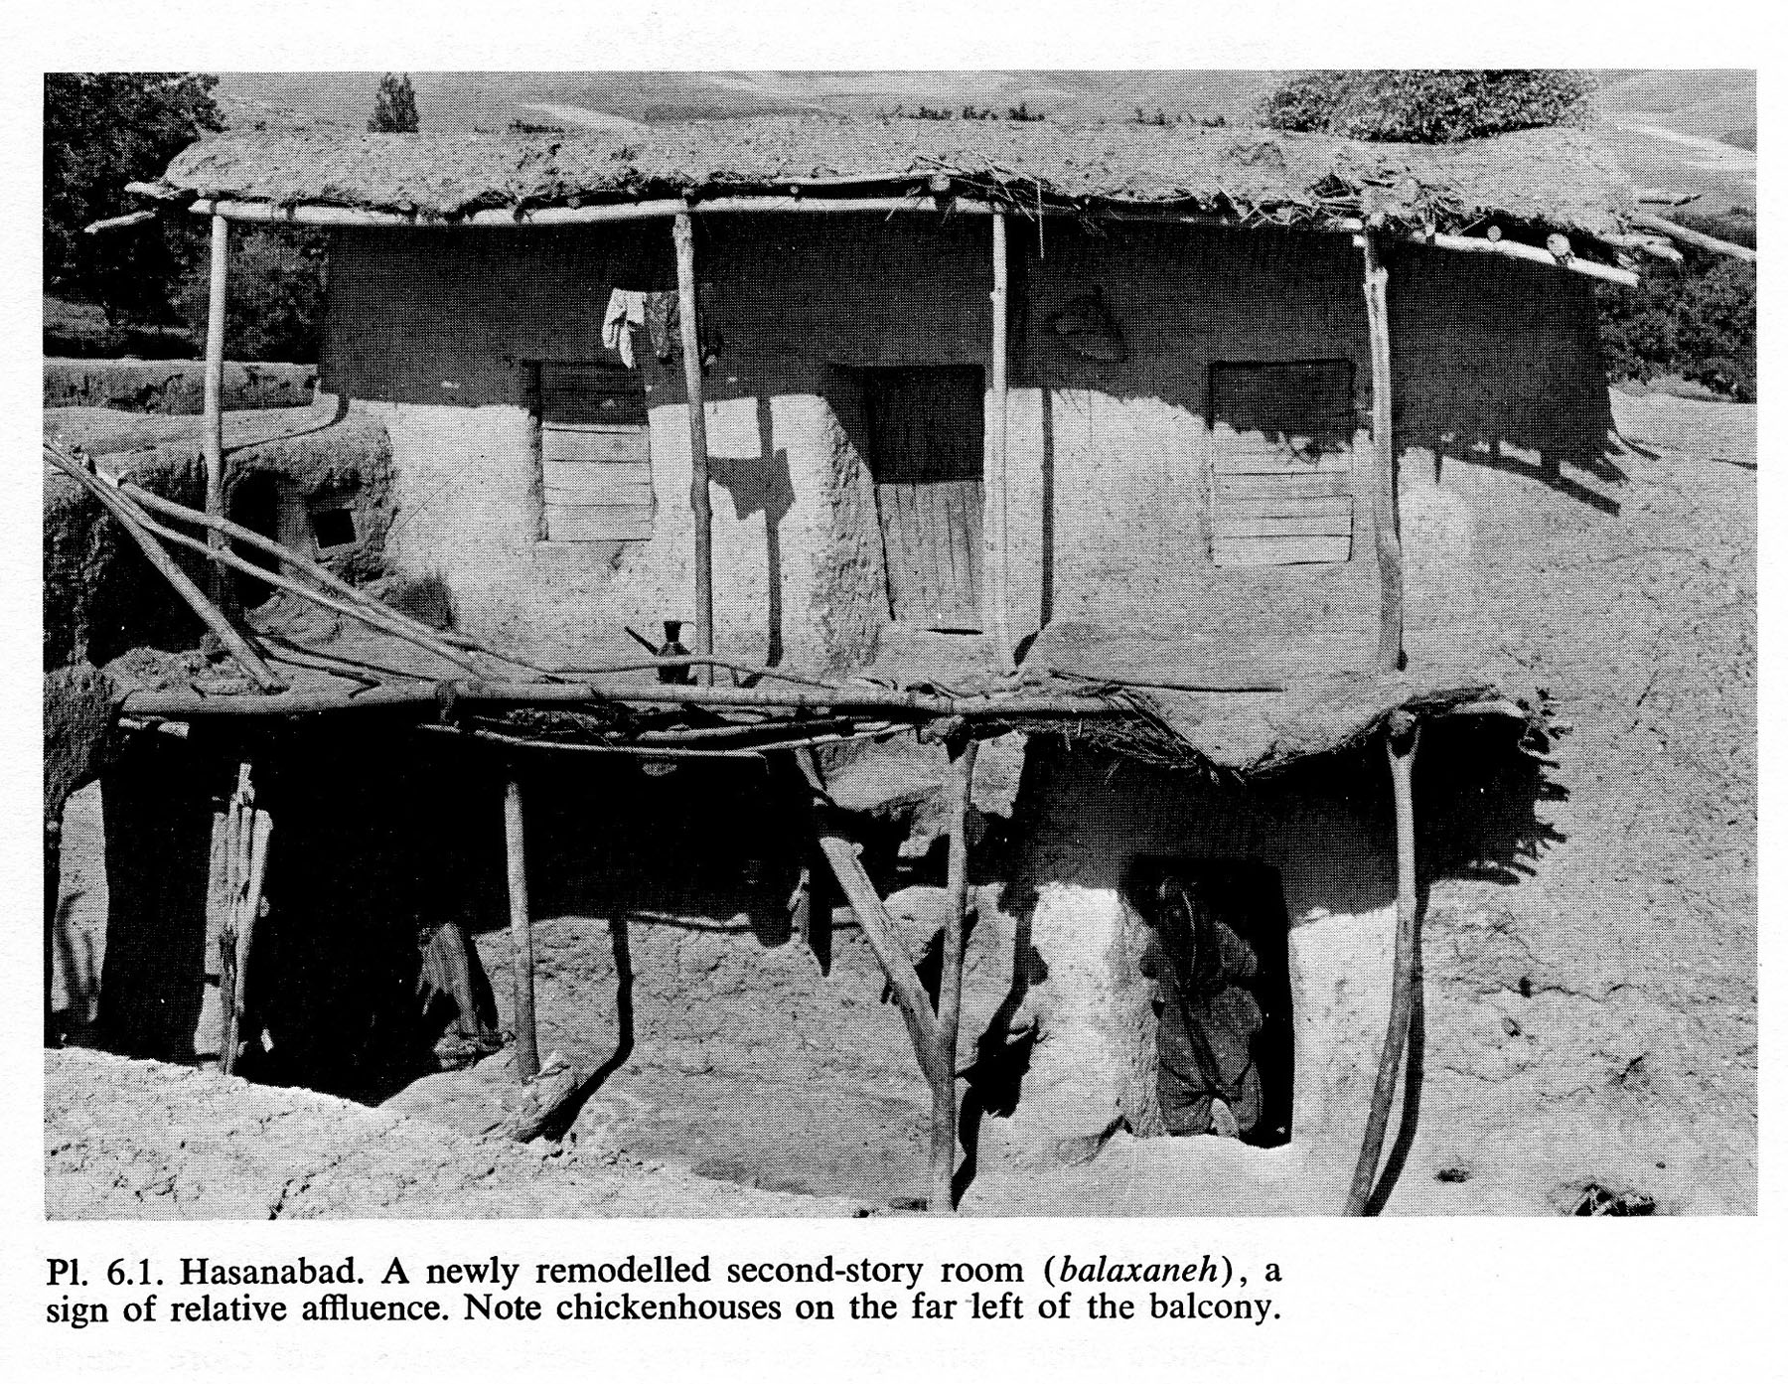

Slide 33
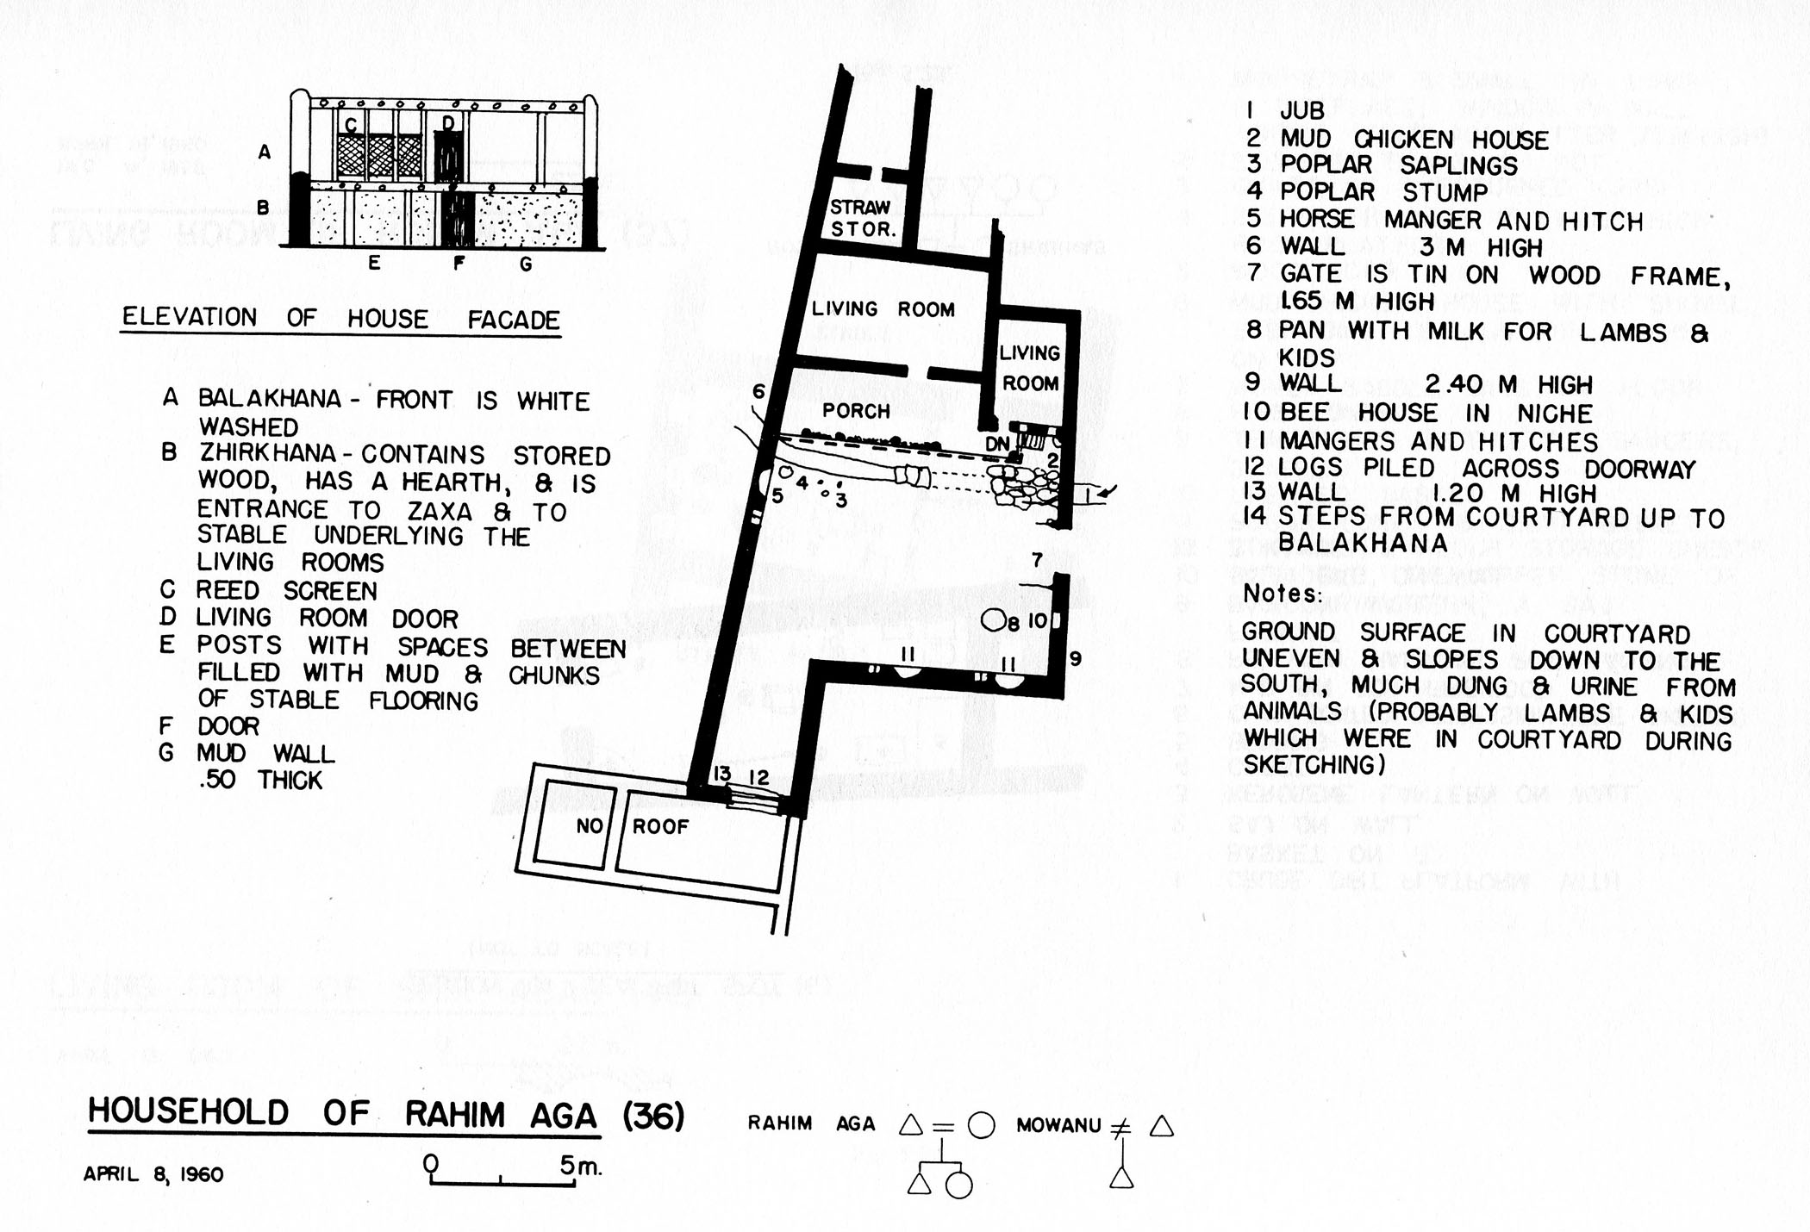

Slide 34
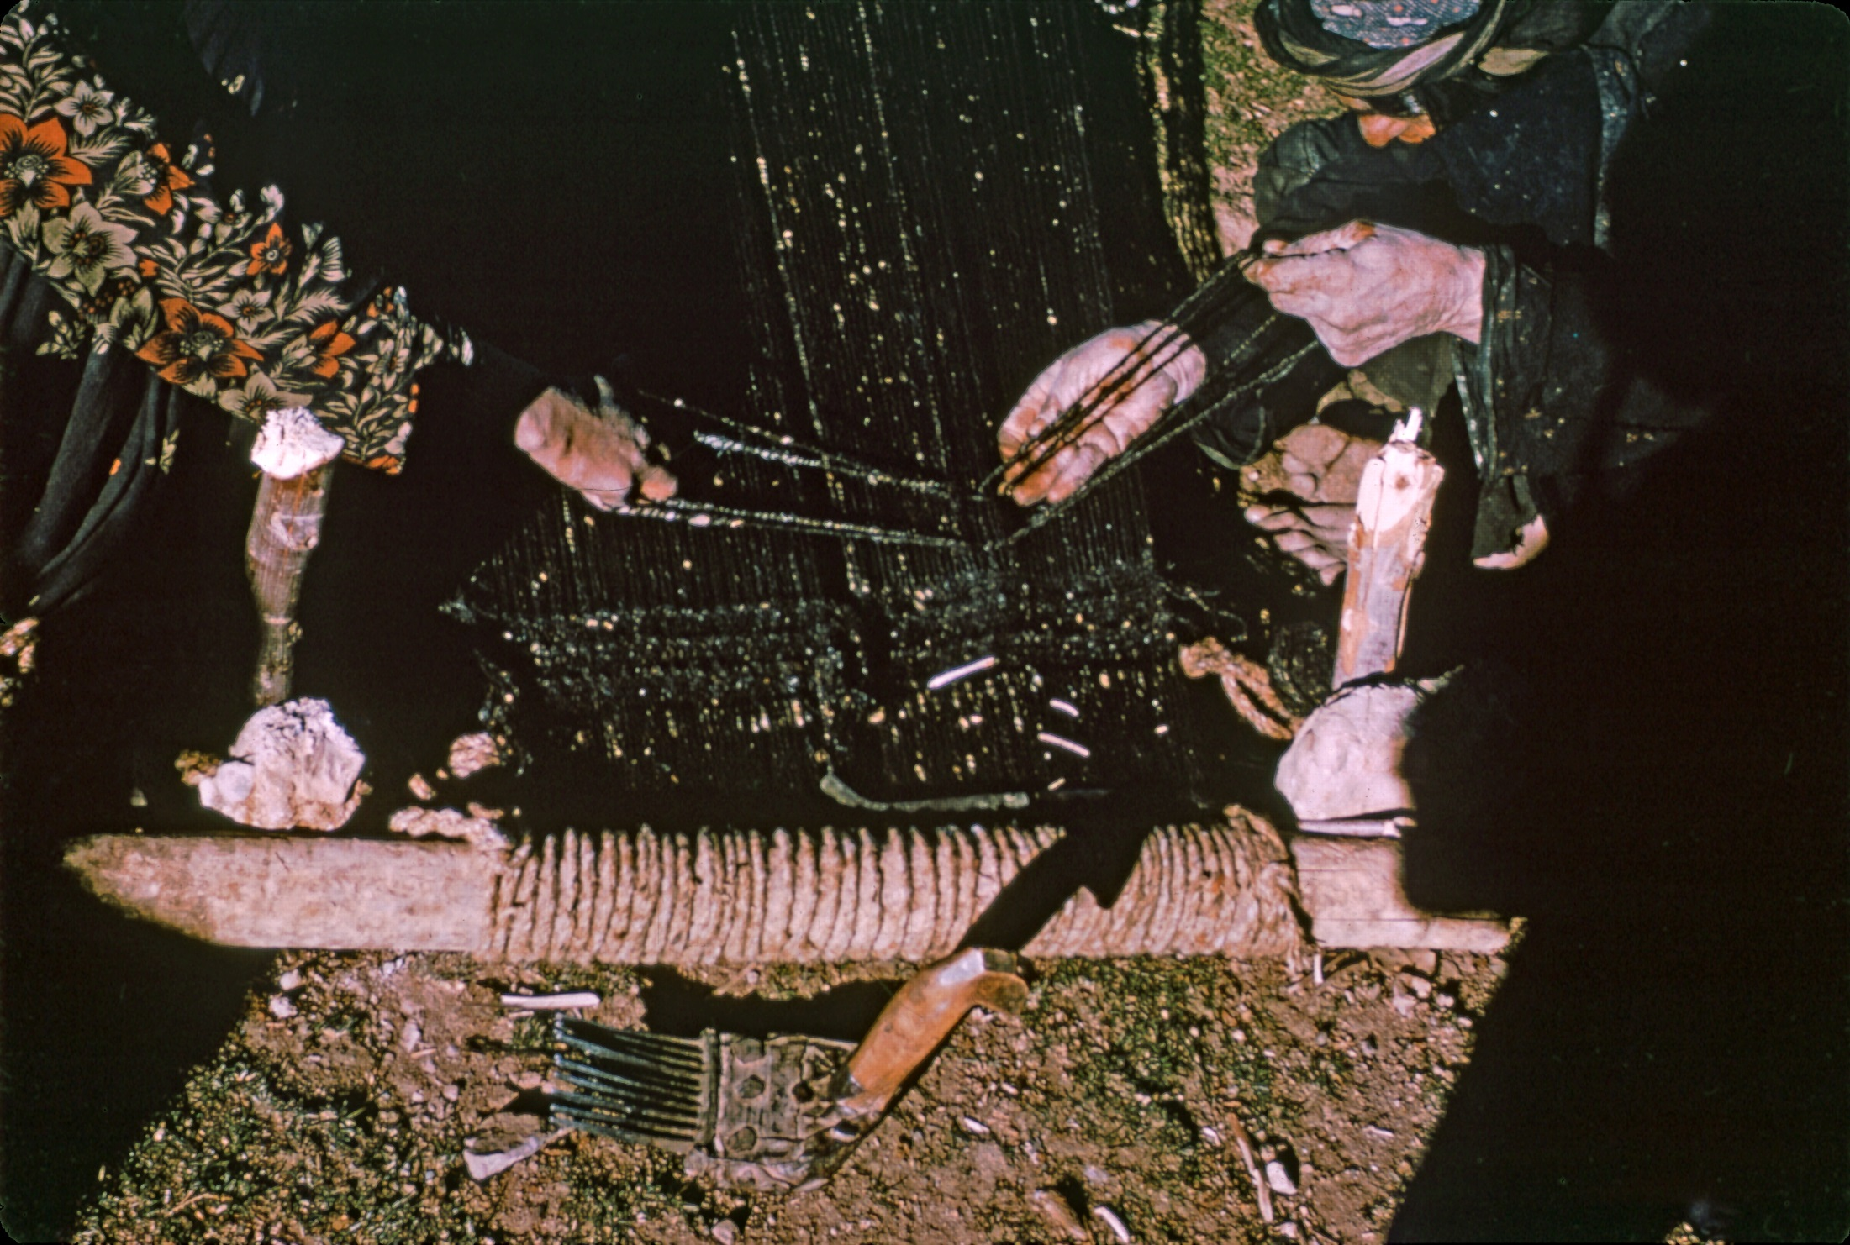

Slide 35
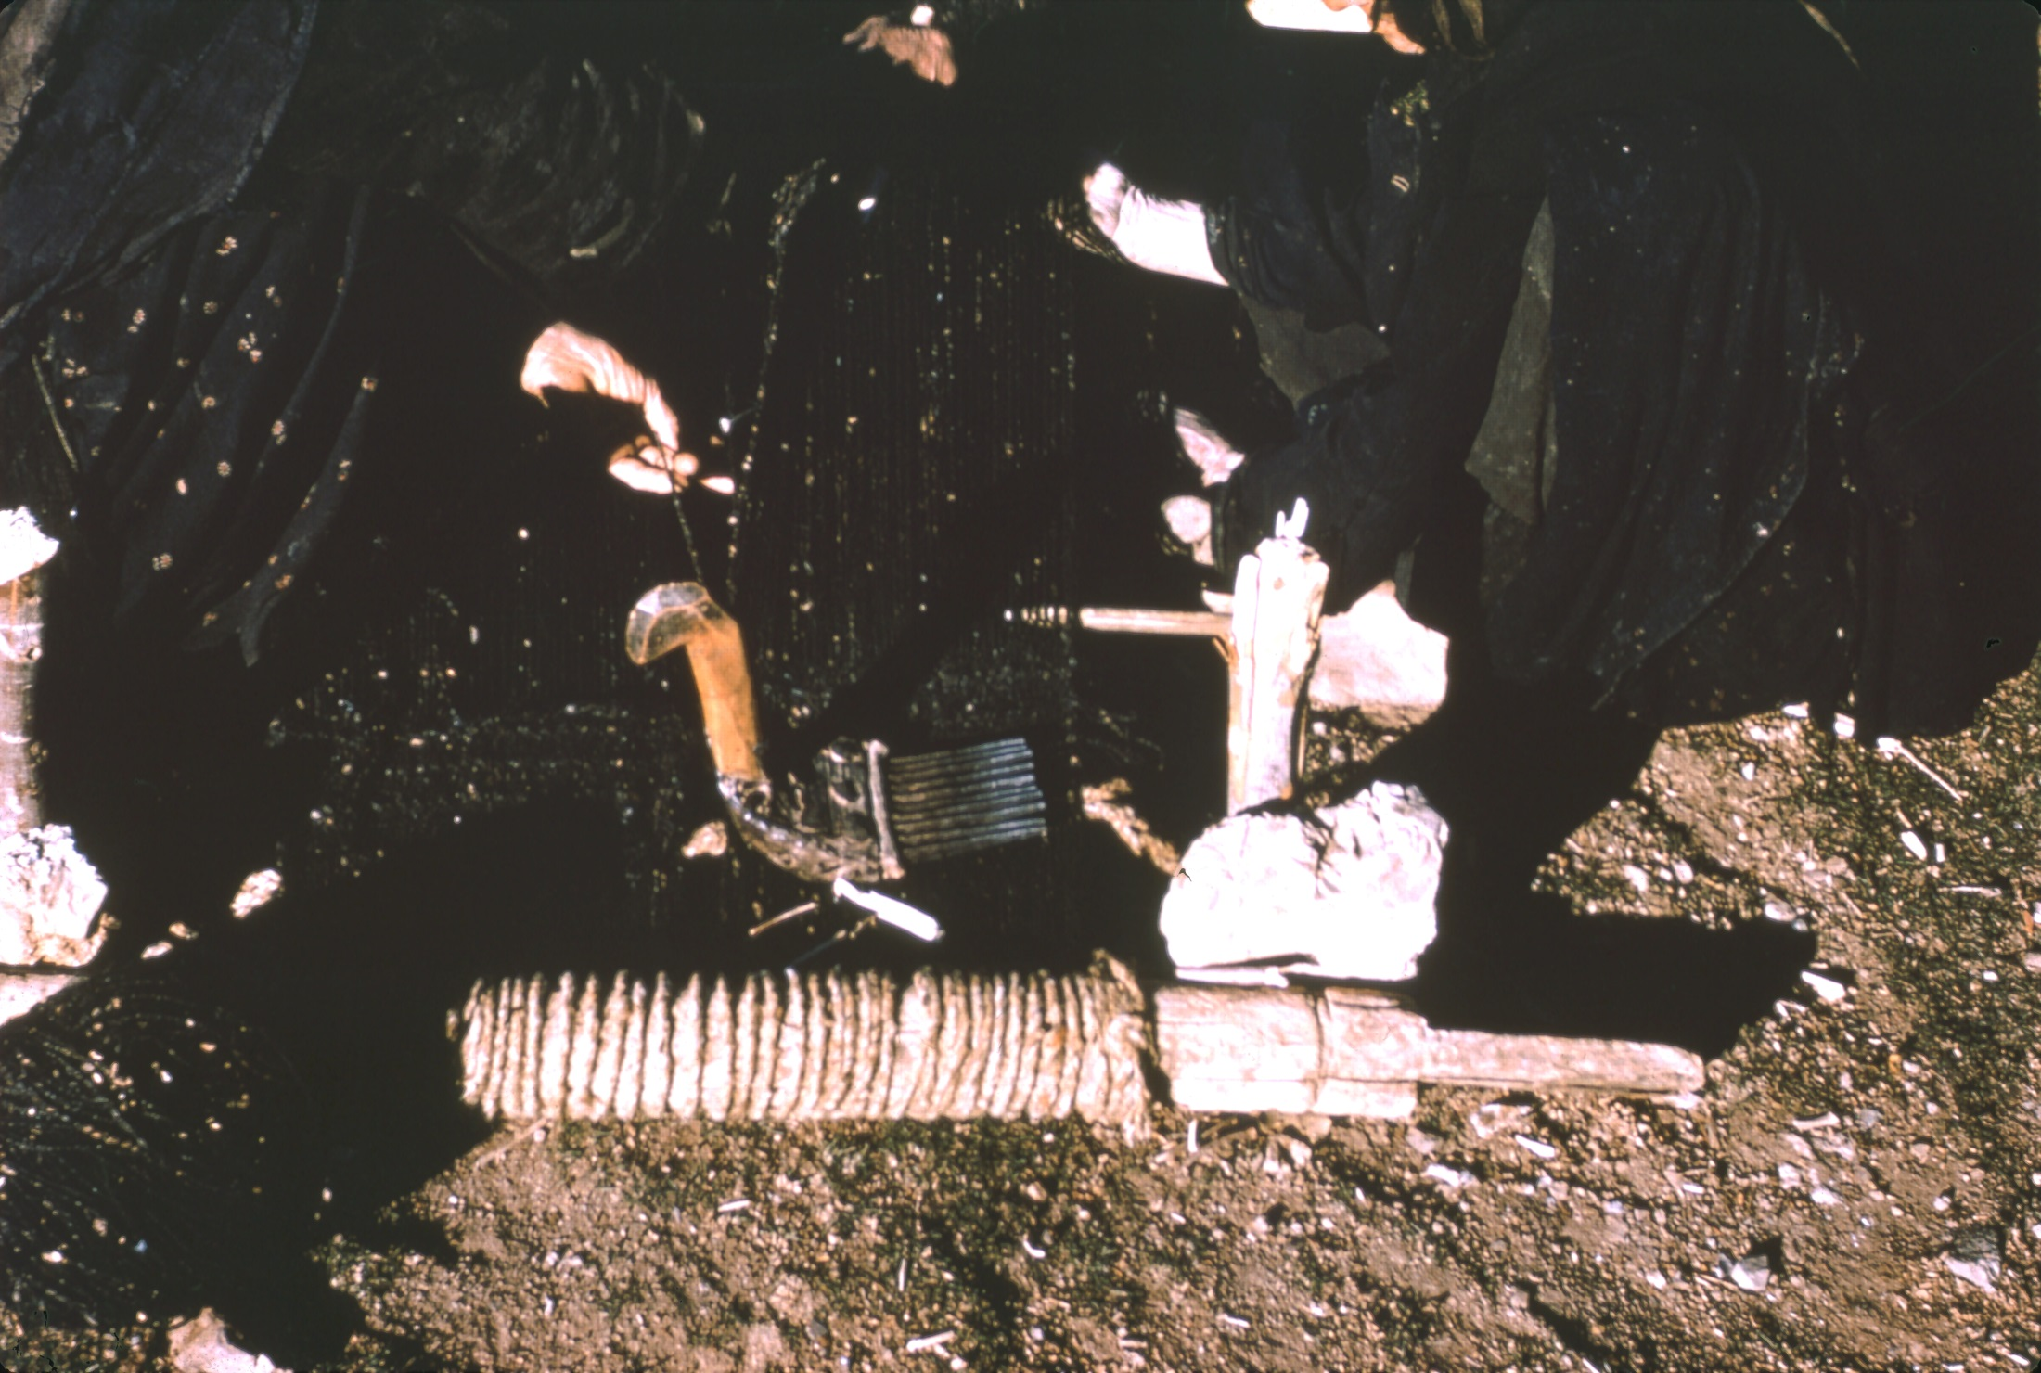

Slide 36
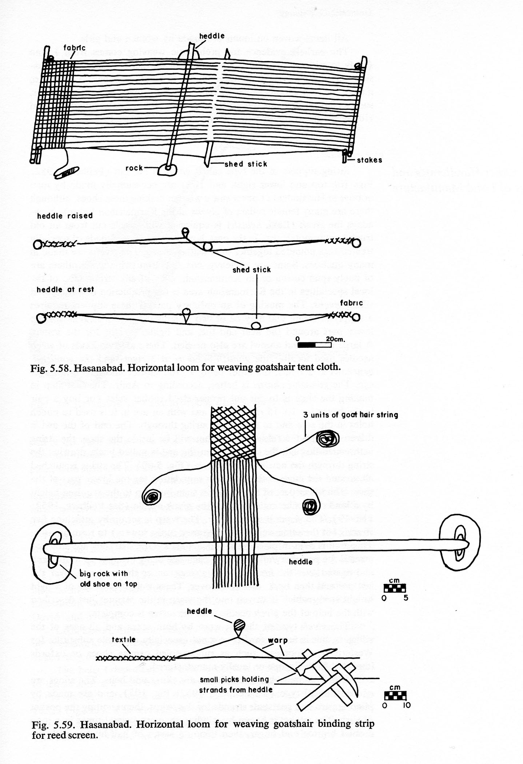
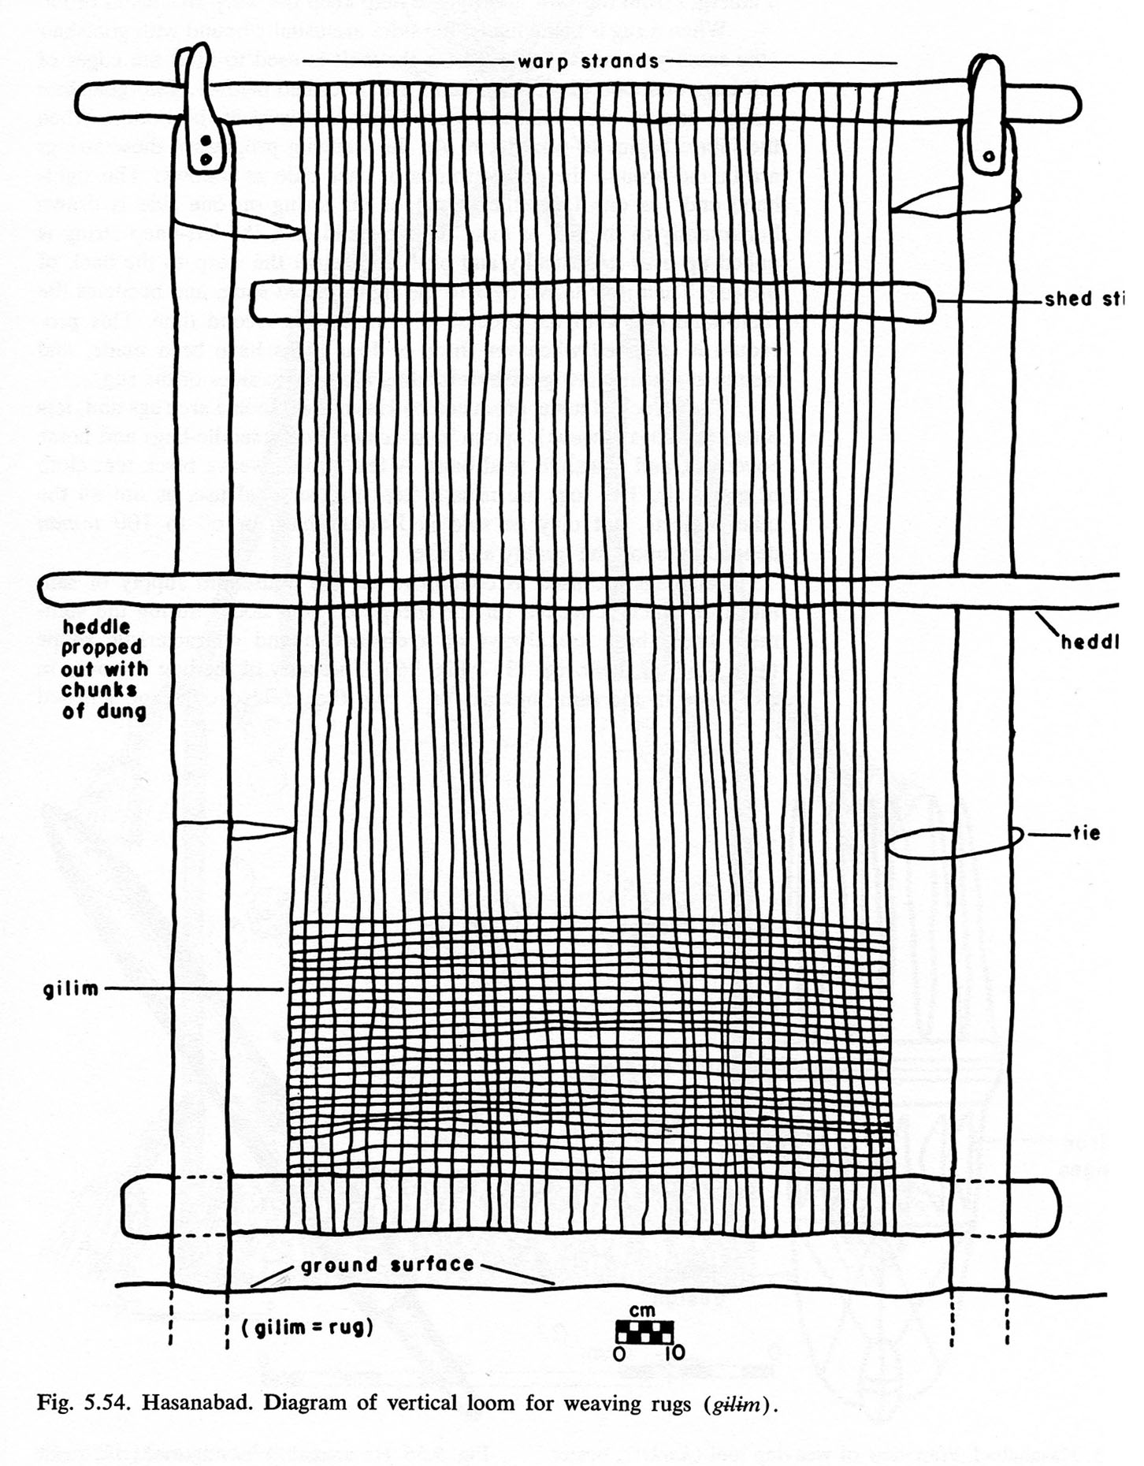

Slide 37
Living Rooms
Open hearths toward centers of room, simply stone-lined.
Niches in walls to store items.
Grain pit may be in corner of living room. Usually bell-shaped about 1m deep and at opening. May also have these in the courtyard.
Chicken coops in some living rooms and courtyards.

Slide 38
Domestic Equipment
Saj, flour sifter, bread board, mixing pan, tongs or poker, small tripod, pot lids, metal bowls, tablespoon, wooden spoon, tea kettle and tea pot, sugar bowl and adze, basketry tray for cleaning rice, flour chest.
A few mortars and pestles and even querns.
All houses have a chest in which valuables can be locked.
Vertical loom for kilims. Horizontal loom for tent covers.

Slide 39
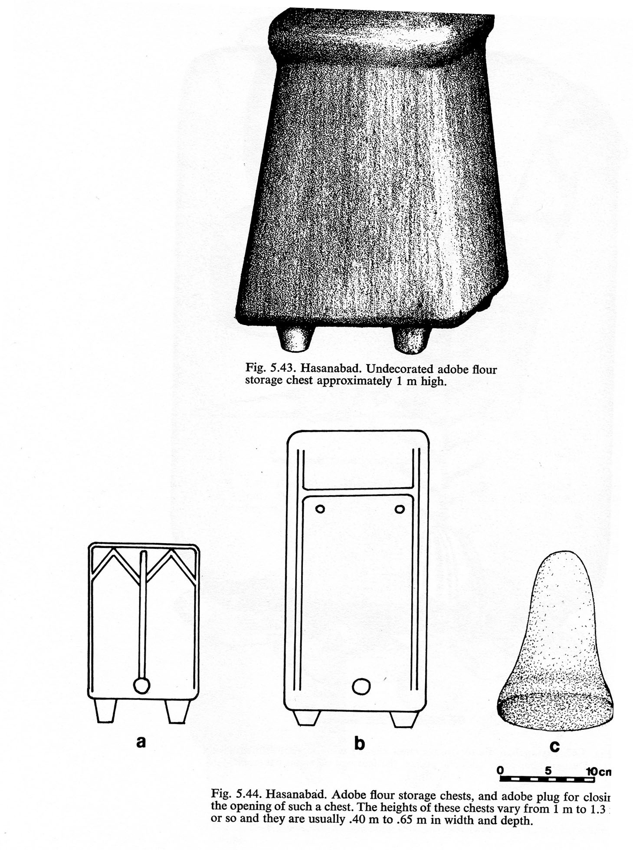
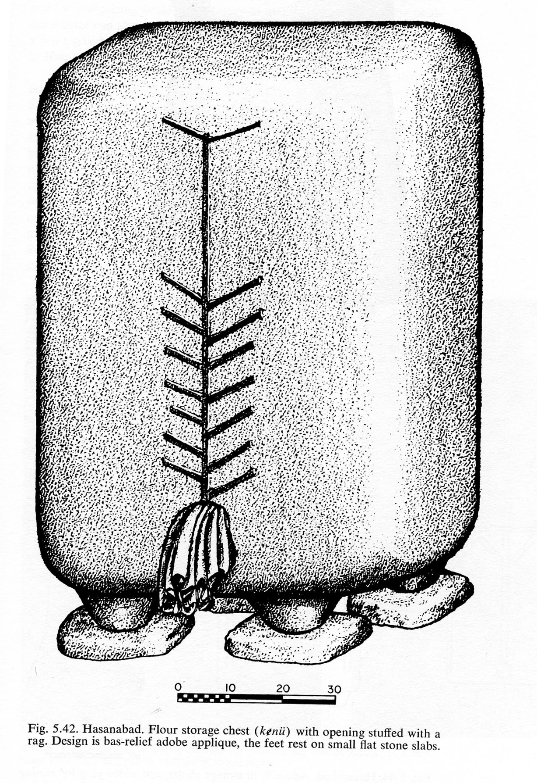

Slide 40
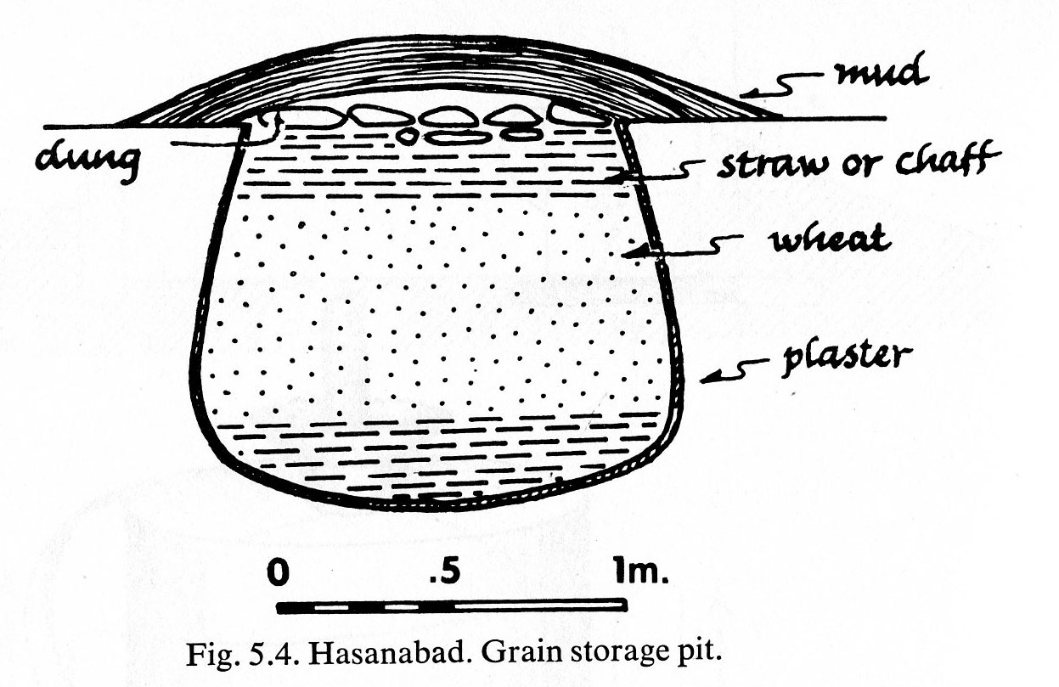
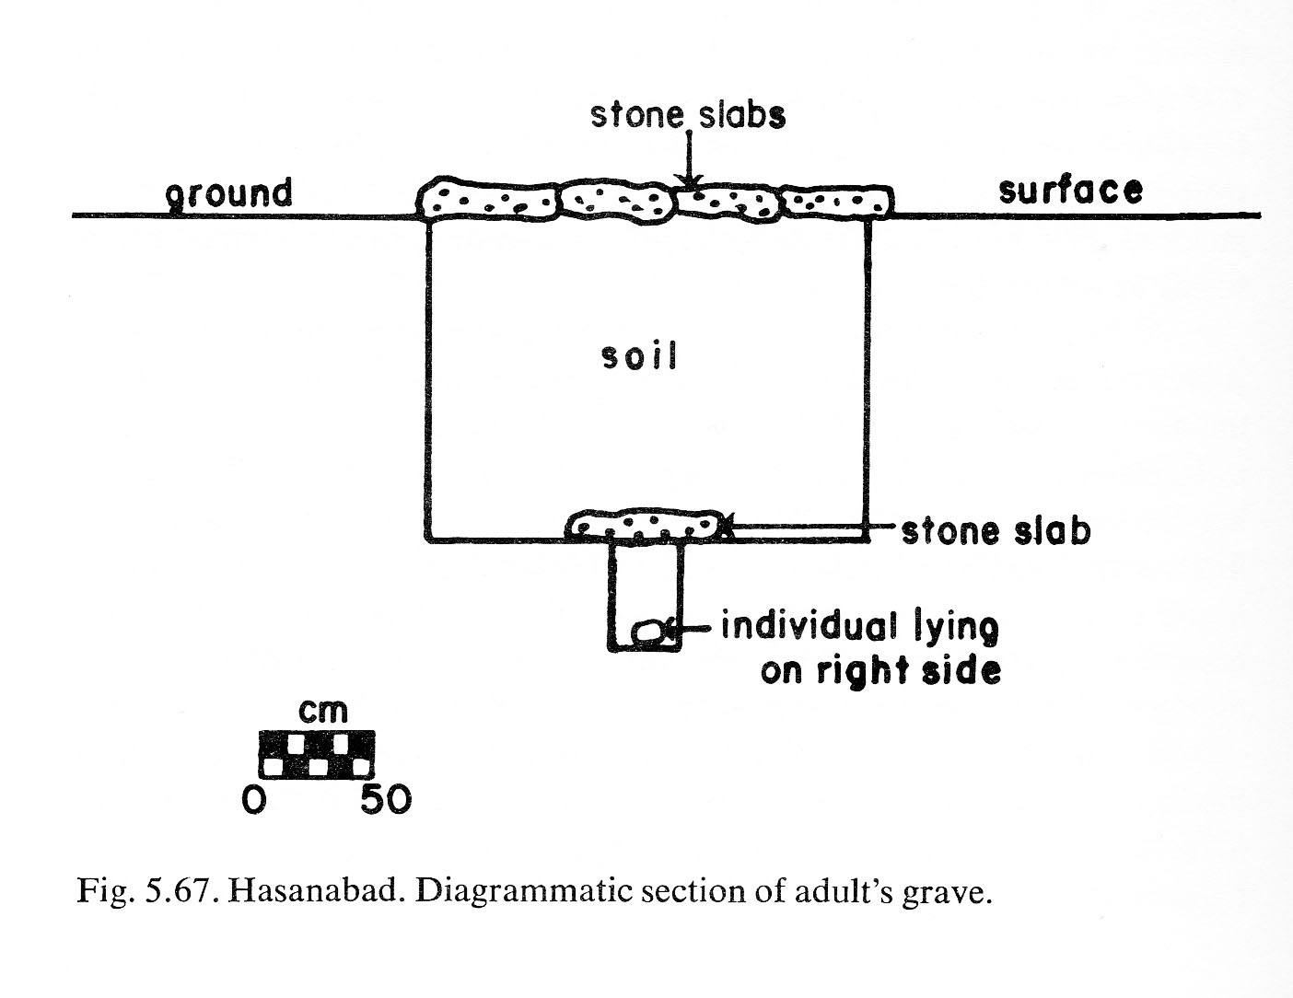
Grain Storage pit
Typical grave

Slide 41
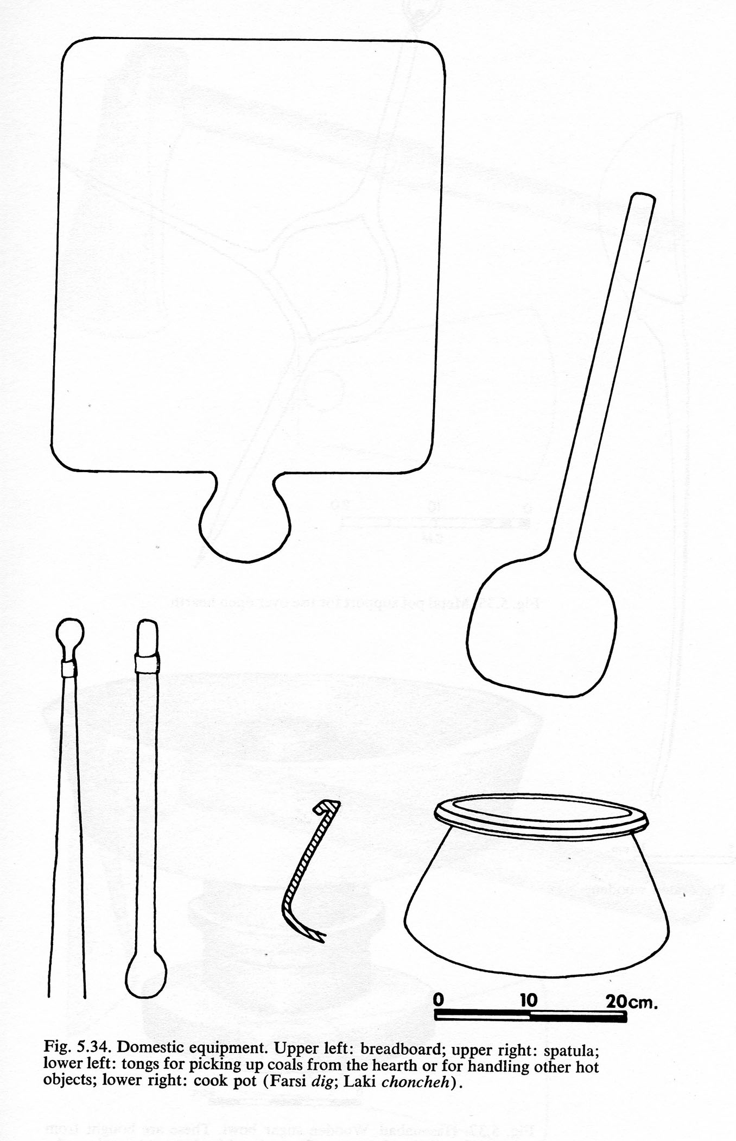
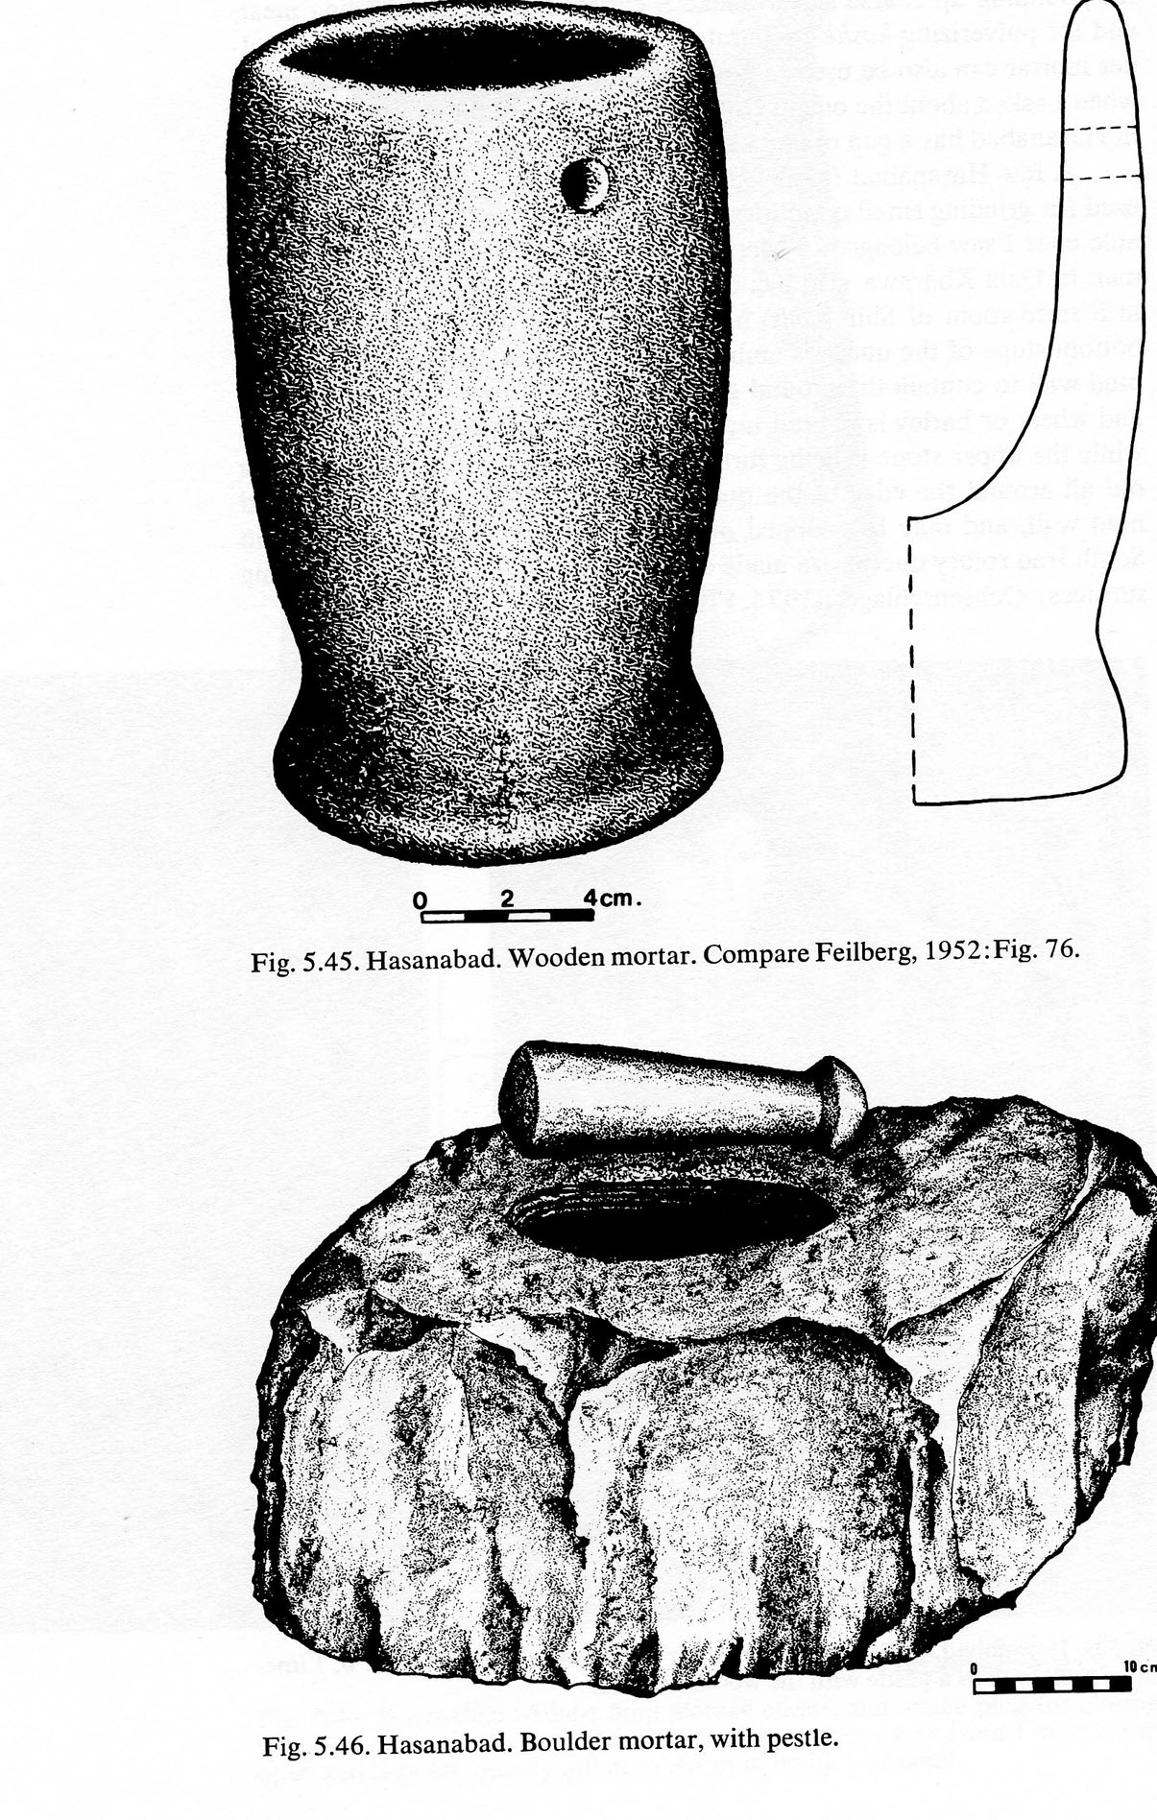
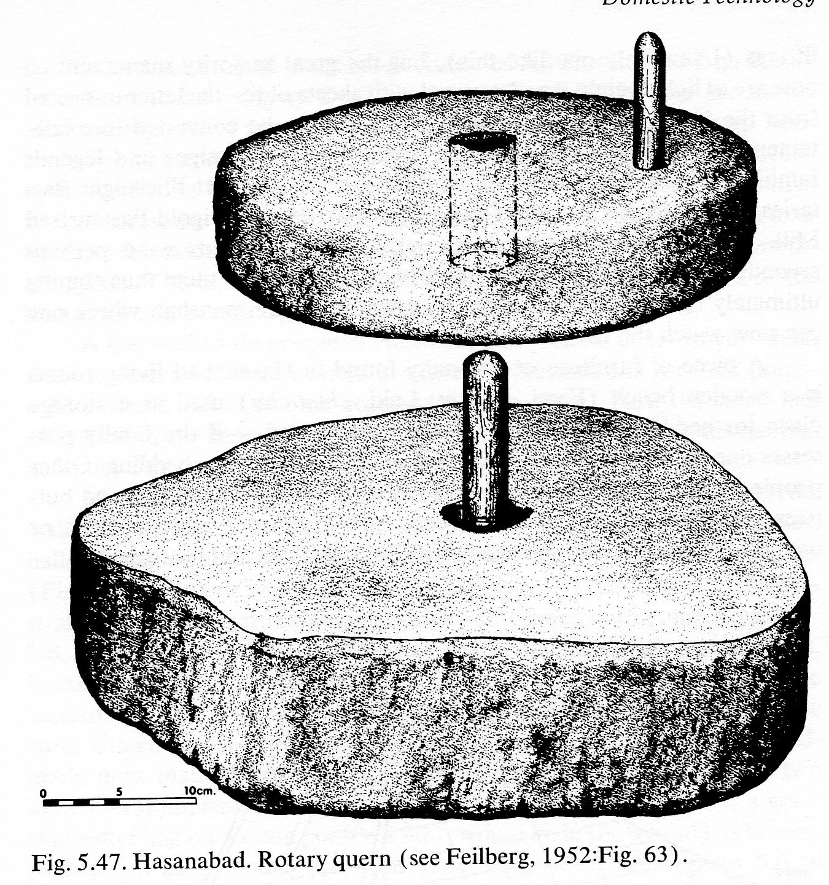

Slide 42
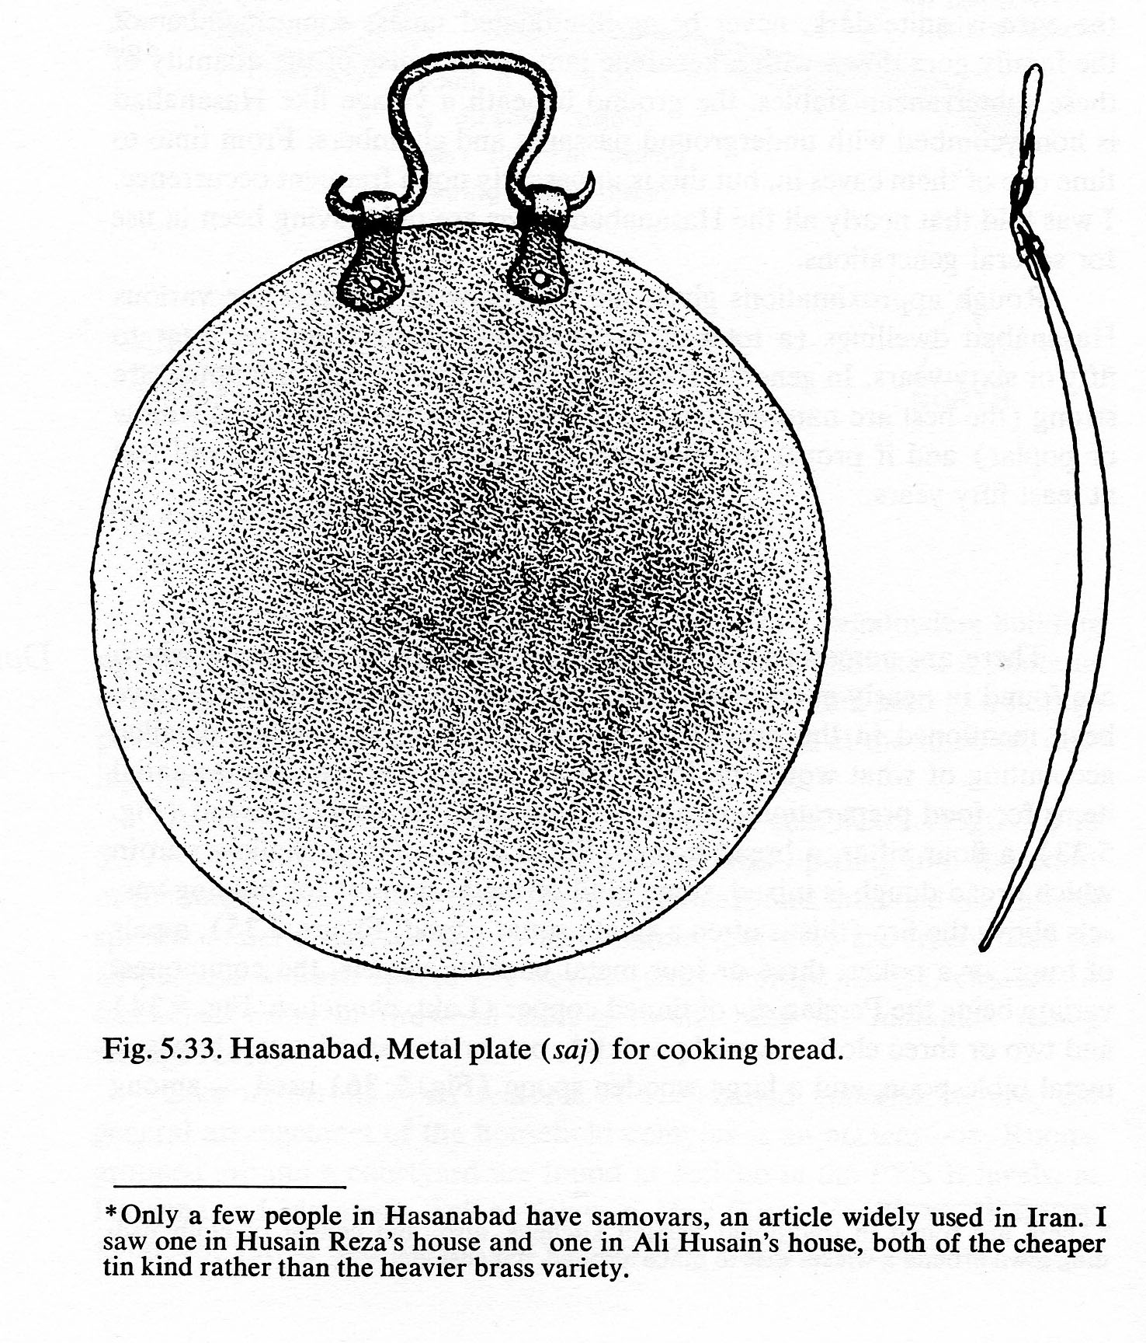
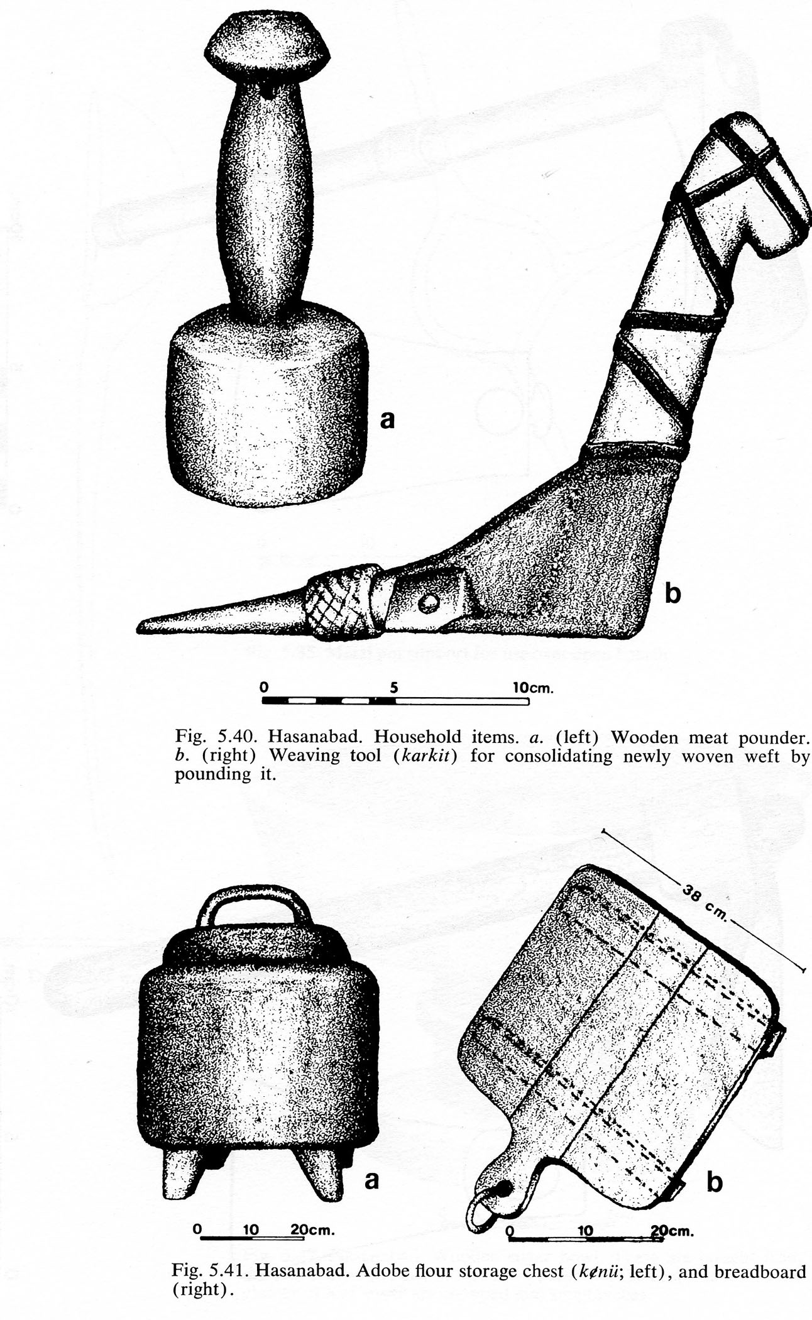
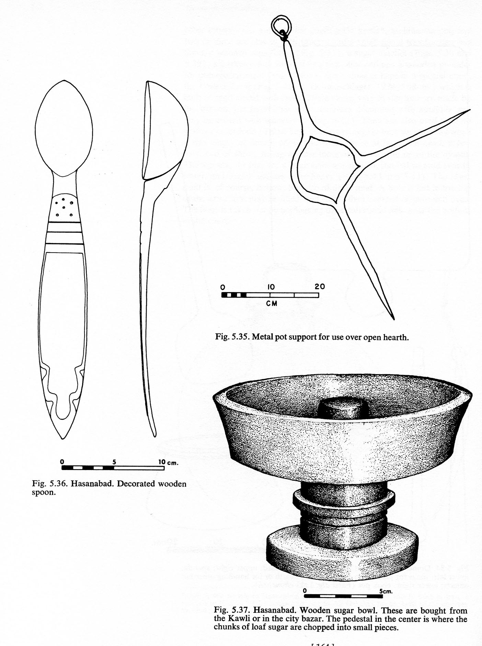
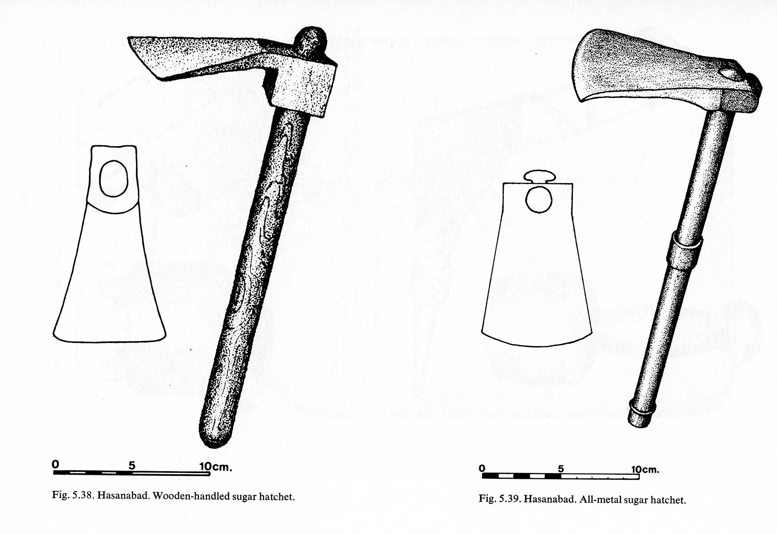
Household utensils

Slide 43
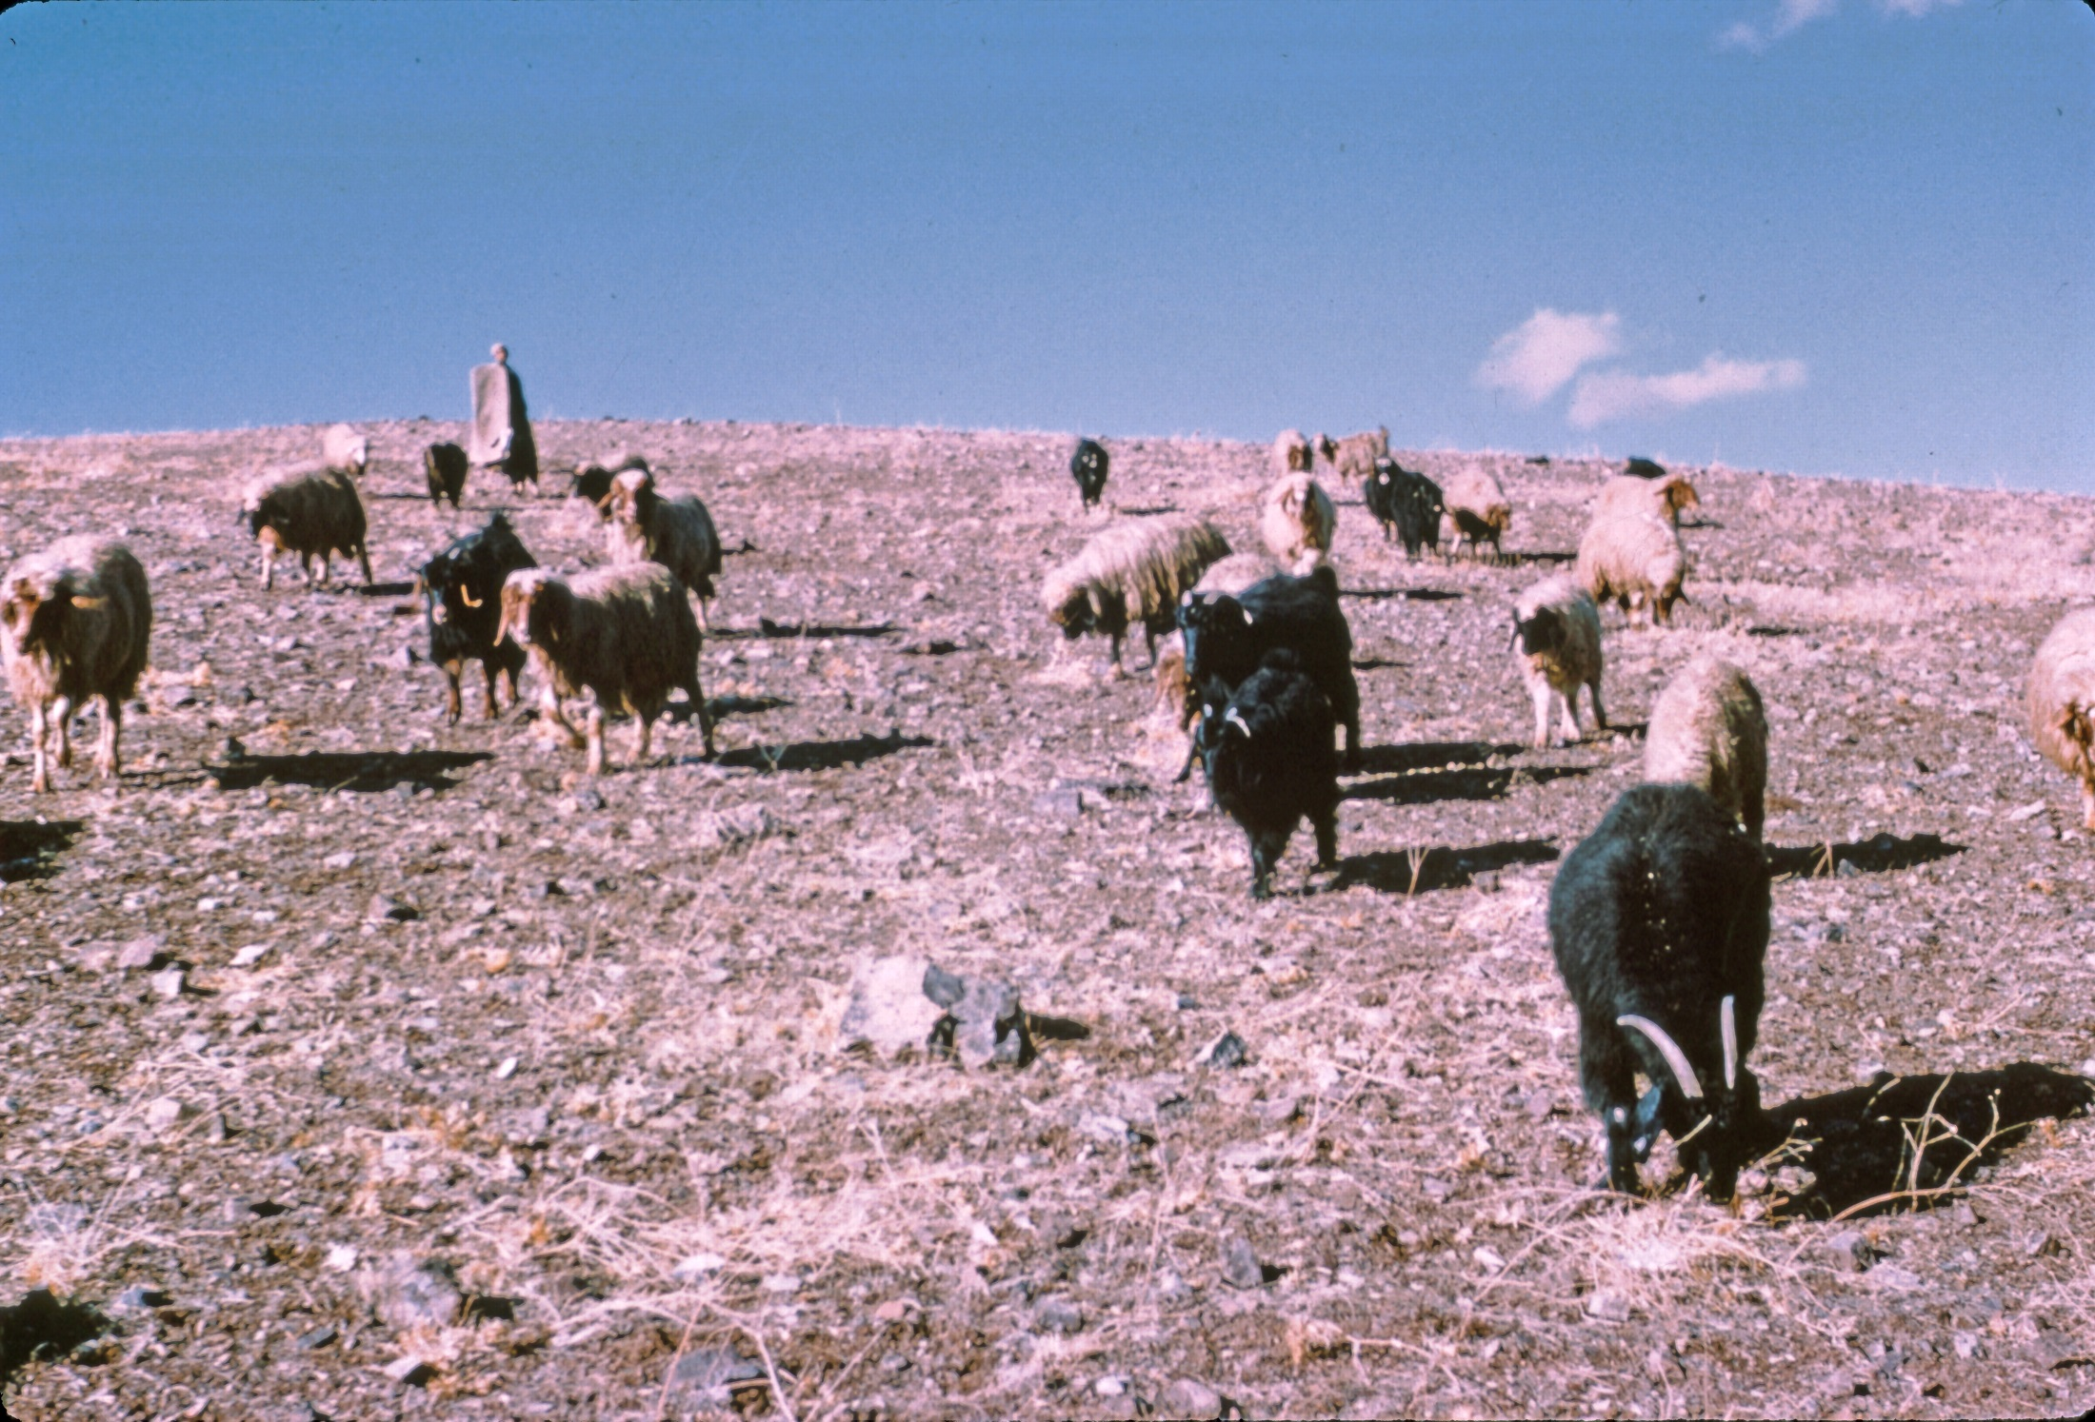

Slide 44
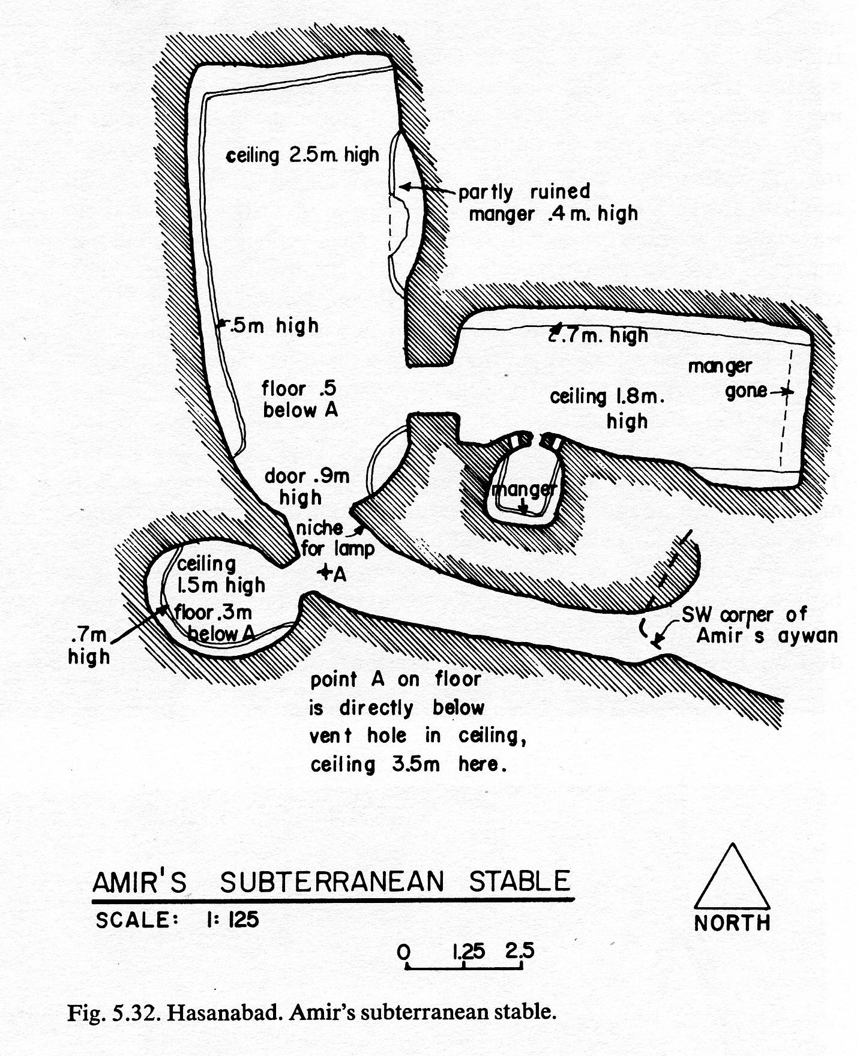

Slide 45
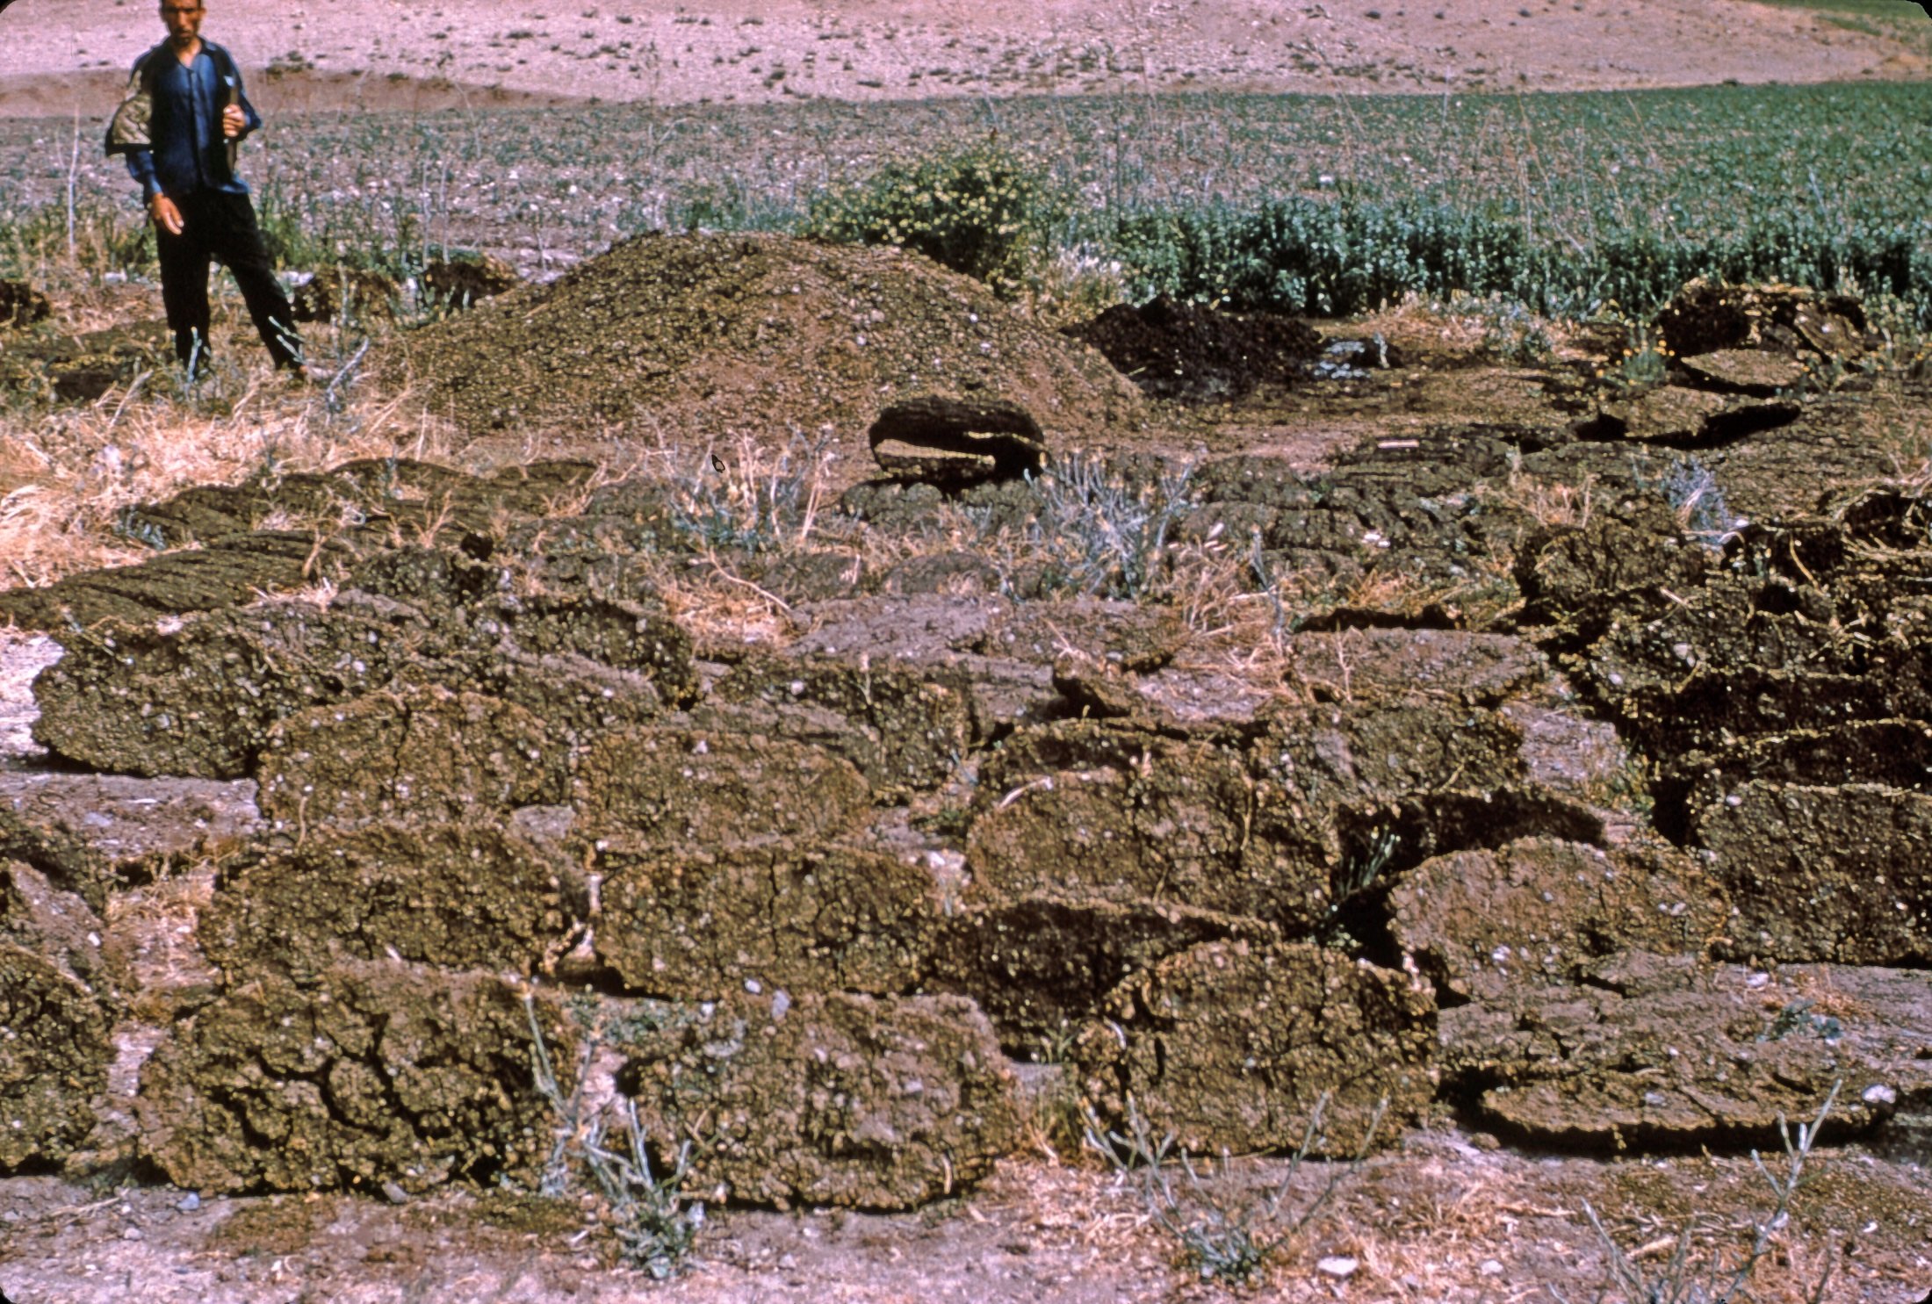

Slide 46
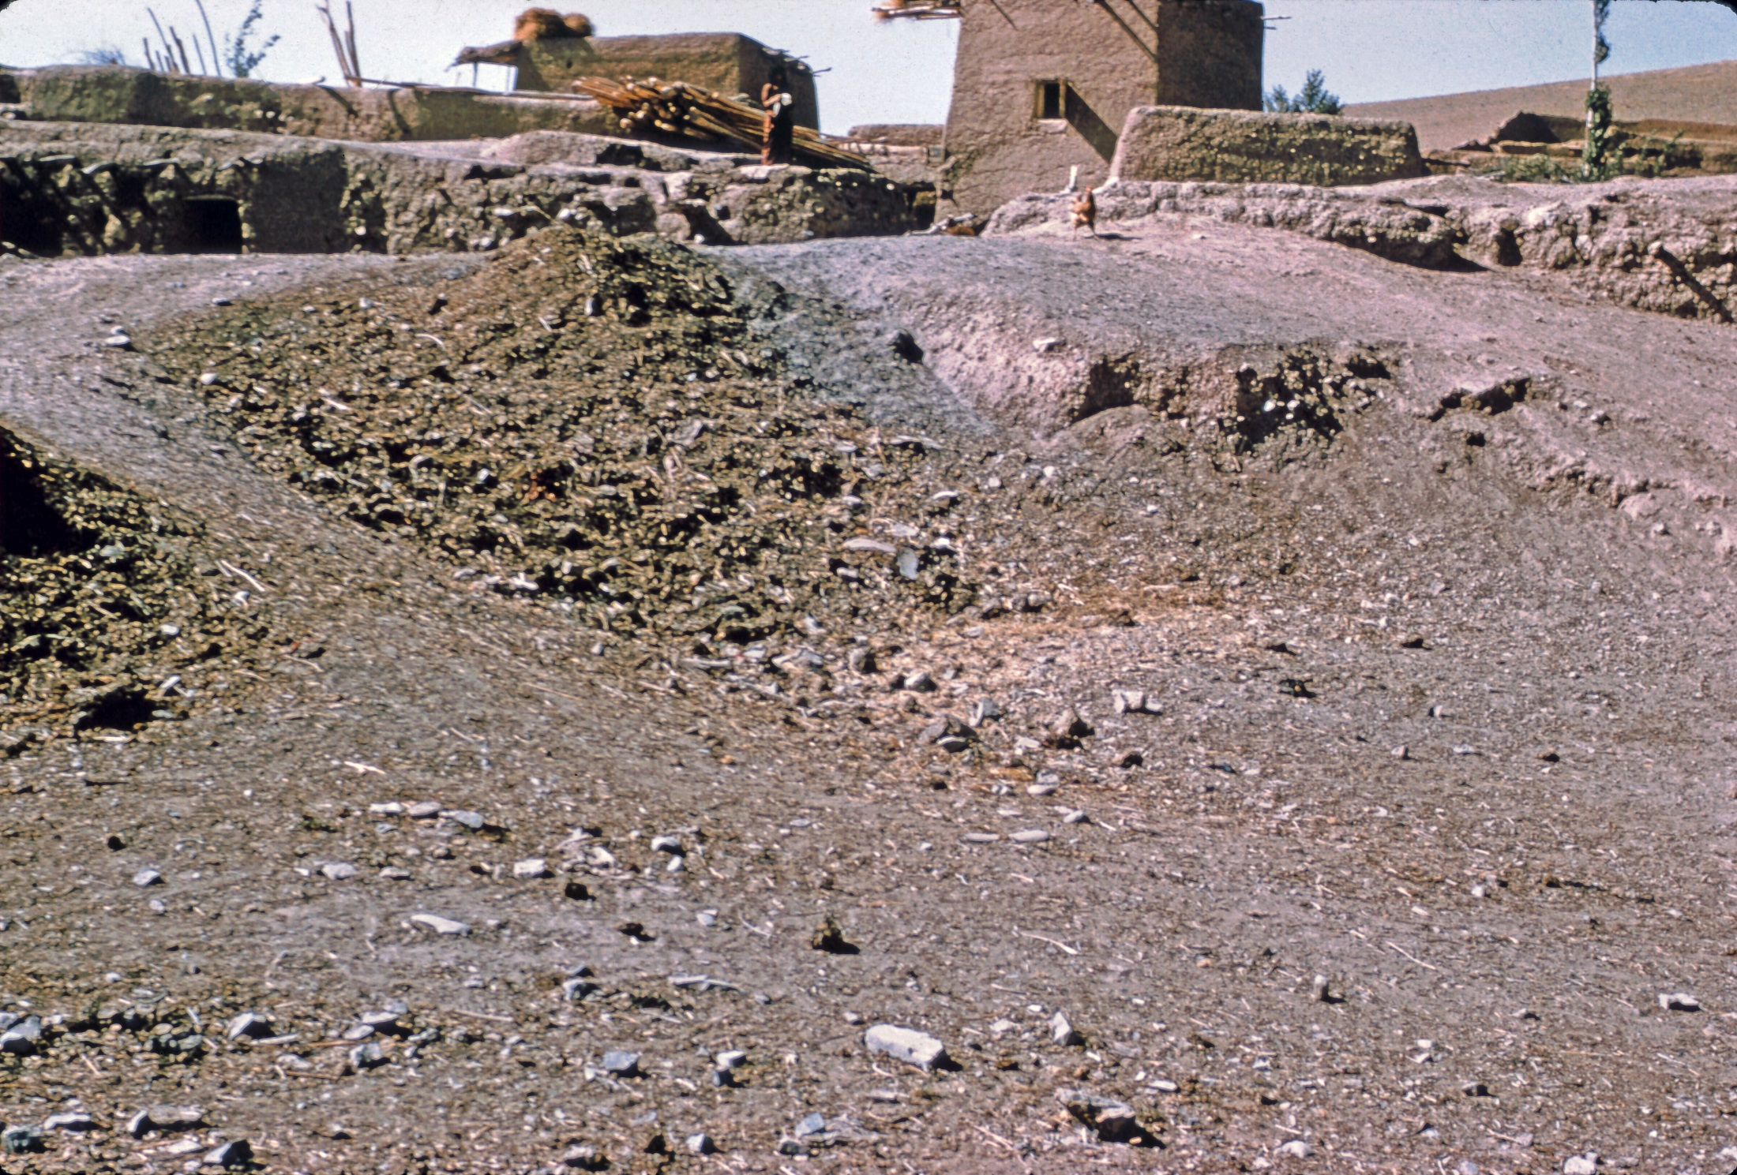

Slide 47
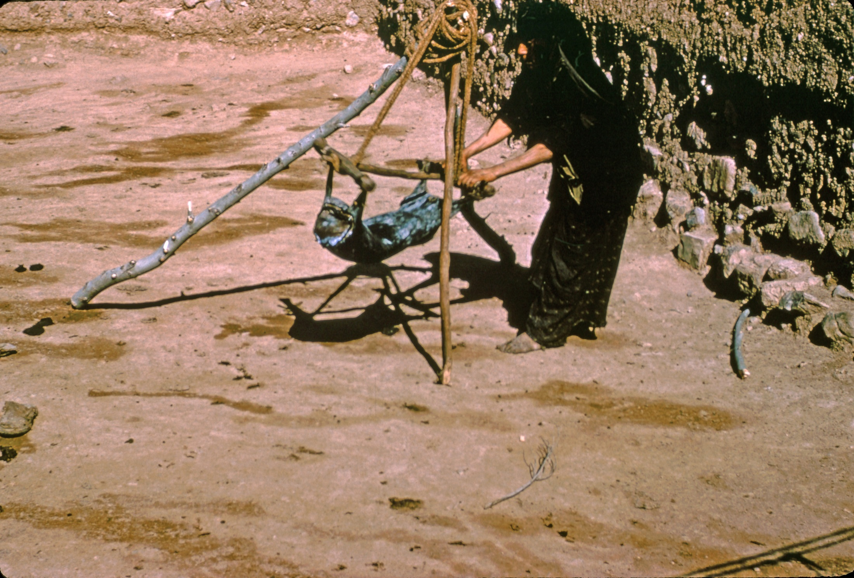

Slide 48
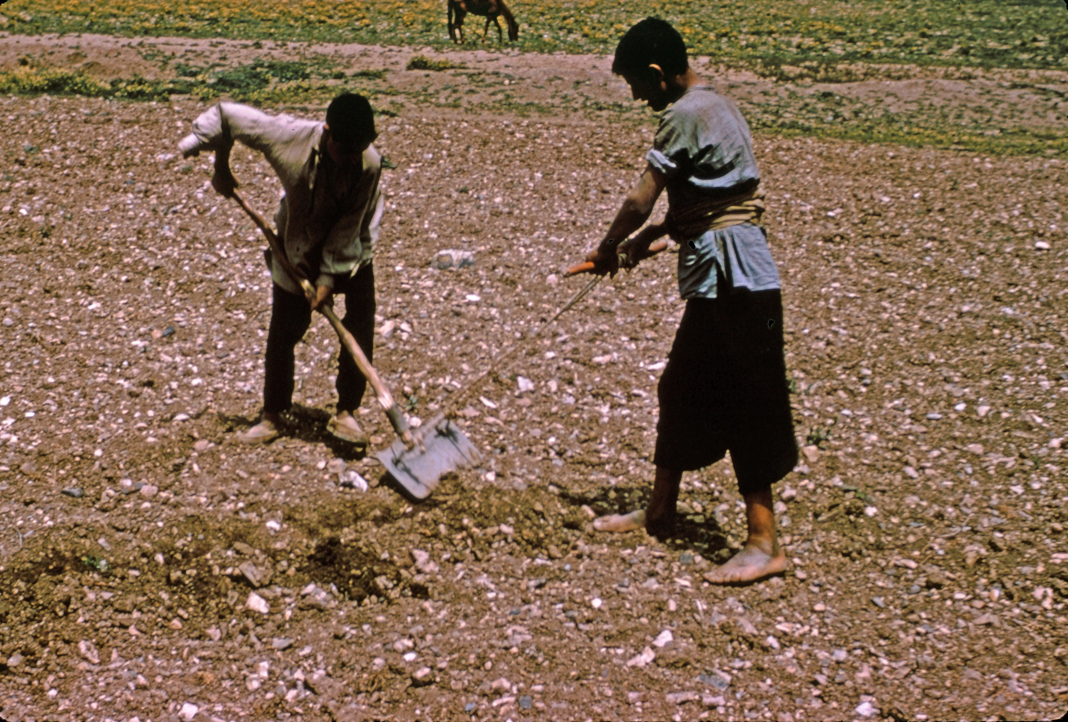

Slide 49
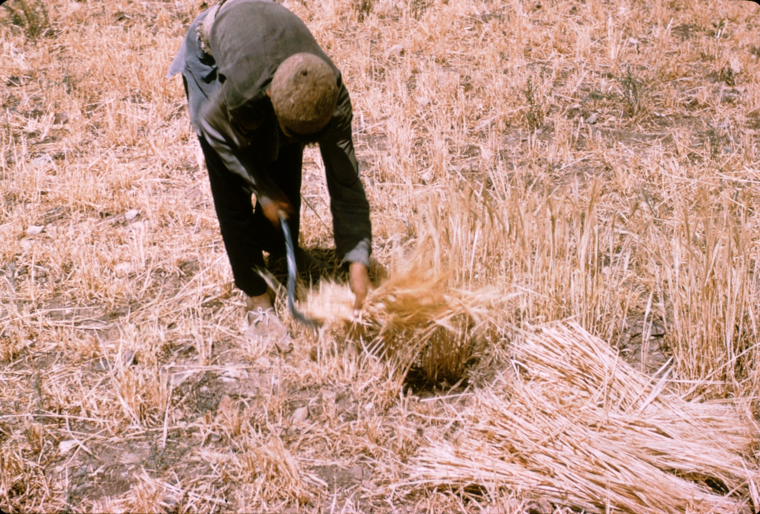

Slide 50
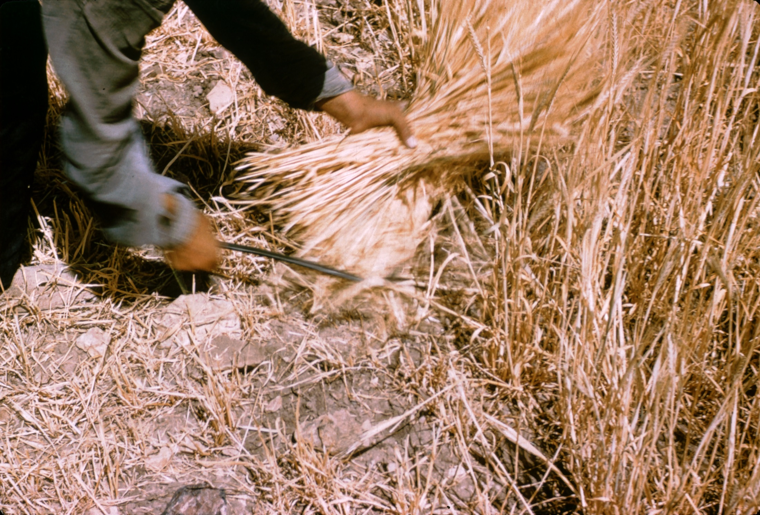

Slide 51


Slide 52


Slide 53


Slide 54


Slide 55


Slide 56


Slide 57


Slide 58


Slide 59


Slide 60


Slide 61


Slide 62
Supernatural
Evil Eye is real danger; also wicked jins and peris. 233
“Children, animals, and even dugh
Manufactured by the women of the household are protected by charms and amulets” 233
Mashallah (what God wills) is invoked when praise is given to ward off evil eye.
Charms are worn by children, blue is particularly effective, as are words from the Koran.
Jin a witch-like creature (female) that can possess a person. Particularly dangerous during childbirth, but also accounts for various diseases and afflictions

Slide 63
Examples of charms
Mashallah (what God wills) is invoked when praise is given to ward off evil eye.
Charms are worn by children, blue is particularly effective, as are words from the Koran.
Examples: on child’s back, a brass bell, two white cowrie shells (excellent protection against Evil Eye), a blue glazed paste disc with multiple perforations, and a cloth case with Kuranic inscriptions; on his left shoulder three buttons –orange, yellow and white, on his right shoulder a red button, a blue glazed perforated disc, an old coin, two blue beads, and a large pink bead.
Another boy had a rooster bone, a blue glazed disc, a cowri shell, a small comb-like wooden object (tawi).
Chicken bones for mubaraki (blessing).

Slide 64


Slide 65


Slide 66


Slide 67


Slide 68


Slide 69


Slide 70


Slide 71


Slide 72
Behavioral Correlates
Naroll (1962) estimated that there is 10m² per person of roofed area. At Faraman the average roofed area per person is 21.0m², and the average roofed dwelling area is 7.3m² with a great deal of variability (as seen in the house plans). 291 (see Figure of room sizes)
Average number of rooms per family is 4.5 (including underground stables)
Richer families have two living rooms (one a guest parlor). Poorer folks have smaller compounds.
Living rooms always have a stone-lined hearth, wall niches or pegs for storage, furniture, bedding, and vessels for cooking and serving food.

Slide 73


Slide 74
Land & Storage
A family of five, has 5-6 ha of land sown annually with 150 mann (1500 kg) of wheat that will be ground for family use. The 41 households, therefore, require 120-125 ha of dry-farmed wheat and barley.
Family has 1ha wheat, 0.5 ha barley, but with yearly fallow, need 3ha in all. 293
Straw storage very important, to be used as fodder and also for plaster.
Storerooms lack features, but usually have mud mangers.
Storerooms are for fuel or animal fodder and not for food – pits and bins are for food.

Slide 75


