Slide 1
Evoked Culture and Rethinking Conventional
Wisdom
Tom Lawson
LEVYNA
Masaryk University

Slide 2
Culture as a reified object
In conventional talk about culture we often attribute causal properties to culture
So we tend to describe specific forms of human behavior as being influenced by “culture”
For example, we say that we speak a specific language because of the culture in which we grew up

Slide 3
Folk and scientific perspectives
For most every day purposes this way of talking is perfectly acceptable
However, from a scientific point of view, this conventional way of speaking can be very misleading
  Because it reifies culture (treats ‘culture’ as a thing rather than as a description of features)
  Because it leaves the causal properties unexplained

Slide 4
What is “Culture” anyway?
So, what, upon reflection, do we normally mean by “culture”?
OED definition: “The ideas, customs, and social behavior of a particular people or society”
Notice: three different kinds of things in this definition
  Ideas (mental things)
  Customs (social things)
  Behavior (physical and biological things)

Slide 5
WHAT TO DO
Clearly, therefore, we need an explanation of how mental, social and physical/biological things do the job they are supposed to do
In other words we need an account of the cognitive and emotional mechanisms involved
This calls for a “big” decision
Are cultural features a cause of these mental, social, and physical/biological factors?
  Or is it an effect?
  Or is it an effect that then becomes a cause?

Slide 6
If you choose the first alternative the problem is showing how three different kinds of features can do this!
If you choose the second you are simply stating the obvious, namely, that ideas have consequences, that social arrangements provide context, and that behavior makes a difference in that context

Slide 7
If you choose the third, you have available both cognitive and evolutionary explanations of how those features are structured in a particular way, how social facts inform the content of the various cultural features, and how the bodily behavior, informed by the brain in its present form, got to be that way and why its specific behavior can be accounted for in evolutionary terms.

Slide 8
Capacities
Now you will remember that we have already developed the notion of capacities or dispositions
The capacities of an organism need to be triggered in order to have an effect
Triggers are specific features of our environment that activate these capacities
This is where the specific context that activates the capacities makes a difference

Slide 9
AN EXAMPLE
Let’s take an example: an organism develops in a variable climate with extremes of heat and cold
From the view point of natural selection, those members of the species involved that grow enough fur to keep them from the cold and not so much that they die of heatstroke have a selective advantage
But some of the members of this species find a short cut: They use the skins of furred animals to protect them in the cold weather and go naked in the hot weather
So the idea “let’s make clothing from skins”, is evoked by the environmental conditions but becomes a cultural feature that gets transmitted from one generation to another

Slide 10
Fashion
This leads to the social situation in which people not only wear clothing some of the time
but could even develop rules about which skins are better, which look more beautiful, which are easier to obtain, and so on
and, without further ado, you are on your way to fashion!

Slide 11
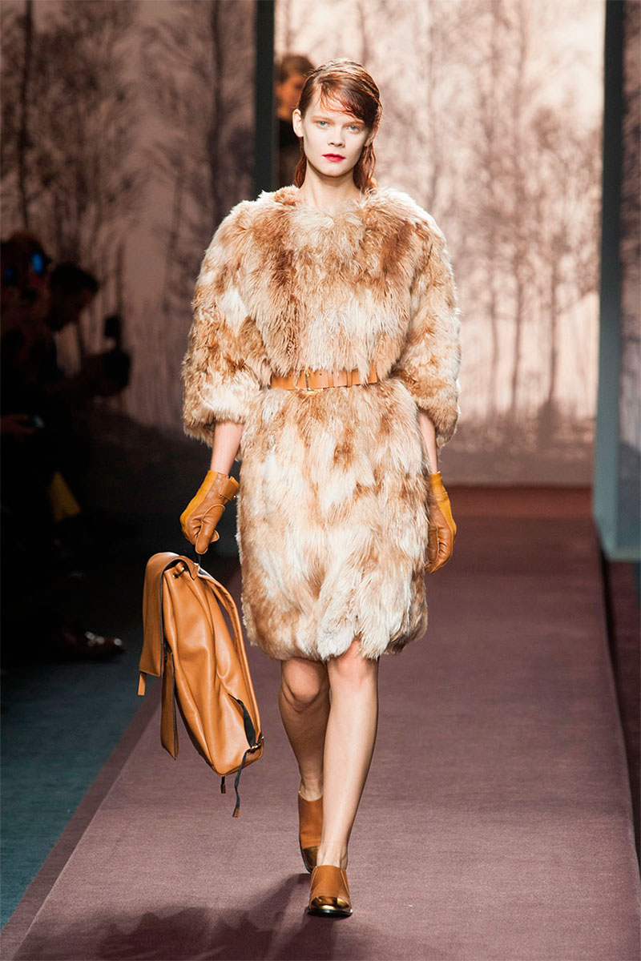
Fur Fashion

Slide 12
Selective Advantage
Despite environmental differences the mechanisms that become activated by the environmental conditions, aided now by the cultural features that transmit information from one person to another and from one time period to another, remain the same —because they provide a selective advantage.

Slide 13
CALIBRATION
A good way of explaining how the mechanism works is to see the same capacity as being calibrated by different environmental conditions in two ways
  As the refining of the mechanism over evolutionary time to make it optimal
  As the immediate response to specific conditions that make one alternative behavior which the mechanism has evolved to produce, more appropriate than another

Slide 14
Natural selection and local conditions
The first provides an account, via natural selection, of the development of the mechanism
The second provides an account of the operation of the mechanism under local conditions
Hence, an explanation for cultural variation!

Slide 15
Application to Problems
With these ideas in place we are now ready to apply them to specific problems
Such as the problem of “conventional wisdom” which covers all kinds of beliefs that people have about the world in which they live

Slide 16
Rethinking Conventional Wisdom
Dominance and Subordination of Potential Danger Domains
Comparing UK and SA

Slide 17
THE TEAM
TOM LAWSON
JOEL MORT
MICHAL FUX

Slide 18
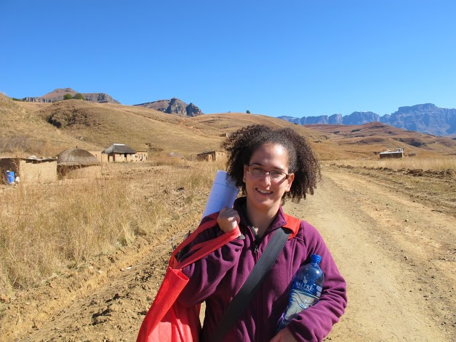

Slide 19
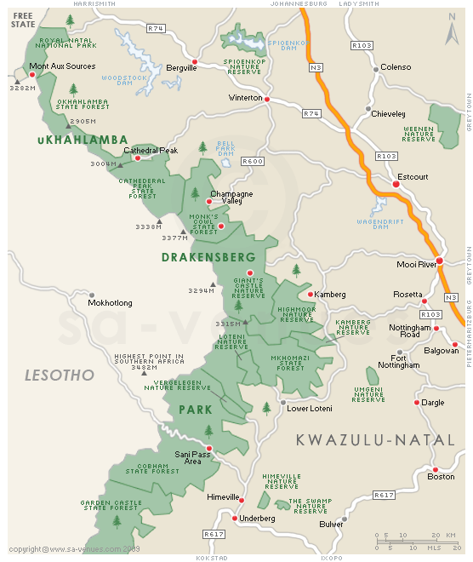
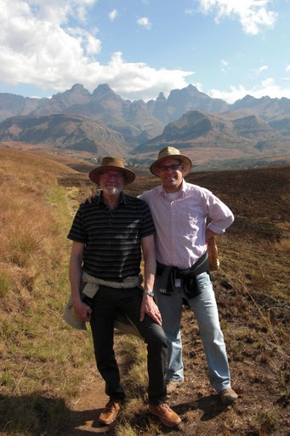
Okhombe District, KZN
Languages
isiZulu (several dialects), English, and Afrikaans
Notes:
Not only does this support good research but allows RH to fulfill desirable roles as postgraduate student supervisors, postdoc managers. In addition the resources available through these academic connections will facilitate heretofore unavailable cross-cultural data collection opportunities, particularly in the UK and sub-Saharan Africa.
19

Slide 20
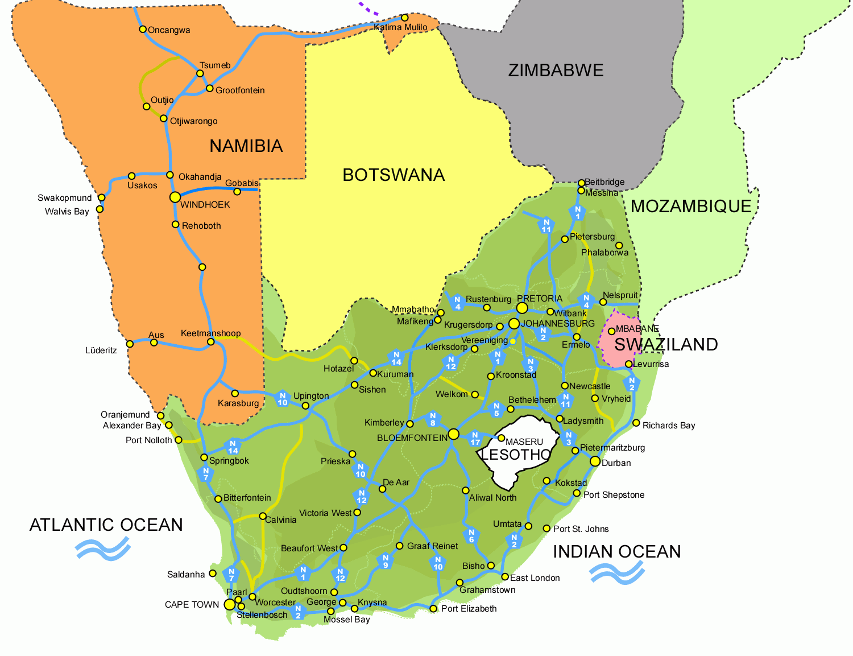

Slide 21
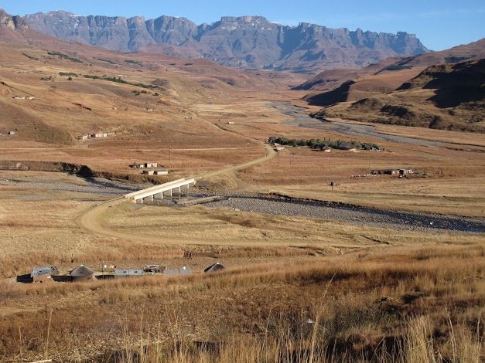

Slide 22
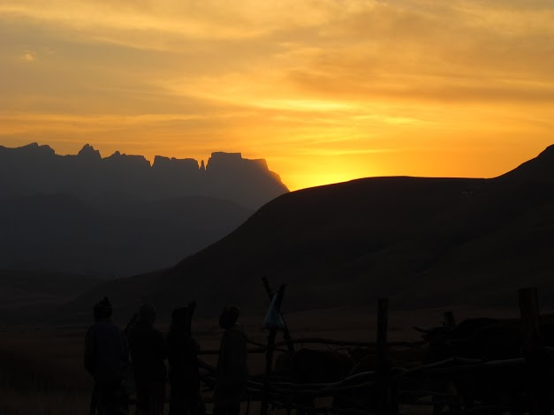

Slide 23
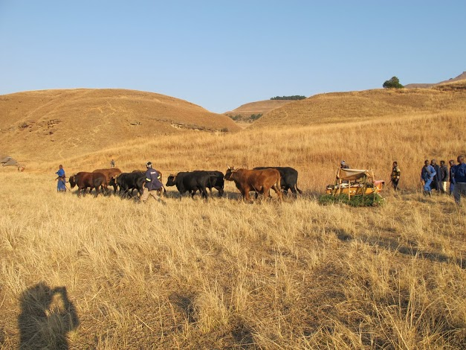

Slide 24
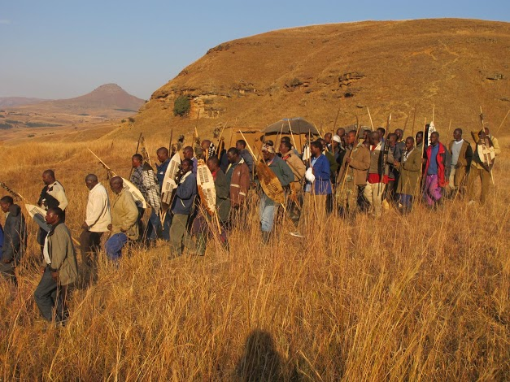

Slide 25
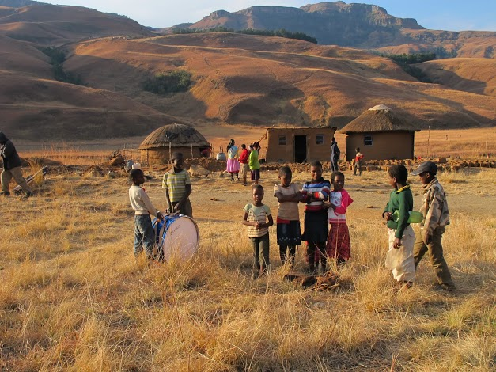

Slide 27
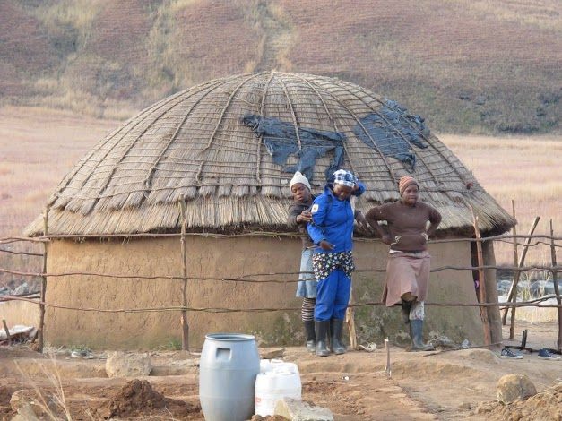

Slide 28
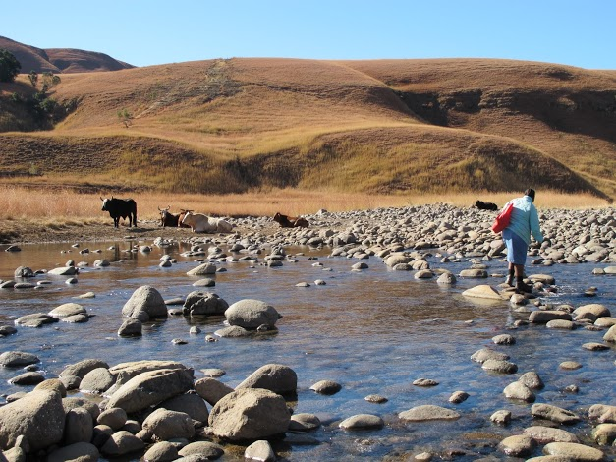

Slide 29
Despite the frequent reliance on Conventional Wisdom about potential threats (and the level of preoccupation with them) in political, policy, intelligence, and other domains, until now there have been few empirical studies addressing the spread, common features, or differences of precautionary preoccupations across cultures, a fact that underscores the importance of adding to the current state of knowledge.

Slide 30
Initial Study
This presentation exhibits some of our initial investigations of any significant variation or subordination of dominant themes (e.g. contamination/contagion, social status threats, predation/assault, decline in resources)
within and between populations and
how these themes may be reflected in each target populations’ collective precautionary behaviors (i.e. rituals, customs, ideological proscriptions, etc.)

Slide 31
Hypothesis
*Environmental triggers and specific cognitive capacities
*constrain the dominance of particular precautionary themes generally
*as well as their variability between distinct populations.

Slide 32
Our initial results support these claims.
We further posit that in many populations there is significant continuity between
1. the degree of individual preoccupation with possible threats,
2. individual precautionary measures, and
3. collective religious rituals.

Slide 33
Calibrating the mechanisms
Collective rituals and prescribed ideological contexts provide an occasion at least for calibrating evolutionarily bequeathed cognitive precautionary mechanisms and
the eliciting of particular precautionary themes. (We have addressed these in subsequent studies.)

Slide 34
Summary
What is CW and why is it puzzling?
Questions About and Importance of Precaution
Our Project Aims
Overview of All Studies
Study One - Likert Scale Instrument
Analysis and Results
Discussion

Slide 35
What do we mean by
Conventional Wisdom?
...and why SHOULD it matter?
CW is constantly in the spotlight in the form of significant and generally accepted claims that directly (or indirectly) result in business communication, policy-making, naïve explanations, and world descriptors.

Slide 36
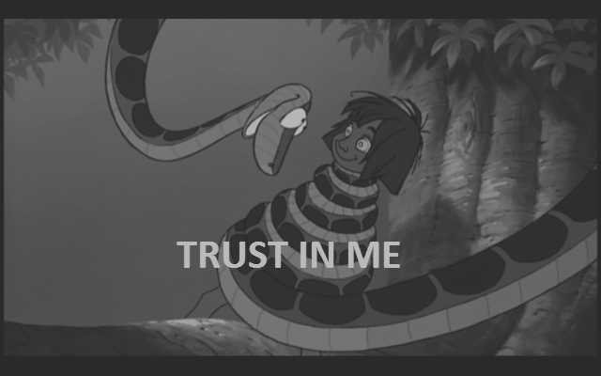
Why CW is puzzling & deserves scrutiny 1
Eye Contact CW:
In human beings, eye contact is a form of nonverbal communication and is thought to have a large influence on social behavior. Coined in the early to mid-1960s, the term has come in the West to often define the act as a meaningful and important sign of confidence and social communication.
F. S. Chen:
There is a lot of cultural lore about the power of eye contact as an influence tool but our findings show that direct eye contact makes skeptical listeners less likely to change their minds, not more, as previously believed. (2013)
Notes:
Eye Contact CW is from Wikipedia
F. S. Chen is an assistant professor at the University of British Columbia

Slide 37

Why CW is puzzling & deserves scrutiny 2
Gov Rick Perry:
...I know this — the world has never been as dangerous as it is today…
Gen Martin Dempsey:
I will personally attest to the fact that [the world is] more dangerous than it has ever been.
Steven Pinker:
Ours is the most peaceful time in history.
Mueller and Stewart:
The chances of an American dying in a bathtub are much higher than dying in a terror attack.
Notes:
Gen Martin Dempsey is the Chairman of the Joint Chiefs of Staff (USA)
Rick Perry is the Govenor of Texas and erstwhile candidate for President of the United States (defeated by Mitt Romney in the Republican primary)
Steven Pinker is Harvard College Professor and Johnstone Family Professor in the Department of Psychology at Harvard University.
John Mueller is Professor and Woody Hayes Chair of National Security Studies Mershon Center for International Security Studies and Department of Political Science at Ohio State University
Mark Stewart is Professor of Civil Engineering and Director of the Centre for Infrastructure Performance and Reliability at The University of Newcastle

Slide 38
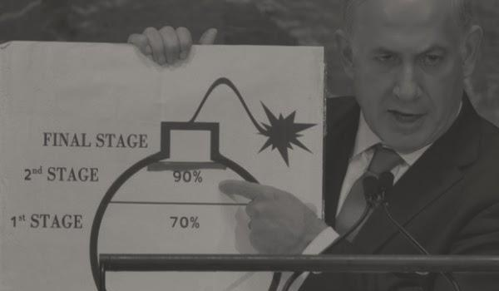
Why CW is puzzling & deserves scrutiny 3
PM Benjamin Netanyahu:
...[Iran] poses the biggest threat to Israel since the war of independence.
National Resilience Survey (Israel):
Israel's Jewish population...is more calm than ever about the possibility of an attack by an enemy country... reporting an all-time low on its..."fear index."
Notes:
Not only did the Resilience Survey report an all-time low of Israeli Jews in terms of fearing attack by a foreign state, it also reported that Israeli Arabs fear such an attack more than Israeli Jews.

Slide 39
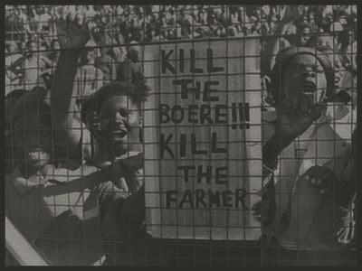
Why CW is puzzling & deserves scrutiny 4
Independent Online:
SA Whites Fear Mayhem After Mandela’s Death
Steve Hofmeyer:
A white farmer is being murdered every five days
Lizette Lancaster:
Whites are far less likely to be murdered than their black or coloured counterparts
Africa Check:
1.8% of SA murders are white victims
Notes:
Lizette Lancaster is at the Institute for Security Studies in South Africa
Africa Check is a non-partisan organisation that exists to fact-check claims made in the public arena, impartially and fairly, and publish the results. We also aim to spread the culture and enable the practice of fact-checking among the wider journalistic community.
Independent Online is a South African online news source (http://www.iol.co.za/)
Steve Hofmeyer is one of South Africa’s most popular, and controversial, Afrikaans singers and performers. In a post on his blog and Facebook page titled “My tribe is dying”, Hofmeyr made several sweeping statements about South Africa’s murder rate and the quality of life of white Afrikaans-speaking South Africans.

Slide 40
Nothing in all the world is more dangerous than sincere ignorance and conscientious stupidity.
- Martin Luther King Jr.
We aimed to provide some clarity, or at least more information, about the actual worries people around the world have about potential danger.

Slide 41
Main Question of Interest
What is the nature of potential danger preoccupation and what role does it play in generating human behavior, particularly ritualized behavior and probably cultural ritual behavior?

Slide 42
First a Distinction…
POTENTIAL DANGER | IMMINENT DANGER
Inferred Threats | Manifest Threats
Require behavioral adjustments that may take time | Require a prompt response, the faster the better
May be countered by indirect measures like avoidance or probing | Reactions involve immediate interaction with source of danger
Information regarding presence and elimination of threats is asymmetrical | Information of presence and elimination of threats gained externally

Slide 43
Why Focus on Precaution?
Relevant Domains Are Broad
Psychological development, kin protection, disease avoidance, ritual performance, psychopathology, security motivation, trust and cooperation, violent terrorist motivation, coalitional identification, mate guarding, religious ideologies, etc
“Domain” = Socio-cultural and environmental context to which the mechanisms are sensitive

Slide 44
Aims
Seminal Literature:
Boyer, P. P., Liénard. (2006). Why ritualized behavior? Precaution systems and action parsing in developmental, pathological and cultural rituals. Behavioral and Brain Sciences, 29, 1-56.
Szechtman, H., & Woody, E. (2004). Obsessive-compulsive disorder as a disturbance of security motivation. Psychological Review, 111(1), 111-127.
Special Issue: “Threat-Detection and Precaution: Neuro-physiological, Behavioral, Cognitive and Psychiatric Aspects.” Neuro & BioBeh Rev. 2011
Cross-cultural data
Account for variations and similarities
Employ multiple, interdisciplinary methodologies grounded in evolutionary science
Compare results with CW

Slide 45
Systems
Some of the mechanisms jointly operate to form systems such as:
  Security Motivation System
    Henry Szechtman, Professor of Psychiatry, McGill University, Canada
  Hazard Precaution System
    Pascal Boyer, Henry Luce Professor of Psychology and Anthropology, Washington University, St. Louis, USA and Dr. Pierre Lienard, Anthropology, University of Las Vegas, Nevada, USA

Slide 46
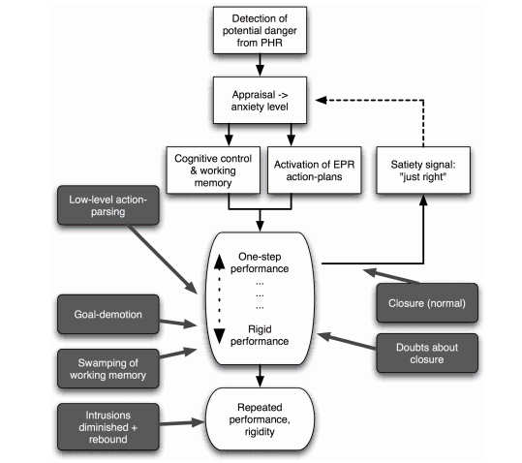

Slide 47


Overview
Populations: UK, South Africa
Individual protocols
Likert Scale
Thurstone Scale
Ranking Scale
Vignette Study
Budget Allocation Protocol
Video analysis
Questionnaires
Foci
Potential danger Preoccupations
Salience in ritualized behavior
Structure of ritual action sequences

Slide 48
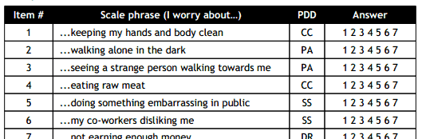
Study 1 - Likert Scale Instrument
Likert Scale (1-7) Items
20 Items (5 per domain)
Administered in random order
No. of subjects
  UK - 98
  SA - 88
Data collection: 2009-2012
Notes:
Survey A - In this questionnaire participants were asked to state how much they worry
about different potential threats. The sentences started with ‘I worry about…’ and
followed by an example that belongs to one of the domains mentioned above, for
example ‘ I worry about eating raw meat’, which would belong to the CC domain.
Participants used a scale of 1-7 to indicate their level of worry regarding to each
sentence. Overall there were 20 sentences, 5 for each domain.
Domains
PA - Predation/Assault Threats
CC - Contamination/Contagion Threats
SS - Social Status Threats
DR - Decline in Resources Threats

Slide 49
Analyses and Results (highlights)
Participants from South Africa reported significantly higher scores for the Depletion of Resources (DR) and Predation/Assault (PA) domains compared with the UK participants
Female participants scored significantly higher on the Predation/Assault (PA) domain both in the UK and SA populations
In the SA population, non-whites scored significantly higher on ALL threat domains
Notes:
Statistical Analyses:
MANOVA and separate Univariate ANOVA were performed to compare the effect of the separate independent variables on the four threat domain groups. Tables in the next few slides report the means, standard deviations, F statistics, and partial Eta squared for all threat perception domains by question. Violations of MANOVA or ANOVA assumptions, when occur are reported in the endnotes.

Slide 50
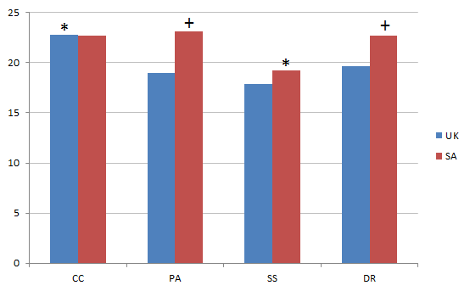
Analyses and Results (overall)
SA vs UK overall
+ Significance between populations, * Significance within population
Notes:
Question 1: How do the different potential threat domains rank among UK and SA citizens, and compare the two locations (i.e. what do people worry about more and what less).
• MANOVA was performed to compare the effect of independent variable (Country) on the four threat domain groups (outcome variables). The results indicate that country context (UK, SA, IMM) has a significant effect on threat domain responses, Pillai’s Trace [F(8,482) =5.510, p<.001, Partial Eta² = .08].
• Separate univariate ANOVA were performed indicating that these differences are mainly in responses for Depletion of Resources (DP) [F(2,243) = 8.865, p < .001, Partial Eta² = .068] and Predation and Assault (PA) [F(2,243) = 9.626, p < .001, Partial Eta² = .073] (Error! Reference source not found.). Post hoc analyses using Bonferonni correction revealed that participants from South Africa reported significantly higher scores for Depletion of Resources and Predation and Assault compared with the UK or the Immigrant group (Table 1).

Slide 51
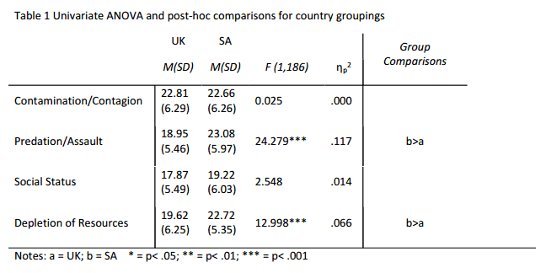
Analyses and Results (overall)
SA vs UK overall

Slide 52
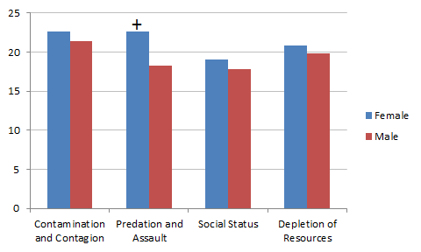
Analyses and Results (gender)
Gender (UK and SA overall)
+ Significance between genders
Notes:
Question 2: Are there differences between women and men regarding to which domains worry them most or least?
• MANOVA was performed to compare the effect of gender on the four threat domain groups. The results indicate that gender has a significant effect on threat domain responses, Pillai’s Trace [F(4,227 =9.218, p<.001, Partial Eta² = .14].
• Separate univariate ANOVA were performed indicating that these differences are in responses for Predation and Assault (PA) [F(1,230) = 31.245, p < .001, Partial Eta² = .120] (Table 2).
• In other words, females scored significantly higher on predation and assault.

Slide 53
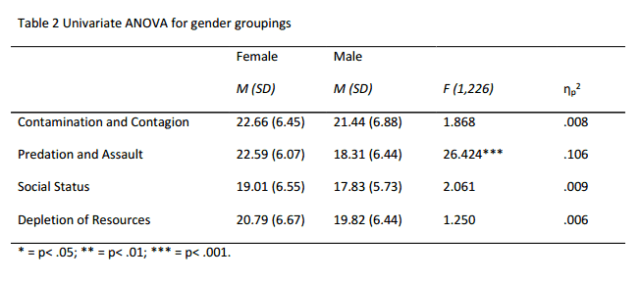
Analyses and Results (gender)
Gender (UK and SA overall)

Slide 54
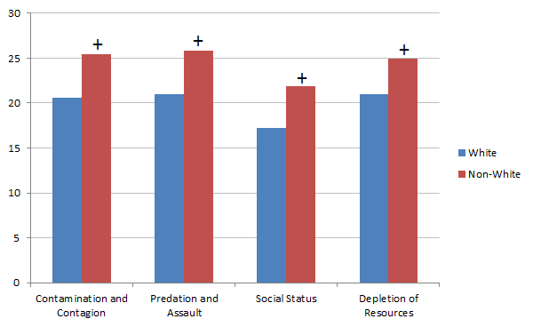
Analyses and Results (ethnicity)
White vs Non-white (SA only)
+ Significance between white and non-white
Notes:
Question 3: Are there differences between white South Africans and non-white South Africans regarding to which domains worry them most or least?
• MANOVA was performed to compare the effect of SA ethnicity on the four threat domain groups. The results indicate that ethnicity classification has a significant effect on threat domain responses, Pillai’s Trace [F(4,90 =6.548, p<.001, Partial Eta² = .225].
• Separate univariate ANOVA were performed indicating that these differences are in responses for all threat domain groups, Contamination and Contagion [F(1,93) = 16.140, p < .001, Partial Eta² = .148], Predation and Assault [F(1,93) = 12.311, p = .001, Partial Eta² = .117], Social Support [F(1,93) = 13.854, p < .001, Partial Eta² = .130], Depletion of Resources [F(1,93) = 13.523, p < .001, Partial Eta² = .127] (Table 3).
• In other words, non-whites scored significantly higher on all threat domain groups.

Slide 55
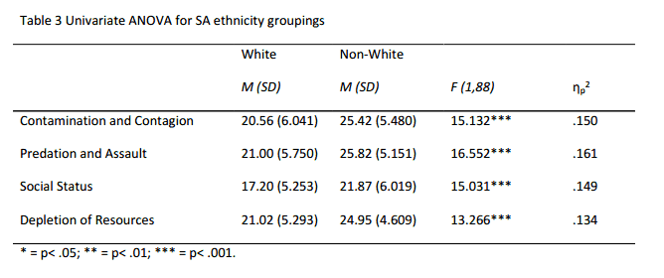
Analyses and Results (ethnicity)
White vs Non-white (SA only)

Slide 56
Discussion
[Compare with CW points]
Like the Israeli National Resiliency Survey, our results do not match anecdotal and intuitive CW about actual potential danger preoccupations; in this case of white vs non-white South Africans.
Notes:
Also similar to the CW statements of high-ranking US government and military officials (who have authority and influence in policy making and mission activities) compared to the empirical work of Pinker, Mueller, and Stewart in terms of the dangerous nature of the world.

Slide 57
Discussion
Our gender and ethnicity analyses support the notion that the outputs of precautions systems are both universal in some respects and variable as a result of developmental calibration or social learning.
[Universality and Variability]

Slide 58
From Hazard Precaution system to Religious Rituals
Cognitive capacities → Hazard precaution system → Ritualized behavior → Cultural Rituals → Religious Rituals
Reverse Engineering

Slide 59
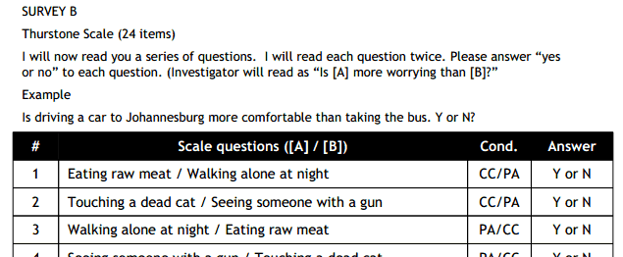
Discussion
[Next Scale Data to be Analyzed: Thurstone]
Notes:
Analysis of this data will appear in forthcoming publications

Slide 60
Discussion
Delineate unambiguous precaution domains
Biobehavioral protocols
Clarify evolutionary framework
Integrate evidence from other studies and disciplines (De Dreu 2010)
[Future Directions]
Continue data analysis of economic and behavioral (video) protocols.

Slide 61
Discussion
[Conclusions]
One stands out:
The tenets, theories, and interdisciplinary methods of evolutionary science (especially psychology) are crucial, and heretofore neglected, tools for understanding human behavior AND informing policy decision-making.
Notes:
If only to present a justifiable defense against unwarranted CW “facts.”

Slide 62
End
Prof E. Thomas Lawson
Visiting Professor
Masaryk University
tomlawson1931@gmail.com
Dr Joel Mort
Social Scientist
Joel.Mort@gmail.com
Dr Michal Fux
Postdoctoral Fellow
University of South Africa
fux.michal@gmail.com

