Slide 1
Informační průmysl
2013/14
Petr Šmejkal
43262@mail.muni.cz, smejkal.petr@email.cz
Notes:
For information on applying this template onto existing presentations, refer to the notes on slide 2 of this presentation.
The Input area of the Beam can be customized to reflect the content of the
presentation. The Input area is an AutoShape with a picture fill. To change this, ensure you have the image you wish to use (ideally a .jpg or a .png file) in an accessible folder. The image should have a ratio of 1:1 to ensure it does not appear distorted.
Acceptable images for importing into the Input area of the Beam are the three approved graphics (lines), and black and white photography or illustrations which follow the principles laid out on The Branding Zone. Color images should never be imported into this area.
To create a thank you slide with a picture in the Input area of the Beam, duplicate this master slide and create a new master slide. If using the graphic on the title slide the same should be used on the thank you slide. If using a picture in the Input area of the Beam in the title slide, the same or different but related picture can be used on the thank you slide.
Customize the Input area of the Beam as described below.
Click on the View tab from the menu bar and select Master>Slide Master
Right-click on the Input graphic and select Format AutoShape
From the Fill menu, under the Color and Lines tab, click on the drop-down arrow next to Color and select the Fill Effects menu
From the Picture tab, click on Select Picture. Navigate to the folder containing the image you wish to insert in the Input area. Highlight the image and tick the Lock picture aspect ratio box. Click on OK.
You can now preview the image before continuing. If you are happy with how it looks, click Ok to continue. Otherwise, repeat the process until you are happy with your selected image
To exit from Master View, click on View>Normal. The change you made to the Input graphic should now be visible on the title slide

Slide 2
přehled analytických metod
Informační průmysl

Slide 3
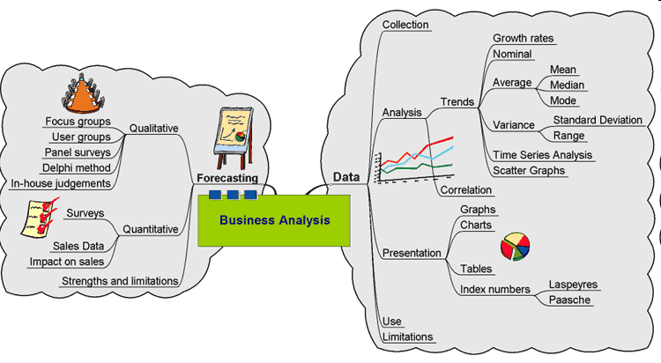

Slide 4
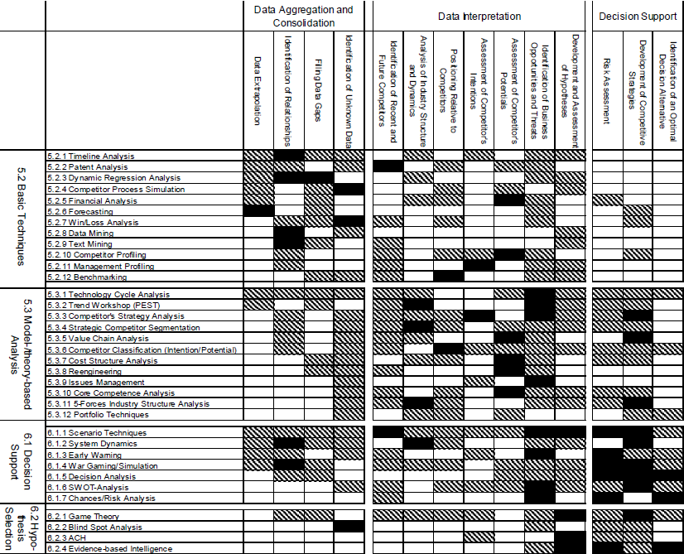

Slide 6
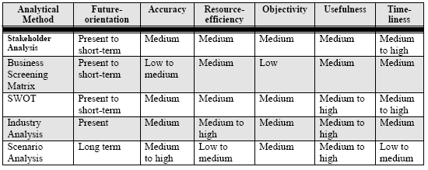
Vhodnost použití
K různým účelům různé metody - FAROUT Rating Systém
Např. není vhodné vybrat metodu scénáře pro rychlou, levnou, analýzu orientovanou na krátkodobý výhled.

Slide 7
Druhy analýz
Informační průmysl

Slide 8
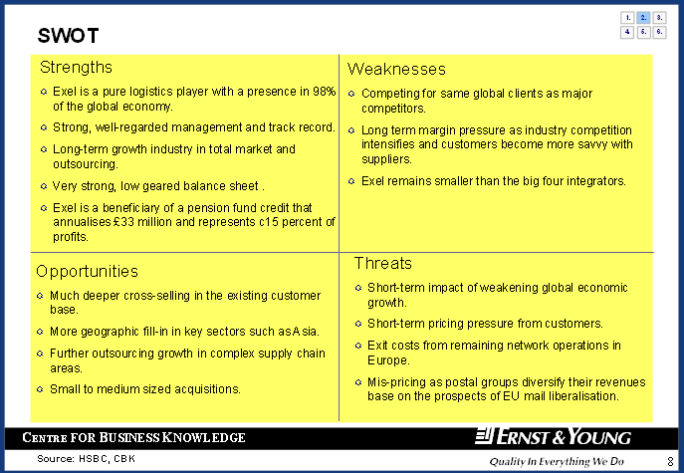
SWOT Analysis
A SWOT analysis is a useful tool when first considering a company, its performance, and the external environment it operates in.
When compiling a SWOT analysis it is useful to consider:
Strengths: What are the company’s strengths – does it hold market leading positions, does it have unique and desirable technology, is its management strong, does it have a clear and strong strategic direction?
Weaknesses: How is the company’s financial/internal management, are there any competing strategies causing conflict, does the company have the backing of its shareholders/City opinion?
Opportunities: Is there potential for product expansion or a push into new markets?
Threats: In the macro and micro environment, legislative and environmental issues.
USEFUL FOR: Snapshot, Company Analysis, Micro & Macro Environment
Caution/Remember!
An effective SWOT analysis provides a snapshot summarising a more detailed analysis of a company’s current performance and future potential.

Slide 9
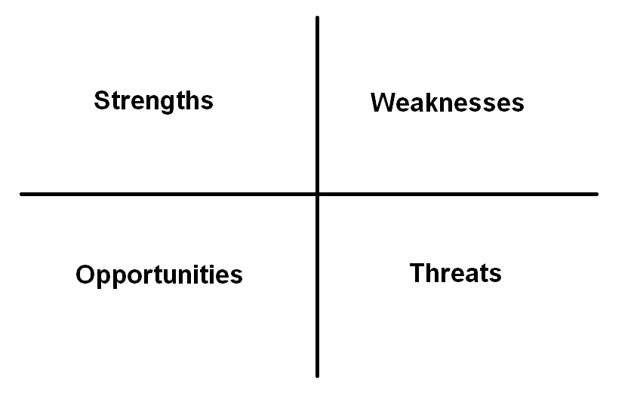
SWOT
nejčastěji užívaná metoda, jedna z nejefektivnějších
strengths, weaknesses, opportunities, threats
požaduje nadhled a objektivitu

Slide 10
SW část - interní prostředí firmy
finanční sílu a zdraví firmy
míru její diverzifikace či naopak specializace
vlastnickou strukturu a její stabilitu
pozici v jednotlivých částech trhu
strukturu a stabilitu zadavatelů zakázek či zákazníků
míru flexibility
schopnost pronikat do nových segmentů
technickou a technologickou úroveň
složitost a účelnost organizační struktury
goodwill podniku
úroveň strategie rozvoje firmy
způsob získávání potenciálních investorů, účinnost akviziční činnosti
pozici firmy na trhu a v jeho jednotlivých částech (oborově i územně)
plynulost a komplexnost činností
celkovou výrobní kapacitu firmy (poměr vlastních prací a externích subdodávek)
úroveň subdodavatelských činností
technologickou úroveň činností
strojně mechanizační vybavení, know-how
způsob a průběh financování a hospodářské výsledky
personální strukturu firmy, odbornost a dovednost zaměstnanců

Slide 11
OT část - externí prostředí
vztah investorů ke stavební firmě a jejich reakce na akviziční činnost
pozice vůči konkurenci
image a goodwill firmy směrem k investorům a širšímu okolí
dynamika a struktura investic ve vztahu k ekonomickému vývoji národního hospodářství

Slide 12
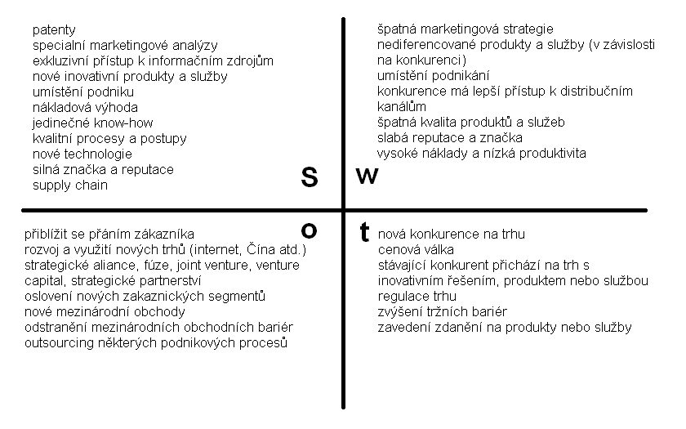
SWOT

Slide 13
Plnění SWOT matice
V každém sektoru ideálně 10-25 bodů
Interní i externí informační zdroje
Určení aktuální pozice i určení hlavních trendů
V externích zdrojích hledáme:
    Hrozby ohrožující danou oblast podnikání
    Hlavní konkurenční síly
    Faktory vytvářející dynamiku změn
    Faktory prostředí klíčové pro úspěch
    Atraktivita oboru
Interní zdroje:
    Náklady a finanční zdroje
    Lidské a výrobní kapacity
Vnitřní struktura
Styl řízení
Sdílení hodnot
Vnitřní kultura

Slide 14
Závěrečná fáze SWOT - uplatnění
Formulovat problém aby:
    Silná stránka byla zachována
    Slabá stránka eliminována
    Příležitosti efektivně využity
    Ohrožení odraženo nebo mu bylo předejito
V dalším kroku se stanoví způsob, jak problém řešit

Slide 15
Příklad
Cesta k řešení | Problém | Záznam ve SWOT
Realizovat „Program péče o pracovníky“ Zavést racionální výcvik pracovníků Zavést plánování lidských zdrojů Zavést účinné hodnocení pracovníků | Kvalita výroby | S - Dobrá kvalita výroby Stabilizovaná struktura pracovníků a stabilní zaměstnanecké vztahy
-Koncepce odměňování a mzdového vývoje | Fluktuace | Relativně nízký průměrný věk pracovnic
Realizovat „Program péče o pracovníky“ … (viz výše) | Kvalita výroby | O Možnost získání a zaškolení nekvalifikovaných pracovníků
-Koncepce odměňování a mzdového vývoje | Fluktuace | - Možnost zvýšení produkce dvousměnným provozem

Slide 16
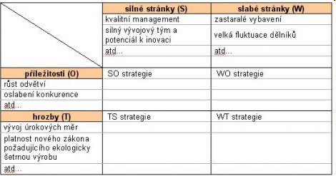
Rozšířená SWOT
nabízí 4 východiska pro tvorbu strategií

Slide 17
SWOT příklad
Levné jízdenky
Flexibilní rezervace
Značka, pokrytí, komfort
Obsluha, ženy
Recyklace
Nejrychlejší spoj, top 5 firem
ČD – lepší pozice
Jen velká města
Nefunkčnost některých prodejních míst
Přehnaný marketing
Fluktuace
S
W
O
T
Problémy s D1
Růst cen PHM + poplatků
Nevlastní infrastrukturu
Nehody
Technologie
Nízká kvalita konkurence
Rozšíření služeb
Zahraničí
Závěr: Při přetrvávajících problémech s ČD navrhujeme přesun na Slovensko a využití značky tam.

Slide 18
TOWS
rozšíření SWOT, více zaměřena na externality
rozdíl v pohledu na problematiku
aby bylo možné vyhnout se klíčových hrozbám a nepromarnit významné příležitosti
zabraňuje přílišné zaměření se na interní situaci
Hrozby (T)
objektivní trendy a změny, které
ohrožují nebo budou
ohrožovat dosažení cílů
v dané oblasti a daném území.
Slabé stránky (W)
věcné, kapacitní, znalostní atp.
slabiny daného územního celku,
ohrožující obranu proti hrozbám
nebo využití příležitostí.
Příležitosti (O)
objektivní trendy a změny, které
je možné nebo bude možné
využít k lepšímu dosažení cílů
v dané oblasti a daném území.
Silné stránky (S)
věcné, kapacitní, znalostní atp.
přednosti daného územního celku,
které ohrožují obranu proti hrozbám
nebo využití příležitostí.

Slide 19
Analýza konkurenčních hypotéz
Hypotéza – předpověď budoucího stavu
  vždy několik vzájemně konkurenčních
Vybrat jen klíčové důkazy
Vylučovat hypotézy !!!
  Nikoliv ověřovat !!!
  Pro vyloučení stačí jeden důkaz

Slide 20
Kroky analýzy
Určit hypotézy
Sestavit seznam zdrojů
Sestavit seznam argumentů pro a proti
Připravit matici s hypotézami a důkazy
Sestavit předběžné závěry
Analyzovat citlivost závěrů vůči důkazům
Podat zprávu o závěrech
Stanovit milníky pro následné sledování

Slide 21
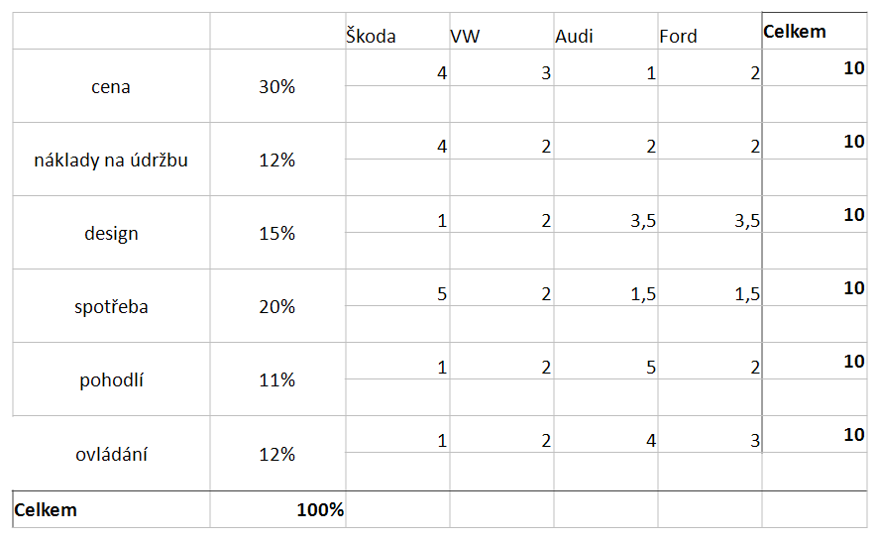
Analýza konkurenčních hypotéz

Slide 22
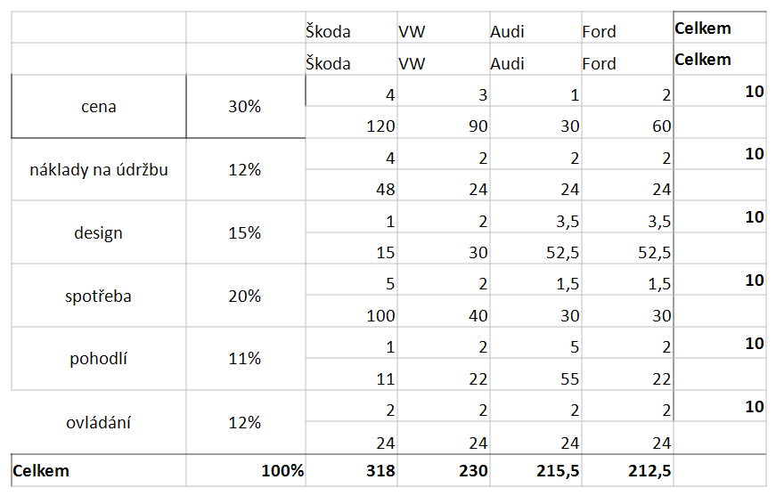
Analýza konkurenčních hypotéz

Slide 23
Kontrola
Analýza citlivosti
  Vliv výsledku na vstupní parametry
  Přepočet vah a vstupů
  =>
  Jak můžu ovlivňovat váhy než se změní výsledek?

Slide 24
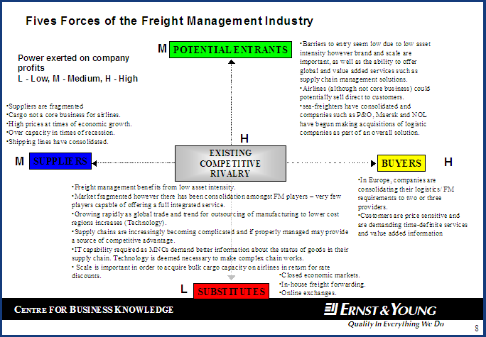
Porter’s Five Forces
Porter’s Five Forces looks at the industrial environment in which a company operates, focusing on five main forces which influence the intensity of competition the company faces:
Rivalry between existing competitors: industry concentration, diversity of competition, product differentiation, excess capacity, pricing stability.
Threat of new entry: economies of scale, capital requirements, product differentiation, access to distribution channels, government/legal barriers.
Buyer power: price sensitivity – product cost versus total costs, product differentiation, competition between buyers; bargaining power – size and concentration of buyers relative to suppliers.
Supplier power: price control, product uniqueness, competition between suppliers, supplier size and concentration versus buyers.
Threat of substitution: new technologies, buyer loyalty/likelihood of substitution, relative price performance against substitutes.
USEFUL FOR: Company Analysis, Micro & Macro Environment
Caution/Remember!
Ranking can be used to indicate the importance of each force (eg: high. medium, low).

Slide 25
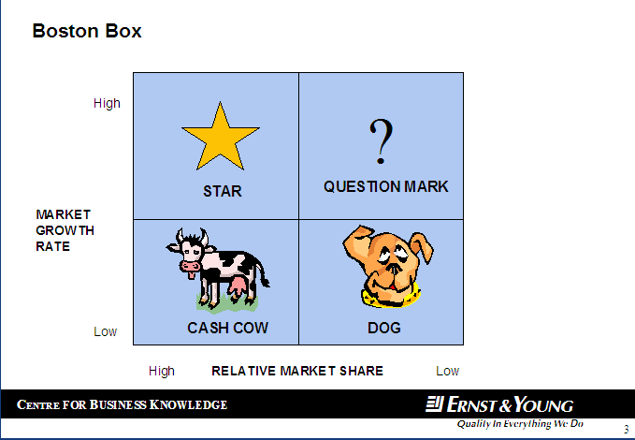
Boston Box
důležité
A Boston Box provides a useful means of showing the relative strengths, in terms of market share and market potential, of individual products/services within a company’s portfolio.
Products are placed within the grid depending on their relative market shares and the prospects for growth within their markets. The grid should then give a clear picture of each product’s value and future prospects.
Dogs: have a low market share of a low growth market. Not cash generative (tend to absorb it). Products should be disposed of.
Cash Cows: have a high share of a slow growth market. Cash Cows generate cash providing useful funds for investment in new products. Products should be retained.
Problem Children/Question Mark: have a low share of a high growth market. They consume resources, particularly when a company attempts to increase market share.
Stars: Products have high shares of high growth markets and generate high amounts of income. These are the kind of products that every company wants to build.
USEFUL FOR: Snapshot, Company Analysis, Micro & Macro Environment
Caution/Remember!
Add extra value to a Boston box by showing the importance of individual products to the company, turnover or profit contribution, by varying the size of the circle or box being used to represent it.
Plot the position of competitor products alongside to show relative market share.
Příklad: http://www.businessvize.cz/strategie/bcg-matice-ktera-urci-smer-vasemu-businessu

Slide 26
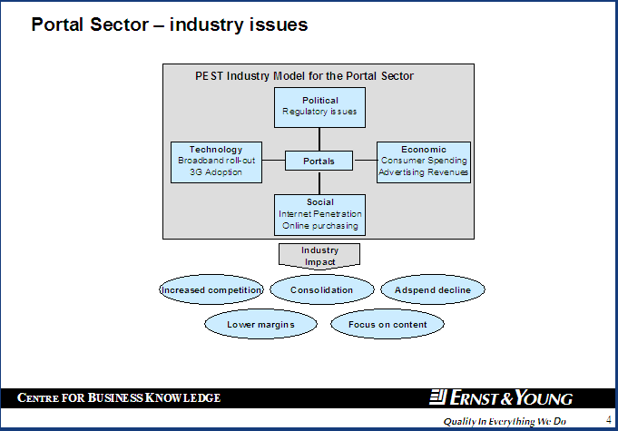
PEST Analysis
důležité
A PEST analysis is a useful way of examining the macro environment in which a company operates. Four different external factors are considered which may impact upon a company.
When undertaking a PEST analysis consider:
Political: stability of the political environment, government economic and taxation policies, nationalised or privatised industries, deregulation in progress, cross border trading agreements in operation (EU, NAFTA, ASEAN), political regime fairly isolated?
Economic: long and short term prospects for the regional/national/international economy? – consider GDP, inflation, employment, interest rates, disposable income etc.
Socio-cultural: any religious or ethical influences, general attitude to foreign products, demographic profile, wealth profile, gender equality, level of education, dominant attitudes towards work and leisure?
Technology: Is technology allowing products/services to be delivered more cheaply/ to higher standards, supply chain changes, routes to market, better communication with customers?
USEFUL FOR: Snapshot, Company Analysis, Micro & Macro Environment
Caution/Remember!
Why not extend a PEST analysis to include environmental and legal factors? See PESTEL analysis.

Slide 27
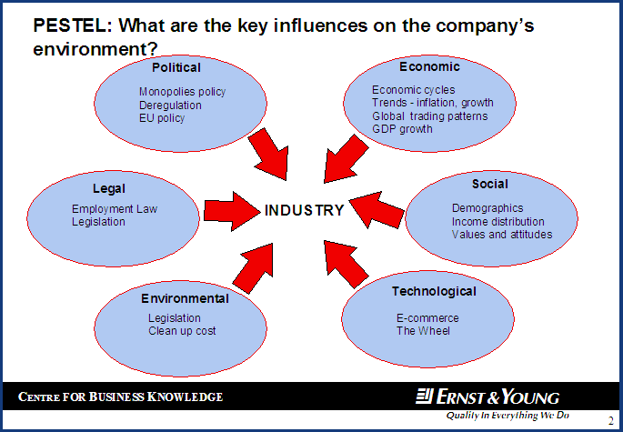
PESTEL Analysis
A PESTEL analysis is a continuation from the PEST analysis which additionally examines Environmental and Legal factors impacting a company and its industry.
Environmental: the environmental impact made by a particular industry – consider pollution, waste, noise etc. What restriction/threat does existing/proposed environmental legislation pose to the company or industry? Also consider consumer opinion towards particular environmental issues.
Legal: the regulatory environment by which the company or industry is bound – health and safety, employment law, monopolies & mergers, trade restrictions, national and international product standards – BS, ISO etc.
USEFUL FOR: Snapshot, Company Analysis, Micro & Macro Environment
Caution/Remember!
Think about the future operating environment, not just the present situation.

Slide 28
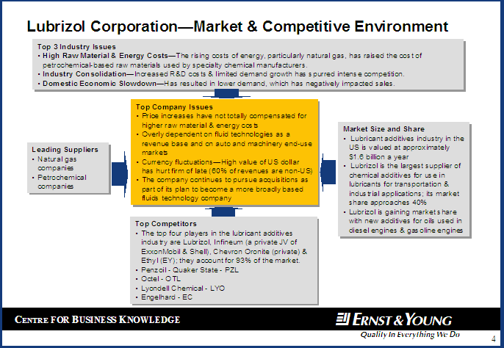
Market & Competitive Analysis
Another way to consider the external forces to which a company is exposed. Key industry issues, competition and supplier characteristics, the market size and shape, and the company’s position within the market are examined.
From this, the top issues for the company are shown.
USEFUL FOR: Snapshot, Company Analysis, Micro & Macro Environment
Caution/Remember!
Think about changing the titles for the individual boxes if data is not available.

Slide 29
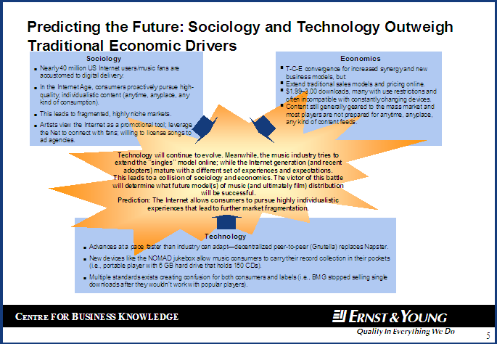
SET Analysis
A variation on a PEST analysis, SET examines the Social, Economic and Technological changes impacting a company and its industry. Consider:
Sociology: any religious or ethical influences, general attitude to foreign products, demographic profile, wealth profile, gender equality, level of education, dominant attitudes towards work and leisure?
Economic: long and short term prospects for the regional/national/international economy? – consider GDP, inflation, employment, interest rates, disposable income etc.
Technology: Is technology allowing products/services to be delivered more cheaply/ to higher standards, supply chain changes, routes to market, better communication with customers?
USEFUL FOR: Snapshot, Company Analysis, Micro & Macro Environment
Caution/Remember!
Add value to a SET analysis by offering some conclusions and predictions on the impact of the combined threats and changes posed by external factors.

Slide 30
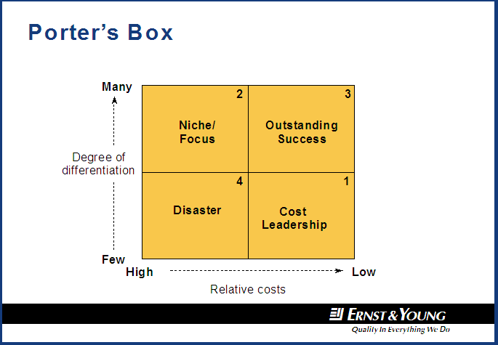
Porter’s Box
Porter’s Box examines a company’s success in achieving competitive advantage.
Two main routes to competitive advantage exist: cost leadership and niche focus:
Cost leadership: competitive advantage achieved through producing at the lowest cost. Costs are constantly scrutinised and capacity is built for benefits of economies of scale.
Niche/focus: where a product cannot compete on price, due to new technology or high production costs, a different approach is needed. A niche focus can build competitive advantage through strong differentiation. Long term the niche market may disappear.
Outstanding success: products that combine strong differentiation with low costs of production produced the best margins for the company as price differentiation is not an issue.
Disaster: a commodity type product with a high production cost is a disaster! Product may survive in the short term if demand exceeds supply.
USEFUL FOR: Company Analysis, Micro & Macro Environment
Caution/Remember!
It may be possible to track the success of a company’s strategy against progress from box to box.
Remember that the position of a company’s products within the boxes will depend on its industry focus. Cost leadership is a good position if you are in a commodity market.

Slide 31
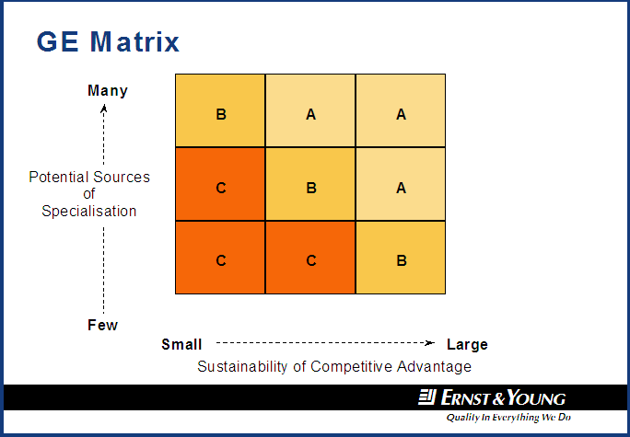
GE Matrix
Developed by McKinsey for General Electric, the GE Matrix is a useful tool for analysing products and services in terms of value to the organisation and value to the customer.
The GE Matrix is a more detailed version of the Ansoff’s matrix and Porter’s box.
Value to the company: Why does the company offer this product/service – is it highly profitable, in high demand, does it enhance the company’s image? Does it require minimal investment, or is it just what the company is good at providing?
Value to the customer: Why would the customer by this product/service: price, quality, performance, reliability? Or pre-sales advice, delivery performance and availability?
USEFUL FOR: Company Analysis, Micro & Macro Environment
Caution/Remember!
This chart can be time consuming to compile.

Slide 32
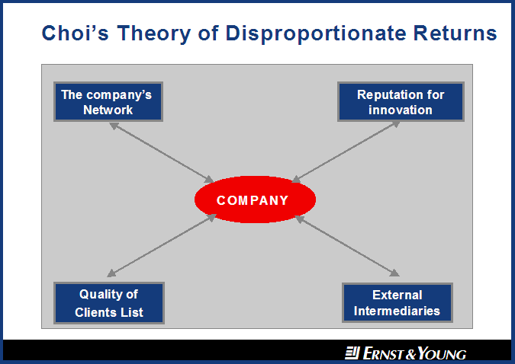
Disproportionate Returns
Developed by Chung Choi and Charles Baden-Fuller, the theory of disproportionate returns is particularly useful for analysing a company’s success in leveraging its reputation.
A company that competes in markets that have a high knowledge component, or a high degree of quality intangibility or uncertainty can generate disproportionate returns by leveraging four external influences:
  Company network
  Reputation for innovation
  External Intermediaries
  Quality of clients.
The resulting is enhanced competitive advantage will lead the company to earn disproportionate returns.
USEFUL FOR: Company Analysis
Caution/Remember!
This chart is particularly useful for companies operating in fast moving industries,

Slide 33
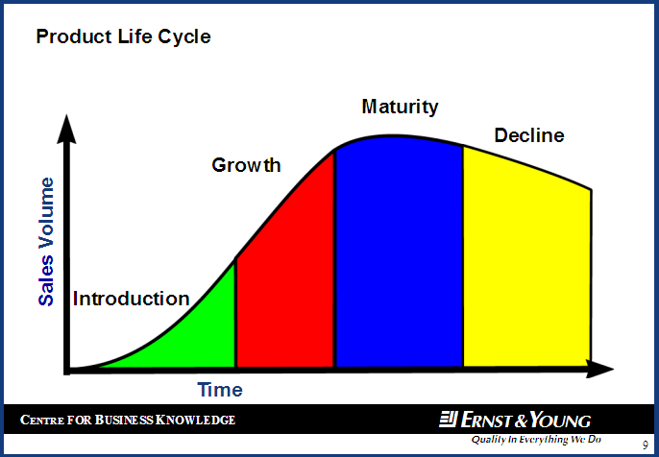
Product Life Cycle
důležité
All products, brands and industries move through identifiable phases from introduction through to maturity, decline, and occasionally obsolescence. Each phases brings associated changes in unit margins, gross margins and the company strategy towards these conditions. The analysis plots products against these changes: identifying their exact circumstances, and what needs to be done with them.
The position within the cycle is determined by:
Market growth rate
Growth potential
Breadth of product lines
Number of competitors
Spread of market share between competitors
Customer loyalty
Barriers to entry
Technology
The product position in relation to competitors can be classified as:
Dominant, Strong, Favourable,Tenable & Weak.
USEFUL FOR: Company Analysis, Micro & Macro Environment
Caution/Remember!
This chart is very useful for comparing different industries and markets.

Slide 34
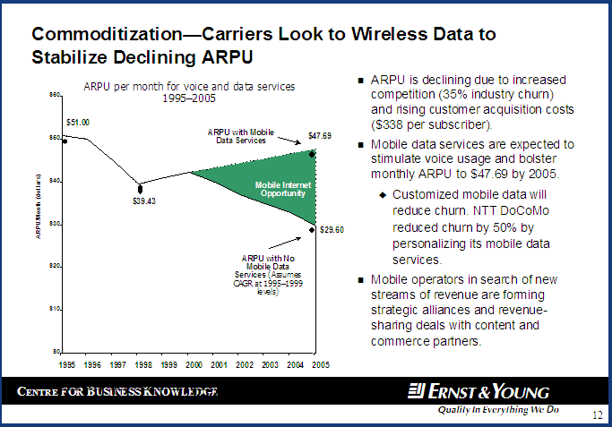
GAP Analysis
A GAP analysis looks at a company or industry’s objective against its actual, or predicted, performance. Between the two lies the gap.
In a traditional company analysis, the gap usually represents the difference between a sales objective and the long-range forecast for sales. This gap can be filled in a number of ways:
Improved productivity
Market penetration
Market extension
Product development
Diversification
By examining each of these options, strategies for growth can be found.
USEFUL FOR: Company Analysis, Micro & Macro Environment, Financial Analysis
Caution/Remember!
Actual data does not always need to be used.

Slide 35
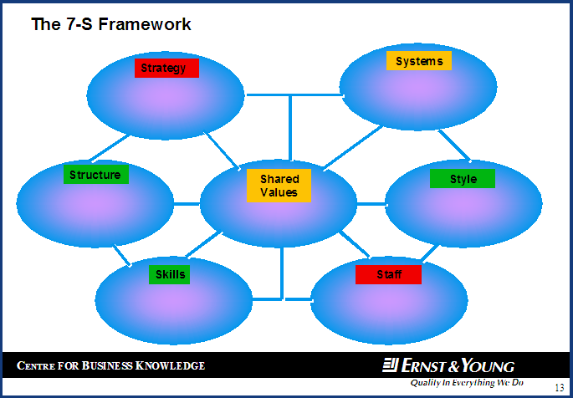
The 7-S Framework
Another way to understand the core forces influencing a company.
When compiling a 7-S framework it is useful to consider:
Strategy: The way in which competitive advantage is intended to be achieved.
Structure: The way in which people and tasks are divided.
Systems: Formal systems and procedures.
Staffing: The people, their background and competencies.
Skills: Basic competencies.
Style: Leadership style.
Shared Values: Guiding concepts within the organisation.
USEFUL FOR: Company Analysis Macro & Micro Environment.
Caution/Remember!
The 7-S’s can be prioritised via colour coding.

Slide 36
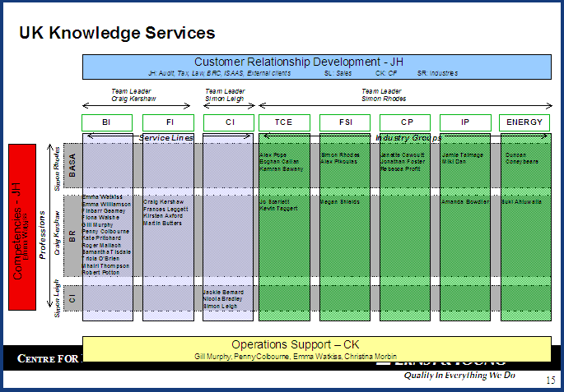
Organisation Chart
Organisation charts show organisations, hierarchies, networks, or flows between nodes, all without regard to time or comparison of quantity.
In particular, they are very good at showing internal company interactions and relationships, and very useful when analysing large multinational companies.
USEFUL FOR: Company Analysis & Micro Environment.
Caution/Remember!
Can be time consuming to compile with complex organisations.

Slide 37
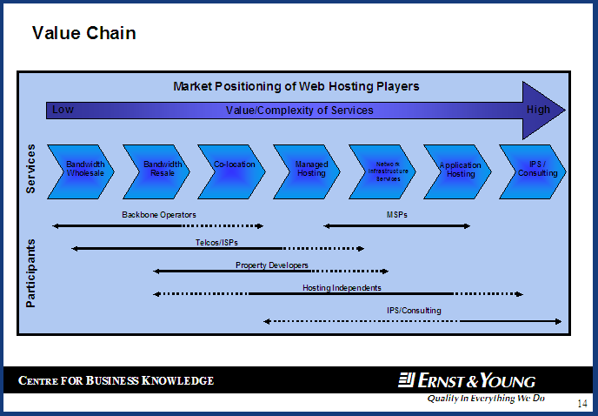
Supply Chain
A supply chain diagram outlines each stage of an industry, indicating where value is added.
Industry participants at each stage can also be plotted.
USEFUL FOR: Company Analysis Macro & Micro Environment.
Caution/Remember!
You can also compare strengths & weaknesses of each competitor for each stage of the chain.

Slide 38
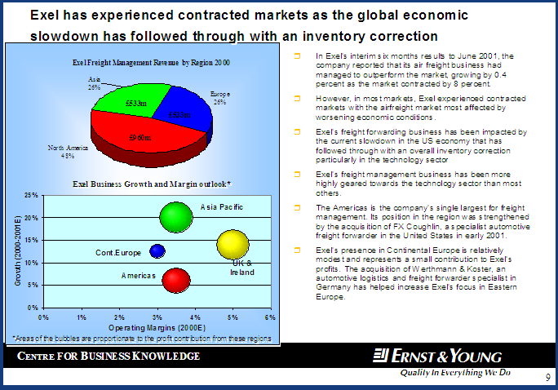
Bubble Chart
důležité
Bubble charts are a variation of X-Y chart, where the data points are replaced by bubbles.
The bubbles provide a means for displaying a third variable in the chart. Either the diameter or area of each bubble is proportional to the value it represents.
In particular, a bubble chart is a very powerful tool to illustrate financial and market trends. It can also be used for competitive and product portfolio analysis.
USEFUL FOR: Company Analysis Macro & Micro Environment, Financial Analysis.
Caution/Remember!
Bubble charts can be easily combined with other charts and tables.

Slide 39
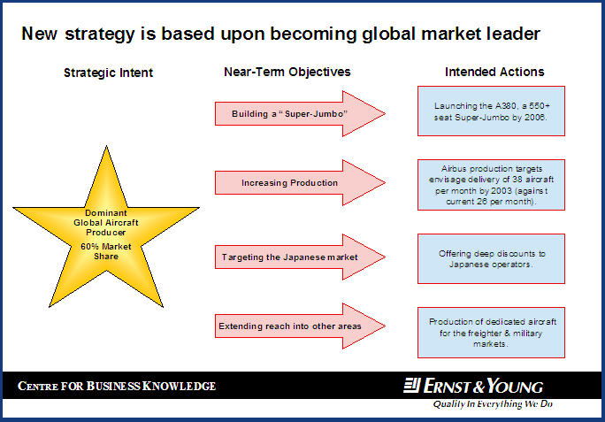
Strategy-Actions
A simple but effective tool to outline corporate culture and strategy.
This model breaks down the overall strategy of a company into major near objectives and key success factors.
The strategic intent and near-team objectives are the general direction of the firm, while intended actions are the key initiatives being undertaken.
USEFUL FOR: Company Analysis Micro Environment.
Caution/Remember!
Limited the number of objectives to under five to maximise there impact. The strategic intent and near-team objectives are the general direction of the firm, while intended actions are the key initiatives being undertaken.

Slide 40
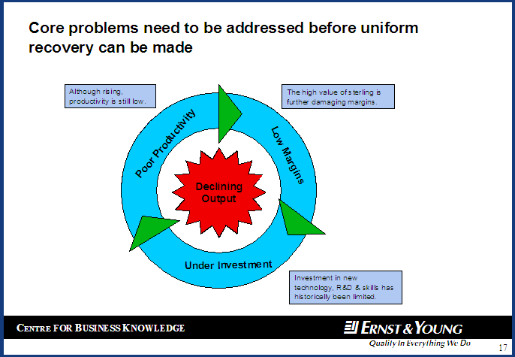
Vicious Circle
A vicious circle is a good tool to illustrate interactions between key market drivers.
USEFUL FOR: Company Analysis Micro Environment.
Caution/Remember!
Vicious circles can be positive as well as negative in nature.

Slide 41

Vicious Circle II
Additional details can be added to vicious circles. These can include solutions/problems, initiatives and issues.
USEFUL FOR: Company Analysis Micro Environment.
Caution/Remember!
Can be combined with E&Y solutions slides (see Swirl Diagram).

Slide 42
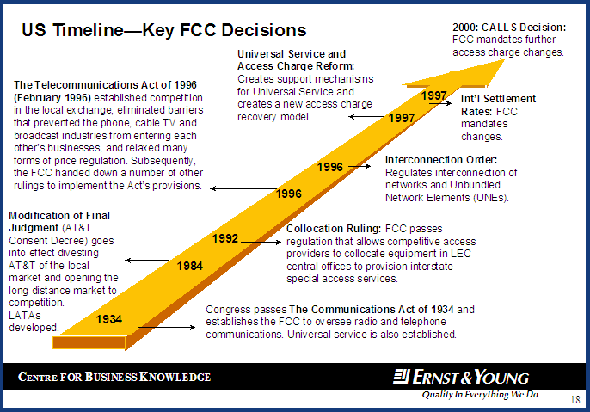
Timeline
důležité
A surprisingly effective method to outline key developments of an industry or company.
USEFUL FOR: Company Analysis Macro & Micro Environment.
Caution/Remember!
Only include major events. Try to keep the number of events under ten.

Slide 43
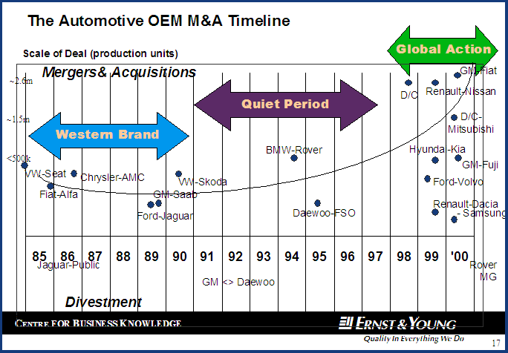
Timeline II
důležité
A more detailed timeline.
USEFUL FOR: Company Analysis Macro & Micro Environment.
Caution/Remember!
Only include major events. Try to keep the number of events under ten.

Slide 44
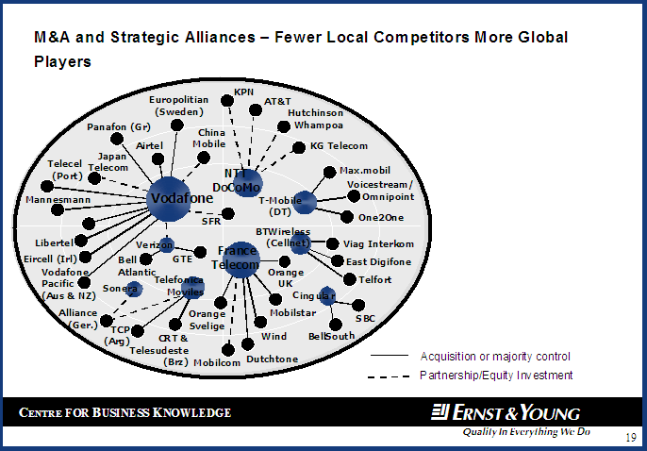
Industry Radar
The industry radar can be used in a wide variety of ways to identify the competitive arena. They are also useful as a tool for assessing the dynamics across an industry.
When compiling a industry radar, major industry players can be shown as well as M&A and strategic alliances.
Major players can be sub-defined (eg: Innovators, Sleeping Giants, Laggards, Niche Players etc), while outside influences can also be plotted.
USEFUL FOR: Company Analysis, Micro & Macro Environment.
Caution/Remember!
Compiling industry radars can be very time consuming. Remember, simple version can be just as powerful as more complex version.

Slide 45
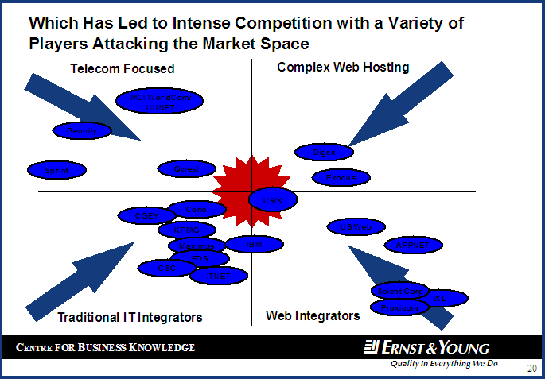
Industry Radar II
A matrix approach can be also used as a framework for industry radars.
This can be useful for identifying market opportunities.
USEFUL FOR: Company Analysis, Micro & Macro Environment.
Caution/Remember!
It can be useful to group competitors into clusters to understand the market better and give an idea about which sorts of strategy are feasible.

Slide 46
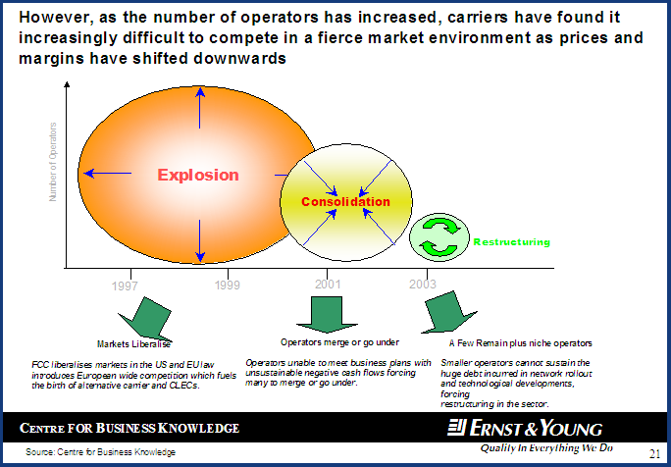
Market Evolution
This hybrid diagram is a useful tool when analysing historical and future market dynamics.
In particular, specific corporate characteristics of an industry (eg: fragmentation, consolidation, restructuring) can be plotted against a timeline to create a standalone chart.
USEFUL FOR: Company Analysis, Micro & Macro Environment.
Caution/Remember!
If actual data is available, best guess estimates can always be used to illustrate broad trends.

Slide 47
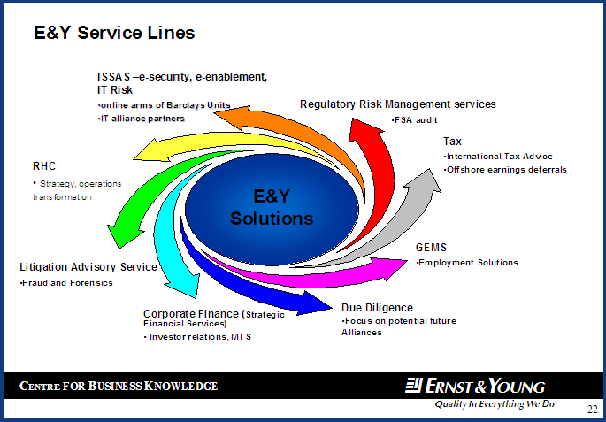
Swirl Diagram
A swirl diagram is a good tool to illustrate key industry trends. It can also be used to show specific industry solutions and relationships.
USEFUL FOR: Snapshot, Company Analysis, Micro & Macro Environment, Relationship & Solutions.
Caution/Remember!
Although arrows can be easily removed for this diagram, adding extra arrows is more difficult.

Slide 48
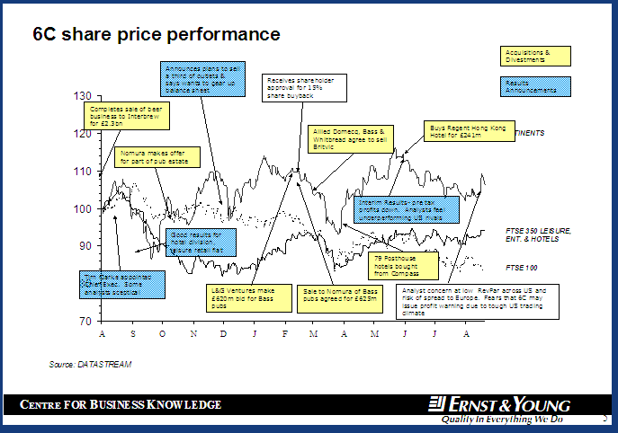
Share Price
A share price chart is an excellent tool to show key influences on individual company stocks.
When compiling a share price chart, it is useful to compare individual company stocks against an industry wide index such as the FTSE 100 or FTSE All-Share.
USEFUL FOR: Company Analysis, Financial Analysis
Caution/Remember!
It can be useful to cluster share price influences into different categories (eg: financial & non-financial).
The Reuters quote/shareprice facility is a useful tool. It allows the user to select high/low points in performance and search for related news.

Slide 49
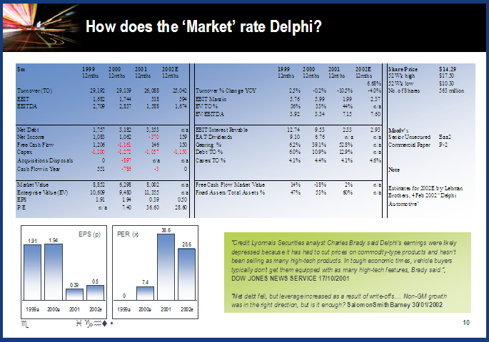
Financial Analysis
důležité
A detailed slide providing financial analysis.
A Cash Point of View slide.
USEFUL FOR: Company Analysis, Financial Analysis
Caution/Remember!
Compiling financial ratios can be very time consuming.

Slide 50
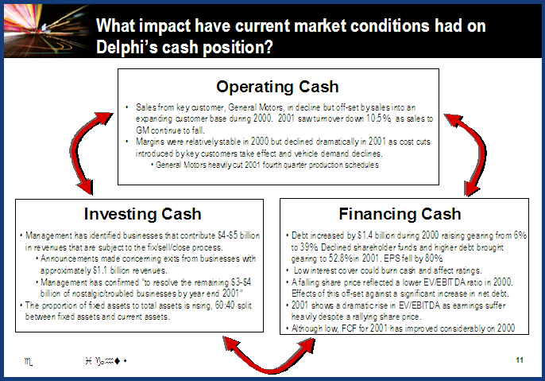
Financial Analysis II
A second Cash Point of View slide.
USEFUL FOR: Company Analysis, Financial Analysis
Caution/Remember!
Compiling financial ratios can be very time consuming.

Slide 51
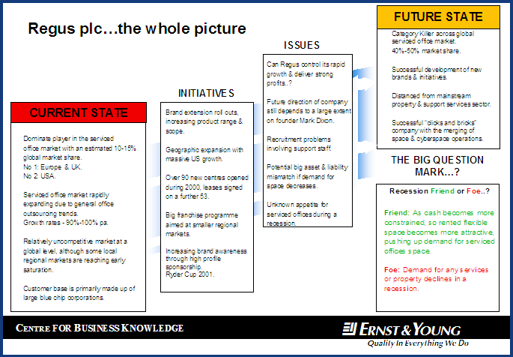
Current State/Future State
A fashionable single frame model useful for evaluating company strategy and market characteristics.
When compiling a current state/future state model it is useful to consider:
Current State: Current market characteristics, company strategy & market position.
Initiatives: Specific company actions, areas of expansion.
Issues: Market risks, potential company weaknesses.
Future State: Future market characteristics, strategy, market position.
USEFUL FOR: Company Analysis, Micro Environment.
Caution/Remember!
Data points should be concise and impactful. List only the most relevant issues. Extra information can be presented in standalone boxes.

Slide 52
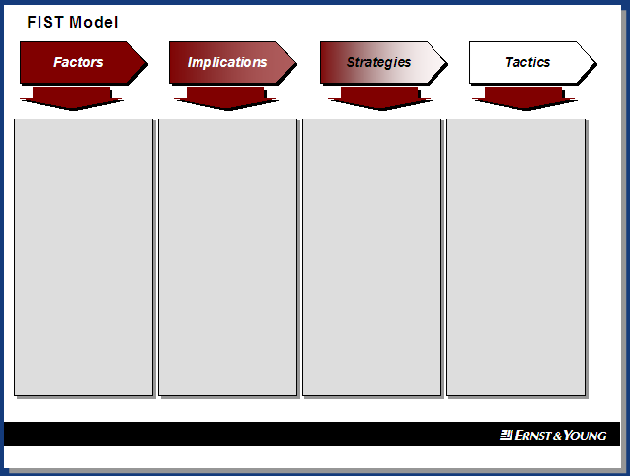
FIST Analysis
A very popular US model used for company analysis.
When compiling a FIST model it is useful to consider:
Factors: Industry-focused information that provides a general overview, without specific company reference.
Implications: Information that outlines implications of the factors.
Strategies: Specific high-level company strategies that are currently being implemented.
Tactics: Specific steps that the company has taken in order to carry out its strategies.
USEFUL FOR: Company Analysis, Micro Environment.
Caution/Remember!
Data points do not have to have a one-a-one relationship as you go from heading to heading.

Slide 53
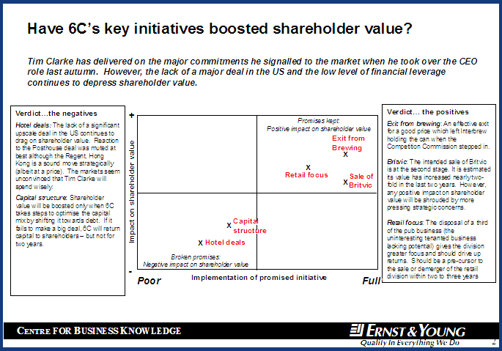
Value/Implementation Chart
A useful matrix to analysis a company’s stated strategic actions, against their impact on shareholder value.
When compiling this matrix implementation of strategy is plotted along the horizontal axis, while impact on shareholder value is plotted along the vertical axis. Positive and negative events can be summarised in boxes at the side.
Positioning is all about 'perception'. As perception differs from person to person, so do the results of this chart. However, there will be similarities and this chart can be very powerful.
A risk insight model.
USEFUL FOR: Company Analysis, Micro Environment.
Caution/Remember!
The position of events in the matrix are derived from news sources and the general perception of a company.

Slide 54
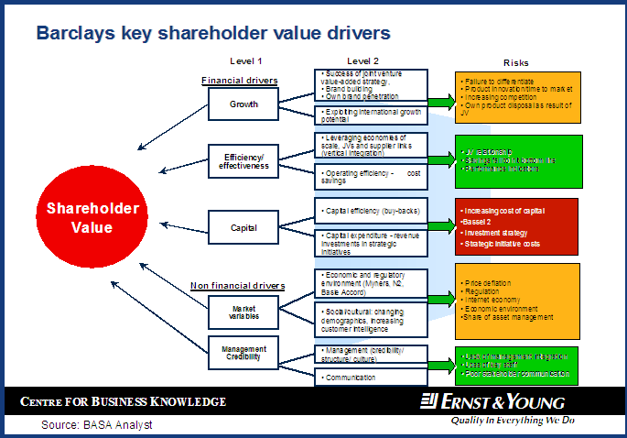
Shareholder Value Divers
A fixed graphical tool outlining key corporate drivers of value and associated risks.
When compiling this chart, level 1 and level 2 drivers are fixed.
A risk insight model.
USEFUL FOR: Company Analysis, Micro Environment.
Caution/Remember!
Risks can be prioritised via colour coding (eg: red=high risk, amber=medium risk, green=low risk).

Slide 55
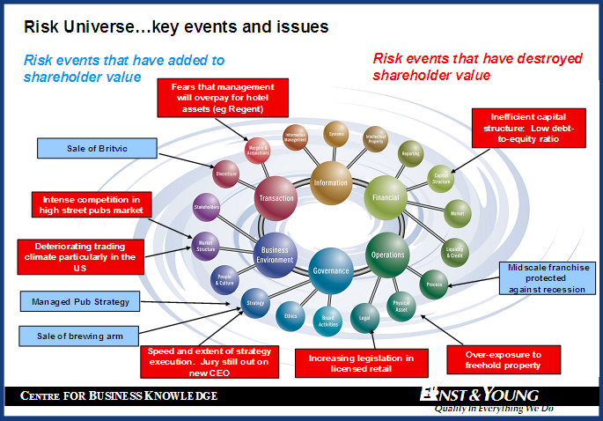
Risk Universe
Another fixed model analysing corporate risk.
The balls in this model remain fixed, while key risks are added. These can be colour coded (added value & destroyed value).
A risk insight model.
USEFUL FOR: Company Analysis, Micro Environment.
Caution/Remember!
Risks do not have to be found for every ball.

Slide 56
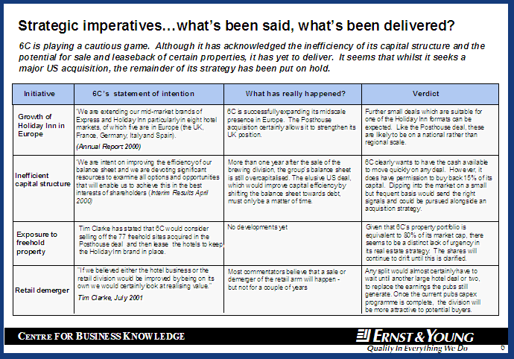
What’s been said & delivered table
This table exams corporate actions against actual delivery of these initiatives.
A consensus verdict based upon broker opinion can also be added.
A risk insight model.
USEFUL FOR: Company Analysis, Micro Environment.
Caution/Remember!
Intention statements are based upon direct company quotes.

Slide 57
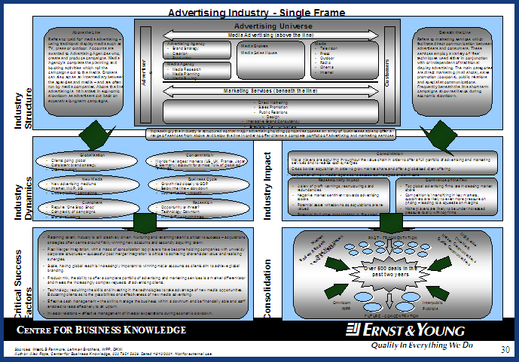
Single Frame
důležité
Single frame models are a very good methods of analysing complete industries.
Various templates can be used depending on the level of detail.
USEFUL FOR: Company Analysis Macro & Micro Environment, Snapshot.
Caution/Remember!
These models can be very time consuming to compile.

Slide 58
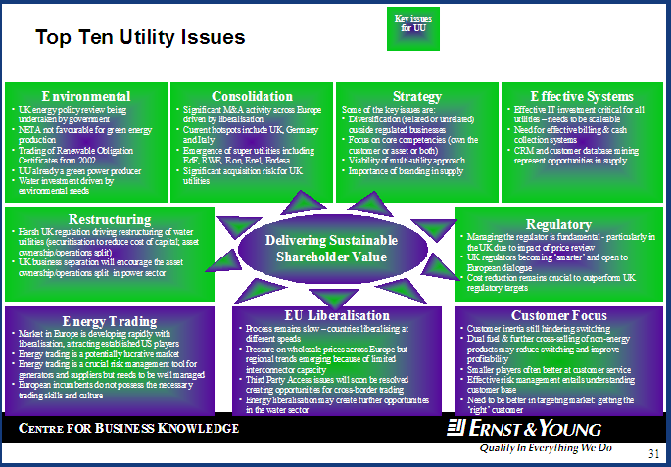
Single Frame II
důležité
Single frame models are a very good methods of analysing complete industries.
Various templates can be used depending on the level of detail.
USEFUL FOR: Company Analysis Macro & Micro Environment, Snapshot.
Caution/Remember!
These models can be very time consuming to compile.

Slide 59
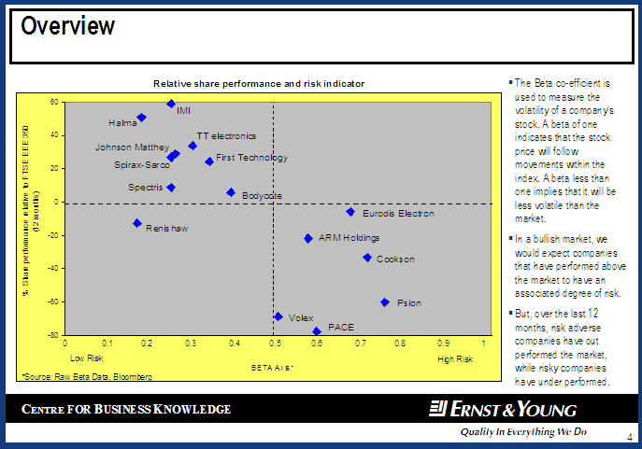
Beta Analysis
A beta is used to measure the volatility of a company’s stock. A beta of one indicates that the stock price will follow movements within the index. A beta less than one implies that it will be less volatile than the market.
This slide compares individual beta’s against the FTSE 250 index to find out which stocks have outperformed relative to their risks.
USEFUL FOR: Company Analysis Macro & Micro Environment.
Caution/Remember!
Compare the beta against a relevant index.

Slide 60
Kvantitativní analýza
Informační průmysl

Slide 61
Kvantitativní přístup
Data
  Spousta dat – musíme správně určit ta nejužitečnější pro analýzu
  Data nelžou — je to o výkladu a souvislostech
Techniky
  Year-over-year srovnání, poměrové ukazatele (ratiios) and procentuální poměry
  Porozumět podstatě – např. správný business model nebo vztahy různých proměných
Použitelnost
  Znalosti jsou to, co se snažíte dát dohromady a zodpovědět tím „So what?“ a poskytnout vhled do problematiky

Slide 62
Analýza dat / benchmarking
Kvantifikovaný údaj je silnější a přesvědčivější
  Job opportunity in Spain is bad (nevím jak moc špatný znamená „bad“)
  Job opportunity in Spain is bad. Unemployment rate at the end of Q3 was 25%. Youth unemployment rate, age between 15 and 24, is above 50%
Musíme srovnávat srovnatelné (apples with apples)
  Merck’s 2013 price to earnings ratio is 11.7x. Amgen 2013 P/E ratio is 11.4x. Can we say both stock prices are trading with similar premium? (jde o jiný typ segmentu, jiný zákazníky, jiné odvětví?)
  2013 P/E average for US major pharma is 12.2x. Average for US biotech is 16.0x. Merck P/E is in line with peer average while Amgen is significant below peer average
Data pomáhají kontrolovat úhel pohledu
  “A market in which winners tend to take all. By the end of 2011, top four players accounted for over 56% of the total online video market share”
  Can we say 56% market share is all? (někdy je to většina, někdy není ani 85% dost na většinu trhu)
Data pomáhají vidět trendy a získat pochopení
  Xerox 2009 revenue was $15.2bn. 2010 revenue was $21.6bn, 42% increase from 2009
  Musíme zjistit odkud se takový nárůst vzal, v tomto případě je to akvizicí, (není možné růst tak moc organicky, muselo dojít k akvizici, proč akvizice? Chystají změnu?)
Notes:
Merck is a big pharmaceutical company. Amgen is biotech company. Products and business model are different. They have different peers.
Winners take all to me is close to 95% market share. 56% market share isn’t all. Statement is not correct.
Any other tech company is doing what Xerox doing? HP? Dell? How do we evaluate hybrid companies like Xerox? Is it a new norm?

Slide 63
Efektivní komunikace čísel zlepšuje analýzu
Zjednodušujte
  Předpokládejte, že víte víc než posluchači
  Nepište víc jak 2 sady čísel v jedné větě
    Sales increased 10% to $3.5bn (1st set), while profits rose 5% to $25mm (2nd set)
  Nepředstavovat nové hodnoty nebo nové myšlenky
    Musíme posluchače k závěrům trochu vést – aby jejich pozornost byla soustředěná na správných místech
    Sales increased 10% to $3.5bn in 2012, a slight improvement from 2011’s 8%, while profits for 2012 rose 5% to $25mm, up from 4% in 2011
  Zjištění/fakta rozdělovat
    Sales increased 10% to $3.5bn in 2012, a slight improvement from 2011’s 8%
    Profits for 2012 rose 5% to $25mm, up from 4% in 2011
Náznaky / Indície
  Vyvarujte se příliš detailním informacím v jednom odstavci. Každý z posluchačů hledá trochu jiné informace. Někdo má rád detailní sdělení, jiný zas nikoliv. (např prodej aut dosáhl téměř 10 tisíc kusů vs. Prodej aut dosáhl 9789 kusů)
    Underlying net revenues, the best metrics for sales, increased 9.7% to $2.7bn, while profits made strong progress, increased 5% to $23mm
    Sales and profits both grew strongly on the company’s key metrics. Underlying net revenues increased 9.7% to $2.7bn, and profit grew 5% to $23mm
  Indície musí být krátké a jednoduché
Notes:
You know more because you are writing the numbers. Your audience often don’t know your thinking process.
Readers know what to look for and expect. Key words are grew strongly, key metrics

Slide 64
Efektivní komunikace čísel zlepšuje analýzu
Buďte specifičtí
  Jednotky a desetinná čísla
    Volte vhodné jednotky, pro většinu posluchačů se snažte vyvarovat desetinných míst
    Někde je naopak přesnost žádoucí. Např. kurzy měn – 4 desetinná místa, ceny akcií – 2 desetinná místa
  Alternativní popis
    20% of people in my class is taller than 6 feet
    One in five people in my class is taller than 6 feet
    The chance of hurricane has increased threefold
    The chance of hurricane has increased from 1% to 3%
  Při projekcích či chybějících údajích je akceptovatelná určitá míra nepřesnosti
    Sales are expected to be 10,825 units next year
    Sales are expected to reach 10,000 units next year
References:
“How to communicate numbers”, James Ball, emphasis business writing trainers

Slide 65
Typy analýzy dat
Popis
  Popisuje set dat – statistická data, demografická, ekonomická
  Popis a interpretace se liší
  Popis nemúže bát zobecněn a použit bez dalšího statistického testování – např. -48% populace Brna jsou muži neznamená, že to platí pro celou ČR
Extrapolace (přiblížení, přechod z užší na širší oblast pomocí analogie)
  Může být využita k odhalení spojitostí
  Extrapolace by neměla být použita k zobecňování nebo předvídání
Dedukce
  Použijte malý vzorek dat k nalezení vyšších spojitostí
  Obsahuje míru neurčitosti
Predikce
  Data z jednoho objektu jsou použita pro odhad jiného objektu. Víc dat a jednodušší model vede k přesnějším výsledkům
Příčina
  Jedna věc přímo zapříčiňuje druhou

Slide 66
Benchmarking – porovnání skupiny stejných firem
Benchmarking zvyšuje kvalitu a pomáhá zjistit:
  Co hledaná firma dělá
  Jak to firma a ostatní dělají
  Jak dobře to daná firma dělá ve srovnání se sobě rovnými
Proč dělat benchmarking?
  Většina trhů je značně konkurenčních
  Když jsou ostatní lepší, můžeme se od nich učit
Musíme vědět co porovnávat
  Firmy musí být srovnatelné Tescan vs. Olympus
  Porozumět významu nejvyššího, průměrného a nízkého výkonu ve skupině
  Použijte výsledky benchmarkingu k vyhledání klíčových faktorů a trendů
Notes:
Usually benchmarking involves a client company and a group of comparable companies. Suggest to have at least 5 peers to compare. We can benchmark from company premium, stock price performance and corporate finance strategies to financial performance, products and country profile (GBB).
Know the implication of in each performance group. It’s not simply a writing of company X ranked #2 in the peer group

Slide 67
Pro benchmarking je je klíčové mít správné firmy
Apple vs. apple
  Srovnání ve stejném sektoru či subsektoru, stejný typ zákazníků, stejný business model, produkty nebo služby
  Můžeme použít firmy i z jiného sektoru?
    Musí mít stejné zbývající charakteristiky: např. přímý prodejci bez ohledu na produkt (vysavače – kosmetika, hypotéky – pojištění,…)
    DŮLEŽITÉ: nezapoměňte zvážit faktory z jiných oblastí, které ve vašem sektoru nejsou – např. státní regulace. Proveďte s nimy nezbytná přizpůsobení.
Konkurenti pro hybridní firmy
  2008 GE: 37% revenue from financial unit 63% from industrial
  Johnson & Johnson: 23% CP; 38% Pharma and 39% medical devices
  Použijte několik setů firem pro porovnání dané části firmy – tj. část GE porovnat s finančními institucemi a část s průmyslovými firmami
Notes:
Comparables must have same nature or characteristics
Sectors with a small population. E.g. Online trading, rental cars, companies with single product/service. We can identify comps by business model, function and customers

Slide 68
K interpretaci výsledů benchmarkingu jsou nutné znalosti
Benchmarking není jen jednoduché prohlášení:
  Company A outperformed the peers by xx%
  Company A ranked #1 among the peer group
  Company A is below the peer average
  Je potřeba identifikovat klíčové faktory výkonu firmy
    Proč je daná firma nad/pod ostatními firmami ve výkonu?
    Co můžeme na základě dat předvídat či očekávat?
    Co to pro nás znamená? Pro dané oddělení/firmu?
Co dělat když data nepodpořila naše očekávání a hypotézy?
  Ujistěte se, že porovnávaná skupina je skutečně srovnatelná
  Zkontrolujte data a ujistěte se, že jsou správná a srovnatelná
  Ověřte zdroje z nichž vychází očekávání – hypotéza je založena na neznámém blogu nebo světoznámé publikaci?

Slide 69
Analýza dat
Sledujeme trendy – nárůst, průměr, odchylky, časové osy, rozptyly
  hledáme vzory a zákonitosti
  posuzujeme vliv externích faktorů, sezónních obměn, náhodných událostí a cyklických trendů
Statistické metody
  průměr – součet položek v sadě/počtem položek
  medián - hodnota, jež dělí řadu podle velikosti seřazených výsledků na dvě stejně početné poloviny
  modus – nejčastěji se vyskytující hodnota v sadě dat
  odchylky - rozsah – rozdíl mezi největší a nejmenší hodnotou; standardní odchylka – ke zjištění odchylky od průměru

