Slide 1
Key Trends in American Film
Session Four
Gen-X Cinema
Department of Film and Audiovisual Culture
Dr. Richard Nowell

Slide 2


Agenda
14:20–15:50
Screening: Mallrats (1995)
15:50–16:05
Break
16:05–17:25
Discussion: Gen-X Cinema

Slide 3








Generation X Cinema

Slide 4
Agenda
US Indie Culture and Gen-X Sensibility
Hollywood and Gen-X
The challenge of subcultural cultivation

Slide 5
Screening Questions: Mallrats (1995)
How does this film portray its Gen-X protagonists?
2. How is the “mainstream” media portrayed in this film?
3. What roles do “mainstream” media texts play in the lives of these young people?
4. How do the makers of this film attempt to ensure that Gen-Xers will view it as “credible”?

Slide 6
Agenda
US Indie Culture and Gen-X Sensibility
Hollywood and Gen-X
The challenge of subcultural cultivation

Slide 7
What does Michael Z. Newman identify as the distinguishing characteristics of American “Indie Culture”?

Slide 8

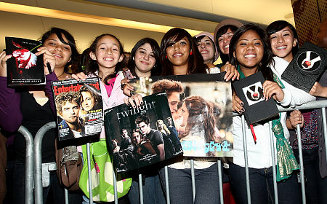
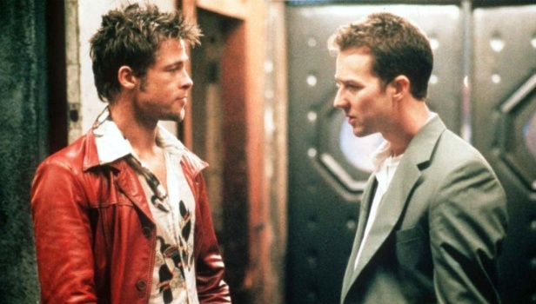
Fantasies of an Authentic, Autonomous, Alternative
Subcultural disposition characterized by a specific manifestation of oppositional taste
Elitist left-liberal sensibility positioned as superior to the imagined “mainstream”
Mainstream: a mass culture caricature
1. Cynical, corporate production … suits
2. Stupefying, formulaic texts … trash
3. Mindless, conformist consumers … dupes
Embraces fantasies of authenticity and autonomy: products of integrity, made outside commerce

Slide 9
What does Oake suggest characterizes Gen-X as a distinct subculture?

Slide 10
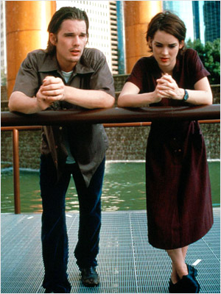


Gen-X: An extreme manifestation of youth angst and alienation?
A historically specific development within US indie culture: late 1980s to mid-1990s
A youth subcultural disposition based on a specific way of consuming media products
Hyper-media literate; cynical, detached, and ironic modes of media consumption
Media central to understanding the world
Like indie, is associated with middle-class, educated, white, left-liberal, anti-corporates

Slide 11
Questions about Reality Bites
1. What does Oake argue about the makers of Reality Bites’ attempts to portray Gen-X?
2. Do you agree with his assessment?
3. What would the motivation be for portraying this group in such a way?

Slide 12

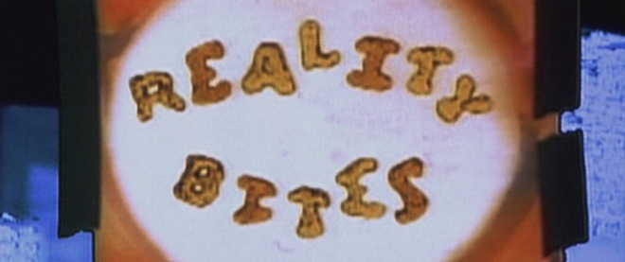
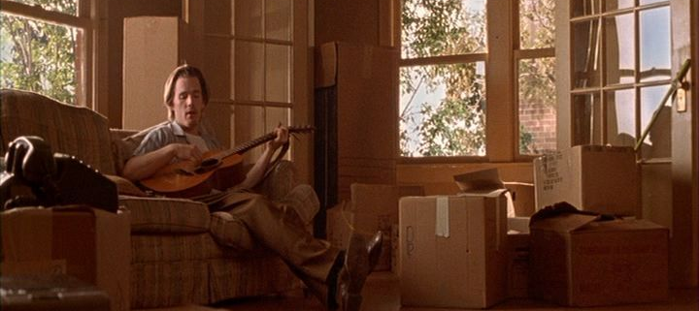

Oake on how Reality Bites Bites …
In spite of his claims to neutrality, Oake is clearly shaped by his own Gen-X politics.
Reality Bites seeks to contain and disempower Gen-X, through domestication of protagonists
Hollywood cannot be true to this group, because it is essentially conservative in outlook
But why would commercial film producers reach out to an audience, only to condemn it?
Perhaps, Oake is missing the point …

Slide 13
Screening Questions: Reality Bites (1994)
How does this film portray its Gen-X protagonists?
2. How is the “mainstream” media portrayed in this film?
3. What roles do “mainstream” media texts play in the lives of these young people?
4. How do the makers of this film attempt to ensure that Gen-Xers will view it as “credible”?

Slide 14
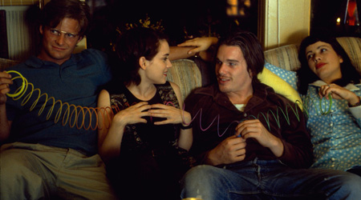
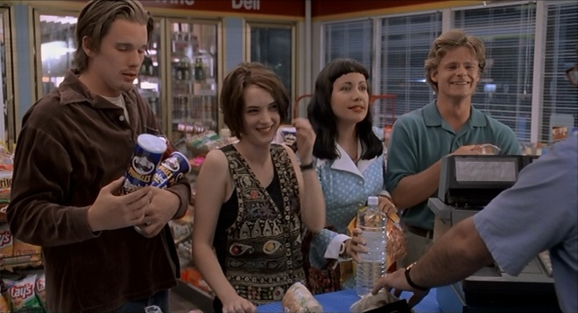

Reality Bites: Well-meaning but perhaps trying a little bit too hard to be “cool” (?)
Reality Bites was made to appeal to Gen-X, a group of loyal but alienated media consumers
This film seeks to remind Gen-X that “mainstream” media is central to its identity
Emphasizes how Gen-X uses “mainstream”: nostalgia, ironic appropriation, quotation etc …
Also suggests that corporate media personnel might be unhip, but also love popular culture
Frames extreme Gen-X sensibility as a coping mechanism, too much is sad not bad!

Slide 15
Screening Questions: Mallrats (1995)
How does this film portray its Gen-X protagonists?
2. How is the “mainstream” media portrayed in this film?
3. What roles do “mainstream” media texts play in the lives of these young people?
4. How do the makers of this film attempt to ensure that Gen-Xers will view it as “credible”?

Slide 16
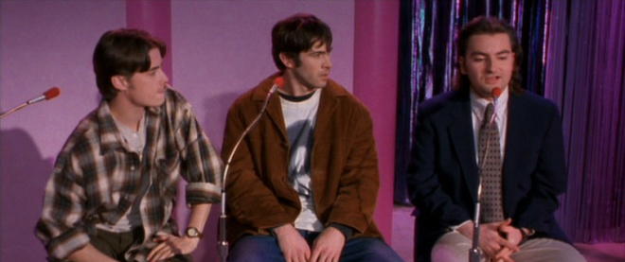
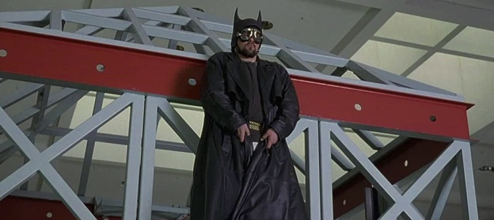

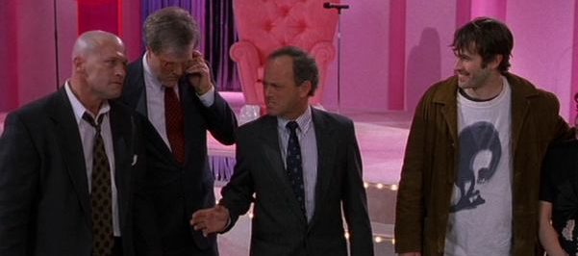
Mallrats: Quietly “Correcting” Gen-X critique of “Mainstream” to appeal to Gen-X
Sympathetic Gen-Xers are contrasted to unlikable characters (youths and adults)
Uses self-reflexive depictions of media to reach out to Gen-X, and insulate itself from critique
“Mainstream” media portrayed as:
Sometimes a product of “autonomous” personnel
Capable of “authentic” expression
Enabling consumer discrimination and choice
Enabling challenging/empowering consumption
Stresses an alternative to oppositionality!
That a gen-X-friendly subculture can exist – because it does exist – within the “mainstream”

Slide 17




Why Hollywood Needed Gen-X: Or holding on to the life blood of the industry
Oake claims Gen-X was invented by media, which then sought to discredit it: hokum!
Gen-X preceded media interest; this interest simply cemented Gen-X’s traits and identity
Youth-oriented blockbusters of mid-1980s gave way to period of youth market decline
Not in Hollywood’s interest to further alienate Gen-Xers; they were avid media consumers!
Moreover, independently released films clearly indicated the commercial power of this group

Slide 18


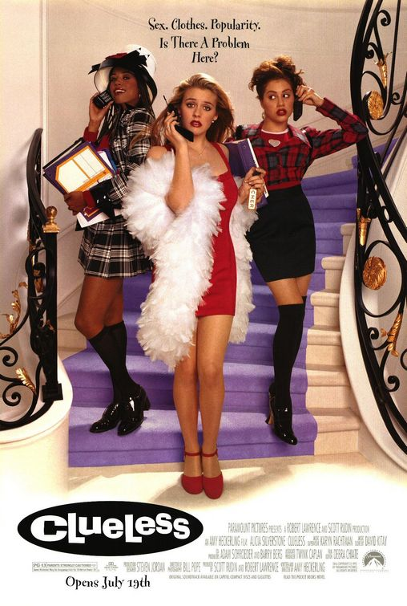
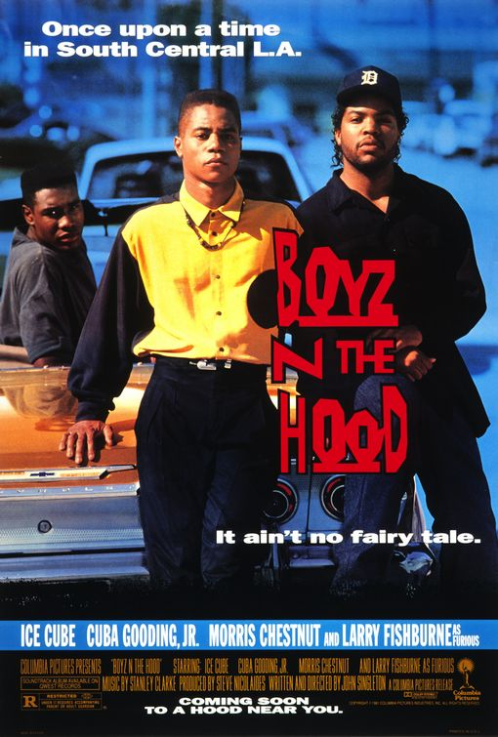
Gen-X Cinema as a Overlooked Audience Targeting Strategy
Commonly argued that early1990s Hollywood abandoned youth in favor of families/children
Also argued, that only in late 1990s did Hollywood return to youth-oriented product
But, Gen-X films were part of Hollywood’s ongoing cultivation of American youth
These films also included tales of ghetto life, and a number of films that failed commercially
These tend to be overlooked as youth films, as they are not about middle-class white teens!

Slide 19
Framing Gen-X Cinema: Perennial/Indie/Hollywood
Clerks Trailer:
http://www.youtube.com/watch?v=Mlfn5n-E2WE
Reality Bites Trailer:
http://www.youtube.com/watch?v=xDYGo0UgIVM
Mallrats Trailer:
http://www.youtube.com/watch?v=eOd5zJLsZEc

Slide 20




The Case of Hollywood & Skateboarding
Their failure is indicative of the challenge of Hollywood’s courting subcultural sensibilities
Skateboarding booms take place in the late 1970s, the mid 1980s, and the late 1980s
Each time, a Hollywood company sought to tap into this pastime but with no success
Like other sizable subcultures, skateboarding has not translated into strong box office
Hollywood usually fails to undermine its status as an “Other” of many subcultures

Slide 21




Coda: Gen-X Cinema and Indiewood
Failure of Gen-X films prompts Hollywood to rethink cultivation of Indie sensibility
Miramax’s successes, especially with Pulp Fiction, indicated Hollywood was the problem
Conglomerates that own Hollywood studios set up specialty divisions to handle indie films
These companies enjoyed some success from the late 1990s to the mid 2000s
Hollywood continued to remind young people mainstream media is central to youth identity

Slide 22
In Sum
Where Gen-X films were scorned as inauthentic appropriations of a subculture, this romanticizes independence and Otherizes Hollywood
Hollywood clearly intended to reach out to the declining young market
The films were used to “remind” cynical media-literate Gen-Xers that “mainstream” media was central to their identities and their lives
Here, mainstream media was presented as offering an alternative, and as accommodating supposedly autonomous talent and authentic visions
This strategy struggled due to Hollywood’s status as a key foil against which audio-visual subcultures define themselves: as the enemy

