Slide 1
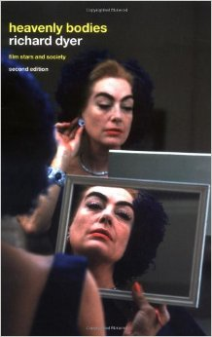
Star Studies Theory
Part 1: Mapping the Field

Slide 2
Introduction
This lecture will map out the field of star studies and identify the most influential works associated with it.
Discuss Richard Dyer’s work (Stars, 1979).
Discuss the earlier studies that influenced Dyer’s work on stars.
Consider how scholars have subsequently developed and departed from Dyer’s work.

Slide 3
Richard Dyer’s Stars (1979)
In 1991, Christine Gledhill noted that Dyer’s book had “laid the groundwork for star analysis within film studies” (Gledhill, Stardom: Industry of Desire, 1991: xiv).
In 2000, Ginette Vincendeau wrote that Dyer had, “single-handedly created ‘star studies’” (Vincendeau, Stars and Stardom in French Cinema, 2000: Preface, x).
In 2006, Karen Hollinger wrote that Dyer’s study precipitated a “seismic shift in the way in which star studies were perceived” (Hollinger, The Actress, 2006: 35).

Slide 4
Richard Dyer’s Stars (1979)
Dyer’s book combined semiotics and sociology, introducing the notion of the ‘star text’ – an intellectual construct produced across a range of media and cultural practices (only partly films).
The star text also included promotional material and publicity.

Slide 5
Richard Dyer’s Heavenly Bodies (1986)
This book extended and deepened the nature of his earlier work through its case study analysis of three major stars: Marilyn Monroe, Paul Robeson and Judy Garland.
It also placed more emphasis on audiences and how stars mean different things to different kinds of audience.

Slide 6
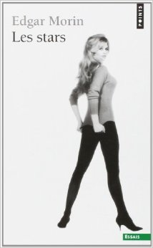
Star Studies before Stars
Roland Barthes, Mythologies (1957)
Edgar Morin, Les Stars (originally published in French in 1957 and translated into English by Richard Howard for the University of Minnesota Press in 2005).
‘the star straddles both sacred and profane, divine and real, aesthetic and magic, like the kings’ (Morin, 1957/2005: 84)’
The star is a sacred monster: one born from a conjunction of capitalism, modernity and the mythology of love (p. 147).

Slide 7
From Les Stars to Stars
In the conclusion to Stars, Dyer calls his own book, “a survey of what has been done in the study of stars and what needs to be done” (Richard Dyer, 1979: 160).

Slide 8
The structure of Dyer’s Stars
Three parts:
Part 1 is sociological and entitled ‘stars as a social phenomenon’
Part 2 is sociological and semiotic, entitled ‘stars as images’
Part 3 is semiotic and entitled ‘stars as signs’
Texts are considered as “social facts,” Dyer reasoning that, “textual assumptions must be grounded in sociological ones” (Dyer, 1979: 1).
Therefore, the fundamental (or foundational) concept running throughout the book is ideology.

Slide 9
Structured Polysemy
‘From the perspective of ideology, analyses of stars – as images existing in films and other media texts – stress their structured polysemy, that is, the finite multiplicity of meanings and affects they embody and the attempt so to structure them that some meanings and affects are foregrounded and others are masked or displaced. The concern of such textual analysis is then not to determine the correct meaning and affect, but rather to determine what meanings and affects can legitimately be read in them. How these are in fact appropriated or read by members of different classes, genders, races, etc. is beyond the scope of textual analysis (although various conceptualisations of this will be found throughout the book)’ (Dyer, 1979: 3). [Emphasis mine]

Slide 10
Economics and more
‘The enormous economic importance of stars, the elaborate machinery of image-building and film’s importance in establishing character-types all suggest the potential power of the forces of cinematic production for creating the star phenomenon. However, these explanations of the star phenomenon are not sufficient in themselves and we need to see the phenomenon in its cultural, historical and ideological context to understand where the producers’ ideas and images of stardom and of specific stars themselves come from’ (Dyer, 1979: 17).

Slide 11
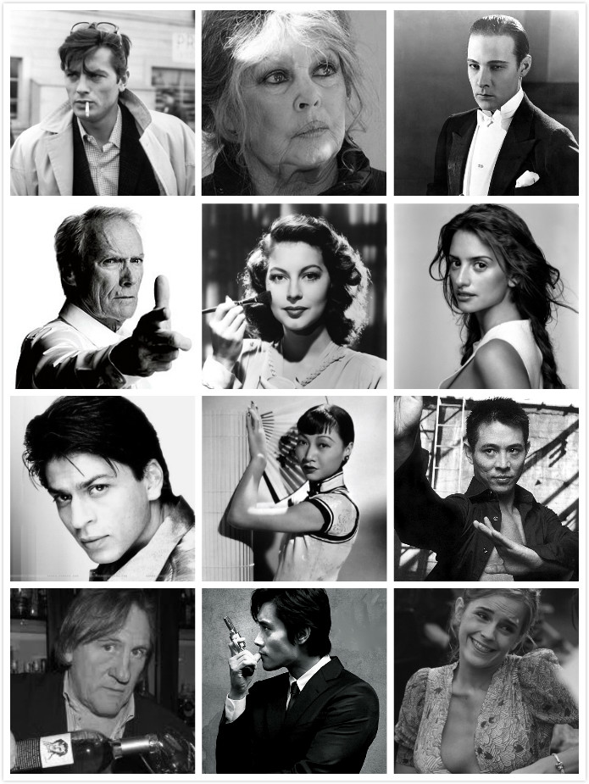
Audience-star relations
Dyer defines four aspects to is:
emotional affinity
self-identification
Imitation
projection

Slide 12
Ordinary & Special Qualities
‘One of the problems in coming to grips with the phenomenon of stardom is the extreme ambiguity/contradiction … concerning the stars-as-ordinary and the stars-as-special. Are they just like you and me, or do consumption and success transform them into (or reflect) something different?’ (Dyer, 1979: 43)

Slide 13
The Paradox
‘The paradox of the extravagant lifestyle and success of the stars being perceived as ordinary may be explained in several ways. First, stars can be seen as ordinary people who live more expensively than the rest of us but are not essentially transformed by this. Second, the wealth and success of the stars can be seen as serving to isolate certain human qualities (the qualities they stand for) without the representation of those qualities being muddied by material considerations or problems. Both of these explanations fit with notions that human attributes exist independently of material circumstances. Stars may serve to legitimate such notions’ (Dyer, 1979: 43).

Slide 14
Types & Individuals
Dyer points out that, ‘stars … relate to the social types of a society’ and also that the ‘star both fulfils/incarnates the type and, by virtue of her/his idiosyncrasies, individuates it’ (Dyer, 1979: 47).
‘Stars embody social types but star images are always more complex and specific than types. Types are, as it were, the ground on which a particular star’s image is constructed’ (Dyer, 1979: 60).

Slide 15
Analyzing Star discourses
Plethora of star texts across the various regimes of promotion, publicity, films and criticisms and commentaries.
Emphasis on textual analysis
Film texts read as star vehicles
‘Films were often built around star images. Stories might be written expressly to feature a given star, or books might be bought for production with a star in mind. Sometimes alterations to the story might be effected in order to preserve the star’s image. This is what is implied in the term “star vehicle” (a term actually used by Hollywood itself)’ (Dyer, 1979: 62).

Slide 16
Analyzing extra-cinematic materials
Criticism and commentaries.
‘This refers to what is said or written about the star in terms of appreciation or interpretation by critics and writers. It covers contemporary and subsequent writings (including obituaries and other material written after a star’s death or retirement), and is found in film reviews, books on films …. To this can be added film, radio and television profiles of stars. These always appear after the initial promotion and film-making of a star, although they may act back on subsequent promotion and film activity …’ (Dyer, 1979: 62).

Slide 17
Analyzing Performance
In Part 3 of Stars, the focus is on acting and performance (including characterization).
This includes how audience identify with characters on screen.
Dyer identifies three distinct modes of star-character relationship:
selective use (i.e. where the characters reveals aspects of the star’s image while ignoring offer aspects)
perfect fit (i.e. where the star’s image fits with all the traits of a character, e.g. Clark Gable as Rhett Butler)
problematic fit (i.e. where the star’s image conflicts with the character they are playing, e.g. Bette Davis as Charlotte Vale) (see Dyer, 1979: 125-29).

Slide 18
Analyzing the fit
‘What analysis is concerned to do is both to discover the nature of the fit between star and image and character, and, where the fit is not perfect or selective, to work out where the contradictions are articulated … and to attempt to see what possible sources of “masking” or “pseudo-unification” the film offers (such as the irresistible unifying force of a star image)’ (Dyer, 1979: 131).

Slide 19
Analyzing Performance Signs
‘any attempt to analyse performance runs up against the extreme complexity and ambiguity of performance signs’ (Dyer, 1979: 133).
‘The signs of performance are: facial expression; voice; gesture (principally of hands and arms, but also of any limb, e.g. neck, leg); body posture (how someone is standing or sitting); body movement (movement of the whole body, including how someone stands up or sits down, how they walk, run, etc.). Of these the first is often held to be the most important … Yet just as its importance may be the greatest, so too is its ambiguity….’ (Dyer, 1979: 134)

Slide 20
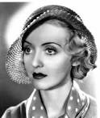
Culture-bound interpretations
‘Our reading of performance signs depends in the first instance on our very general knowledge of what intonation, gesture, eye dilations, etc. mean. This knowledge is culture- and history-bound’ (Dyer, 1979: 134)
‘This signification of a given performance sign is determined by its place within culturally and historically specific codes. In other words, in terms of film, to read Bette Davis’s eye movements or John Wayne’s walk, we cannot refer to a general and universal vocabulary of eye and walking movements, but to specific vocabularies, specific to the culture and specific within it’ (Dyer, 1979: 135)

Slide 21
A Cultural Studies Approach
This is a Cultural Studies approach to analyzing screen performances. The emphasis is on interpretation by audiences rather than the intentions of the actors.

Slide 22
Signature Style
‘a star will have a particular performance style that through its familiarity will inform the performance s/he gives in any particular film. The specific repertoire of gestures, intonations, etc. that a star establishes over a number of films carries the meaning of her/his image just as much as the ‘inert’ element of appearance, the particular sound of her/his voice or dress style’ (Dyer, 1979: 142).

Slide 23
Challenging the auteur director
‘an important tradition in film theory has tended to deny that performance has any expressive value: what you read into the performer, you read in by virtue of signs other than performance signs’ (Dyer, 1979: 143)

Slide 24
Dyer’s Conclusions
Four main concluding remarks (pointing towards where further research would be beneficial):
(1) The Audience is ‘fundamental to every assumption one can make about how stars, and films, work’ (Dyer, 1979: 160)
(2) Stars can provide insight into ideological crises (introducing the notion of charisma)

Slide 25
Charisma
‘This sense of crisis as to what a person is seems to me to be central also to the star phenomenon. It can be seen to lie behind star charisma as a generalised phenomenon, in that stars speak centrally to this crisis and seem to embody it or to condense it within themselves. How they speak to, embody or condense it may be predominantly in terms of reaffirming the reality of people as individuals or subjects over against ideology and history, or else in terms of exposing precisely the uncertainty and anxiety concerning the definition of what a person is. Whether affirming or exposing, or moving between the two, stars articulate this crisis always through the cultural and historical specificities of class, gender, race, sexuality, religion, subcultural formations, etc. Yet all stars seem to me to work at the more general level – itself culturally and historically specific – of defining what a person is’ (Dyer, 1979: 160-61).

Slide 26
Dyer’s Conclusions
Four main concluding remarks (pointing towards where further research would be beneficial):
(3) The radical potential of stars for marginal audiences (reading against the grain) (Dyer, 1979: 162)
(4) Retaining beauty, pleasure and delight when conducting film analysis/interpretation

Slide 27
Conclusion
Stars was not the first sustained academic book-length study of film stars and stardom’
It drew on and synthesized the existing literature on the topic.
It lay the foundations of what would become (certainly by the 1990s) a recognized sub-disciplinary field within film studies in terms of concepts, areas of investigation and methodologies, promoting analysis of stars as texts (films, publicity and promotion) and as performers/actors and creators of meaning.

