Slide 1
Stars Studies Theory, Part 2:
Historicising Hollywood’s Industrial System of Stardom

Slide 2
Introduction
This lecture will discuss the legacy of Richard Dyer’s work by examining a radical shift away from his approach that signals a more historicised understanding of the industrial conditions of stardom. Here I shall be concentrating on the work of scholars such as Danae Clark, Barry King and Paul McDonald. .

Slide 3
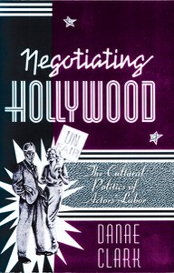
A Dyer Backlash in the 1990s
Danae Clark, in the Preface of her book Negotiating Hollywood, claimed that by the mid-1980s star studies ‘was an accepted and established subgenre of film studies’ (Clark, 1995: Preface, x).
Here Clark declared her intention of seeking ‘to destabilize the concept of “star” and to interrogate the very premises upon which “star studies” traditionally rests’ (Clark, 1995: ix).
‘Armed with my own suspicions about reception studies, as well as with my background in Marxism and political economy, I began to resituate the star within the sphere of production’ (Clark, 1995: x).

Slide 4
Danae Clark’s Negotiating Hollywood
Clark defined her work ‘in direct opposition to standard star studies analyses, which posited the star (image) as an object/text/sign to be read and interpreted by the spectator’ (1995: xi)
Clark reconceived of the star ‘as a social subject who struggles within the film industry’s sphere of productive practices’ (ibid.).
Explores relations between different types of film actor (e.g., star, lead player, character actor, extra, stunt person, etc.) in terms of their ‘various antagonisms and affiliations contributing to an understanding of their subject identities and positionalities’ (ibid.).

Slide 5
Negotiating Hollywood
Clark sought to ‘include a space for the actor as social subject and to intervene in the historical formation of this subjectivity’ (ibid.).
This involved looking beyond the star image and the spectator-image relations in order to refocus on ‘the conditions of labor that produce the image’ (Clark, 1995: xii).
An anti-textual approach
‘A theoretical emphasis on film aesthetics and film reception has ... led scholars to focus on the image and the spectator-image relationship and to ignore the conditions of labor that produce the image’ (ibid.).

Slide 6
Actors’ labor
Clark attempts to, ‘map the terrain of actors’ labor and subjectivity, to locate the various sites in which actors’ labor power and subjectivity is constructed, fought over, and played out’ (Clark, 1995: 16).
She notes that, ‘the majority of work in this field analyzes the actor as a “star image” or “text” and thus reduces the actor to the status of object’ (1995: 120)

Slide 7
And resistance
Clark conceives of the actor ‘as a social agent or political subject who actively participates in or resists studio discourses of stardom and the material conditions upon which they rest’ (1995: 121).
Her approach was to examine the ‘social relations of power that determine and influence their status as subjects in the industry’ (ibid.).
She ‘avoided a fetishized reduction of actors as objects within the representational field’ (ibid.).

Slide 8
Actor as worker
Clark defined the actor as ‘a social subject who works and is positioned within the acting profession’ (1995: 121)
This ‘provides a space for interrogating what it means to be constituted as an actor’ (ibid.).
‘The “actor as worker” thus serves as a theoretical starting point from which to analyze the material and discursive struggles over actors’ subjectivity. As a challenge to the elitism of text-based analyses concerned only with stars, this construct also serves to question the appropriateness of the label “star studies” in describing this area of research (I would prefer, in other words, the more neutral term “actor studies”…’ (ibid.). [NB: Star Studies is elitist]

Slide 9
The case against textual analysis
Two main objections to textual analysis:
it has led scholars to ignore what goes on beyond or behind the screen (e.g., their working conditions)
‘Textual analyses of star images travel a well-worn path’ (Clark, 1995: 127).

Slide 10
Fetishization of stars
‘… fetishization of stars and the equation of stars with star images remains the prevailing tendency of star studies. Even Richard Dyer’s early work on stars must be understood in relation to this aesthetic tradition. First of all, his emphasis on stars as images in media texts tends to ignore the role of actors’ labor in the production process. In addition, given his concern with the significance that star images have for spectators, Dyer promotes a concomitant fetishization of stars and their performances’ (Clark, 1995: 9).

Slide 11
Audiences as workers
Clark claims that subcultural (i.e., black, women and gay) audiences are ‘film workers’ (1995: 83).
Clark posits the notion of such spectators being ‘film workers’.
She states that they, ‘perform specific labours in relation to the cinema. The amount or type of labor that spectators perform is determined by the way they are positioned or position themselves in relation to the cinema and other social practices. Seen in this light, a spectator’s appropriation of or resistance to meaning is not a behavioural reaction caused by a certain “condition of behaving,” but a form of labor that becomes necessary in order to make sense of (or derive pleasure from) a particular subject position’ (1995: 122).

Slide 12
Gay and lesbian reception
‘Thus, gay and lesbian reception can be viewed in terms of the labor involved in resisting heterosexist narratives or in reformulating “straight” representation into camp readings. Gay and lesbian spectators must also expend more physical effort in locating gay films and videos since these do not enjoy the same degree of visibility and circulation as their mainstream counterparts’ (Clark, 1995: 122).

Slide 13
Trivializing
‘By highlighting the possibilities of the spectator’s labouring practices I do not mean to trivialize the labor performed by actors in an industrialized setting. Actors’ labor is, after all, paid labor, and conditions of production and consumption will necessarily result in varying types and intensities of labor practices’ (Clark, 1995: 123).

Slide 14
Behind the scenes of star images
‘there is a great deal more going on behind the “scenes” of star images’ (Clark, 1995: 126).
‘Actors are labouring subjects who encounter and must negotiate the ongoing economic, political, and discursive practices of their profession within the film industry’ (ibid.)
‘From a contemporary perspective, film scholars need to address the changing political economy of the film industry and how this affects the role of actors and other film workers’ (ibid.).

Slide 15
Begrudging acknowledgement
Richard Dyer ‘almost singlehandly [sic] developed the field of star studies as we currently know it. No one working in this field can fail to acknowledge a debt to the theoretical and ideological groundwork he laid. While his work is admittedly text-based, he occasionally marks the importance of actors’ roles as labourers’ (Clark, 1995: 127).
In Heavenly Bodies, Dyer noted the way each of his three case studies (Marilyn Monroe, Paul Robeson and Judy Garland) rebelled against studio control.
Clark finally (rather begrudgingly) acknowledges her own debt to Dyer’s work on Paul Robeson, which she admits helped her to develop her theoretical approach to actor’s labour and subjectivity.

Slide 16
Two distinct routes
The publication of Negotiating Hollywood in 1995 marks a moment where Star Studies appears to split and pursue two distinct routes:
one advancing and refining an approach pioneered by Richard Dyer (e.g., Jackie Stacey)
and another (often) defined in opposition, as way of rethinking stars beyond the notion of a text or image to be read by spectators in different ways by placing increasing emphasis on the industrial context of film stardom (e.g., Barry King and Paul McDonald).

Slide 17
Barry King
In 1984, Barry King gained his PhD from the University of London for his thesis on ‘The Hollywood star system: the impact of an occupational ideology on popular hero-worship’.
Part of this thesis was published as an essay entitled ‘Articulating Stardom’ the journal Screen (1985) and this was later reprinted in an abridged version in Christine Gledhill’s anthology Stardom (1991).

Slide 18
‘Articulating Stardom’
In this essay, Barry King set out a semiotics of acting, while developing ‘a means of reconciling a “political economy” approach to stardom in mainstream (Hollywood) cinema’ (King, 1991: 167).
King argues that the economics of acting lie partly (but principally) with exclusivity: namely, actors with more exclusive attributes and skills (that their colleagues cannot replicate) are able to command higher salaries.
The economies of film are different to those of the stage. In the theatre, highly trained and gifted actors acquire the means (which King designates ‘impersonation) to subsume their own identities when performing characters, displaying versatility in the way they can convincingly perform a wide range of character types.

Slide 19
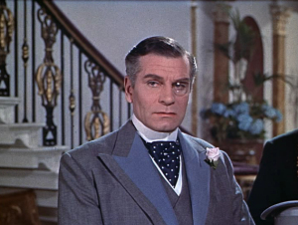
‘Impersonation’
King writes that, ‘the process of character representation through impersonation entails that the actor should strive to obliterate his or her identity in order to become a signifier for the intentionality inscribed in the character’ (King, 1991: 170).
The minute the actor begins to assert his or her own identity as an individual (e.g., as a star or public personality) the original authorship (and authority) of the writer is undermined.
King notes that, ‘the actor as a private individual is already constituted as a sign within the host culture, in so far as his or her behavioural and physical attributes have been read and will be read as cues to personality’ (1991: 170).

Slide 20
‘Personification’
Many actors are cast according to the correspondence of their own personality (behavioural and physical, i.e. appearance) and that of the character they are required to play.
King uses the term ‘personification’ to designate the opposite of impersonation.
With personification the actor’s public identity is not subsumed within their character but rather remains on full display, with the character overshadowed by the vividness (and dominance) of the actor’s star persona.
‘the actor becomes the most rudimentary form of the sign’ and the ‘actor is the person’ (King, 1991: 176).

Slide 21
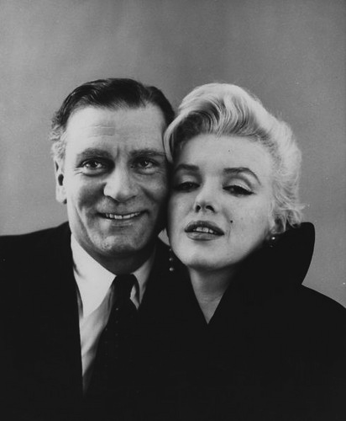
A marketable persona
King writes that, ‘actors become committed in their on- and off-screen life to personification in the hope that by stabilising the relationship between person and image on screen they may seem to be the proprietors of a marketable persona’ (1991: 176).
King notes that, ‘the bargaining power of the actor, or more emphatically, the star, is materially affected by the degree of his or her reliance on the apparatus (the image), as opposed to the self-located resources (the person) in the construction of persona’ (1991: 178).

Slide 22
The labour market for actors
Historically the film industry has maintained an oversupply of actors that keeps the average earnings of film actors low.
King observes that, ‘of those actors who do find work, there is a marked disparity between the earnings of leading players and stars, who are able to negotiate personal contracts and the majority of actors who earn at or slightly above the basic rate set by collective agreements’ (1991: 178)
Star actors can earn sometimes a hundred times more than non-stars.

Slide 23
Unique attributes
‘In film, the construction of a personal monopoly rests on shifting the emphasis in performance towards personification’ (King, 1991: 178).
‘actors seeking to obtain stardom will begin to conduct themselves in public as though there is an unmediated existential connection between their person and their image’ (ibid.).
The person becomes a character, ‘one that transcends placement or containment in a particular narrative’ (1991: 179)
For example, stars perform their public persona in TV and press interviews, public appearances, etc.

Slide 24
Actors in competition
‘For actors of limited or average ability, investing their energies in the cultivation of a persona represents something within their control and a means of competing with actors who have ability in impersonation’ (1991: 179).
King argues that, ‘in the studio system impersonatory skills were assigned a lower value compared to the cultivation of personae’ (ibid.).

Slide 25
Character actors & Counterstars
‘alongside the star system … one finds the operation of a hierarchy of character actors, whose professional reputation, length of careers and durability of earnings may outpace that of more transitory stars’ (1991: 179).
‘counterstars’ are those ‘whose claims to eminence rest squarely on their impersonatory skills and character playing’ (ibid.).

Slide 26
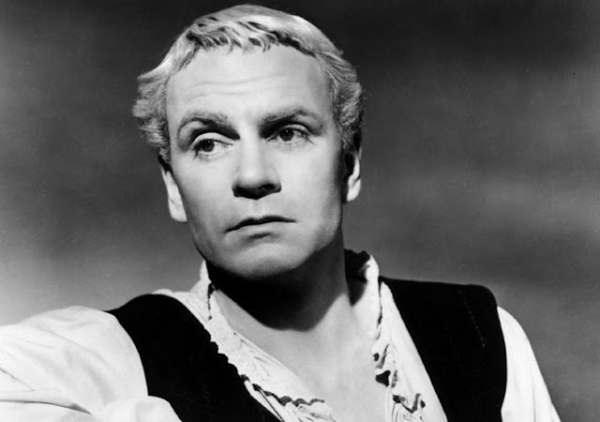
Lawrence Olivier: Counterstar
Lawrence Olivier was a theatre producer, film star and a movie director.
Born in Surrey in 1907.
1924: studied at the Central School of Speech and Drama in London
1926: joined the Birmingham Repertory Company.
1927: he played Hamlet and Macbeth
1930: Noel Coward’s Private Lives, and Romeo and Juliet, (playing Romeo and Mercutio on alternative nights).
1930: film debut in a short called Too Many Crooks (George King, 1930).

Slide 27
Lawrence Olivier: ‘36-9
1936: starred opposite Elizabeth Bergner in Shakespeare’s As You Like It (Paul Czinner).
1937: break-through film role in Fire Over England (Wm. K. Howard, 1937), with Flora Robson and Vivien Leigh.
1937: joined the Old Vic theatre company in London and appeared in Henry V, Coriolanus and Twelfth Night.
1937: starred with Merle Oberon in The Divorce of Lady X (Tim Whelan).
1939: starred on Broadway with Katherine Cornell in No Time for Comedy.
1939: starred as Heathcliff opposite Merle Oberon as Cathy in Wuthering Heights (Wm. Wyler). Nominated for Academy Award for Best Actor in a Leading Role.

Slide 28
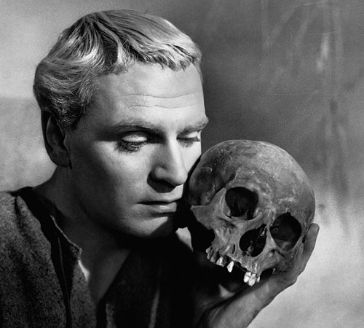
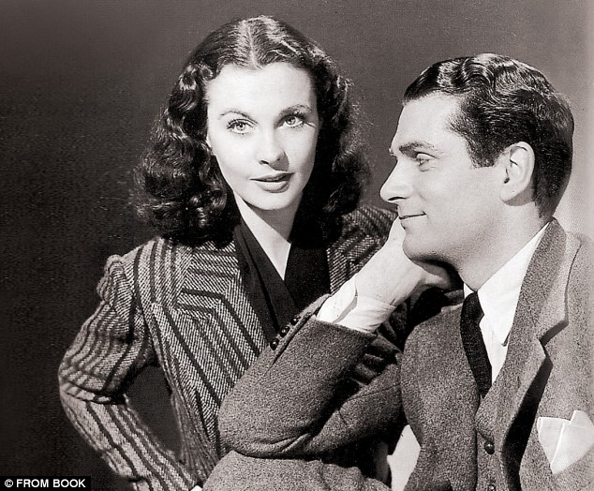
Lawrence Olivier: ‘40-48
Rebecca (Alfred Hitchcock, 1940), with Joan Fontaine. Nominated again for the Best Actor Oscar.
Pride and Prejudice (Robert Z. Leonard, 1940), with Greer Garson.
Lawrence Olivier and Vivien Leigh married in 1940.
That Hamilton Woman (Alexander Korda, 1941), with Vivien Leigh.
1944: starred in and directed Henry V. Won a special Oscar for Outstanding Achievement as Actor, Producer and Director.
1947: he was knighted.
1948: starred and directed Hamlet. Won Oscars for Best Picture, Best Actor in a Leading Role and was nominated for Best Director.

Slide 29
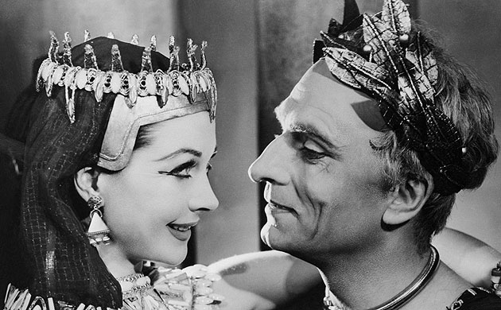
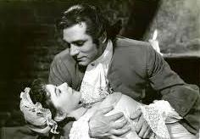
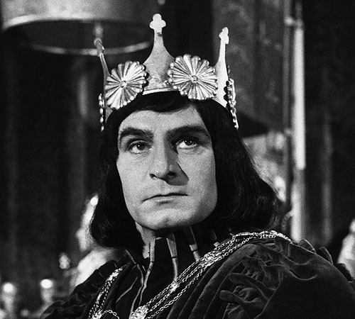
Lawrence Olivier: ‘51-57
1951: on stage in Shakespeare’s Anthony and Cleopatra and G.B. Shaw’s Caesar and Cleopatra.
1953: The Beggar’s Opera (Peter Brooks).
1955: starred in and directed Richard III. Nominated for an Oscar for Best Actor in a Leading Role.
1957: starred in and directed Terence Rattigan’s play ‘The Sleeping Prince,’ which became The Prince and the Showgirl.

Slide 30
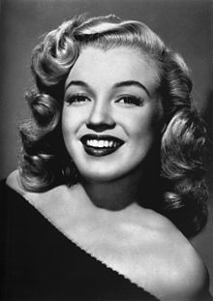
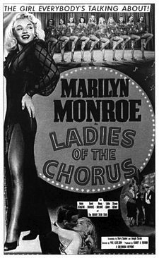
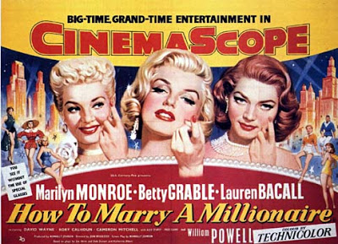
Marilyn Monroe: Movie Star
Born Norma Jean Mortenson in Los Angeles in 1926.
1946: working as a ‘pin-up’ model.
Took literature courses as UCLA.
1948: contract with Columbia Studios, cast in Ladies of Chorus (Phil Karlson).
1950, Joseph L. Mankiewicz cast her in small roles in The Asphalt Jungle and All About Eve.
1950: seven year contract with 20th Century-Fox.
1953: leading roles in Niagara (Henry Hathaway), Gentlemen Prefer Blondes (Howard Hawks) and How to Marry a Millionaire (Jean Negulesco).

Slide 31
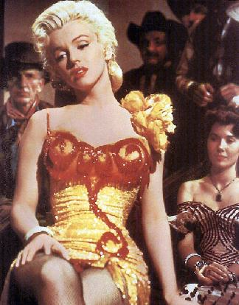
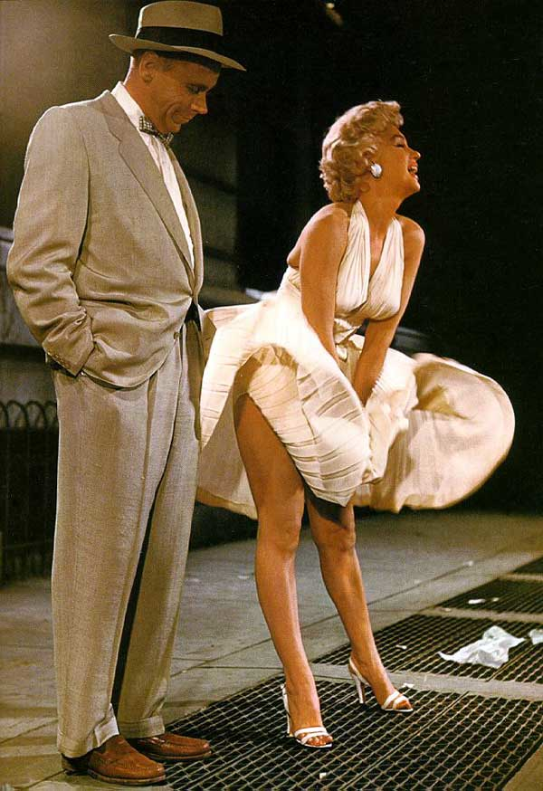
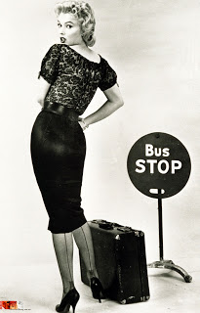
Marilyn Monroe: ’54-57
1954, starred in the western River of No Return (Otto Preminger).
1955, The Seven Year Itch (Billy Wider, 1955). BAFTA nomination her for Best Foreign Actress.
1955: began acting classes with Lee Strasberg at the Actor’s Studio in New York.
1956, Bus Stop (Joshua Logan). Nominated for a Golden Globe award for Best Motion Picture Actress in a Comedy/Musical.
1956, married playwright Arthur Miller.
1957, hired to play Elsie opposite Sir Lawrence Olivier in Terence Rattigan’s ‘The Sleeping Prince’.

Slide 32
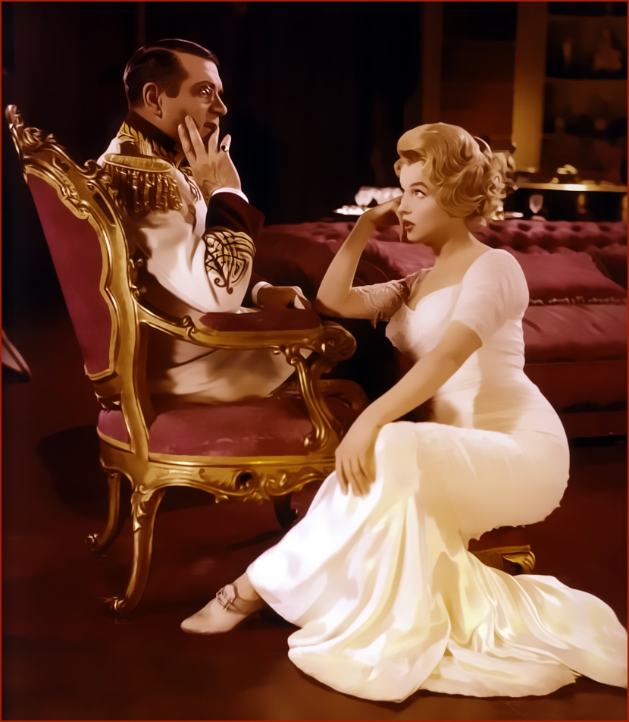
The Counterstar and the Movie star
The Prince and the Showgirl (Lawrence Olivier, 1957).
BAFTA nominations for:
Best British Actor (Olivier)
Best British Film
Best British Screenplay (Rattigan)
Best Film from any source
Best Foreign Actress (Monroe)

Slide 33
About to break
Any questions?

