Slide 1
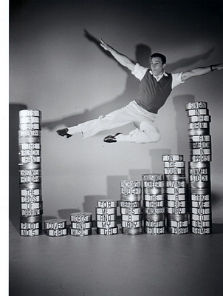
Stars Studies Theory, Part 2b:
Historicising Hollywood’s Industrial System of Stardom

Slide 2
Introduction
This the second part of this lecture we will be looking at the contributions that Barry King and Paul McDonald have made to the development of a more historicized and industry-focused approach to Star Studies

Slide 3
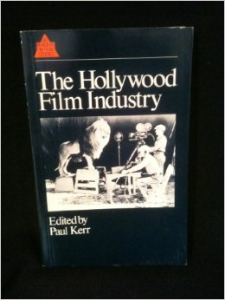
‘Stardom as an Occupation’
Barry King’s essay ‘Stardom as an Occupation’(also drawn from his PhD thesis) was included in Paul Kerr’s book The Hollywood Film Industry (1986).
Stars as industry selected and manufactured rather than audience created.

Slide 4
A predetermined list of contenders
‘… it is entirely consistent with industrial survival and predominance that the public influence over film production should be restricted to the selection of stars from a predetermined list of contenders’ (King, 1986: 157).
King envisaged ‘film acting and stardom as different activities within one profession, or strictly stardom is a specialization based on film acting’ (ibid.).

Slide 5
Acting as a service, work and skill
‘For our purposes we can note that acting is that form of work in which the relation between self and role becomes a consciously studied process and that such a study depends on maintaining the distinction between self and character’ (King, 1986: 158).

Slide 6
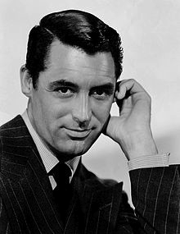
Star actors are different
‘What is particular about the star is that he or she is not so much an actor in the sense defined above but a self or personality that behaves. To say that a star behaves does not mean that they are themselves, but rather that stars do not, as it were, surrender their public personality to the demands of characterization’ (King, 1986: 160).
He adds that, ‘stars do not function as actors. This does not mean necessarily that a given star cannot act, but that acting is not essential to stardom’ (160).

Slide 7
Personality rather than character
‘Professional judgment regards character actors as representing the peak of the skill hierarchy; whereas stars are at the peak, albeit short term on average, of the reward hierarchy’ (King, 1986: 160).

Slide 8
In Singin’ in the Rain (1952)
The stars in the film are Lina Lamont (Jean Hagen) and Dan Lockwood (Gene Kelly) but neither is a great actor.
The stars of the film are Gene Kelly, Donald O’Connor and Debbie Reynolds. The film showcases their talents as dancers and singers.
The only actor nominated for an Oscar was Jean Hagen (Best Actress in a Supporting Role)

Slide 9
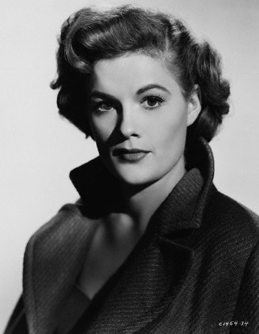
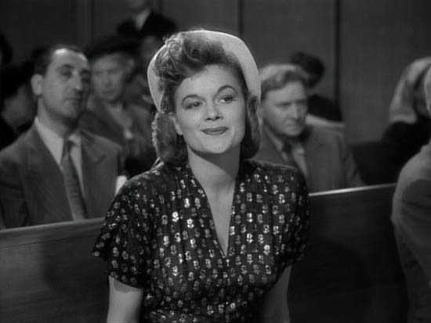
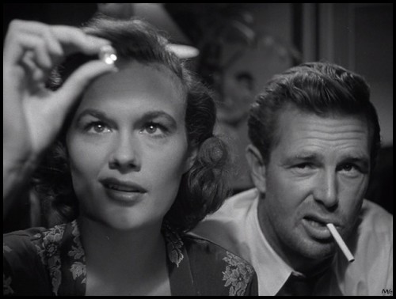
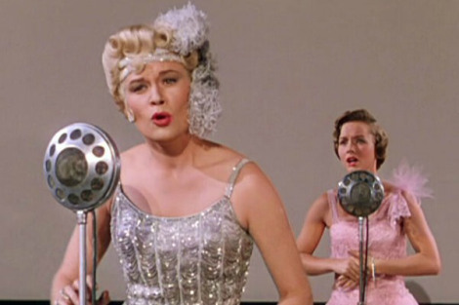
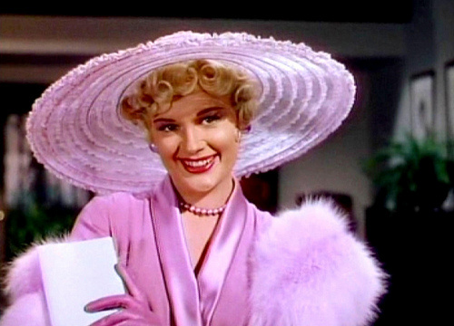
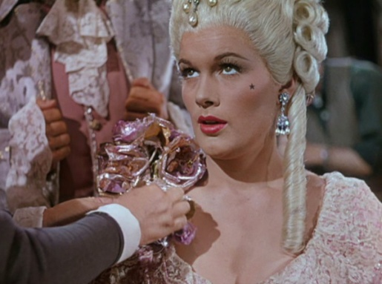
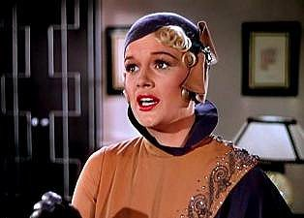
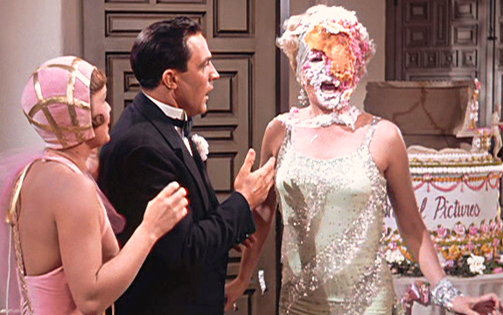
Jean Hagen
Jean Hagen plays Lina Lamont.
After studying drama at Northestern University (Boston), Hagen made her film debut in Adam’s Rib (George Cukor, 1949) and supported Marilyn Monroe and Sterling Hayden in The Asphalt Jungle (John Huston, 1950).

Slide 10
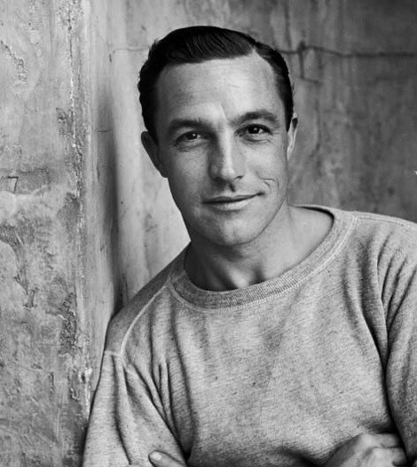
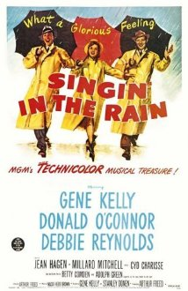
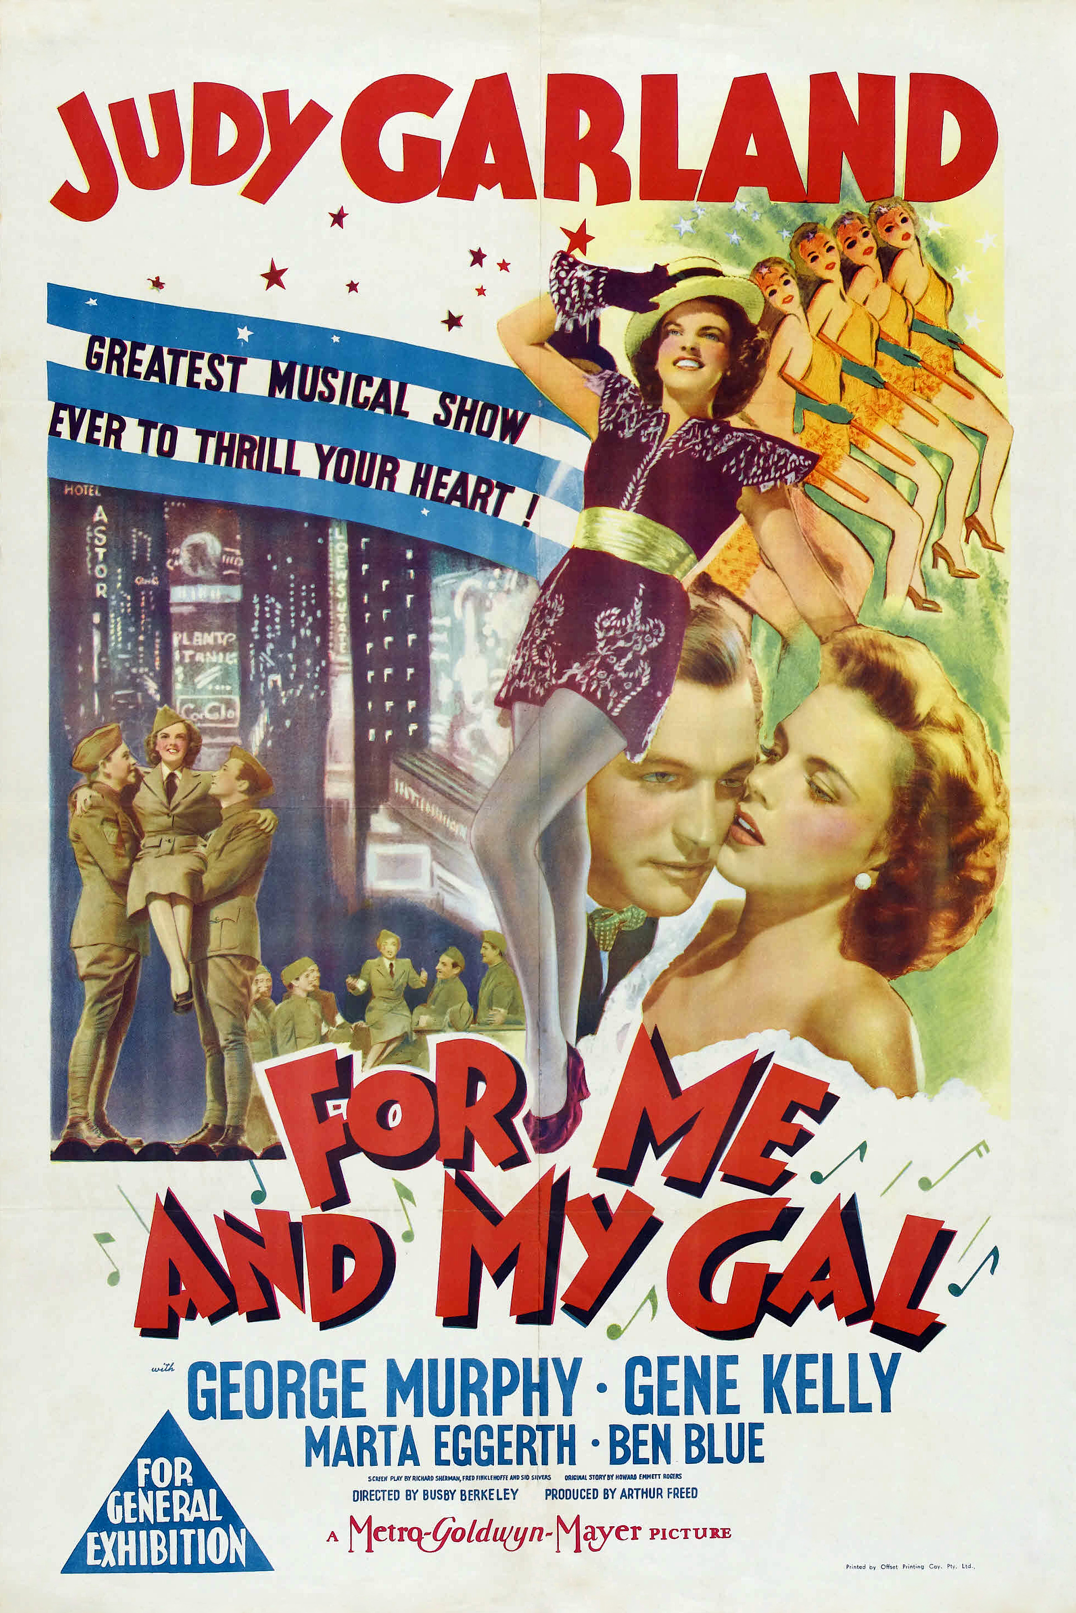
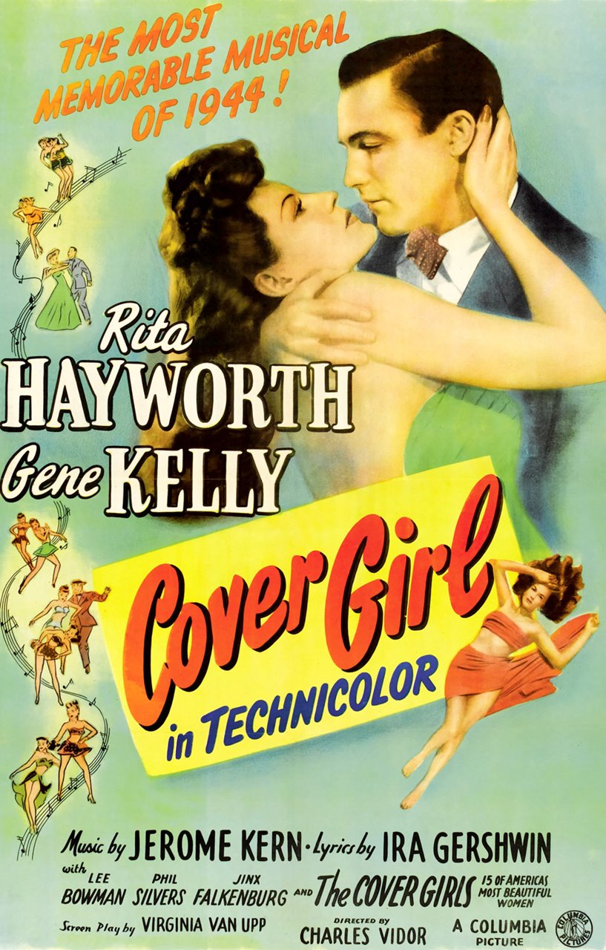
Gene Kelly
Gene Kelly co-directed Singin’ in the Rain with choreographer Stanley Donen (1952).
Gene Kelly was hired by MGM in 1941 after a career as dance teacher and dancer on Broadway (e.g., Pal Joey, 1940).
Film debut in Judy Garland’s For Me and My Girl (Busby Berkeley, 1942)
Supported Rita Hayworth in Cover Girl (Charles Vidor, 1944)

Slide 11
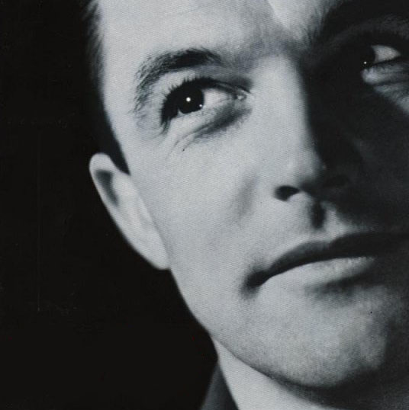
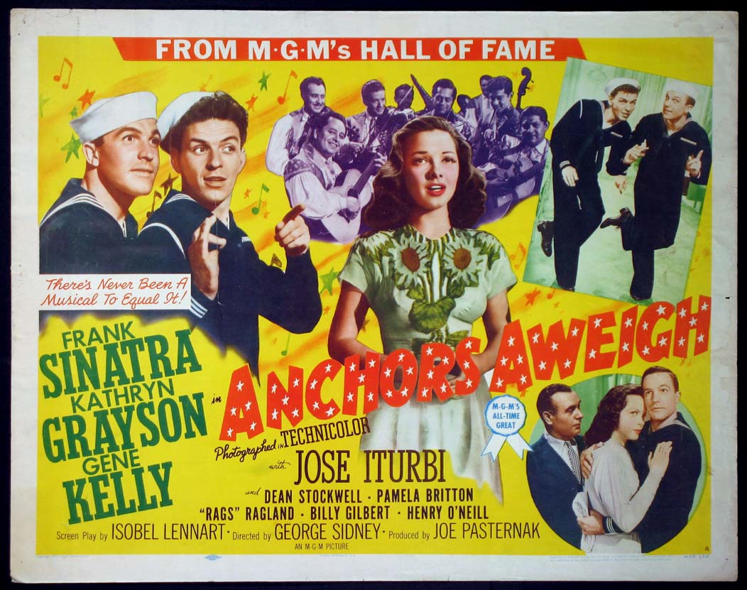
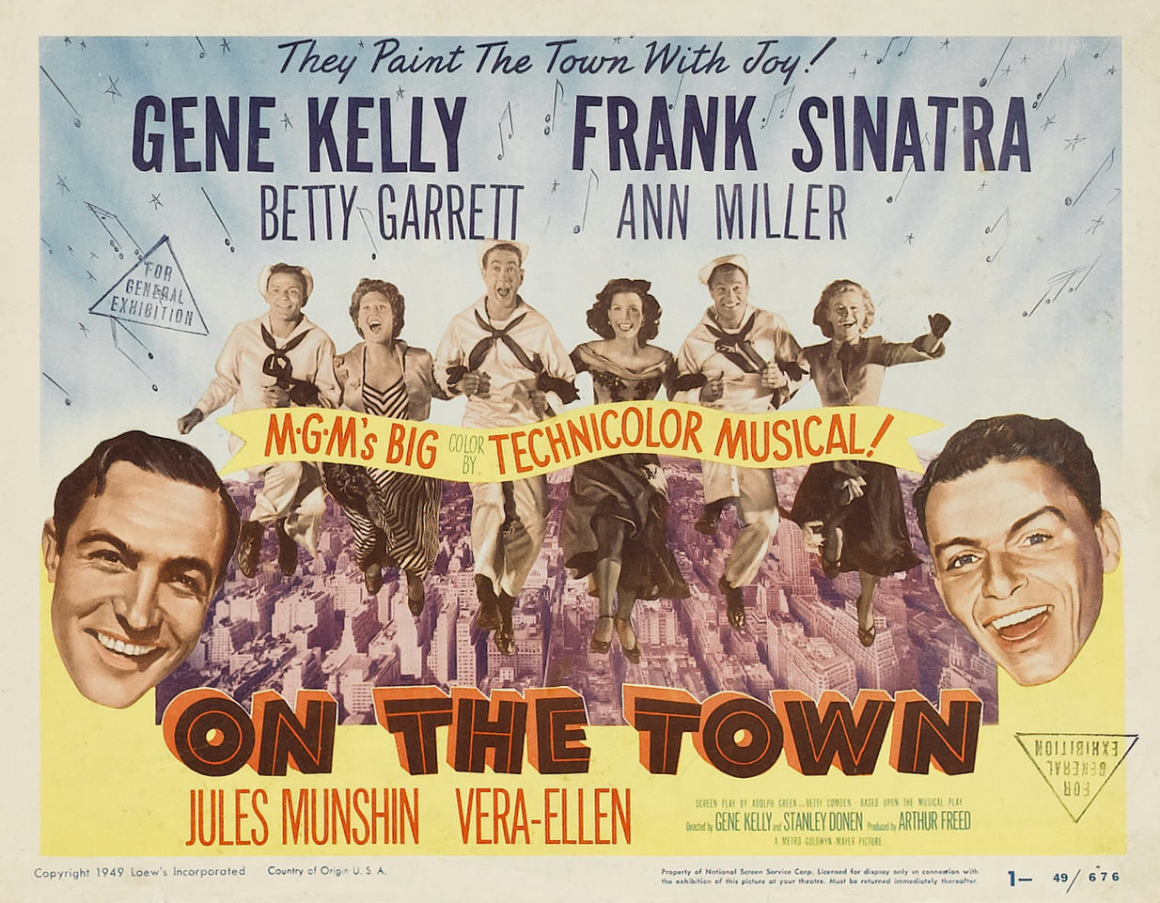
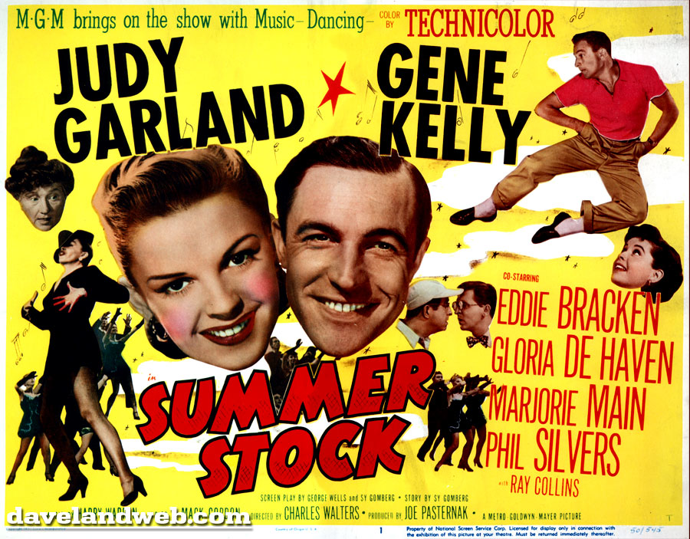
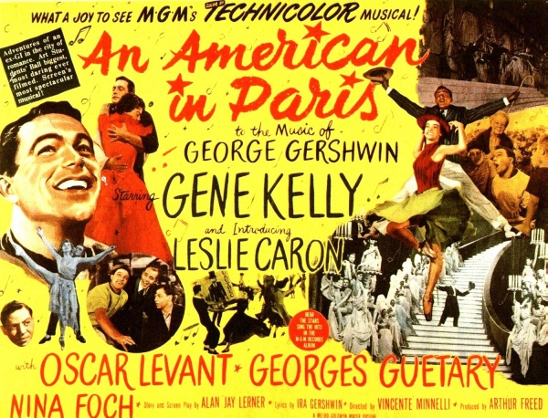
Gene Kelly Musicals
Nominated for Oscar for his leading role in Anchors Aweigh (George Sidney, 1945) with Frank Sinatra.
Co-starred with Judy Garland in The Pirate (Vincente Minnelli, 1948)
Co-directed and starred in On the Town (with Stanley Donen, 1949) with Sinatra.
Co-starred again with Judy Garland in Summer Stock (Charles Waters, 1950)
Starred in An American in Paris (Minnelli) with newcomer Leslie Caron, which won 6 Oscars. Kelly nominated for a Golden Globe.

Slide 12
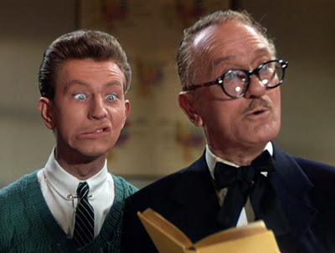
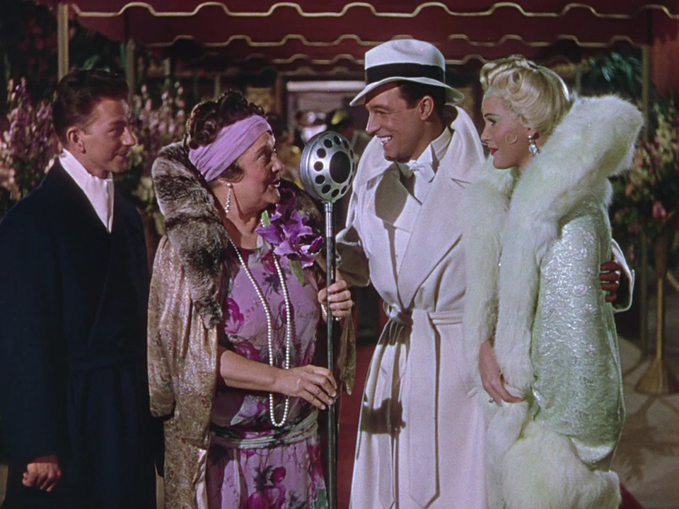
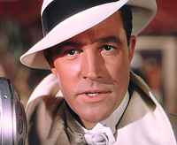
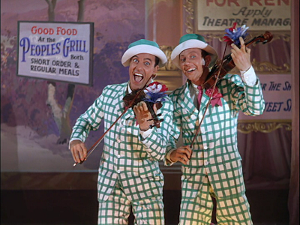
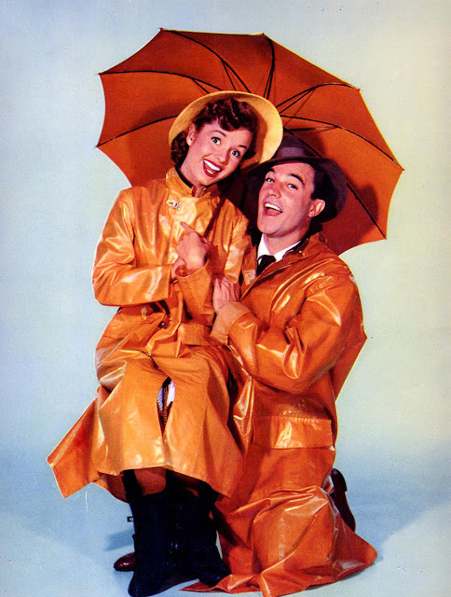
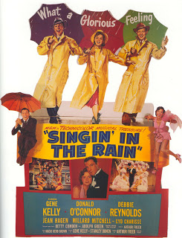
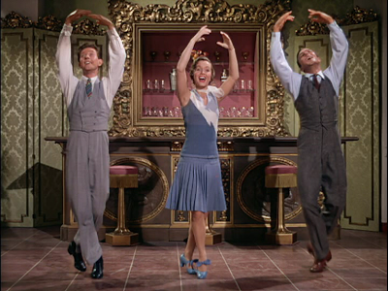
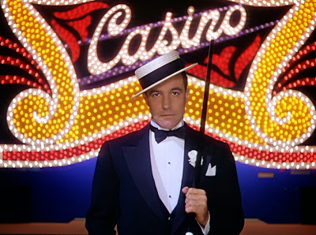
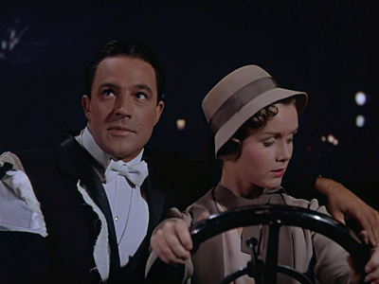
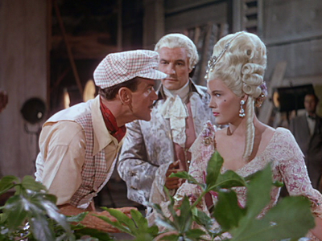
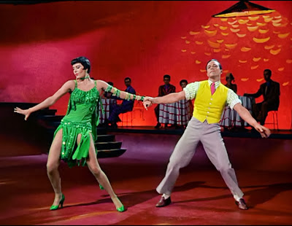
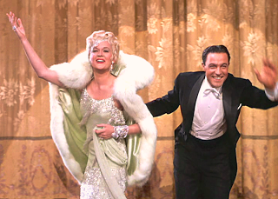
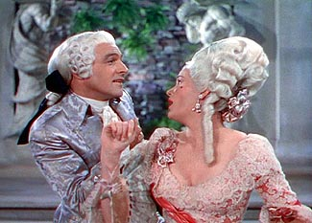
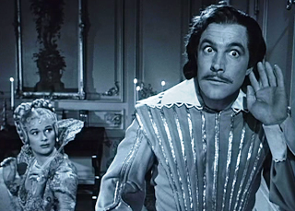
A Star Vehicle for Gene Kelly

Slide 13
Unlike other actors
‘to the extent that the star is, unlike other actors, the bearer of a meaning that transcends the plotted meaning, then the star can function as a marker of a quality – a meta-meaning – that survives particular embodiments. In other words, the star can circulate without necessarily losing their quality of being a distinct property’ (Barry King, ‘Stardom as an Occupation,’ 1986: 166).

Slide 14
The Elastic Self
Barry King, ‘Embodying the Elastic Self: The Parametrics of Contemporary Stardom,’ in Thomas Austin and Martin Barker (eds.) Contemporary Hollywood Stardom (2003).
Here King notes that in contemporary Hollywood, stars construct multiple and ever-changing identities, rendering them indeterminate and essentially performative thereby enabling their fans to interpret, understand and/or use them according to their own desires and concerns (2003: 45).

Slide 15
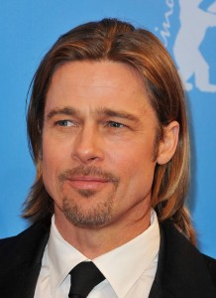
Today’s stars
‘today’s stars are discursively challenged in their efforts to meld all the practices undertaken in their name into a coherent commercial identity’ (King, 2003: 49).
Star’s identities are now manufactured and maintained by a series of specialists who undertake responsibility for various and distinct aspects of their public profile and engagement/interaction.
‘Stars now have a “wardrobe of identities” connected to a product stream’ (ibid.).

Slide 16
Stars as stakeholders
Stars are now no longer employees of the studios but rather ‘stakeholders in the enterprise that manages their career’ (King, 2003: 49).
‘Yet, the star as entrepreneur must be ready to switch roles as business opportunities arise’ (ibid.).
‘the globalisation of the market for the star’s services exacerbates this process, because claims of existential commitment multiply as films and product open in different markets and address cultural constituencies’ (ibid.).

Slide 17
‘Autographic’ stardom
King notes the constant re-writing of star personae as former identities are maintained in some roles and films alongside newly invented ones (King, 2003: 52)
Thus, ‘Stars today seem permanently resettling the terms of their representation, and this equivocation becomes their story’ (ibid.).
‘Autographic’ (i.e., self-writing).

Slide 18
No longer just polysemic
Stars are no longer there to be read by audiences differently (i.e. polysemic, as Dyer described them) but rather they produce themselves differently in order to be read differently, therefore playing a much more fundamental role in the process of interpretation (aided in this by publicists, agents, managers, etc.) than studio era stars.
Operating in a fragmented, highly competitive, intensely scrutinized, highly commodified and global market, the new generation of successful entrepreneurial stars are forced to manage their personae by ‘stretching an apparent core of personal qualities to cover all contingencies, and rationalising every shift and change as an aspect of constancy’ (King, 2003: 60).

Slide 19
Elastic rather than plastic
‘… persona is elastic rather than plastic’ (2003, 60).
Barry King’s work on film stars and stardom represents a theoretical elaboration upon Richard Dyer’s work, one that embraces the economic dynamics of the film industry far more forcefully, while responding to contemporary changes in the film industry.

Slide 20
Historicising the Hollywood Star System
Paul McDonald, The Star System (2000).
This looks ‘at the place of the star in the changing shape of the Hollywood film industry’ (McDonald, 2000: 115).
He regards the star as a ‘phenomenon of production,’ ‘exploring the links between the star as image, labour and capital’ (ibid.).

Slide 21
Stars as capital
‘Stars are used by the film industry as a means to try and manage audience demand for films. Distributors use the presence of stars to sell films to exhibitors in domestic and overseas markets. Exhibitors, who own and run the theatres showing films, are attracted to films with stars because it is believed the presence of stars help to draw audiences to films. In this circuit of commercial exchange, the star therefore becomes a form of capital, that is to say a form of asset deployed with the intention of gaining advantage in the entertainment market and making profits’ (McDonald, 2000: 5).

Slide 22
Stars are labour and capital
‘In the Hollywood industry, stars are placed in the structure of specialized and hierarchically organized relationships with other categories of labour. Unlike other performers, stars have greater power in the industry because of their dual capacity as labour and capital’ (ibid.).
Other actors (non-stars) are labour but not capital.

Slide 23
Star contracts
‘The star becomes a form of capital inasmuch as his or her image can be used to create advantage in the market for films and secure profits. Because the image is not the person but rather a set of texts and meanings that signify the person, then the image is something separable from the star. Star contracts cover both the labour of the star but also the product of the labour, the image. Contracts set out the ownership and control of the image, defining who has the right to use the image, or parts of the image, and in what contexts. The images of stars are therefore legal entities’ (McDonald, 2000: 14).

Slide 24
In The Star System
McDonald examines ‘the general structural trends that have defined particular phases in the organization of the star system, looking at the conditions in which the system emerged, how the studios controlled the ownership of star images, and the power of the star in contemporary Hollywood’ (McDonald, 2000: 115).

Slide 25
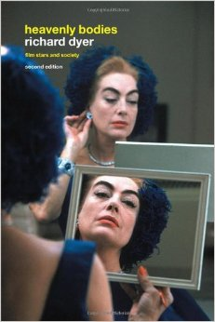
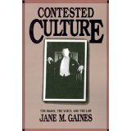
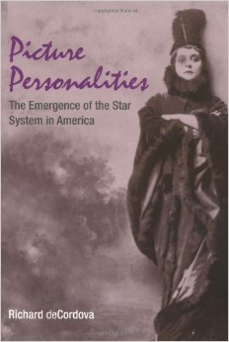
McDonald’s key sources
Richard Dyer’s Stars (1979) and Heavenly Bodies (1986)
Richard de Cordova’s Picture Personalities (1990)
Jane Gaines’ Contested Cultures (1992)
Danae Clark’s Negotiating Hollywood (1995)

Slide 26
Filling the gaps
‘Where the greatest gaps in research seem to exist at the moment is on the star system in the second half of the twentieth century. There is a lack of historical research on what happened to the Hollywood star system after the breakdown of the vertically integrated studios’ (McDonald, 2000: 116).
‘In the absence of such research, it is not clear, for example, what differences may have existed in the organization of the star system between the 1960s and 1970s, and how those periods compare to Hollywood stardom in the 1990s’ (2000: 117).

Slide 27
Picture Personalities (1990)
Richard deCordova’s Picture Personalities (1990) revealed that stars began to emerge in the American film industry as early as 1907 as a result of practices inaugurated by both trust and independent companies. However, it was not until 1909 that film actors were named in the American film trade press and other publications. By 1911, numerous American film companies were producing articles to accompany their films that promoted their leading players. And by 1913, the details of the actors’ off-screen lives began to emerge in this literature, so that some film performers began to gain public identities independent from their picture personalities or film roles, constructing a ‘private’ life for these players.

Slide 28
Actors, personalites and stars
Paul McDonald suggests that de Cordova’s work, “not only provides an early history of the star system in American cinema but also identifies levels of knowledge relevant to reading and understanding star images at all stages of cinema history” (2000: 38).
‘From de Cordova’s study, a general definition emerges of the star’ as actor, as picture personality and as star, the discourses of actor, personality and star operating as levels of knowledge, each one implying a deeper level of knowledge being exposed in order for the performer to achieve higher levels of stardom (2000: 39).

Slide 29
Periodisation
McDonald divides Hollywood up into three distinct phases:
Phase 1, the pre-studio era, 1907-1919;
Phase 2, the studio era, 1920-1959
Phase 3, the post-studio era, 1960-99.
McDonald argues that three factors were necessary for the development of the star system in American cinema:
(1) the industrial organization of film-making, involving mass produced and a detailed division of labour
(2) the narrative film and the use of close-ups and editing techniques such as shot/reverse shot for the purposes of dramatic storytelling, creating closer links between spectators and performers
(3) the circulation of information about the identities of the screen performers.

Slide 30
Consolidation
McDonald observes that all of these conditions were in place by 1913 but that the consolidation of the star system occurred during the 1930s-40s, operating under the general direction of the five major studios: Paramount, Warner Bros., the Fox Film Corporation (Twentieth Century Fox after 1935), Radio Keith-Orpheum (RKO) and Metro Goldwyn Mayer (MGM).
‘The studio era of the 1930s and 1940s was a period in which Hollywood worked actively to make and market its stars. Stars became a vital asset in maintaining the hegemony of the major studios over the whole domestic film industry, with the effect that control of the film market required the strong control of its stars’ (McDonald, 2000: 40).

Slide 31
Star power
‘While powerful figures in the economics of the studio system, the professional freedom of stars was contained by contractual conditions under which they were employed by the studios. The term contract defined the relationship between the star and the studio in ways that served the economic interests of the studios first and foremost. For the duration of the contact, producers and studio executives were able to manipulate the career of the star’ (McDonald, 2000: 70).

Slide 32
Stars in the post-studio era
The ‘package-unit’ system was introduced after 1960. Here, the ‘package’ consisted of a producer, a director and usually a writer and one, two or several stars.
McDonald’s interest in this signaled not only an increasing turn towards history in star studies but also to the appreciation of the role of key workers in the industry of stardom such as talent agents, managers, publicists and lawyers that are part of the star systems infrastructure.

Slide 33
Conclusion
In my next two lectures, I shall be exploring the history of stardom in more detail and considering the changing roles of these professionals.
I shall also be looking at the contractual arrangements that bind stars to studio and take responsibility for their careers, their images and orchestrate their relationship with their fans.
In the process, I shall be returning to the research of many of the star scholars that I have discussed so far, including Edgar Morin, Richard Dyer, Jackie Stacey, Ginette Vincendeau, Barry King and Paul McDonald.

Slide 34
Any questions?

