Slide 1
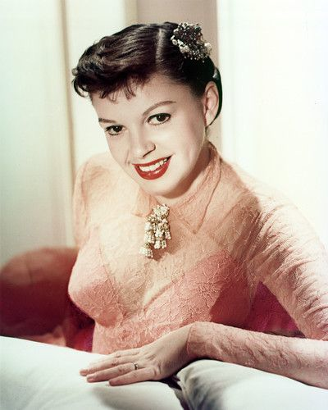
A History of Film Stardom, Part 1:
The Studio Era, 1920-60

Slide 2
Introduction
This lecture is about the economics and business practices of stardom and the ways in which stars operated within the industrial context of film production, distribution and exhibition between 1920 and 1960: that is, as workers, commodities and capital.
It sets out some of the main characteristics of the Hollywood star system, noting how stars have functioned in the studio era.
This includes the terms and conditions of the contracts between stars and studios.
It is also about casting practices (particularly typecasting) and the use of star vehicles as a means of stabilizing demand for film among movie-goers.

Slide 3
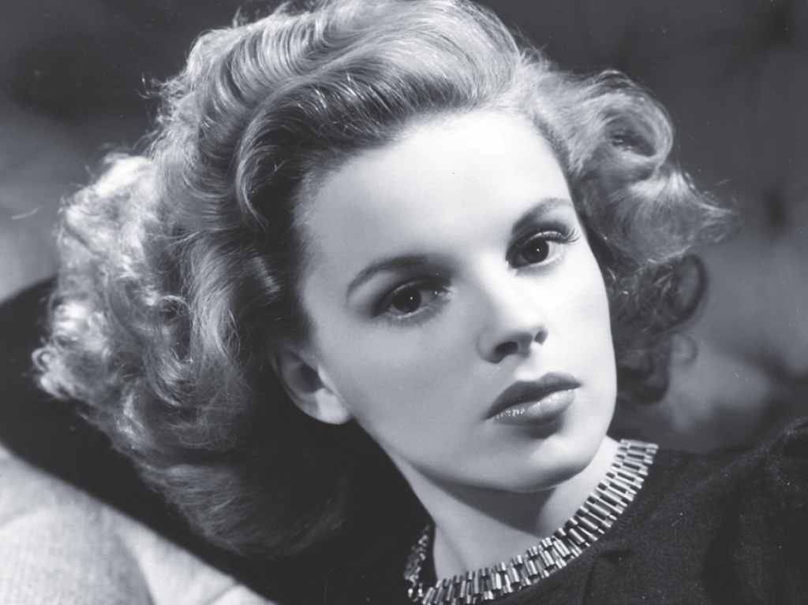
Under Contract
Between 1920 and 1960, most Hollywood stars were under contract to a particular studio.
MGM: Greta Garbo, Judy Garland and Gene Kelly.
Warner Brothers: Bette Davis, Humphrey Bogart and James Dean.
In order to retain control and ownership of their talent, studios employed stars on contracts that could last for seven years, with an annual or biannual option to release the star if they were no longer viable.

Slide 4
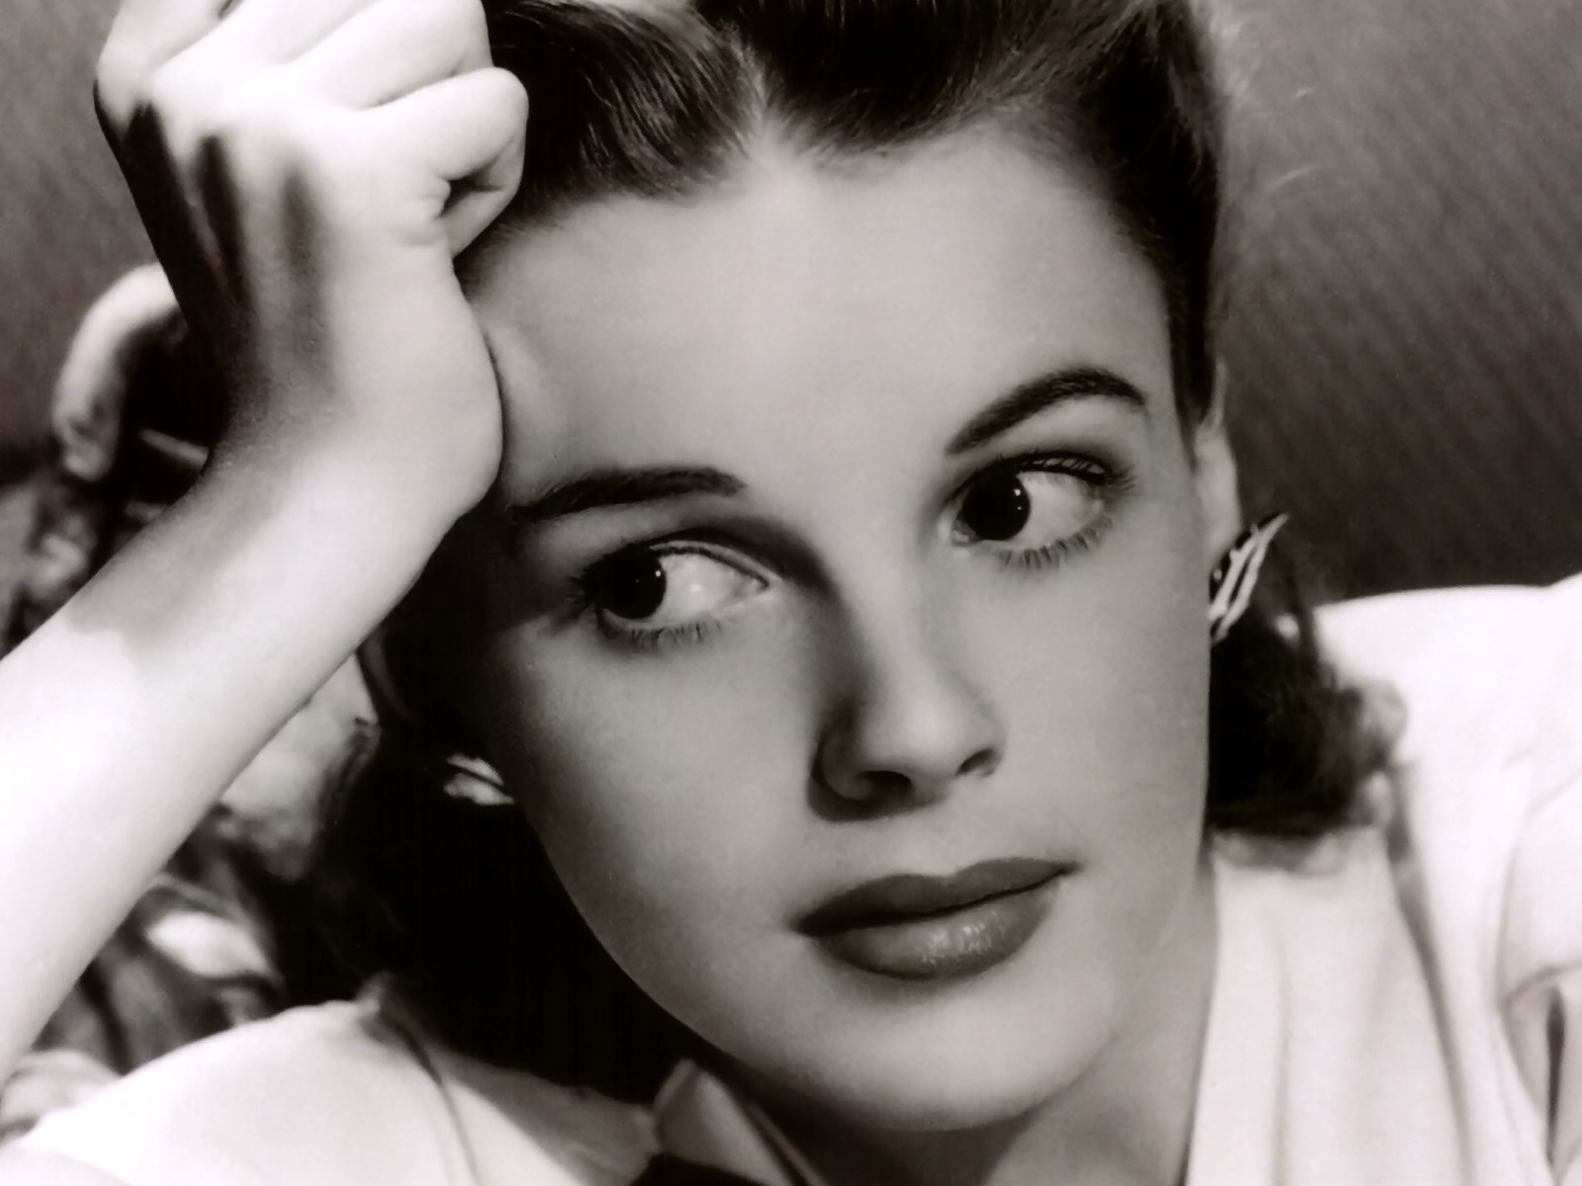
‘Performance specialists’
Within the detailed division of labour that was a defining characteristic of the studio system (c. 1920-60) stars were ‘categorized as performance specialists’, who assumed a range of tasks, including reading scripts and learning lines, rehearsal, shooting scenes (repeating takes when required), dubbing or post-synchronization and promotional activities (Paul McDonald, The Star System, 2000: 9).
Stars functioned like any other actor but with additional responsibilities in terms of promotion and generating publicity (McDonald 2000: 10).

Slide 5
The Hollywood Star System
How it worked:
talent scouts searched for new stars in the theatres and night-clubs of major cities.
They then recruited performers from vaudeville, burlesque, theatre and radio during the 1930s-50s.
Following a successful screen test, many performers were placed under exclusive long-term contracts with the studio.

Slide 6
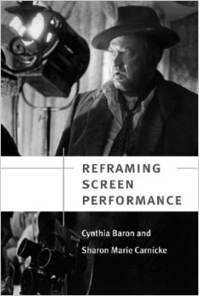
Contract players
Once signed, a ‘contract player’ would receive a weekly wage and undergo an intensive apprenticeship, including tuition from the studio’s speech and diction coaches, along with acting classes with the drama coach.
Acting teachers taught actors to use the script as a blueprint for building characterization, while preparation was required to ‘integrate directorial suggestions and interact effectively with other actors’ (Cynthia Baron & Sharon Marie Carnicke, Reframing Screen Performance, 2008: 27).

Slide 7
Actor training
The peculiar method of mainstream commercial filmmaking made actor ‘training, experience, and more independent preparation’ essential (Baron and Carnicke, 2008: 236).
With limited time for rehearsal and with scenes being shot out of sequence, actors needed to arrive on set prepared, understanding how each scene fits into both the story and their character’s development.

Slide 8
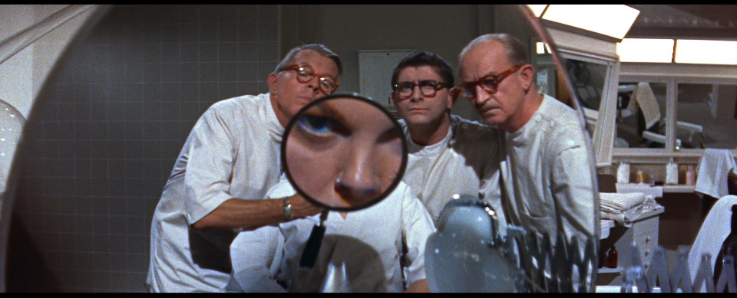
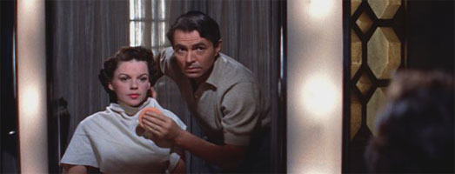
The Hollywood Make-over
Besides acting, other lessons included singing and dancing, etiquette, movement, fencing, horse riding, swimming, boxing and languages (McDonald 2000: 44).
Stylists would be consulted about hair, make-up and fashion.
Hair was frequently restyled and dyed.
Occasionally electrolysis was used to change the shape of the actor’s hairline.
Eyebrows were also reshaped.
False eyelashes were fitted and teeth were capped and enameled.
Teeth might be removed to give greater definition to cheekbones
Surgery might realign noses or remove blemishes to the skin.

Slide 9
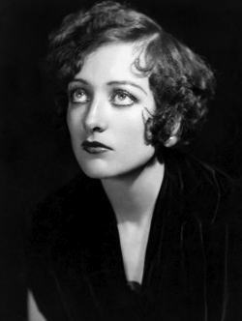
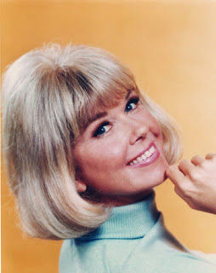
Re-naming
New recruits were often renamed to augment their glamorous new image.
Some stars were able to retain their names, especially if they suited their persona, had an attractive rhythm and were easy to pronounce and spell.
Most had to be adapted. Ruth Elizabeth Davis became Bette Davis and Lucille LeSueur became Joan Crawford.
Doris von Kappelhoff became Doris Day, which sounded more American and was better suited the actress’s sunny disposition.

Slide 10
The Hollywood star treatment
The Hollywood star treatment was ‘ruthless, impersonal, and universal’ (Robert S. Sennett, Hollywood Hoopla, 1998: 37)
After a name had been found, a biography was invented for the newcomer, who would then be escorted to parties, premieres and nightclubs by a studio publicist to generate media interest (Sennett 1998: 37).

Slide 11
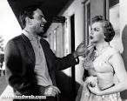
The Star Machine
The major Hollywood studios of the 1930-50s used a three-step process for developing new stars, known in the industry as ‘the build-up’ (Jeanine Basinger, The Star Machine, 2007: 45).
Stage 1: Contract players appeared in ‘bit parts’ and ‘walk-ons,’ small roles with minimal dialogue.
Success at this stage could lead to speaking parts if they were singled out for praise by reviewers or if they received fan mail.
All newcomers were subjected to intense scrutiny (e.g., by research companies hired by the studios to study and assess their performers’ popularity).

Slide 12
The build-up: Stage 2
Studio publicists produced fake biographies and studio portraits for the newcomers and ‘planted’ these in a range of publications.
Often this included female ‘cheesecake’ or male ‘beefcake’ images being put into circulation, featuring the starlets appearing scantily clad in beach wear, exposing their shapely figures (i.e., legs, waists, arms and shoulders).
Newcomers were then introduced to the editors of popular film magazines such as Photoplay, Modern Screen, Screenland, Movie Stories and Screen Album.
Interviews would be set up with reporters and gossip columnists; most notably, with Louella Parsons and Hedda Hopper, the gossip queens of Hollywood who could make or break a star’s reputation overnight.

Slide 13
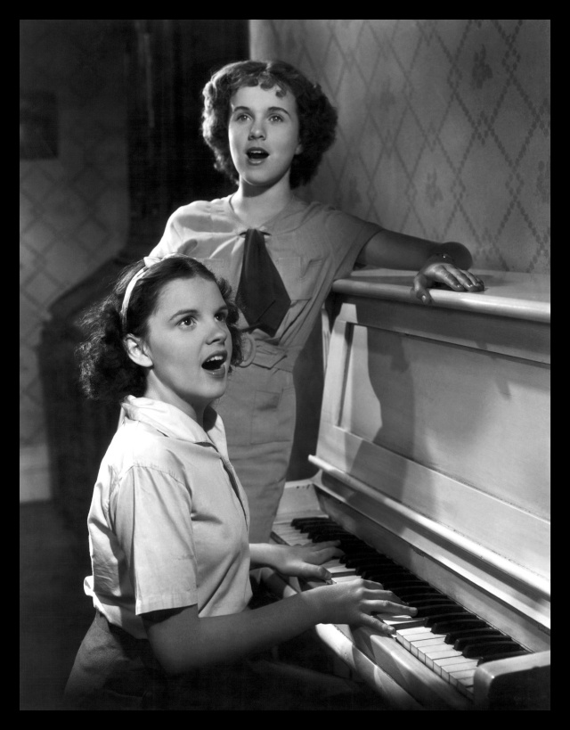
During Stage 2
In between all these photo-shoots and interviews, the newcomer would test out their newly acquired performance skills in leading roles opposite other newcomers or in supporting roles for more established stars.
If they received good reviews and proved popular with audiences at previews, they would graduate to the third and final stage of the star-making process.

Slide 14
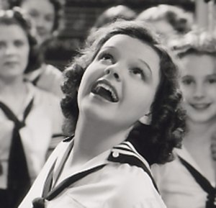
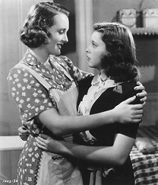
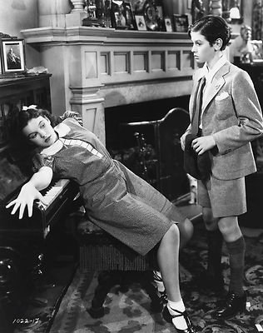
Stage 3
This consisted of being cast in leading roles in their own vehicles in an attempt to find the most appropriate ‘type’
This was a role that best suited the actor’s image and persona and which had the greatest appeal for audiences.
Jeanine Basinger notes that this final stage of the ‘build-up’ usually involved three types of film:
1. the actor gets noticed by audiences
2. their perfect type was discovered
3. the favoured role was repeated (Basinger, The Star Machine, 2007: 79).

Slide 15
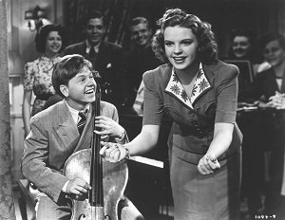
Typecasting
‘Every top-of-the-line movie star had to find a type that he or she could play over and over’ (Basinger 2007: 71).
Typecasting was the dominant practice in Hollywood from the silent to the sound era, and from the studio to post-studio era.

Slide 16
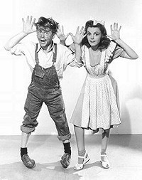
Factory efficiency
Despite actors’ resistance to being typecast, the practice remained central to the operations of the Hollywood studio system because it guaranteed factory efficiency and allowed studios to develop movies called ‘vehicles’ for their top stars (Basinger 2007: 100).

Slide 17
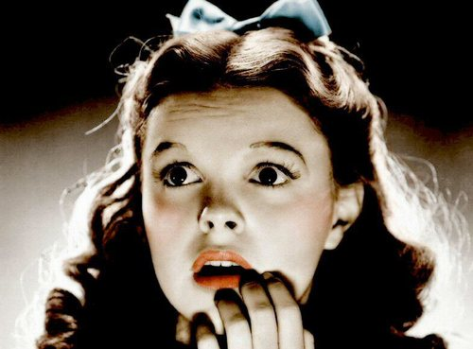
Vehicles
The Hollywood star vehicle emerged out of the studio system’s attempt to reduce the uncertainty of the market appeal for films.
After incurring all the costs of producing the film before its release, the studio needed a way to maximize the probability that audiences would be willing to pay to see it on its release at the cinema.
The star vehicle was a film designed to exploit the popularity of a particular performer by accommodating their established ‘type.’
This involved both reworking aspects of their previous work that had already proven popular with an audience while, at the same time, offering a new twist.

Slide 18
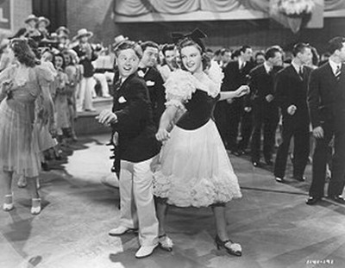
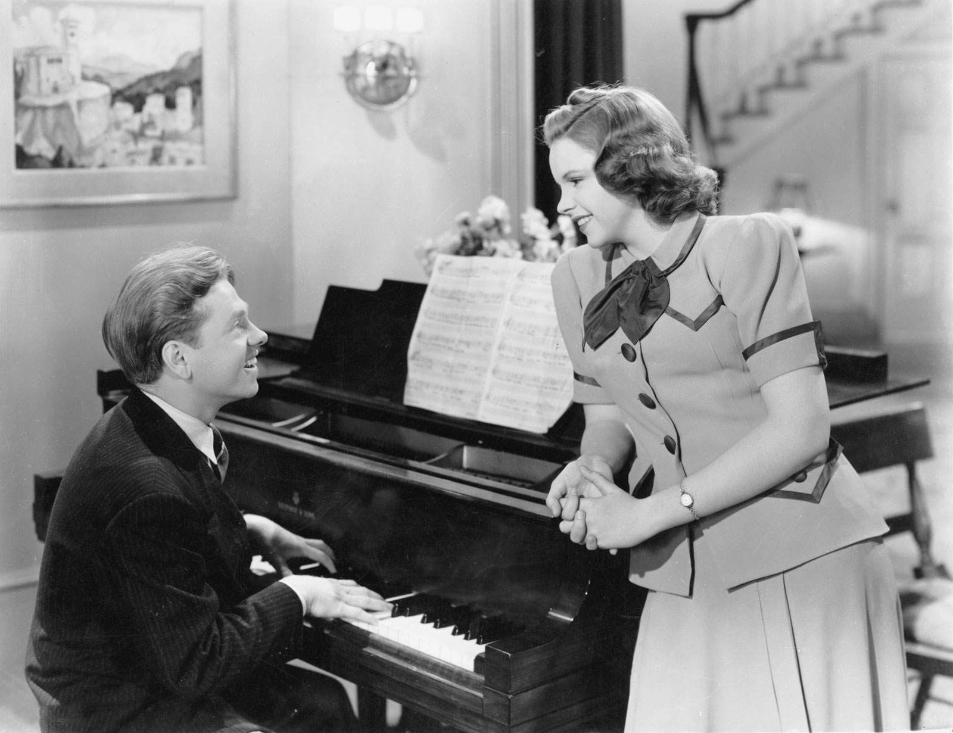
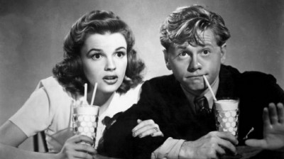
A string of films in quick succession
A studio’s production of several star vehicles a year inevitably led to the standardization of its products.
While this involved repeating the tried and tested means of delivering audience satisfaction, it always offered something new, something different.
Consistency was often achieved by having stars work within a specific genre, a limited range of genres or by devising star vehicles that incorporated aspects of two distinct genres (e.g., the screwball comedy and the crime thriller, or the western and the musical).

Slide 19
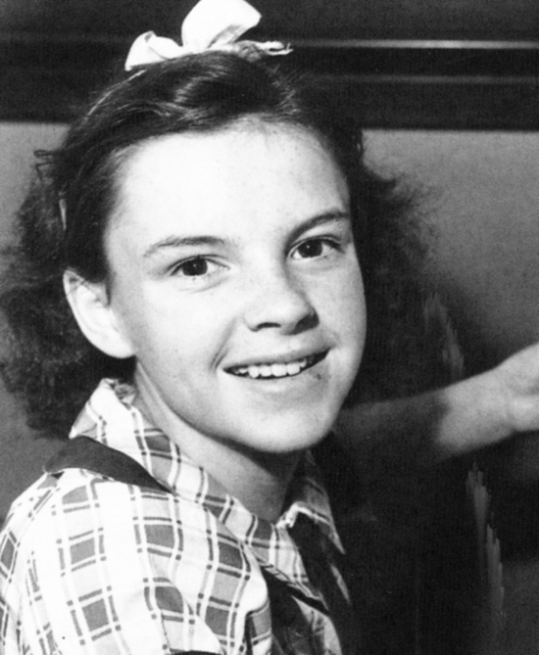
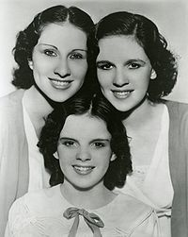
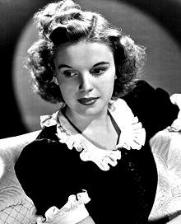
Frances Ethel Gumm
Born 1922 in Minnesota, the youngest child of Ethel and Frank Gumm, vaudeville performers.
1924, she appeared on stage at age 2, with sisters Suzy (Mary Jane) and Jimmie (Dorothy Virginia). The Gumm Sisters performed on stage together until 1934. In 1934, they changed their name to The Garland Sisters.
In 1935, Judy Garland became a contract player at MGM.
Her teeth were capped and she wore a rubber nose.
Every Sunday (Felix E. Feist, 1936) musical comedy short with Deanna Durbin.
Broadway Melody (Roy del Ruth, 1938), performed 4 songs.

Slide 20
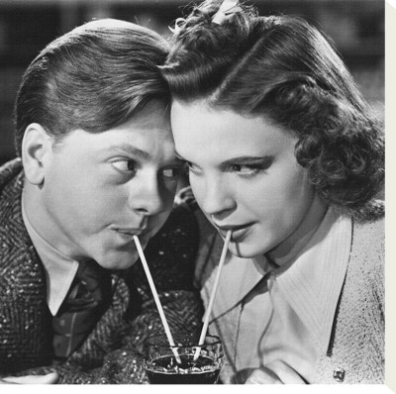
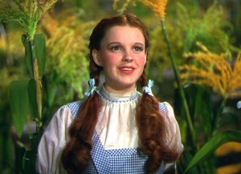
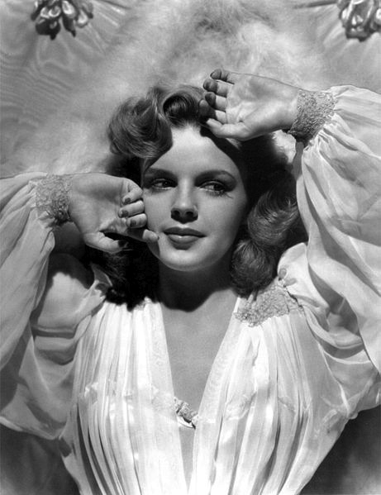
Mickey Rooney & Judy Garland
Teamed up with Mickey Rooney on Andy Hardy series of films: Love Finds Andy Hardy (1938), Andy Hardy Meets Debutante (1940) and Life Begins for Andy Hardy (1941).
The Wizard of Oz (Victor Fleming & George Cukor, 1939)
Babes in Arms (Busby Berkeley, 1939) with Mickey Rooney
1940, won Juvenile award at the Oscars.
Little Nelly Kelly (Norman Taurog, 1940) was first adult role
Co-starred with James Stewart, Hedy Lamarr & Lana Turner in Ziegfeld Girl (Robert Z. Leonard & Busby Berkeley, 1941)
Top billing in For Me and My Girl (B. Berkeley, 1942) with Gene Kelly
Glamorized in Presenting Lily Mars (Norman Taurog, 1943) age 21.
Meet Me in St. Louis (Vincente Minnelli, 1944). Reshaped hairline and eyebrows. Margaret O’Brien won the Oscar.

Slide 21
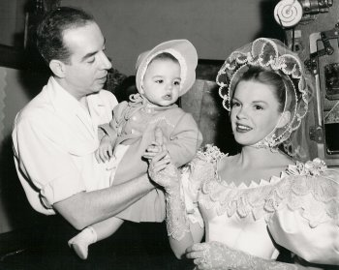
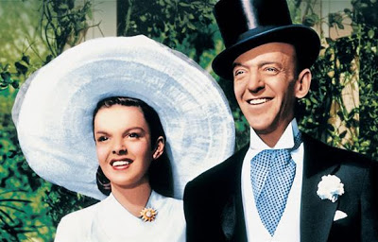
Garland & Minnelli
Married in June 1945 and gave birth to Liza in 1946.
During the filming of The Pirate (1948), Garland had a nervous breakdown. The film later flopped.
Hit with Easter Parade (Charles Walters, 1948) with Fred Astaire.
Pulled off The Barkleys of Broadway (Charles Walters, 1949) and replaced by Ginger Rogers, due to her drinking and drug problems. Put on suspension until she recovered.
Words and Music (Norman Taurog, 1948), was Garland’s last film with Mickey Rooney. Poor box-office.
Suspended and replaced by Betty Hutton on Annie Get Your Gun (George Sidney & Busby Berkeley, 1950)

Slide 22
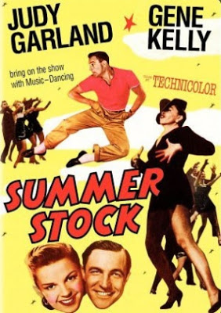
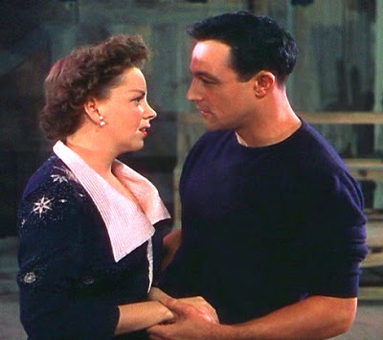
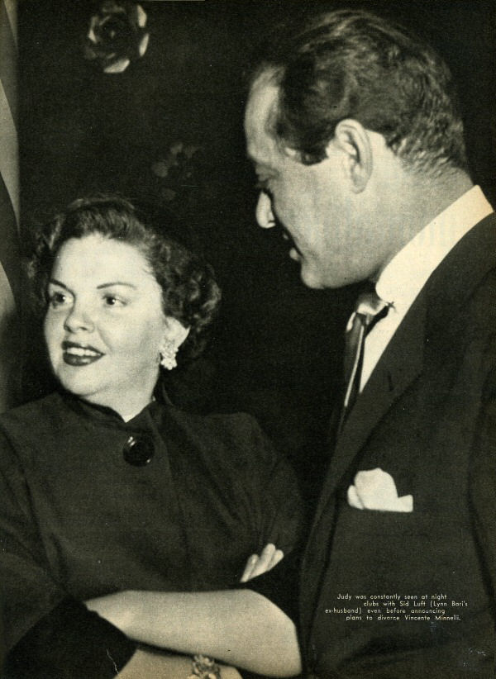
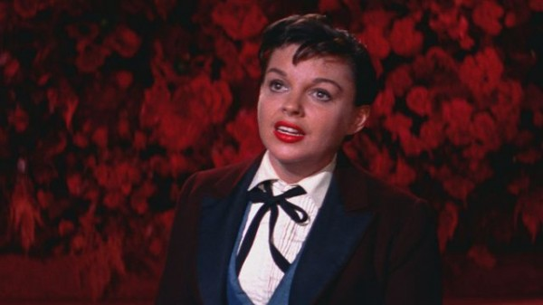
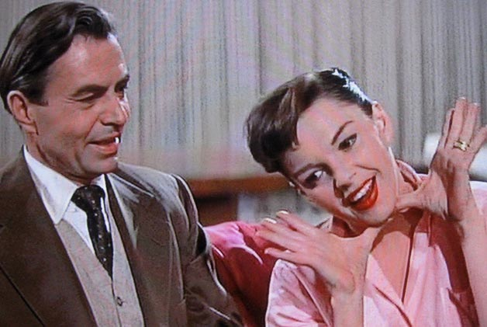
Garland, the Comeback Star
Co-starred with Gene Kelly in Summer Stock (Charles Walters, 1950) weight gain and loss was visible, drink and drug problems held up production.
Suspended from Fred Astaire’s Royal Wedding (Stanley Donen, 1951) and replaced by Jane Powell, due to failure to report on set. Attempted suicide and MGM contract terminated.
1951, hired Sid Luft as her manager and divorced Minnelli. Sell-out Concert tour in UK. In October, she sold out her show on Broadway (Palace Theater).
1952, Garland and Luft married and formed Transcona Enterprises, which produced A Star is Born (George Cukor, 1954) with Warner Bros. ‘Born in a Trunk’ was inserted as a musical biography of Garland. Rave reviews and earned Garland a nomination for Best Actress Oscar. The Norman Maine character owes as much to Judy Garland as the Vicky Lester character, i.e. as an object of bad publicity.

Slide 23
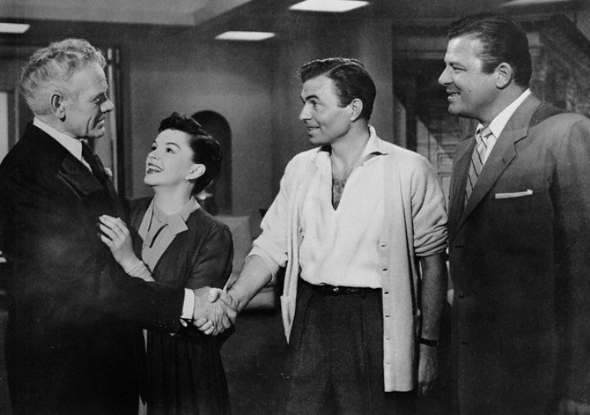
Publicity
By the 1930s, all the Hollywood studios had publicity departments, staffed by large numbers of people responsible for ‘constructing and disseminating a star’s image across the media of posters, photographs, newspapers, magazines and radio’ (McDonald 2000: 52).
Each studio had a head or director of publicity in charge of organizing marketing campaigns.
The most important were Howard Strickling at MGM, Harry Brand at Twentieth Century Fox and Bob Taplinger at Warner Bros.
MGM’s publicity department employed sixty members of staff, each taking responsibility for three or four stars (McDonald 2000: 52).

Slide 24
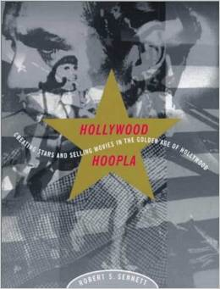
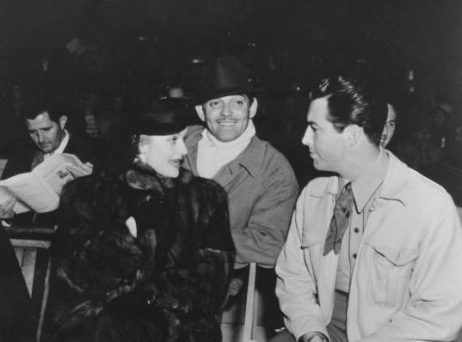
Howard Strickling’s team at MGM
‘Howard Strickling’s staff turned the business of motion picture publicity into a campaign as complex, widespread, and unavoidable as a military invasion’ (Robert Sennett, Hollywood Hoopla, 1998: 69).
This involved the star in making a series of personal appearances, as well as appearing across the country in posters, trailers, song recordings, newspaper and radio advertisements, product endorsements and book tie-ins.

Slide 25
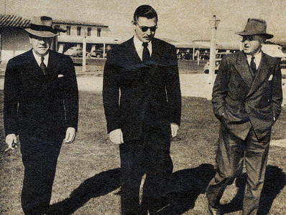
The Unit Publicist
A ‘unit publicist’ was ordinarily assigned to a film when it first went into production.
‘Their job was to create and manage the publicity surrounding it from the moment it began production right the way through to its release across throughout the world’ (McDonald, The Star System, 2000: 52).
Articles, gossip and news stories would be placed in the trade press and the general news media by ‘planters’ to gain maximum exposure.
These were designed to intensify audience interest to ensure a sell-out opening weekend at the first-run movies theatre, the ones that charged the highest admission prices.

Slide 26
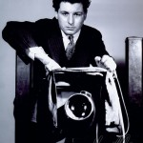
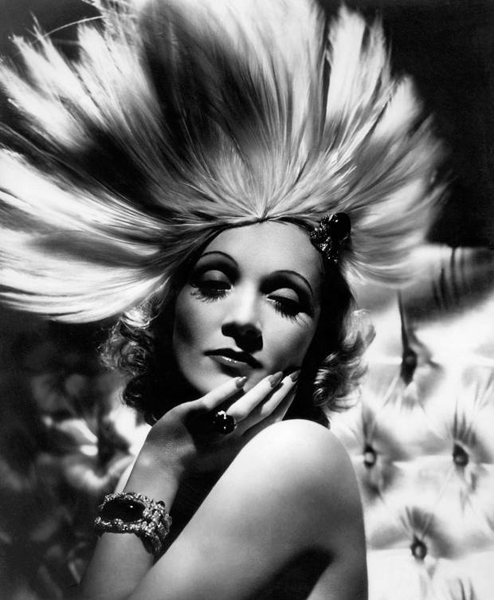
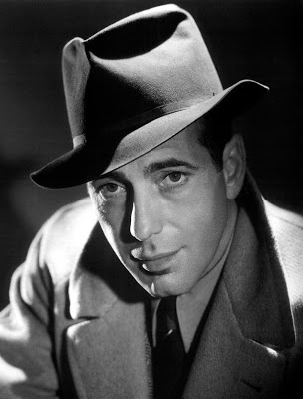
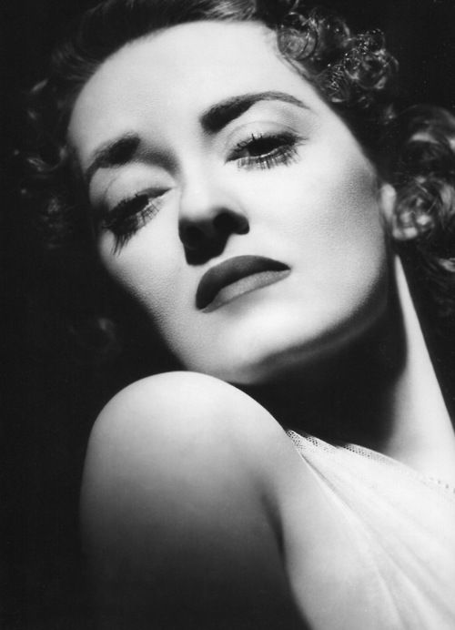
Photographers & Fan Clubs, etc.
Hollywood publicity departments employed photographers to take flattering portraits of the stars, many of which would be signed and sent out to fans and fan clubs (e.g., George Hurrell).
While part of the publicity team responded to fan mail and liaised with fanzine editors, others produced the previews of forthcoming releases, writing articles for magazines and newspapers.
Another group organized merchandising tie-ins, soliciting product testimonials and endorsements, organizing fashion shoots and arranging personal appearances and radio assignments.
Others designed the movie ads and posters for the new releases, providing a range of designs, including international variations to be distributed to countries around the world.

Slide 27
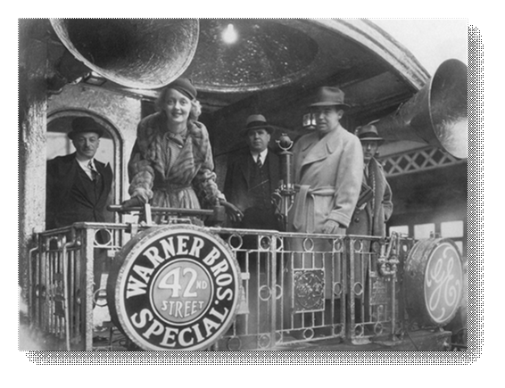
Public appearances, etc
While stars were hired to perform in front of cameras and microphones, they were also contractually obliged to make public appearances and participate in media interviews to promote their films.
A refusal to comply with these demands could lead to a star being suspended without pay until they complied.
Under the terms of the standard Hollywood contract, the period of the suspension, such as one week or six months, would be added to the overall term of their contract.
Before 1949, this actually meant that a star’s contract with a studio could be extended indefinitely.

Slide 28
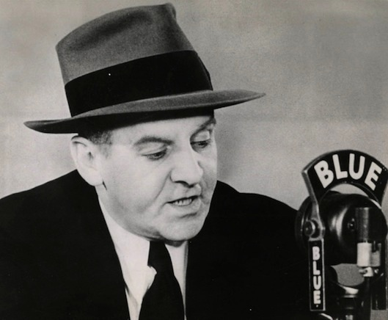
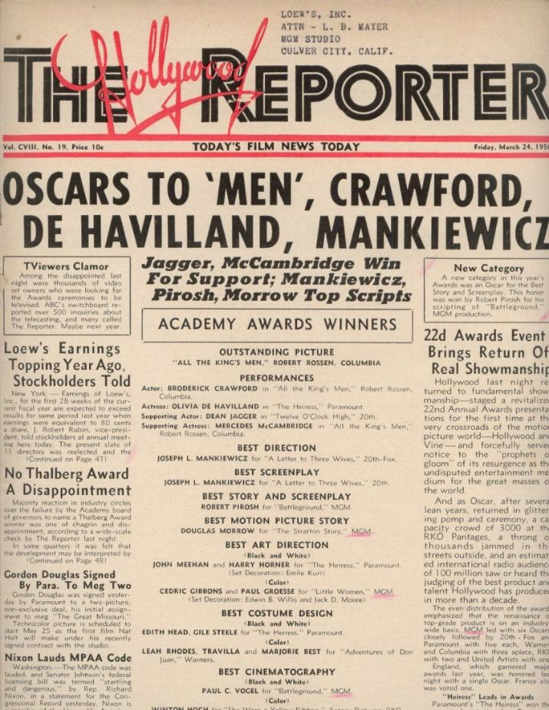
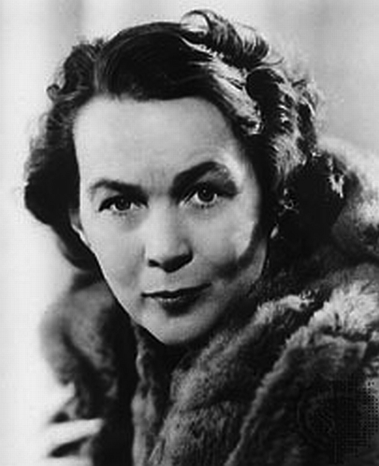
Hollywood Reporters
By the late 1930s, there were over 300 members of the press based in Los Angeles, reporting daily on star activities.
Many of the biggest names in journalism of the thirties and forties were associated with Hollywood, including syndicated columnists and radio broadcasters, such as Walter Winchell and Dorothy Kilgallen.
The most important trade reporters were Edith Gwynne of the Hollywood Reporter and Mike Connelly of Variety.
The top magazine interviewers were Adele Rogers St. John and Sheila Graham, who both worked for Photoplay, the most important film magazine in the USA.

Slide 29
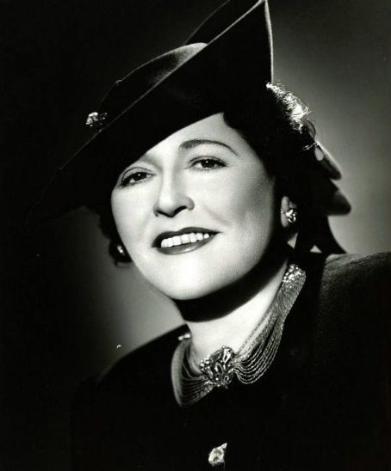
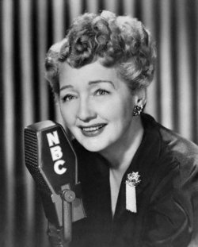
Gossip columnists
The most powerful reporters in Hollywood were the gossip columnists Louella Parsons, of the San Francisco Examiner, and Hedda Hopper, of the Los Angeles Times, who were feared, respected and loathed by Hollywood stars of the studio era.
Edgar Morin described gossip columns as ‘the nutritive plankton of the star system’ (Morin, Les Stars, 1957/2005: 73).
‘journalists of the cinema are more interested in the stars than in films, and more interested in gossip about the stars than in the stars’ (ibid.).

Slide 30
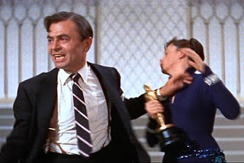
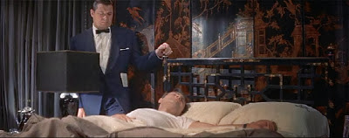
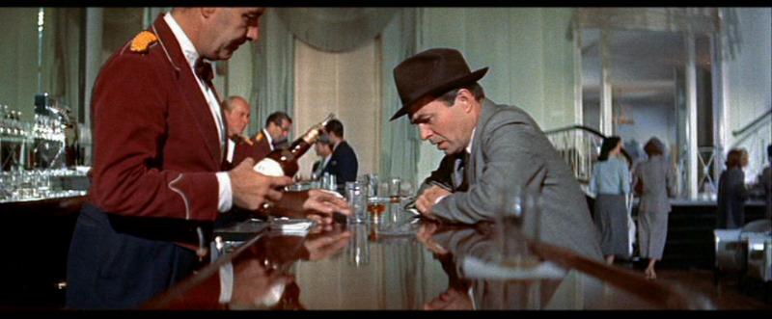
Star Wars
So while studio publicists attempted to protect their stars from harmful publicity, the gossip columnists, press and magazine reporters tried to expose them and leak these to a readership of fans hungry for salacious information.

Slide 31
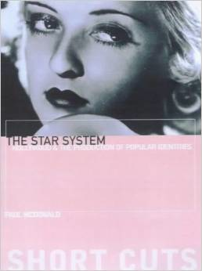
Private Lives & ‘Private Lives’
Paul McDonald has noted in The Star System that the significance of star scandal lies in the way that it divides a star’s private life into two distinct components: ‘a publicly controlled private-image and a hidden secret private-image’ (McDonald 2000: 39).
A ‘private life’ is intended for public consumption.

Slide 32
Conclusion
In the second part of this lecture, after a short break, I shall discuss how one film star in the 1930s fought against her studio and redefined her image in the process.
Any questions?

