Slide 1
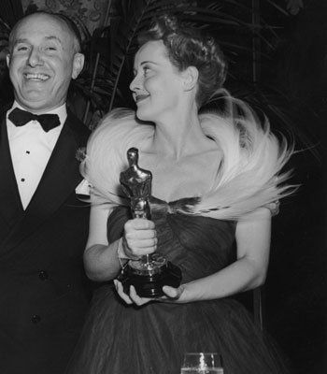
A History of Film Stardom, Part 1
The Case of Bette Davis

Slide 2
Introduction
In this part of the lecture, we will consider how studio era stars were managed, controlled and constructed by Hollywood studios with a case study of Bette Davis in the 1930s.

Slide 3
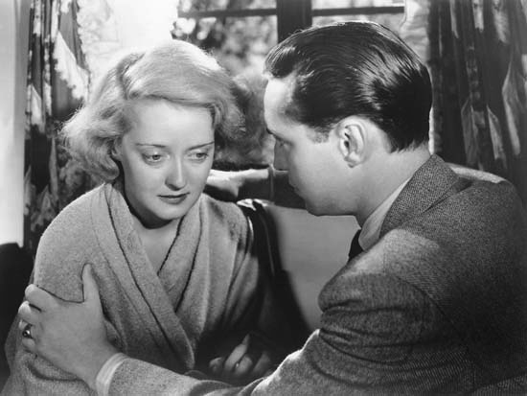
Bette Davis
Bette Davis won two Academy Awards for Best Actress, for the films Dangerous (1935) and Jezebel (1938).
From 1931-49 she was employed by Warner Bros. under the terms of an ‘option contract’ that transferred all authority to manage her name, image and voice to the studio.
This gave her no legal right to determine her star identity.
Success gave her no greater legal claim to influence her film work or public profile.

Slide 4
Controlling Stars
‘… it is the transferability of rights that is the basis of the mass marketing of the human image and the human voice in the communications industries’ (Jane Gaines, Contested Culture, 1992: 115).
‘In contrast with the ordinary worker, who leaves the proceeds of his work with his employer, the screen actor may be permanently separated from tangible aspects of personhood – his voice and photographic likeness’ (ibid., 155).

Slide 5
Bette’s 1943 Contract
‘To quote the 1943 contract: “The artist hereby grants to the Producer the right, which shall be sole and exclusive during the full term hereof, to use or make use of and control her name and/or her professional name and to use and/or distribute her pictures, photographs or other reproductions of her physical likeness for advertising, commercial or publicity purposes, whether or not in connection with the acts, poses, plays and appearances of the Artist or the advertisement or publicity of the photoplays produced hereunder.” In other words, the 1943 contractual agreement that handed to Warner Brothers all rights to the Davis name, voice, and likeness is worded in such a way that the studio can claim “Bette Davis” as its own corporate trademark for seven years. It would seem, then, that Warner Brothers alone authorized the popular discourse on Bette Davis’ (Gaines, 1992: 161).

Slide 6
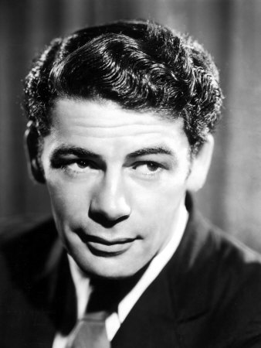
Paul Muni’s 1932 contract
Paul Muni signed a two-year contract with Warner Bros. in 1932.
This was restricted to a total of 8 pictures for which he would receive $50,000 per film.
This contract also granted him story approval (role and script).
The contract also stipulated that he would receive star billing for all his films for Warners whatever the size of the role
He would have the right to veto any loan-out deals and receive a 50% split of the fee paid by the borrowing studio.
A maximum twenty-one week year, with the right to take stage work.

Slide 7
Bette Davis: Universal Contract Player
Bette Davis joined Warner Bros. in September 1931, with relatively little acting experience and no hits films to her credit, and almost nothing in terms of celebrity.
1930-31 under contract to Universal Studios, appearing in small roles in 6 pictures, 3 being loan-outs to minor studios:
Bad Sister (Hobart Henley, 1931) starring Conrad Nagel and Sidney Fox
Seed (John M. Stahl, 1931) starring John Boles and Genevieve Tobin
Waterloo Bridge (James Whale, 1931) starring Mae Clarke and Kent Douglas
Way Back Home (RKO, Wm. A. Seiter, 1932) starring Phillips Lord & Effie Palmer
The Menace (Columbia, Roy Wm. Neill, 1932) starring H.B. Warner
Hell’s House (Capital, Howard Higgins, 1932) starring Junior Durkin

Slide 8
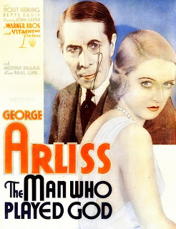
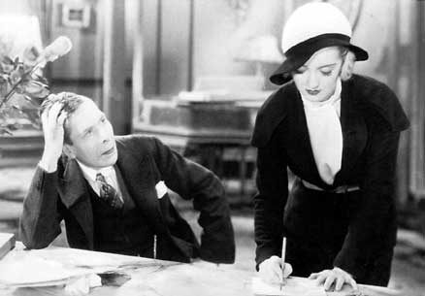
Bette Davis: Warner Contract Player
In September 1931, Warner Bros. hired Davis on a one-picture deal and a weekly salary of $320 to appear in the supporting cast of George Arliss’s star vehicle The Man Who Played God (John Adolfi, 1932).
After this project was completed, the studio offered her a five-year option contract at a weekly starting salary of $400, which she accepted.
The actress was pledged to working exclusively for Warner Bros. for a minimum period of five years
The studio, however, could terminate the agreement at various times during the currency of the contract: that is, after the first six months, after the next six months and then annually thereafter.

Slide 9
Renewing the options
An increase in the star’s popularity would ensure that their ‘option’ was be picked up each year and every time this happened he or she would receive an increase in salary that had been determined at the outset.
An exclusivity clause prevented stars from breaking their contract and working for a rival studio or anyone else in the entertainment business, such as a theatre, music producer or advertising agency.
This meant that the studio had exclusive rights to use the star’s name, their acting, singing, dancing, posing, speaking and performances.

Slide 10
Extending the contract
Under the terms of the contract they could dictate which and on how many projects the actor was to work on. A further clause stipulated that if the actor refused an assignment, the studio could suspend them without pay and extend the duration of the contract for the full period of the suspension. In this way a five or seven-year contract could be extended over much longer periods.

Slide 11
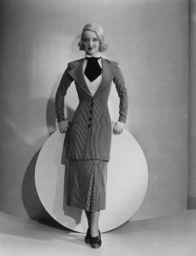
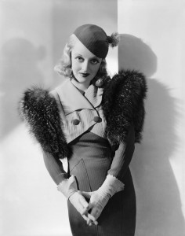
Bette Davis suspended
Warner Bros. regularly suspended Bette Davis without pay when she refused to play her assigned roles.
In April 1934, she refused to perform a role that had been assigned to her. After receiving a series of increasingly stern telegrams from head office she dutifully complied. She refused to do next project she was offered as it gave her no resting period between the two films. She was suspended without pay until she accepted the part.

Slide 12
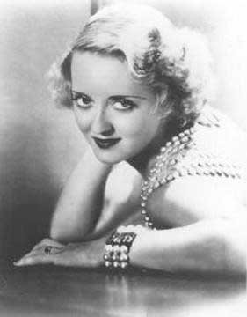
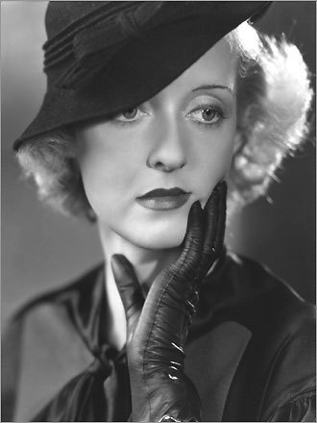
Suspended again
In December 1935, she rebelled again when instructed to begin work on a new film two days after completing her last one. Her claims of exhaustion were ignored and she was suspended without pay until she honoured her contractual obligations.
In early 1936, she was nominated for an Academy Award for her performance in the film Dangerous and, with this as leverage, she instructed an attorney to demand a new contract.

Slide 13
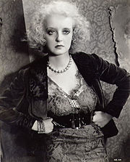
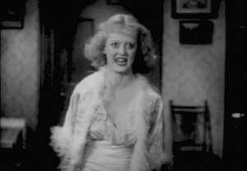
Davis’s demands
Davis’s attorney demanded:
an increase in salary
a limit on the number of films she made a year
a guaranteed resting period of three months between productions, during which time she could, if she wished, do an outside picture.

Slide 14
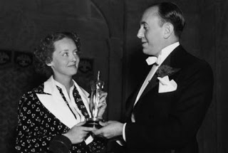
Davis’s request
At the same time, she put in a request to be loaned out to RKO, to appear as Elizabeth I opposite Katharine Hepburn in the film Mary of Scotland being directed by John Ford.
On the 3rd of March 1936, Warner Bros. rejected Davis' request for a loan-out.
On the 5th of March 1936, Davis won the Oscar for Best Actress of 1935.
When the studio assigned her to play the role of a female lumberjack in a film called God's Country and the Woman, Davis refused and was suspended without pay.

Slide 15
Cost-effective miscasting
‘Studio head Jack Warner was particularly adept at using the technique in conjunction with the contractual provision for suspension as a means of keeping costs down. Warner would assign a high-salaried actor an unsuitable role, and when the actor refused it, the producer would suspend the actor without pay, thus cutting his own costs’ (Jane Gaines, Contested Culture, 1992: 152).

Slide 16
Davis’s next move
Davis accepted a part in a film being made at Ealing Studios in England for Toeplitz Productions Ltd., was a direct infringement of her contract.
In such cases, a studio could enforce ‘the contract’s negative services covenant, which stipulates that the employee must not work for anyone else during the term of the contract’ and sue for breach of contract (Gaines, 1992: 153).

Slide 17
The court case
On Monday 19 October 1936, the High Court in London granted Warner Bros. an injunction to restrain Bette Davis from working for anyone else other than itself.
In the following day's edition of the Daily Mail, Davis declared that, 'If I had won, it would have been the greatest legal case in cinema history’.
This judgement validated the Hollywood contract as both lawful and binding, constituting a victory for Warner Bros. and indeed for all the major studios.

Slide 18
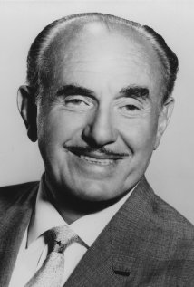
Warner’s admission
Jack Warner, Vice President of Warner Bros.,, admitted in court that, under the terms and conditions of the contract, actors could be made to endorse any product in an advertisement or even to attend a public rally for a political party they didn’t actually support.
He also admitted that the contract enabled studios to instruct actors (particularly actresses) to appear in publicity material in a state that was revealing and intimate if not actually vulgar and licentious.

Slide 19
A life sentence
Davis’s defence lawyer (Sir William Jowitt)revealed that when the clause in the contract that added periods of suspension on to the original term (Clause 23) was used in conjunction with the clause that gave the studio exclusive rights to an actor's professional services across all entertainment media (Clause 9), the Hollywood contract became a life sentence.

Slide 20
The Daily Mail reports
The Daily Mail carried detailed reports of the court proceedings from the 15-20th of October 1936. Headlines included:
'Miss Bette Davis's "Slavery with a silver lining"' (Thursday)
'Miss Bette Davis "Not a money grabber" - Hollywood contract is "Life sentence" - Sir William Jowitt' (Friday).
The Daily Mail ran the court case as a major story over four days, featuring it prominently and carrying photographs of the actress, significantly raising Davis’s public profile in Britain.

Slide 21
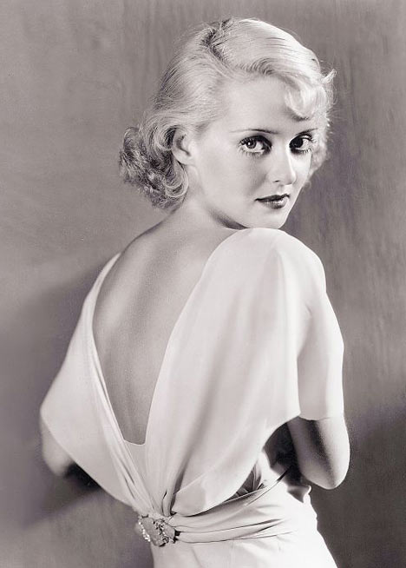
Davis’s Publicity and Typecasting
From 1932-36, Warner Bros. experimented with a series of images for Davis:
the glamour-girl
the seductress/vamp
the talented but self-destructive actress.
But in general the studio created for her a certain ‘type’ in low-budget programme-fillers, with the exception of the films Cabin in the Cotton (Michael Curtiz, 1932) and Of Human Bondage (RKO, John Cromwell, 1934).

Slide 22
Davis’s types
'Until recently, as you know, I played a long series of sophisticated and stereotyped roles - nearly always the girl friend with strong ideas on how to manage men' (Bette Davis: 'It pays to be a "type", Film Weekly, March 29, 1935: 7).
After playing the very different role of Mildred Rogers, the contemptible Cockney waitress in Somerset Maugham's Of Human Bondage, Davis declared: 'I want to go back to my nice, smartly dressed secretaries, lady journalists, commercial artists, and understanding girl friends for a while’.

Slide 23
Davis adds
'Let's face it, it is useless to disguise the fact that to become popular, and keep her popularity, a Hollywood actress has to establish a definite screen style - an identity to which one must frankly attach the horrible description "type”. … Once she has discovered a style which the public acclaims, she must remain more or less the same little woman in every picture she makes: rather more than less, too!’ (Bette Davis: 'It pays to be a "type", Film Weekly, March 29, 1935: 7).

Slide 24
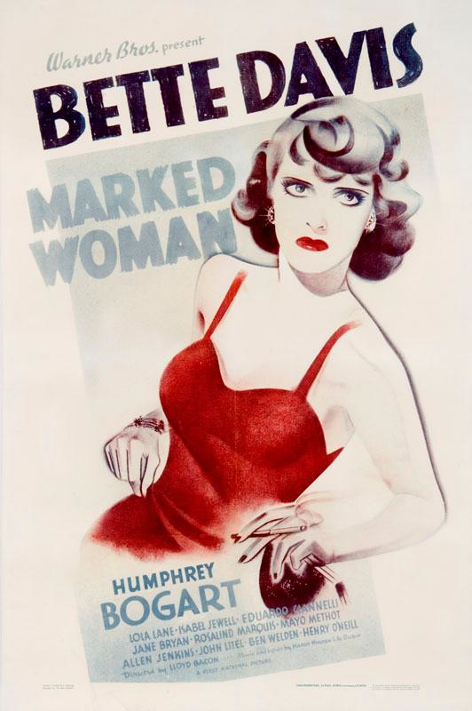
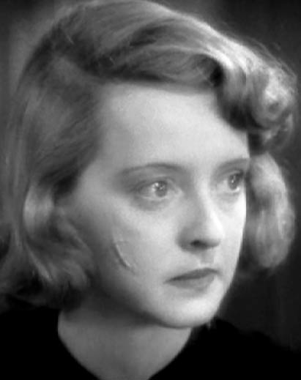
Battling Bette Wins
When Davis returned to Warners after the court case in London, she was given the female lead, opposite Humphrey Bogart, Marked Woman (Lloyd Bacon, 1937).
This was a tough court room drama about a vice and prostitution ring run by the mafia.
Davis’s on-screen character is wilful, rebellious, courageous, determined, ambitious and, above all, a fighter.

Slide 25
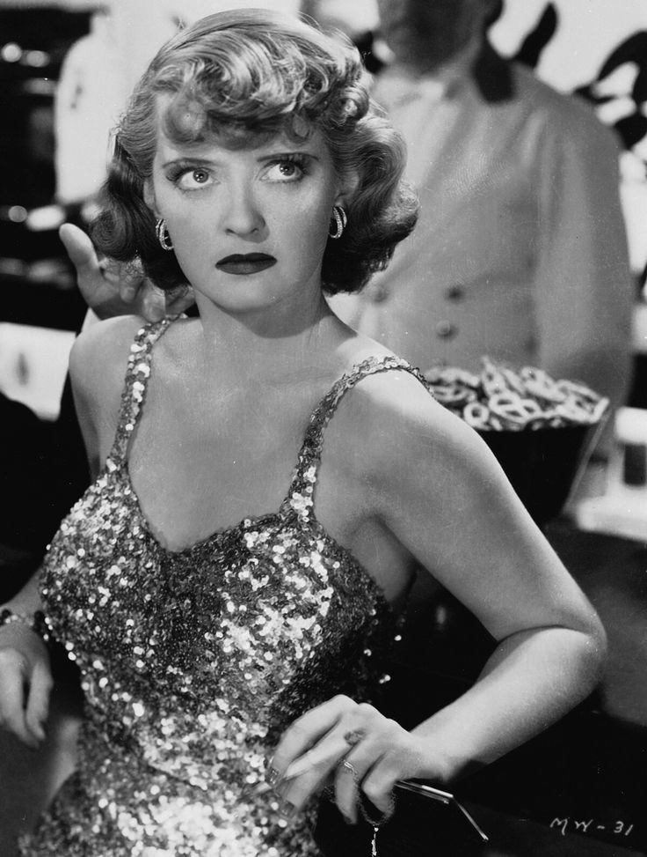
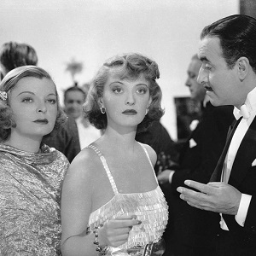
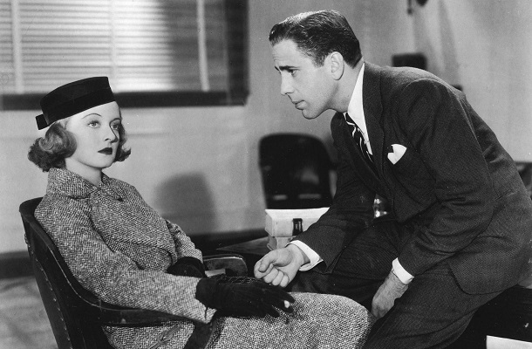
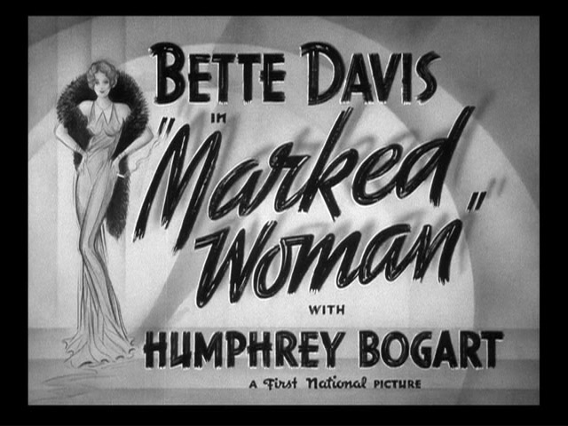
Rave reviews
'Regardless of what happens to the picture financially, it cannot help but react favourably to Miss Davis' (Variety, 14 April 1937: 12).
'Miss Davis has turned in her best performance since she cut Leslie Howard to the quick in "Of Human Bondage"' (Frank S. Nugent, the New York Times, 12 April 1937: 15).

Slide 26
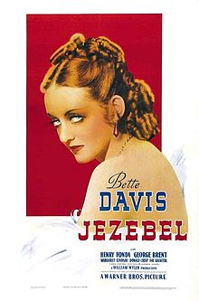
Jezebel: a star vehicle
Jezebel (Wm. Wyler, 1938)
Freda Bruce Lockhart pointed out that in Jezebel, 'Bette Davis has at last won the battle which her film career has been' (Freda Bruce Lockhart. 'Battling Bette Wins!', Film Weekly, Saturday 3 September 1938: 6).
Davis won her 2nd Oscar for her role.

Slide 27
Conclusion
Did Davis play a part in determining her star persona and directing the course of her film career?
Any questions?
In the next lecture. I shall discuss the conditions of stardom in Hollywood from 1960-2010, during the post-studio era, and looking at the ways in which a number of stars have gained increasing levels of control over their work by becoming hyphenates (e.g., star-directors, star-producers, etc.).

