Slide 1
A History of Film Stardom, Part 2b
The Post-Studio Era, 1960-2010

Slide 2
Introduction
In this part of the lecture, we will be looking at the role of agents, managers, attorneys and publicists in the post-studio era, i.e. since 1960, starting with the publicists.

Slide 3
Publicity & Publicists
Since the 1990s, information about stars has circulated more widely and more quickly than ever before. Information is circulated though official sources such as promotional materials, publicity, criticism and commentaries but also through the grapevine, the Internet and Twitter, often circulating in different ways among different sectors of society.
An increase in ‘textual curiosity’ through Internet, print and broadcast media (Barry King, ‘Embodying the Elastic Self,’ in Contemporary Hollywood Stardom, 2003: 51).

Slide 4
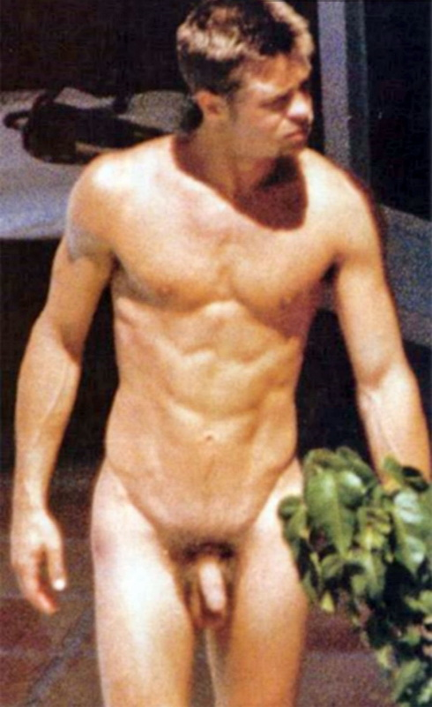
Film stars on the Internet
‘… television and print media continue to actively circulate the discourses of film stardom, yet the most rapid growth in the dissemination of those discourses has come with the widespread adoption of the Internet’ (Paul McDonald, The Star System, 2000: 113).
Official websites provide details of new releases, featuring trailers, competitions, merchandise, along with a plot synopsis and profiles of the stars.
Film stars also appear on celebrity porn sites, featuring both authentic nude images taken from earlier stages of a star’s career or faked images in which their heads are digitally attached to a naked body.

Slide 5
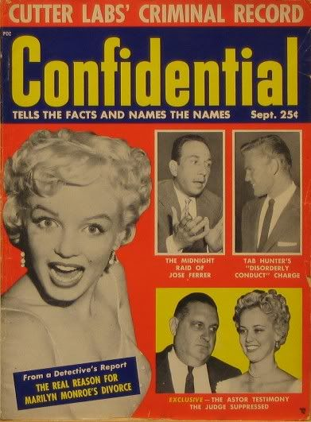
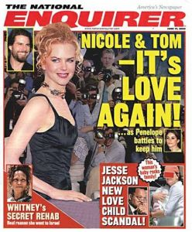
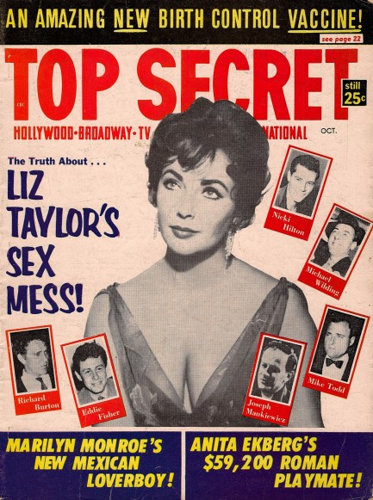
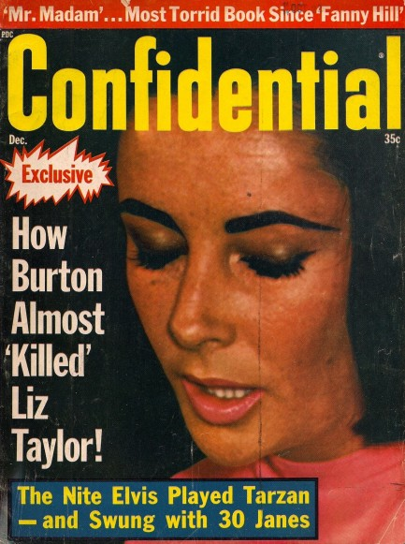
Exposé
‘During the 1950s, the opulent homes of film stars came under scrutiny. By the 1960s, this also included their extravagant lifestyles and their sex lives. Transgressions of normative behaviour became was exposed in best-selling publications like Confidential and the National Enquirer. Knowledge of a star’s divorce, hints of improper liaisons, and scandals that involved sexual indiscretions became commonplace in the press’ (P. David Marshall, Celebrity and Power, 1997: 105).
During the 1960s and 1970s, Elizabeth Taylor was seldom out of the newspapers, which detailed her obsession with expensive jewels, her various marriages and even her weight and health problems, including alcohol and drug addictions.

Slide 6
Hollywood publicists since the 1980s
When the in-house publicity departments of the big Hollywood studios were downsized during the fifties and sixties, their operations were increasingly taken over by independent publicity firms (Paul McDonald ‘The Star System: the Production of Hollywood Stardom in the Post-Studio Era’ in The Contemporary Hollywood Film Industry [eds] Paul McDonald & Janet Wasko, 2008: 173).
Their work has chiefly involved creating and managing ‘relationships between film stars and the array of other media channels through which the identities of stars are circulated’, such as personal appearances at press conferences, premieres and charity events, in magazine interviews and on television chat shows (McDonald 2008: 174).

Slide 7
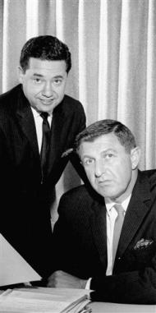
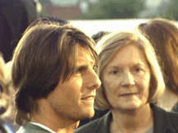
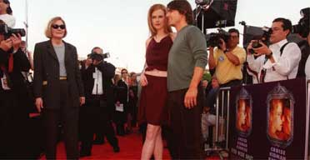
PR: R&C to PMK/HBH
Rogers and Cowan was set up in 1950 by Henry Rogers, who had previously worked as a press agent for Hollywood stars (e.g., Rita Hayworth).
By the 1970s, R&C was the biggest PR company in Los Angeles.
Pat Kingsley joined R& C as a secretary in 1959 and was eventually promoted to ‘planter’.
She left in 1971 to form Pickwick Public Relations with Lois Smith.
In 1980 they merged with Maslansky-Koenigsberg to form PMK, becoming Hollywood’s leading PR company, handling publicity for Tom Cruise, Sharon Stone, Richard Gere, Jodie Foster and Al Pacino.
In 1999, PMK was acquired by Interpublic.
In 2001, PMK was merged with Huvane Baum Halls to form PMK/HBH.

Slide 8
The Top Players in Hollywood
Interpublic, owns three of the top six PR companies in Hollywood.
CAA, the Creative Artists Agency, the top talent agency.
‘… another significant challenge to studio hegemony involved top filmmaking talent and the leading agencies, most notably William Morris, CAA, and ICM, which formed a veritable cartel during the 1980s and exercised far more authority over Hollywood filmmaking than any studio (Tom Schatz, ‘The studio system and conglomerate Hollywood,’ in McDonald & Wasko’s The Contemporary Hollywood Film Industry (2008: 25).

Slide 9
Top talent
‘Besides representing most of the top talent required to produce top features, these agencies were adept at packaging major studio productions, with the agency and its clients exercising enormous creative control and siphoning off a sizable portion of the revenues through “participation” deals’ (Tom Schatz, ‘The studio system and conglomerate Hollywood,’ in McDonald & Wasko’s The Contemporary Hollywood Film Industry, 2008: 25).
In 1980s, William Morris had over 500 agents and thousands of clients.

Slide 10
New rivals
End of 1974: International Creative Management (ICM) was formed.
Start of 1975: Creative Artists Agency (CAA)
1980s: Triad Artists and InterTalent
1990s: United Talent Agency was formed out of a series of mergers.
1995: The Endeavor Talent Agency (ETA) was set up by 4 ex-ICM agents.

Slide 11
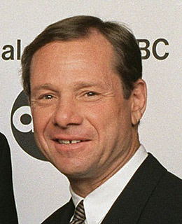
CAA talent
‘CAA under Mike Ovitz was arguably the more powerful industry force’ (Tom Schatz, ‘The studio system and conglomerate Hollywood,’ in McDonald & Wasko’s The Contemporary Hollywood Film Industry, 2008: 25).
CAA had over 150 directors, 150 actors and 300 writers, including ‘the cream of Hollywood’s top talent,’ including Steven Spielberg, Martin Scorsese, Spike Lee and Oliver Stone.
In 1990, Premiere magazine put Michael Ovitz (head of CAA) at the top of the Hollywood ‘power list’.
In 1995, Ovitz left CAA to become President of the Disney Corporation.

Slide 12
CAA Packages (1980s)
CAA agents packaged:
Stripes (1981) with Bill Murray (actor) and Harold Ramis (writer) and Ivan Reitman (director)
Ghostbusters (1984) with Bill Murray (actor) and Harold Ramis (writer) and Ivan Reitman (director)
Tootsie (1982) with Dustin Hoffman (actor) and Teri Garr (actress) and Sydney Pollack (director).

Slide 13
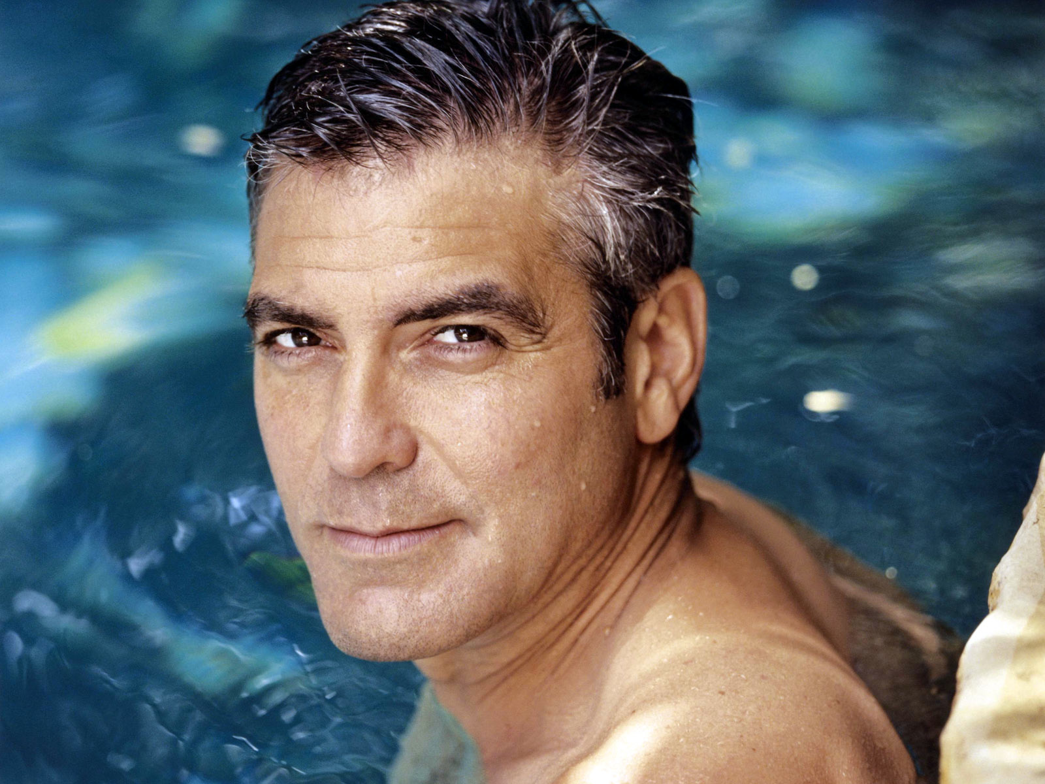
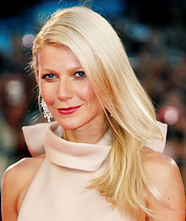
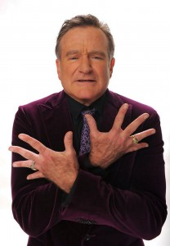
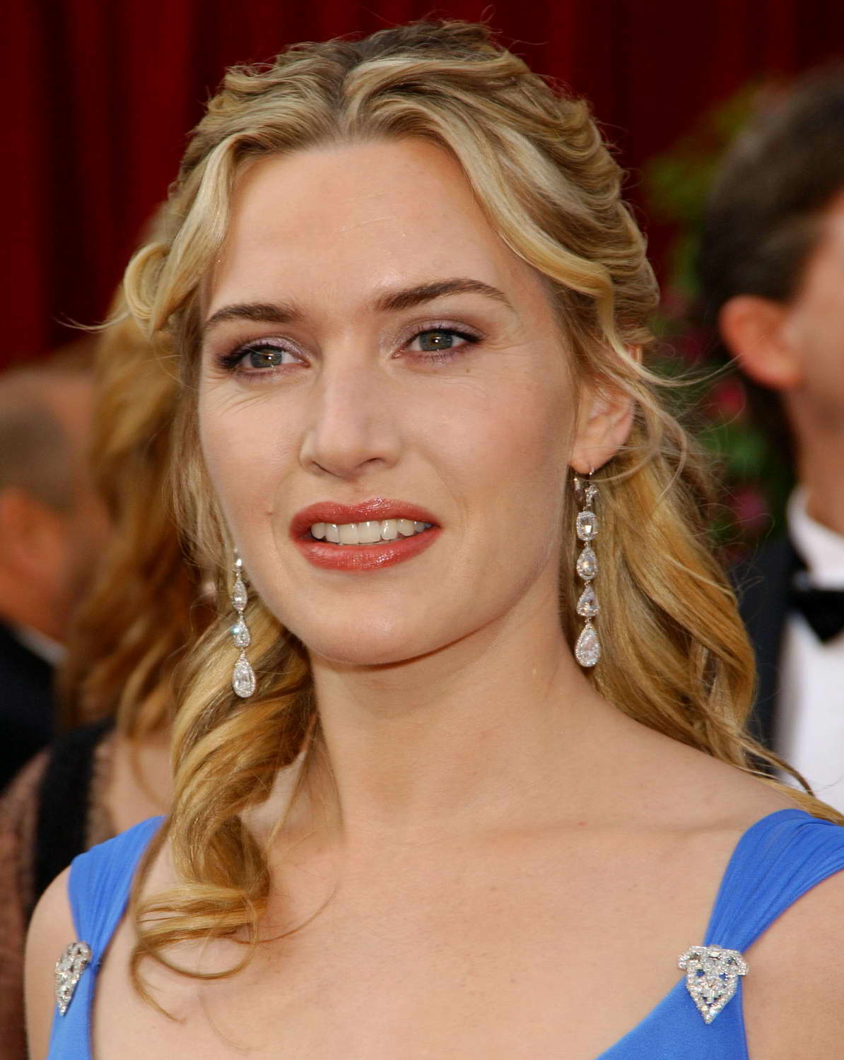
CAA star list (2006)
George Clooney
Sean Connery
Tom Cruise
Penelope Cruz
Hugh Grant
Tom Hanks
Angelina Jolie
Nicole Kidman
Julianne Moore
Gwyneth Paltrow
Brad Pitt
Julia Roberts
Will Smith
Meryl Streep
Robin Williams
Bruce Willis
Kate Winslet

Slide 14
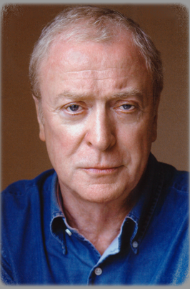
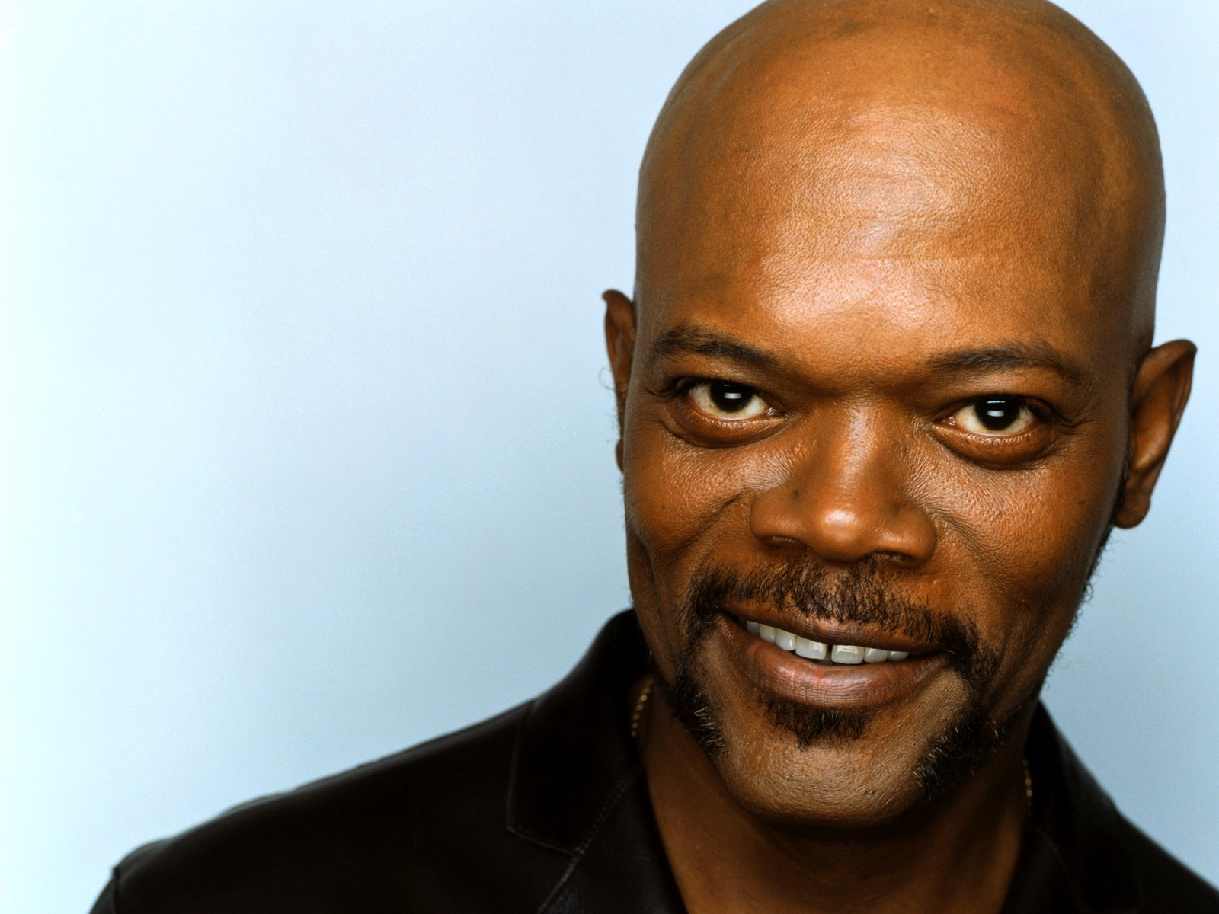
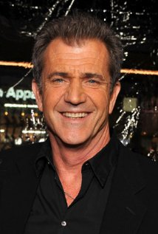
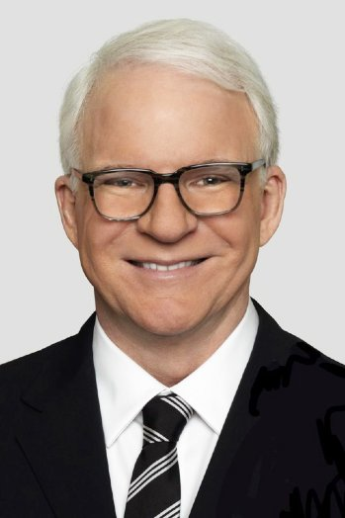
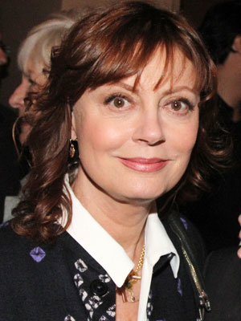
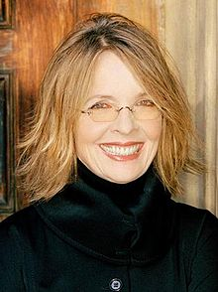
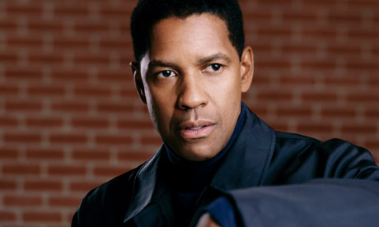
ICM Star list (2006)
Michael Caine
Jodie Foster
Mel Gibson
Samuel L. Jackson
Diane Keaton
Steve Martin
Susan Sarandon
Denzel Washington
Sigourney Weaver

Slide 15
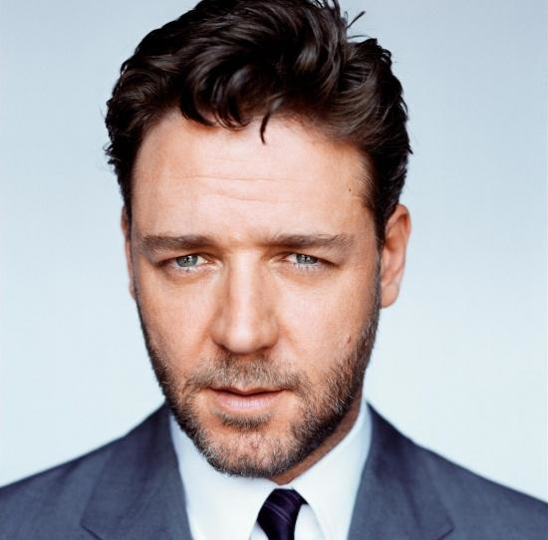
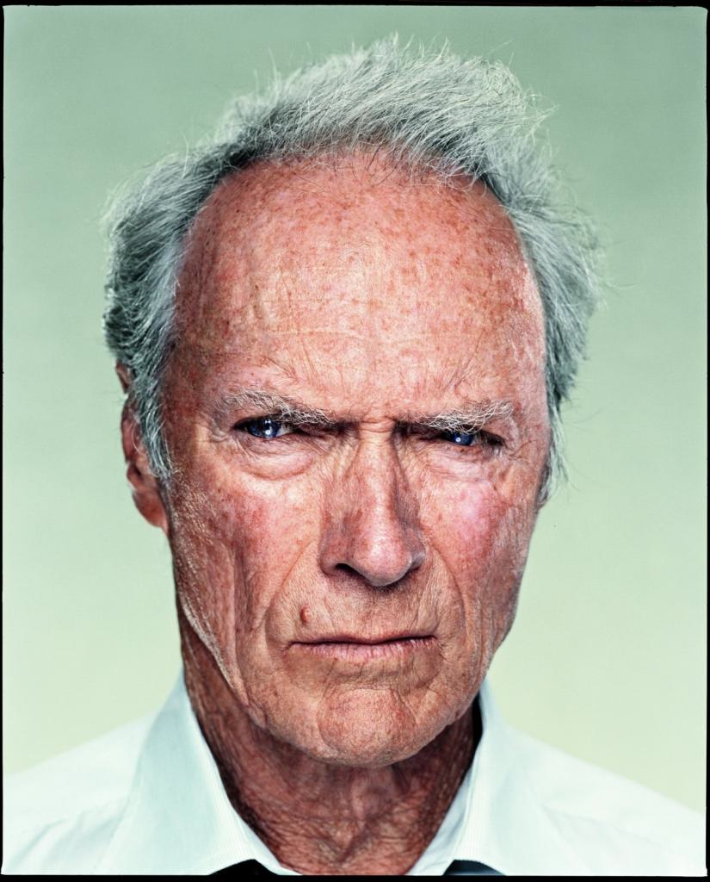
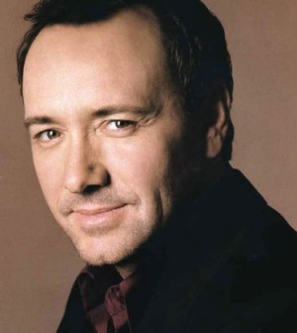
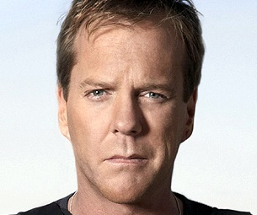
William Morris Star list (2006)
Russell Crowe
Clint Eastwood
Scarlett Johansson
Jennifer Lopez
Kevin Spacey
Kiefer Sutherland
Catherine Zeta-Jones

Slide 16
Personal Managers
Provide a more personal service than agents
Offer career and business guidance
Negotiate better deals for their clients
Can earn up to 15% of their client’s salary
Sometimes gain executive or co-producer credits on their client’s films

Slide 17
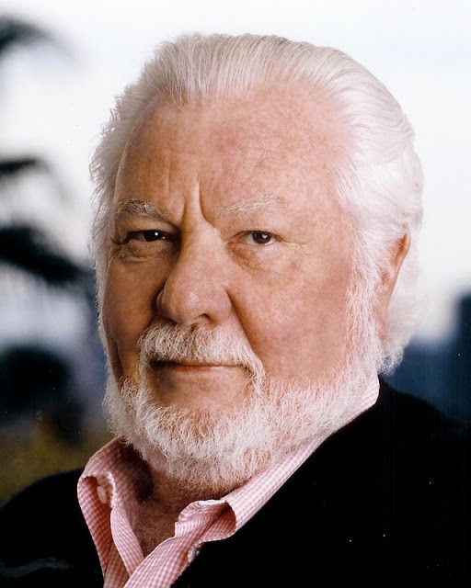
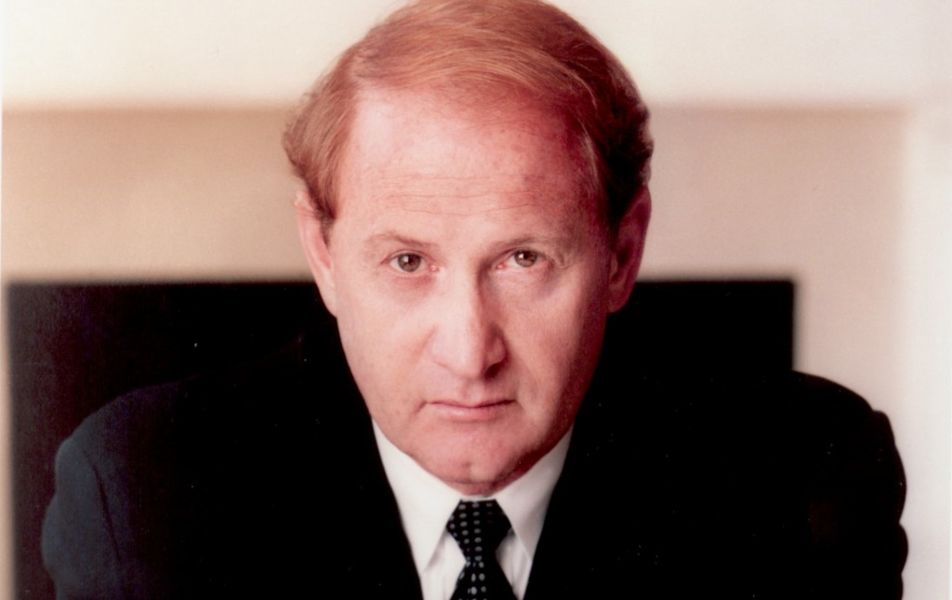
Top Management Companies in LA
Brillstein-Grey (set up by Bernie Brillstein)
Management 360
3 Arts Entertainment (Howard Klein and Erwin Stoff)
Bresler Kelly and Associates (Bresler Kelly)
More Medavoy Management (Erwin More and Brian Medavoy)

Slide 18
Entertainment Attorneys
Ziffren, Brittenham, Branca, Fischer, Gilbert-Lurie, Stiffelman & Cook was formed in 1978 and subsequently worked for DreamWorks and Pixar, arranging deals and drawing up contracts for Tom Hanks, Keanu Reeves and Bruce Willis, Tim Burton and (producer) Scott Rudin.
Barnes, Morris, Klein, Mark, Yorn, Barnes and Levine set up in 1996. Clients include Jim Carrey, Samuel L. Jackson, Will Ferrell and Scarlett Johansson.
Bloom, Hergott, Diemer: Brad Pitt and Sylvester Stallone
Jackoway, Tyerman, Wertheimer, Austen, Mandelbaum & Morris: Cameron Diaz and Nicole Kidman)

Slide 19
Stars as brands
A team of personnel (including stylists, hairdressers, personal trainers and coaches) play their part in maintaining the star as a prestige brand in a highly competitive market where film stars compete with other film stars but also with pop stars, supermodels, sports stars and other types of celebrity.
The star’s team is large, diverse and highly-paid, making stardom an expensive business.

Slide 20
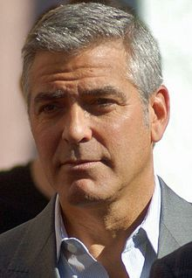
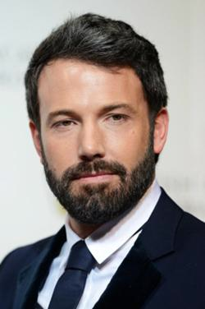
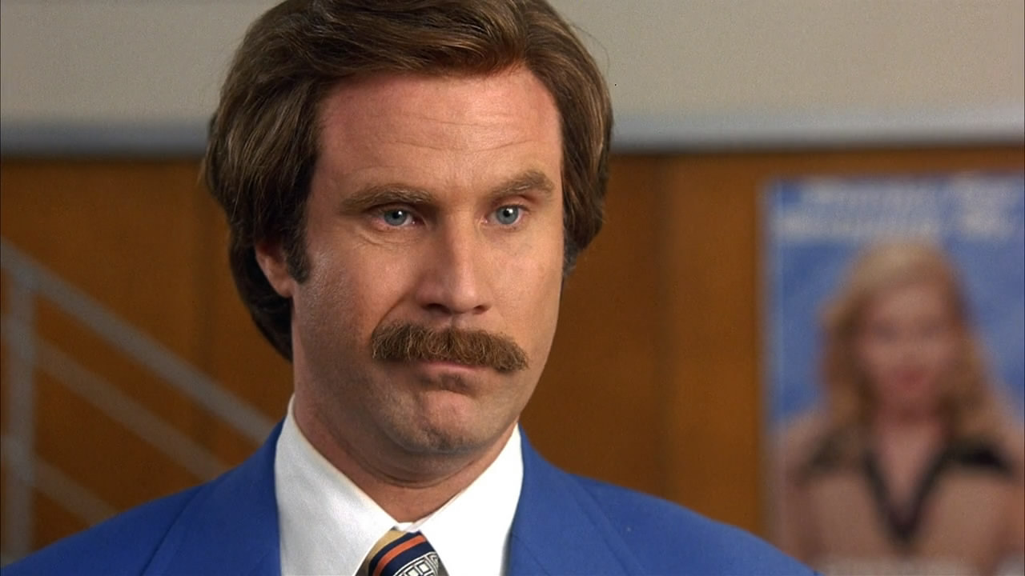
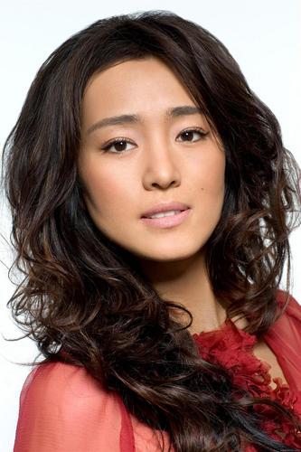
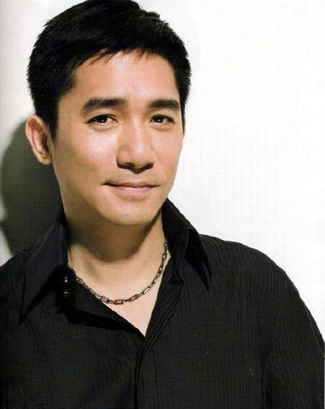
Brand Wars
Hollywood stars not only compete with other stars (e.g., sports stars, pop stars, TV stars, Reality stars, supermodels, etc.) but also with film stars from other parts of the world, especially China and India.

Slide 21
21st Century Bollywood
Bollywood is one of the world’s largest and most important cinemas (after Hollywood and Chinese cinema).
It caters to vast numbers of movie-goers not only in India but throughout the world, particularly the USA and Canada, Australia, UK, South Africa, Saudi Arabia and many parts of Europe (i.e., those with large Non-Resident Indian populations, aka the Indian Diaspora)

Slide 22
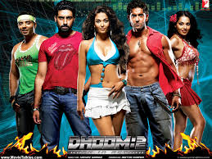
Brand Bollywood
By 2006, Bollywood had redefined itself into a prestige brand.
Derek Bose’s book Brand Bollywood: A New Global Entertainment Order (2006) discusses how and why Mumbai was poised to become the international centre of film and media production in 2005, by specializing in hi-tech special effects (see Bose, p. 73).
The synthesis of Bollywood style with the Hollywood blockbuster has produced a new wave of action thrillers: Dhoom:2 (Sanjay Gadhvi, 2006) and Don (Farhan Akhtar, 2006) and science-fiction fantasies: Aladin (Sujoy Ghosh, 2009) and Enthiran/Robot (S. Shankar, 2010).

Slide 23
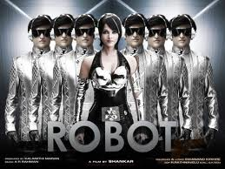
Hybrid Productions
“those films most likely to circulate transnationally are those that are more ‘Western friendly,’ adopting familiar genres, narratives, or themes in their hybrid productions” (Jigna Desai, Beyond Bollywood, 2004, p. 45).
“To capture worldwide audiences, it makes sound financial sense to produce Hindi movies for modern sensibilities, even if they confound the average Hindi speaker” (Alana Rosenbaum, ‘Dangerous Kisses: The changing face of Hindi Cinema’, Metro: Media & Education Magazine, n. 152, April 2007, p. 64).

Slide 24
Leading Bollywood Studios
Amitabh Bachchan Corporation Ltd
Aamir Khan Productions
Yash-Raj Films
Dharma Productions
Red Chillies Entertainment
Many of these are owned and run by India’s leading male film stars (e.g., Amitabh Bachchan, Aamir Khan and Shah Rukh Khan).

Slide 25
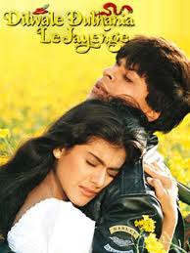
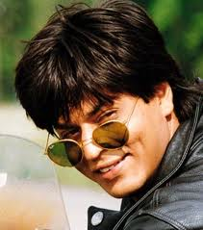
Shah Rukh Khan, aka SRK
His star vehicle Dilwale Dulhania Le Jayenge/The Brave Hearted Will Take the Bride (dir. Aditya Chopra) broke all box-office records in India when it was released in October 1995, breaking Bachchan’s long-standing record for Sholay.
By 1996, SRK was the hottest star in Bollywood and the face of Indian Pepsi (replacing Aamir Kahn).
Dubbed the ‘Tom Cruise of Hindi cinema’ and the ‘King of Bollywood’.

Slide 26
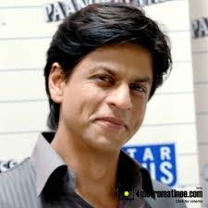
SRK
An infectious personality with boundless energy and a charismatic smile, SRK was transformed by a team of writers, publicists, photographers, choreographers, costume designers and film directors into ‘the ultimate brand ambassador for Bollywood and India’, making him the ‘face of a glittering new India’ (Anupama Chopra, King of Bollywood, 2007, pp. 221 and 11).

Slide 27
New India, New Bollywood
India underwent massive and rapid development in the 1990s, becoming a major, hi-tech global super-power with a fast-growing professional middle-class.
SRK became one of the nation’s most prominent media representatives. Despite his Muslim and Pakistani background, he became the embodiment of New India and Hindi cinema.
His fan-base was largely within the diasporic communities outside India than within the Indian subcontinent.

Slide 28
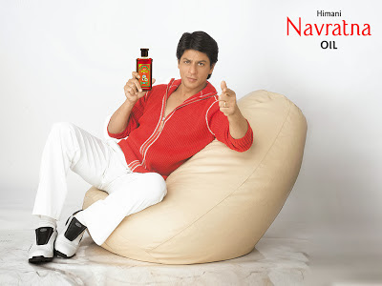
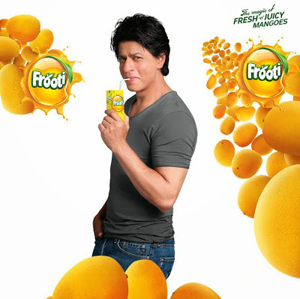
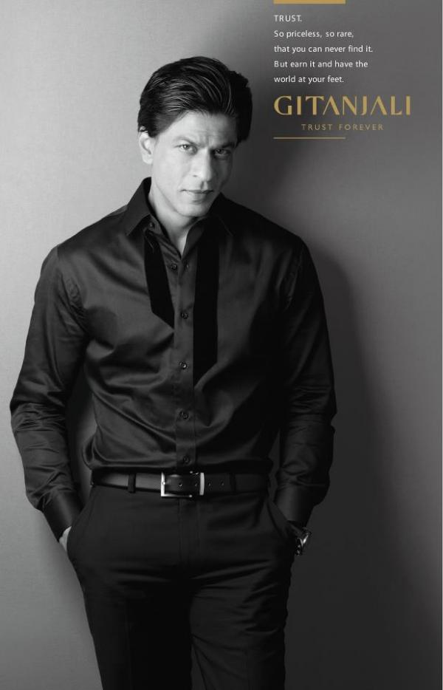
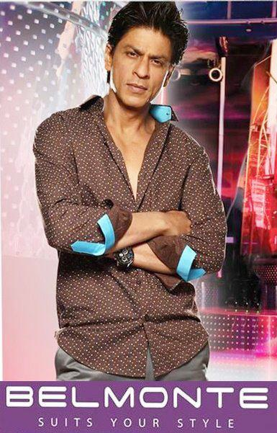
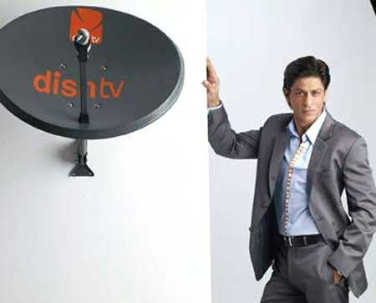
SRK’s Brands
In 1996, Shah Rukh Kahn became the face of Pepsi cola in India.
Advertising and endorsement has ‘played a key role in the branding of Shah Rukh Khan’ and ‘over the years he advertised a bewildering array of products ranging from a local biscuit to international brands’ (Chopra, King of Bollywood, 2007: 7).

Slide 29
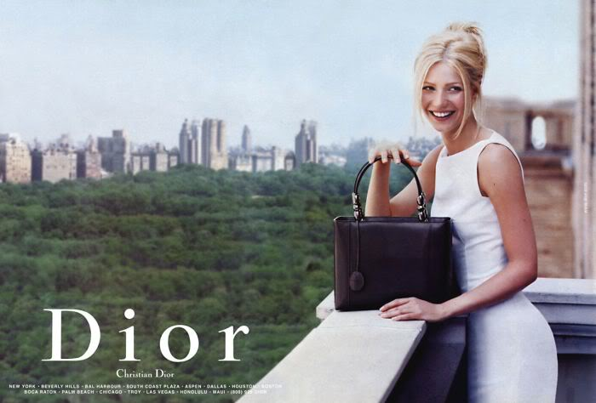
Stars that sell
Aishwarya Rai Bachchan, Gwyneth Paltrow and Kate Winslet.

Slide 30
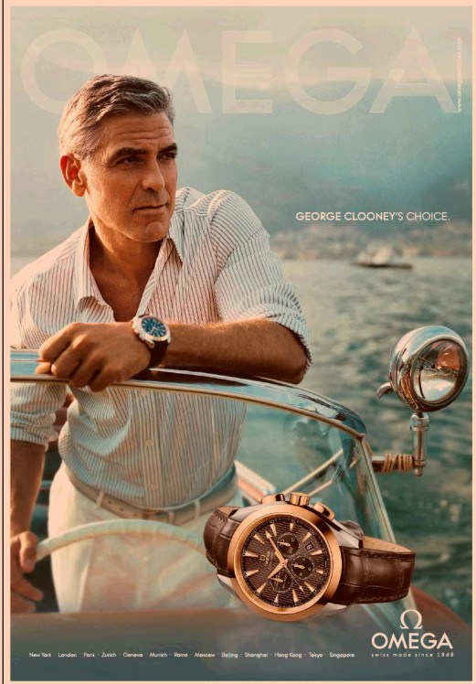
Conclusion
Advertising is not a minor activity for stars. It is central to what they do. Selling films and generating publicity is the star’s business and it is what sets them apart from other (less well paid) actors.

Slide 31
In the next lecture
I shall consider in more detail the economic benefits of having stars in films.
I shall also take another look at the career of Bette Davis.
Any questions?

