Slide 1
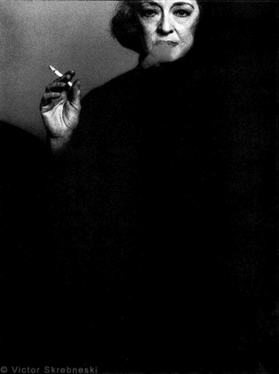
Manufacturing Stars & Stardom
Part 1

Slide 2
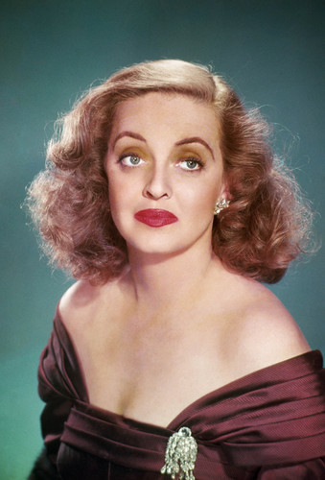
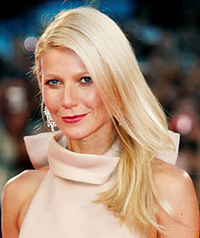
Introduction
This lecture will discuss the value of stars and take another look at the career of Bette Davis.
In the second part of the lecture I shall look at why some actors become stars rather than others, using Gwyneth Paltrow as a case study.

Slide 3
Proven popularity
An actor’s star status rests ultimately upon their proven popularity with large numbers of moviegoers and the extent to which that sizeable audience can be predicted to attend a movie in which the star appears.

Slide 4
Economic studies of stardom
A. De Vany and W.D. Walls, ‘Uncertainty and the Movie Industry: Does Star Power Reduce the Terror of the Box Office?’ Journal of Cultural Economics, volume 23, 1996, pp. 285-318.
This article claimed that stars cannot reduce the uncertainty of a film’s success with a potential audience in order to guarantee greater profitability in terms of box-office returns.
John Sedgwick and Michael Pokorny, An Economic History of Film (Routledge, 2005).
This book claimed that big-name and expensive stars can influence a film’s profitability (although only in a limited way), and that many stars do have a positive financial impact but only across a portfolio of films rather than on each and every film they make.

Slide 5
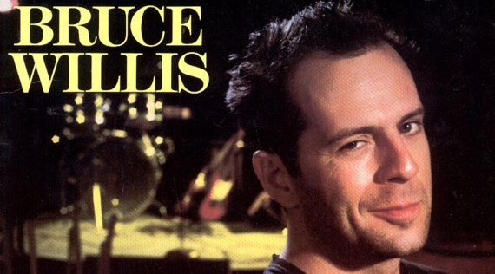
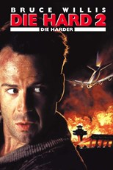
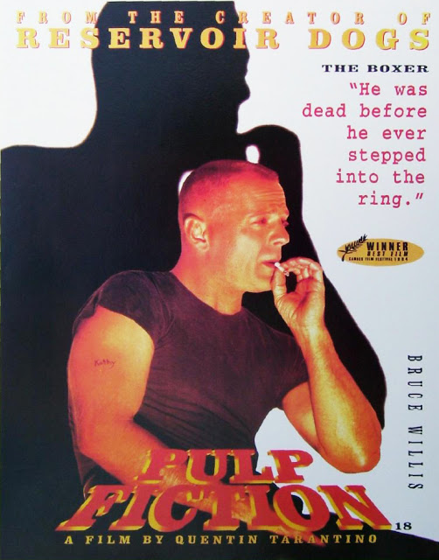
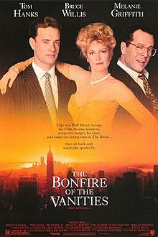
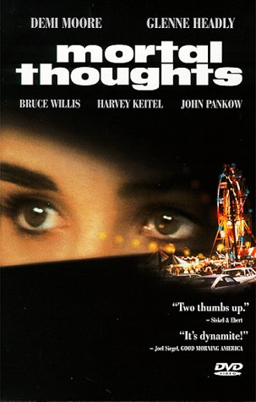
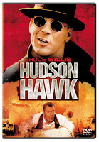
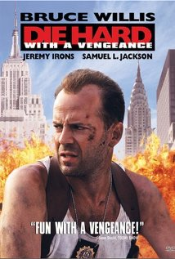
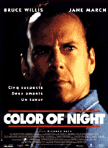
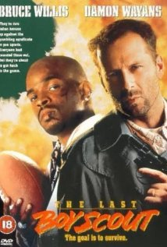
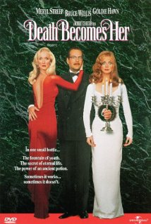
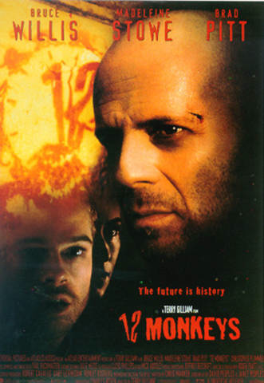
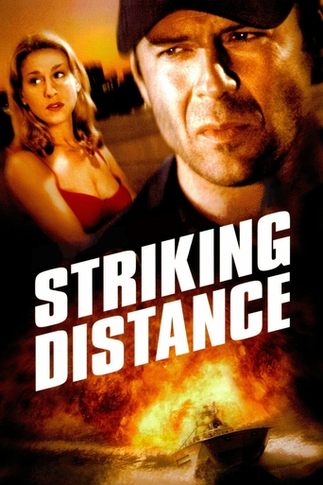
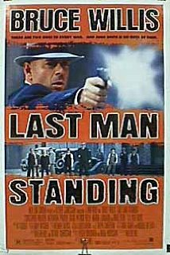
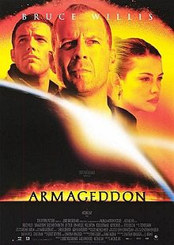
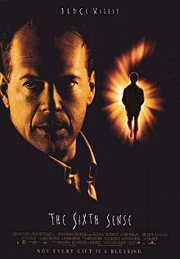
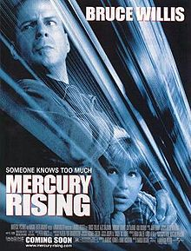
Bruce Willis in the 1990s
Die Hard 2: Die Harder (1990) grossed $117.5 million
The Bonfire of the Vanities (1990) grossed $15.6m
Mortal Thoughts (1991) – $19m
Hudson Hawk (1991) - $17.2m
Billy Bathgate (1991) - $15.9m
The Last Boy Scout (1991) - $59.5m
Death Becomes Her (1992) - $58.4m
Striking Distance (1993) - $30m
Pulp Fiction (1994) - $107m
North (1994) - $7m
Color of Night (1994) - $19.7m
Nobody’s Fool (1994) - $39.4m
Die Hard 3: With a Vengence (1995) - $100m
Twelve Monkeys (1995) - $57m
Last Man Standing (1996) - $18m
The Fifth Element (1997) - $63.5
Mercury Rising (1998) - $32.9
Armageddon (1998) grossed $201.6m
The Siege (1998) - $40.9m
Breakfast of Champions (1999) grossed just $200,000.
The Sixth Sense (1999) grossed $276.4m
(See McDonald, 2000: 104-5).

Slide 6
Achievement
Stars generate interest in a film prior to and during its initial release.
To do this, they need to perform within the media circus of press conferences, media interviews, premieres, public appearances and TV chat shows around the world.
These duties are part of their contractual obligations when signed to a movie.
It’s their ability to attract press and public interest that results in them being paid more than any other member of the cast.

Slide 7
Generating interest
Stars generate interest in their films by winning prestigious awards, garnering rave reviews, appearing in popularity polls, and being granted tributes and honours.
Awards, reviews, polls, tributes and honours also determine and chart the fluctuations of a star’s career, along with billing, marquee values and box-office.

Slide 8
The standard career pattern
Most star careers follow a specific pattern:
A period of training or work in other forms of entertainment (e.g., TV or theatre).
A film debut and early film roles that include a ‘break-through.’
A period of typecasting and turning-points (i.e., where a star might become associated with different genres over time or different types of role as they age or develop their performance skills).
Peaks and troughs in status and popularity, which are often related to the effects of exposure or over-exposure.
The effects of ageing and the management of decline (i.e. physical decline or their type my seem outdated).
The acquisition of a posthumous reputation.

Slide 9
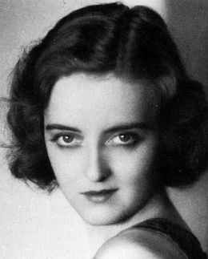
Another Look at Bette Davis
Davis arrived in Hollywood in 1930 (age 22) and signed a contract with Universal after a short but successful spell on Broadway (most notably, in the comedy Broken Dishes, 1929).
6 supporting roles under her Universal contract (the last 3 being loan outs to Radio Pictures, Columbia and Capital Films)
She was dropped by Universal in 1931. The studio did not know what to do with her given that she was not considered beautiful enough to be a young Hollywood starlet.
Turning point: On the point of leaving Los Angeles to return to Broadway, Davis was offered a one-picture deal with Warner Bros. to play a supporting role in a George Arliss film, The Man Who Played God (John Adolphi, 1932).

Slide 10
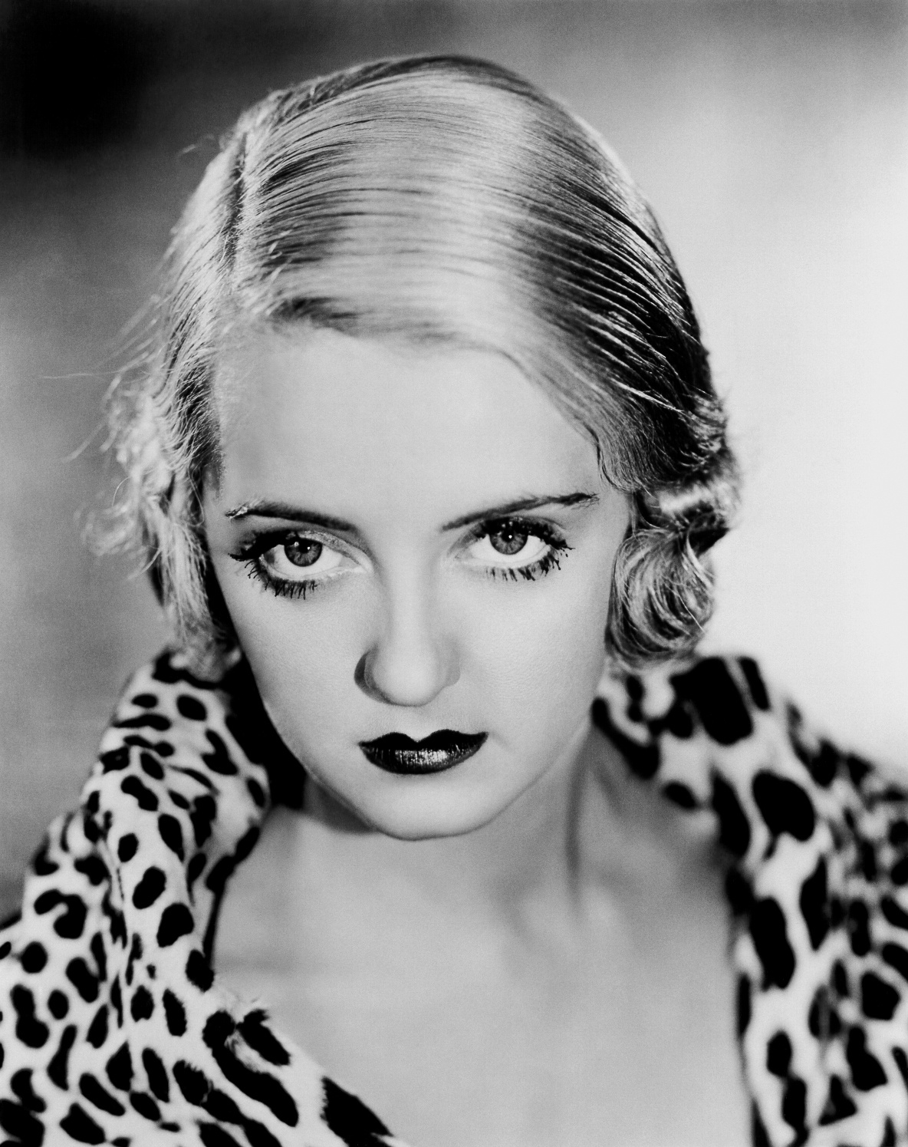
Warners’ Contract Player
At the start of 1932, Warner Bros. offered Davis a 5 year option contract.
She was cast in minor and supporting roles in So Big (1932), The Rich Are Always with Us (1932), The Dark Horse (1932), Cabin in the Cotton (1932), Three on a Match (1932), 20,000 Years in Sing Sing (1933), Parachute Jumper (1933), The Working Man (1933).
First starring role in Ex-Lady (1933). It flopped.
Cast in 6 small and supporting roles in Warner comedies and crime dramas, Bureau of Missing Persons (1933), Fashions of 1934 (1934), The Big Shakedown (1934), Jimmy the Gent (1934), and Fog Over Frisco (1934).

Slide 11
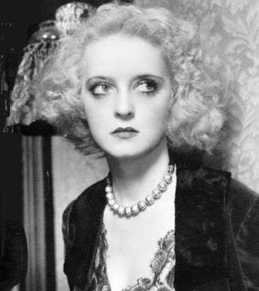
Loaned out
In 1934, she was loaned out to RKO to appear in Leslie Howard’s film Of Human Bondage (1934). This was the first time that Davis got noticed by the film critics, who commented on her remarkable acting talent. However, she failed to be nominated for an Oscar.
Hired Mike Levee as her agent. He helped Davis renegotiate a new contract (dated 27th December 1934) with an increase in her weekly salary from $750 to $1350.
Returning to Warners, she was cast in supporting roles in two more films, opposite George Brent in Housewife (1935) and opposite Paul Muni in Bordertown (1935), in which she gave another remarkable performance (e.g., courtroom mad scene).

Slide 12
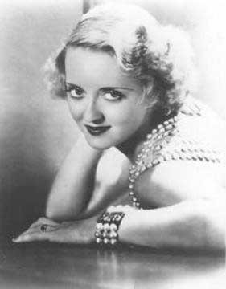
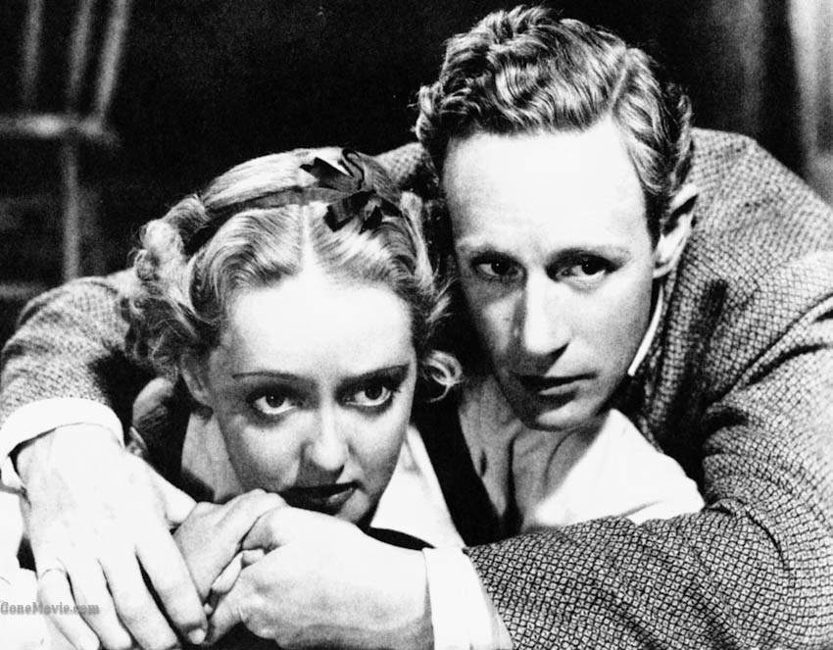
With George Brent and others
2nd star vehicle: The Girl from Tenth Avenue (1935), failed to generate much interest from critics or movie-goers.
Co-starred with George Brent in two crime thrillers, Front Page Woman (1935) and Special Agent (1935).
3rd star vehicle: Dangerous (1935), playing an alcoholic stage actress. In March 1936, she won her first Oscar for Best Actress in a Leading Role for this part.
Co-starred with Leslie Howard and Humphrey Bogart in a film version of a successful Broadway play, The Petrified Forest (1936). This confirmed her newly acquired status as a talented actor.
What do you think happened next?

Slide 13
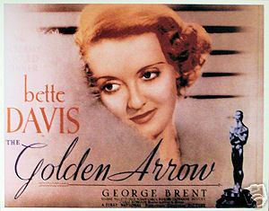
More cheap crime thrillers!
The Golden Arrow (1936) and Satan Met a Lady (1936).
Davis walked out on her Warners’ contract. She hired attorney Martin Gang (of Gang & Kopp) to represent her.
Gang informed Warners that Davis wanted:
an increase in salary
a limit on the number of films she made each year
a guaranteed resting time between pictures
the chance to do the occasional film at a rival studio.
Warners offered to increase her weekly pay from $1600 to $2000. Davis refused the offer, fired Martin Gang and accepted a part in a British film in defiance of her contract. This resulted in a court case in London, where she was finally forced by the High Court of Justice to return to Los Angeles to honour her contractual obligations.
Marked Woman (1937) with Humphrey Bogart.
A boxing movie, Kid Galahad (1937) with Edward G. Robinson and Humphrey Bogart.

Slide 14
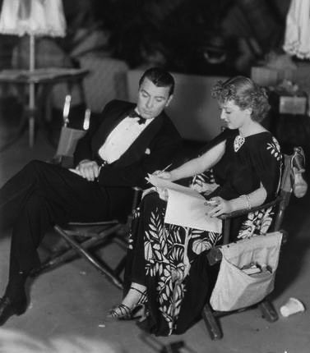
Team Davis
Mike Levee – agent
Dudley Furse – attorney
Vernon Wood – business manager (who in 1936 tried to raise Davis’s salary from $83,200 p.a. to $100k raising to $220k by 1940)

Slide 15
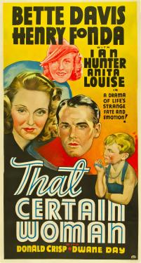
The ‘Bette Davis film’ is born
That Certain Woman (1937) marked the beginnings of the ‘Bette Davis film’. Written and directed by Edmund Goulding, cinematography by Ernest Haller and music composed by Max Steiner.
The ‘Bette Davis film’: a series of films marketed under Davis’s name in which she took the leading role, had her name above the titles in the largest type.
These were star vehicles tailored to her unique talents as an actress and her independent and rebellious persona.
These films were made by a team of writers, directors, producers, cinematographers, make-up and costume designers and composers who would repeatedly be hired to make her films for the next ten years.

Slide 16
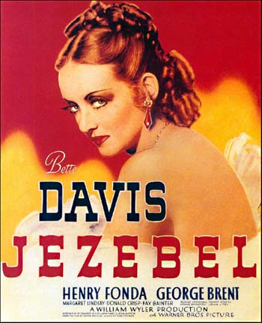
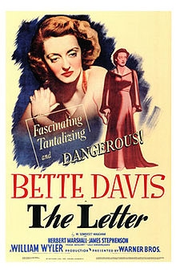
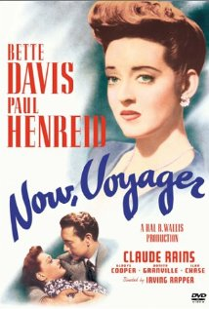
Davis’s star vehicles
won 2nd Oscar [DoP: Ernest Haller]
The Old Maid (Edmund Goulding, 1939) Script: Casey Robinson [DoP: Haller]
The Private Lives of Elisabeth and Essex (Michael Curtiz, 1939)
Dark Victory (Edmund Goulding, 1939) Script: Casey Robinson
All This and Heaven Too (Annatole Litvak, 1940) Script: Casey Robinson [DoP: Haller]
The Letter (William Wyler, 1940) Script: Howard Koch
The Great Lie (Edmund Goulding, 1941) Script: Lenore Coffee
Now, Voyager (Irving Rapper, 1942) Script: Casey Robinson
Old Acquaintance (Vincent Sherman, 1943) Script: Lenore Coffee
Mr. Skeffington (Vincent Sherman, 1944) [DoP: Haller]
The Corn is Green (Irving Rapper, 1945) Script: Casey Robinson
A Stolen Life (Curtis Bernhardt, 1945) [DoP: Haller]
Deception (Irving Rapper, 1946) [DoP: Haller]

Slide 17
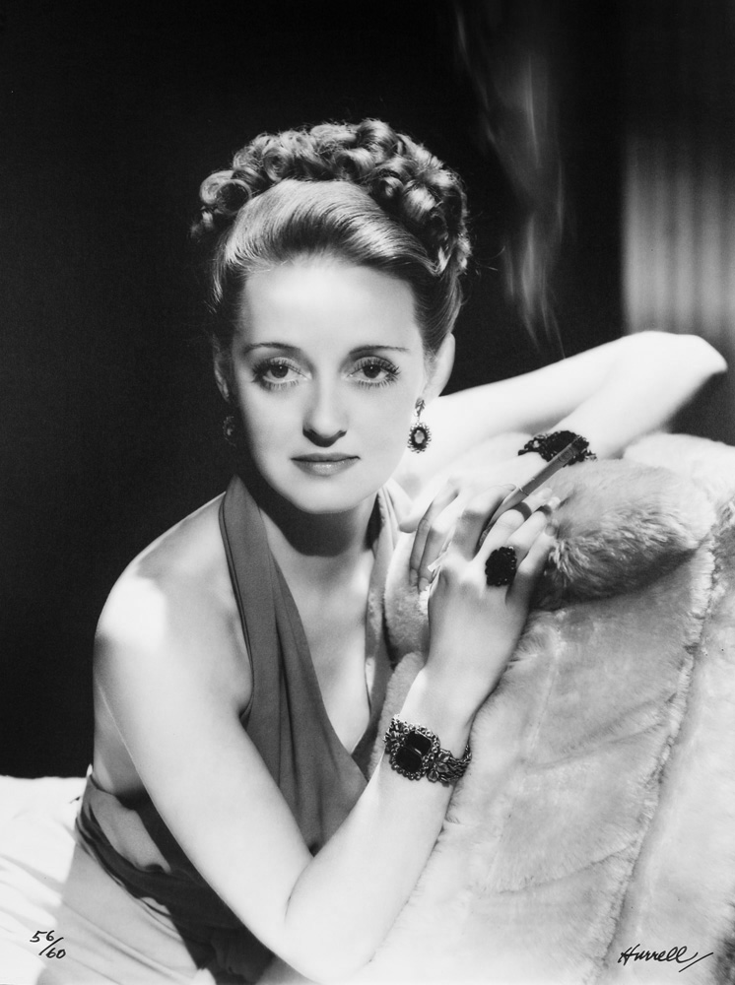
Another new contract
17th August 1938, Davis signed a new contract with Warners, accepting a weekly salary of $3500.
Otherwise this gave her no more control over her career, such as script approval or a limit on the number of films she made each year.
Over the next 12 months she made 5 films.

Slide 18
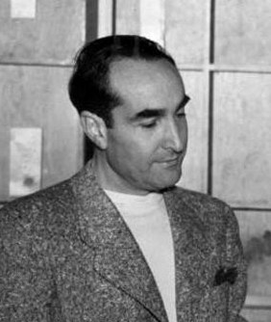
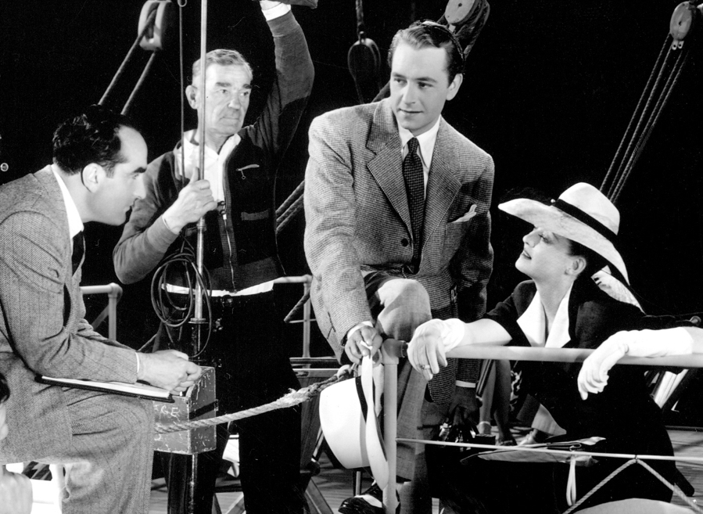
Irving Rapper
Davis’s Dialogue Director on:
Kid Galahad (Michael Curtiz, 1937) and Assistant Director
The Sisters (Anatole Litvak, 1938) and Assistant Director
Dark Victory (Edmund Goulding, 1939)
Juarez (William Dieterle, 1939) and Assistant Director
The Private Lives of Elizabeth and Essex (M. Curtiz, 1939)
All This and Heaven Too (A. Litvak, 1940) and Assistant Director
Davis’s Director on:
Now, Voyager (1942)
The Corn is Green (1945)
Deception (1946)
Another Man’s Poison (1951)

Slide 19
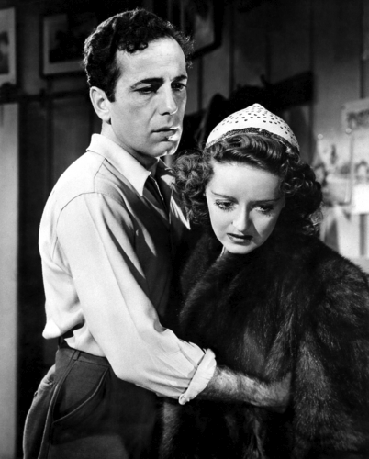
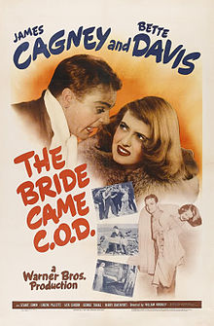
Weepies & Comedies
Weepies
Jezebel (William Wyler, 1938)
The Old Maid (Edmund Goulding, 1939)
The Private Lives of Elisabeth and Essex (Michael Curtiz, 1939)
Dark Victory (Edmund Goulding, 1939)
All This and Heaven Too (Annatole Litvak, 1940)
The Letter (William Wyler, 1940)
The Great Lie (Edmund Goulding, 1941)
Comedies
The Bride Came C.O.D. (Wm. Keighley, 1941)
The Man Who Came to Dinner (Wm. Keighley, 1942)
In November 1942, Davis recruited Lew Wasserman as her agent. Wasserman worked for MCA (Music Corporation of America). He helped Davis renegotiate her WB contract in 1944, 1946 and 1949.

Slide 20
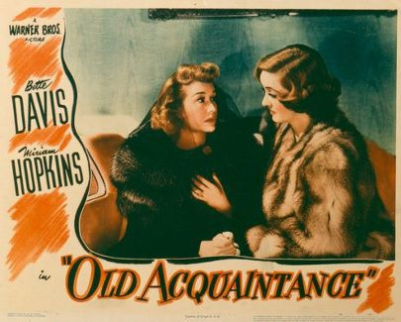
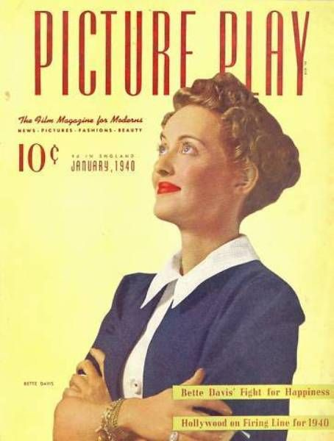
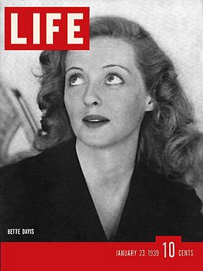
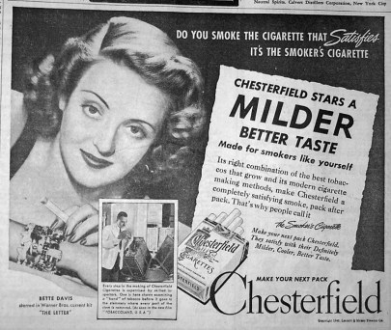
Weepies with comedy
Now, Voyager (Irving Rapper, 1942)
Old Acquaintance (Vincent Sherman, 1943)
Mr. Skeffington (Vincent Sherman, 1944)
The Corn is Green (Irving Rapper, 1945)
1942-45: She regularly featured in movie magazines, often featuring on the cover of magazines like Photoplay and Modern Screen but also featured in Life and Ladies Home Journal.
She featured in photo-spreads and appeared in advertisements for products such as cigarettes, Lux soap and Max factor cosmetics.

Slide 21
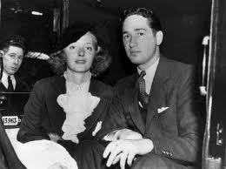
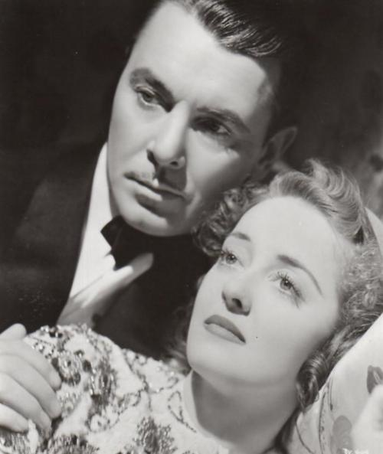
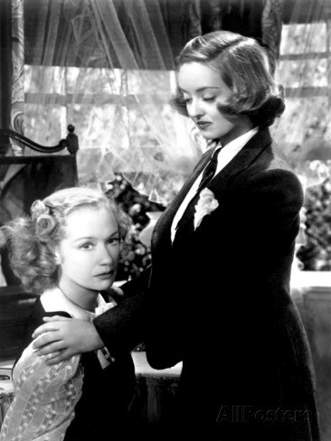
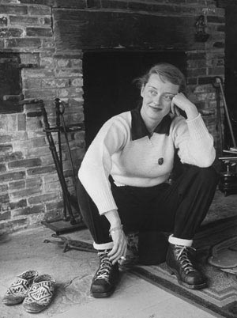
Romance & Rivalry
Her marital break-downs featured regularly in reports, with intimations of her relationships with co-stars (e.g., George Brent with whom she appeared in Jezebel, Dark Victory, The Old Maid and The Great Lie).
Articles detailed her rivalry with other actresses (e.g., Miriam Hopkins, who co-starred with in The Old Maid and Old Acquaintance).
A running theme in her publicity was marriage-career conflict, her struggles to maintain a high-level career whilst being a wife and home-maker.
Davis was often depicted in casual and even masculine clothing and reports of her ‘private life’ frequently presented a picture of her as non-glamorous, enjoying nature and the simple things in life, including her love of dogs and horses.
She was also closely associated with her hometown of Boston and represented as a no-nonsense down-to-earth New Englander rather than a Hollywood glamour queen.

Slide 22
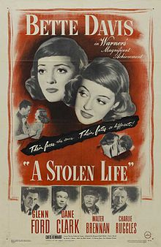
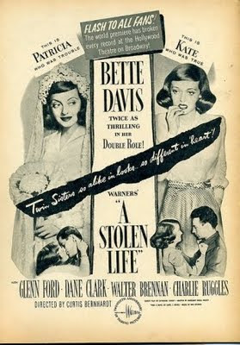
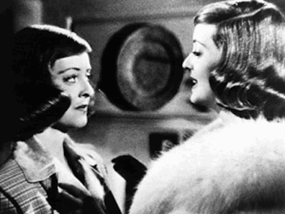
Another WB Contract
In June 1944, Davis signed a new 5 year contract with Warners for a total of 14 films, 9 for Warner Bros. and 5 for her own production company B.D. Films Inc.
This would give the actress creative freedom to choose her own projects, directors, writers and co-stars for B.D. Film Inc. productions.
Davis would be paid $115k for the first 5 Warner productions and $150k for the remaining 4.
She would receive a share of the box-office for her own productions.
B.D. Films Inc. produced just one film under this new agreement, A Stolen Life (1946).

Slide 23
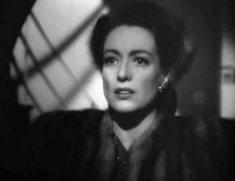
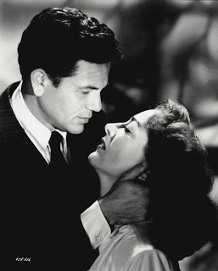
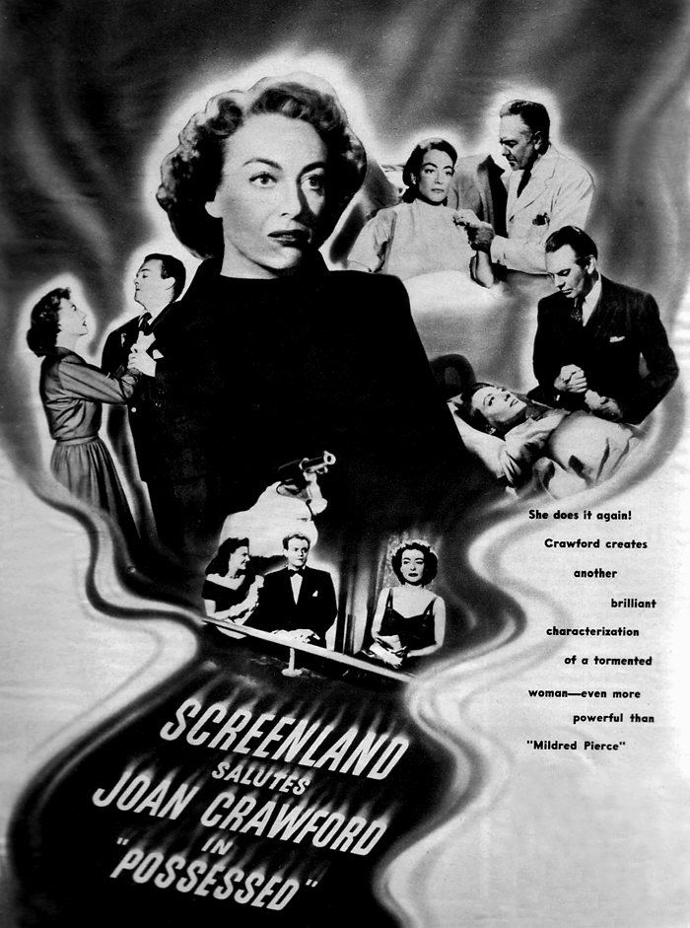
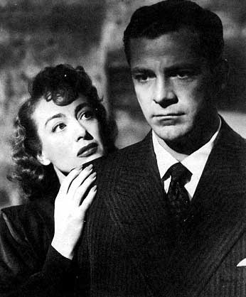
Joan Crawford joins Warners
In June 1943, Joan Crawford left MGM and joined Warner Bros.
Her contract gave her script approval.
Achieved hits with:
Mildred Pierce (Michael Curtiz, 1945) – Oscar
Humoresque (Jean Negulesco, 1946)
Possessed (Curtis Bernhardt, 1947) – Oscar nom
Daisy Kenyon (Otto Preminger, 1947)
The Damned Don’t Cry (Vincent Sherman, 1950)
Harriet Craig (Vincent Sherman, 1950)

Slide 24
After World War II
Joan Crawford, Ava Gardner, Rita Hayworth, Lana Turner and Marilyn Monroe all enjoyed greater success with their films than Bette Davis after 1946.
4th February 1946, Davis renegotiated her contract with Warners.
She wound up B.D. Films Inc.
The new contract ran for 172 weeks (3.3 years), being due to end in the middle of 1949. It was for just 8 films.
Davis was to be paid $6k per week for the first 66 weeks and $7k per week thereafter.

Slide 25
In Decline
Declining box-office returns for Deception (1946), Winter Meeting (1948), June Bride (1948) and Beyond the Forest (1949).
In January 1949, Davis signed a new contract with Warners for 1 picture a year for next 4 years, paying her $200k per picture.
In August 1949, Warner Bros. terminated Davis’s latest contract, ending their 18 year association with the actress.

Slide 26
Freelance
Starring role in a drama at RKO. It was originally called Story of a Divorce but was later released in 1951 as Payment on Demand (Curtis Bernhardt).
Cast in a leading role in Joseph L. Mankiewicz’s All About Eve. When this film was released in 1950, Davis stole the show with a career-defining role as ageing Broadway diva Margo Channing.
Though the part had not been written with Davis in mind, she proved to be a perfect fit and produced the greatest performance of her entire career.
She won a New York Critics Award and earned an Oscar nomination.

Slide 27
At Twentieth Century-Fox
Phone Call from a Stranger (Jean Negulesco, 1952)
The Star (Stuart Heisler, 1952)
Virgin Queen (Henry Koster, 1955)
Marilyn Monroe was the big star at 20th Century-Fox in the 1950s: After her small role in All About Eve in 1950, Monroe achieved spectacular success in the early to mid 1950s in Gentlemen Prefer Blondes (1953), River of No Return (1954) and The Seven Year Itch (1955). Monroe went on to achieve further success starring opposite Lawrence Olivier in The Prince and the Showgirl (1957) and with Tony Curtis and Jack Lemmon in Some Like it Hot (1959).

Slide 28
Character parts
The Catered Affair (Richard Brooks, 1956)
Storm Center (Daniel Taradash, 1956)
John Paul Jones (John Farrow, 1959)
The Scapegoat (Robert Hamer, 1959)
Pocketful of Miracles (Frank Capra, 1961)

Slide 29
Transferred to Television
All Star Revue (1952)
The 20th Century-Fox Hour (1956)
Schlitz Playhouse (1957)
The Ford Television Theatre (1957)
Telephone Time (1957)
Studio 57 (1958)
General Electric Theater (1957-8)
Suspicion (1958)
Alfred Hitchcock Presents (1959)
Wagon Train (1959-61)

Slide 30
Back to the stage
Two’s Company (1952-3)
The World of Carl Sandburg (1959-60) with her husband Gary Merrill.
Tennessee Williams’ The Night of the Iguana (1961-62).
1962, she published her autobiography The Lonely Life (ghost-written by Sanford Dody)

Slide 31
The Comeback
What Ever Happened to Baby Jane? (Robert Aldrich, 1962) with Joan Crawford.
Robert Aldrich’s previous credits: Sodom and Gomorrah (1962) with Stewart Granger, The Last Sunset (1961) with Rock Hudson, The Angry Hills (1959) with Robert Mitchum, Ten Seconds to Hell (1959) with Jack Palance, Attack (1956) with Jack Palance, Kiss Me Deadly (1955).
Eliot Hyman at Seven Arts Associates agreed to finance the picture.
Distribution deal with Warner Bros.

Slide 32
The Deal
Davis received $60,000 up front, plus 5 per cent of the profit.
The film took $1,600,000 in rental on its opening weekend in October 1962.
It grossed almost $4 million dollars during its initial run in the USA and $9 million worldwide.
This turned out to be one of the Davis’ most lucrative pictures.
Earned Davis an Oscar-nomination.

Slide 33
Surviving in the Sixties
Earned Davis starring roles in Hollywood and British films during the 1960s:
Dead Ringer (Paul Henreid, 1964)
Hush, Hush Sweet Charlotte (Robert Aldrich, 1965)
The Nanny (Seth Holt, 1965)
The Anniversary (Roy Ward Baker, 1968).
Television Shows:
The Virginian (1962)
Perry Mason (1963)
The Decorator (1964)
Gunsmoke (1966)
It Takes a Thief (1970)

Slide 34
Seventies Sinema
Cinema films included:
Bunny O’Hare (1970)
Burnt Offerings (1976)
Return from Witch Mountain (1978)
Death on the Nile (1978)
Made for TV Movies:
Madame Sin (1971)
The Judge and Jake Wyler (1972)
Scream, Pretty Peggy (1973)
Hello Mother, Goodbye! (1974)
The Disappearance of Aimee (1976)
Strangers: the Story of a Mother and Daughter (Milton Katselas, 1979), for which she won an Emmy.

Slide 35
Eighties TV Movies
White Mama (Jackie Cooper, 1980)
A Piano for Mrs Cimino (George Schaefer, 1982)
Right of Way (1983), in which she co-starred with James Stewart.

Slide 36
In Person and on Film
Davis toured regularly with Bette Davis in Person and on Film (1973+)
This consisted of a sequence of clips from the actresses illustrious film career, followed by a live questions and answer session in which Davis answered questions about her life and career from an interviewer and from members of the audience.
These shows were highly successful and maintained the actress’s fan-base during the twilight of her film career. The shows attracted large audiences of gay men and established Davis as both a cult star and a queer one.

Slide 37
A Gay Icon
By the 1980s, Davis was well-established as a gay icon, widely celebrated in the gay communities of New York, San Francisco and London.
Her old movies were often shown in small art-house movie theatres and late night cinemas, most notably Now, Voyager, All About Eve and What Ever Happened to Baby Jane?
In this way, she won new fans among generations of gays and lesbians around the world.
She was frequently impersonated by drag queens in cabarets and gay bars, all of which consolidated her cult status.

Slide 38
Bette Davis Eyes
In 1981, American singer-songwriter had number one hit record with ‘She’s Got Bette Davis Eyes’ (written in 1974 by Donna Weiss and Jackie DeShannon).
It spent 9 weeks at number one in the Billboard charts and became Billboard’s biggest hit of 1981.
In 1982 it won Grammy awards for ‘Record of the Year’ and ‘Song of the Year’.

Slide 39
In poor health
In June 1983, Bette Davis had a mastectomy after discovering a lump in her left breast.
Nine days later she had a major stroke and her doctors declared that she was unlikely to ever work again.
Later in the year, she fell and broke her hip.
Davis returned to work in 1984, appearing in a Warner Bros. television production of an Agatha Christie novel made in England and starring veteran actors Helen Hayes and John Mills. Murder with Mirrors (Dick Lowry) aired on CBS television in February 1985, introducing audiences to Bette Davis’ frail and emaciated body and her thin, stilted voice, emanating from a contorted mouth.
As Summers Die (1986) with Jamie Lee Curtis

Slide 40
The Perfect Final Film
The Whales of August (Lindsay Anderson, 1987) co-starring Lillian Gish and Vincent Price. Adapted by David Barry from his off-Broadway play and produced by Mike Kaplan for the independent production company Alive Films. This was a quality production that was well received among the critics and reviewers.

Slide 41
Final Words
Bette Davis, with Michael Herskowitz, This ‘N That (G.P. Putnam’s Sons, 1987).
Wicked Stepmother (Larry Cohen), a straight-to-video black comedy.
Davis died in October 1989, aged 81.

Slide 42
After Davis
The BFI staged a season of Bette Davis films at the National Film Theatre in London in August 2006, screening 30 of her films from across her career.
In April 2008, The London Gay and Lesbian Film Festival celebrated the centenary of her birth with a special presentation on the lasting impact of her films.
In 2009, a documentary was released in cinemas around the world called Queer Icon: The Cult of Bette Davis, having its world premiere at the Roxie Theater in San Francisco.
In 2011, a play by Anton Burge was staged in London’s West End called Bette and Joan, depicting the rivalry of Bette Davis and Joan Crawford on the set of What Ever Happened to Baby Jane?

Slide 43
Bette Davis & Star Studies
Bette Davis provides a rich topic for star studies.
Her long and distinguished career demonstrates many of the classic hallmarks of film stardom, the rise to success and the fall, the peaks and troughs, the adjustments with age and to changes in the nature of the film industry.
Her films have much to tell us about attitudes to gender and sexuality in the late 1930s and early 1940s.
Her career after 1945 is instructive of female stardom in Hollywood during the break-up of the studio system and the shift undertaken by stars as they were transformed from studio-owned and controlled properties to freelance agents responsible for their own choices and publicity.
Davis’s career after 1960, provides a test case for how studio stars survived in the post-studio era by becoming cult stars, appealing predominantly to marginalized audiences, while continuing to move between mainstream and more marginal productions.
Her posthumous career is instructive in terms of how and why some stars are remembered while others are forgotten.

Slide 44
After a short break
After the break, I shall be discussing why some actors become stars rather than others.
I shall discuss the qualities associated with stardom and use Gwyneth Paltrow as a case study of contemporary female film stardom.
Before then are there any questions?

