Slide 1
Digital libraries and metadata interoperability
Lecture 1 at Masaryk University
Nils Pharo

Slide 2
Who am I?
Professor in knowledge organization and information retrieveal at Oslo and Akershus University College
Teaching courses in Knowledge organization and IR (bachelor level) and Digital knowledge organization (master level)
Research interests: interactive information retrieval, information searching behaviour, metadata interoperability

Slide 3
Content
Introduction to digital libraries
  Technological development
  History
  Typology
Indexing digital libraries
  Owner
  Collection
  User
Metadata interoperability problems
  Metadata types
  Case: library metadata interoperability
  Solutions

Slide 4
From document surrogates to full text 1
early 1960s: first complete texts (full text) made computer searchable
1960s: first full text information retrieval systems developed
1970s: common to use free text search in bibliographic databases
1980s: lots of experience in efficient full text search algorithms
1980s: comparisons of full text versus controlled vocabularies
1990s: the Web arrives
2000s: digital libraries and repositories of digital documents

Slide 5
What is a digital document?
Digital originals
  a web page?
  a web site?
  *.wpd, *.docx, *.pdf, *.ps, *.xls, *.*?
  images, movies, songs etc?
  ebooks?

Slide 6
Digital library history
Some «classic» digital libraries
Project Gutenberg (1971) - the oldest digital library
Perseus Project (1987) - classic texts
Project Runeberg (1992) - Nordic equivalent to Project Gutenberg
American Memory (1994) - Library of Congress Digital Archive
The World Digital Library (2007) - Library of Congress
IFLA's list of resources (from 2008)
Wikipedia's list of digital library projects (dated 2013)

Slide 7
Typology of digital libraries
discipline oriented
format/genre oriented
institutional
task oriented
(Bearman, 2007)

Slide 8
Discipline oriented digital libraries
designed for specific group of users
barriers for non-experts
internal documentation of systems
Example: arXiv.org
Example 2: Countway library of medicine

Slide 9
Institutional DLs
academic institutions
external providers
digital repositories
Example1: ODA
Example2: Repozitar.cz

Slide 10
Audience/Task-oriented DLs
distance learning
children
Example: Open Library, from The Open University
Example: International Children's Digital Library

Slide 11
Digital library architecture
collection
metadata
interface
services
authentication
…

Slide 12
Challenges
Acquisition
Indexing
Information retrieval
User-centered design/personalization
Economics

Slide 13
Acquisition
digitization
harvesting
collaboration/federation
purchase
  license agreements
  consortium agreements

Slide 14
Indexing
What?
  metadata
  full text
  semantic markup
Who?
  owners
  Authors (Collection)
  users

Slide 15
Information retrieval
boolean perfect match
full text best match
combination

Slide 16
User-centered design/personalization
user-centred interfaces
authentication
user profiles
interaction
recommendation
privacy
etc

Slide 17
Economics
to secure economic sustainability it is crucial to integrate the DL in the mother organization!
costs:
  collection development (acquisition)
  software & hardware
  tech staff
  technological updates

Slide 18
Discussion
What roles should the librarian take?

Slide 19
Who should index?
owners
collection
users

Slide 20
1. Owner based indexing
subject experts
indexing experts

Slide 21
Old tradition
constitute important basis of librarians' profession
based in the "second order of order“ (D. Weinberger)

Slide 22
Owners
know their users
know their collection
should develop an indexing policy based on this knowledge

Slide 23
Manual indexing
consistent(?)
language independent
provides query support
use subject languages

Slide 24
Objectives of subject languages
collocation of documents
facilitate navigation

Slide 25
Collocation objective
Charles Cutter's objective from 1876:
To show what the library has
by a given author
on a given subject
in a given kind of literature

Slide 26
Collocation measures
recall
  number of relevant documents found/number of relevant documents in collection
precision
  number of relevant documents found/number of retrieved documents

Slide 27
Navigation objective
"To navigate a bibliographic database (that is, to find works related to a given work by generalization, association, and aggregation; to find attributes related by equivalence, association, and hierarchy)." (Elaine Svenonius, 2000)

Slide 28
Subject language typology
controlled vocabularies
alphabetic subject-languages
classification languages

Slide 29
Semantics
category semantics
referential semantics
relational semantics

Slide 30
Category semantics
subject languages can be:
synthetic or
enumerative

Slide 31
Referential semantics
What a term in a subject language refers to:
the set of all documents indexed with the term
procedures for dealing with homonyms, polysemes and the unclarity of language
semantic disambiguation

Slide 32
Methods for clarifying language
domain specification
qualifiers
notes
hierarchy

Slide 33
Relational semantics
hierarchical
eqivalence (synonymy)
relatedness

Slide 34
Vocabulary selection
terminology
domain definition
warrant

Slide 35
Warrant
literary warrant
use warrant
structural warrant

Slide 36
2. Collection based indexing
authors' own words:
  explicit keywords
  Automatic extraction of meaning

Slide 37
Automatic indexing
let the content represent itself - automatic indexing
neutral
fast
cost-efficient

Slide 38
The basics of automatic indexing
The indexing task consists of
first to assign to each stored item terms, or concepts, capable of representing document content, and
second to assign to each term a weight, or value, reflecting its presumed importance for purposes of content identification (Salton & McGill, 1983)

Slide 39
Good index terms fulfill to purposes
The term must be related to the documents content so as to make it retrievable when it is wanted, but also
A good index term should distinguish between the documents it is assigned to from the remainder in order to prevent indiscriminate retrieval of all documents.

Slide 40
Inverse Document Frequency (IDF) Weight
term importance is:
proportional to the occurrence frequency of each term k in each document i (FREQik)
inversely proportional to the total number of documents to which each term is assigned

Slide 41
Other components in automatic indexing weighting algorithms
term placement
term proximity
element markup
pagerank
popularity

Slide 42
3. User based indexing
create folksonomies
based on "folk" + "taxonomies"
consists of tags (generating the verb "to tag")
related to "free keywords"
users make up their own index terms
uncontrolled vocabulary
Citeulike and Librarything

Slide 43
How are folksonomies used?
users may tag their own and other users' collections
used on a variety of digital collections (bookmarks, pictures, books, articles...)
facilitates the indexing of new topics

Slide 44
Some observation of tag content
describe different aspects (facets?) of the object they index
aboutness (at variable levels of abstraction)
emotional characteristics
genre
place
space
whereabouts
+++

Slide 45
Metadata interoperability
Different types of metadata
Case: library metadata
Interoperability

Slide 46
Definition
Metadata is machine understandable information about web resources or other things (Berners-Lee, 1997)

Slide 47
Purposes of metadata
facilitate information retrieval
document management
document encoding and analysis

Slide 48
Metadata types
descriptive metadata
  Descriptive metadata describes a resource for purposes such as discovery and identification. It can include elements such as title, abstract, author, and keywords.
structural metadata
  Structural metadata indicates how compound objects are put together, for example, how pages are ordered to form chapters.
administrative metadata
  Administrative metadata provides information to help manage a resource, such as when and how it was created, file type and other technical information, and who can access it.
(NISO, 2004)

Slide 49
Metadata, level of aggregation
Collection level
Series/volume level
Document level
Document part level

Slide 50
Case: bibliographic metadata
MARC
Dublin Core

Slide 51
Dublin Core
DCMES - Dublin Core Metadata Element Set
initiated at a workshop in Dublin, Ohio in 1995
consists of 15 core elements
(DC Metadata Element Set)

Slide 52
DC characteristics
very simple metadata schemes
descriptive, structural and administrative elements
no obligatory elements
all elements are repetitive
system independent
several syntaxes
  html
  xml
  rdf

Slide 53
Qualified Dublin Core
the objective is to refine the 15 core elements
element represent same content with more specificity
use encoding schemes to restrict interpretation
in addition three new elements have been added to QDC
  Audience
  Provenance
  RightsHolder

Slide 54
Enchoding schemes
used to specify how the value taken by an element should be interpreted. There are two types of encoding schemes:
vocabulary encoding schemes
  DCMI type vocabulary
  DDC
syntax encoding schemes
  ISO 3166
(Encoding schemes)

Slide 55
Example bibliographic record in MARC
*000 $a010041702
*008 $ap$bv$cnob$hno
*009c $ak
*015 $anf0105587
*020 $a82-05-27748-6$bib.
*080c $a839.6
*082g $d839.823[S]
*082kj$a839.82
*082xn$a839.82
*086d $aS 4b
*100 $aHamsun, Knut$d1859-1952
*245 $aSult$cKnut Hamsun
*260 $a[Oslo]$bGyldendal$c2001
*300 $a147 s.
*440 $aGyldendals 10 store
*500 $a1. utg. København : Philipsen, 1890
*776 $w101353413
BIBSYS-MARC

Slide 56
MARC-record transformed to Dublin Core
DC.Format="p"
DC.Type="v"
DC.Language="nob"
DC.Identifier="82-05-27748-6"
DC.Subject="839.823[S]"
DC.Subject="839.82"
DC.Subject="839.82"
DC.Creator="Hamsun, Knut"
DC.Creator="1859-1952"
DC.Title="Sult"
DC.Publisher="Gyldendal"
DC.Date="2001"
DC.Description="1. utg. København : Philipsen, 1890"
DC.Relation="101353413"
Mapping from BIBSYS-MARC to Dublin Core

Slide 57
Example 2
Movie: True Grit
MARCXML
Dublin Core

Slide 58
Problem
Similar kind of content is described using different metadata standards and syntaxes
Why?
Create groups of four and discuss possible reasons why such situations occur?

Slide 59
Interoperability
"Interoperability is the ability of multiple systems with different
hardware and software platforms, data structures, and interfaces to
exchange data with minimal loss of content and functionality."

Slide 60
Metadata interoperability
3 levels of interoperability
  schema level
  record level
  repository level
(Chan & Zeng, 2006; Zeng & Chan, 2006)

Slide 61
MARCsism: the uniform solution
Everybody should use the same system! :-)
top down approach (MARCsism): "everybody should use MARC", is in theory the optimal solution, but is no longer realistic

Slide 62
Schema level interoperability
Efforts are focused on the elements of the schemas, being independent of any applications:
derivation
application profiles
crosswalks
switching-across
metadata framework
metadata registry

Slide 63
Derivation
To create a new schema from an existing source schema, e.g.:
USMARC and MARC21 har been the basis for a number of national MARC formats, including NORMARC
MARCXML is also based on MARC21, example from Library of Congress
Qualified Dublin Core is derived from simple DC, e.g. <abstract> is a refinement of <description>

Slide 64
The DC dumb down principle
The fifteen elements should be usable and understandable with or without the qualifiers
Like saying that nouns can stand on their own without adjectives
If your search engine encounters an unfamiliar qualifier, look it up somewhere -- or just ignore it!
To test whether a qualifier is "good", cover the qualifiers with your hand and ask:
  Does the statement still make sense?
  Is it correct?

Slide 65
Application profiles
Solutions based on a (combination of) existing schemas optimized for a specific community. The developers will typically have a bottom-up approach
an AP may also specify the specific value schemes, cardinality and syntaxes that are allowed used
Dublin Core is often used to provide the core set of elements
combination of DC and LOM for education purposes
BIBLINK Core BIBLINK was an attempt at coupling ePublishers and national bibliographic agencies.
new elements must be accompanied by a namespace declaration

Slide 66
Crosswalks
specifies the mapping of elements, semantics and syntax between different schemas. Very common way of securing interoperability. Two forms of crosswalks, absolute and relative
absolute crosswalk:
  exact mapping between elements in the two schemas: MARC.260$c = DC.date.created
relative crosswalk:
  mapping between elements that do not share eqivalent meaning:MARC.240 (Uniform title) = DC.title

Slide 67
Crosswalk challenges
different degres of equivalence; one-to-one, one-to-many, many-to-one, one-to-none
crosswalks work better from a complex schema to a simpler one
crosswalk from a complex to a simple schema results in data loss. Several different MARC fields map to DC.subject
Examples
TEI header to MARC
Dublin Core to LOM
Dublin Core to MARC
MARC to Dublin Core

Slide 68
Switching across
To map between multiple schemas one of the schemas are used as a switch
Example: Getty's crosswalk where CDWA (Categories for the Description of Works of Art) is used to map between 12 different schemas

Slide 69
Metadata frameworks
Created to provide guidelines for developers of metadata schemas in specific environments. Frameworks can be developed based on existing schemas or prior to any schema has been developed
Example: OAIS reference model

Slide 70
Metadata registries
Provide overview of relevant metadata schemas, their elements, syntax, semantics etc to facilitate adoption and reuse of existing schemas in favour of creating new (and redundant) schemas
Example: Dublin Core Metadata Registry

Slide 71
Record level interoperability
Efforts are intended to integrate the metadata records through the mapping of the elements according to the semantic meanings of these elements.
conversion
data reuse and integration

Slide 72
Metadata conversion
convert the content of metadata records in one schema into another
problem: data loss
Example from Zeng & Chan

Slide 73
Data reuse and integration
This approach is based on combining metadata from various sources in one common format. METS (Metadata Encoding and Transmission Standard) and RDF provide two different solutions for this.
a METS record (may) contain its own metadata on an item in addition to pointers to metadata records that describe the same item
RDF records use XML's namespace declaration to combine the values from different metadata schemas

Slide 74
RDF example
<?xml version="1.0"?>
<rdf:RDF
xmlns:rdf="http://www.w3.org/1999/02/22-rdf-syntax-ns#"
xmlns:dc="http://purl.org/dc/elements/1.0/"
xmlns:skos="http://www.w3.org/2004/02/skos/core#">
<rdf:Description rdf:about="http://mitpress.mit.edu/catalog/item/default.asp?ttype=2&tid=3792">
<dc:title>The Intellectual Foundation of Information Organization</dc:title>
<dc:creator>Elaine Svenonius</dc:creator> <dc:publisher>MIT Press</dc:publisher>
<dc:date>1999</dc:date>
<dc:language>en</dc:language>
<skos:prefLabel>information organization;/skos:prefLabel>
</rdf:Description>
</rdf:RDF>

Slide 75
Repository level interoperability
Secure interoperability of harvested or integrated records from varying sources
Different solutions:
keep each providers original format
aggregation of metadata from different sources
convert/integrate into a standard format

Slide 76
No conversion
harvest from several sources
store metadata in original schema
add collection meta data
possible to enter the individual source via the repository

Slide 77
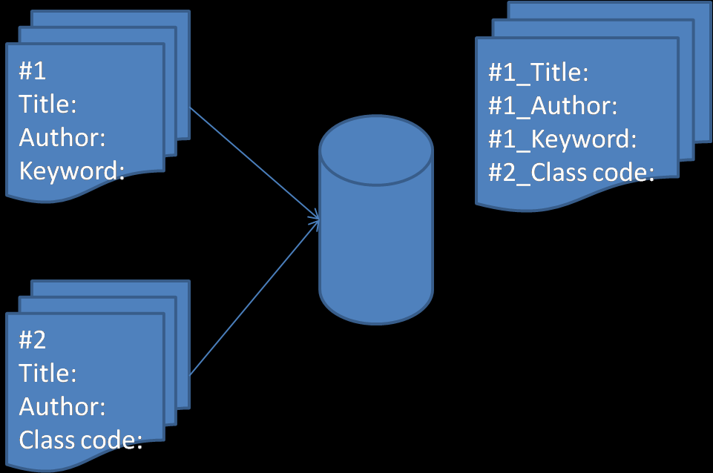
Content aggregation
The content of a metadata record for an item is the aggregated contents of all the item's metadata records

Slide 78
What’s next?
Wednesday: semantic web and linked data
Thursday: ontology modelling, RDF and Topic Maps

