Slide 1
Linked data and Topic Maps Lecture 3 at Masaryk University

Slide 2
Content
ontology modelling revisitet
interoperability recapitulated
the data silo problem
linked data
Topic Maps

Slide 3
Ontology modelling in RDF, things to remember
classes represent the collection of objects or individuals
classes may contain other classes
instances can belong to multiple classes
sometimes things are better represented as properties...
Start with creating the class hierarchy!

Slide 4
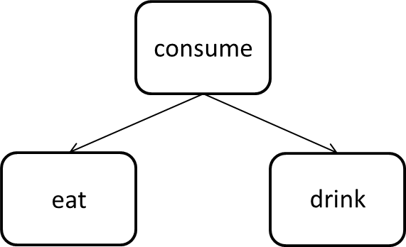

Slide 5
The Semantic Web
Facilitates
data sharing
data merging
data reuse

Slide 6
Challenges to the Web
too much noise
internal systems with bad communication capabilities (data silos)
large costs of communication

Slide 7
Silo problem

Slide 8
Tim Berners-Lee on the next Web

Slide 9
Linked data - bottom up approach to the semantic web
Solve the silo problem by:
making your data available in RDF format (as SPARQL end points)
linking them to other existing data

Slide 10
The basics of linked data
Use URIs to identify things.
Use HTTP URIs so that people can look up those names.
When someone looks up a URI, provide useful information, using the standards (RDF, SPARQL)
Include links to other URIs. so that they can discover more things
Tim Berners-Lee (2006). Linked data - design issues

Slide 11
1. Use URIs as names for things
Unique identifiers are essential for finding and referring to "things"
URL - Uniform Resource Locator, known as a "web address", the same content may exist on several addresses
URN - Uniform Resourse Name, less well known. States the unique "name" of a resource. ISBN is a commonly used example

Slide 12
2. Use http URIs so that people can look up those names
Use the Web's standard protocol for hypertext transfer rather than other naming scheme.
facilitates access to resource describing the "thing"
secures decentralized resource management
enables "dereferencing"

Slide 13
Dereferencing URIs and content negotiation
lookup URI
URI identifies the wanted information resource
server sends an http response code 200 as well as the resource
URI identifies a resource as a non-information resource
servers sends an http response code 303 along with a URI to a description of a resource representing the non-information resource
client asks to get the representation resource in specified format, e.g. XML/RDF-format
server sends client the RDF/XML-document
See more on How to publish Linked Data on the Web

Slide 14
3. When someone looks up a URI, provide useful information, using the standards (RDF*, SPARQL)
An Excel spreadsheet or a scanned PDF is better than nothing, but using standards is better

Slide 15
4. Include links to other URIs so that they can discover more things
If there are no links the data will remain in their silos...

Slide 16
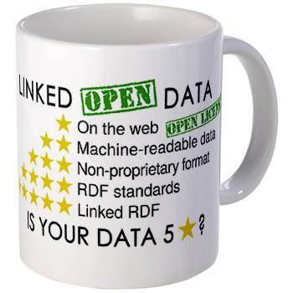
Levels of linked open data (one to five stars)
Data openly available on the web
Data available in a machine-readable format
Data available in a non-proprietary format
Data available in W3C-format (RDF and SPARQL)
Data linked to other people's data

Slide 17
RDF revisited
<?xml version="1.0"?> <rdf:RDF xmlns:rdf="http://www.w3.org/1999/02/22-rdf-syntax-ns#" xmlns:dc="http://purl.org/dc/elements/1.1/"> <rdf:Description rdf:about="http://www.jbi.hio.no/bibin/dig_korg/sem_web.htm"> <dc:Creator>Nils Pharo</dc:Creator> <dc:Subject>Semantic Web</dc:Subject> </rdf:Description> </rdf:RDF>
equals:
<@prefix dc: <http://purl.org/dc/elements/1.1/>. <@prefix rdf: <http://www.w3.org/1999/02/22-rdf-syntax-ns#>. <http://www.jbi.hio.no/bibin/dig_korg/sem_web.htm> dc:Creator "Nils Pharo" ; dc:Subject "Semantic Web" .
This is valid RDF, but it does not link with other data sets

Slide 18
Linked data means connecting data sets!

Slide 19
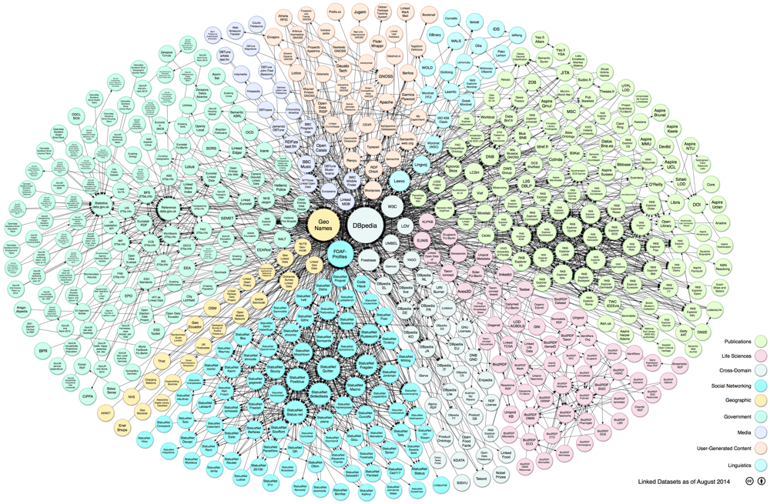

Slide 20
Example

Slide 21
Three types of RDF links
relationship links
identity links
vocabulary links

Slide 22
Relationshiop links
purpose is to reuse other information sources to enrich your data
<http://hioa.no> <http://xmlns.com/foaf/spec/based_near> <http://dbpedia.org/page/Oslo>

Slide 23
Identity links
Coupling resources that speak about the same things, establish URI aliases
<http://dbpedia.org/page/Oslo> <http://www.w3.org/2002/07/owl#sameAs> <http://www.geonames.org/3143244/>
explicates different opinions
facilitates traceability
secures robustness

Slide 24
Vocabulary links
Basic principle: reuse existing vocabularies instead of creating your own!
Describe new vocabularies in RDFS/OWL
create mappings between terms from different vocabularies
owl:equivalentClass can be used to map between classes

Slide 25
Vocabulary links example

Slide 26
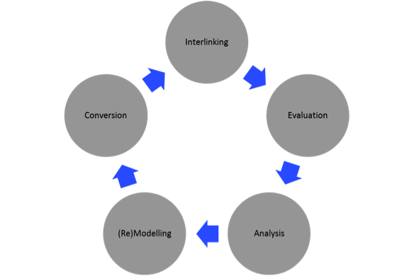
Linked data in practice, challenges
The linked data restructuring cycle

Slide 27
Conversion problems, example

Slide 28
Philosophy of open data
certain data should be freely available to anyone
non-textual data such as:
maps, formulaes, genomes
textual data
government data, facts, public library records?

Slide 29
Open data arguments
data belong to the human race
data was funded by public money
data was created by government
facts cannot legally be copyrighted
openness accellerates progress
See also Wikipedia

Slide 30
The Linking open data project
goal: to convert data that are available under open licences to RDF
The state of the LoD cloud 2014

Slide 31
Exploring linked open data
Swoogle
Semantic Web search engines

Slide 32
Library data as linked open data
descriptive bibliographic metadata (title, edition and document languages)
authority control (author and title languages)
content indexing (subject languages)

Slide 33
Using RDF to represent subject languages - SKOS
"SKOS is an area of work developing specifications and standards to support the use of knowledge organization systems (KOS) such as thesauri, classification schemes, subject heading systems and taxonomies within the framework of the Semantic Web.“
Simple Knowledge Organisation System
vocabulary for expressing controlled vocabularies in RDF
can be used for modelling ontologies up to thesaurus "level"
W3C Recommendation, 18. August 2009
SKOS home page

Slide 34
SKOS concept example
<rdf:RDF
xmlns:rdf="http://www.w3.org/1999/02/22-rdf-syntax-ns#"
xmlns:skos="http://www.w3.org/2004/02/skos/core#">
<skos:Concept rdf:about="http://www.example.com/concepts#abattoirs">
<skos:prefLabel>abattoirs</skos:prefLabel>
<skos:altLabel>slaughterhouse</skos:altLabel>
<skos:hiddenLabel>abatoirs</skos:hiddenLabel>
<skos:hiddenLabel>abbatoirs</skos:hiddenLabel>
<skos:hiddenLabel>abbattoirs</skos:hiddenLabel>
</skos:Concept>
</rdf:RDF>

Slide 35
SKOS hiearchical relationship example
<rdf:RDF
xmlns:rdf="http://www.w3.org/1999/02/22-rdf-syntax-ns#"
xmlns:skos="http://www.w3.org/2004/02/skos/core#">
<skos:Concept rdf:about="http://www.example.com/concepts#mammals">
<skos:prefLabel>mammals</skos:prefLabel>
<skos:broader rdf:resource="http://www.example.com/concepts#animals"/>
</skos:Concept>
<skos:Concept rdf:about="http://www.example.com/concepts#animals">
<skos:prefLabel>animals</skos:prefLabel>
<skos:narrower rdf:resource="http://www.example.com/concepts#mammals"/>
</skos:Concept>
</rdf:RDF>

Slide 36
SKOS associative relationships example
<rdf:RDF
xmlns:rdf="http://www.w3.org/1999/02/22-rdf-syntax-ns#"
xmlns:skos="http://www.w3.org/2004/02/skos/core#">
<skos:Concept rdf:about="http://www.example.com/concepts#birds">
<skos:prefLabel>birds</skos:prefLabel>
<skos:related rdf:resource="http://www.example.com/concepts#ornithology"/>
</skos:Concept>
<skos:Concept rdf:about="http://www.example.com/concepts#ornithology">
<skos:prefLabel>ornithology</skos:prefLabel>
<skos:related rdf:resource="http://www.example.com/concepts#birds"/>
</skos:Concept>
</rdf:RDF>

Slide 37
SKOS is concept-oriented
In contrast to termed-based thesauri, SKOS focus on concepts which may have several labels. In a standard thesaurus a term would relate to another term using relationships. See also the SKOS FAQ
Examples
The Integrated Public Service Vocabulary
Library of Congress have made their subject headings available

Slide 38
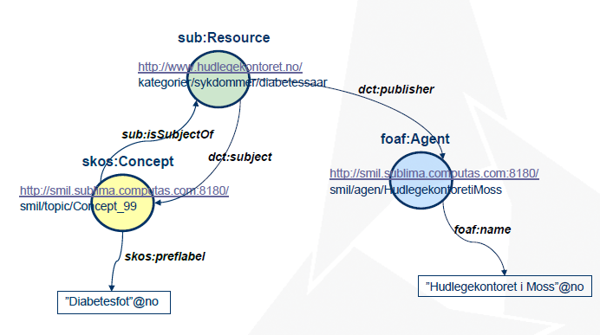
SKOS used in a subject portal

Slide 39
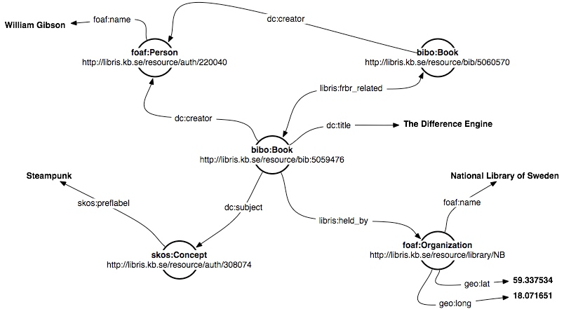
SKOS used in Libris

Slide 40
Characteristics of examples
a rich variety of name spaces
foaf, sub, dct, dc, libris, bibo

Slide 41
Using RDF to represent document and work languages
Many attempts have been made...
the bibliographic ontology
BIBFRAME
Schema.org with extensions

Slide 42
Bibliographic description - from records to graphs?
MARC has been used for describing bibliographic records for a long time
international standard since 1973
billions of MARC records exist
developed in the pre-web world

Slide 43
BIBO - the bibliographic ontology
BIBO specification
primarily developed for handling citations and bibliographic references
can be used for simple bibliographic description

Slide 44
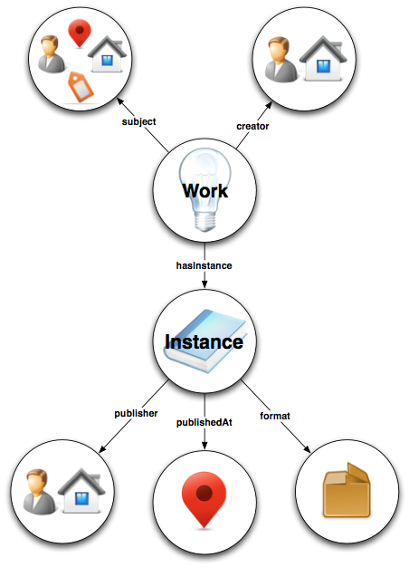
BIBFRAME Model

Slide 45
BIBFRAME
bibframe.org
Library of Congress report
planned to be successor of MARC
reflects the FRBR model
develops a new namespace
Transformation tools

Slide 46
Schema.org's BIB extensions model
Schema.org - initiative for creating structured data embedded in web pages
supported by Google, Bing, Yahoo and Yandex
light weight, cors-sectoral schema which is extensible for new domains, thus
compatible with RDF
Report from OCLC

Slide 47
Discussion
What are the pros and cons of the BIBFRAME approach?

Slide 48
Topic maps
a standard for organising digital content
ISO certified in 2002 (ISO-standard 13250)
Used for structuring web sites and a large varity of knowledge management purposes

Slide 49
Background
inspired by back-of-book indexes
X
XML. See Extensible
Markup Language (XML)
XML Topic Maps (XTM) 61,
72, 78
XML web services. See services
XPointer 99
XTM. See XML Topic Maps
(XTM)
XUL widgets
widgets 37
See also Extensible User
interface Language
(XUL)
From Passin (2004). The explorer's guide to the Semantic Web

Slide 50
Two-layer model
(index)
Metadata layer
Information layer
(content)

Slide 51
The information layer
Contains information (sic) - occurences
independent of location, format or form
not necessarily digital

Slide 52
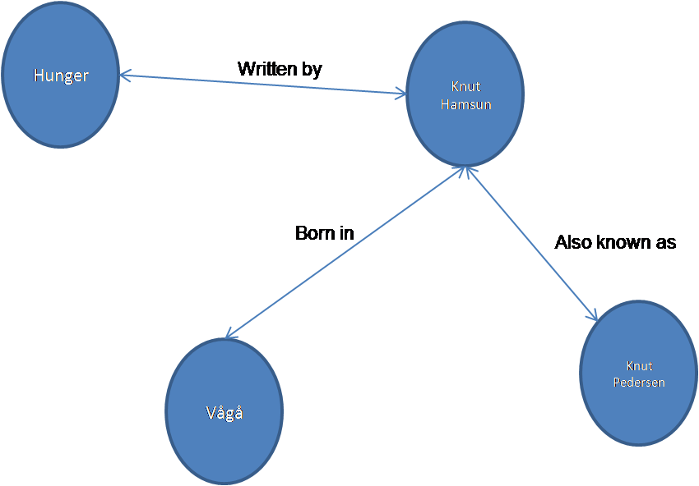
The metadata layer
contains topics and associations which ties topics together

Slide 53
The basic elements of topic maps
Topic maps consist of
Topics
Associations
Occurrences
i.e. the TAO of topic maps (Pepper, 2002)

Slide 54
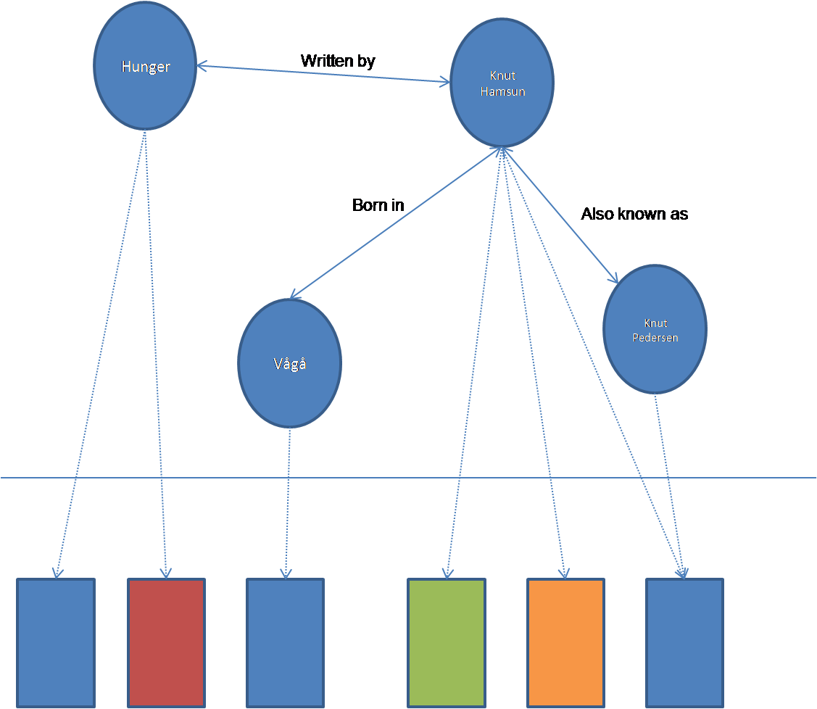
Occurences link the two layers

Slide 55
Topic maps and ontologies
an ontology contains the topic map's input
minimum requirement: some topics with associations

Slide 56
Topic types
Topics can be typed; Hamsun is an author, Vågå is a place, Hunger is a title. This is comparable to classes in RDF
Topic types are also topics

Slide 57
Association types
Associations types: Hamsun was born in Vågå, Hunger was written by Hamsun
Cf properties in RDF
Association types are also topics

Slide 58
Occurence types
Occurence types:
<http://nobelprize.org/nobel_prizes/literature/laureates/1920/hamsun-bio.html> is a biography of Hamsun. <http://en.wikipedia.org/wiki/Knut_Hamsun> is an encyclopedia article
Occurence types are also topics

Slide 59
Topic map sytaxes
HyTM - SGML based
XTM - XML Topic Maps
CTM - Compact syntax for Topic Maps

Slide 60
XTM example 1
<topic id="nils"> <instanceOf> <topicRef xlink:href="#employee"/> </instanceOf> <instanceOf> <topicRef xlink:href="#teacher"/> </instanceOf> <baseName> <baseNameString>Nils Pharo</baseNameString> </baseName> <occurrence> <instanceOf> <topicRef xlink:href="#description"/> </instanceOf> <resourceData>Nils has worked at Oslo UC since 1997</resourceData> </occurrence> </topic>

Slide 61
XTM example 2
<topic id="ouc"> <instanceOf> <topicRef xlink:href="#institution"/> </instanceOf> <subjectIdentity> <subjectIndicatorRef xlink:href="http://home.hio.no/~nilsp/psi/hio.psi"/> </subjectIdentity> <baseName> <baseNameString>Oslo University College</baseNameString> </baseName> <occurrence> <instanceOf> <topicRef xlink:href="#website"/> </instanceOf> <resourceRef xlink:href="http://www.hio.no/"/> </occurrence> </topic>

Slide 62
XTM example 3
<association id=" nils-ouc-association"> <instanceOf> <topicRef xlink:href="#employment"/> </instanceOf> <member> <roleSpec><topicRef xlink:href="#employee"/></roleSpec> <topicRef xlink:href="#nils"/> </member> <member> <roleSpec><topicRef xlink:href="#employer"/></roleSpec> <topicRef xlink:href="#ouc"/> </member> </association>

Slide 63
Characteristics of topic maps
topics have names
topics are knit together using associations
a topic may be categorised by an unlimited number of topic types
topic types are topics on a higher level of abstraction
association types are association on a higher level of abstraction
occurrences may be external or internal to the topic map
topics can be disambiguated using subject indicators

Slide 64
Topic and topic types
a topic type defines a class/category of things
topic types need instances!
domain dependent
Choose an appropriate level of generality
"Countries" is better than "Countries in South-East Asia"
The domain of the topic map tells you which countries it includes
Don't make it too general!

Slide 65
Type hierarchies
topic types can be arranged in hierarchies
subtype/supertype hierarchies have a specific syntax
If A is a superclass of B, then
Both A and B must be classes
If C is an instance of B, it must also be an instance of A
If C is a subclass of B, it must also be a subclass of A, (in which case an instance of C is also an instance of B and an instance of A)

Slide 66
Topic maps and RDF
"Surface" level similarities
both are standards for ontology modelling
both use XML
both use URIs for securing identity
both have constraint and query languages
Important differences
they are optimized for different purposes; TM for human reading, RDF for machine processing
RDF is document centric whereas TM is subject centric

Slide 67
Thank you!
Any questions?

