Slide 1
Education in library about information safety in theory and practice
New Technology in Education
8th December 2014

Slide 2
Information society
Economically (Machlup, Porat, Drucker) - from material to intelectual property
Technologically (Shannon, Mansuda) - impact of IT on society, incl. increasing importance of IL/IT literacy
Sociologically (Castells, Bauman, Bell) - incl. Digital Divide
Historically (McLuhan, Toffler) - changing role of information in history
Definitions of information society = growing importance of IT and information in all spheres

Slide 3
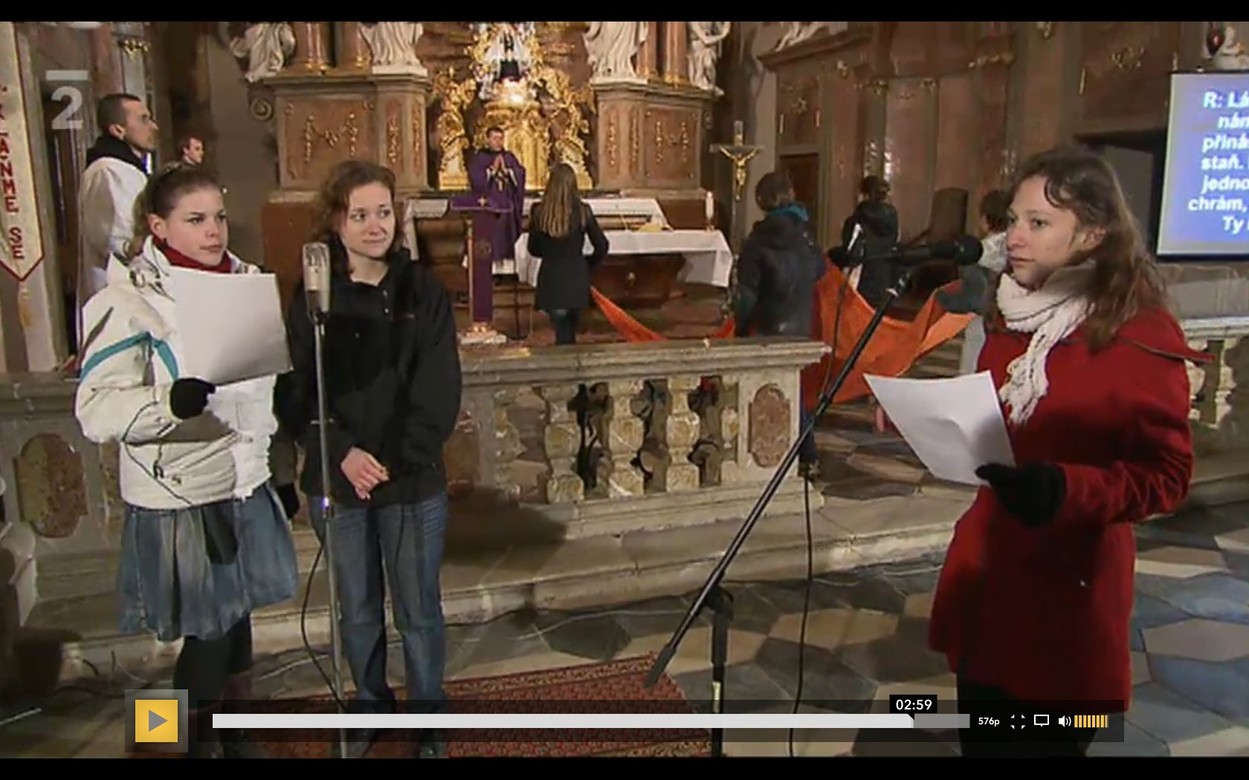
Can we speak about information society today?
The Czech republic is atheistic country, but…

Slide 4
IL and IT in information society
“To be information literate, a person must be able to recognize when information is needed and have the ability to locate, evaluate and use EFFECTIVELY the needed information“ (American Library Association, 1989)
IT simplify many activities with information
IT = tool => can be (mis)used
Information is key, but using it is changed by IT => IL closely connected with IT
Both sides of coin in MIL lessons in libraries

Slide 5
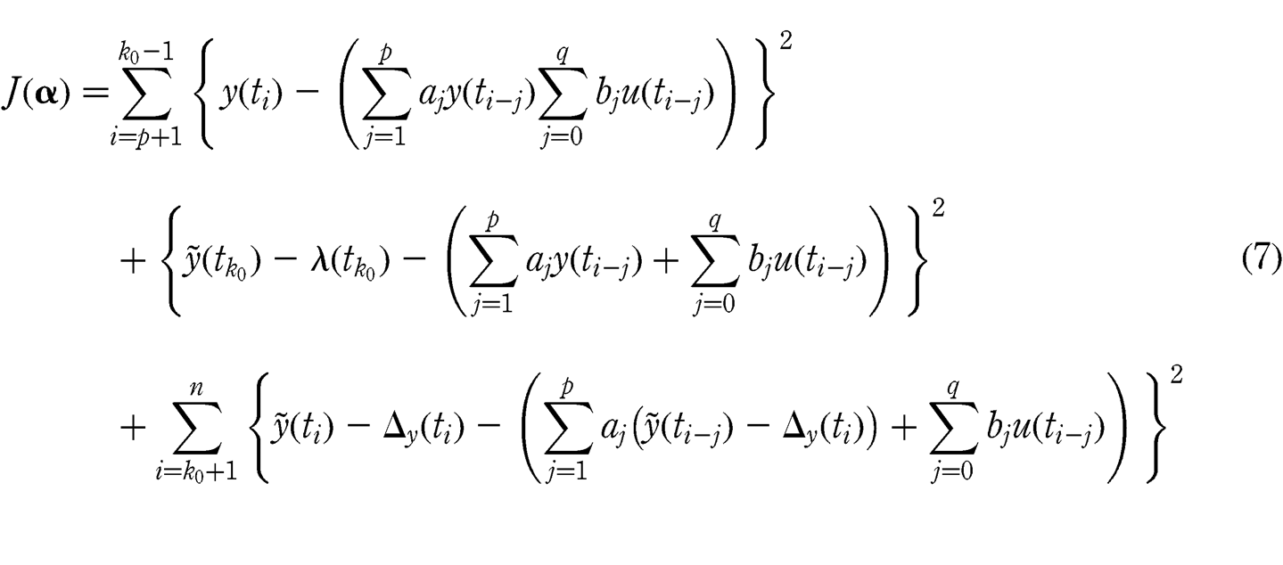
Simplifying
You still need to understand how and why, but using IT you can restrict occurrence of mistake

Slide 7
Changes of IT
Confront document analysis with changes of IL definitions => minimal

Slide 8
Crucial changes of IT related to IL (Helvoort)
“content integration (federated search engines)
amateur publishing (user generated content)
use of social networks to find information
personalization and push technology
loss of context / fragmentation of information”
=> should be reflected in IL (use of this = condition to effectively cooperate with information in information society)

Slide 9
Using IT without IL
Research of using IT (especially children) - often limited and not effective
But users are convinced about their knowledge - do not want to learn more
Hard to show that it can be better with IL - everyday work with user

Slide 10
IT
IL

Slide 11
Future
Information Society can´t be “Information” without IT
Countless and unpredictable changes of IT in last 10 years
We can not predict what the future of technologies will be
Develop the established definitions (to avoid “reinvent the wheel”)

Slide 12
Information safety in library?
Part of MIL => mediate appropriate resources (trustworthiness)
Important topic to educate - 12 % 9-16 year Europeans some harm on the Internet (Livingstone et al.)
Library in cooperation with school accepted (Livingstone et al.; Martin and Rice)

Slide 13
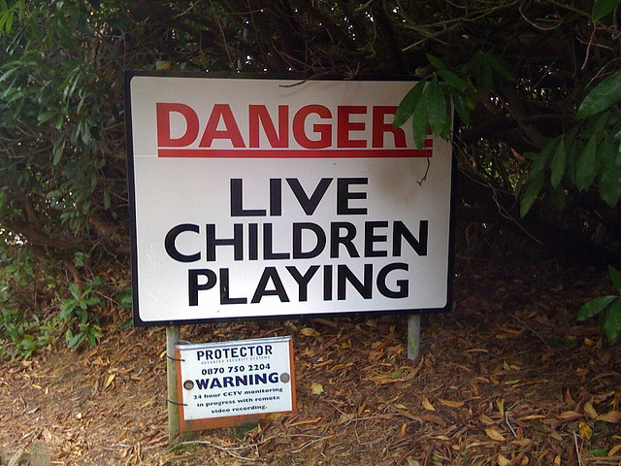
Attitudes of Children's Departments of Czech Libraries to the Information Safety
Focused on children
my interest
their vulnerability and attitudes forming
the best available target group
Education through public libraries to increase internet safety of children – focused on key issues
Limits of formal education => cooperation with non-formal
Benefits depend on quality at both sides
Non-formal education – more space for active learning
Knowledge
Skills
Attitudes
Case study – Czech republic (specific)
Potencial and real situation

Slide 14
Potential of libraries in education about IT threats
Free Internet for public by law, assisted on request
Traditionaly credible
Thick nationwide network of collaborating institutions
Non-formal education to MIL (+ umbrella organizations)
Services to public without restriction
Long-term relationship with the local community X centralized initiatives for safe Internet
Permanent availability, but not necessary
Usually established cooperation with (more) schools

Slide 15
Empirical data from my research
Despite the potential something not working
No research linking education in libraries with internet safety – this begin with mapping the situation
Quantitative pilot research
On-line questionnaire
Open from the 8th to the 19th of August 2011
Librarians addressed via 7 electronic conferences
261 responses, 62 responses from institutions offering the education for children (Q5)

Slide 16
Educational activities and their content
Multiple answers of institutions with children education
“Other” most frequently the cooperation with schools
Lesson for schools (Nejezchlebová, 2010): almost all libraries organize lessons connected to their services
Libraries offer enough but mostly traditional activities

Slide 17
Topics of internet safety
Education for all focus groups – any “no, in my opinion it makes no sense”, 38 beginning “yes”
Restricted on children – one “no, in my opinion it makes no sense”, less than general beginning “yes”
Both similar frequency – mostly a lecture once or twice a year

Slide 18
Attitudes to education of children about information safety
Q8 Do you think that libraries should engage the internet safety in their educational activities for children?
Positive response from 58 employees of institution offering education for children
Negative responses:
7 from all 180, none knew any online educational project
4 employees of institution offering education
1 employee of institution offering education for children

Slide 19
Awareness of educational project devoted to child internet safety

Slide 20
Comments from respondents
“I think that the problem of child internet safety should be integral to information literacy courses starting with grade school”
“As the director of a library I am aware of the unsatisfactory state of providing appropriate education in an area, covered by the questionnaire, by our institution. It is not at present in our personnel resources or among our priorities. When it comes to the education of children in this area I assume that it is covered in primary school as part of the standard program and if not then the problem lies with the curriculum. This does not, of course, mean that libraries are not appropriate public educators in matters of ‘internet safety’.”
“It is not possible to warn about this issue at every event – it should now belong to basic social habits like for instance street manners, it is already just plain part of life.”
“(…) In our city we do so in cooperation with the police. It is a necessity.”
Majority interested in the topic but don’t know how to go about it

Slide 21
Discussion – what the questionnaire did not cover
The potential not fully realized – further research
Some possible reasons:
Librarians’ loud complaints: “The employees of child sections are convinced that they should primarily focus on areas other than ICT, including internet safety.”
Analogy with research of Czech teachers (Zounek, 2009): “Often librarians stay away from topics that are connected to technology out of fear that they would lose their authority because kids are often more knowledgeable of ICT.”
Problematic fields: opinions of librarians, status of children (services X protect), uncertainty of an approach
Librarians should help where they can - education

Slide 22
Lesson of safe communication for primary school

Slide 23
Process of action research
Goal: contribute to the solution of practical problems and show possible change by inclusion libraries into education about information safety
All 4th and 5th grades from the Masaryk primary school in Polička came through the created lesson of safe communication
Lessons as an action research
Participated observation
Fast feedback from children at the end of the lessons
Analysis of documents created by children
Interviews with 6 people

Slide 24
Cooperating school
Polička: small city (approx. 9000 people), library cooperating with many local schools
Masaryk primary school
Meeting with deputy director for the first degree organized by library
Collective meeting with almost all teachers in the first degree (topic + cooperation in the library)
Training for teachers about IT threats and safety measures
Interest of teachers surprisingly positive

Slide 25
Lesson for children with participated observation
70 minutes, 5 classes, 135 pupils
Both 4th grades on 9th April, two on 5th grades 23rd April, one 5th grade on 21st May
RWCT type learning strategy: ERR framework – same as previous lessons for school in library
Basic risks of communication over the Internet with someone unknown + warning signals

Slide 26
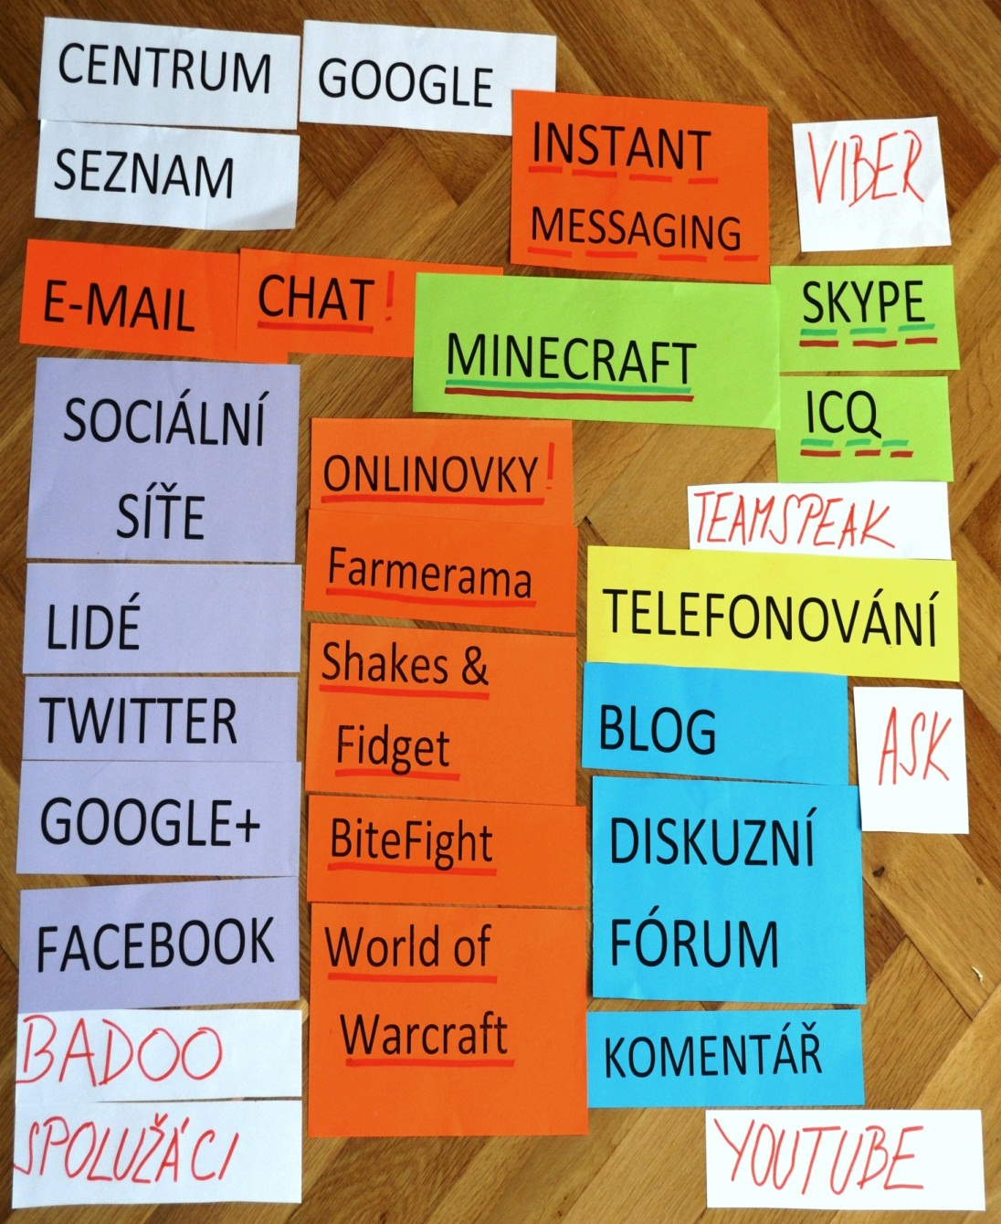
Evocation by brainstorming
Methods of Internet communication
Some papers stormy reaction
Categorization with functions
In the most possibility to communicate with unknown => competition

Slide 27
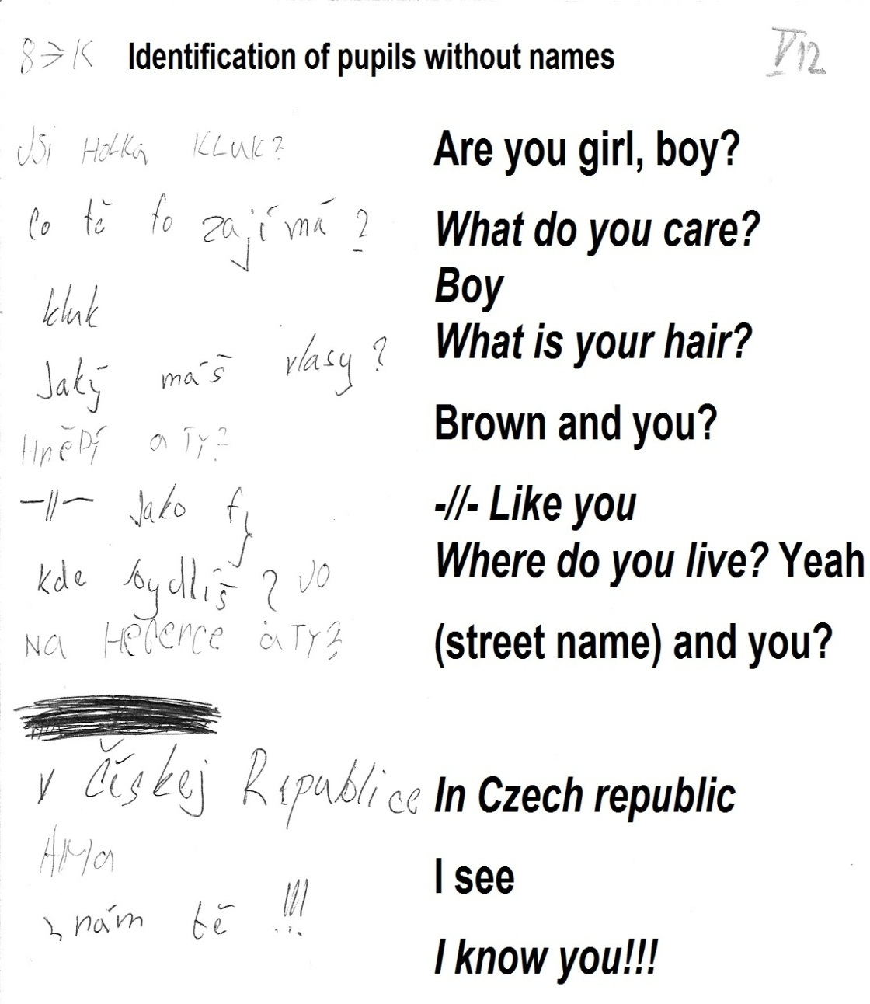
Realization of meaning - competition
2 groups in 2 rooms messages over the "Internet"
No names (identifiers = badges) and e-mails, only true answer
Goal to find out as much as possible identities and not be detected
Usually do not end up
Evaluation of the rules on the Internet

Slide 28
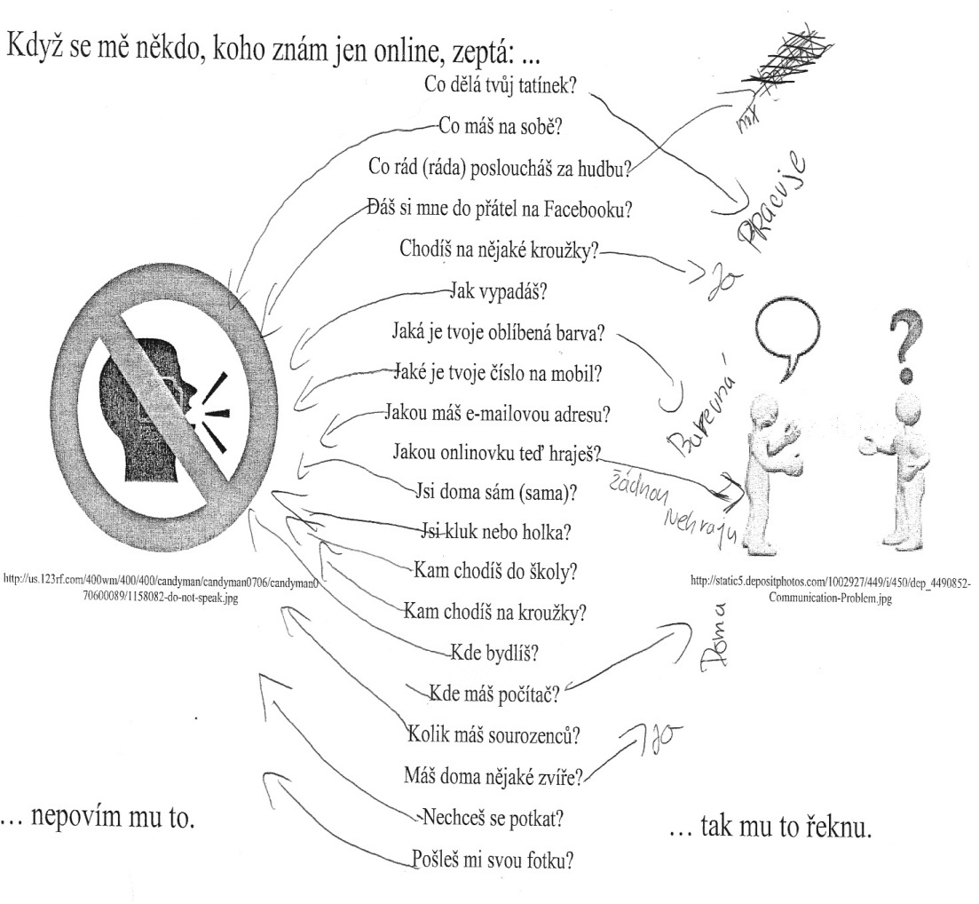
Reflection – table with Internet questions
Decide what to answer
Some examples in lesson, the rest for discussion at school
Goal:
For one question possible many answers
To unknown better non-identifying
Stress warning questions
When leaving badges used for evaluation lessons

Slide 29
Feetback from children after the lesson

Slide 30
Document analysis
All documents (222) left by pupils after the lessons
SPSS
Identification of class, pupils (anonym) and documents
Topics, their order, (un)identifying by answer, topic in depth (more questions)
Accepted the simulation (form and content of communication) – topic similar as on the Internet according to other researches
the most common: sex, adress, hair, age, clothes
the most identifiable: sex, hair, clothes, brothers and sisters, sport

Slide 31
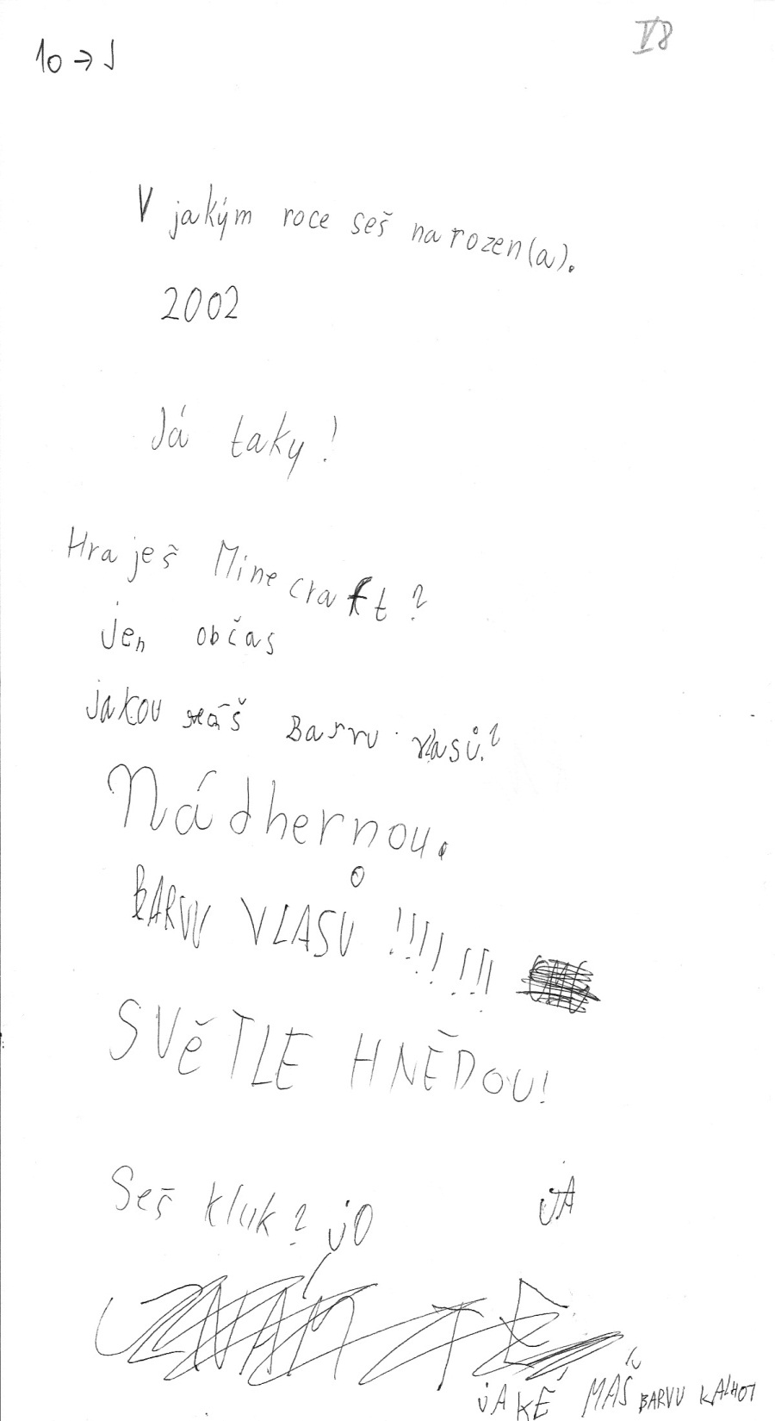
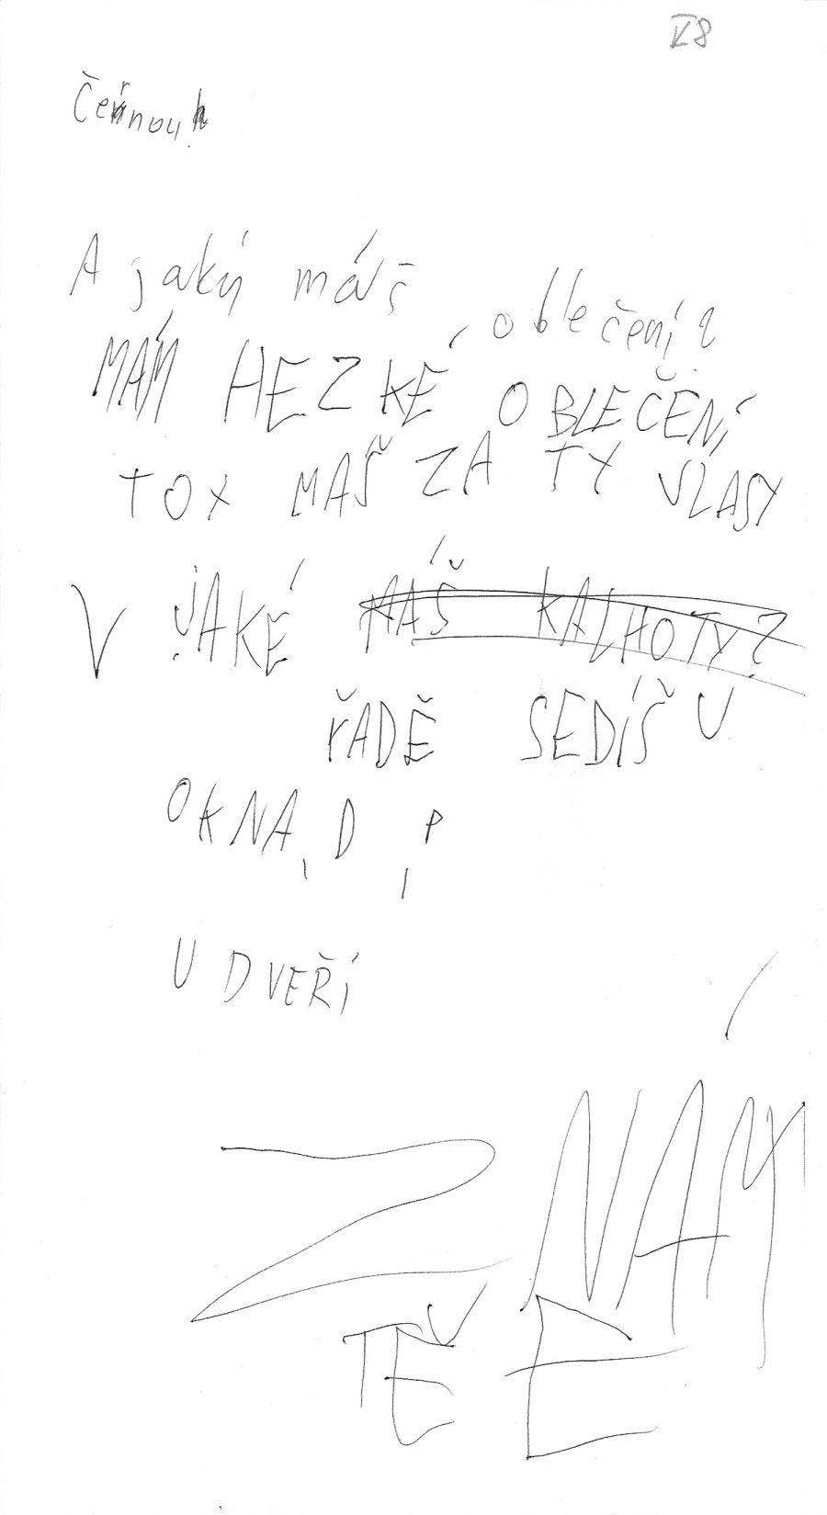
Collected document

Slide 32
Interviews on information safety education in libraries - methodology
Goal: barriers in information safety lessons in library and their solutions
360-degree feedback - stakeholders:
library
school
family
Six semi-structured interviews in summer and autumn 2013 (6 weeks to 5 months after lesson)

Slide 33
Barriers in library
Benefits for the library unseen
=> research-based, solution of social demand
"In order to teach things missing in the schools for which there is a demand, which undoubtedly Internet safety is (...) I have started to realize from that in last few years that it really could be a one of the main functions of libraries, (...) the educational... " (DL)
Limited budgets
=> teaching librarian as a good expense, enthusiasm - teacher can help with didactics
"city administration and school leaders (...), all the library activities immensely appreciate and conversely it is another added value." (L)

Slide 34
Barriers in librarians
Resources (knowledge, time, materials...)
=> management support, expert consultations
"I often hear that the library manager (...) says, and now you will educate, (...) but the one has not the conditions to the work. (...) he has not his office to prepare the lesson. He has not dedicated part-time, easily. Because there are not money for this in the budget." (L)
Generation differences => fear to teach
=> (often) no local choice, most specialized in information
"Despite I'm the younger generation of librarians, (...) I needed some support like the other." (L)
"These literacy course and, with the safety, (...) this belongs to the library. To whom else? " (M)

Slide 35
Barriers in school
School should educate rather than library
=> primary intermediation, library 1st for solution, teachers only limited additional education
"I do not know how in depth they would be able to bring this. They teach you Excel and these text programs, but this [information safety] I do not know" (DS)
Interpersonal relationships in library and school
=> willingness to cooperate for children good
„Important was that you did well explained why we educate children, the way we want to do it and (...) what will be the results. I consider the communication as the most important, personal meetings." (L)

Slide 36
Barriers in teachers
Quality uncertainty
=> feeling of the importance, small local competition, substantial content and form
"I think the teachers were pleasantly surprised that even that kind of issue that they always feared and shunned, can be conceived in this form. Which is understandable for them, they see that the children are having fun, but it really has the knowledge outputs and it has the skill fundamentals." (L)
Time from school schedule
=> links to school instruction, due to children behaviour
"Perhaps it would be even better if the lesson (...) was the first two or three hours, so we had the option to continue in the classroom (...), because the next day, when we return to it, that's not quite it." (T)

Slide 37
Barriers in children
School should educate rather than library
=> in library possible expressing lack of knowledge
"I think the great advantage of this lesson is that children
actually find everything themselves. That they try it and
realize how to behave and maybe more realize that how
they behave now, can have its consequences." (L)
Librarian cannot bring anything new
=> some pupils huge, some small knowledge about threats, discussion to realize aware behaviour
"They themselves were surprised (...) They probably do not normally realize this when sitting at the computer. They something write and think, so what, I send it. But that they retrospectively realize" (T)

Slide 38
Barriers in family
Parents should educate rather than library
=> not all parents interested in all parts of children life, not all know enough about the Internet
"What parents are interested in everything taught in school?" (DL)
"I think that such consultancy maybe for the kids is missing (...), because probably not every parent is versed at this..." (DS)
Attention of children and parents
=> motivated child attracts parents
"Your questions were better than my thinking. Because they lead me far away" (M)

Slide 39
Aim of education
Start with 9-10 years
In connection to IL
Discussion, real behaviour, possible consequences
"The whole Internet safety is relatively trivial, it's not anything different than as don't talk to strangers." (DL)
"Children are not stupid but the perception of danger is something that is taught, right, and especially for something as innocent-looking as the computer itself." (DL)
Topics: sharing of personal information, netiquette, identity theft and cyberbullying
Helping point

Slide 40
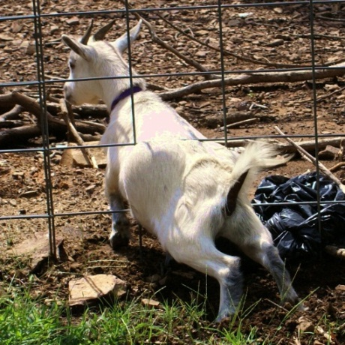
Conclusion
Here beginning of the problem – librarians are open but need help
Library traditionaly teach discrimination between (un)trustworthy information sources = basis of many Internet threats
Libraries + schools = cooperate to help with Internet safety
Choice in problem and in education => more people accepting help
Barriers will or will not appear, but solution too
Positive experience - all wanted extending
All feel importance of the topic and benefits (e.g.)
for family: discussion and better rules in behaviour
for school: distant topic solved by information experts
for library: important position in information society (effective solving of the social demand)
=> any library can try

Slide 41
Thank you for your attention.
kovarova@phil.muni.cz

Slide 42
References
American Library Association. Presidential Committee on Information Literacy. Final Report. Chicago: American Library Association. (1989). Retrieved September 24, 2013, from http://www.ala.org/ala/mgrps/divs/acrl/publications/whitepapers/presidential.cfm
Helvoort, J.v.: Impact of Recent Trends in Information and Communication Technology on the Validity of the Construct Information Literacy in Higher Education. Communications in Computer and Information Science 96, 61--73 (2010)
Livingstone, S., Haddon, L., Görzig, A., Ólafsson, K.: Risks and Safety on the Internet: The perspective of European Children. Full Findings. LSE, London (2011)
Martin, N., Rice, J.: Children's Cyber-safety and Protection in Australia: An Analysis of Community Stakeholder Views. Crime Prevention and Community Safety. 3, 165--181 (2012)
Nejezchlebová, J. (June 18, 2010). Dotazník k informačnímu vzdělávání uživatelů v knihovnách ČR. In Duha. Retrieved September 16, 2011, from http://duha.mzk.cz/clanky/dotaznik-k-informacnimu-vzdelavani-uzivatelu-v-knihovnach-cr.

Slide 43
Pictures (Creative Commons)
https://farm6.staticflickr.com/5205/5346737067_bcd7dedf01.jpg
https://www.flickr.com/photos/benterrett/2912441612/
http://en.wikipedia.org/wiki/Goat

