Slide 1
An Introduction to cognitive poetics
Lecture 1: COGNITIVE POETICS BASICS
(September 24-25, 2015)
Presented by Svitlana Shurma (Kyiv, Ukraine)
Email: lanashurma@gmail.com

Slide 2
Outline
Types and kinds of poetics
Basic principles of CP
Basic notions of CP

Slide 3
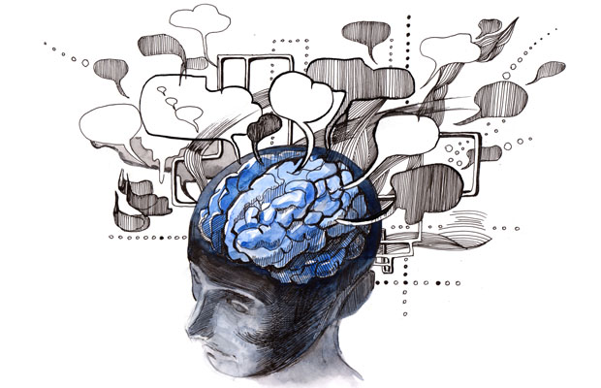
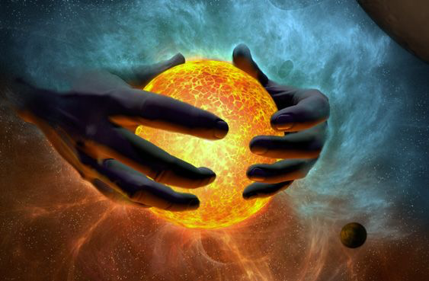

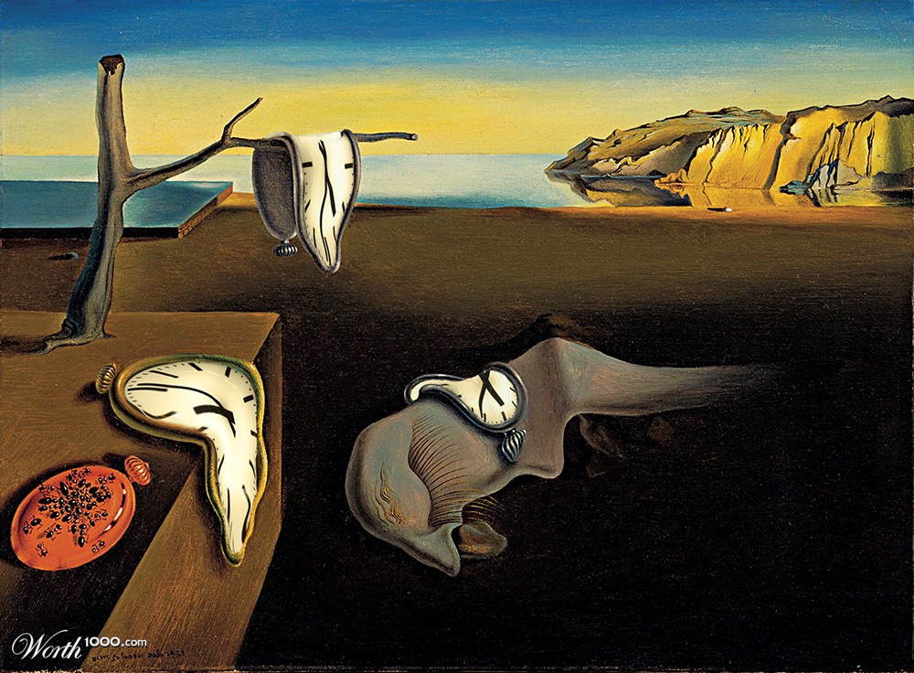

Slide 4
What is Poetics?

Slide 5
Origin
Greek poietikos - pertaining to poetry; lit. creative, productive

Slide 6
Who introduced the term ‘poetics’?

Slide 7
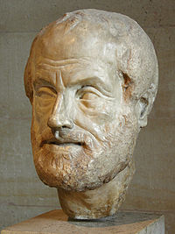
Principles of Aristotle’s Poetics
Notes:
The principles of Poetics as it exists today were laid as long ago as 335 BC by a famous Greek philosopher Aristotle. The philosophical treatise Poetics marked the shift from approaching poetry as social and religious means of public influence to poetry as a form of art.

Slide 8
Principles of Aristotle’s Poetics
Mimesis (imitation) by means of language (man has an instinct to imitate things)
Universal vs individual
Metaphor and knowledge
Human as encoder of information
Perception comes prior to mental representation

Slide 9
Modern Poetics?
Major issues:
  Objective world in literature
  Creativity and its nature
  Everyday speech vs the language of literary works
  See Vorobyova O.P. Cognitive Poetics: gains and new vistas: in Ukrainian. Accessed at http://uaclip.at.ua/Kognitivna_poetikakharkiv2004pdf.pdf

Slide 10
Micro- and macropoetics
Macropoetics
  a branch of science bordering linguistics and literary studies which approaches literature as a system, and deals with the notions of “genre”, “composition”, etc.
Micropoetics
  focuses on the peculiar elements of artistic speech, and the expressive meaning behind the author’s choice of words, grammatical structures, literary forms, artistic details, images etc.

Slide 11
Micro- and macropoetics
Micropoetics | Macropoetics
Rhetocal poetics | Linguopoetics
Mythopoetics | Literary poetics
Semantic poetics | Semiotic poetics
 | Structural poetics
 | Historical poetics
 | Organic poetics
Notes:
Rhetorical poetics, or the study of language means which become the "building blocks" of tropes, stylistic devices and the whole text on a wider scale from the perspective of rhetoric strategies and tactics.
Semiotic poetics mainly associated with the names of Roland Barthes, Algirdas Greimas, Umberto Eco. It regards language as a generative system which creates semiotic sequences or texts as well as other signs in the process of communication and cognition
Structural poetics, sometimes mixed with semiotic poetics, was popular in 1960-1970s, and had its centers in Paris, France, Moscow, Russia, and Tartu, Estonia. The representatives include Claude Levi-Strauss, Roland Barthes, Yuri Lotman, Vladimir Toporov, Viacheslav Ivanov, Jan Mukarovsky and others. Structural poetics proclaimed the systematicity of a literary text as well as any other semiotic object. This meant that the text was viewed as a whole, which was greater than its hierarchically structured compositional elements. They introduced statistics, information theory, mathematical analysis into the studies of literature.
Historical poetics, introduced by Alexander Veselovsky, and further developed by Mykhail Bakhtin and Vjacheslav Propp. This is the study of literary theory in diachrony, or from the historical perspective. It mainly focuses on the development of literary genres, styles and texts in the history of literature.
Mythopoetics, or poetics of myth. It is viewed as a part of general poetics, which focuses on myth (its motif, element, image, plot) projection onto the text of a specific writer.
Generative poetics is viewed as a part of structural poetics and was developed in the USSR in 1960s under the influence of generative linguistics. The founders of generative poetics were Yuri Shcheglov and Alexander Zholkovsky, who now both live in the USA. Yet, the ideas became quite popular with Teun Van Dijk, Richard Ohmann, Samuel Levin and others. The main focus was that of modeling the process of text generation. The text was regarded as a sum total of some abstract theme and expressive means that were used to transform the theme into a real text.
Organic poetics. The term emerged from the notion of "organicism" which was used to describe the "conditions of poetic unity and the nature of form, as well as … the inextricability of form from meaning" (The Princeton, p. 981). The idea dates back to Plato and Aristotle and was further elaborated by the 18 century German philosophers and poets such as Goethe, Kant, Schiller. In the 20 century the idea of organic poetics was discussed in the works of representatives of Russian Formalism, New Criticism and the Chicago School. Organic poetics focuses on establishing the connection between the being and the text. The word is viewed not a separate building block, but in its unity with thingness which is encoded in it.
Semantic poetics. The term dates back to the article by Vladimir Toporov, Yuriy Levin, Dmitiy Segal, Tatiana Tsivjan, Roman Timenchik. They speak about two Silver Age poets Anna Akhmatova and Osip Mandelshtam, focusing their attention on the semantic indefiniteness of poetry and two-fold nature of it. They also focused on the interplay of conscious and subconscious in poetry.

Slide 12
Basic Principles of CP
Where is the place of Cognitive Poetics?

Slide 13
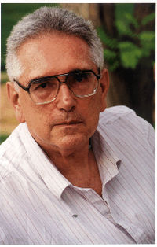
Basic Principles of CP
Reuven Tsur, 1983

Slide 14
Basic Principles of CP
Cognitive poetics, as I conceive of it, offers cognitive theories that systematically account for the relationship between the structure of literary texts and their perceived effects
(‘Aspects of Cognitive Poetics’ in Cognitive Stylistics: Language and Cognition in Text Analysis, 2002, p. 279)

Slide 15
Basic Principles of CP
R. Tsur
Emotional qualities of poetry
  Poetic texts convey meanings and emotions perceived by the reader
  Words are tags used to identify mental processes
  Poetry exploits, for aesthetic purposes, cognitive processes that were initially involved for non-aesthetic purposes

Slide 16

Basic Principles of CP
Margaret Freeman
  “cognitive poetics is Janus-faced: looking both toward the text and toward the mind”
  (Article “The Fall of the Wall Between Literary Studies and Linguistics: Cognitive Poetics”)

Slide 17
Basic Principles of CP
Reader’s perspective
  Prototypical reading
  Conceptual space of imagery
  Emotivity
  Categorization
  Aesthetic effects
  Defamiliarization
  Discursive attitudes and interpretation
  Text processing
  Context and reading

Slide 18
Basic principles of CP
Text perspective
  Embodied understanding
  Blurring the borderline between common and literary mind
  From analogous projection to parabolic projection
  Cognitive constraints or metaphoric entailments
  Literary texture and literariness
  Rhetoric patterns and grammatical representation of conceptual structures
  Conceptual spheres and conceptual picture of the world

Slide 19
Basic notions of CP
Reading
Figures and grounds
Cognitive deixis
Text worlds
Iconicity

Slide 20
Basic Notions of CP
Reading
P. Stockwell: “Cognitive poetics is all about reading” (p. 1)
  Reading as the object of research and tool
  Reading as cognitive solution
  Reading = text-processing of aesthetic and polyvalent nature
  Reading occurs in context
Notes:
Miall “A Feeling for Foregrounding: Why conventionalism isn’t the whole story”: An interpretation can never be more than a distant, possibly distorted echo of the reading experience. The action at stake in reading is not usually direct but potential, encoded in feeling: feeling situates readers in relation to complex modes of experience, memory, and social understanding; as such, literature intervenes on readers' modes of feeling and may challenge them or modify them in significant ways. Such challenges lead primarily to action, not thought: they embody alternative ways of construing the self and its position and effect in the world.

Slide 21
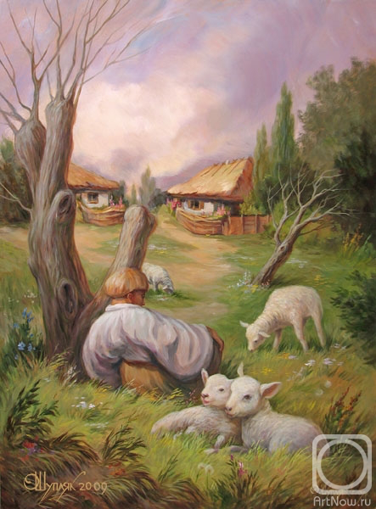
Basic notions of CP
Oleg Shupliak. A portrait of Taras Shevchenko

Slide 22
Basic notions of CP
Figure and ground
  Foregrounding
    Czech theorist Jan Mukarovský
    It refers to the range of stylistic effects that occur in literature, whether at the phonetic level (e.g., alliteration, rhyme), the grammatical level (e.g., inversion, ellipsis), or the semantic level (e.g., metaphor, irony)
Notes:
Mialll: Striking stylistic features. Reading tends to slow down, a sense of ‘strikingness’, greater degree of ‘uncertainty’, heightened feeling. Three-phase model of response to foregrounded moments: 1. Defamiliarization; 2. Search for context; 3. Recontextualization.

Slide 23
Basic Notions of CP
Figure and ground
  Defamiliarization
  1917 Viktor Shklovsky’s essay 'Art as Technique’
  the technique of writing through which objects are made 'unfamiliar’
  Forces readers to experience the ordinary in new ways through the use of artistic language
The dominant
Gestalt
Notes:
Miall: Defamiliarization is response to foregrounding

Slide 24
Basic Notions of CP
Cognitive deixis
  Person (perceptual) deixis
  Spatial deixis
  Temporal deixis
  Psychological (relational) deixis
  Textual deixis
  Compositional deixis

Slide 25
Basic Notions of CP
  Deictic center
  Deictic projection
  Deictic shift

Slide 26
Basic Notions of CP
Text (discourse) worlds
  the sets of scenarios and type of reality that the text is about
  (E. Semino “Text Worlds” in Cognitive Poetics: Goals, Gains and Gaps, 2009, p. 33)
    Possible worlds of logic

Slide 27
Basic Notions of CP
    Possible world of fiction and literature
      Dynamic and “furnished”
      “Parasitical” and incomplete
      Principle of minimal departure
      Intertextuality
      Flexible and superficial
      Believable and plausible

Slide 28
Basic notions of CP
Iconicity
Peirce’s signs: icons, indices and symbols
Icons share a direct relation between the sign and what the sign represents

Slide 29
Basic Notions of CP
Iconicity is motivation between form and meaning
(According to M. Freeman):
  Ontology
  Metaphor
  Fusion
  Feeling

Slide 30
Basic notions of CP
Freeman:
“Poetic iconicity creates sensory-emotional perceptions in language that enable us to encounter them as phenomenally real. In this way, poetic iconicity bridges the “gap” between mind and world, not through conceptual reasoning or scientific methodology by which we attempt to know the world, but through aesthetic experience of the world…”

