Slide 1
An Introduction to cognitive poetics
Lecture 2: Conceptual Metaphor and Blending Theories. The notions of Conceptual Metonymy and Oxymoron
(September 24-25, 2015)
Presented by Svitlana Shurma (Kyiv, Ukraine)
Email: lanashurma@gmail.com

Slide 2
Outline
Some basic notions of CMT
Conceptual metaphor
Blending theory
Conceptual metonymy
Conceptual oxymoron

Slide 3
Some basic notions
Сoncept
Domain
Image-schema
Idealized Cognitive Model

Slide 4
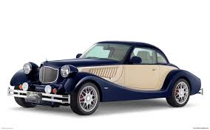
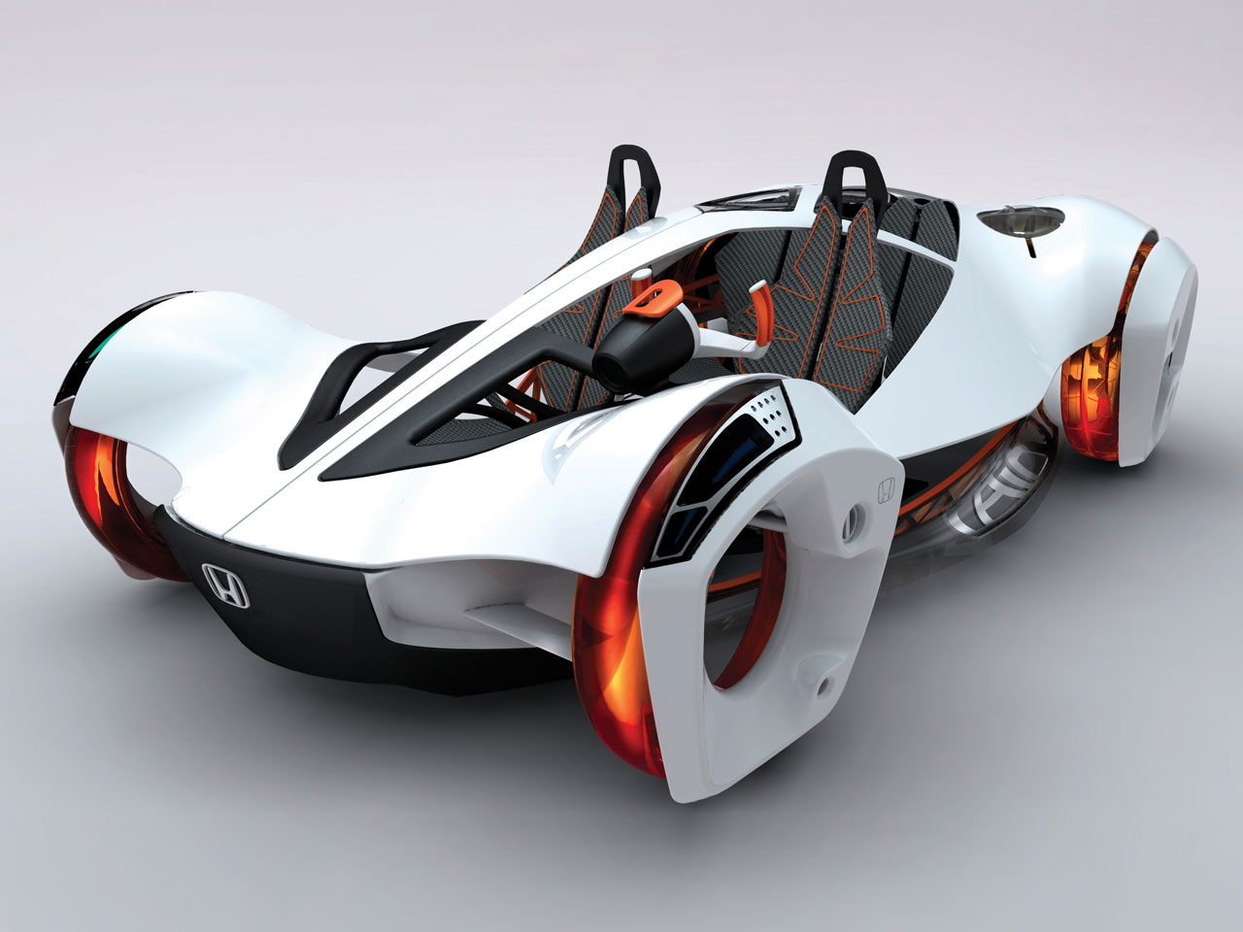
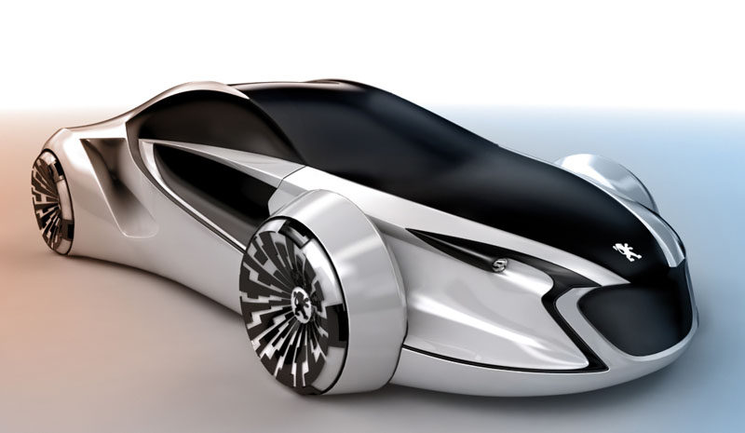
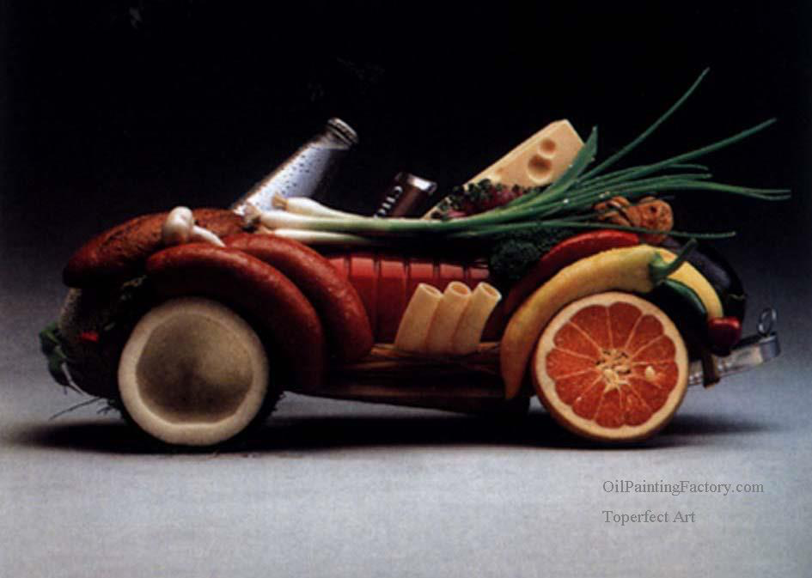
Some basic notions
Concept
Notes:
Concept is basic to Cognitive Poetics. Concept is the basic unit of knowledge. It is central, because meaning of a linguistic unit or expression is connected to a concept. Mental representation which exists in the brain. Preserves contingent and bodily experience. Concept is an intermediary between the words and reality.

Slide 5
Some basic notions
Basic unit of knowledge
Mental representation which exists in the brain
Preserves contingent and bodily experience

Slide 6
Some basic notions
Concepts and pictures of the world
Concept (O. Vorobyova)
Unit of knowledge and memory
Reflects knowledge and experiences
Partially embodied
Verbalized through language means
Includes non-verbal information (mental imagery)
Bears cultural markers

Slide 7
Some basic notions
Ways of concept manifestation in texts
Explication : gradual explication : implication
Concentrated representation : cumulative representation : diffuse representation
Convergent representation : divergent representation
Direct nomination : hint : associated representation

Slide 8
Some basic notions
Concepts
According to the medium
Linguoconcepts
Textual
Discourse
Philosophical
Cultural (linguocultural and ethnical)
Literary
Aesthetic

Slide 9
Some basic notions
According to their content
Categorial (TIME)
Theosophical (LIFE)
Teleonomic (TRUTH)
Anthropoconcepts (MOTHER)
Emotional concepts
Psychological concepts
Gender concepts
Mythoconcepts, etc.

Slide 10
Some basic notions
Concepts
Degree of abstraction
Universal
Intermediate
Concrete
According to a place in a hierarchy
Mega- / macro- / hyper- / mezo - / cata –

Slide 11
Some basic notions
Degree of variance
Variable (constants)
Invariable
According to their format
Singular (LOVE)
Gestalt (LIFE/DEATH)
Cluster (ROAD TO FAME)
Iconic (GOLDEN AUTUMN)
Parables (PRAGUE SPRING)
Essayistic (MODERNISM)

Slide 12
Some basic notions
Picture of the world
A part of individual or collective consciousness
Elements:
Common for the humanity
National
Personal
Language picture of the world
Conceptual picture of the world

Slide 13
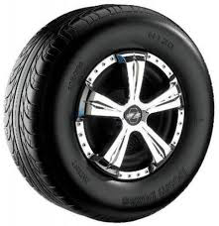
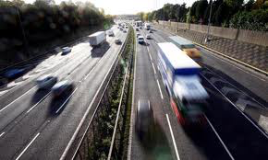
Some basic notions
Domain
CAR
Notes:
Domain is a conceptual entity. A background knowledge structure. Relates to interconnected aspects of experience. Frame analysis is used to reveal the structure of a domain. JOURNEY includes traveller, mode of transport, route, feelings, destination, obstacles.

Slide 14
Some basic notions
A conceptual entity
A structure of background knowledge
Relates to interconnected aspects of experience

Slide 15
Some basic notions
Image schema
Notes:
Lakoff (1987), Lakoff and Turner (1989), Johnson (1987). Experimental research in psycholinguistics, cognitive psychology. Image – representation of experience. Imagistic domains vs nonimagistic domains. The most rudimentary concepts (Evans). Refer to body experience: movements through space, manipulation of objects, perceptual interactions. Image-schemas are schematic. Help to structure bodily and non-bodily experience.

Slide 16
Some basic notions
The most rudimentary concepts (Evans)
Refer to body experience: movements through space, manipulation of objects, perceptual interactions
Schematic
Help to structure bodily and non-bodily experience

Slide 17
Some basic notions
John went out of the room.
Pump out the air.
Let your anger out.
Pick out the best theory.
Down out the music.
Harry weasled out of the contract.
Notes:
CONTAINER image-schema consists of structural elements: interior, boundary and exterior. Lexical concepts associated with the following forms: full, empty, in, out. The form of an image schemas mirrors the sensory experience. Can be described using words and pictures. Refer to holistic sensory experiences, similar to an echo of them.

Slide 18
Some basic notions*
SPACE | UP-DOWN, FRONT-BACK, LEFT-RIGHT, NEAR-FAR, CENTER-PERIFERY, CONTACT
SCALE | PATH
CONTAINER | CONTAINMENT, IN-OUT, SURFACE, FULL-EMPTY, CONTENT
FORCE | BALANCE, COUNTERFORCE, COMPULSION, RESTRAINT, ENABLEMENT, BLOCKAGE, DIVERSION, ATTRACTION
UNITY/MULTIPLICITY | MERGING, COLLECTION, SPLITTING, ITERATION, PART-WHOLE, MASS-COUNT, LINK
IDENTITY | MATCHING, SUPERIMPOSITION
EXISTENCE | REMOVAL, BOUNDED SPACE, CYCLE, OBJECT, PROCESS
Notes:
* Clausner, T.C. and Croft, W. Domains and image schemas. In Cognitive Linguistics 10-1(1999), 1-31 Do not look like words. Exist between ordinary language and ‘mental’ language. Domain forms the framework for an image-schema. Image-schemas are often geometrical or topological structures. Image schemas are “abstract concepts consisting of patterns emerging from repeated instances of embodied experience” (Evans).

Slide 19
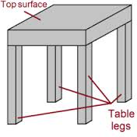
Some basic notions
Idealized Cognitive Models (ICM)
Notes:
Idealized prototypical image. Something typical. Domains of knowledge accompanied by conceptual slots. Individual by nature. Experience-based. Tend to constantly develop with new experience. In the texts are activated by minimal syntactic or lexical marker (Simpson). Allow ‘cognitive short-cuts’ (ibid).

Slide 20
Some basic notions
Idealized prototypical image
Domains of knowledge accompanied by conceptual slots
Individual by nature
Experience-based
Develops constantly
In the texts, activated by minimal syntactic or lexical marker

Slide 21
What is conceptual metaphor?
Notes:
A process of mapping between two conceptual domains. A relationship between tenor and vehicle. A girl (vehicle/target) is a flower (tenor/source)

Slide 22
What is conceptual metaphor?
People might say that they try to give their children an education so they will get a good start in life. If their children act out, they hope that they are just going through a stage and that they will get over it. Parents hope that their children won’t be burdened with financial worries or ill health and, if they face such difficulties, that they will be able to overcome them. Parents hope that their children will have a long life span and that they will go far in life. But they also know that their children, as all mortals, will reach the end of the road.
Notes:
Kovecses Z. Metaphor: A Practical Introduction. LIFE IS A JOURNEY

Slide 23
What is conceptual metaphor?
The Road Not Taken
Two roads diverged in a yellow wood, And sorry I could not travel both And be one traveler, long I stood And looked down one as far as I could To where it bent in the undergrowth; Then took the other, as just as fair, And having perhaps the better claim, Because it was grassy and wanted wear; Though as for that the passing there Had worn them really about the same, And both that morning equally lay In leaves no step had trodden black. Oh, I kept the first for another day! Yet knowing how way leads on to way, I doubted if I should ever come back. I shall be telling this with a sigh Somewhere ages and ages hence: Two roads diverged in a wood, and I- I took the one less traveled by, And that has made all the difference (R.Frost).
Read by Alan Bates
Notes:
A large part of the way they speak about life in English derives from the way they speak about journeys. Cognitive linguists suggest that they do so because thinking about the abstract concept of life is facilitated by the more concrete concept of journey. One of the startling discoveries of work on poetic language by cognitive linguists is the recognition that most poetic language is based on conventional, ordinary conceptual metaphors.

Slide 24
George Lakoff

Slide 25
Mark Johnson

Slide 26
Zoltan Kovesces

Slide 27
Raymond Gibbs

Slide 28
Eve Sweetser

Slide 29
Mark Turner

Slide 30
What is conceptual metaphor?
Metaphor is a matter of thought
Conceptual metaphors are embodied
Organized by cross-domain mappings or projections
Tenor and vehicle are linked to embodied experiences
Based on analogical reasoning
Understanding of complex abstract entities in terms of bodily experiences
Notes:
Lakoff and Turner 1980: Metaphor is a fundamental principle of thought and action. Conventional metaphors structure our conceptual system. Aristotle: Metaphor consists in giving the thing a name that belongs to something else; the transference being either from genus to species, or from species to genus, or from species to species, or no the ground of analogy. (metaphor is a matter of words, metaphor is deviant). Paul Ricoeur (1977): changed meanings of words; deviance; transfer of a name to some object belonging to a different category. Max Black (1962): cognitive status of metaphor; substitution view; metaphors are ornamental; nominative function of metaphor; comparison view (elliptical simile)

Slide 31
Types of conceptual metaphors
According to frequency of use
Conventional
Unconventional

Slide 32
Types of conceptual metaphors
Source domain
Orientational
Ontological
Structural
Conduit
Container

Slide 33
Types of conceptual metaphors
Origin (Grady)
Primary
HAPPY IS UP
MORE IS UP
SEEING IS TOUCHING
Complex
RELATIONS ARE ENCLOSURES + INTIMACY IS CLOSENESS = INTIMATE RELATIONS ARE CLOSE ENCLOSURES
Notes:
Primary metaphors have minimal structure and combine sensory and subjective elements. They are automatically construed. Complex ones are usually created of primary metaphors and are based on cultural models, beliefs and knowledge.

Slide 34
Structure of conceptual metaphor
She really blew her lid.
Source domain: HEATED FLUID IN A CONTAINER
Target domain: ANGER
She exploded with anger
She let her steam off
Notes:
Simpson: relationship between metaphor and linguistic form is an indirect one => we can express one and the same conceptual metaphor in a variety of ways. In literary works metaphors are more novel and less clear

Slide 35
Blending theory
Notes:
Fauconnier and Turner (1994; 1998); Grady, Oakley, Coulson ‘Blending and Metaphor’: Mapping – a knowledge structure; tells how elements in two domains line up. Mental space which depends on domain is the basic unit of cognitive organization. Mental space is partial and temporary, conceptual slot. It is constructed. A short-term construct of a particular domain. Generic space is a shared conceptual structure for both inputs. Blend space combines and interacts input from two spaces. Lines represent cross-space correspondence. Emergent structure – juxtaposition of elements from the inputs.

Slide 36
Blending theory
A surgeon is a butcher
Notes:
Joseph Grady, Todd Oakley, Seana Coulson: Blending involves composition (projection onto blended space), completion (filling out of a pattern in the blend) and elaboration (simulated mental performance of the event in the blend, ‘imagined scenarios’). Optimality principles: integration, web, unpacking, topology, good reason.

Slide 37
What happens to a CM in a literary text
Elaboration
Extension
Questioning
Combining
Notes:
Lakoff and Turner (1989): More Than Cool Reason: Poets share most of the CM with other language speakers, yet, they tend to manipulate with them. Kovecses: Elaboration – elaborating of an existing element of the source in an unusual, unconventional way. Extension – conventionalized linguistic expression is expressed by new linguistic means that is based on introducing a new conceptual element in the source domain. Questioning – calling into question the appropriateness of common everyday metaphors. Combining – a combination of several conceptual metaphors.

Slide 38
What happens to a CM in a literary text
Types of verbal metaphors (Belehova)
Archetypes
Stereotypes
Prototypes
Idiotypes
Kainotypes
Notes:
The archetype is regarded as a concept shared by all humans irrespective of their nationality, race, and cultural code [Jung 1991; Wierzbicka 1996]. Stereotype is an idealized image recognized by everybody, a socially coloured prototype. A prototype is understood as a culturally dependent ‘‘best representative’’ of the category [Rosch 1977: 32; Lakoff 1987: 45-49; Taylor 1995: 12]. All these images are presumed to descend to a definite archetype. An archetype can be embodied in several prototypical images. Each of them underlies a number of idiotypes. An idiotype is a prototype’s modification preferred by a particular writer. It is a complex image which reflects idiolect and idiostyle of the author, his peculiarities of world perception. A clash between mental spaces of an archetype and an idiotype gives birth to a kainotype.

Slide 39
What happens to a CM in a literary text
Archetype
Homer’s ‘river of life’ (LIFE IS MOTION; HUMAN LIFE IS UNATTENDED MOTION)
Idiotypes
Owen’s ‘and half his lifetime lapsed in the hot race’ (HUMAN LIFE IS A RACE)
Frost’s ‘two roads diverged in a wood, and I – I took the one lest traveled by’ (LIFE IS A JOURNEY)
Prototypes
Sandburg’s ‘Life is just a bowl of cherries’ (LIFE IS A CONTAINER)

Slide 40
Conceptual Metonymy
I am reading Shakespeare
America does not want another Pearl Harbor
Washington is negotiating with Moscow
Nixon bombed Hanoi
We need a better glove at third base
Notes:
From Kovesces 2002

Slide 41
Conceptual Metonymy
ICM
PART 1
Contiguity
Part 2
Notes:
Kovesces 2002: Metonymy is a cognitive process in which one conceptual entity, the vehicle, provides mental access to another conceptual entity, the target, within the same domain, or ICM. Single mapping. Relation between more concrete an more abstact entity within one domain

Slide 42
Conceptual metonymy
Thing and part ICM (synechdoche)
America for the USA
Constitution ICM
Wood for ‘the forest’
Complex even ICM
Mother is cooking potatoes
Category and member ICM
Xerox for ‘any copying machine’
Category and property ICM
Blacks for ‘black people’

Slide 43
Conceptual metonymy
Part and part ICM
To shampoo one’s hair
Causation ICM
She is my ruin
Production ICM
We are reading Shakespeare
Control ICM
The Mercedes has arrived
Possession ICM
He married money
Containment ICM
The milk tipped over

Slide 44
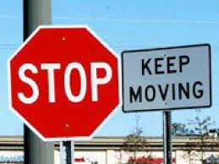
Conceptual oxymoron

Slide 45
Conceptual oxymoron
Francisco de Quevedo
It’s ice that burns, it is frozen fire,
It’s a wound that hurts and is not felt,
It’s something well dreamt, an evil present,
It’s a brief retiring, that quickly tires.
Notes:
Gibbs The Poetics of Mind: Figurative Thought, Language, and Understanding: a poem about love and Cupid

Slide 46
Conceptual oxymoron
Reflect paradoxical way of conceiving things in life
Is a ground for novel images
Cognitive operations of overlaying, overlapping and clashing
Clash within one conceptual domain

Slide 47
Conceptual oxymoron
Oxymoron
Epistemic
Structural
Orientational
Ontological

Slide 48
Conceptual oxymoron
Ontological
Sinful pleasures, awfully beautiful, a perfect fool
POSSIBLE VS IMPOSSIBLE, EVIL VS VIRTUE
Epistemic
Progress is a comfortable disease (Cummings)
You are my future of the past (Bly)
HERE VS THERE, FUTURE VS PRESENT, GOOD VS BAD

