Slide 1
Minipresentations
November 18, 2015

Slide 2
Večerníček/bedtime story

Slide 3
Krteček / Little Mole
Maxipes Fík
Křemílek a Vochomůrka
Broučci / Fireflies

Slide 4
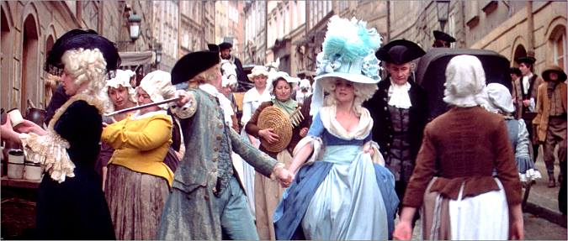

Slide 5
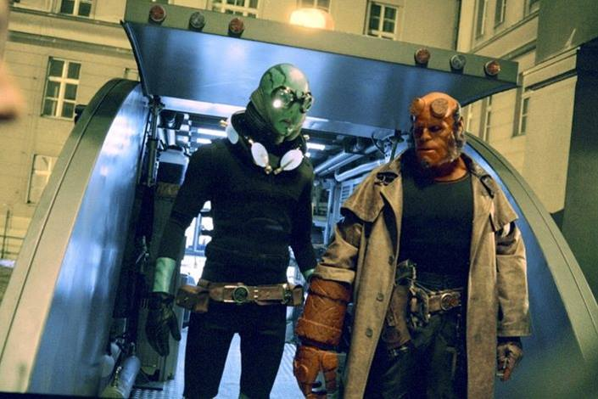

Slide 6
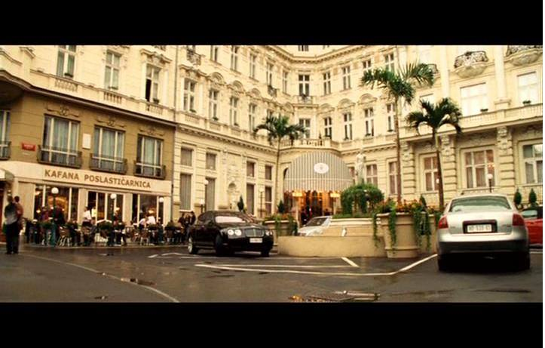

Slide 7
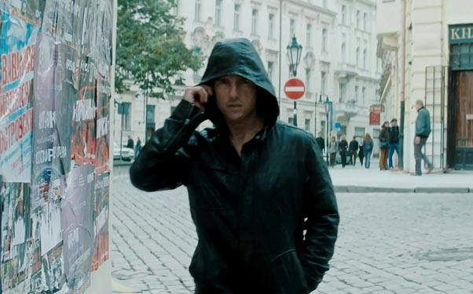

Slide 8
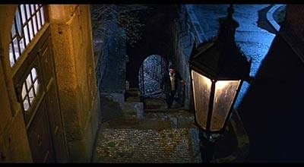

Slide 9
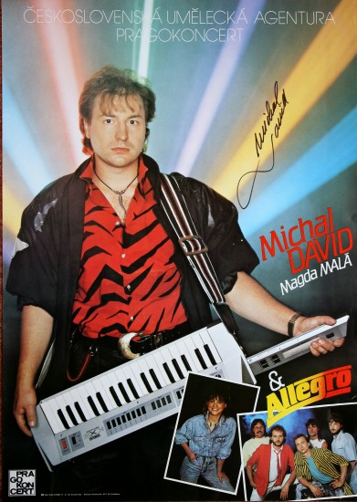
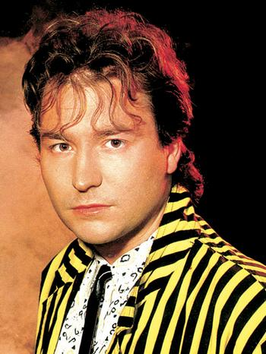
Michal David *1960

Slide 10
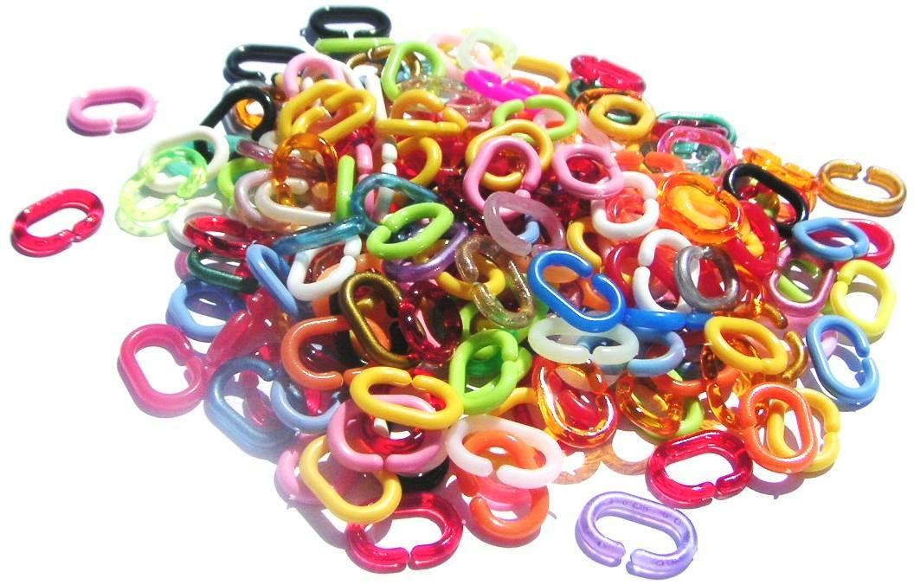
the king of Czech discos
over 3,000,000 records sold
1998 he composed the "hymn" for the Czech national ice hockey team
his song appeared in the movie HOSTEL

Slide 12
https://www.youtube.com/watch?v=91YIRgBZioc

Slide 15
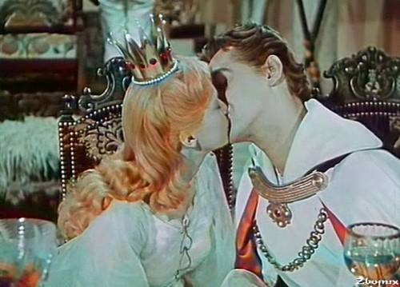
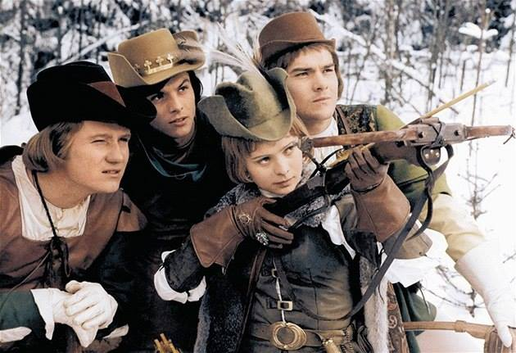
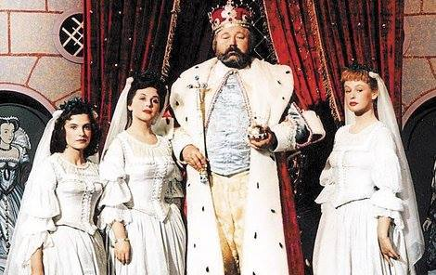

Slide 16
