Slide 1
Minipresentations Wednesday Videoconferences

Slide 2
Outline
Historical background – Terka
Slovak x Czech culture – Natália
Time for questions
Czech Beer – Tommy
Czech Food – Daniela
Sicilian Food – Federica
Time for questions
Sports in CR - Barbora

Slide 3
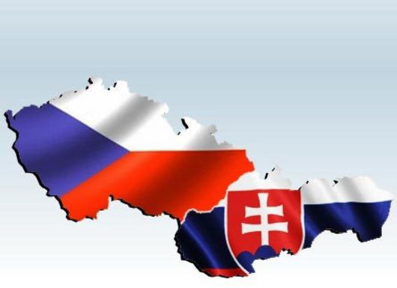
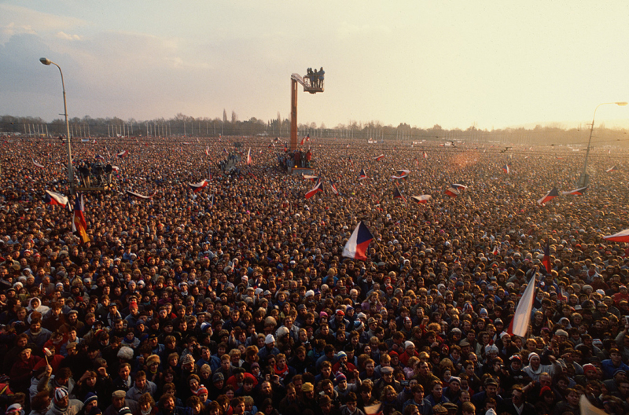
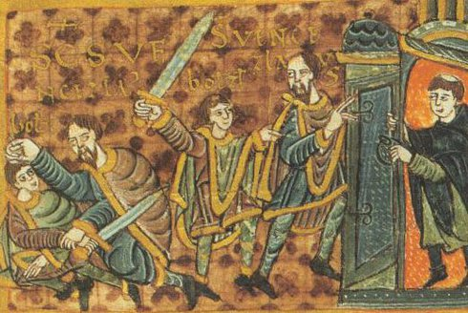
Historical background

Slide 4
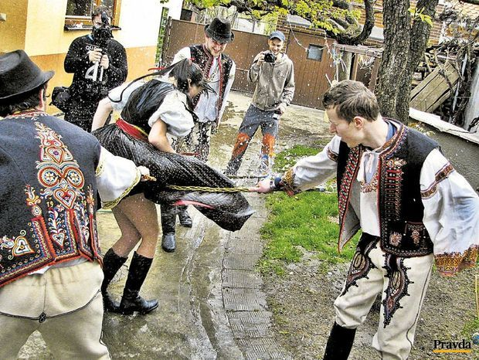
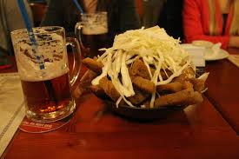
Slovak x Czech culture
Slovak culture
Eastern weird custom
High Tatra mountains
Most people are christians
Slovak people understand czech
Czech culture
Much better beer
Keep getting lost in Slovak mountains
Subway
Many students from SK

Slide 5
Questions

Slide 6
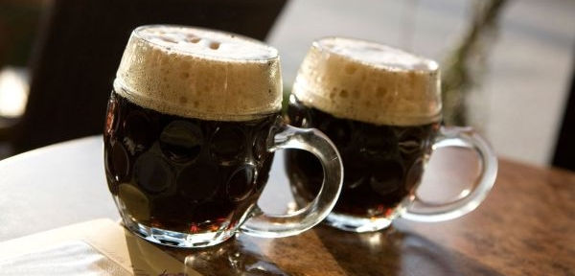
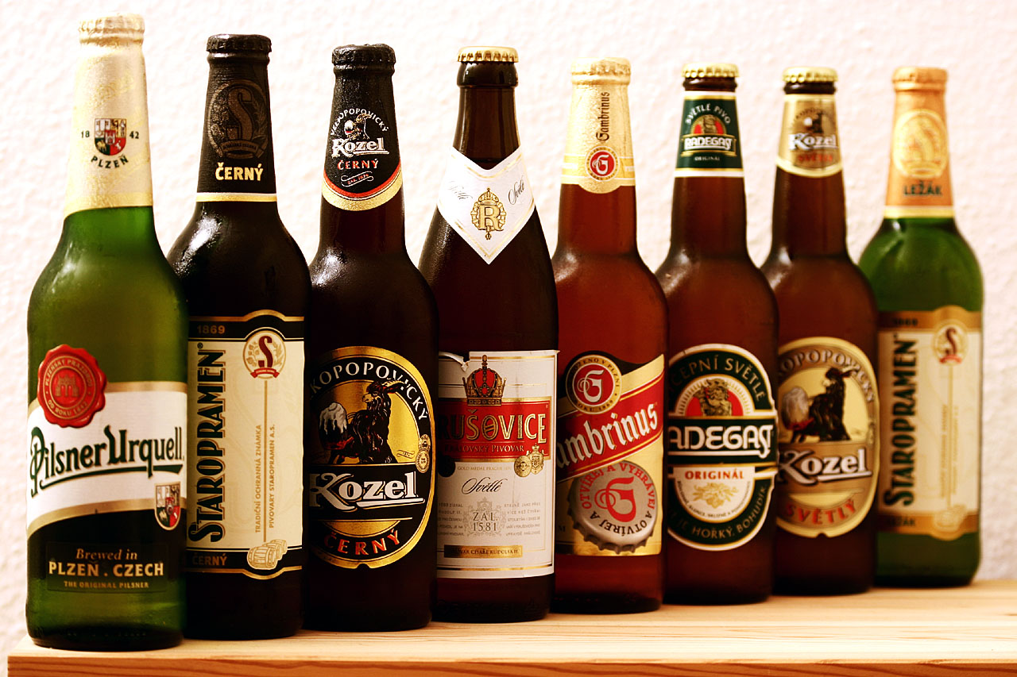
Czech Beer

Slide 7
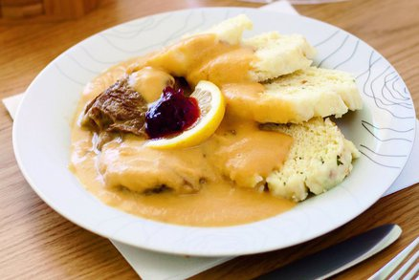
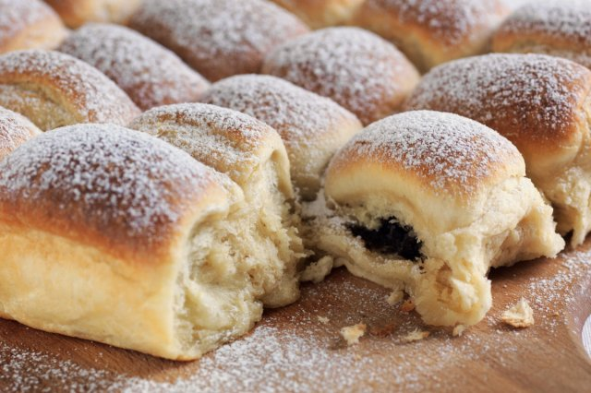
Czech Food
Svíčková na smetaně (Marinated sirloin with cream sauce and dumplings)
3 examples – a menu:
Bramboračka (Potato Soup)
Buchty (Sweet rolls/buns)

Slide 8
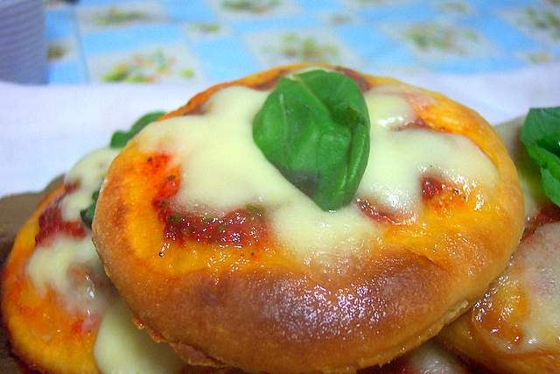
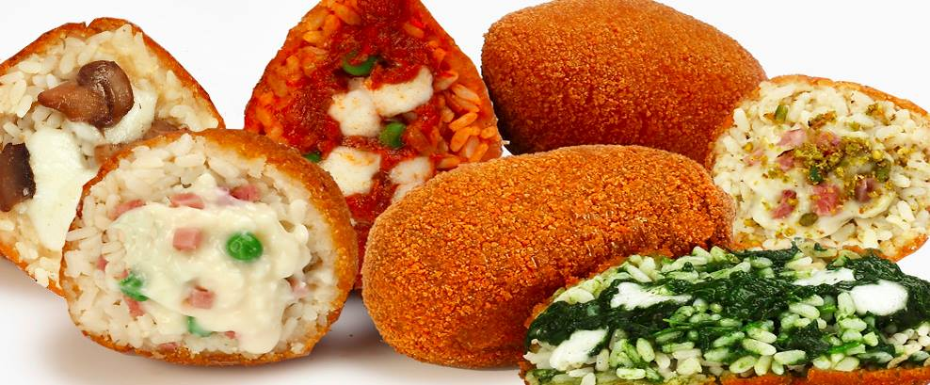
Sicilian Food

Slide 9
Questions

Slide 10
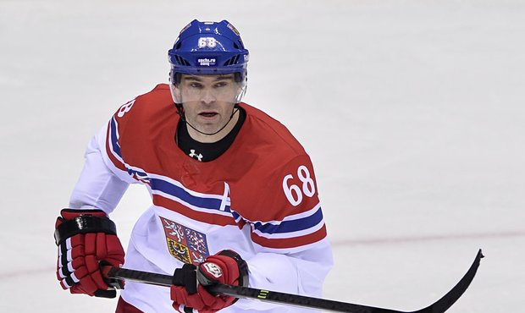
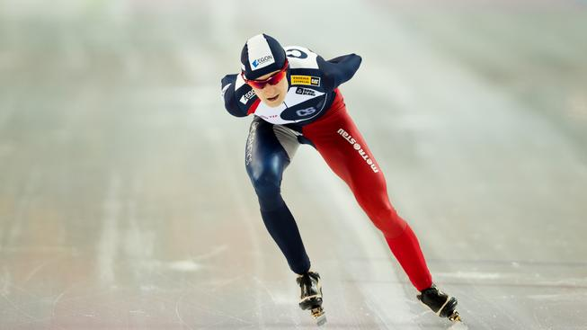
Sports in Czech, Czech Sports Abroad WINTER SPORTS

Slide 11
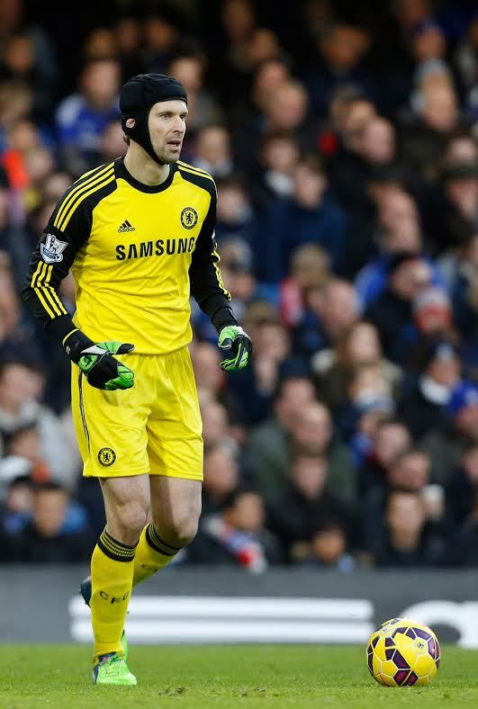
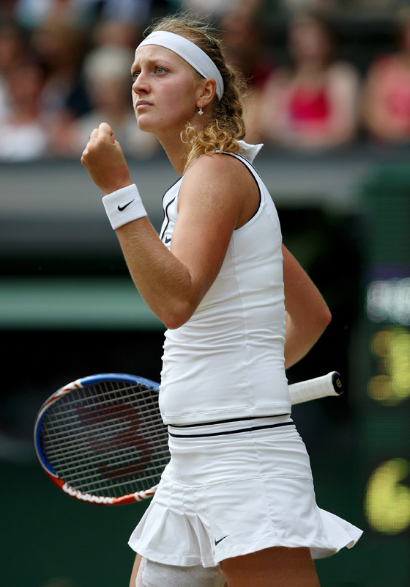
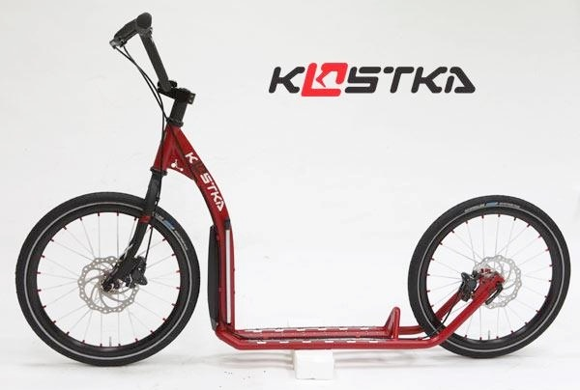
Sports in Czech, Czech Sports Abroad SUMMER SPORTS

Slide 12
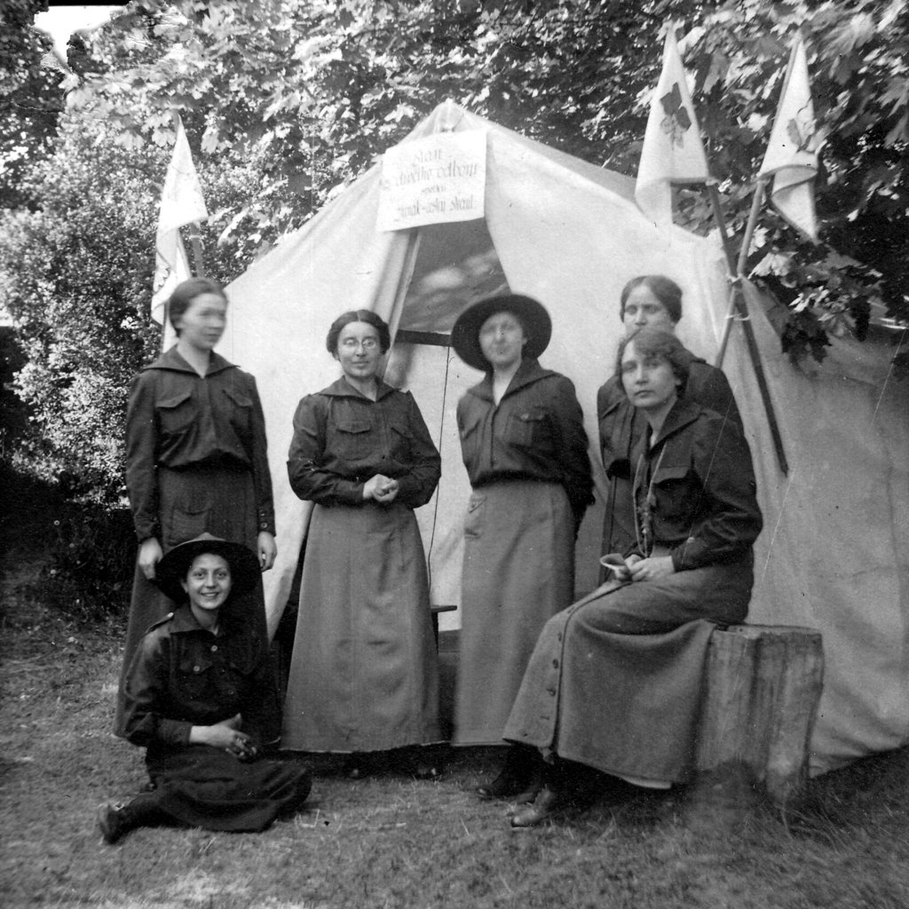
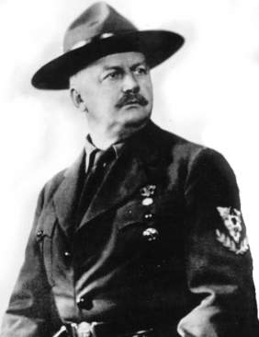
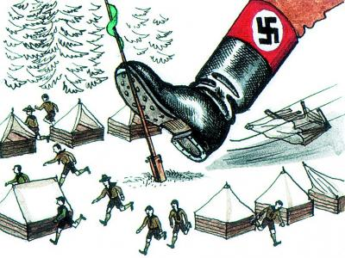
History
1907 camp at Brownsea Robert Baden Powell
Ernest Thompson Seton - woodcraft
1912 first squad - Antonín Benjamin Svojsík
1915 girls scouting – Anemonies -Anna Berkovcová
Forbidden:
1940 – 1945 by nazies (K. H. Frank)
1950 – 1968 by communists
1970 – 1989 by cummunists
1989 definitely reestabished
2012 hundred years of Czech scouting

Slide 13
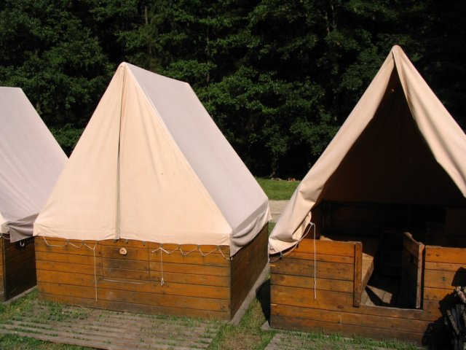
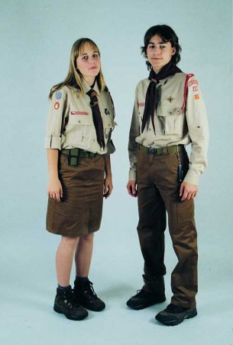
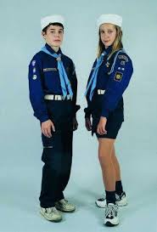
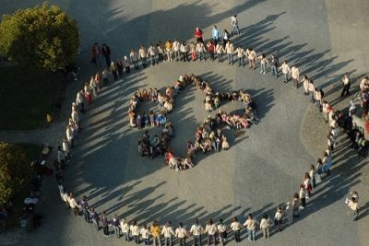
Today
53 028 members in 2 093 squads / 20 000 000 scouts in the world
1 001 children´s camps
Regular meetings
World jamboree, Central european jamboree

