Slide 1
Videoconferencing in English
Presenting Capitals
November 11, 2015

Slide 2
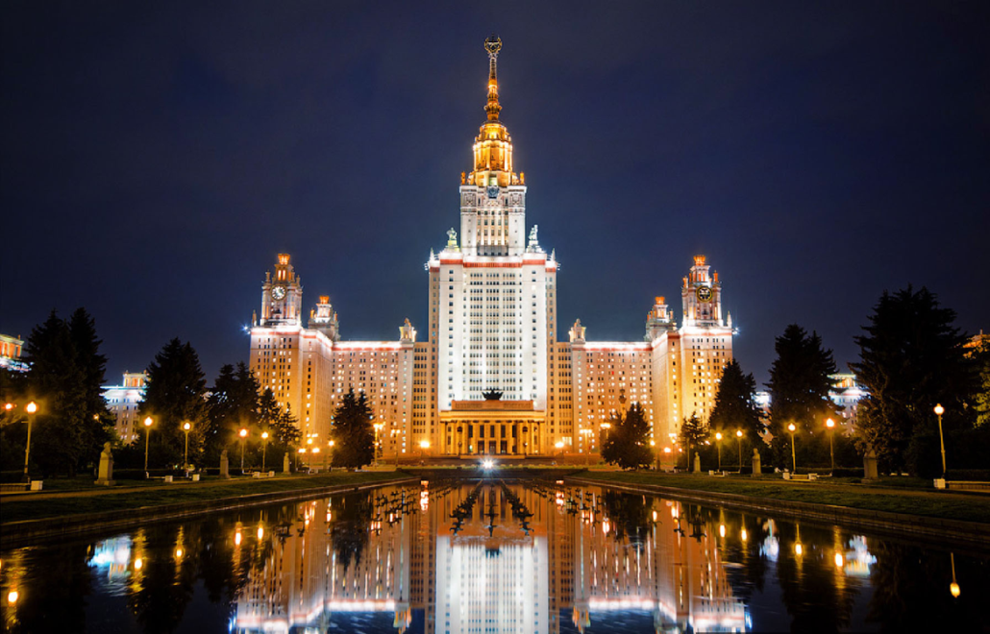
Warm-up speaking
Which places / capitals would you describe as
stunning / impressive / memorable / astonishing?

Slide 3
Reading
Every tram in ___________ congregates in front of the station, and there´s an infectious buzz about the place in the early afternoon, after work. A steady stream of people plough up and down ______--a somewhat hazardous coctail of cobbles, steaming manholes and tram lines, which leads to _________. Don´t let that stop you from looking up at the five-storey mansions, laden with a fantastic mantle of decorations, some grotesquely disfigured by pollutants.
To the left as you head up _______ is ______ (literally „cabbage market“). The chaotic vegetable market on a sloping cobbled square, now beginning to return to the brisk trade of its pre-war days, and somewhat ill-served by the mishmash of buildings which line its edges. At its centre is the petrified diarrhoea of the huge _________ fountain by Fischer von Erlach: in the good old days, when it worked properly, live carp was sold from its waters at Christmas,
________ is better known for its pubs than cafés, though of course you can get a coffee in either. During the summer, outdoor tables abound the various cafés around ____________More specifically, ________ and _____ are both trendy art venues to hang out in. As for pubs, the local brew is Starobrno but the best places are actually the ones which don´t serve it. Try ____________

Slide 4
Quiz
https://docs.google.com/document/d/1goBQtS2QVEr5RmWsmlfYHf4b82yt7FVKTEQK-9KJfqg/edit

Slide 5
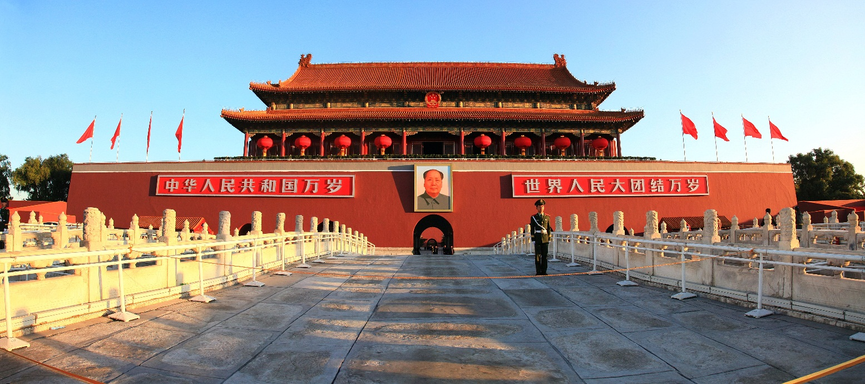
Speaking – guided tours
use the pictures to introduce one of the capitals
use the sentences to comment on the guided tour

Slide 6
Language focus
I _never ___ (see) so wonderful ________
It was _________ AAEIOYDNTR.
Absolutely ____________ AAIICFGNNST!
I_______ (learn) so much about_____________
All these beatiful ________. AEEOUBFGLRT.
I could _______ (stay) longer.
I _____ always ______ (want to visit)____________
It was a ___________ AAICGLM experience.

Slide 7
Aber presentations / Brno questions
http://www.video.muni.cz/download.cgi?furl=%2Fauth%2Fel%2F1421%2Fpodzim2015%2FCJVAVC%2Fum%2Fvi%2F;so=nd;id=36955:wfkbs1r1ha:1447183959:9a688c6ed23b0b72265e10ed5b04a0ecba79756d;uco=13766
Tbilisi: 5:00, 22:10, 26:35, 28:15
Rabat: 17:05
Beijing 33:40, 44:20
Seoul 48:20, 55:00

Slide 8
Our capitals
What?
How?
https://www.youtube.com/watch?v=wwYHty-jaRo
https://www.youtube.com/watch?v=2Iu1qph_IyM

Slide 9
Watching
https://www.youtube.com/watch?v=V3-M6lnZ1fk

Slide 10
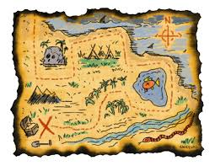
Map dictation

Slide 11
Map dictation
The 430-foot Constitution Hill overshadows the northern end of Marine Terrace.
The New Promenade cuts around War Memorial to a rocky headland, where the castle ruins stare blankly out to sea.
Northgate street winds east, becaming Penglais Road as it climbs the hill towars the university´s main campus and the National Library of Wales.
While in Penglais area, you might want to check out the excellent Aberystwyth Arts Centre, a quarter of a mile further up the hill from the National Library.
Aberystwyth´s twin train stations are adjacent to each other on Alexandra Road.

