Slide 1
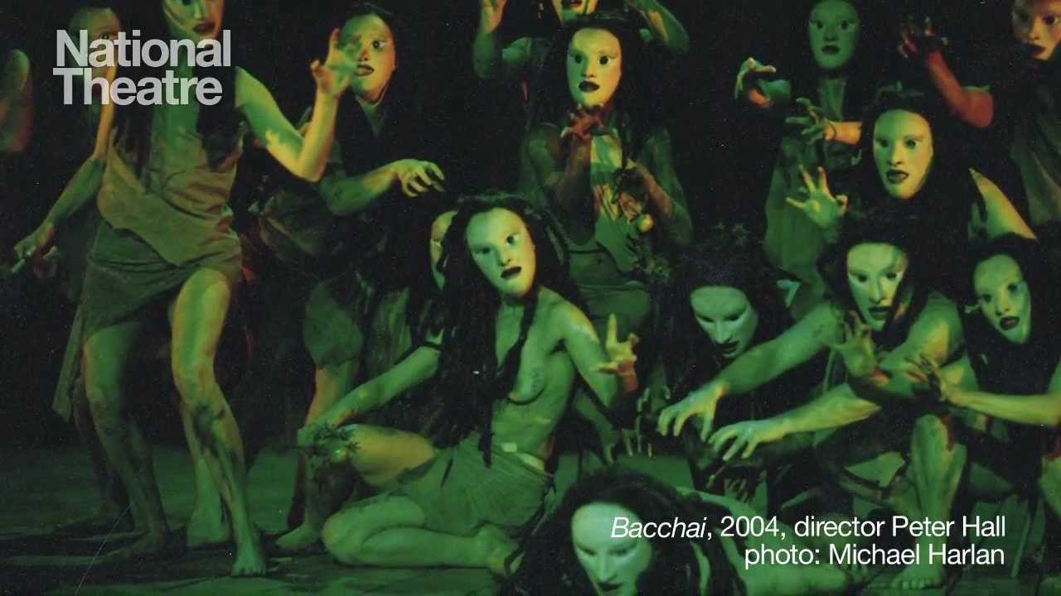
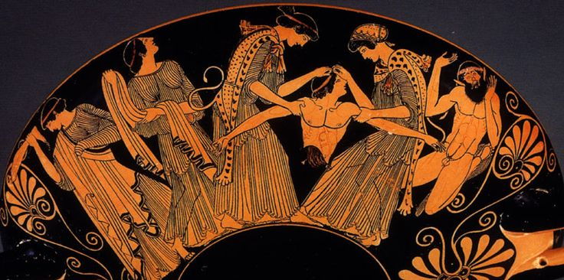

Slide 2
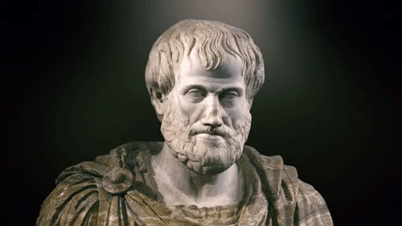
Umělecky nejkrásnější tragédie tedy vzniká z takového uspořádání látky: […] děj má obsahovat změnu nikoli z neštěstí ke štěstí, ale naopak ze štěstí v neštěstí, a to ne pro špatnost [charakteru] hrdiny, ale pro určité jeho pochybení.
Aristoteles: Poetika

Slide 3
Původ tragédie
Tragoidia → tragos + oidé
HÉRODOTOS: Sikyon → Athény (Kleisthenes), cca 550 BC
ARISTOTELES:
[Tragedy] coming from an origin in improvisation – and also comedy, the former from those who led off (exarchonton) the dithyrambs, and the latter from those [who led off] the phallic performances, which still even today remain a custom in many cities – grew little by little as they developed whatever they noticed in it, and after undergoing many changes it stopped [growing] when it had attained its own form.
→ spojitost s dithyrambem a Dionýsem

Slide 4
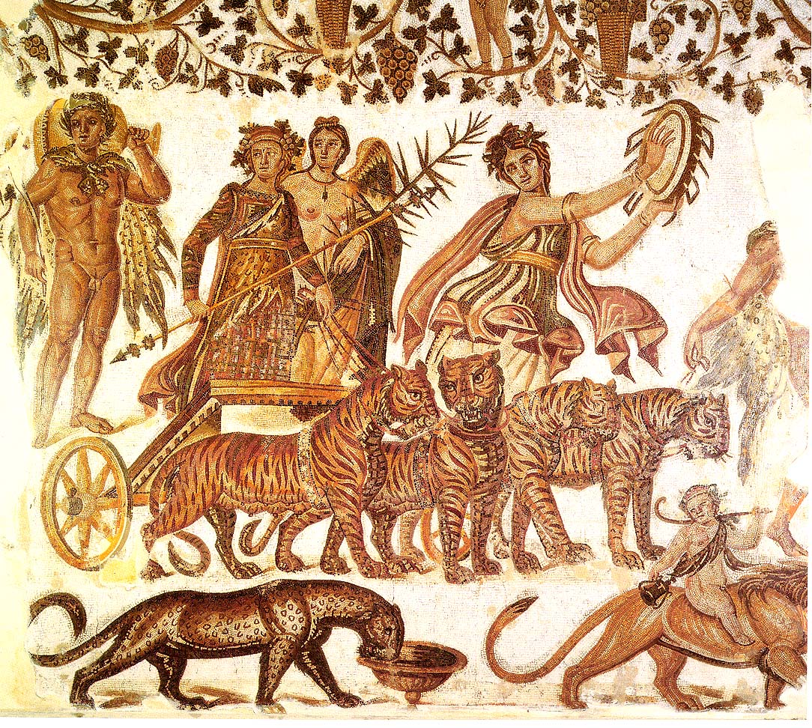
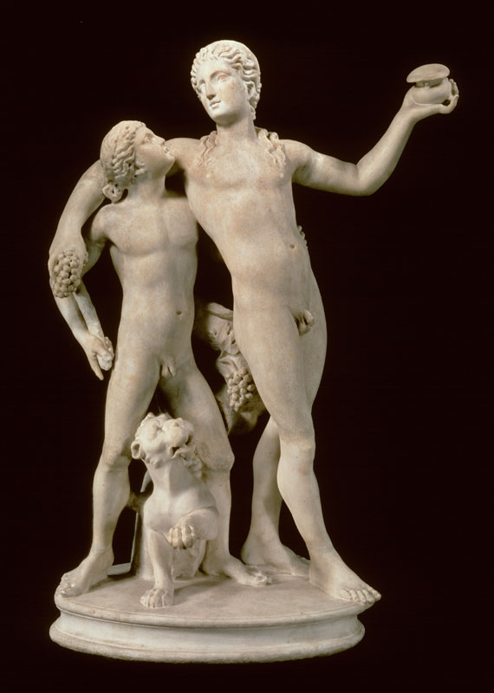
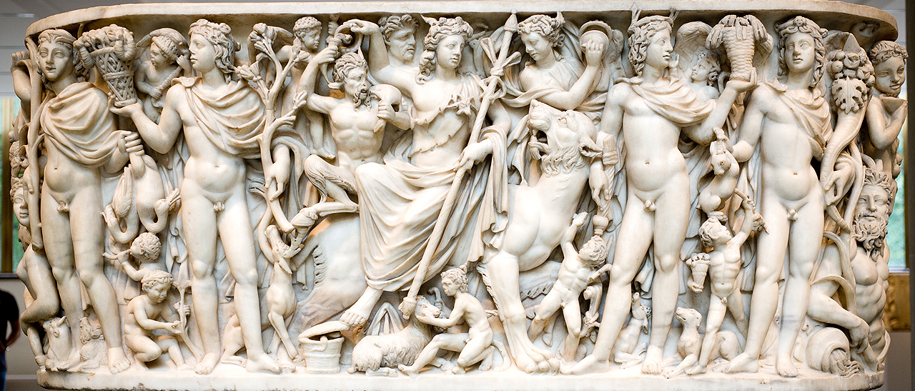

Slide 5
[Chorus:] King of sacred Athens, lord of the luxuriously-living Ionians, why has the bronze-belled trumpet just now sounded a war song? [5] Does some enemy of our land beset our borders, leading an army? Or are evil-plotting robbers, against the will of the shepherds, [10] rustling our flocks of sheep by force? What is it that tears your heart? Speak; for I think that you of all mortals have the aid of valiant young men at your disposal, [15] son of Pandion and Creusa.
[Aegeus:] Just now a herald arrived, having come by foot on the long road from the Isthmus. He tells of the indescribable deeds of a mighty man. That man killed overweening. [20] Sinis, who was the greatest of mortals in strength; he is the son of Lytaeus the Earthshaker, son of Cronus. And he has slain the man-killing boar in the valleys of Cremmyon, and reckless [25] Sciron. He has closed the wrestling school of Cercyon; Procoptes has met a better man and dropped the powerful hammer of Polypemon. [30] I fear how this will end.
[Chorus:] Who is the man said to be, and from where? How is he equipped? Is he leading a great army with weapons of war? [35] Or does he come alone with only his attendants, like a traveller wandering among foreign people, this man who is so strong, valiant, and bold, who has overcome the powerful strength [40] of such great men? Indeed a god impels him, so that he can bring justice down on the unjust; for it is not easy to accomplish deed after deed and not meet with evil. [45] In the long course of time all things come to an end.
Bakchylides 18 (Theseus)

Slide 6
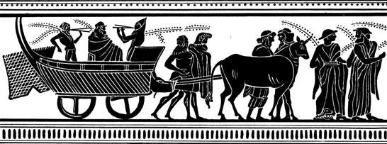
Původ tragédie – záchytné body
sborové písně a tance
homérské eposy
spojení s rituálem (kozel, Dionýsos)
neattická tradice
vydělení herce → dramatický dialog (Thespis? 535/4 BC)
502/1 BC: institucionalizace

Slide 7
Tragedy is the representation [mimesis] of a serious and complete set of events [praxis], having a certain size, with embellished language used distinctly in the various parts of the play, the representation being accomplished by people performing and not by narration, and through pity and fear achieving the katharsis of such emotions.
Aristoteles
An Attic tragedy is a self-contained piece of heroic legend, poetically reworked in elevated style for dramatic presentation by a chorus of Attic citizens and two or three actors as part of public worship in the sanctuary of Dionysus.
Wilamowitz-Moellendorff

Slide 8
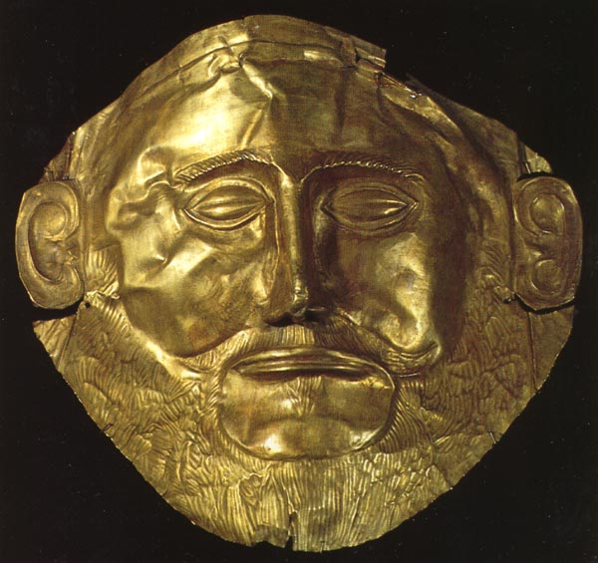
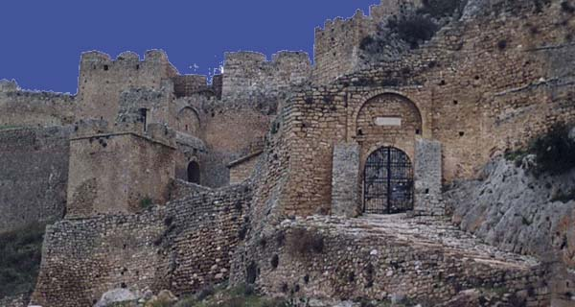
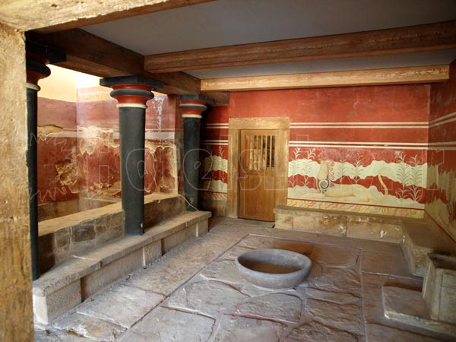
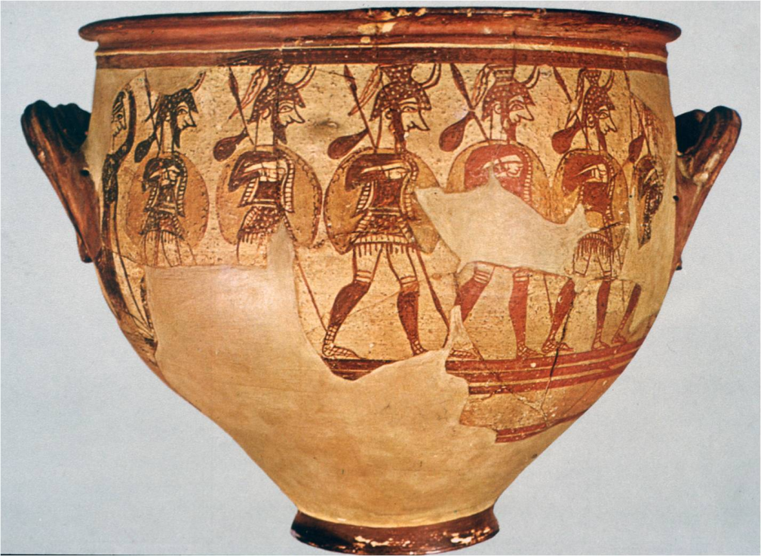

Slide 9
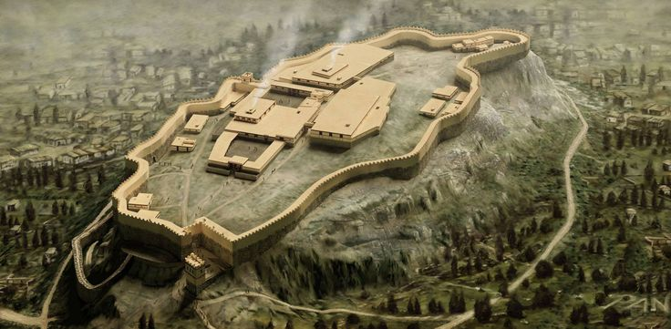
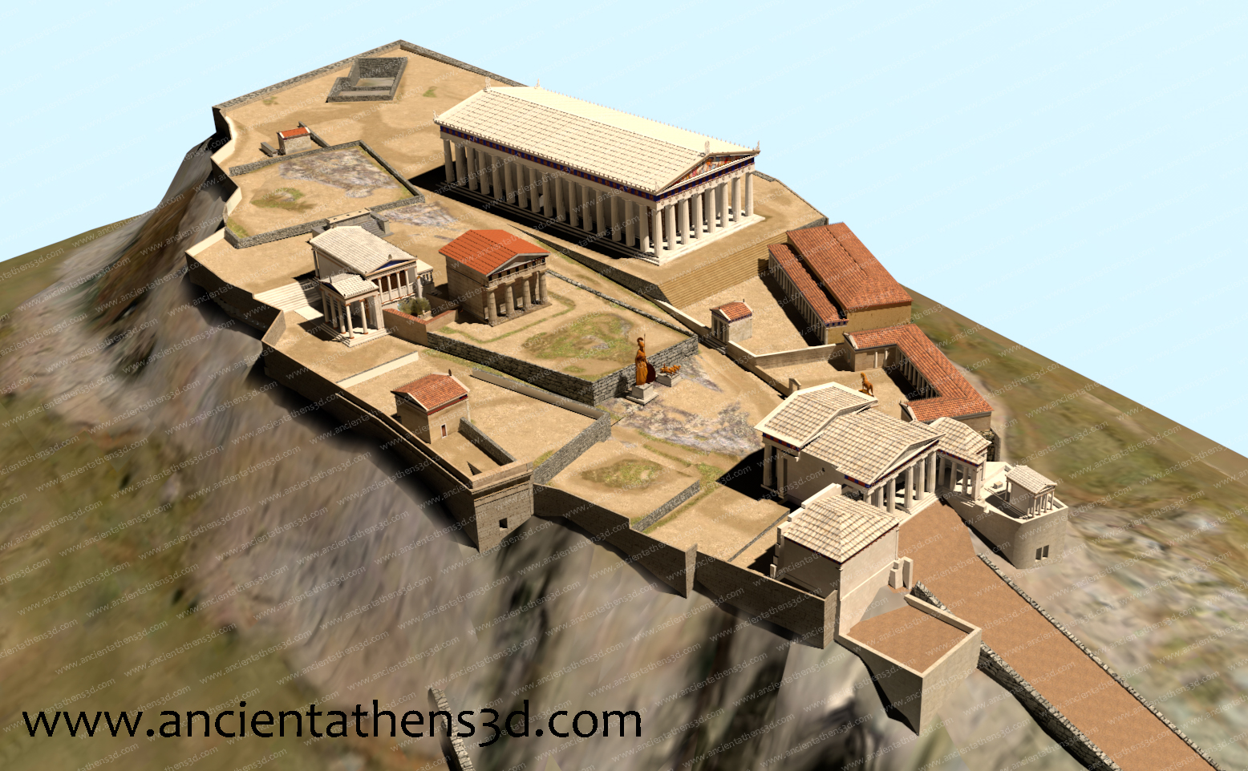

Slide 10
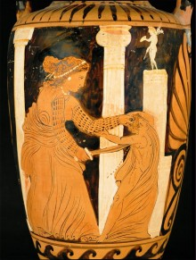
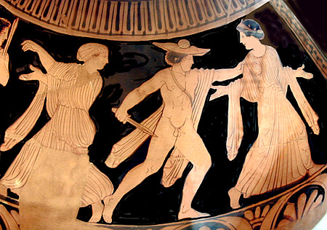
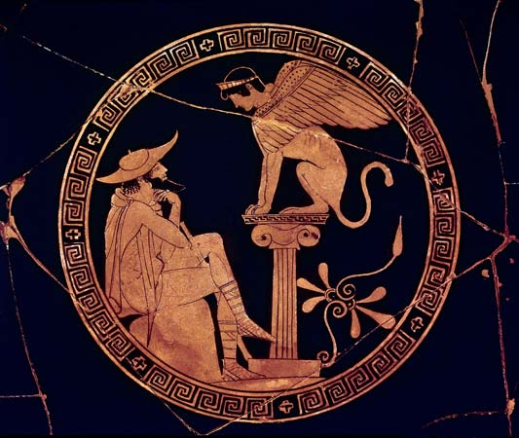
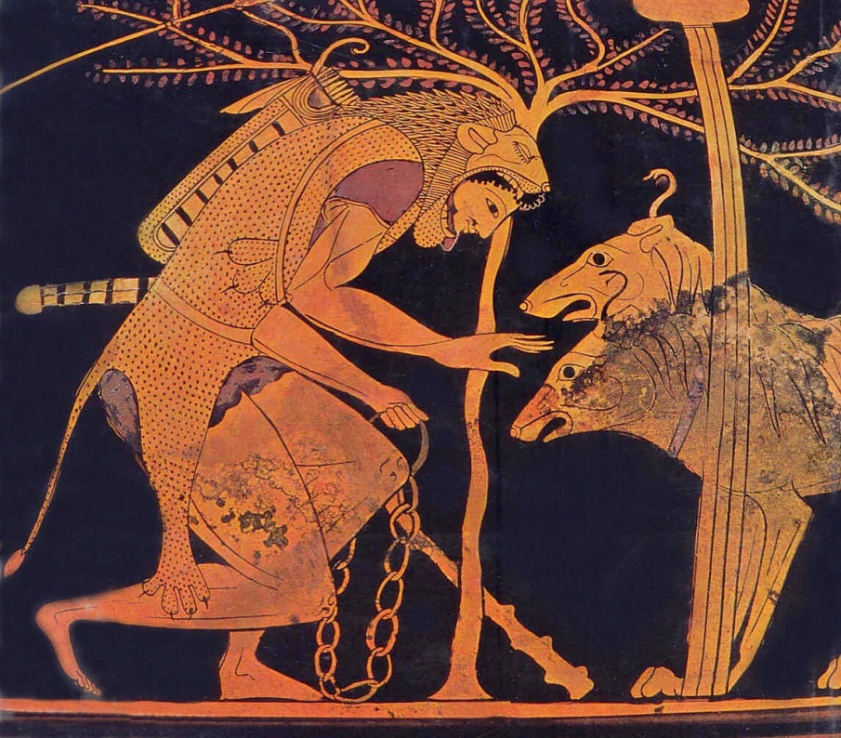

Slide 11
First of all it is clear that one must not portray admirable men undergoing a change from good fortune to bad, as this is not pitiful or fearful but just dreadful.
Nor [should one portray] evil men going from bad to good fortune, as this is the most non-tragic of all; it has nothing of what it should, it is neither pitiful nor fearful nor does it satisfy our human sensibilities.
Nor [should one portray] a thoroughly bad person falling out of good fortune into bad, as such a situation might satisfy our human sensibilities but would not furnish pity or fear . . .
What is left lies in between these: the situation will involve a person who is not outstanding in either virtue or just behavior, who falls into bad fortune not through vice or wickedness, but through some mistake [hamartia], one of those who enjoys great reputation and prosperity.
Aristoteles: Poetika

Slide 12
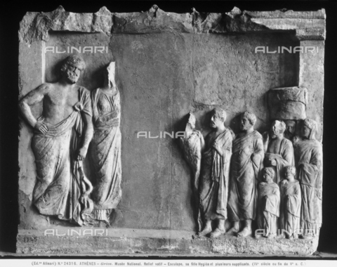
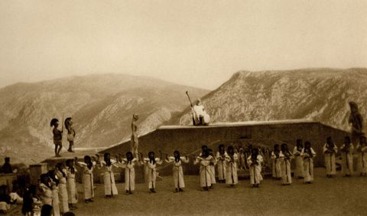
Aeschylus' Suppliants, in the ancient theatre of Delphi during the Delphic festival of 1930

Slide 13
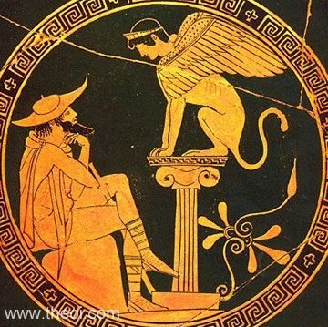
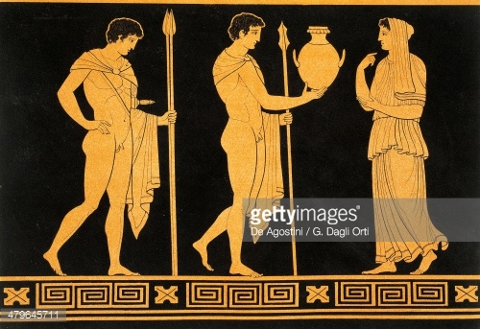
ANAGNORIZE
Sofokles: Oidipus král
Aischylos: Oresteia (Oběť na hrobě)

Slide 14
Nejdůležitější z nich [složek tragédie] je způsob seřazení činů (dějových komponentů): neboť tragédie je nikoli napodobením lidí samotných, nýbrž jejich činů a života a štěstí a neštěstí. Štěstí a neštěstí však vychází z činů (děje) a cílem [tragédie] je tedy zobrazení činů, nikoli vlastností.
[… Dramatičtí] básníci neusilují napodobovat povahy, nýbrž v činech zahrnují zároveň povahy, takže cílem tragédie jsou činy a děj.
Aristoteles: Poetika
He knows how to arrange the action with such a sense of timing that he creates a character out of a mere half-line or a single expression. This is the essential thing in poetry: to delineate character or feelings.
Život Sofokleův

Slide 15
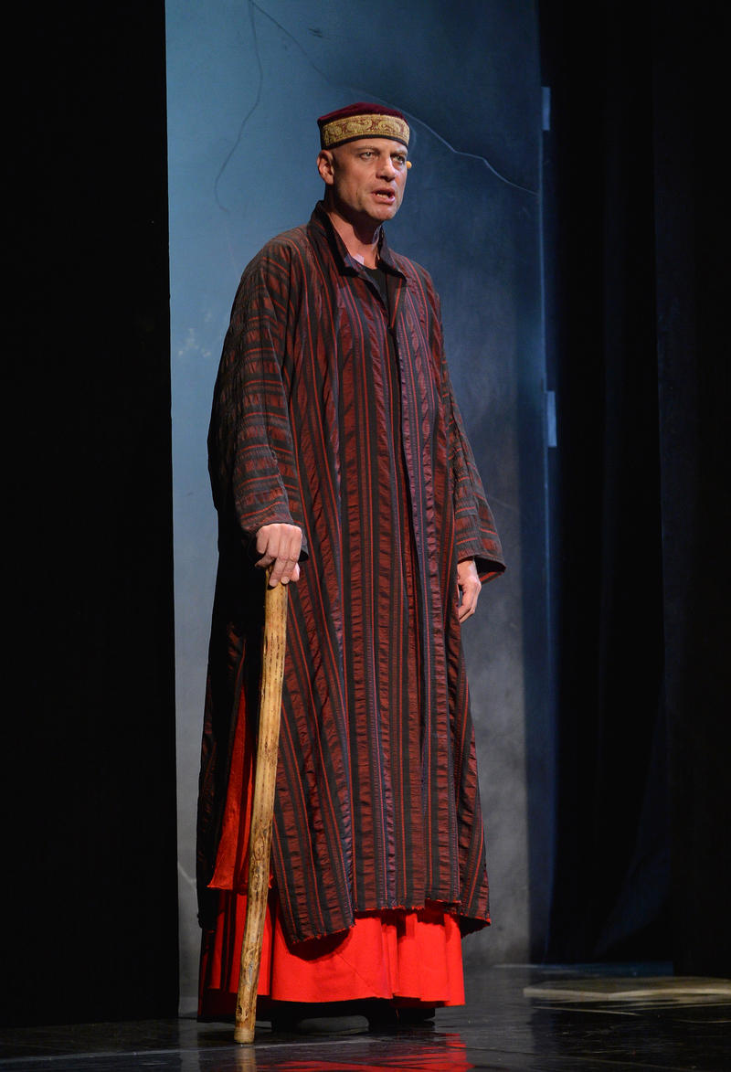

Slide 16
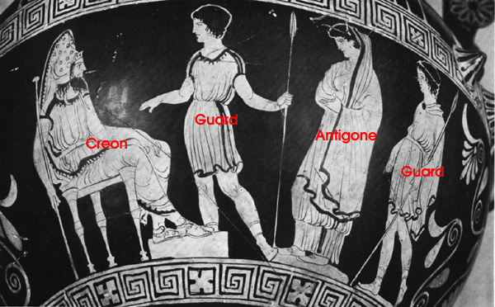
Struktura tragédie
ARISTOTELES: epeisodion x stasimon
TYPOLOGICKY
prolog – řeč
episoda – řeč
kommos – zpěv
melé – zpěv
monodie – zpěv

Slide 17
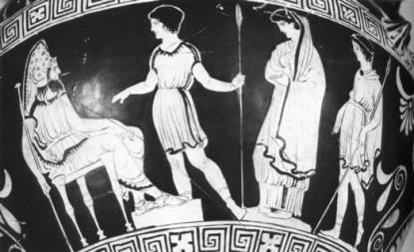
STICHOMYTHIE
KREON
To vidíš jen ty sama z Thébanů!
ANTIGONA
I ti to zří, však mlčí před tebou.
KREON
A nestydíš se od nich lišiti?
ANTIGONA
Ctít bratra netřeba se styděti.
KREON
A ten, jejž zabil, není bratr tvůj?
ANTIGONA
Je bratr můj, z týchž rodičů jak já!
KREON
Proč tedy prvého ctíš bezbožně?
ANTIGONA
V tom za pravdu ti nedá nebožtík!
KREON
Když jej jak bezbožníka stejně ctíš!
ANTIGONA
Ne otrok, nýbrž bratr zahynul!
Sofokles: Antigona

Slide 18
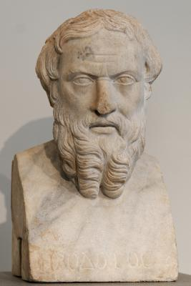
Autoři tragédií
Aischylos
Frinychos
Pratinas
Choirilus
Sofokles
Ion
Achaios
Agathon
Achaios

Slide 19
Dochování textů
AISCHYLOS
SOFOKLÉS
EURÍPIDÉS
Dochováno 7
Dochováno 7
Dochováno 17
+ jedna sporná
+ satyrské drama Kyklóps
(82–90 her)
(123 her
podle Súdy)
(92 her)
Známo 46 jmen dalších tragiků, kteří dohromady napsali kolem 600 her.
Zachovaný fragment představuje tedy přibližně 3,5 % někdejšího celku.

Slide 20
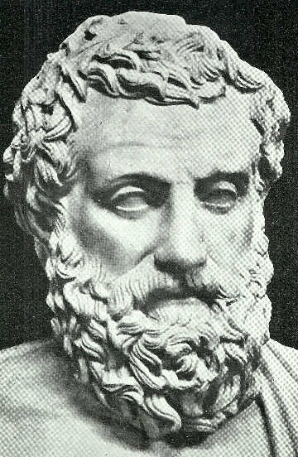
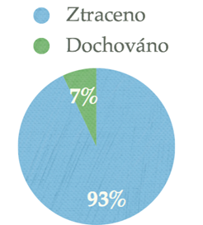
Aischylos
Beneath this stone lies Aeschylus, son of Euphorion, the Athenian,
who perished in the wheat-bearing land of Gela;
of his noble prowess the grove of Marathon can speak,
and the long-haired Persian knows it well.
525/524–456/455
TRILOGIE:
Laios + Oidipus + Sedm proti Thébám + Sfinx
Oresteia: Agamemnon + Oběť na hrobě + Usmířené lítice + Próteus

Slide 21
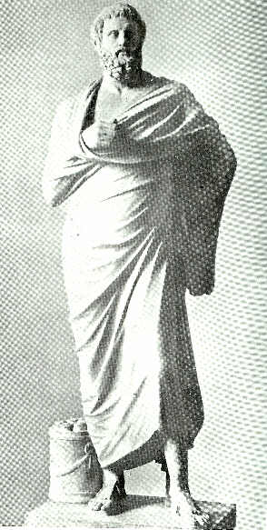
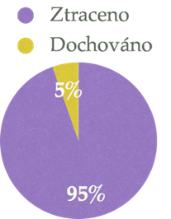
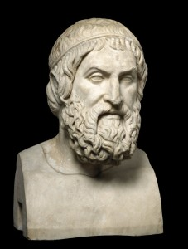
Sofoklés
Napsal 123 her
Dochováno 7
+ fragment satyrské hry Slídiči
496–406 BC

Slide 22
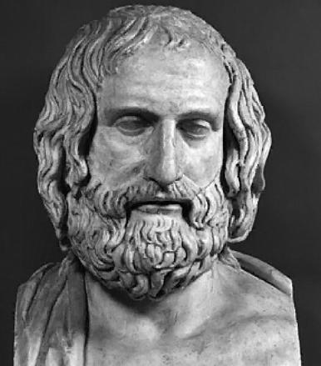
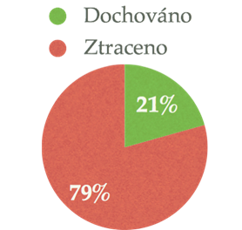
Euripidés
Napsal 92
Dochováno 17
+ jedna sporná
+ satyrská hra Kyklóps
485/480–406 BC

