Slide 1
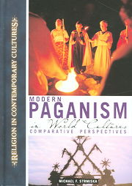
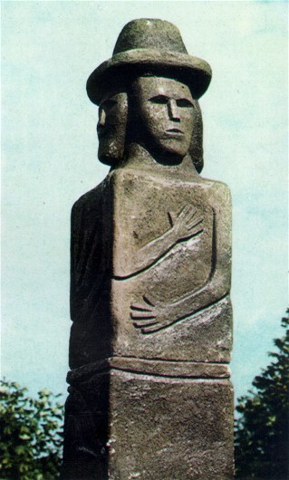
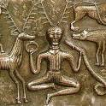
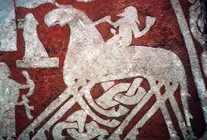

Neo-Paganism and New Religious Movements ::
Class Six
Modern Baltic Paganism:
Masaryk University :: Faculty of Arts
Dept. for the Study of Religions
Professor Michael Strmiska :: RLB 502 ::
Neo-Paganism and New Religious Movements

Slide 2
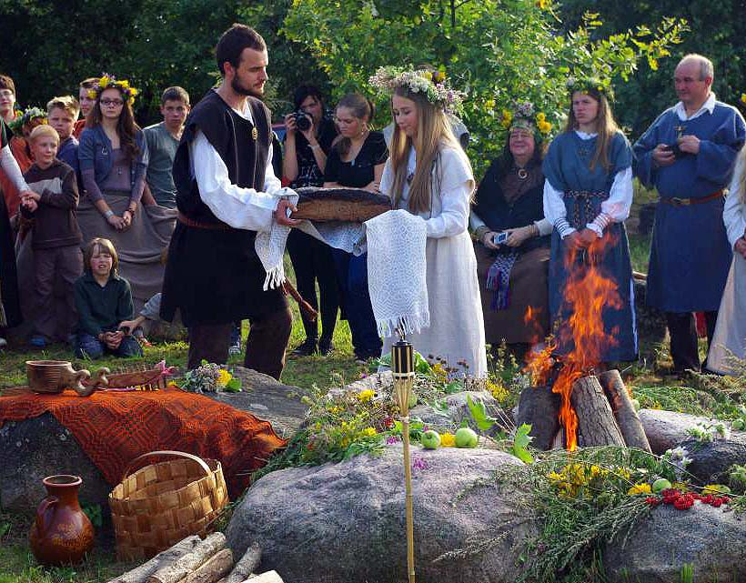
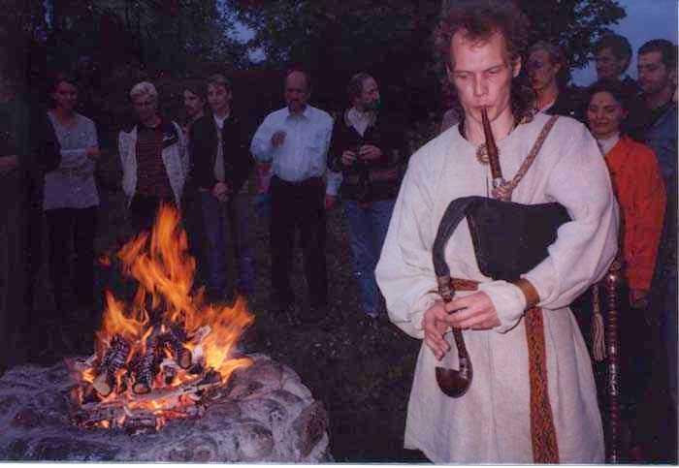
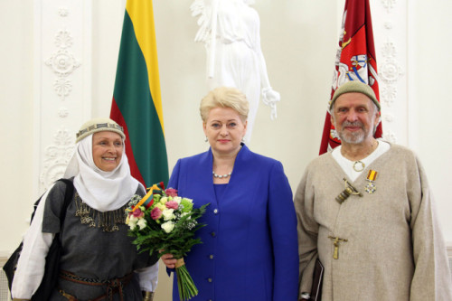

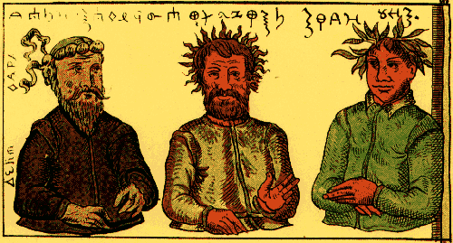

Slide 3
Lithuanian Romuva Paganism
This type of Paganism draws on old Lithuanian texts and myths, with old folk songs called dainas the most complete and important source of information.
Lithuania was the last European kingdom to convert to Christianity in 1386, and much of the population remained Pagan, with result that folk culture of country retained many Pagan elements.
Romuva is named for an ancient Pagan sanctuary in modern-day Kaliningrad
Modern group first founded in Lithuania as a folklore organization in 1967, suppressed by Soviet government in 1970s and 1980s, became an openly religious association in 1989.
The leaders of modern Romuva from its inception have been Jonas Trinkūnas and his wife Inija Trinkūnienė, both folk singers who also lead a pagan-oriented recording group called Kulgrinda (meaning “path”).
Romuva groups are also found in the USA and Canada

Slide 4
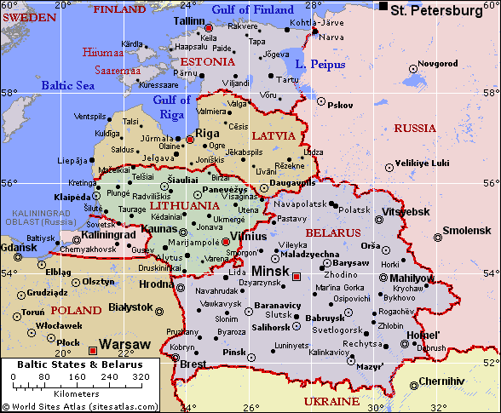
Baltic States today

Slide 5
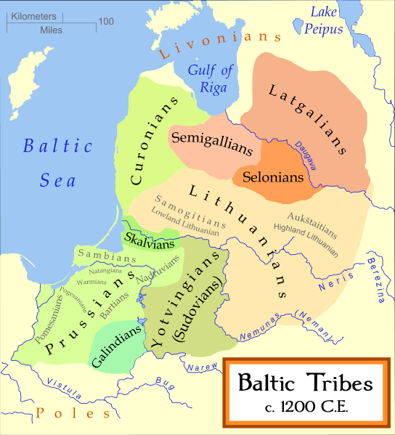
Baltic Region ~1200

Slide 6
Historical Overview of Lithuania
In early 14th century, GDL was one of most diverse and tolerant states in Europe: Pagans, Christians, Jews and people of different nations co-existed.
In 1387, joined with Poland to form the “Polish-Lithuanian Commonwealth,” aka “The Republic of Two Nations,” one of the largest states in Europe until dissolution in 1795
Last country in Europe to become Christian (1386), hence, Lithuanians often called “the Last Pagans in Europe”
In 13th to 14th centuries, the Grand Duchy of Lithuania was one of the largest states in medieval Europe, through conquests or alliances with Belarus, Ukraine, and parts of Russia.

Slide 7
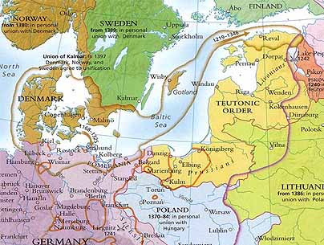
Map of Baltic States in 14th Century showing German Crusader (Teutonic Knights) conquest of Latvia (Livonia).
Of the Baltic states and tribes, only Lithuania resists, forming union with Poland in 1386 which crushes the Germans in the Battle of Grünwald/Zalgiris in 1410.

Slide 8
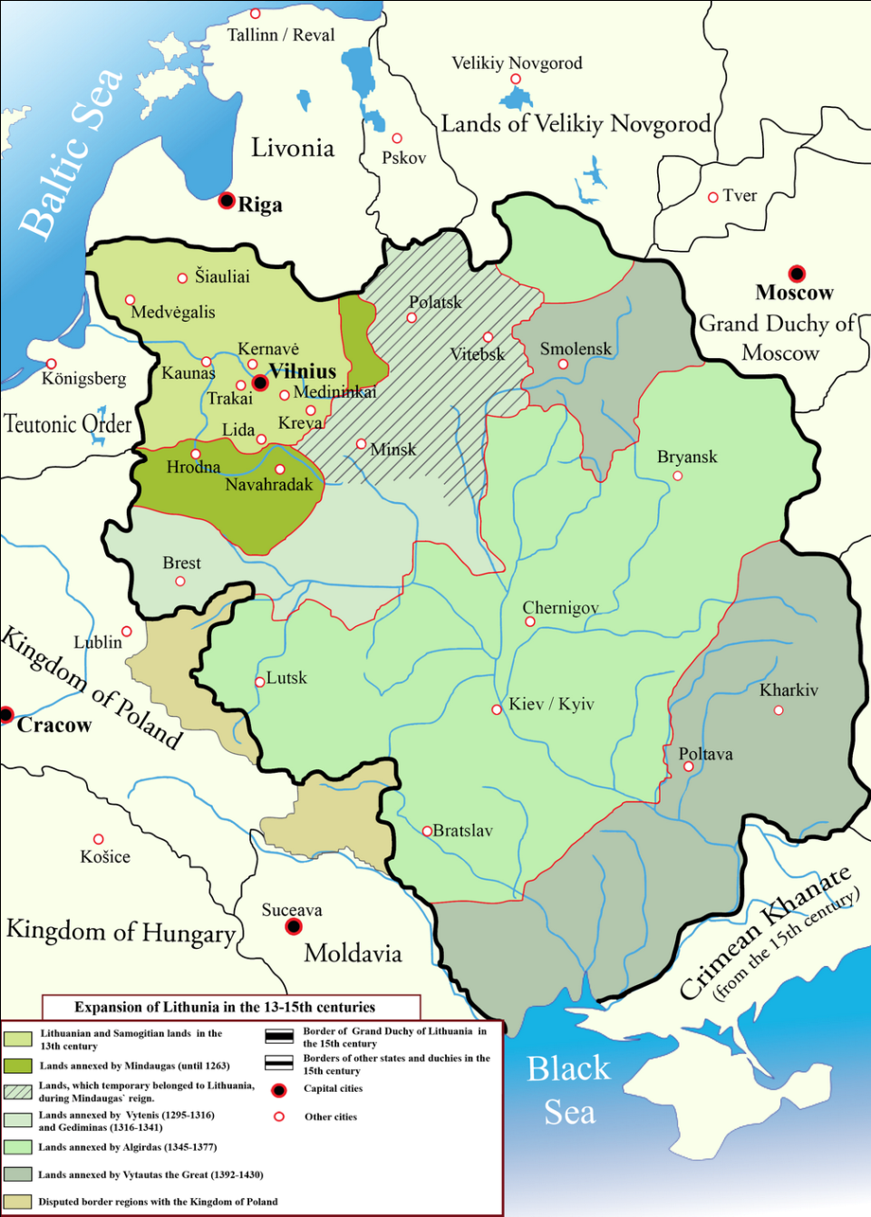
Grand Duchy of Lithuania in 13th to 15th centuries, prior to union with Poland
Notes:
From http://en.wikipedia.org/wiki/Image:Lithuanian_state_in_13-15th_centuries.png

Slide 9
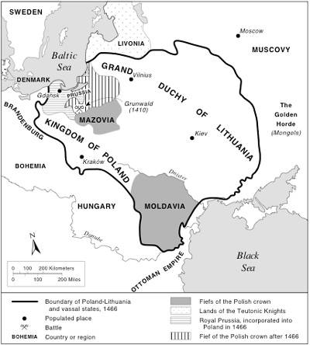
Poland-Lithuanian Commonwealth in 15th Century

Slide 10
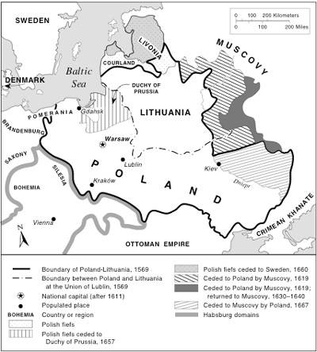
Polish-Lithuanian Commonwealth in 16th Century, one of the largest states in Europe

Slide 11
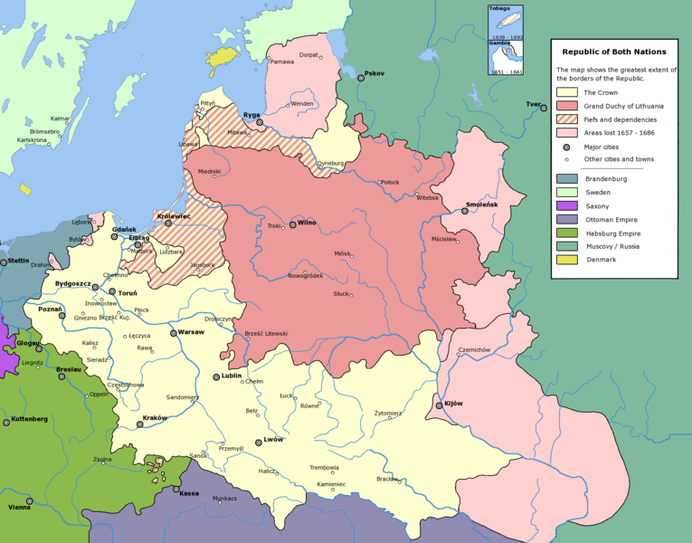
Polish-Lithuanian Commonwealth, the “Republic of Two Nations,” in 17th century at height of power

Slide 12
Further facts about Lithuania
Lithuania came under Russian rule from 1795-WW I, after which it was independent until WW II, when it was invaded and occupied by the USSR…then Nazi Germany…then the USSR again.
During the Nazi period, Lithuania’s sizable Jewish was population nearly wiped out.
Under Soviet rule, thousands of Lithuanians were sent to their death in the Russian Gulags.
Lithuania was the first Soviet Republic to declare independence, in 1990, setting off chain reaction and ending the USSR.
Lithuania became a member of NATO and the European Union in 2004.

Slide 13
Baltic States today

Slide 14
Brief History of Riga, Latvia
Prior to 11th century, Riga is village of Pagan Baltic Latvians on banks of Daugava (Dvina) where river meets Baltic Sea.
From 12th century, German Christian Crusaders build up Riga as German-style castle and town. Native Latvians treated as inferior class.
First record of Riga is from year 1200.
In Middle Ages, Riga prospers as port city and East-West trading center, joins Hanseatic League of German trading cities.
Prosperous Riga is conquered by Lithuania-Poland in 1581, Sweden in 1621, Russia in 1710.
By 19th century, Riga is the 2nd largest city in the Russian Empire.

Slide 15
Later History of Riga & Latvia
In 19th century, Riga is affected by new trend of nationalism, with rise of of Latvian Independence movement. New focus on Latvian folklore, mythology, culture.
After WW I, Latvia becomes independent state 1918-1940.
In 1940, USSR invades Latvia. Thousands of unethusiastic Latvians are killed or deported to gulags.
In 1941, Nazi Germany invades. Some Latvians greet Germans as liberators. Pro-Soviet Latvians are killed as are 70,000 Latvian Jews.
In 1945, the Soviet army reconquers Latvia. Some Latvians greet Soviets as liberators. Pro-German Latvians are killed or deported to Gulags.
In1991, Latvia gains independence from USSR.

Slide 16
Baltic States today

Slide 17
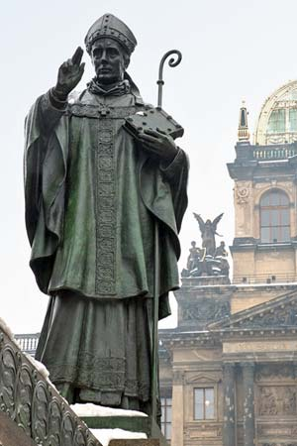
St. Adalbert (956-997), Bishop of Prague who conducted missionary activity in Baltic Prussia.
Adalbert was killed by native Balts for entering sacred Pagan groves.
His fate illustrates how Baltic Pagans resisted Christianization for centuries.
Eventually, Germanic Christian knights would invade and colonize area in the “Baltic Crusades,” lasting 1192-1410.
Only Lithuania would resist and remain Pagan.

Slide 18
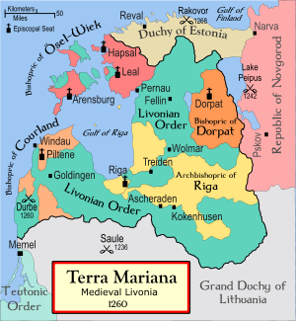
1236: The Battle of Saule
In 1236, crusading German knights attempting to invade the Grand Duchy of Lithuania were crushed by Lithuanian forces in Saule, which would later become the Lithuanian city of Šiauliai.

Slide 19
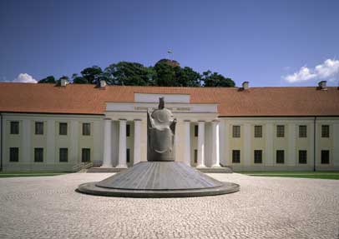
National Museum of Lithuania in Vilnius, with statue of 13th century king, Mindaugas, who converted to Christianity and was murdered by his subjects, who refused to convert

Slide 20
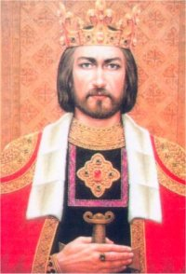
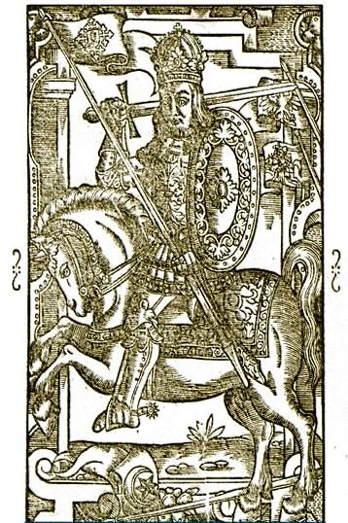
King Mindaugas (~1203 -1263)
Due to his acceptance of Christianity, Mindaugas is beloved by modern Lithuanian Catholics; non-Christians appreciate his efforts to unify Lithuania

Slide 21
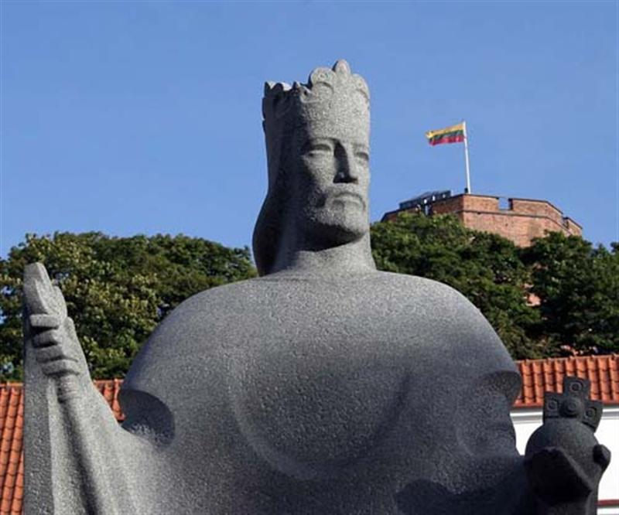
Monument to Mindaugas in front of the National Museum; Castle Hill in background

Slide 22
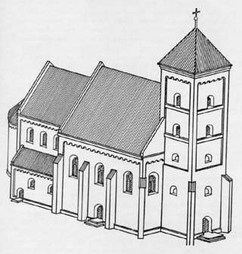
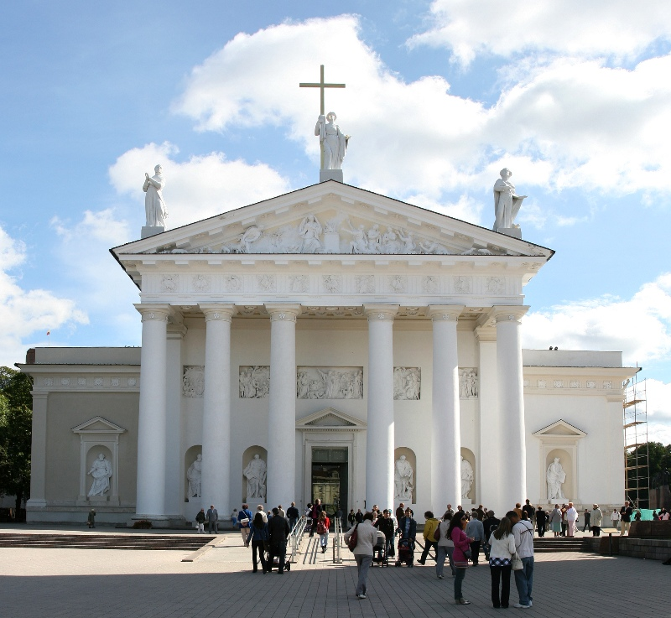
Reconstructed image of the first Cathedral, built by Mindaugas in mid-13th century, next to the oft-rebuilt Cathedral, as it is today

Slide 23
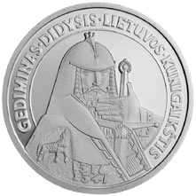
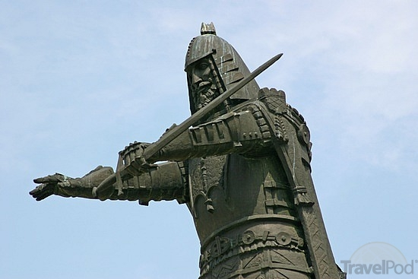
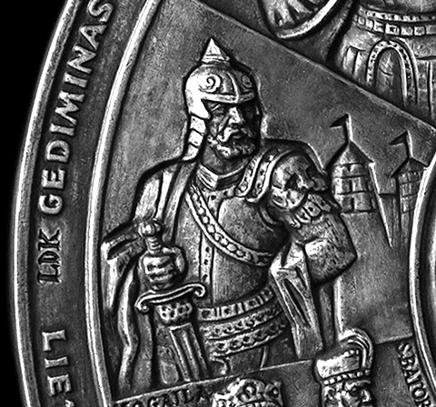
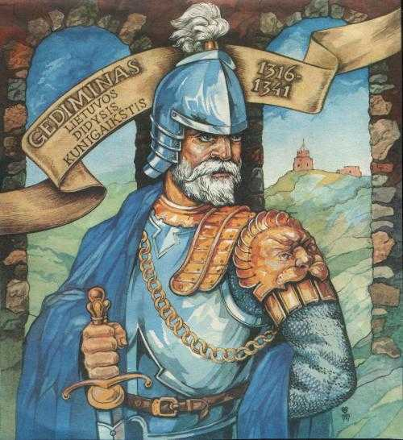
Grand Duke Gediminas: remembered as a skillful and tolerant ruler
Gediminas, born 1275, ruling 1315-1341,founded the city of Vilnius and its hilltop castle fortress based on his dream of an iron wolf howling on a hill
He allowed Christians to settle in Lithuania, but remained Pagan
He invited Germans and others to settle in Vilnius to help develop city
Conquered Slavic-Russian lands to east but avoided war with Mongols

Slide 24
Gediminas’ Importance to Lithuanian Pagans
If Mindaugas is the favorite ancient ruler of the Catholics, Gediminas is the favorite of the Pagans for remaining a Pagan despite pressure from Christian nations and Germanic Crusaders
In letters with the Pope, he offered conversion as a possibility, which he never actually attempted to implement
Inside Lithuania, he permitted both Catholic and Orthodox Christianity to coexist alongside traditional Paganism
He is therefore known as an unusually tolerant leader of the European Middle Ages, a point of pride to Lithuanians
His sons maintained similar policies

Slide 25
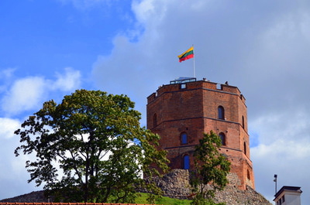
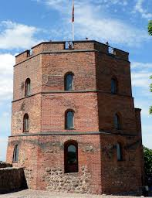
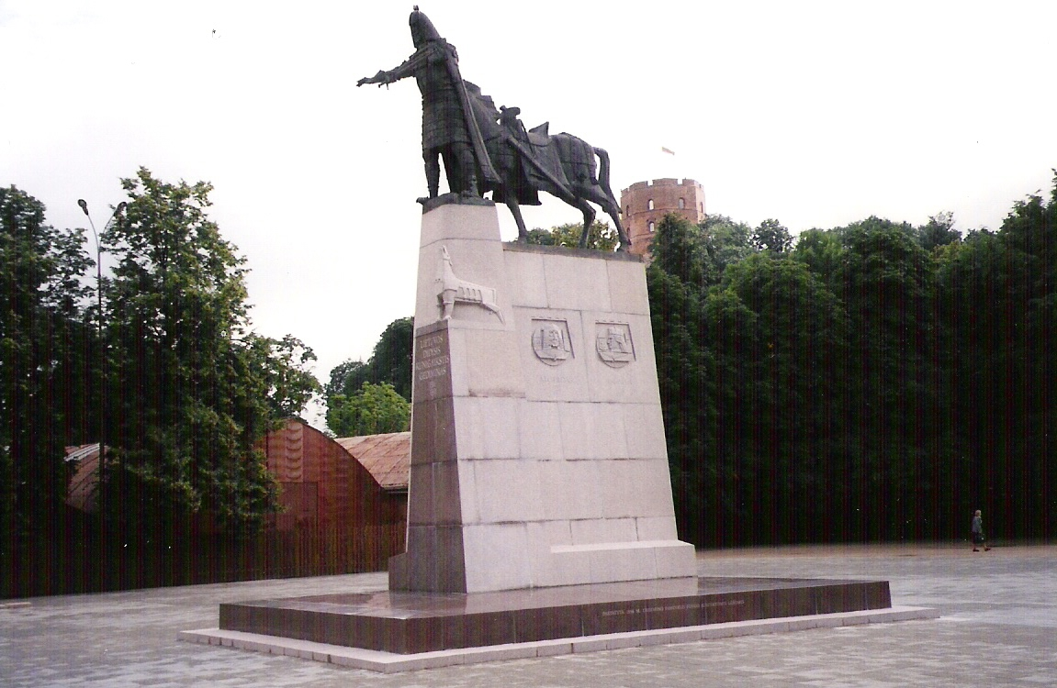
Gediminas castle and monument

Slide 26
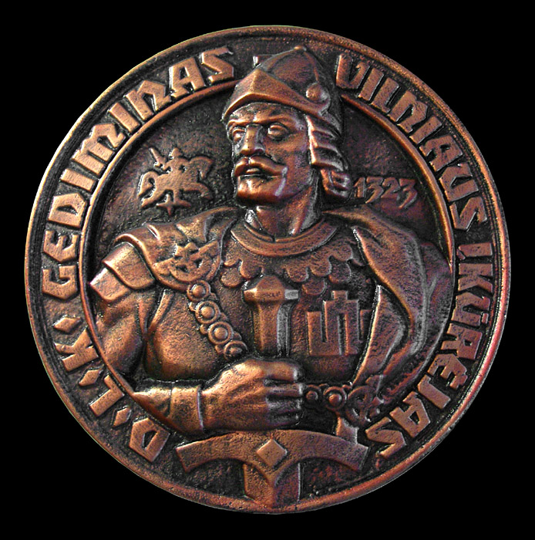
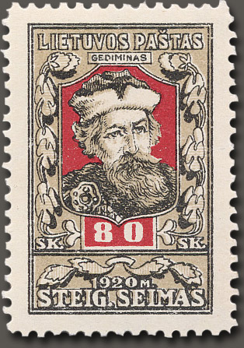
Images of Gediminas

Slide 27
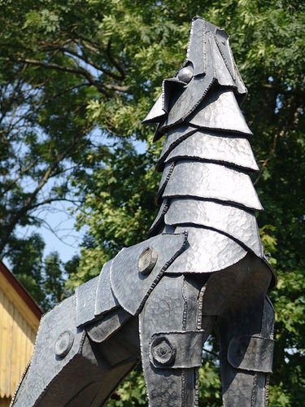
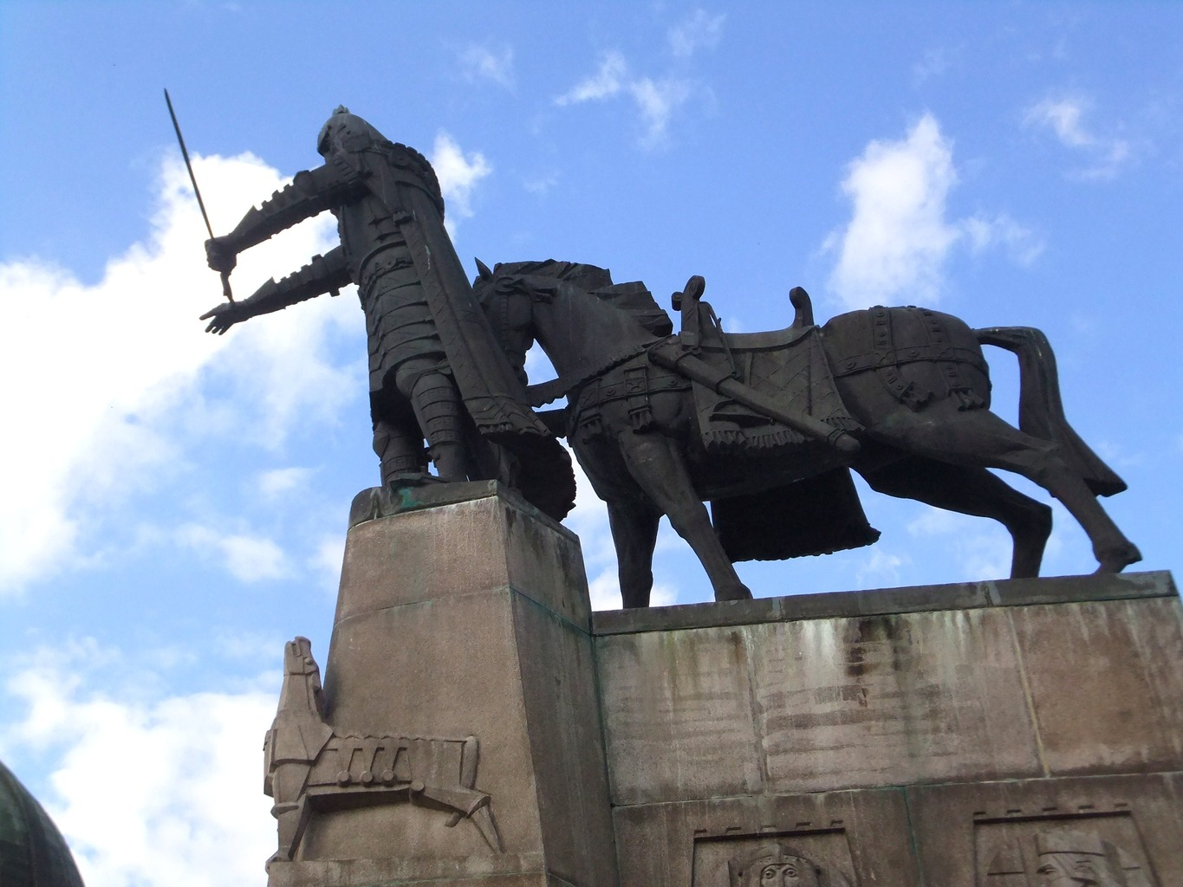
Two modern tributes to the Iron Wolf of Gediminas’ dream, which inspired him to undertake the construction of Vilnius, according to legend

Slide 28
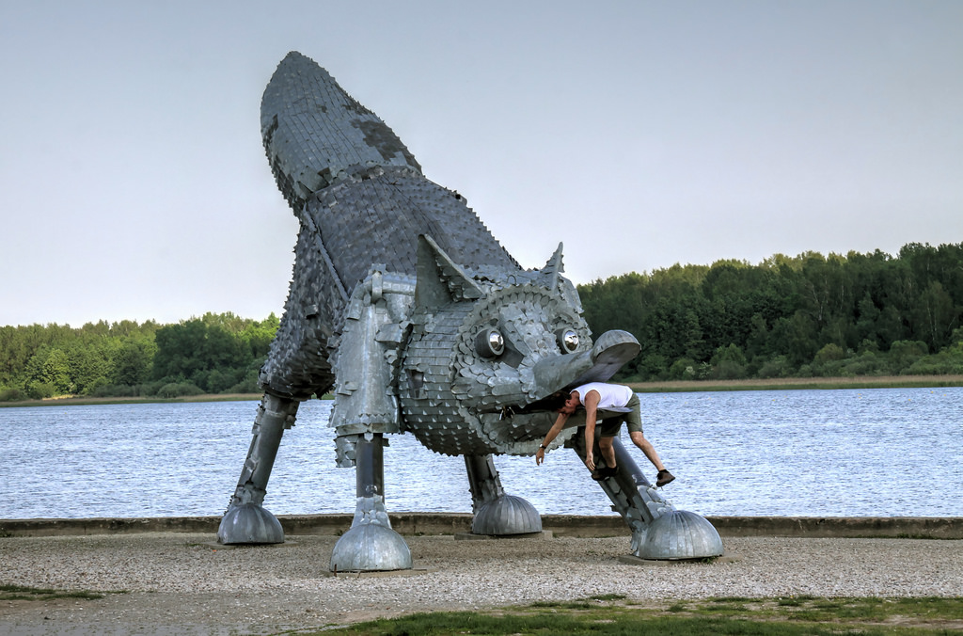
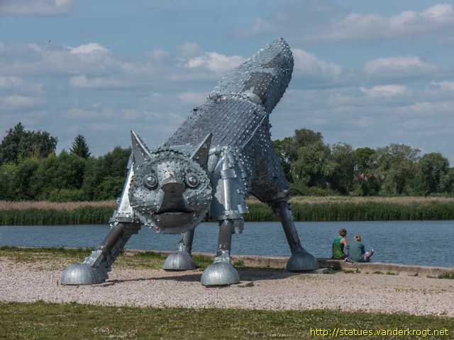
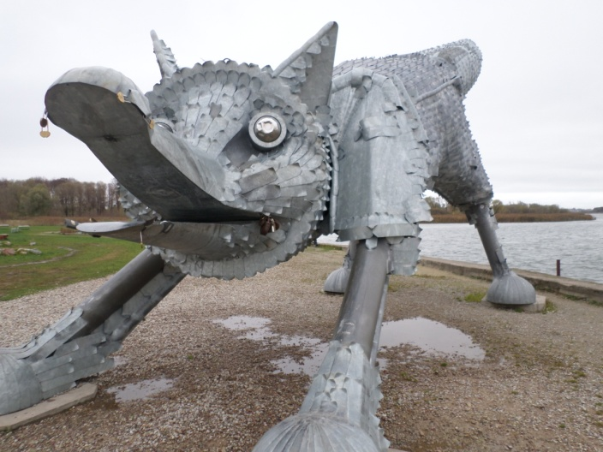
In city of Šiauliai, “Iron Fox” statue is local parody of Vilnius’ “Iron Wolf”

Slide 29
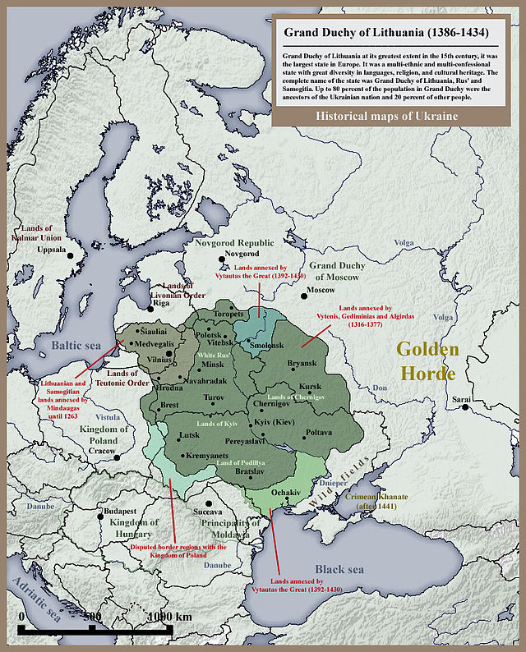

Slide 30
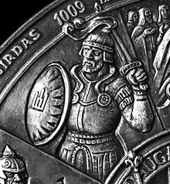
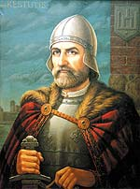
Gediminas’ Successors: Algirdas and Kęstutis

Slide 31
Gediminas’ Successors: Algirdas and Kęstutis
Two of Gediminas’ sons shared rule of the Grand Duchy. Algirdas ruled the Vilnius region as one duchy, Kęstutis, the region of Trakai.
Algirdas conquered Russian-Ukrainian lands to the east, while Kęstutis protected western Lithuania from German Christian attack.
Kęstutis raised the possibility of converting to Christianity to gain allies, such as Hungary, but he never did it.
Algirdas married a Russian princess who was Orthodox Christian, again showing the same tolerance and diplomatic astuteness of his father.

Slide 32
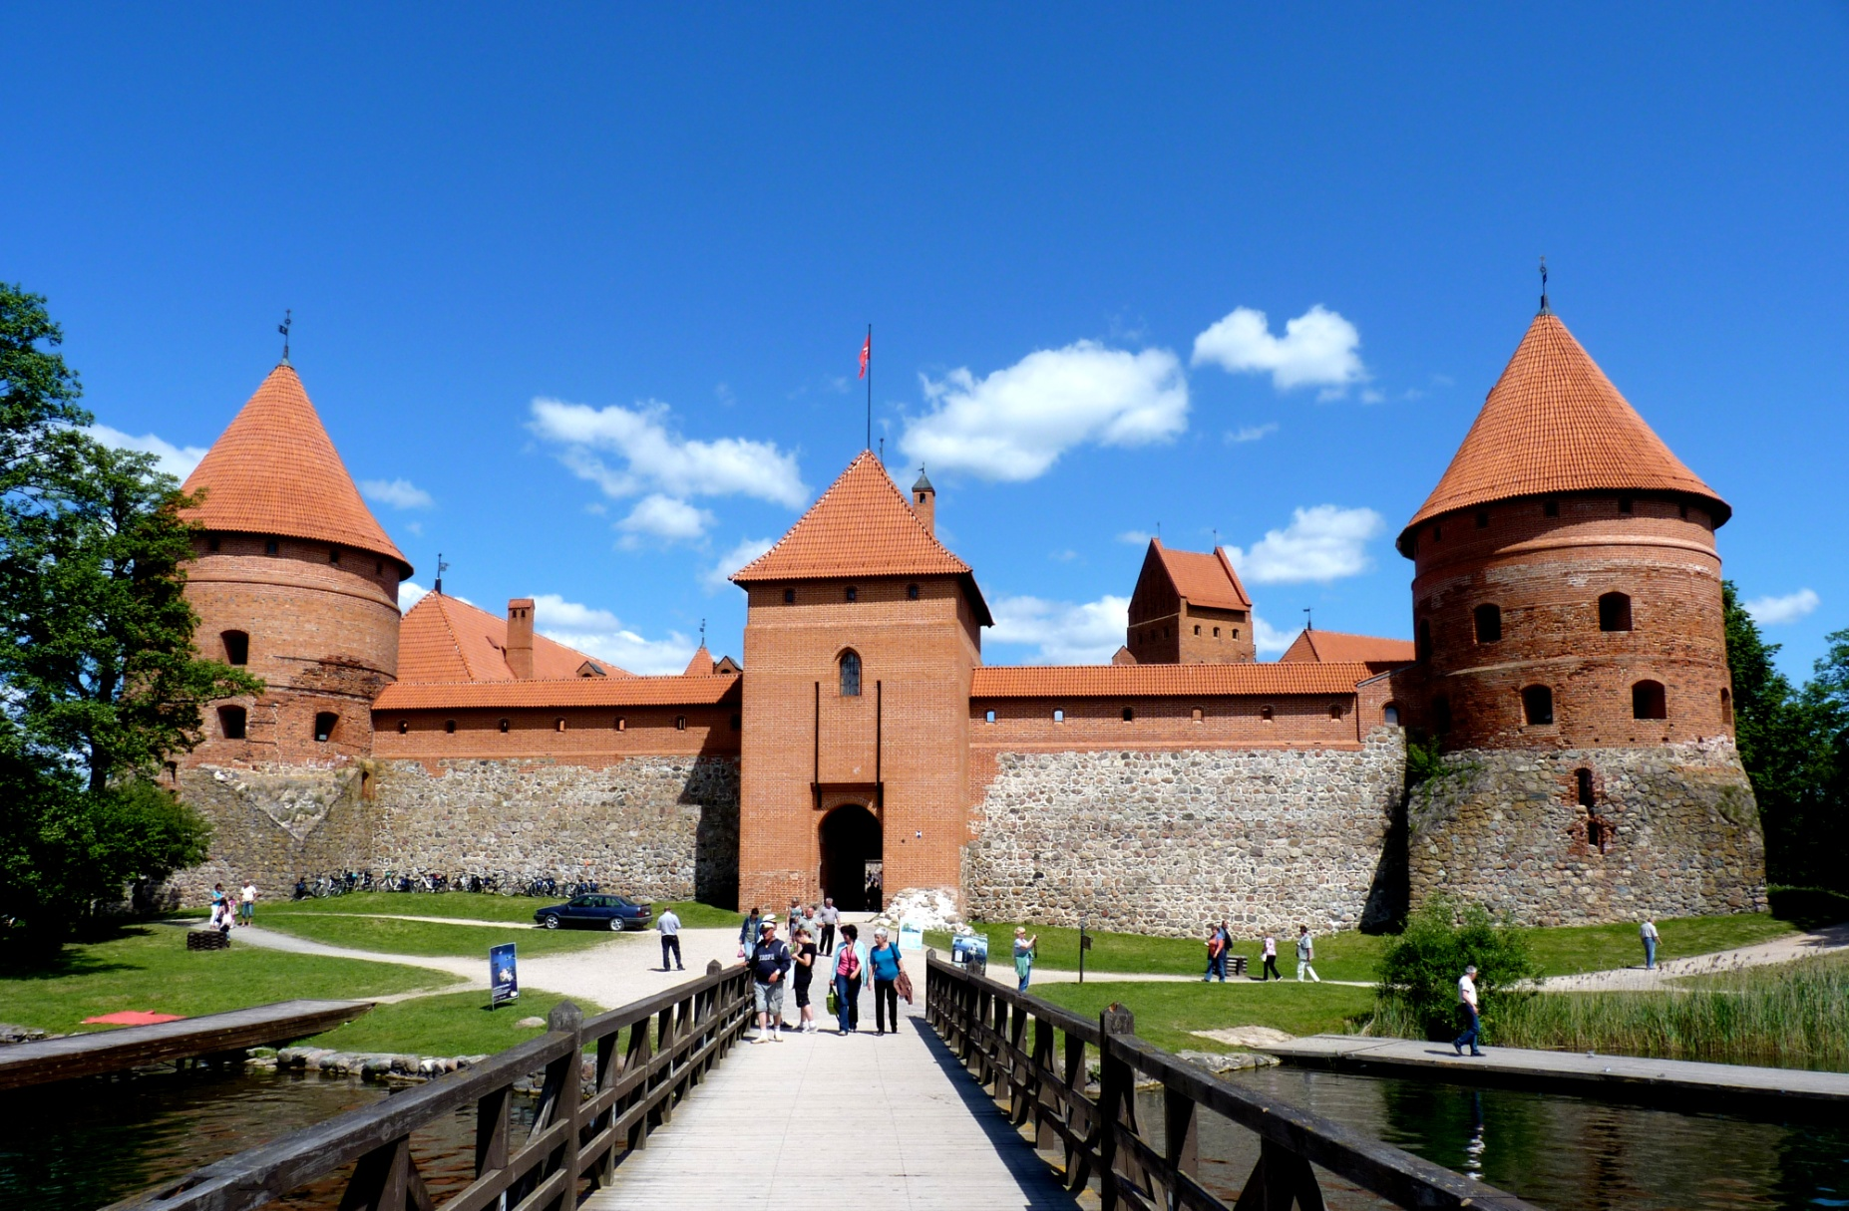
Trakai Castle

Slide 33
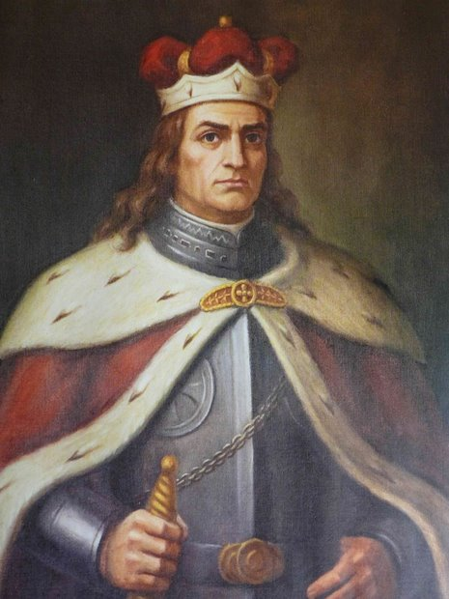
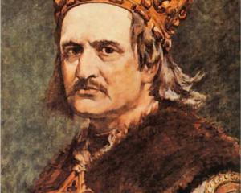
King Jogaila (Władislaw II Jagiello) of Poland and Vytautas the Great, Grand Duke of Lithuania

Slide 34
Lithuanian-Polish King Jogaila and Grand Duke Vytautas
The next generation also divided rule between them. Jogaila allied with Poland and became joint king of Poland/ Lithuania by wedding the Polish princess Jadwiga and converting in 1386.
The Polish-Lithuanian alliance defeated the Teutonic Knights in 1410.
Jogaila ruled Poland from Kraków, while Vytautas ruled Lithuania.
Despite his conversion, Jogaila gave his uncle Kęstutis a glorious Pagan funeral—even though he may have had him killed in a power struggle!
Vytautas is called “The Great” for his success in expanding Lithuania to the east, alliances with Tatars and others
He accepted Jews, Tatars and Karaites into Lithuania, adding to the diversity and tolerance of previous rulers.

Slide 35
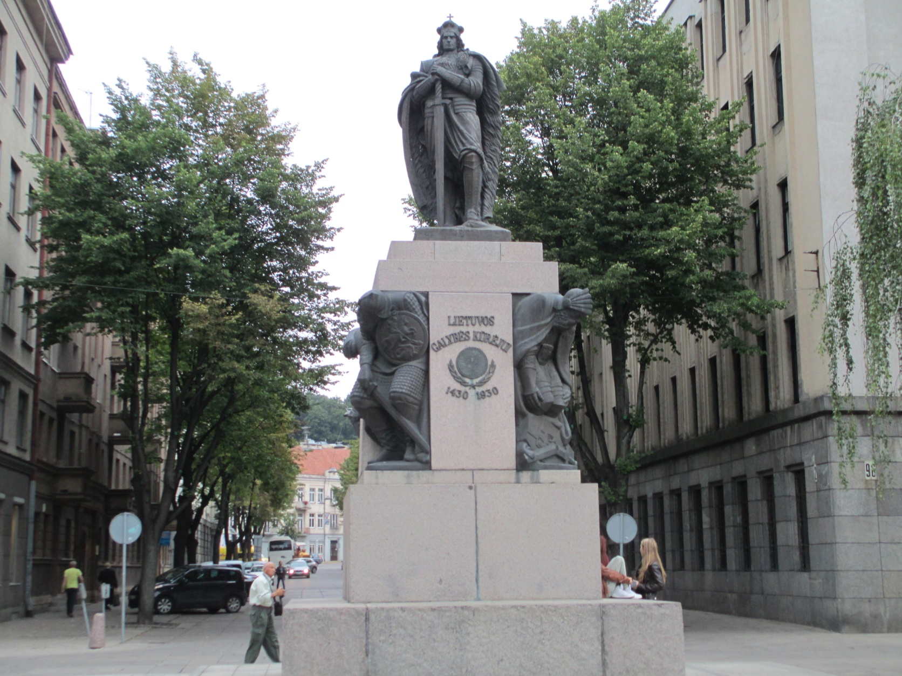
Monument to Vytautas the Great, in city of Kaunas, marking his victories over the Teutonic Knights and others

Slide 36
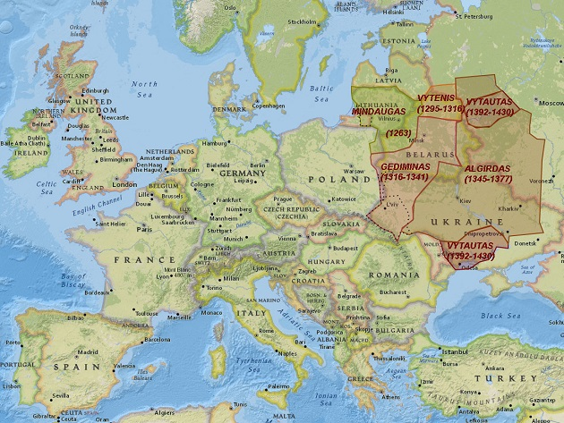
Map of Grand Duchy of Lithuania, showing territories acquired by various leaders, and size relative to modern European countries

Slide 37
Lithuanian Paganism: suppressed, but not forgotten in Lithuanian history
By the generation of Jogaila and Vytautas, all the rulers of Lithuania were Christian, and Christianization of the country was underway
However, conversion seemed half-hearted, and many Pagan customs remained alive, especially in rural areas
The Polish half of the Polish-Lithuanian alliance became dominant, and the Lithuanian aristocracy became Polish-speaking and Catholic in religion
Lithuanian language, and Lithuanian Pagan customs, was consigned to the lower classes and the countryside

Slide 38
The19th Century “National Awakening”
In the 19th century, Lithuania, like other parts of Europe, experienced a new fascination with old folk customs, tales, songs and legends, as part of a new sense of ethnic and national identity
Indo-European language study revealed Lithuanian had ancient roots, kindred with Sanskrit
The Indo-Baltic parallel was also found to include Hindu-Pagan parallels in terms of gods, beliefs, religious practices
Artists, writers and politicians began to romanticize Lithuania’s Pagan past
Summer solstice Rasa festival revived
Ancient Daina folk songs gained new popularity & prestige

Slide 39
Example of Lithuanian-Sanskrit
(Indo-European) correspondences
In Sanskrit:
Devas adadat datas; Devas dat dhanas.
In English:
God gave teeth, God will give bread.
In Lithuanian:
Dievas dave dantis; Dievas duous duounos.

Slide 40
Ramuva/Romuva: Lithuanian Paganism revived secretly, then officially
In the 1960s, folklore studies are permitted by Soviet authorities; Jonas Trinkūnas collects daina folk songs in rural areas
Secretly, he gathers people to honor old gods and practice Pagan rituals like summer solstice; this is disguised as strictly folkloric activity, group named Ramuva
1970s, Trinkūnas’ Pagan activities are discovered; he is punished, Ramuva suppressed
In late1980s, under Gorbachev’s Glasnost policy, Ramuva revived; in 1991, Trinkūnas openly proclaims religious purpose, renamed Romuva, name of legendary medieval Baltic sanctuary

Slide 41
The Baltic Way, Singing Protests and Independence from the USSR
Lithuania was first Soviet Socialist Republic to demand independence, in 1989. This led to “Baltic Way” protests across all 3 Baltic states (Lithuania, Latvia, Estonia) 8/23/99, on 50th anniversary of Soviet-Nazi Molotov-Ribbentrop agreement, which led to invasion of Baltic States in WW II.
Two million Lithuanians, Latvians, and Estonians formed a human chain across the 600 km length of the three Baltic States, singing traditional folk songs banned under Soviet rule
This “Singing Revolution,” inspired other republics to seek to leave the USSR, with end of USSR in 1991

Slide 42

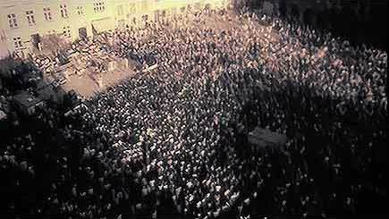
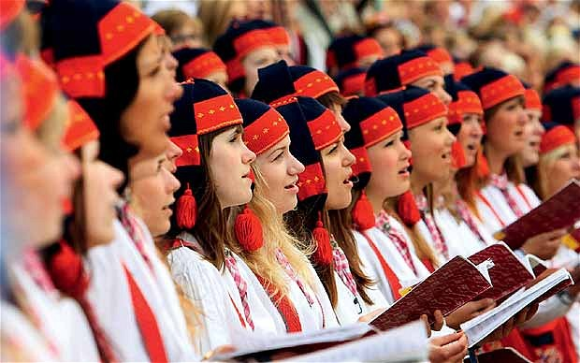
“The Singing Revolution:” folk song protest across the Baltic States in August, 1989 (three months before Berlin Wall protests). Two million people formed a human chain across Estonia, Latvia and Lithuania to sing forbidden traditional songs in protest of Soviet rule.

Slide 43
Acceptance and Consolidation of the Romuva Movement
In the euphoria of the successful struggle for independence, Romuva gained exalted status as a symbol of traditional Lithuanian culture, and its numbers swelled
Trinkūnas served in the Ministry of Ethnic Culture and received many awards for his folkloric activities
Trinkūnas and wife Inija formed folk music group, Kulgrinda, to perform Pagan folk music, a musical extension of Romuva that helps promote the movement
In summer of 1998, Trinkūnas calls together Pagan groups across Europe and beyond for “World Pagan Congress”, soon renamed WCER

Slide 44
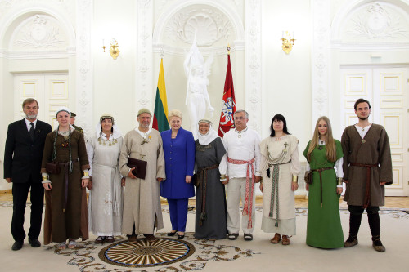
Romuva ritual. Romuva leader Jonas Trinkūnas receiving Grand Duke Gediminas award from the President of Lithuania in 2013.

Slide 45
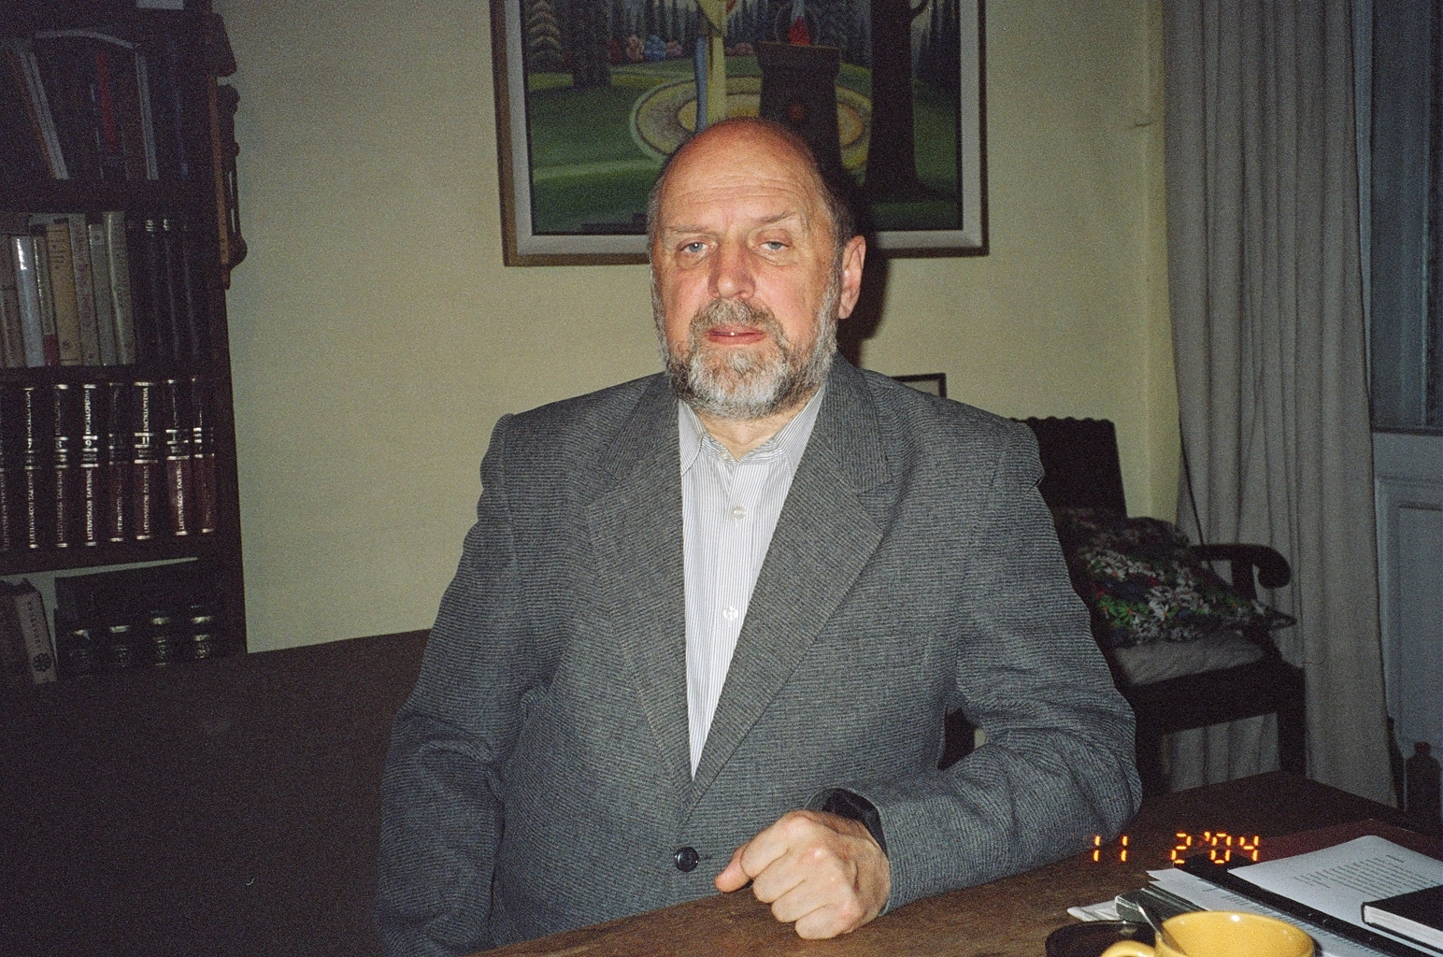
Jonas Trinkūnas (1939-2014), head of Lithuanian Pagan movement Romuva. Home in Vilnius, 2004.

Slide 46
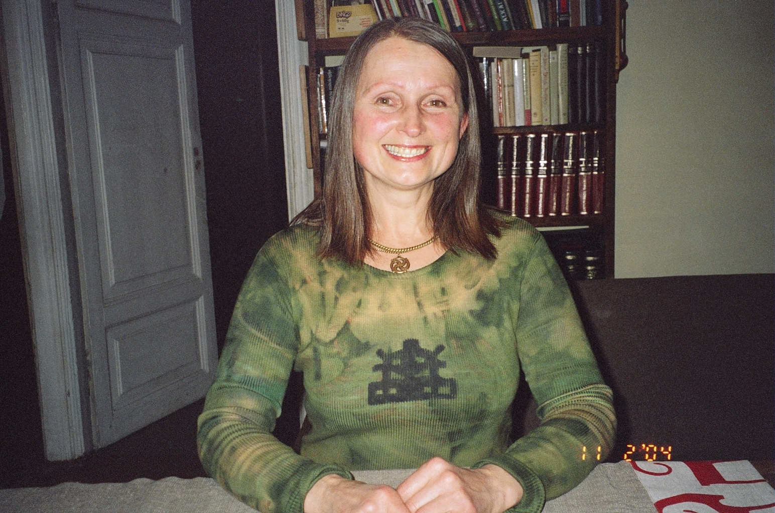
Jonas’ wife, folk singer and sociologist Inija Trinkunienė 2004.

Slide 47

Jonas Trinkunas and Tourist. 2004.

Slide 48
Relationship of Romuva to Lithuanian Society
(1) It is respected, even among Christians, as a keeper of old Lithuanian traditions & identity; in this sense, Paganism is understood as patriotic!
(2) Romuva runs summer “folklore camps” that are open to all, Christian, Pagan or other
(3) Summer Solstice “Rasos” festival likewise open to all, not just Pagan, has Christian form too, “Jonines”
Many travel guides or articles about Lithuania call it a “Catholic nation” due to the predominance of the Catholic church.
How then to explain the popularity and influence of Romuva, an explicitly Pagan movement?
People relate to Romuva on many levels besides “religion” per se

Slide 49
Relationship of Romuva to Lithuanian Society (2)
As Lithuanian culture is quite saturated with folklore, Romuva’s function as a preserver of folkloric traditions is highly respected
Trinkūnas and his wife Inija, who has now succeeded him as leader of Romuva, are respected as folklore scholars, as is their folkloric musical group Kulgrinda, which performs internationally
Many young people in their teens or twenties attend the folklore camps or join Kulgrinda or similar groups as a kind of folkloric “rite of passage”
Kulgrinda serves as a very effective proponent of Lithuanian folklore and Paganism, and has been open to blending in other musical styles from rock to electronica

Slide 50
Beyond Romuva and Kulgrinda: The “Paganesque” in Lithuanian Culture
For some, Romuva functions as a religion, and Kulgrinda’s songs are sacred music
But not everyone relates to the two with such a strong degree of devotion
For many Lithuanians, Paganism and its folkloric roots and cultural branches add a pleasing accent or atmosphere to life, not a “religion” per se
Experienced in this way, Lithuanian Paganism is more decorative than devotional, less “Pagan” than “Paganesque,” a cultural element with religio-spiritual and folk-historical overtones, but not necessarily explicitly “religious”
Paganism can thus be a gateway to spirituality or just a reassuring marker of past traditions—or both

Slide 51

The Crafty Side of Baltic Paganism
The connection to ethnic folklore and folk crafts inspires many Pagans to make, or collect folk art objects from jewelry to tapestries to medieval-style clothes to swords, which a lot of Pagan guys seem to like.
The belts/sashes below woven by Inese Krumina of Latvian Pagan group Vilki, using traditional Latvian designs

Slide 52
Latvian Paganism
Latvia has a culture and history similar to Lithuania, and parallel Pagan traditions that have given rise to modern Pagan movements
These include Dievturi and Vilki, as noted in my articles
I came to know Inese Krumina, a Latvian Pagan priestess in 2002, and have been friends since
She started in Dievturi, formed a new group Vilki (wolves), that also recorded traditional Latvian songs with Pagan elements, later left Vilki, now an independent teacher and healer
She is a weaver of traditional Latvian textiles with Pagan symbolic patterns of great antiquity, pre-literacy in Latvia

Slide 53
Pagan-Inspired or “Paganeseque” Latvian Music and Culture
As in Lithuania, Paganism has found strong expression among folk musicians, many of whom have moved beyond recreating old styles to create new forms of “Neo-folk” music
Two of the most important are Ilgi and Skyforger
Ilgi is a “post-folkloric” band (in their phrase) that is led by Ilga Reizniece, classically-trained violinist and composer; they have made CDs of summer and winter solstice songs, traditional wedding songs, also originals
Skyforger is a heavy-metal band that uses folk and historical elements

Slide 54


Stelmuze, ancient oak tree sacred to Pagans, Stelmužės ąžuolas.
Notes:
http://www.visitlithuania.net/index.php/places-to-visit/167-zarasai-district/922-stelmuze-oak-tree , http://www.panoramio.com/photo/57635173

Slide 55

Kernavė, site of prehistoric settlements and medieval fortresses of Lithuanian rulers. Sacred to Pagans and Christians alike, Rasos/Jonines annual summer solstice festival held on these hills.

Slide 56


Summer solstice Rasos festival at Kernavė, view of traditional gateway decorated with folk symbols
(my own photos from June,1998, during World Pagan Congress).
https://www.youtube.com/watch?v=GdU3-ru7sKs

Slide 57
Pagan ritual in Lithuania

Slide 58

Kūlgrinda: Lithuanian folk music band, Paganesque extension of Pagan religious group Romuva.
In center: Jonas Trinkūnas and wife Inija

Slide 59




Slide 60





Ilģi: Latvian folk music group led by Ilga Reizniece (violin)

Slide 61






Slide 62

Tadas Šidiskis, another Romuva leader in Lithuania

Slide 63

Young Lithuanian woman with flower wreath at Rasa summer solstice festival, June 2008
Notes:
These and subsequent 2008 Rasos photos, by “Mantas” at : http://www.flickr.com/photos/mantas_lt/sets/72157605926977663/with/2628134471/

Slide 64


Slide 65


Slide 66


Slide 67


Slide 68

Dancing around the sun-wheel

Slide 69



Slide 70

Lithuanian Pagans also celebrate the winter solstice. December, 2008.

Slide 71

American Members of Lithuanian Pagan group Romuva outside Chicago, summer solstice, 2002.

Slide 72

Janis and Inese Krumina, leaders of male and female sections of Latvian Pagan group called Vilki (Wolves). (Here, they struggle to maintain human form.) Outside Riga, Latvia, 2002.

Slide 73

Janis pauses to pray at sacred oak tree. March, 2002.

Slide 74

Laughter after I asked Inese if the vicious dog was the leader of Vilki (Wolves). 2002.

Slide 75

Inese leading summer solstice ritual, Latvia 2008

Slide 76


Slide 77


Slide 78

Clothes, jewelry, candles, instruments all created by these Latvian Pagans

Slide 79




Lithuanian crosses with Pagan motifs (sun, moon, snakes)

Slide 80
The Musical Side of Paganism
The revival of Paganism as a religion has gone hand-in-hand with a revival of Scandinavian and Baltic folk music, sometimes called Neofolk Music.
In Lithuania, Kulgrinda is an outgrowth of the Romuva Pagan movement. They perform traditional Lithuanian folk songs with religious meaning.
In Latvia, the band Ilgi performs traditional and new folk music, often with mythological elements.
In Sweden, the band Hedningarna (The Heathens) does much the same.
The Latvian Pagan movement Vilki (Wolves) has released CDs of men’s and women’s folk songs.

Slide 81

Kulgrinda, folk-music ensemble grown out of Romuva movement, led by Jonas and Inija Trinkunas.
Notes:
From http://www.rokis.suwalki.pl/imprezy/pics/zrodliska_2006_kulgrinda.jpg

Slide 82

Cover of Kulgrinda CD, Rite of Fire, 2004. The swastika-like symbol is traditional Lithuanian, not Nazi.
Notes:
From Dangus.net site

Slide 83

Latvian band Ilgi. The woman is the boss:
Ilga Rezneice. http://www.ilgi.lv/index.php

Slide 84

Ilgi CD, Seji Veju “Sow the Wind.”
Note the instrument: a traditional Latvian kokles, like a zither.

Slide 85

Ilgi Cd, Speleju Dancoju. “I Played and I Danced.” Musical version of poems by a leading Latvian poet.

Slide 86

Latvian Pagan movement Vilki (Wolves) also has a musical group. Here is a photo from a CD.

Slide 87

Vilki’s male division plays traditional Latvian war songs from the 10th -13th century, when Latvian Pagans fought against Christian Crusaders. Here is a Vilki CD.

Slide 88

Vilki’s female branch Vilcenes plays traditional women’s songs.

Slide 89

Vilcenes CD: Karavīra līgaviņa (Bride of the Warrior).

Slide 90

Vaira Vike-Freiberga, President of Latvia 1999-2006, is also a scholar of Latvian folklore and folk music. Here is a CD of traditional songs she selected….and sang.
From the record company: “Latvian folksongs selected and sung by the former Latvian president and folklore researcher Vaira Vīķe-Freiberga. This is a very personal selection of folk songs that have been sung by V. Vīķe-Freiberga’s mother and on special occasions. The songs have been arranged by the reknown Latvian musician and ethno-musicologist Valdis Muktupāvels. “
http://www.lauska.lv/pages/english/products.php

Slide 91

Pagan-oriented Festival,
Menuo Juodaragis (Horn of the Black Moon)
The XVI edition of Mėnuo Juodaragis is blowing horns again, summoning to the burning altar under Great Oak at Zarasai lake island, Northern Lithuania. Traditionally MJR will celebrate the last days of Summer – August 23-25, 2013. And this year the festival will be very Baltic in essence, sharing the ancient mythologies, history and most original contemporary arts. Three days and nights of spellbinding neo-folk, post-folk, ethnic and alternative music, ancient crafts, lectures, films, eco-art and lots of friendly partying – its your best chance to know what Baltic really means! Be welcome!
Notes:
http://heathenharvest.org/2013/07/20/music-menuo-juodaragis-xvi-great-baltic-festival-in-wild-lithuania/

Slide 92

Notes:
http://www.mjr.lt/

Slide 93
Two Faces of Paganism:
Ethnic vs. Spiritual Dimensions
For some Pagans, the most important thing is preserving and continuing ethnic identity and ethnic folk culture, of which religion is just one part.
This side of Paganism is most concerned with accurate reconstruction of folklore, ties in with ethnic nationalism and is sometimes associated with racist attitudes.
For some Pagans, ethnic folk traditions and folk culture are only the gateway to deeper spiritual experience, which transcends racial- tribal-ethnic differences.
This more purely spiritual side of Paganism is more open to ideas of universal spirituality across the earth, and embraces multiculturalism.

Slide 94
And so…
Modern Baltic Paganism therefore has many dimensions and is truly multi-faceted.
Some relate to it as ethnic folk traditions: even Christians can do so..
Some relate to it as music: even your i-Pod/Pad/Phone can.
Some relate to it as an expression of national and ethnic identity: many Latvians and Lithuanians do so.
Some relate to it as a spiritual path, and find deep meaning in its gods, myths, rituals, songs.

Slide 95
Romuva hosting World Congress of Ethnic Religions, June, 1998

Slide 96

Fire ritual. Prayers, songs and offerings around fire.
June 1998. Romuva members plus others, during World Congress of Ethnic Religions.

Slide 97

Romuva summer solstice Rasa festival. Kernave, Lithuania, 1998

Slide 98

Latvian woman preparing traditional wreath at Rasa summer solstice in Lithuania, 1998.

Slide 99

Jonas Trinkunas leader of Romuva, and wife Inija perform fire ritual
Notes:
From http://viewmorepics.myspace.com/index.cfm?fuseaction=user.viewPicture&friendID=386744088

Slide 100

Official Symbols of World Congress of Ethnic Religions, est. 1998 in Vilnius, Lithuania
WORLD CONGRESS OF ETHNIC RELIGIONS

Slide 101

Jonas and Inija Trinkunas, March 2009, home in Vilnius, Lithuania.

Slide 102

Rasa Summer Solstice Festival in Lithuania, June 1998. Symbolic structure in traditional design.
Wheel-shapes refer to the sun.

Slide 103

Early painting of three Lithuanian deities: Dievas, highest god; Perkunas, thunder god; Velnias, god of the dead.
Notes:
From http://www.wcer.org/members/europe/lithuania/religion.htm

Slide 104

Vilnius’s main cathedral: originally a Pagan temple, destroyed/rebuilt by both Pagans and Christians. Romuva has petitioned to be allowed to perform rituals in the basement, where Pagan altars have been found by archaeologists. The Catholic church has refused the request.

Slide 105
Romuva Winter Solstice, Vilnius, 2008
Notes:
From http://www.flickr.com/photos/mantas_lt/2350885062/in/set-72157604193726097/

Slide 106

Arriving

Slide 107

Building the fire

Slide 108

Blowing the horn

Slide 109

Drumming

Slide 110

Singing

Slide 111
All together now.
Notes:
From http://www.flickr.com/photos/mantas_lt/2350885062/in/set-72157604193726097/

