Slide 1
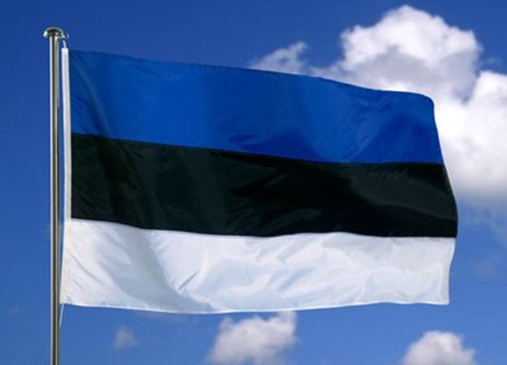
EESTI ESTONIA
(Republic of Estonia )
and
eesti keel
Estonian language

Slide 2
Symbols of Estonia – Eesti sümbolid
Eesti lipp Eesti vapp
Estonian flag Coat of arms

Slide 3
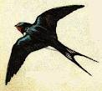
Symbols of Estonia – Eesti sümbolid
Rahvuslill – rukkilill Rahvuslind – suitsupääsuke
National flower- National bird – barn
Cornflower swallow

Slide 4
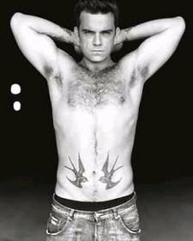
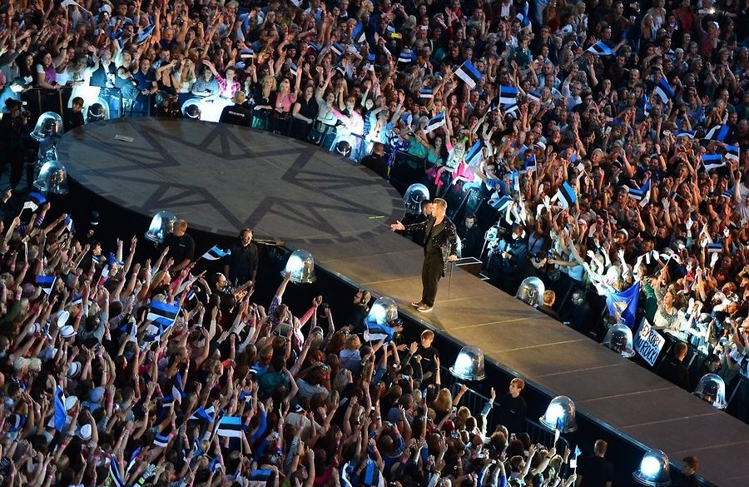
Robbie Williams concert in Tallinn

Slide 5
Facts about Estonia Situation - asukoht

Slide 6
Facts about Estonia Situation - asukoht

Slide 7
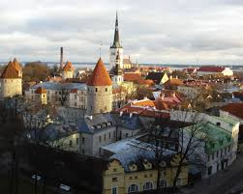
Facts about Estonia
Republic of Estonia (Eesti Vabariik), is a state in the Baltic region of North-Eastern Europe, bordering Russia and Latvia.
The territory of Estonia covers 45,339 km² .
https://www.youtube.com/watch?v=cZ_XgOdVVeA

Slide 8
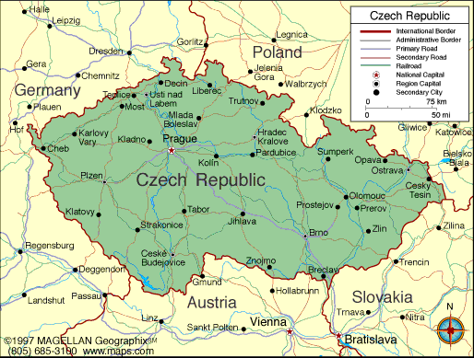
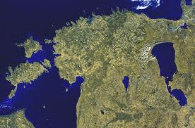
Facts about Estonia
Estonia IS NOT the smallest country in the world. There are 66 countries which are smaller than Estonia (Denmark, Israel, Netherlands, Switzerland, etc...)
116.place / 131.place

Slide 9
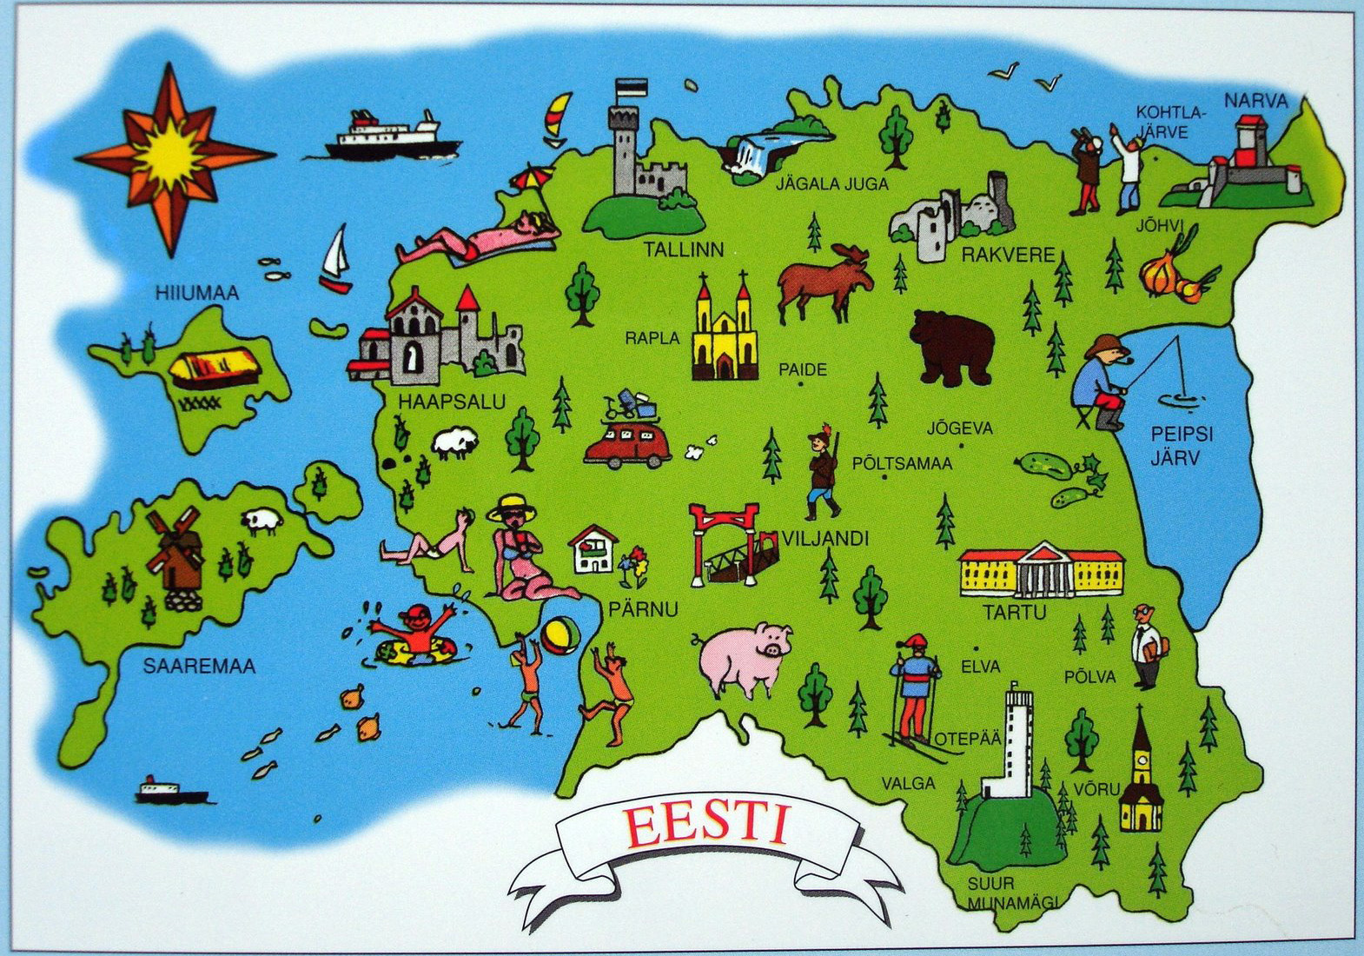
Map of Estonia - Eesti kaart

Slide 10
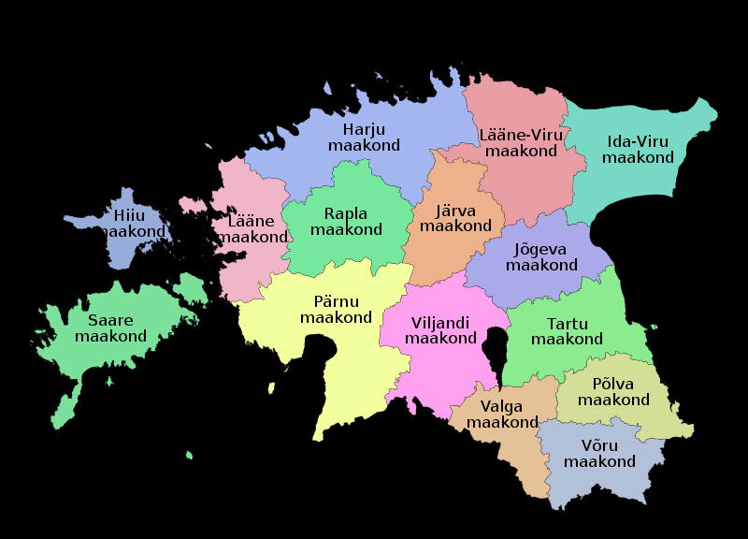
Facts about Estonia Administrative divisions -haldusjaotus
The Republic of Estonia is divided into fifthteen counties.

Slide 11
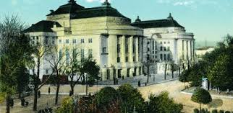
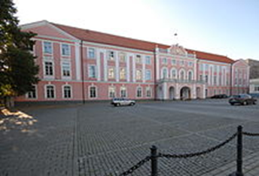
Facts about Estonia Population - rahvastik
There are about 1,3 million people living in Estonia (1 315 944 (01.01.2016))
About 70 percent are ethnic Estonian
About 25 percent are Russians
~ 5 percent are other (Ukrainen, Finnish, Swedesh etc... and a little Czech also ☺)

Slide 12
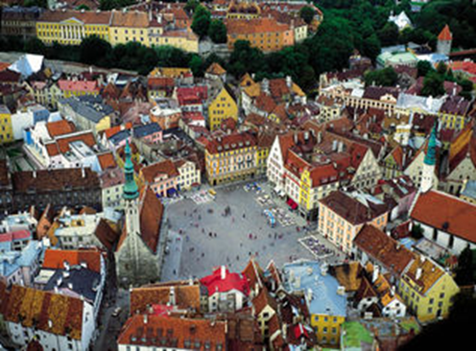
Facts about Estonia Capital - pealinn
The capital of Estonia is Tallinn
Tallinn is Estonian biggest city –
441 961 (01.09.2016.)
In 2011 Tallinn was the European Capital of Culture.

Slide 13
Tallinn

Slide 14
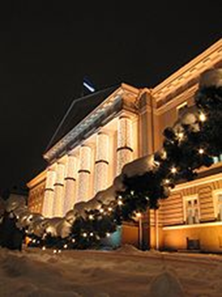
Some more fackts
Everyone in tourism speaks good English and often German, Finnish, Russian and Swedish
Occupation by Germans, Swedes and Russians has influenced the architecture of cathedrals, cobbled streets, manor houses and palaces.
In winter it gets very cold and there is plenty of beautiful snow.
No, there are no polar bears in Estonia.
Roads are traffic jam free.
Estonia is almost 50% forest.
Tartu, with 100,000 people, is our
university town.
Estonia has over 1,500 islands

Slide 15
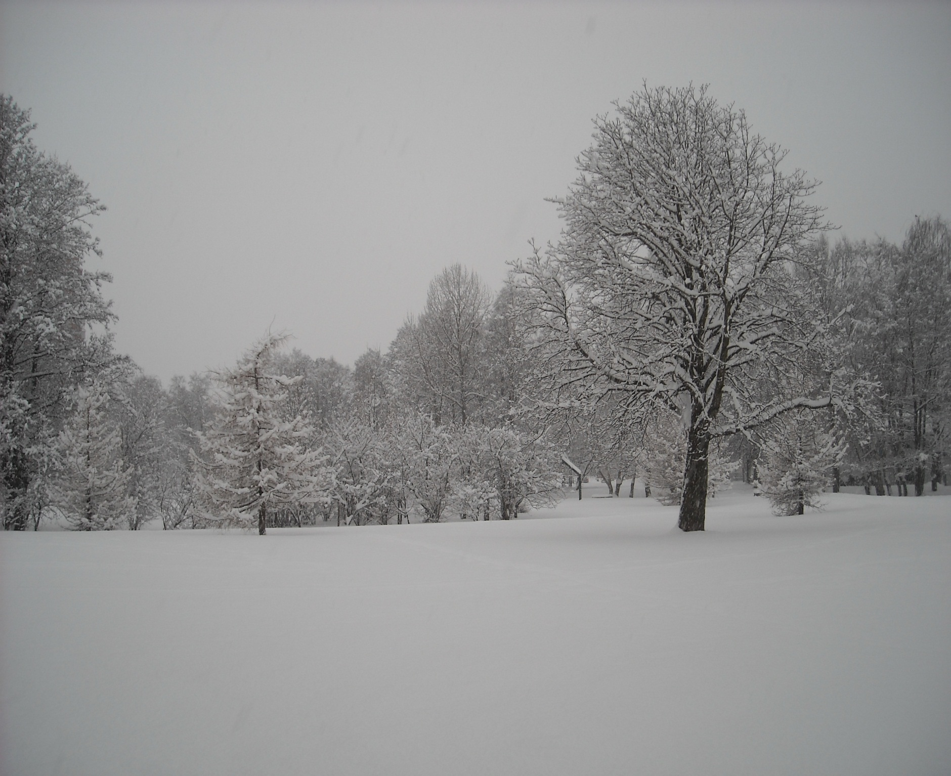

Slide 16
What we belive, we are like
A typical Estonian would like to portray himself as hard-working, reliable, smart, innovative and friendly.
Though these qualities are all true, we are often kept as a hidden treasure. In attempt to avoid being seen as obtrusive or aggressive, Estonians (even service staff) keep to themselves and wait for you to make the first move. Once there, you will be greeted with an honest and kind attitude.

Slide 17
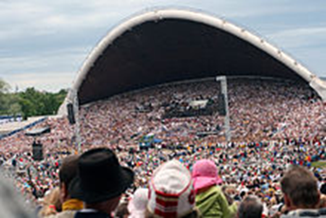
What we belive, we are like
The Estonian sense of humour is dry, very sarcastic and quite often politically incorrect. In Europe, it is most similar to the British one
When asked to sing out loud, you’re met with shy refusal. Yet, many Estonians have sung in a choir and our National Song and Dance festivals (once every 5 years) are the biggest gatherings in Estonia: hundreds of thousands of Estonians will come together to hear choirs of up to 20,000-strong sing and see thousands of people perform folk
dances.
https://www.youtube.com/watch?v=-oW6eo_RMLA&list=PLRDDwZ-WWeK6udsy_LWCa_cwhOUfqAtEo&index=18

Slide 18
National Song and Dance festival https://www.youtube.com/watch?v=rEbr6zG-LZo

Slide 19
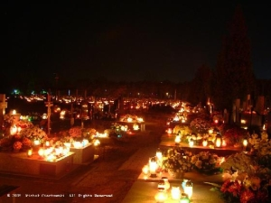
What we belive, we are like
Estonia is one of the most non-religious countries in the world, but Estonians value traditions.
Often, Christian holidays and rituals are followed or mixed with pagan ones. A good example is All Saints Day on 2nd of November: the day before, many visit churches and graves of the lost family members, and at night, candles are lit on the windows of thousands of Estonian homes to greet the wandering souls.

Slide 20
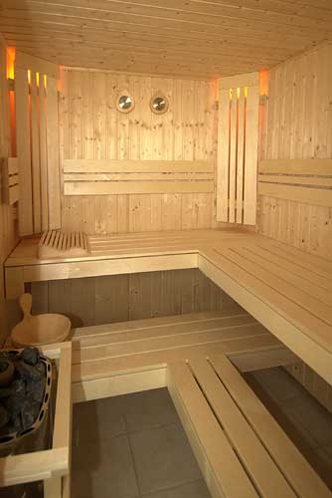
What we belive, we are like
Most of the country houses (and many private houses and even apartments in cities) have a sauna and heating up before
jumping into a lake during
summer or rolling in the snow
during winter, to cool down,
are an important part of our
bonding and cleaning rituals.
But prepare yourself if you plan
to join in: heat is high (80° C
is considered to be “warm”) and
nudity is normal.

Slide 21
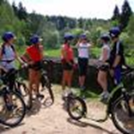
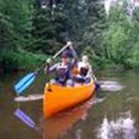
What we belive, we are like
Estonians love nature and feel part of it: weekends are often spent hiking, camping or just walking in the forests or by the sea – both have played an important role throughout history and Estonians are proud of the wild, clean nature rich in varied, and even rare, flora and fauna. Fishing and sailing are popular here and during winter, cross-country skiing captures the mind of most Estonians.

Slide 22
What we belive, we are like
Besides nature, sauna and grilling, photography is probably the most common hobby in Estonia.
Another “big thing” are the cars and new technical widgets and gadgets. The number of Hummers per person is the highest in the world and you will probably never meet young Estonian without a mobile phone, laptop (with internet access, of course) and a blog, twitter page or a personal account in the popular online social networks.

Slide 23
What we belive, we are like
Estonians are the ones behind Skype, mobile parking, e-elections and many of the innovative technologies and solutions.
Various e-services like e-banking, online medical and document registries; digital tickets; full wireless connectivity and excellent mobile coverage are considered to be as elementary as air and water by most modern Estonians.

Slide 24
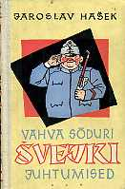
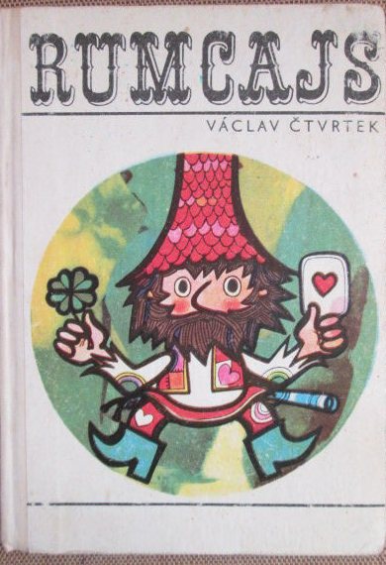
What we know about Czech Republic?
We are sure that Czech beer is good
We love (Czech) Bohemia crystal
Most people have read “The Good Soldier Švejk” and "Rumcajs”.
We know athletes (Železný, Dvořák, Šebrle, Bauer, Neumannová, Kvitová etc…
Prague is very beautiful
city

Slide 25
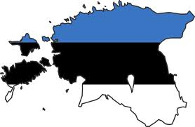
EESTI KEEL
Estonian language

Slide 26
Estonian language - eesti keel
Some say: the Estonian language is a nightmare to learn.
Estonian is different from most spoken languages in Europe, and does not belong to the Indo-European group
Estonian belongs to the Finno-Ugric language family, which also includes Finnish and Hungarian.

Slide 27
Eesti keel
Estonian (eesti keel; pronounced [ˈeːsti ˈkeːl] is the official language of Estonia, spoken by about 1.1 million people in Estonia and tens of thousands in various émigré communities.
One distinctive feature that has caused a great amount of interest in linguists is what is traditionally seen as three degrees of phoneme length: short, long, and "overlong", In actuality, the distinction is not purely in the phoneme length, and the underlying phonological mechanism is still disputed.

Slide 28
Eesti keel
Estonian has been influenced by Swedish, German (initially Middle Low German, later also standard German), and Russian, though it is not related to them genetically.
Like Finnish and Hungarian, Estonian is a agglutinative language, but unlike them, it has lost the vowel harmony, although in older texts the vowel harmony can still be recognized. Furthermore, the apocope of word-final sounds is extensive and has contributed to a shift from a purely agglutinative to a fusional language. The basic word order is subject–verb–object.

Slide 29
Eesti keel
The Estonian dialects are divided into two groups – the northern and southern dialects, usually associated with the cities of Tallinn in the north and Tartu in the south.
The northern group consists of the keskmurre or middle dialect that is also the basis for the standard language, the läänemurre or western dialect, the saarte murre (islands') dialect of Saaremaa and Hiiumaa and the idamurre or eastern dialect on the northwestern shore of Lake Peipsi.
The southern group consists of the Tartu, Mulgi, Võru (Võro) and Setu (Seto) dialects. These are sometimes considered either variants of a South Estonian language, or separate languages altogether. Also, Seto is not usually considered a dialect of Estonian, but rather a variant of Võru.
https://www.youtube.com/watch?v=ow9zh0N-sQY

Slide 30
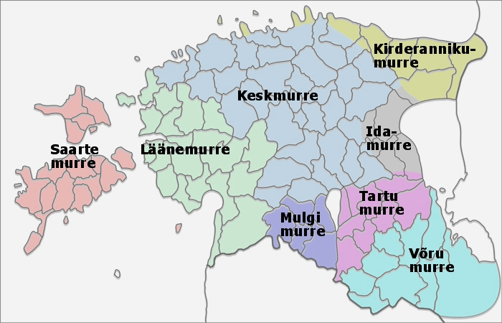
Estonian dialects

Slide 31
Eesti keel (tähestik – alphabet)
The Estonian alphabet is used for writing the Estonian language and is based on the Latin alphabet, with German influence
The official Estonian alphabet has 27 letters:
A, B, D, E, F, G, H, I, J, K, L, M, N, O, P, R, S, Š, Z, Ž, T, U, V,
Õ, Ä, Ö, Ü
https://www.youtube.com/watch?v=3VSQp0hNMaE

Slide 32
Eesti keel (tähestik – alphabet)
The oblique letters are so-called "foreign letters" (võõrtähed). F, Š, Z and Ž occur only in loanwords and foreign proper names. C, Q, W, X and Y do not occur in Estonian words, but are used in writing foreign names.
Including also the "foreign letters", alphabet consists of the following 32 letters:
A, B, C, D, E, F, G, H, I, J, K, L, M, N, O, P, Q, R, S, Š, Z, Ž, T, U, V, W, Õ, Ä, Ö, Ü, X, Y

Slide 33
Õigekiri - orthography
Although the Estonian orthography is generally guided by phonemic principles, with each grapheme corresponding to one phoneme, there are some historical and morphological deviations from this: for example the initial letter 'h' in words, preservation of the morpheme in declension of the word (writing b, g, d in places where p, k, t is pronounced) and in the use of 'i' and 'j'. Where it is very impractical or impossible to type š and ž, they are substituted with sh and zh in some written texts, although this is considered incorrect.

Slide 34
Täishäälikud - vowels
Estonian vowel phonemes:
A, E, I, O, U, Õ, Ä, Ö, Ü
short vowels
AA, EE, II, OO, UU, ÕÕ, ÄÄ, ÖÖ, ÜÜ
long vowels

Slide 35
Täishäälikuühendid - diftongs
There are 36 diphthongs (26 of which are native to Estonian); all nine vowels can appear as the first component of a diphthong, but only [ɑ e i o u] occur as the second component.

Slide 36
Grammatika - grammar
Typologically, Estonian represents a transitional form from an agglutinating language to a fusional language.
The canonical word order is SVO (subject–verb–object).
In Estonian nouns and pronouns do not have grammatical gender
Nouns and adjectives decline in fourteen cases: nominative, genitive, partitive, illative, inessive, elative, allative, adessive, ablative, translative, terminative, essive, abessive, and comitative,

Slide 37
Tere tulemast eesti keele tundi!
Welcome in the Estonian language class!
Tere hommikust!
Good morning!

Slide 38
Tere!
Tere!
Tere!-Tere!
Tere hommikust!
Tere päevast!
Tere õhtust!
Tšau!

Slide 39
Head aega!
Head aega!
Nägemiseni!
- Nägemist!
Head päeva!
Head õhtut!
Head ööd!
Tšau!

Slide 40
Tere hommikust! Priit Aimla
Tere, tere, tere, tere hommikust!
Tere Tiit, tere Mai!
Tere, tere, tere, tere hommikust!
Tere maa ja taevas lai.
Good morning!
Hello Tiit, hello Mai.
Hello earth and wide sky.

Slide 41
Aitäh! = Tänan! ↔ Palun
Thank you You´re welcome
Palun ↔ Aitäh!
Here you are Thank you
Üks kohv, palun!
A (one) coffee please!

Slide 42
Vabandust! ↔ Pole midagi!
I´m sorry No problem
Head isu! ↔ Aitäh!
Enjoy yor meal Thanks
Terviseks!
Cheers! Bless you!

