Slide 1
English Autonomously Lenka Zouhar Ludvíková Martina Šindelářová Skupeňová Eva Trumpešová - Rudolfová

Slide 2
ENGLISH AUTONOMOUSLY 2nd session, 4th September
last week summary, your HW
logs
think outside the box
agreement
support group selection
counselling reservation

Slide 3
ENGLISH AUTONOMOUSLY last week summary
principles of autonomy
evaluating yourself (SWOT)
strategies (SILL)
metacognition (MAI)
CEFR self-assessment
support group offer
Notes:
Martina - instructions

Slide 4
go KAHOOT!
kahoot.it

Slide 5
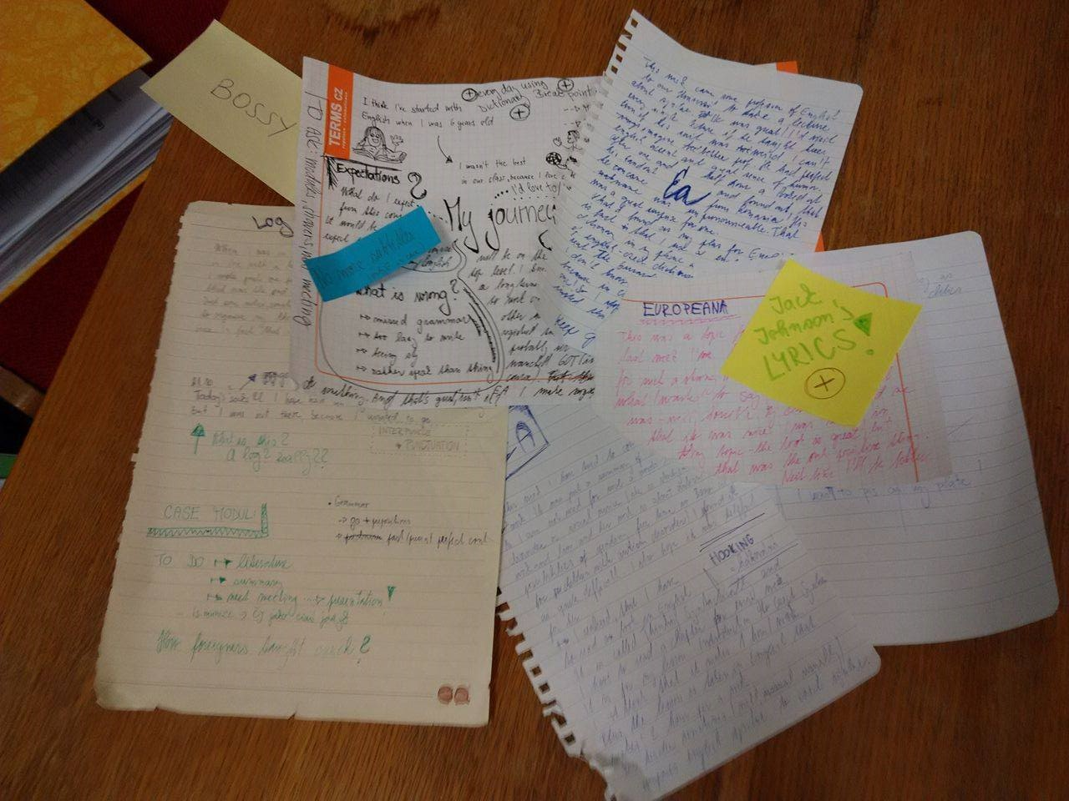
ENGLISH AUTONOMOUSLY learning diary / log / reflective writing
Notes:
examples???

Slide 6
ENGLISH AUTONOMOUSLY learning diary / log / reflective writing
LZL: Last week I was here with Martina. Apart from some time schedule issues, the whole session was really efficient – we did what we had planned, we didn´t forget about anything and the students know everything they should know. Only the papers we handed out went too quickly after each other…
JL: The session Martina and Lenka led last week was a bit „over-efficient“. They wanted to cover too much and missed some lightness or levity that Eva usually adds to the sessions. I suggest they try reduce the paperwork and have more fun next time…
MŠS: Last week we covered everything. The session seemed a bit too long because there is so much to tell the students! We prepared some new activities and the students seemed engaged. I felt we managed the whole crowd of students with relative ease, even though we missed Eva. We even mentioned her name from time to time! Next time we could give them more time and fewer handouts.
Notes:
examples???

Slide 7
ENGLISH AUTONOMOUSLY log writing
“black book“ log
blog -http://myenglishcabbage.tumblr.com/
electronic log
Notes:
examples???

Slide 8
ENGLISH AUTONOMOUSLY reflective writing
University of Hull
Vancouver Community College

Slide 9
ENGLISH AUTONOMOUSLY log writing
regular, frequent, English learning focused
- what, why, when, where…
objective, goal, reflection, actual gain…
online log, video log, audio log, hand-written log, portfolio, book...
Language learning history to start with

Slide 10
ENGLISH AUTONOMOUSLY language learning history
- English learning – first steps…
- English learning milestone
- English learning sticky object
- English learning – my VIP
- English learning – anything else…
Notes:
Martina – learning as a process

Slide 11
ENGLISH AUTONOMOUSLY comfort zone
What I can´t do…
What I can do with help… (zone of proximal development)
What I can do…
katrinaboyle.com

Slide 12
ENGLISH AUTONOMOUSLY flow
katrinaboyle.com

Slide 13
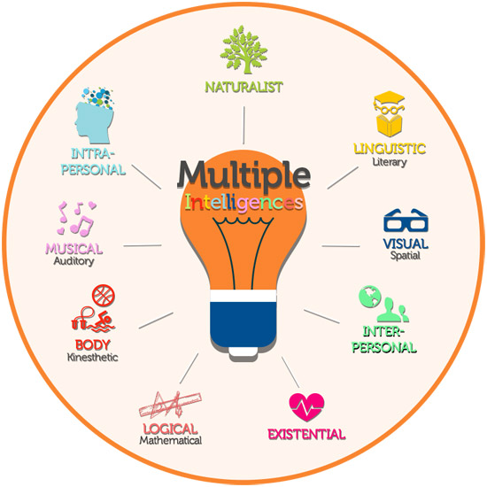
ENGLISH AUTONOMOUSLY personalized support
www.possopreschool.com
www.4yourtype.com
motivatedonline.com

Slide 14
ENGLISH AUTONOMOUSLY passion is the key

Slide 15
ENGLISH AUTONOMOUSLY passion is the key
What is your passion? Can you use it for learning English?
Counsel your neighbour…

Slide 16
ENGLISH AUTONOMOUSLY passion is the key
What do you want/ need to learn most (based on reflection from last week)?
How could you achieve that (what is your MI, how do you proces things, your passion)
How far are you willing to go (comfort zone)
What particular activity can you do?

Slide 17
ENGLISH AUTONOMOUSLY contract / plan / agreement
 | hours
1st and 2nd session + HW + 3 ind.counsellings | 10
min. 2 modules of your choice | 10 + 10
log writing | 5
??? (more modules, showers, your own work…) | 15
TOTAL | 50
Notes:
Odkazy na videopozvánky?

Slide 18
ENGLISH AUTONOMOUSLY
HW for your first counselling session:

Slide 19
ENGLISH AUTONOMOUSLY
HW for your first counselling session:
Language learning history starting your log
SWOT
SILL1
MAI1
CEFR
needs analysis
agreement

Slide 20
ENGLISH AUTONOMOUSLY modules and showers

Slide 21
ENGLISH AUTONOMOUSLY
book your 1st counsellings
choose at least 2 modules
choose a shower or more if you want
Check which modules and showers are going to be open at 6:45pm
Thank you for the second session:).

Slide 22
ENGLISH AUTONOMOUSLY bibliography
Holec, Henri: Autonomy and Foreign Language Learning. Oxford, 1981.
Little, David: Learner autonomy 1: definitions, issues and problems. Dublin, 1991.
Karlsson, Leena, Kjisik, Felicity & Nordlund, Joan: From Here To Autonomy. Helsinki, 1997.
Oxford, Rebecca: Strategy Inventory for Language Learning. 1989.
Schraw, Gregory and Dennison, Ryne Sperling: Assessing metacognitive awareness. In: Contemporary Educational Psychology, 19, 460-475.

