Slide 1
English Autonomously Lenka Zouhar Ludvíková Martina Šindelářová Skupeňová Eva Trumpešová - Rudolfová

Slide 2
ENGLISH AUTONOMOUSLY 1st session, 27th September 2017
Are you ready for autonomy?
https://goo.gl/forms/c0dwPWmvLqaZDNbL2

Slide 3
ENGLISH AUTONOMOUSLY 1st session, 27th September 2017
Are you ready for autonomy?
https://goo.gl/forms/c0dwPWmvLqaZDNbL2
what you need to know
how does EA work

Slide 4
ENGLISH AUTONOMOUSLY key words
Odd one out:
DEMOCRACY / AUTONOMY / ANARCHY / INDEPENDENCE
DIALOGUE / DOMINANCE / GUIDANCE / REFLECTION
INDIVIDUAL / TANDEM / COMMUNITY / TEACHER
PLANNING / EVALUATING / TESTING / MONITORING
SHOWER / BATH / MODULE / COUNSELLING
Notes:
Martina - instructions

Slide 5
ENGLISH AUTONOMOUSLY key words
Odd one out:
DEMOCRACY / AUTONOMY / ANARCHY / INDEPENDENCE
DIALOGUE / DOMINANCE / GUIDANCE / REFLECTION
INDIVIDUAL / TANDEM / COMMUNITY / TEACHER
PLANNING / EVALUATING / TESTING / MONITORING
SHOWER / BATH / MODULE / COUNSELLING
Notes:
Martina - instructions

Slide 6
ENGLISH AUTONOMOUSLY autonomous learning
„Autonomy is the ability to take charge of one's own learning.“ (Holec, 1981)
„Autonomy is drawing together the threads of
self-assessment, goal-setting and reflection...“ (Little, 1991)
Notes:
Lenka – background info: Henri Holec - father of learner autonomy, autonomous learning…
be in charge = setting the goals, taking the responsibility for decision making, accepting the consequences of one´s decisions, adjusting learning to one´s abilities and needs, instant self-reflection and monitoring one´s progress, self assessment…
you are not alone in autonomous learning – there is a FRAMEWORK for your learning
NOT independent learning (requirements and limits given by faculties, peers, major subjects, labour market…)
TODAY - quite traditional, frontal today but the rest of the term will be very different from usual classes
Mindset – you decide where you are going to go and how you are going to travel
The only way to learn successfully in the long term
Process of discovery
Freedom from being told what to do and freedom to do what you think is best for you
NOT about learning English only – learning in general and self development will be influenced
One is in control of his / her life, learning, direction…
SILL
TEACHER
Not the only authority, facilitator, partner
Tourguide – can help
STUDENT
Partner, expert on his / her own learning
To have the instruments and tools, different perspective – the session today
learning situation is different
role of a teacher is different
role of a student is different

Slide 7
ENGLISH AUTONOMOUSLY image of a teacher
Think of Igor Hnízdo. Is he a good teacher? Would you like him to teach you English?
https://www.youtube.com/watch?v=k8YMr9oMtz0
Notes:
Pairs – Groups – focus on TRADITION AND VERBS
What is the traditional role of a TEACHER and STUDENT? What does a TEACHER and/or a STUDENT traditionally do?

Slide 8
ENGLISH AUTONOMOUSLY image of a teacher
Think of the German teacher in the video…
Is he a good teacher?
Would you like him to teach you English?
https://www.youtube.com/watch?v=P_56wwGv9Bk
Notes:
Pairs – Groups – focus on TRADITION AND VERBS
What is the traditional role of a TEACHER and STUDENT? What does a TEACHER and/or a STUDENT traditionally do?

Slide 9
ENGLISH AUTONOMOUSLY 21st century teachers
https://goo.gl/forms/jS7NLP3IC3VgUDuH3
Notes:
Martina - role teachers – facilitators – providing framework

Slide 10
ENGLISH AUTONOMOUSLY 21st century teachers
21st century students
choose to be vulnarable
see themselves as co-learners
allow themselves to fail, often
don´t wait until they aŕe experts to introduce something
move into their students´ world, even if it´s foreign territory
run towards their area of weakness, not away from it
are comfortable not knowing what is going to happen
invite mistakes into their lives
we dream big and ask "why not?"
allow their students to teach each other
step outside their comfort zone
embrace change
feel secure asking their colleagues for help
question everything
believe they can learn anything, given the right attitude and effort
Notes:
Martina - role teachers – facilitators – providing framework

Slide 11
ENGLISH AUTONOMOUSLY metacognition
planning
evaluating
monitoring
Notes:
Lenka – different roles, need of specific skills – metacognition – MAI – students becoming autonomous learners

Slide 12
ENGLISH AUTONOMOUSLY course framework
Students introducing the activities and their purpose:
introductory sessions
modules
showers
individual counsellings
log
own activities
Notes:
Martina - Activity – what is the Framework? Pairs – groups

Slide 13
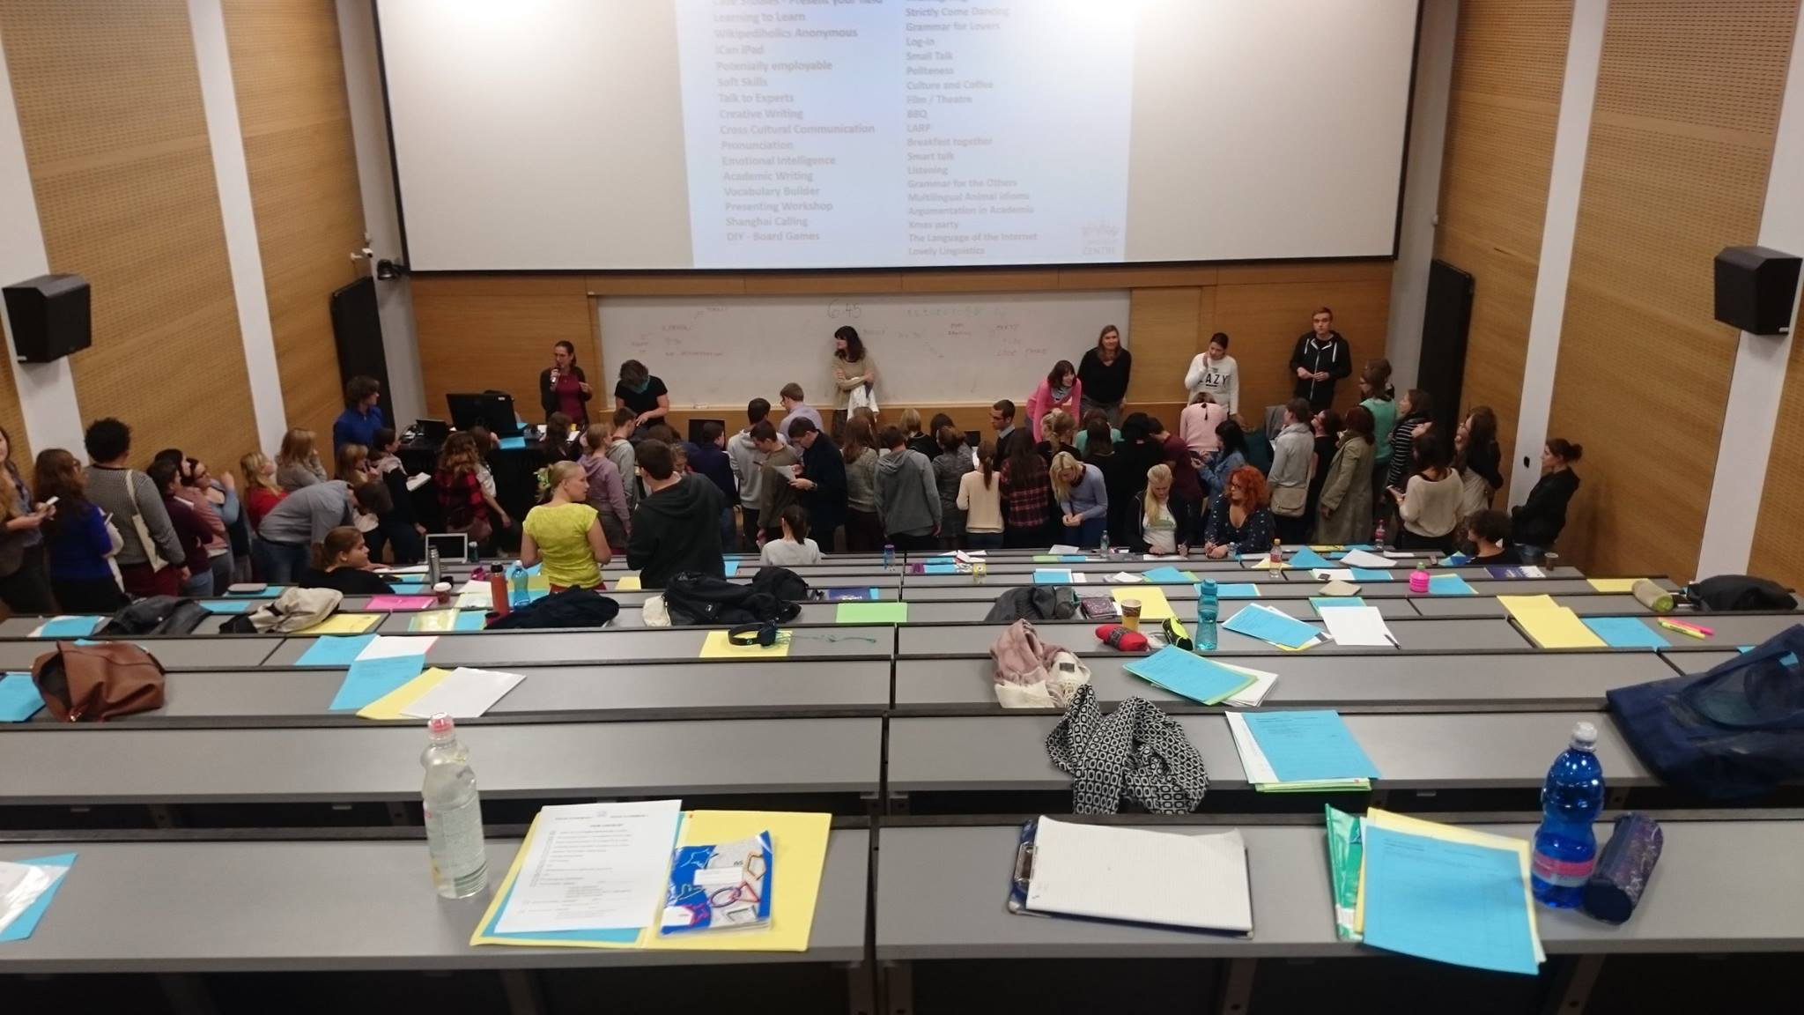
ENGLISH AUTONOMOUSLY course framework
introductory sessions
Notes:
Martina - Activity – what is the Framework? Pairs – groups

Slide 14
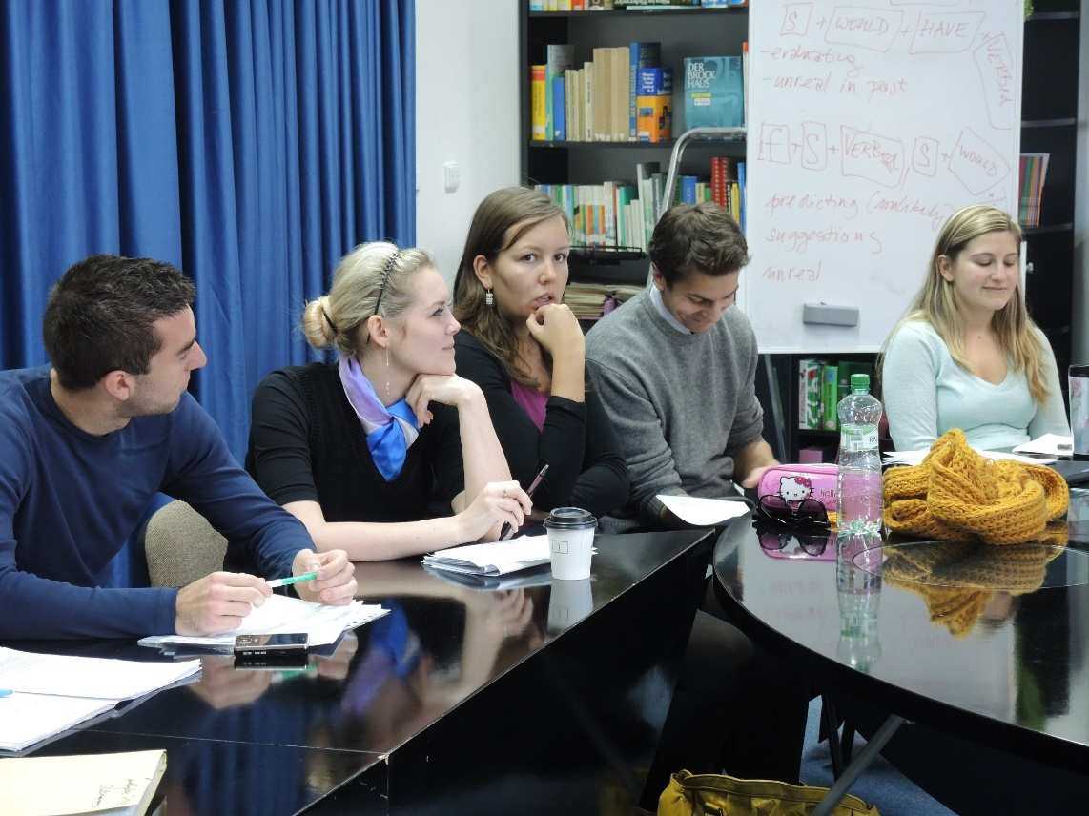
ENGLISH AUTONOMOUSLY course framework
modules
Notes:
Martina - Activity – what is the Framework? Pairs – groups

Slide 15
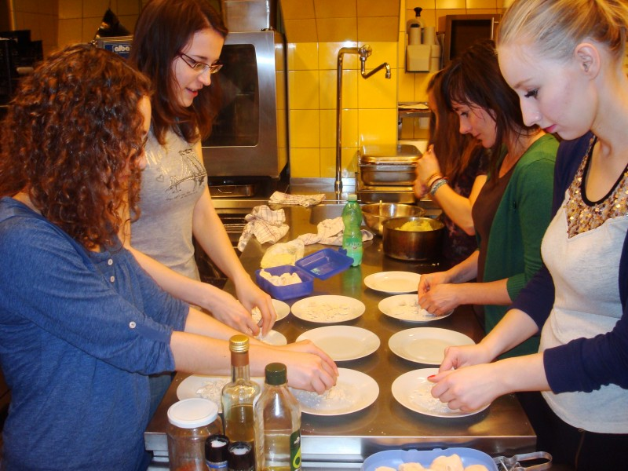
ENGLISH AUTONOMOUSLY course framework
showers
Notes:
Martina - Activity – what is the Framework? Pairs – groups

Slide 16
ENGLISH AUTONOMOUSLY course framework
individual counsellings
Notes:
Martina - Activity – what is the Framework? Pairs – groups

Slide 17
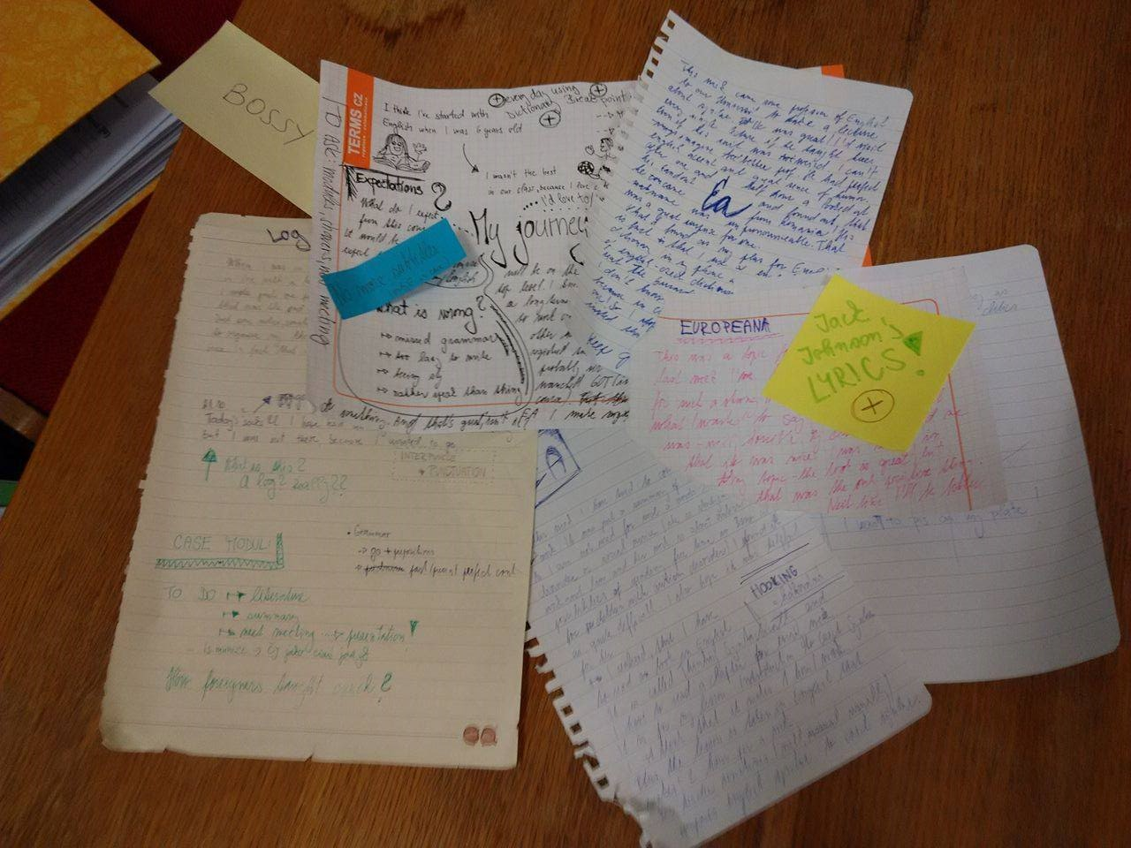
ENGLISH AUTONOMOUSLY course framework
log
Notes:
Martina - Activity – what is the Framework? Pairs – groups

Slide 18
ENGLISH AUTONOMOUSLY course framework
own activities
Notes:
Martina - Activity – what is the Framework? Pairs – groups

Slide 19
ENGLISH AUTONOMOUSLY course framework
introductory sessions - to find out about the course principles
modules - to get an insight into a specific area or topic
showers - to develop (language) skills of your choice
individual counsellings - to guide you through your learning
log - to reflect on your learning
own activities - to get immersed in English
Notes:
Martina - Activity – what is the Framework? Pairs – groups

Slide 20
ENGLISH AUTONOMOUSLY course framework
Gap fill: 90 20 5 2
2 introductory sessions (2x 90 minutes + HW)
modules ( x 3x 90 minutes)
showers (1x 90 minutes)
3 individual counsellings (3x minutes)
log ( hours)
own activities (as much as possible)
Notes:
Martina - Activity – what is the Framework? Pairs – groups

Slide 21
ENGLISH AUTONOMOUSLY course framework
= 50 hours in total
Notes:
Martina – distribute checklist and explain

Slide 22
ENGLISH AUTONOMOUSLY principles and framework
empowering the learners
students analyse their needs
students plan their learning
students reflect on their learning
100% differentiation required and ensured
teachers´support and peer cooperation
Notes:
Lenka

Slide 23
ENGLISH AUTONOMOUSLY needs analysis
SWOT ANALYSIS
strengths | weaknesses
opportunities | threats
Notes:
Martina - first possible tool, distribute pale blue paper

Slide 24
ENGLISH AUTONOMOUSLY CEFR self-assessment
CAN DO STATEMENTS………..
LISTENING
READING
SPOKEN INTERACTION
SPOKEN PRODUCTION
WRITING and much more….
https://rm.coe.int/common-european-framework-of-reference-for-languages-learning-teaching/168074a4e2
https://goo.gl/forms/jiPB0ytbRCjVgVmH2
Notes:
Martina – another tool – compare / contrast what you can and what you need, sample aktivity writing?

Slide 25
ENGLISH AUTONOMOUSLY strategies analysis
remember more effectively
manage your emotions
compensate for missing knowledge
organize your learning
evaluate your progress
learn with others
Notes:
Martina - Brainstorming in groups – compare what strategies you use to, afterwards distribute and explain SILL yellow paper

Slide 26
ENGLISH AUTONOMOUSLY counsellings
planning
evaluating
monitoring
planning (1st meeting)
monitoring (2nd meeting)
evaluating (3rd meeting)
Notes:
Martina – explanation: one to one, time for you

Slide 27
ENGLISH AUTONOMOUSLY log
learning journal / diary / log
to document learning
to support self-reflection
to record your achievements
to …
Notes:
To be explained more next time

Slide 28
ENGLISH AUTONOMOUSLY course schedule
1st introductory session, 27th September
2nd introductory session, 4th October - planning
1st individual counsellings, 5th - 13th October
two modules of your choice
your independent work
2nd individual counsellings in November
3rd individual counsellings in the exam period

Slide 29
ENGLISH AUTONOMOUSLY support group suggestions
https://goo.gl/forms/bj0EmDPIBDSuoLOE2
Notes:
To be explained more next time

Slide 30
ENGLISH AUTONOMOUSLY support groups
to be announced tonight
email
Facebook
EA website
a minimum of 2 modules
open to changes next week (prefered) and at your 1st counselling (exceptional)
Notes:
To be explained more next time

Slide 31
ENGLISH AUTONOMOUSLY homework
Next week
Needs Analysis / SILL / SWOT….
bring the EA folder again
bring your calender
First counselling
Language learning history
SILL / MAI
Notes:
Distribute MAI !!! Brainstorm models options – which one wold you like??? - groups

Slide 32
ENGLISH AUTONOMOUSLY
Thank you for taking the chance to be autonomous with us...

Slide 33
ENGLISH AUTONOMOUSLY bibliography
Holec, Henri: Autonomy and Foreign Language Learning. Oxford, 1981.
Little, David: Learner autonomy 1: definitions, issues and problems. Dublin, 1991.
Karlsson, Leena, Kjisik, Felicity & Nordlund, Joan: From Here To Autonomy. Helsinki, 1997.
Oxford, Rebecca: Strategy Inventory for Language Learning. 1989.
Schraw, Gregory and Dennison, Ryne Sperling: Assessing metacognitive awareness. In: Contemporary Educational Psychology, 19, 460-475.

