Slide 1
LANGUAGE & GENDER how differently we use it BY Anastasia Tsypkina

Slide 2
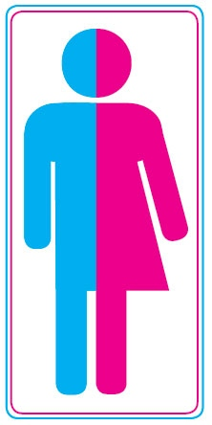
Who is possibly talking
Oh dear, honey, you put the ice-cream into the refrigerator, again!?
Damn! You’ve put the ice-cream into the refrigerator, again?
What a lovely idea! I’m so excited!
An awful idea. I’m done!

Slide 3
Why do we call it Gender?
1980s:
Language and sex
Nowadays:
Language and gender
is not biological sex of speaker, it’s social identity.
(Miriam Meyerhoff)

Slide 4
How does the language affects our thoughts?
German A KEY
Spanish
Masculine
hard, heavy, jagged,
metal
Feminine
golden, little,lovely,
shiny, tiny

Slide 5
Gender Differences in Language
M A L E
Avoid eye contact Physical orientation
From decision to discussion Directness/Indirectness
Talkative in public, quiet in private Public/private talk
Trouble talk avoided, would not put
status in risk Conversation style

Slide 6
Gender Differences in Language
F E M A L E
Uses eye contact Physical orientation
From discussion to decision Directness/Indirectness
Quiet in public, talkative in private Public/private talk
Troble talks used to create rapport Converstion style

Slide 7
George Keith and John Shuttleworh
In “Living language” (p.228) they suggest that:
Women – talk more, than men, talk too much, are more polite, ask more questions…
Men – swear more, don’t talk about emotions, talk about sport/women, machines (in the same way) more…

Slide 8
Reasons for communication
Female
Male
Most common theme – Empathy:
‘To know you’re not alone’.
To establish and maintain relationships:
‘Talking is the essence of relationship‘.
To get practical tips
Direct at practical, straight to the point.
Conversations are fast-paced

Slide 9
Why women are more chatty?
Researchers found the so called ‘language protein’ that makes women more talkative
Women have higher levels of Foxp2 protein
Girls learn to speak earlier and more quickly than boys
Daily women speak about 13000 words, men – 7000.

Slide 10
Summary
There are differences in men’s and women’s speech:
they brought up differently;
have different social tasks/roles.
A possible explanation – evolution

Slide 11
Literature
Jeniffer, C. (1993). Women, Men and Language (originally published 1989, 2nd edition 1993) Harlow: Longman.
Keith, G and J Shuttleworth (2008). Living language and Literature, 2nd ed. Hodler Education
http://www.linguisticsociety.org/resource/neurolinguistics
Why are women more chatty? http://www.dailymail.co.uk/sciencetech/article-2281891/Women-really-talk-men-13-000-words-day-precise.html
http://www.popsci.com/article/science/different-ways-men-and-women-talk-facebook

Slide 12
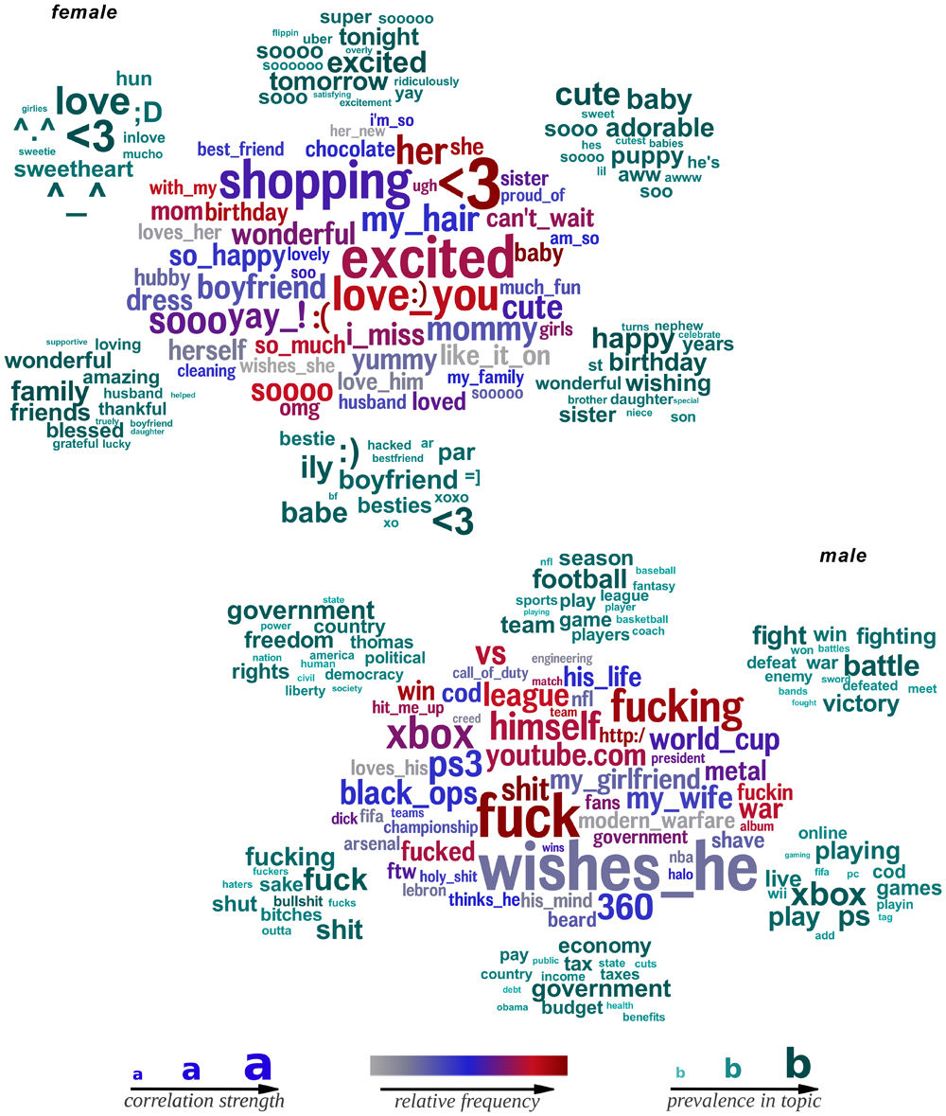
Thank you for your attention

