Slide 1
creative writing as academic writing
Joe Lennon, PhD, MFA

Slide 2
Which genres are academic writing genres?
How do we determine whether a kind of writing is academic or not?

Slide 3
Premise #1
Let’s teach (and evaluate) writing so that students come to perceive it as a continual PROCESS (of trial, failure, dialogue, experimentation), and so that they view any one “finished” piece of writing as only a byproduct of this process (though of course, a useful one).

Slide 4
Premise #2
Let’s show students that a good writer CREATES a unique form every time she writes, to suit the unique rhetorical needs of her audience.
Presenting a genre as an already set form with “rules” and teaching students to follow it is a backward and dead-end strategy (and an easy way to produce boring nonsense).
(see Lloyd Bitzer, "The Rhetorical Situation," 1968)

Slide 5
Premise #3
The most essential values of good writing in genres traditionally called “creative” apply to academic genres as well. If practice with “creative” techniques and forms helps students internalize these values, then these techniques and forms have an important place in an academic writing classroom.

Slide 6
3 style Values in English writing
ACTION
(evoked by strong verbs, as opposed to the STASIS of nouns)
IMAGE
(direct appeal to the senses)
ECONOMY
(if you can do the same work in fewer words, that’s better)
see Lanham, “Revising Prose,” and the Plain English Campaign:
http://www.plainenglish.co.uk/free-guides.html

Slide 7
Applying overall principles
Adapting structures from creative genres
Experimenting with creative forms
Some ways to make bring creative writing into the Academic Writing classroom:

Slide 8
Applying overall principles
(or, “Things My Creative Writing Teacher Taught Me”)
“Show, don’t tell.”

Slide 9
Three steps on the way from telling to showing:
1. Stating a concept
2. Turning the concept into an image (a concrete example)
3. Putting the image into direct relation with the reader’s body/senses (putting it into ACTION with a verb)
“Think of 50 pounds. Think of a 50 pound dog. Think of that 50 pound dog sitting on your head.”
Rhett Allain, Wired
https://www.wired.com/2015/11/holly-holm-ronda-rousey-destroying-kick-packed-a-lot-of-force/

Slide 10
Activity:
Get students to identify an abstract “telling” sentence in their paper (or their classmate’s paper), and take it through 2 more stages on the way to “showing.”
"We are going to make America great again!"
2. We are going to build a wall made of concrete and razor wire.
3. We are going to build a wall made of razor wire that will slice open the legs and arms of desperate women and children who try to get across.

Slide 11
Adapting structural tricks from creative genres
https://www.oxford-royale.co.uk/articles/techniques-creative-writing-improve-essays.html

Slide 12
Experimenting with creative forms
Modernist Poetry
Cento
Erasure

Slide 13
This Is Just To Say
William Carlos Williams
I have eaten
the plums
that were in
the icebox
and which
you were probably
saving
for breakfast
Forgive me
they were delicious
so sweet
and so cold
I use this poem to show:
the importance of image, directness, rhythm, tone
that there can be (and almost always are) multiple audiences and purposes. (Here, who is the audience and what is the purpose? What is the genre?)

Slide 14
Activity:
Students take one of their paragraphs and turn it into a poem by giving it line breaks
(This brings out rhythm (or lack of it); tends to emphasize key ideas, makes repetition more obvious)

Slide 15
Here’s a cento I made from the sources I read for this presentation:
In order to clarify
the next lips
beside the white
poets often bring spaces
into places
a communication so peculiar
The dictionary
a 50 pound dog
defines erase
(without words, please)
for the sake of something
a form of flesh and blood
rope-dancing
beyond itself
Cento:
Ancient Roman poetry form
made from lines taken from other sources
Activity:
- Ask students to keep a research notebook of interesting/useful quotations (a good idea anyway).
- Ask them to make a cento poem from the quotes.
- Share with another student who then rearranges the lines (Students talk about how the meaning changes; why they chose these lines in particular)

Slide 16
Erasure
A literary form in which words (or parts of words) are erased from an existing text. The results can be funny, surprising, satirical, subversive, and profound.

Slide 17
Erasure
A literary form in which words (or parts of words) are erased from an existing text. The results can be funny, surprising, satirical, subversive, and profound.

Slide 18
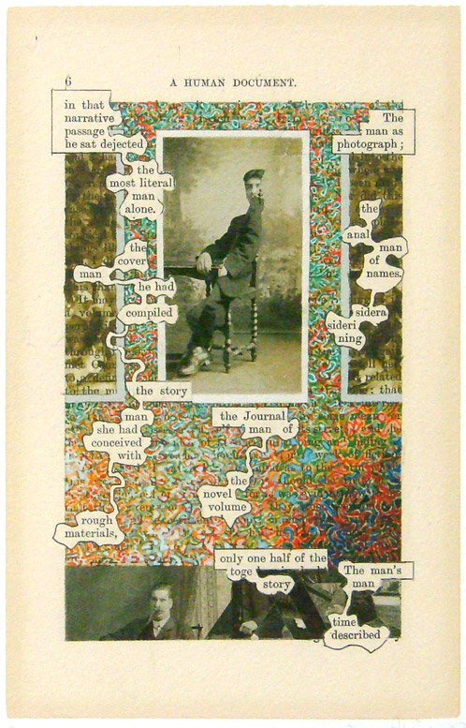
A Humument
Tom Phillips, 1970

Slide 19
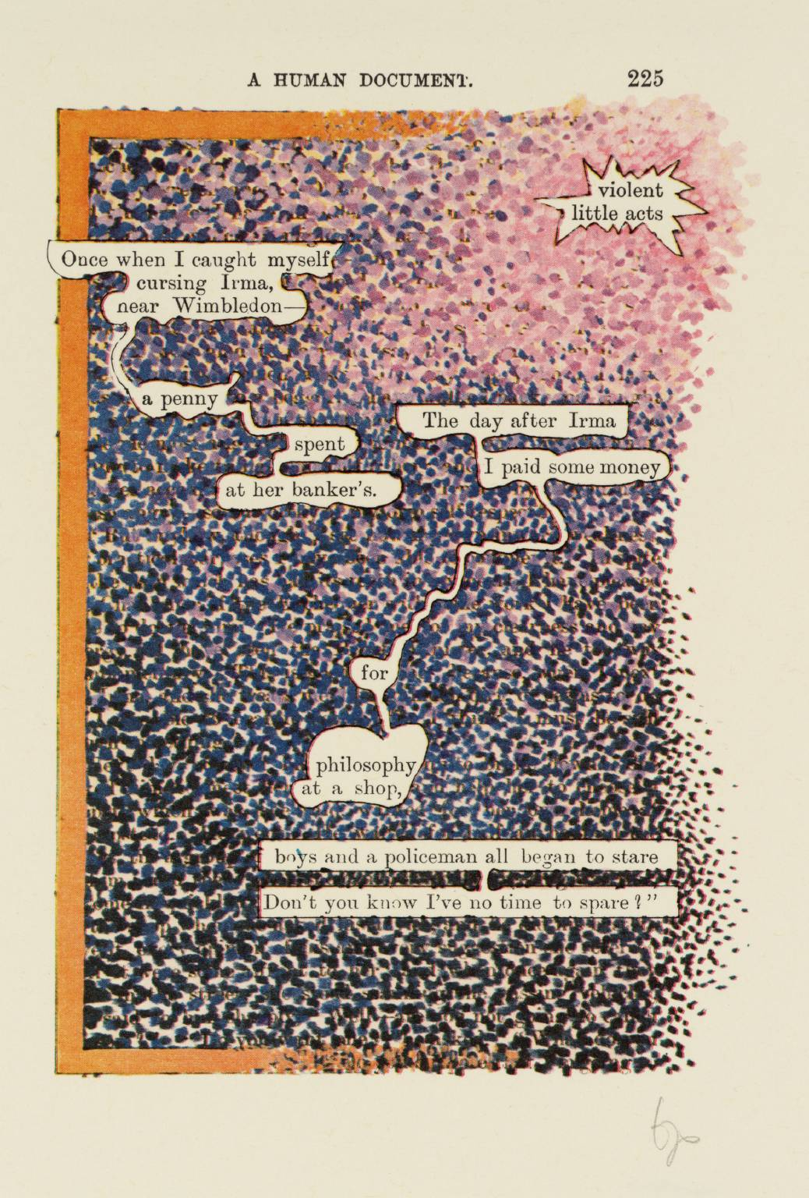
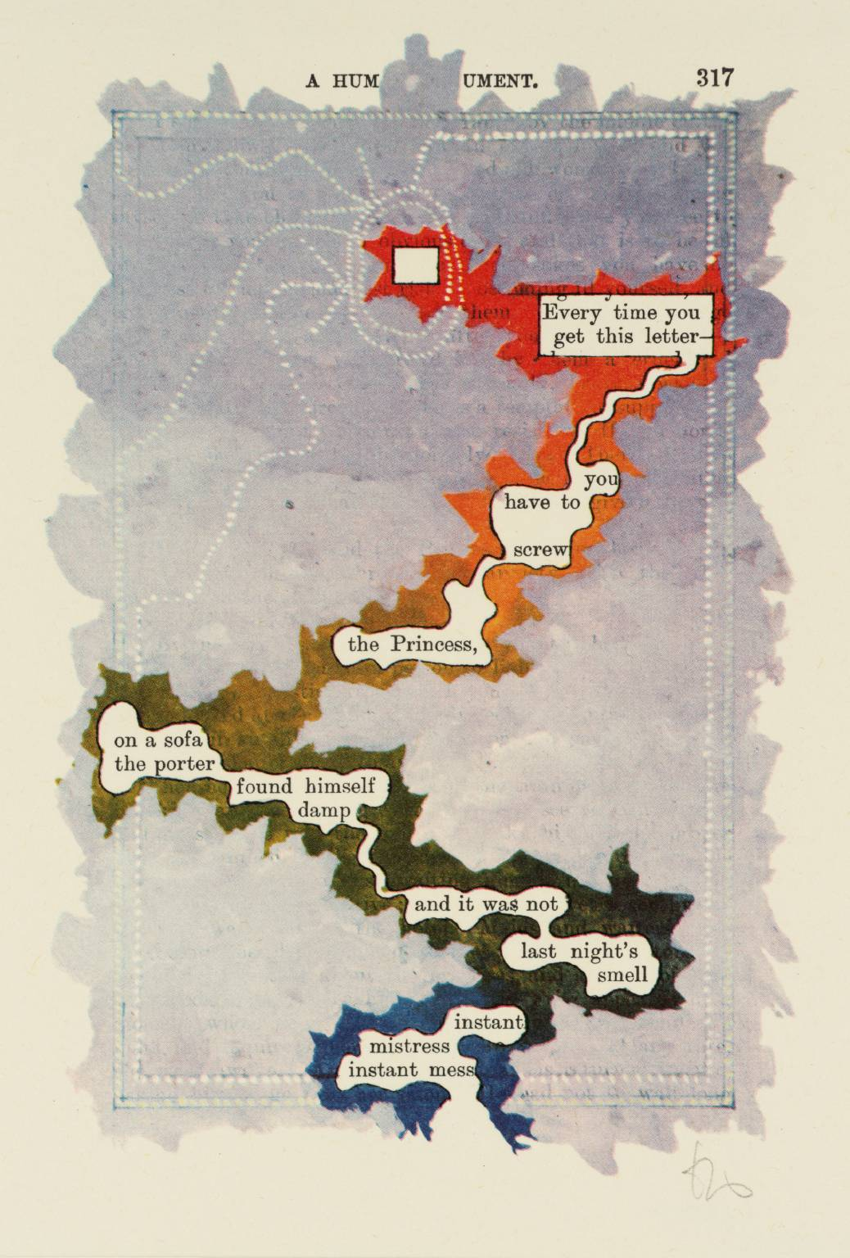

Slide 20
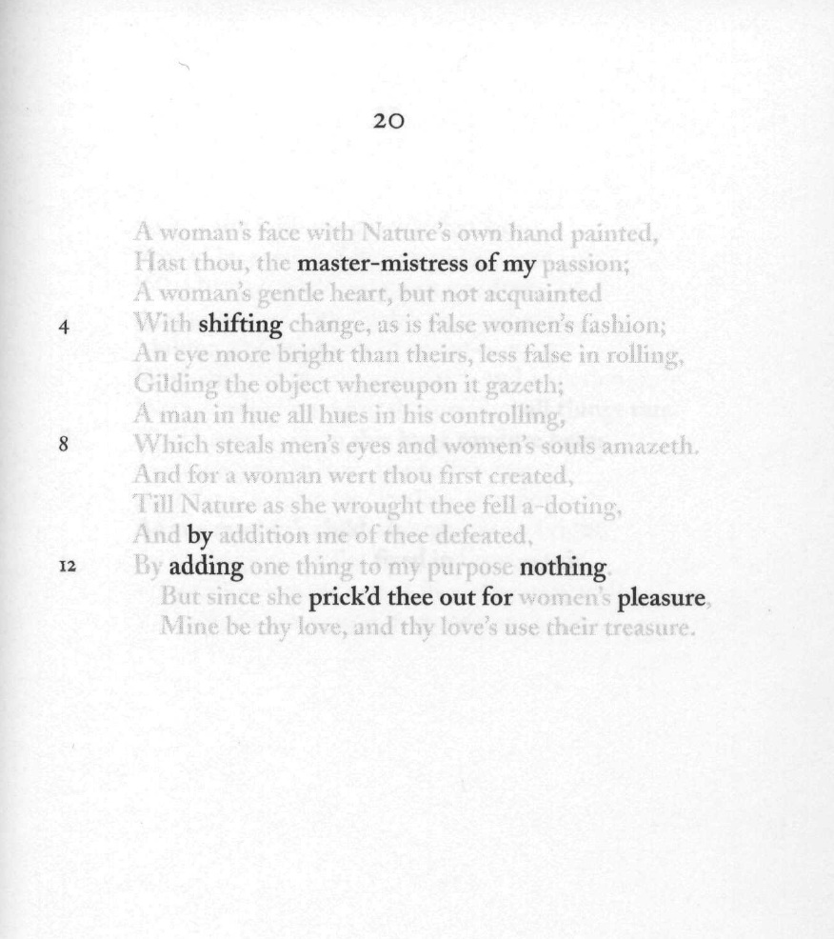
Nets
Jen Bervin, 2003

Slide 21
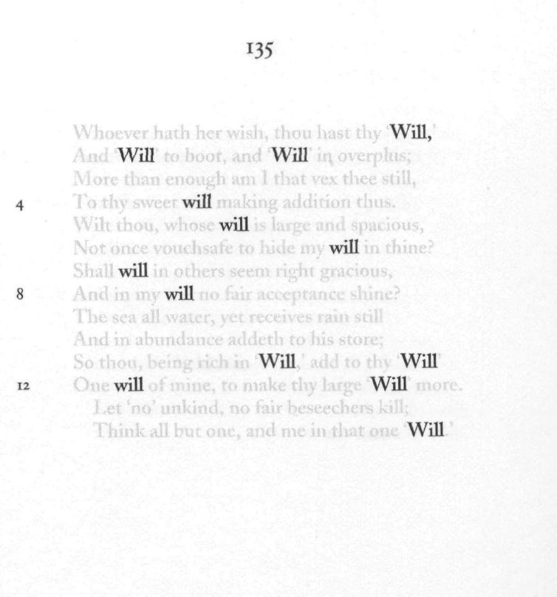
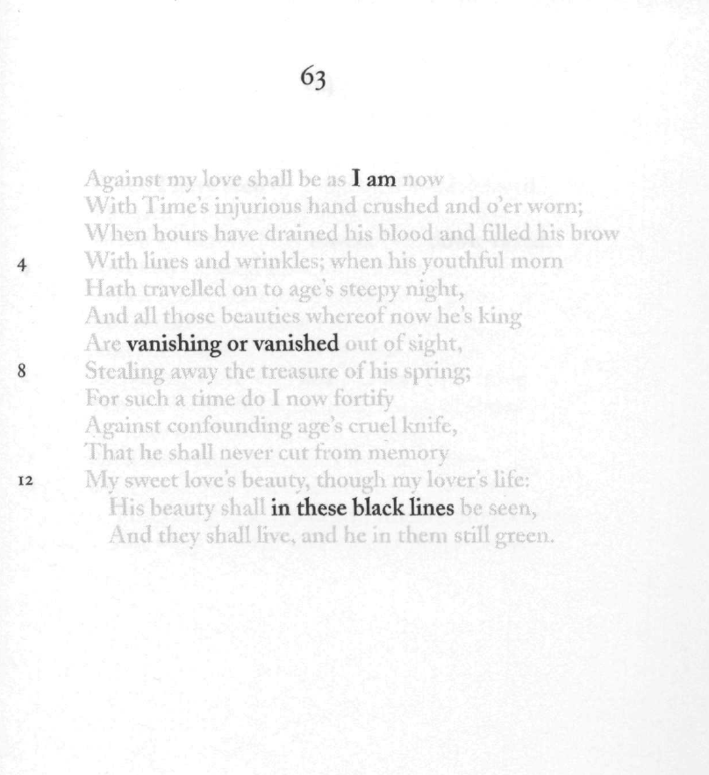

Slide 22
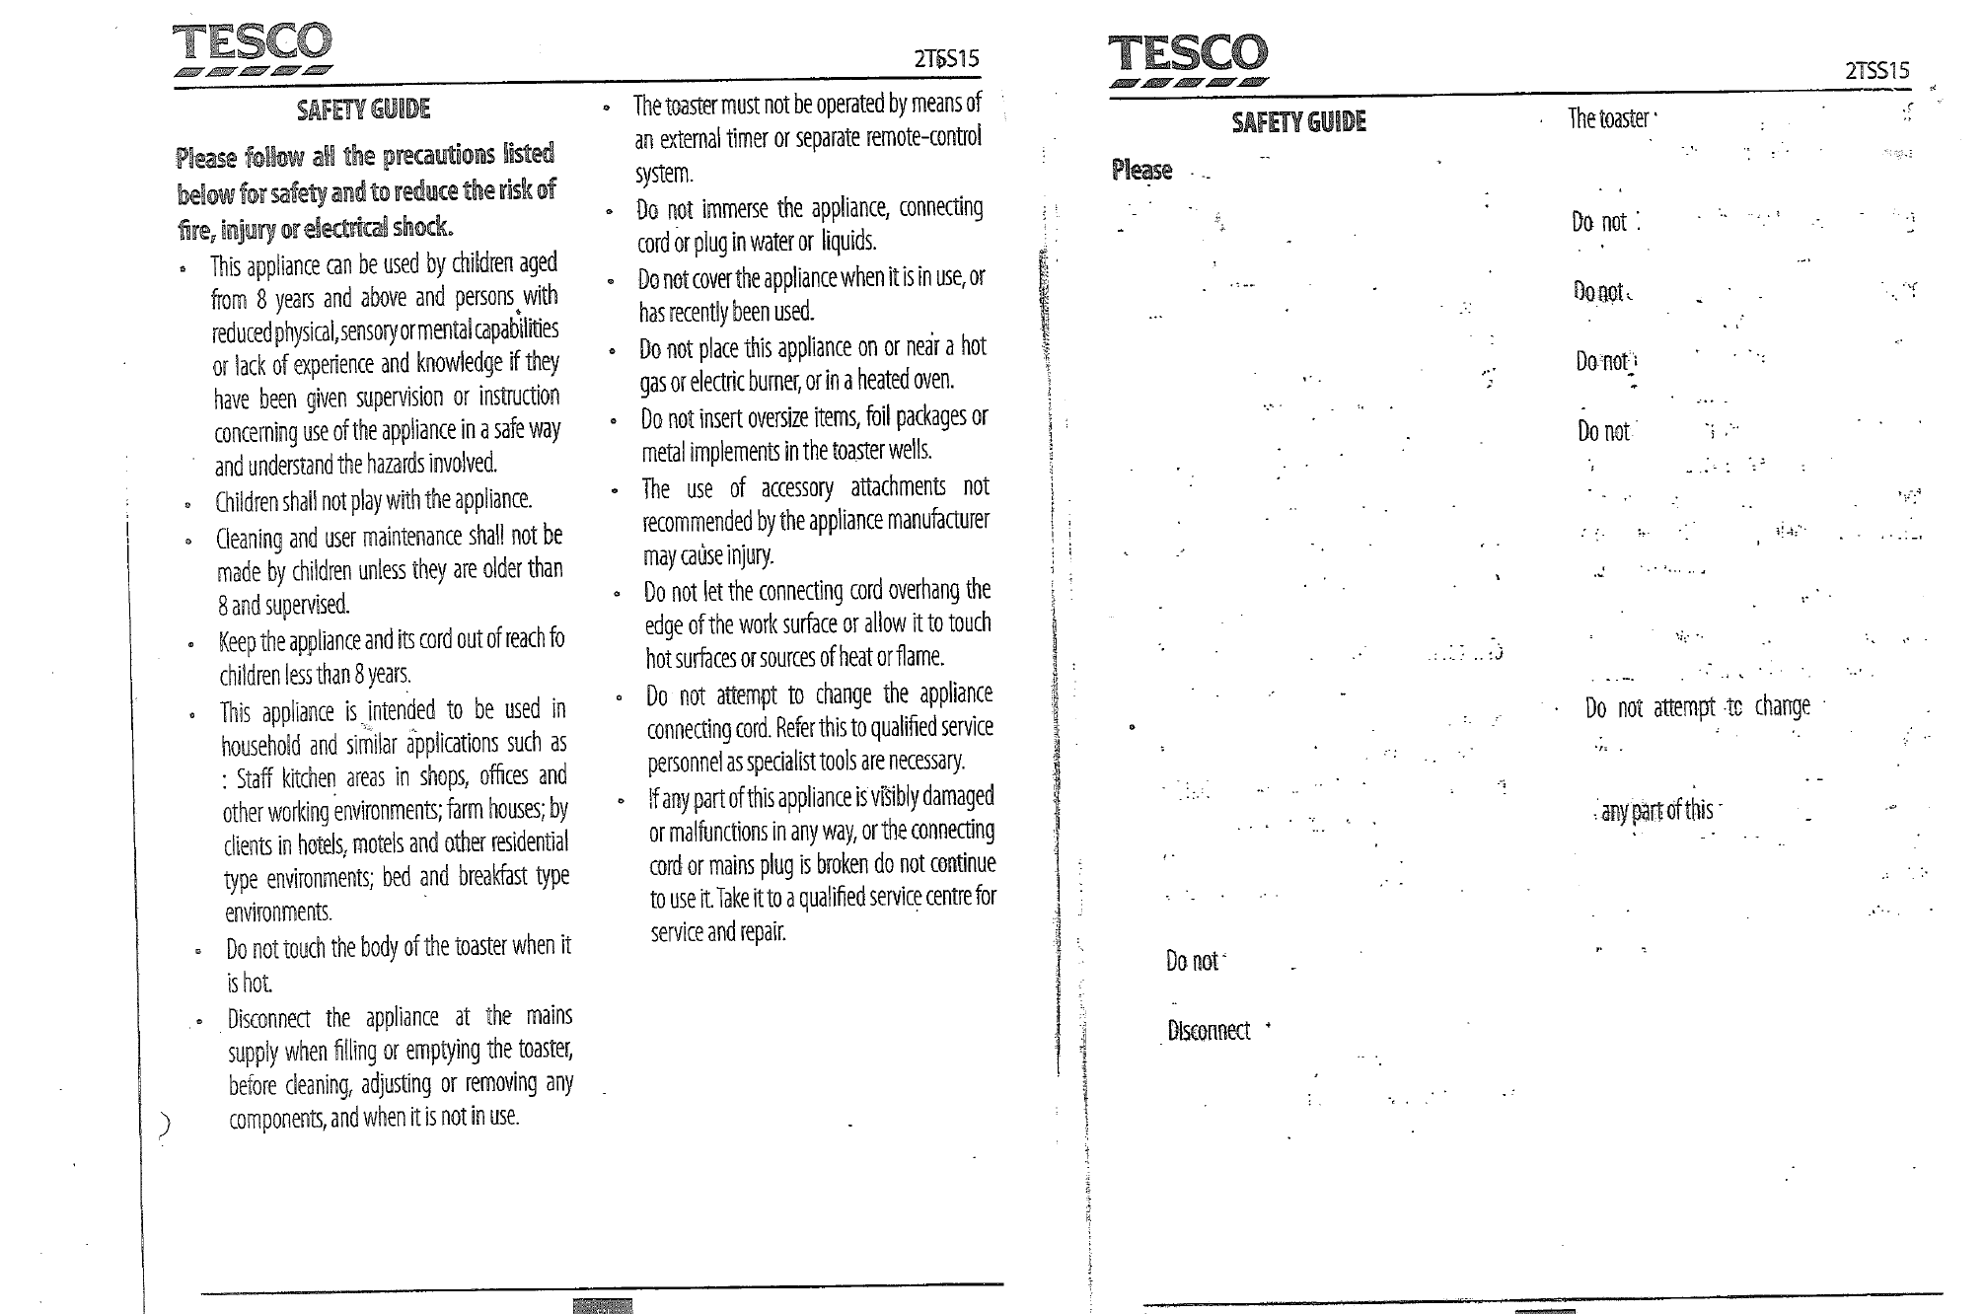
Joe Lennon, 2016

Slide 23
Activities:
Students can do erasures on a reading text, on their own writings, on classmates’ writings…
Have them discuss: How has the meaning changed? The genre? The purpose? The audience?
You could ask them do an erasure with a specific goal (change the text from one genre into another, make the text appeal to a specific audience, erase everything but the verbs…)
Get them to articulate WHY they did what they did!

