Slide 1
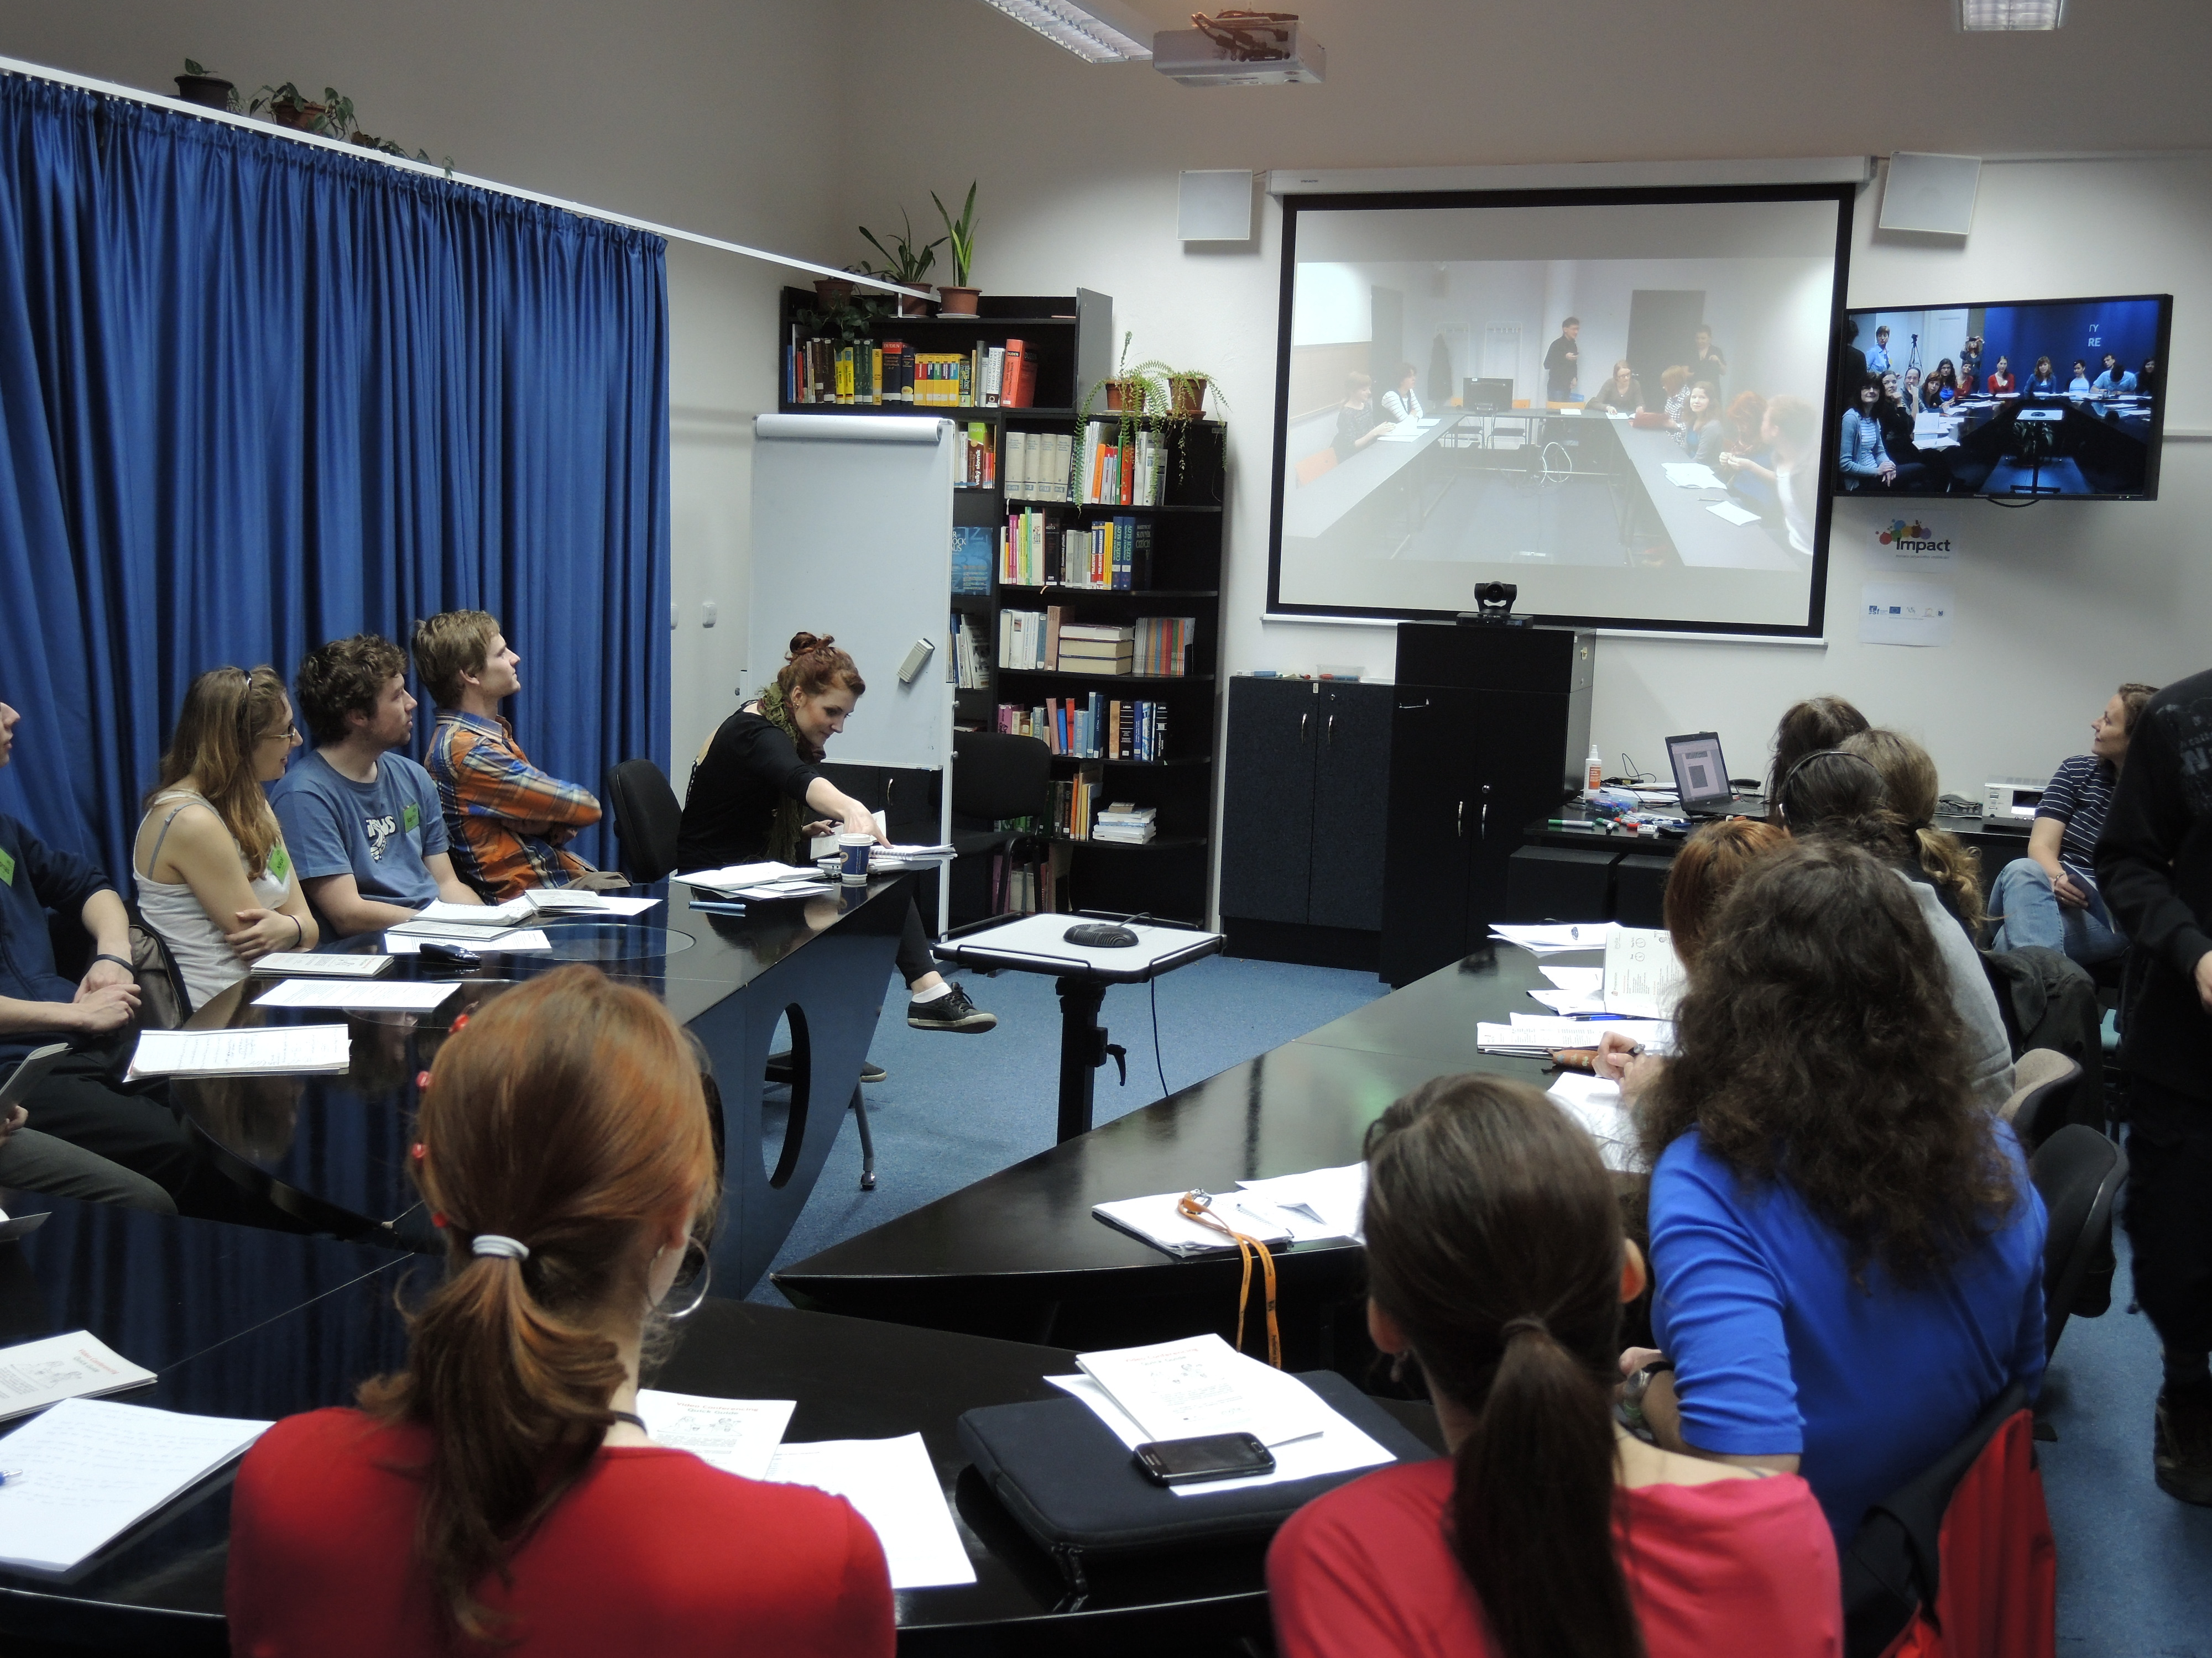
VIDEOCONFERENCING IN ENGLISH
MARTINA Šindelářová Skupeňová

Slide 2
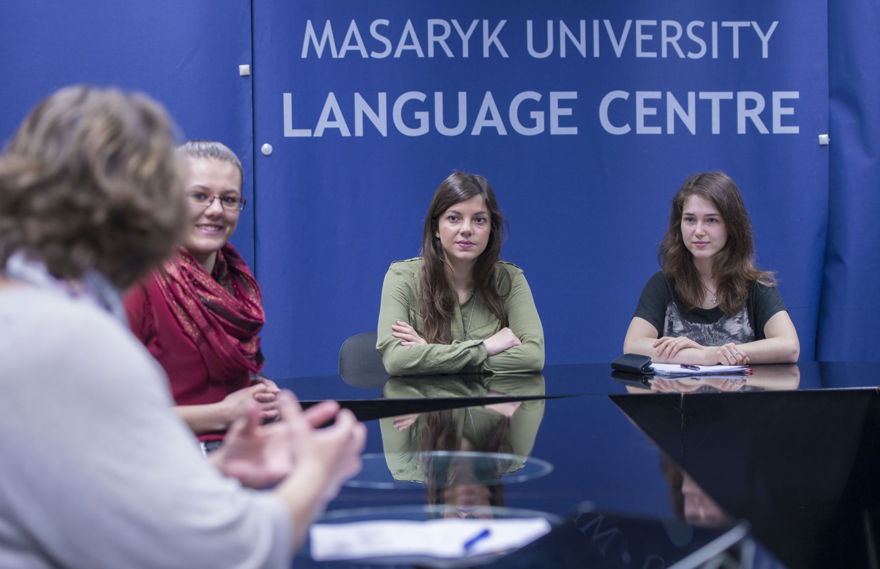
Introduction 1
Write down:
an item you like wear / carry
a regular activity of yours
a feeling you had this morning
a quality you appreciate in people

Slide 3
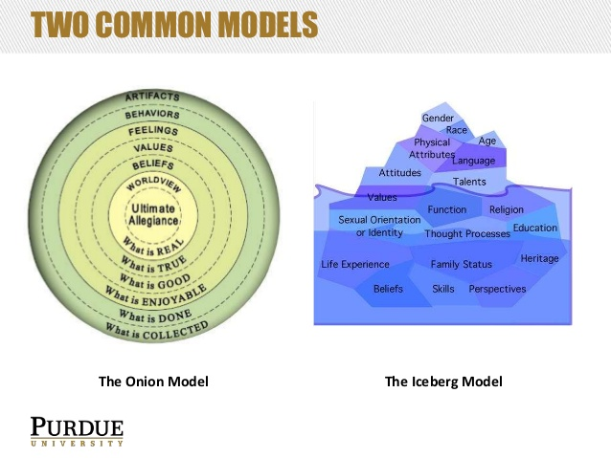
technici.cjv@rect.muni.cz
technici.cjv@rect.muni.cz

Slide 4
Introduction 2
In class
For the camera
HW – in writing

Slide 5
Language focus
Are you able to decipher the following English sayings?
A penny saved is a penny earned.
When in Rome, do as Romans do.
Look before you leap.
Good fences make good neighbours.

Slide 6

Listening
http://www.macmillanincompany3.com/resources/student/resource-centre/intermediate/audio/unit-9/

Slide 7
Intercultural situations
You meet a Spanish business contact you haven´t seen for ages who wants to stop and chat, but you are running late for an appointment. Do you stay or do you make your excuses and go?
Your American boss organizes a weekend barbecue. You find yourself amongst a lot of people you´ve never met. Do you join in the fun or leave as early as you can?
In company3.0 P.140

Slide 8
Listing
Note down 5 types of fruit.
Note down 5 types of vegetables.

Slide 9
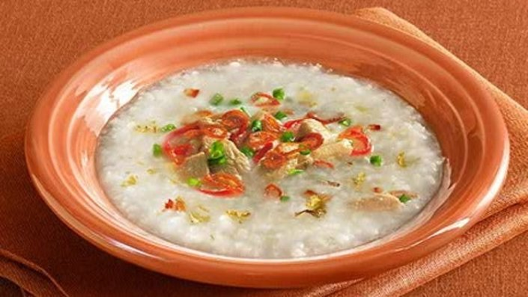
Food A

Slide 10
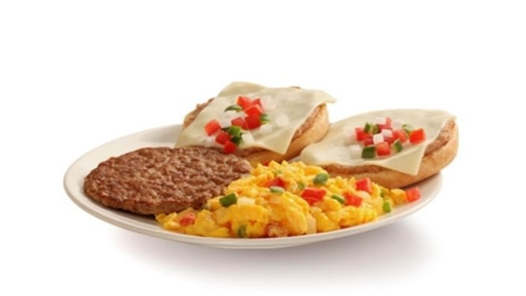
Food B

Slide 11
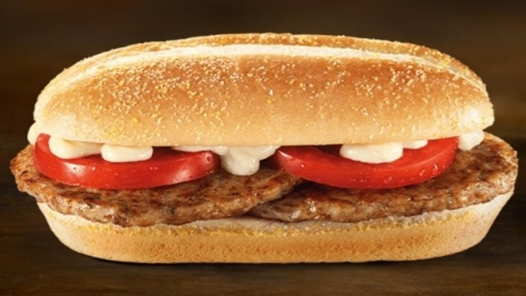
Food C

Slide 12
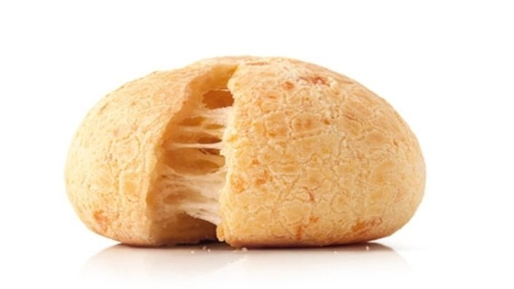
Food D

Slide 13
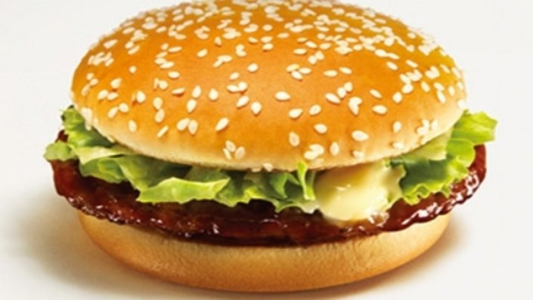
Food E

Slide 14
Key
A: Malaysia B: Mexico C: Czech Republic D:Brasil E: Japan
http://www.foodnetwork.co.uk/article/crazy-meals-mcdonalds-menus-around-world/10.html

Slide 15
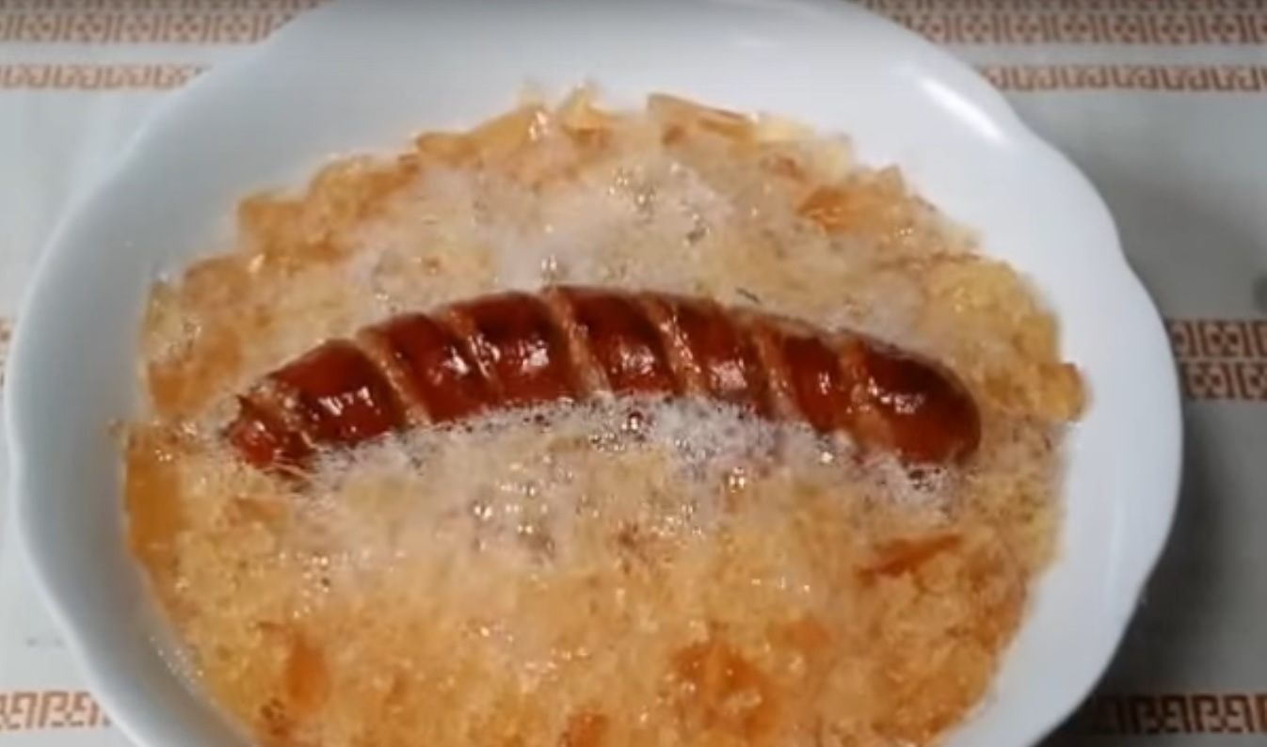
Describing and defining
Describe one FOOD item representing your culture.

Slide 16
Intercultural communication
Watch and describe the following video. https://www.youtube.com/watch?v=WAn6c8H418A
Read the following text and ask your partner for the missing information.

Slide 17

Thank you for your attention.
Notes:
What is learning? How do you learn???

