Slide 1
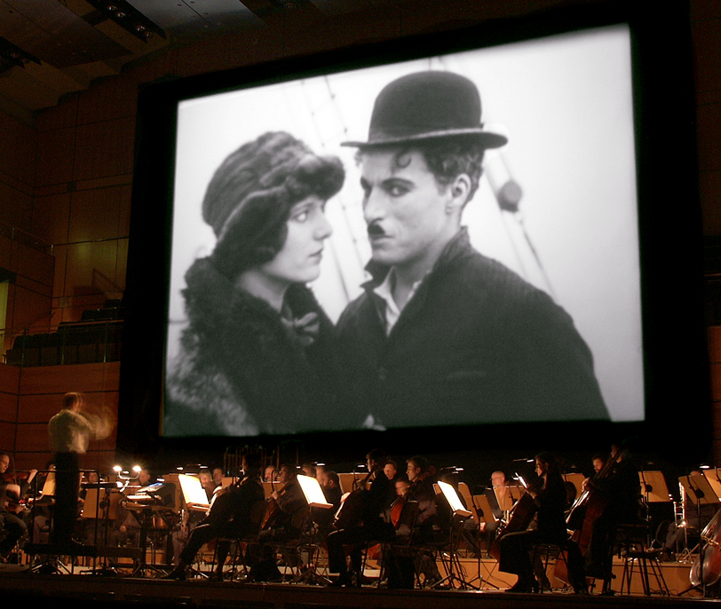
Film Music – Music Film

Slide 2
Contact
Blog: https://filmmusicmusicfilm.wordpress.com
E-Mail: claus.tieber@univie.ac.at

Slide 3
Timetable
15:50 - 19:05 Session 1
16:50 – 17:00: Intermission
17:00 – 19:05: Session 2
19:05-21:35: Screening
Rebel Without a Cause

Slide 4
Thursday 9.11.
15:50 - 19:05: Session 3
16:50 – 17:00: Intermission
17:00 – 19:05: Session 4
19:05 – 21:35: Screening:
Funny Face

Slide 5
Friday 10.11
9:10- 10:40: Session 5
10:40- 10:55: Intermission
10:55 - 12:25: Session 6

Slide 6
Soundtrack

Slide 7
Soundtrack
Voice
Sound Effects, Geräusche
Ambient sound
Foley
Music

Slide 8
Analysis Checklist
Presence or absence of ST elements and balance
Design of ST (over time, changes)
Relation to the narrative
Buhler, Neumeyer, Deemer: Hearing the Movies 32

Slide 9
Foley
Jack Foley, worked at Universal, first sound effect person
Sound effects created artificially and added to the sound track
foley artists

Slide 10
Speech
Voice-over
Volumne
Pitch
Timbre
Synchronization

Slide 11
Music
Score
Source
Diegetic/extra-diegetic

Slide 12
Tempo
Accelerando: smooth and usually gradual speeding up
Ritardando: slowing down
https://www.youtube.com/watch?v=rzloGMxMfsY

Slide 13
Rhythm and Meter

Slide 14
Volumne
Crescendo: gradual increase
Diminuendo or Decrescendo: decrease

Slide 15
Timbre
Distinct coloring of sound

Slide 16
Pitch

Slide 17
Harmony
Consonance
Dissonance
https://www.youtube.com/watch?v=Jj1i6qaTZ3k

Slide 18
Orchestration
The art of choosing and combining instruments to produce a particular sound

Slide 19
Texture
Functional relation of musical lines to one another
layering
Density and liveliness

Slide 20
Monophony: single melodic line
Homophony: more than one line, same rhythm
Polyphony: independence of lines

Slide 21
Sound Bridge
Sound Advance
Sound Lag
Sound Link (Montage Szenen)
Sound Match

Slide 22
Meanings
Levels of meaning in fictional film according to Bordwell:
Referential
Explicit
Implicit
symptomatic

Slide 23
referential
Referents taken as either imaginary or real
Intratexual reference
Extratexual reference

Slide 24
explicit
Explicit meaning („there is no place like home“)

Slide 25
implicit

Slide 26
symptomatic
Economic
Political
ideological

Slide 27
meaning
Comprehension (referential, explicit)
Interpretation (implicit, symptomatic)

Slide 28
Three codes (Gorbman)
Pure Musical codes
Cultural musical codes
Cinematic musical codes

Slide 29
Pure musical
Purely musical siginification
Creating tension and resolution through highly coded structure and syntax

Slide 30
Cultural musical codes
Instrumentation, rhythm, harmony form a veritable language
Culture, (dramatic) situations, history etc.

Slide 31
Cinematic musical codes
Music is codified by the filmic context itself
Beginning, end-title music
Musical themes, leitmotifs

Slide 32
High Anxiety
http://filmmusic.blogs.upv.es/introduction/ambiguous-diegesis-and-emanation-music/

Slide 33
Added Value
"by added value I mean the expressive and informative value with which a sound enriches a given image so as to create the the definite impression, in the immediate or remembered experience one has of it, that this information or express "naturally" comes from is seen, and is already contained in the image itself." (Chion 1994, S. 5)

Slide 34
Synch points
"A point of synchronization, or synch point, is a salient moment of an audiovisual sequence during which a sound event and a visual event meet in synchrony. It is a point where the effect of synchresis (…) is particularly prominent, rather like an accented chord in music." (Chion 1994, S. 58)

Slide 35
Mickey-Mousing
https://www.youtube.com/watch?v=r12gjrtl2bI

Slide 36
Mood
Underscoring
contrapuntual

Slide 37
Functions Copland
Atmosphere of time and space
psychology
background
continuity
dramaturgy

Slide 38
Method
Itemize
Characterize
Locate synch points
Compare sound and image (Neumeyer 2015, S. 51)

Slide 39
Itemize
Pure description
Inventory
list

Slide 40
Characterize
Sound quality
Consistency
Interaction and balance

Slide 41
Locate synch points
Audiovisual phrasing
Seperating out the synch points
Rhythms of synch points

Slide 42
Compare sound and image
Do they match? Do they not?
Complement or contradict

Slide 43
Chion: Masking
Only the sound
Only the visuals

Slide 44
Negative sounds: image calls for them, but they are absent
negative images: sound calls for them, but they are absent

Slide 45
Acousmêtre
Acoustical being
Exists in the diegetic space but is placed consistently offscreen
Heard, but not seen
A character defined wholly in terms of diegetic sound
Psycho, Wizard of Oz, Horror

Slide 46
Silent Film Music

Slide 47
Silent Cinema
Early Cinema
Transitional Era
Classical (Hollywood) Cinema

Slide 48
Early Cinema 1896-1907
“cinema of attractions”
Short, programmes, multi-media
Documentary
Varietés, Vaudevilles, music halls
shock
foreknowledge
Direct address

Slide 49
Music in Early Cinema
Small orchestra, percussion
Lumiére Grand Café Paris 1895: piano
Krugerstr, Vienna: piano
Mechanical music: Walzes, mechanical organs
Structural functions: marking of beginngs and endings
Very broad relation of music to film programme (if at all)

Slide 50
Phonograph

Slide 51
Cinema Organ

Slide 52
Dickson Experimental Sound Film 1894/95

Slide 53
Direct address

Slide 54
Drama and Music
Opera
Operetta
Melodrama
Ballett, Pantomime
Legitimate theater

Slide 55
Songs in Early Cinema
characters
Intertextual and intermedial
Structure of a song
Song/actor/singer/star

Slide 56
Transitional era
Fictional films start to dominate
Feature Films
one reeler
New possibilities and conditions for film music
two-reeler
feature-length films

Slide 57
Nickelodeon

Slide 58
Nickelodeon

Slide 59
Music in the transitional era
First compositions
Cue Sheets
Illustrating music
discourse

Slide 60
L‘Assassinat du Duc de Guise (1908)

Slide 61
Cue Sheets

Slide 62
"My Cousin."
1 . AT SCREENING THEME I. 30 sec.
2. T. AS RUDOLPH IN BOHEME Racconte di Rodolfo Puccini 30 sec. (Aria from "La Boheme")
3. T. AS CANIO IN PAGLIACCI SI Puo Leoncavallo 15 sec. (Aria from "I Pagliaccl")
4. T. AS SAMSON IN SAMSON AND... 15 sec. Mon Coeur Saint-Saens (Aria from "Samson and Delilah")
5. T. AS THE DUKE IN RIGOLETTO.. 30 sec. La Donna e Mobile Verdi (Aria from "Rigoletto")
6. T. IN LITTLE ITALY 3 min. 30 sec. Grazielle Kretschmer Valse Italienne.

Slide 63
Handbooks

Slide 64
Classical cinema
Feature length films
Voyeuristic cinema
continuity editing
Illusion
Goal-oriented single protagonist
causality
Music “unheard”

Slide 65
7 rules
According to Gorbman:
Invisibility
Inaudibility
Emotion
Narrative cueing
Unity
Breaking the Rules

Slide 66
Music for silent films
Edmund Meisel: Panzerkreutzer Potemkim
Gottfried Huppertz: Metropolis
Pietro Mascagni: Rhapsodica Satanica
Robert Stolz: Der Millionenonkel
Eric Satie: Entreacte

Slide 67
Functions
Meaning
Inter- and transmedial connections
Stage/concert hall - cinema
Attraction
Creating a diegetic space
Utopian elements

Slide 68
Silent Film Music
Modernist music (Europe)
Mixture of pre-existing music and composed ones
Leitmotif
Diegetic music
Diversity of modes

Slide 69
Silent Cinema Music
Cinema as concert hall
Vocal music
Pre-existent music
Mostly compiled, not just improvised

Slide 70
Cont.
Pre-existing music: mixture of high and low brow
Discoure critizes missing connection to film
Multiple functions
Practical and economical contexts
Culturall and social prestige of the new media also depends on kind and quality of the music

Slide 71
Tonbilder/ Sound Pictures
Early experiments of synchronizing sight and sound

Slide 72
Buzz Song (D 1907)

Slide 73
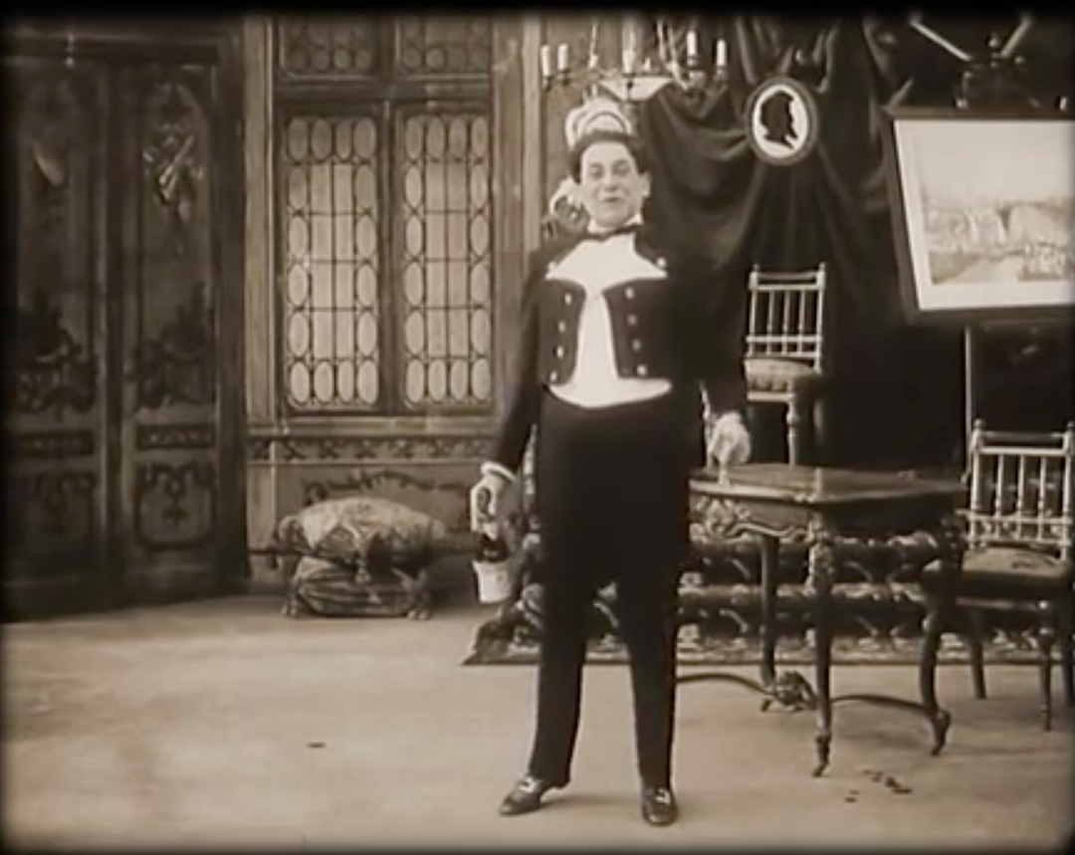

Slide 74
Coming of Sound
sound on disc
sound on film

Slide 75
The Jazz Singer

Slide 76
Film Music in CHC
Studiosystem
Orchestras, composers, musical directors
Production Code
European composers
Post-romantic orchestral music

Slide 77
music department
composers, arrangers, orchestrators, copyists, librarians, music editors
resident orchestra
senior music director

Slide 78
Sub-departments
Research, preparation, pre-existing music, libraries
Production, scheduling, employment
Postproduction, scoring, cue sheetes
All part of the sound department
4-6 weeks for a score

Slide 79
Collaborative effort
1934-38: oscar for department, not composer
Several composers, arrangers, orchestrators
Use of previously composed music until 1944

Slide 80
Leitmotif
Wagner
Star system
Motivated by dramatic need
Music anchors the image in meaning (Gorbman)

Slide 81
Case Studies
Max Steiner
Erich Wolfgang Korngold
Miklos Rosza

Slide 82
Max Steiner

Slide 83
Steiner
Experience of theatrical music, Broadway, operetta
King Kong (1933)
Binary oppositions (disruptive chromaticism vs. Stabe tonality, Cooke)
Leitmotif
Micky-mousing
underscoring

Slide 84
Steiner
Casablanca
Gone With the Wind

Slide 85
Korngold

Slide 86
Korngold
Captain Blood 1935
The Adventures of Robin Hood 1938
The Sea Hawk 1940

Slide 87
CHC composers
Franz Waxman
Alfred Newman
Miklós Rósza
Dimitri Tiomkin

Slide 88
Post-war Hollywood
The beginning of the end:
Unit system of production
Paramount case, end of vertical integration
HUAC
TV

Slide 89
Hollywood after the War
Widescreen, 3D, Cinerama etc
Epics, psycho-drama
Teenage delinquency
Rock'n'roll

Slide 90
Moderinsm
Atonal music: Film noir, psychlogical drama, horror
Jazz

Slide 91
Leonard Rosenman
Studied with Schönberg
East of Eden
Rebel Without a Cause
The Cobweb
Atonal chromaticism
Jazz

Slide 92
Bernhard Herrmann
Citizen Kane
The Day the Earth Stood Still
Hitchcock: Vertigo, Psycho, ...
Taxi Driver

Slide 93
Jazz
Musical Shorts
Race Movies
Biopics
Jazz as score

Slide 94
Paul Robeson
Notes:
Showboat 1936

Slide 95
Musical Shorts

Slide 96
Cabin in the Sky

Slide 97
Jazz inspired scores
The Man With the Golden Arm
Sweet Smell of Success
Anatomy of a Murder (Ellington)

Slide 98
New Hollywood
TV
Youth culture
Indpendent production
AIP American Independent Pictures
End of production code, rating system
Multiplexes, arthouse cinemas, festivals
1958 studios sack musicans

Slide 99
New Hollywood
New generation
Within the system
education
European auteur cinema
Counter culture

Slide 100
Sound
Dolby Stereo Optical Sound
Star Wars was shown in more cinemas without dolby than with
„Second Coming of Sound“
Jaws and Exorcist still mono
Dolby Surround

Slide 101
Pop
The Blackboard Jungle
Elvis films
Beatles films
Bossa Nova: Black Orpheus
Blackploitation (Shaft, Superfly etc.)

Slide 102
Song Scoring
Easy Rider
The Graduate

Slide 103
Nino Rota
Fellini, Visconti
The Godfather

Slide 104
Ennio Morricone
Genre and film music
Sergio Leone dollar trilogy

Slide 105
The Return of the orchestral score
John Williams

Slide 106
Innovations
There Will Be Blood: Johnny Greenwood
Guardians of the Galaxy

