Slide 1
The Film Musical

Slide 2
definition
What is a film musical?
What is not a film musical?
Is it important?
Why?

Slide 3
Altman: Definition: Semantics
Narrative
Feature length
Romantic couple
Rhythmic movement and realism
Diegetic music and dialogue

Slide 4
Altman: Definition: Syntax
Dual focus
Parallelism
Music and dance as signifiers of personal and communal joy, romantic triumph
Continuity between realism and rhythm
Classical narrative hierarchy reversed at climatic moments

Slide 5
Wedel: Musikfilm
I understand the term as a narrative genre with a duration of at least one hour, with repeated musical numbers with dietetically bound singing that established a significant relation between filmic narration and musical discourse

Slide 6
My definition
music part of the diegesis or
based upon a piece of music (or both)

Slide 7
Genre or number?
The musical number
The musical moment
The crystal song

Slide 8
Musical number
Production number: diegetic singing and/or dancing

Slide 9
Musical moment
Amy Herzog
„In short, the musical moments, as I deploy the term here, occur when music, typically a popular song, inverts the image sound hierarchy to occupy a dominant position in a filmic work. The movements of the image, and hence the structuring of space and time, are dictated by the song.“

Slide 10
Crystal Songs
Phil Powrie
“a films’ essence (…) the disruption in question is that of the performance as narrative intervention rather than interlude". (102,
"… [crystal songs] intervene in the narrative to convey change, and in that conveying they also, figuratively, transport us from the artifice of a film to a utopian space beyond artifice, where what we see is what we hear, and conversely, what we hear is what we see." (223)

Slide 11
Genre or Number?
Genre theory also helpful to analyse numbers in other films
Theories about musical moments and crystal songs also helpful to analyse numbers in musicals

Slide 12
Altman: Duality
"Duality as an organizing principle, providing no space for plot, motivation, and chronology, which common sense recognizes as important components of numerous musicals" 58

Slide 13
Altman: dualism
Setting
Shot selection
Music
Dance
Personal style (Star Image)
Style

Slide 14
Style: 1. Audio Dissolve
The audio dissolve superimposes sounds in order to pass from one sound to another (Altman 63)
The movement which we see an screen is now an accompaniment to the music track (69)
The music creates a utopian space (69)

Slide 15
2. Video Dissolve
Any visual device bridging two seperate places, times, or levels of reality (74)
Diegetic space – idealized space
Real – ideal
Time (past, future)
Memory, dreams
Reducing oppositions, dissolving contradictions

Slide 16
3. Personality Dissolve
Each character is double
Internalizing the basic dichotomy
Surface character of each member of the couple corresponds to the repressed personality of the other (81)

Slide 17
Sub-genres
Show musical
Backstage musical
Fairy-tale musical
Folk musical

Slide 18
Jane Feuer: Myths
spontanity
integration
audience
entertainment

Slide 19
Richard Dyer: Utopia
“Entertainment... presents ... what utopia would feel like rather than how it would be organized.”

Slide 20
Dyer: Non-representative signs
Intensity
Energy
Abundance
Transparency
Community
Audience connection

Slide 21
Sources, precursors
Operetta
Broadway
Silent cinema

Slide 22
Austrian-German Operetta Films
Notes:
Der Kongress tanzt

Slide 23
German Musikfilm

Slide 24
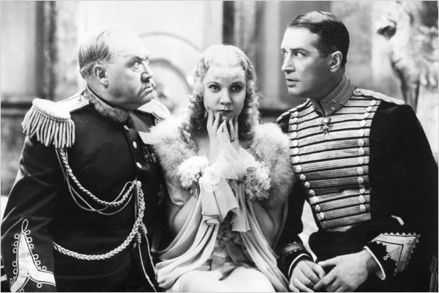
Operetta Musicals
Notes:
Merry Widow

Slide 25
Love Me Tonight

Slide 26
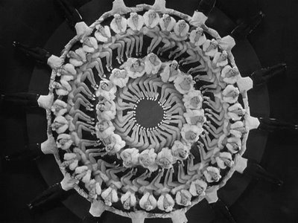
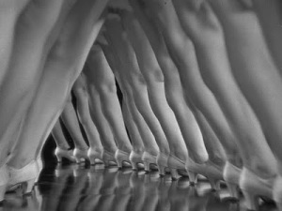
Busby Berkeley

Slide 27
Depression
“presenting a world of opulence and excess’ alongside narratives dealing with ‘struggling chorus girls and Depression hard times”
Rubin (2002, p. 59)

Slide 28
Backstage musical
Theater : film
Stage : backstage
Public : private

Slide 29
Berkeley at WB 1933/34
42nd Street
Gold Diggers of 1933
Footlight Parade
Dames

Slide 30
Berkeley
Camerawork
Tracking shots
Birdseye crane views
The camera dances, not the actors
Editing

Slide 31
Gender politics
identity of camera and spectator
stock casting of women as visible and men as viewer
Male artistic direction
Female bodies

Slide 32
42nd Street
Show=sex
Never danced the lead – never kissed

Slide 33
Backstage structures
Putting on a show
Constituting a romantic couple
“The two separate activities come to be equated, with the long final number celebrating the successful conclusion of show and romance alike” (Altman 227)

Slide 34
Ginger Rogers & Fred Astaire

Slide 35
Freed Unit
Unit system of production
Stars, composers, choreographers, screenwriter
Emphasis on choreography
Long ballet sequences
Camp?

Slide 36
Freed Unit: Films
Meet Me in St. Louis 1944
On the Town 1949
Singin’ in the Rain 1952
The Band Wagon 1953

Slide 37
Wizard of Oz

Slide 38
Post War Musicals
Extended ballet sequences
Great American Songbook
Musical biographies/biopics
Anti-communism, consumerism, captialism

Slide 39
Cont.
Dramatic instead of comedic
Marginalization of African-Americans
New gender roles
New technology

Slide 40
Extended ballet sequences
An American in Paris 1951 (18 min)
Singin' in the Rain 1952 (13 min)
The Band Wagon 1953

Slide 41
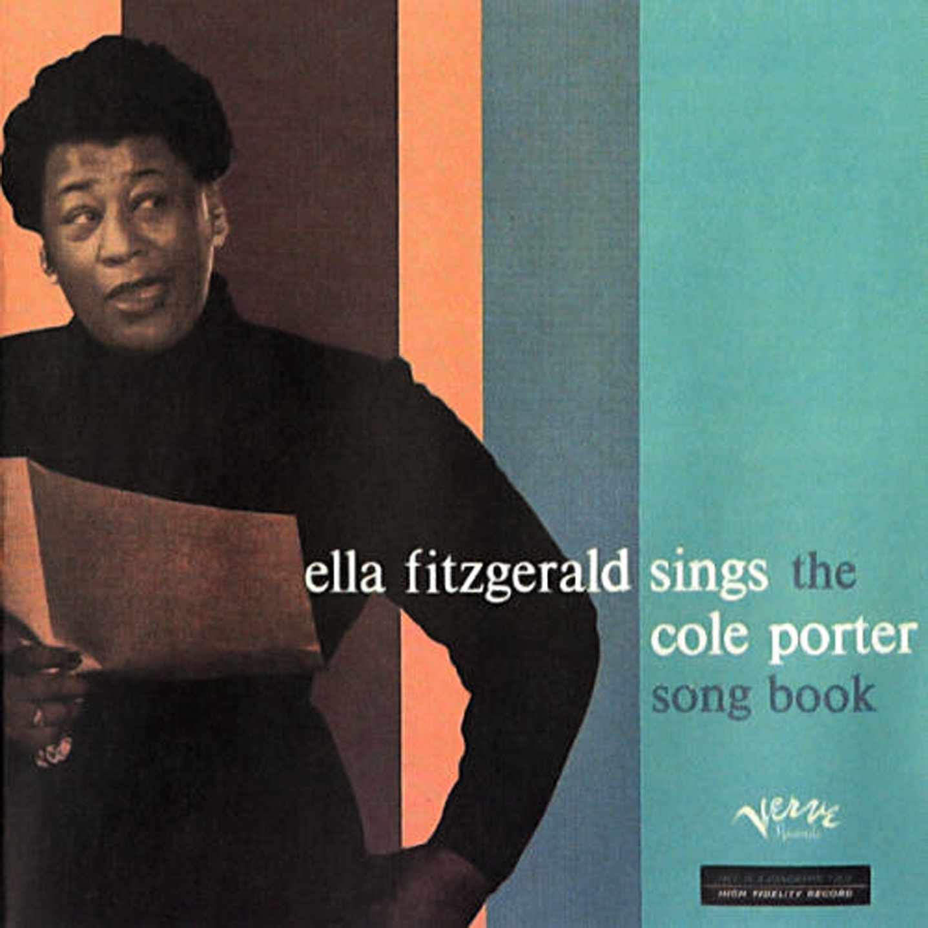
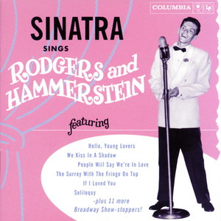
The great American songbook
Long player LP 33 1/3rpm
Composers from the 1920s and 30s recorded as the great American songbook

Slide 42
Biopics
Rhapsody in Blue 1945
Night and Day 1946
The Great Caruso 1951
Glenn Miller Story 1954
Benny Goodman Story 1955

Slide 43
Politics
Anti-Communism: Silk Stockings 1957
Consumersim: Funny Face

Slide 44
Dramatic
West Side Story

Slide 45
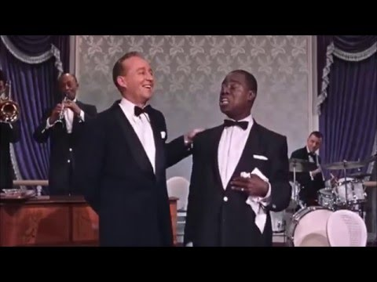
African-Americans
“end of number, beginning of story”

Slide 47
Gender Roles

Slide 48
Cont.

Slide 49
Technology

Slide 50
Dinosaurs
Oklahoma! (1955)
Sound of Music
Hello Dolly!
Paint Your Wagon

Slide 51
Folk Musical
The sound if nature inspire man to make music 306
The rhythm of life already constitutes a dance 307
Colonization, transforming wilderness into civilization 310

Slide 52
Pop
“A Hard Day’s Night found stylistic inspiration and energy from the French New Wave in its jump cuts and handheld camera: The Sound of Music is impeccable in its traditional three-point lightning, carefully balanced framing, and crisp continuity editing.” (Griffin, 235)

Slide 53
Bob Fosse
Cabaret
All that Jazz (1979)

Slide 54
Nostalgia
That's Entertainment! (1974)
Beginning of academic research

Slide 55
Post-modern Musicals
Pennies from Heaven
Moulin Rouge
La la Land

Slide 56
Musicals today
Fairy Tale: Enchanted, Frozen
Show musical: Glee, High School Musical, Pitch Perfect
Folk musical: Lagaan,

Slide 57
French Musicals 1930s
René Clair:
Sous les toits de Paris 1931
Le Million 1931
A nous la liberté 1932

Slide 58
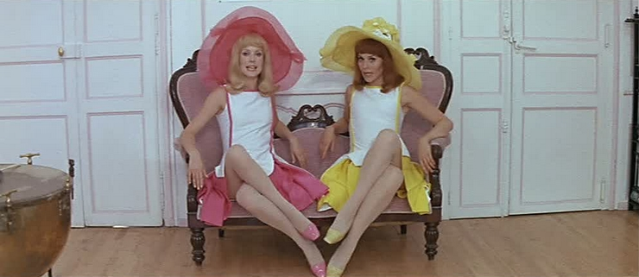
Jacques Demy
Les Parapluies de Cherbourg (1964)
Les Demoiselles de Rochefort (1967)

Slide 59
Bollywood
Musical numbers obligatory
Dubbed
3 hours
Cinema of interruption

Slide 60
Singers
Asha Bohsle
Lata Mangeshkar

Slide 61
Who is singing?
The character
choir
Change from 1st to third person within a song
(f.e. Mother India)

Slide 62
Music as commentary
Lyrics in Urdu
Lyrics referencing the epics

Slide 63
Case studies

Slide 64
Kal Hoo Na Hoo

Slide 65
Conclusion
Meaning
Number/Moment/crystal song
Genre – number
Diegetic music
Overall structure
Theories and methods
terminology

Slide 66
Finale

